Slide 1
Recommendation system for scientific tools and workflows
Master thesis
Anup Kumar
Adviser: Dr. Björn Grüning

Slide 2
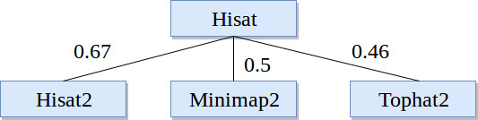
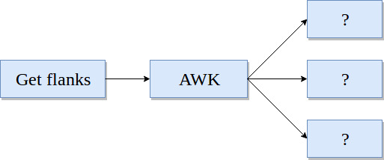
Recommendation system
Find similar scientific tools
2. Predict tools for workflows

Slide 3
Find similar scientific tools
Compute similarity among tools
Recommend similar tools
Replace a tool by its similar tool
Provide more options for data processing

Slide 4
Approach
Collect tools metadata (~ 1,050 tools)
Three attributes - input and output files, name and description and help text
Clean metadata - stemming and stopwords
Learn vectors for tools
Find similarity among vectors - similarity matrix
Combine similarity matrices

Slide 5
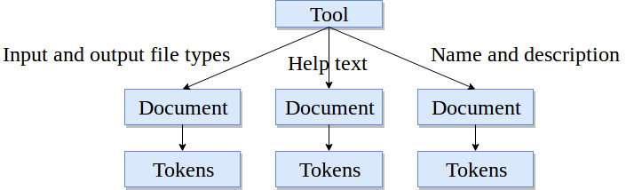
Tool, documents and tokens

Slide 6
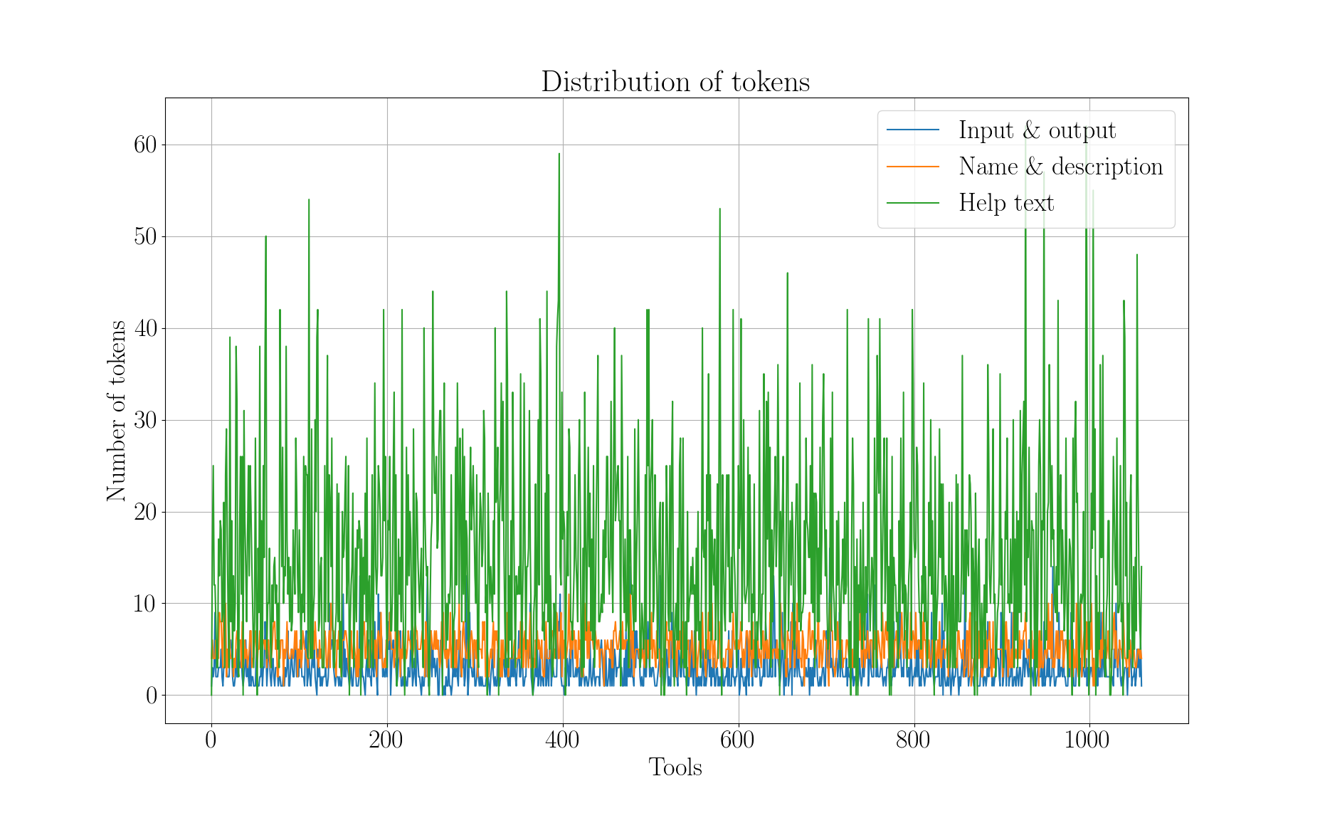

Slide 7
Paragraph (document) vector
Neural network approach [1]
A dense vector for each paragraph
Similar tools have similar vectors
Encode variable length paragraphs
Each tool has three paragraphs (documents)
Input/output file types - Bestmatch25 [2]
https://cs.stanford.edu/~quocle/paragraph_vector.pdf
https://dl.acm.org/citation.cfm?id=1704810

Slide 8
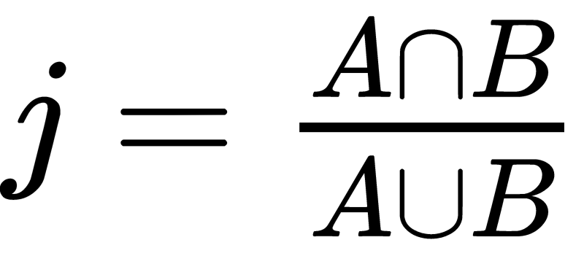
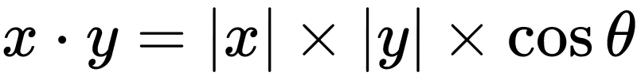
Similarity scores
Jaccard index (input and output file types)
Cosine angle (name and description and help text)
Compute similarity matrix
Three similarity matrices
Simple - average the matrices
Better - learn weights

Slide 9

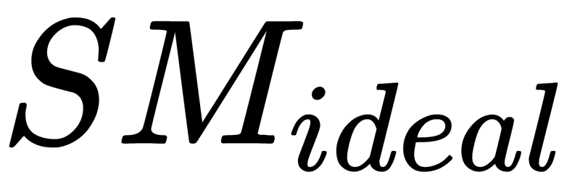
Optimisation
Gradient descent
Learn weights on similarity scores
Obtain a weighted average similarity matrix
is 1.0 as the maximum value of similarity measures can be at most 1.0

Slide 10
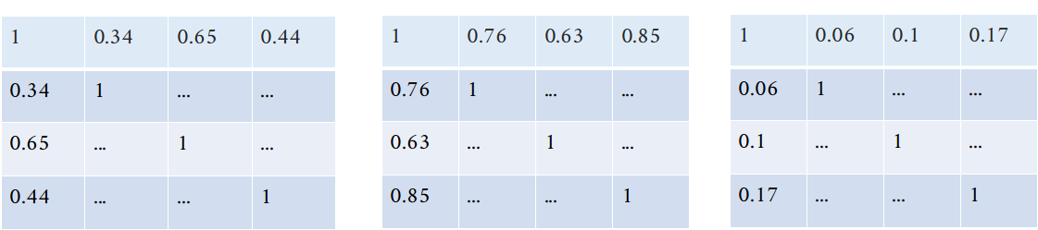
Optimisation
Input and output (a)
Name and description (b)
Help text (c)

Slide 11
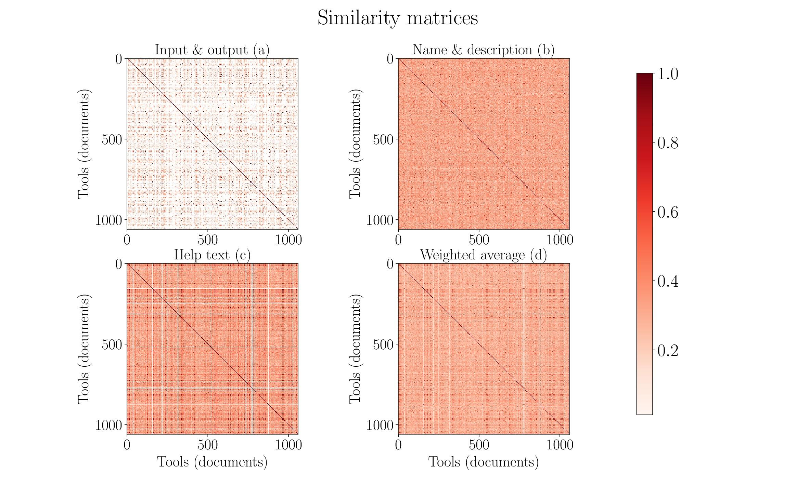

Slide 12
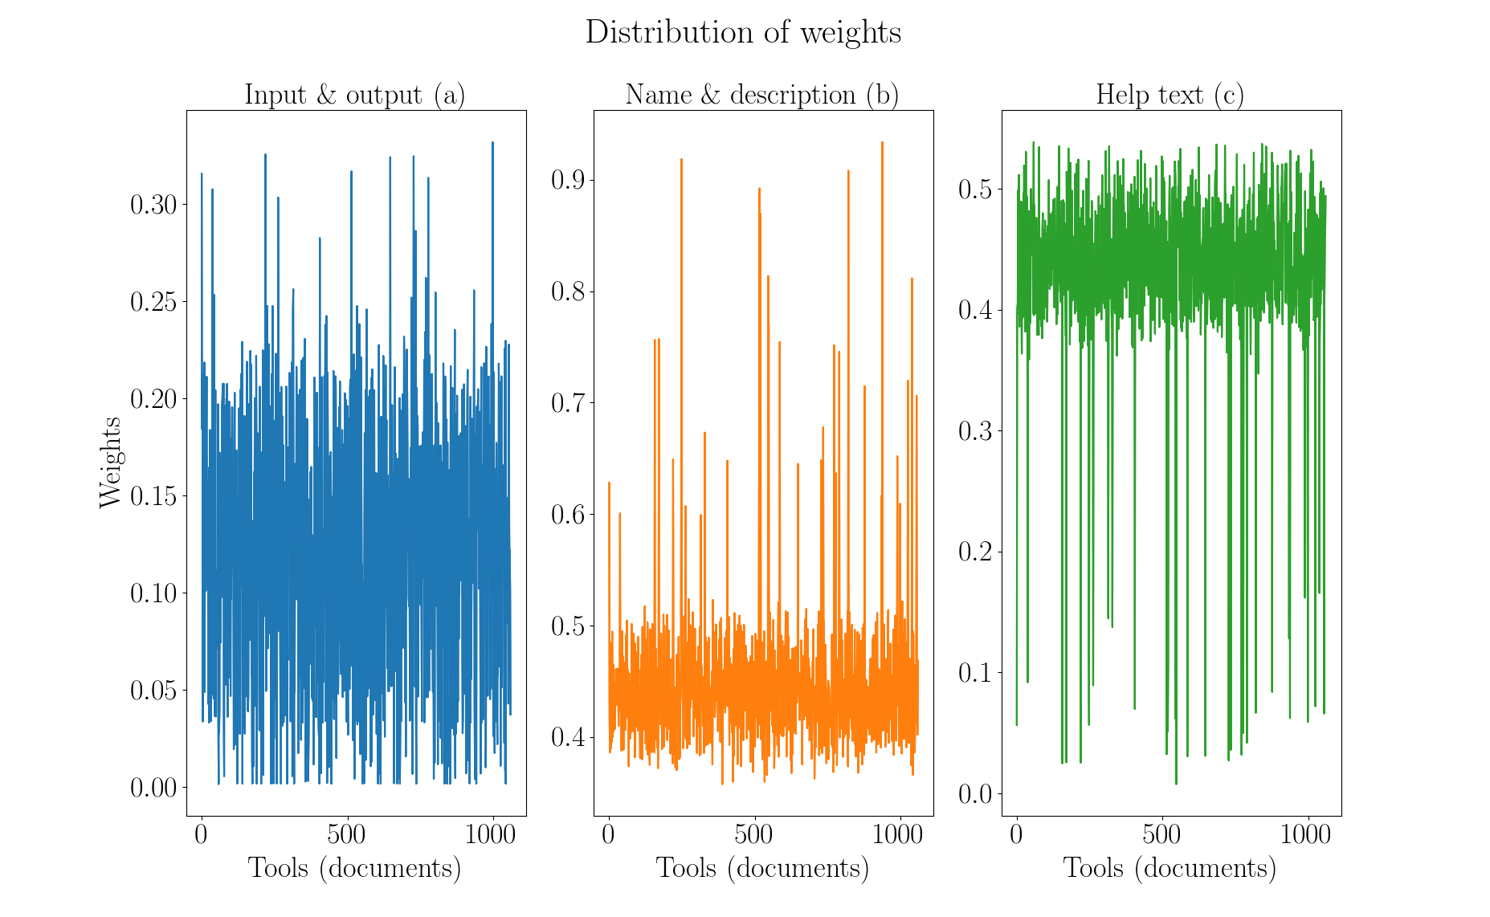

Slide 13
Summary
Collect tools metadata
Clean metadata
Learn vector for each tool
Get similarity matrix
Combine similarity matrices

Slide 14
Conclusion and future work
Paragraph vector
Less data for name and description attribute
No true similarity
Create sets of similar tools
Exclude low similarity values
Run analysis on larger set of tools
Compute similar tools using workflows

Slide 15
Predict tools in workflows
Tough to assemble workflows
Tools compatibility issues
Loss of computation time
Thousands of tools

Slide 16
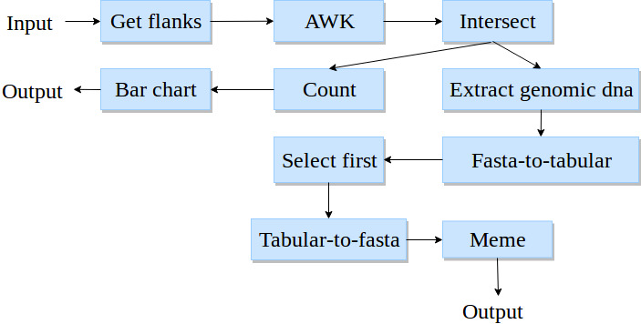
Workflows
Workflow - a directed acyclic graph
Paths in a workflow
193,000 workflows
900,000 paths
Max. 25 tools in a path

Slide 17
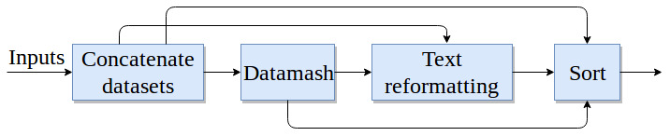
Higher order dependency
Not dependent only on immediate parent
Dependent on all previous tools

Slide 18
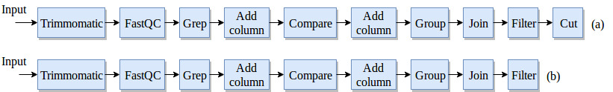
Workflow preprocessing
No decomposition

Slide 19
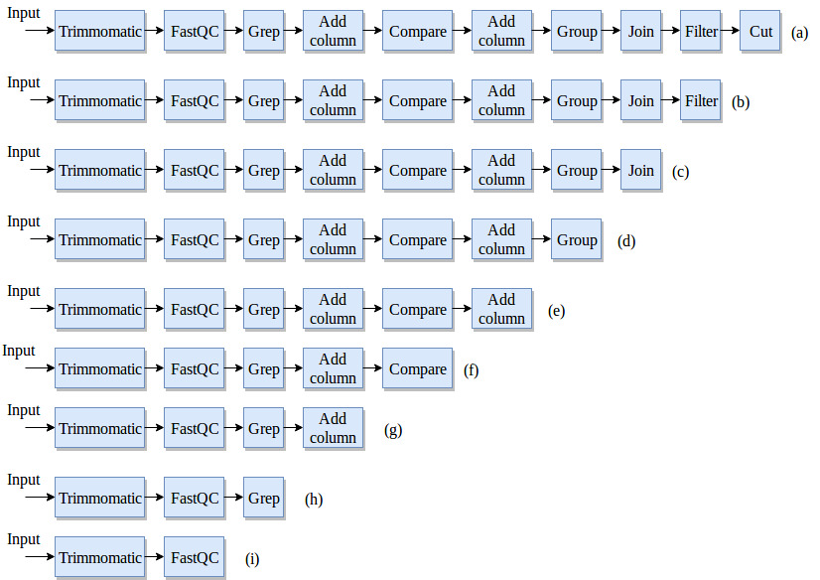
Workflow preprocessing
Keep first tool fixed

Slide 20
Recurrent neural network
Classifier to learn on sequential data
Multilabel, multiclass classification
Recurrent neural network - Gated recurrent units
Learn long-range dependencies
Two hidden layers, one embedding layer and one output layer
Sigmoid output activation
Cross-entropy loss
Root mean square propagation (rmsprop) optimiser

Slide 21
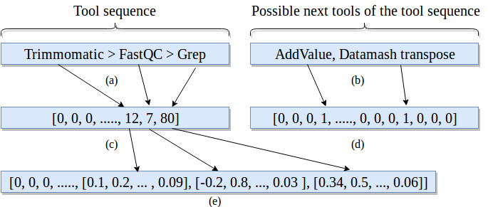
Embedding and label vectors

Slide 22
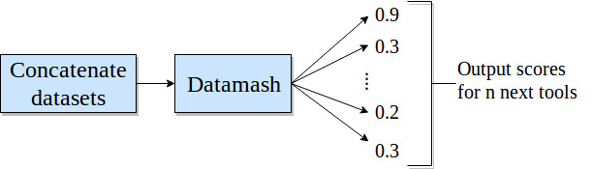
Precision and prediction
Absolute precision
Compatible precision

Slide 23
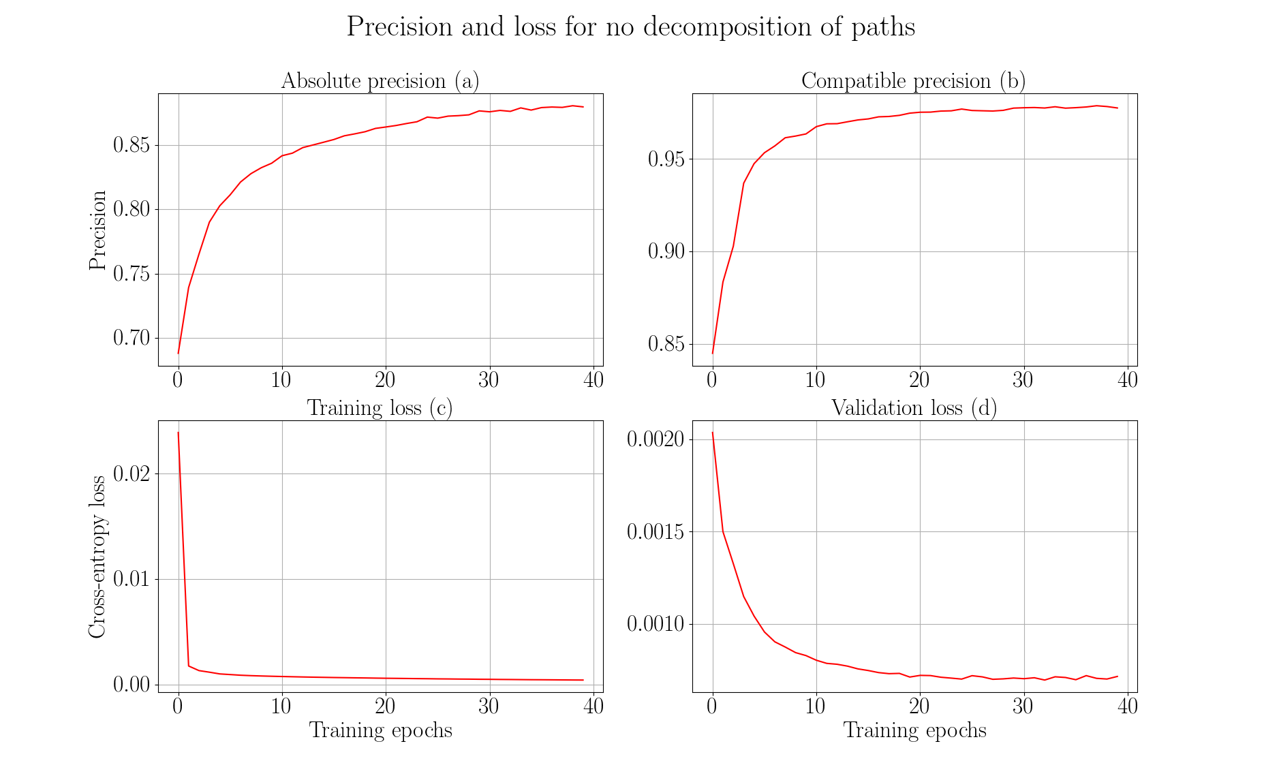

Slide 24
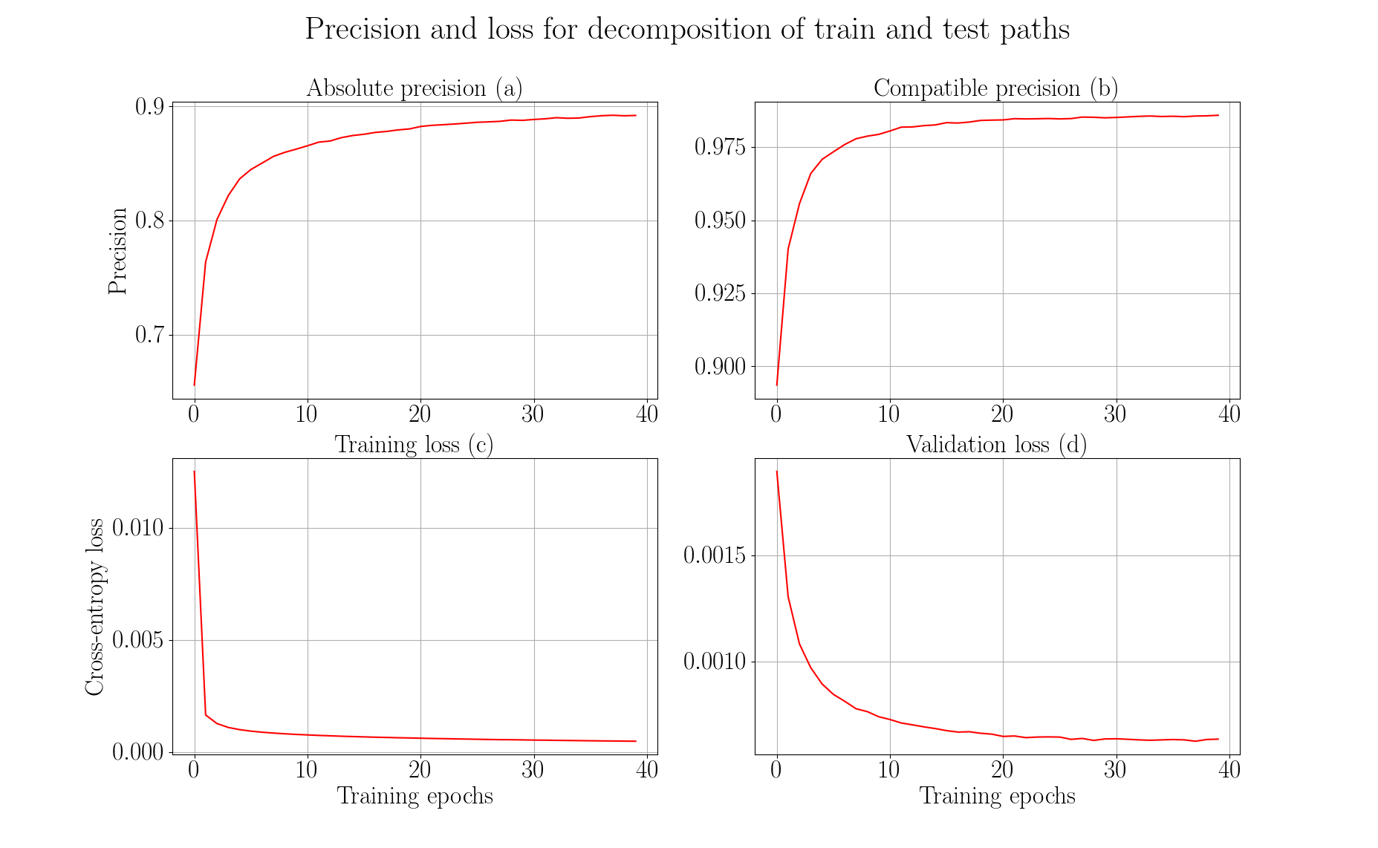

Slide 25
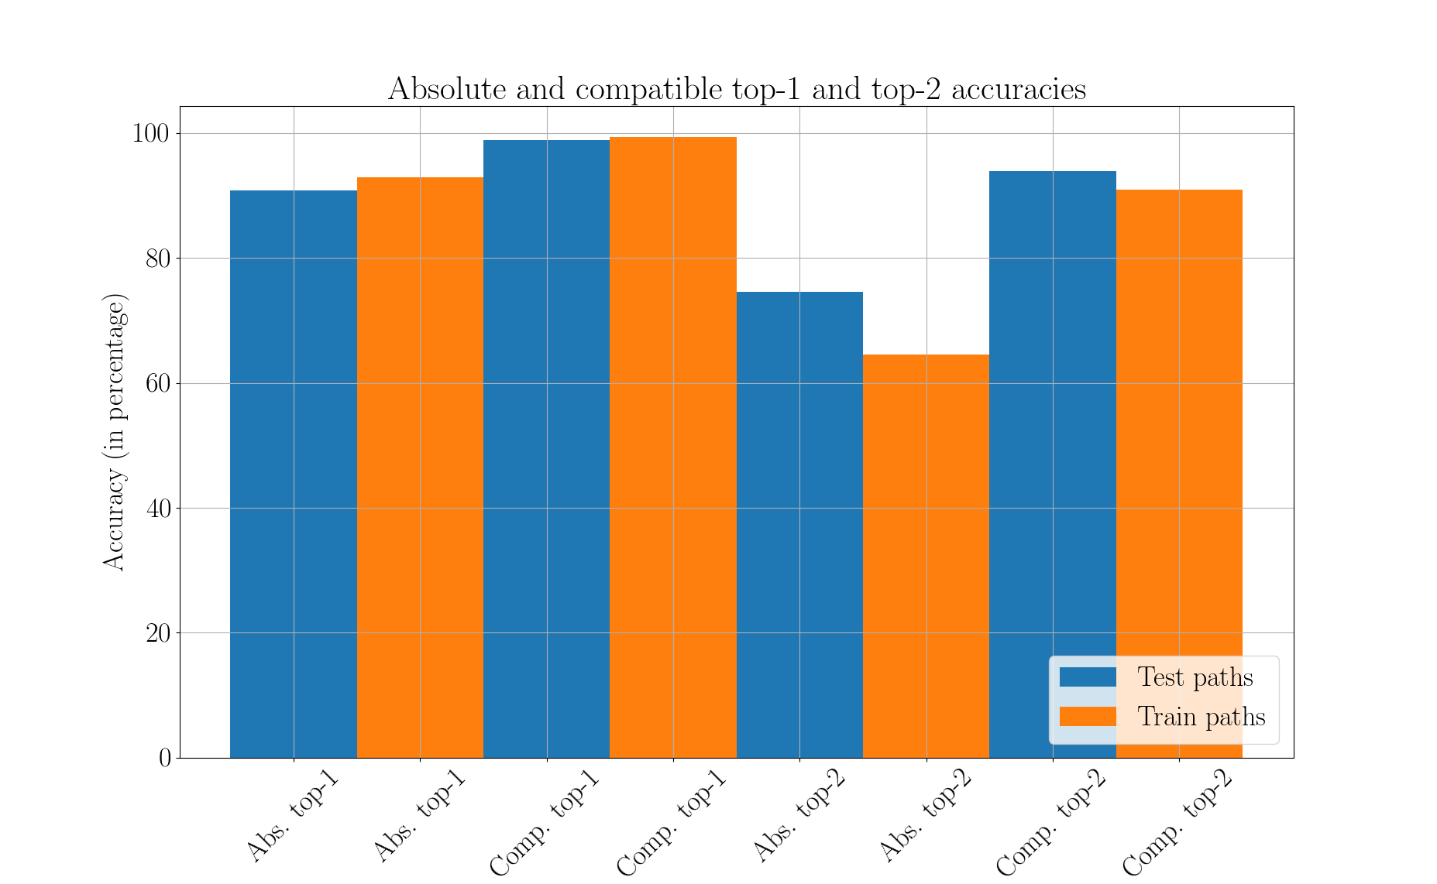

Slide 26
Summary
Workflows are directed acyclic graphs (193, 000 workflows)
Extract paths from workflows
Learn long-range dependencies
Use recurrent neural network (gated recurrent units) as a classifier
Multilabel, multiclass classification
Absolute and compatible precision

Slide 27
Conclusion and future work
Absolute precision ~90%, compatible precision ~99%
Recurrent neural network suitable for sequential learning
More workflows, better results
Restore original distribution
Decay prediction over time
Integrate into Galaxy

Slide 28
Thank you for your attention
Questions?

Slide 29
References

Slide 30
Stemming and stopwords
Stemming - converge all forms of a word into one basic form
“Operate, operating, operates, operation, operative, operatives, operational” into “oper” [1]
Stopwords - “a, about, above, would, could …” [2]
https://nlp.stanford.edu/IR-book/html/htmledition/stemming-and-lemmatization-1.html
https://www.ranks.nl/stopwords

Slide 31
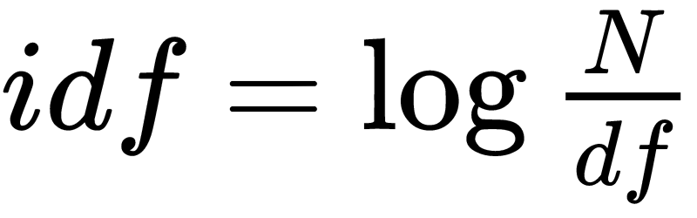
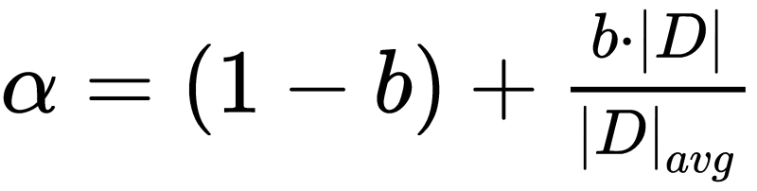
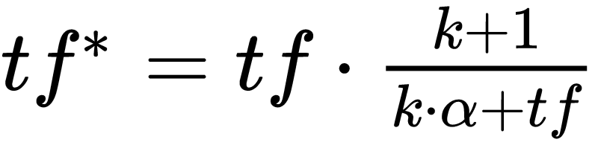
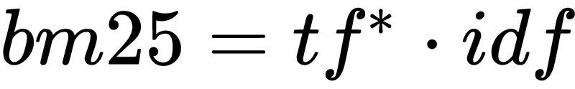
Bestmatch25 (bm25)
Token frequency (tf)
Document and inverted document frequency (idf)

Slide 32
Bestmatch25 (bm25) scores
Tools/Tokens | Regress | Linear | Gap | Mapper | Perform
LinearRegression | 5.22 | 4.1 | 0.0 | 0.0 | 3.84
LogisticRegression | 3.54 | 0.0 | 0.0 | 0.0 | 2.61
Tophat2 | 0.0 | 0.0 | 1.47 | 1.47 | 0.0
Hisat | 0.0 | 0.0 | 0.0 | 0.0 | 0.0

Slide 33

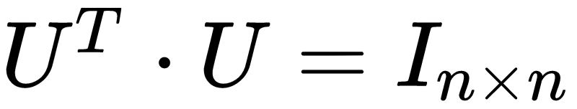
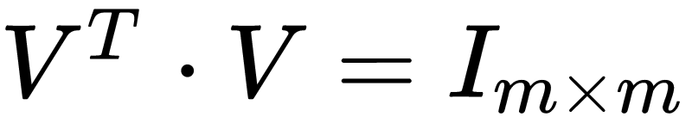
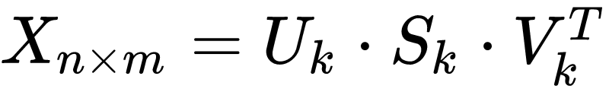
Latent Semantic Analysis
Document-token matrix (X)
Singular value decomposition

Slide 34

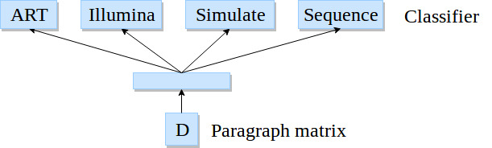
Paragraph vectors
Softmax classifier
Backpropagation
Stochastic gradient descent
Gensim*
*https://radimrehurek.com/gensim/models/doc2vec.html
Image adapted from: https://cs.stanford.edu/~quocle/paragraph_vector.pdf

Slide 35
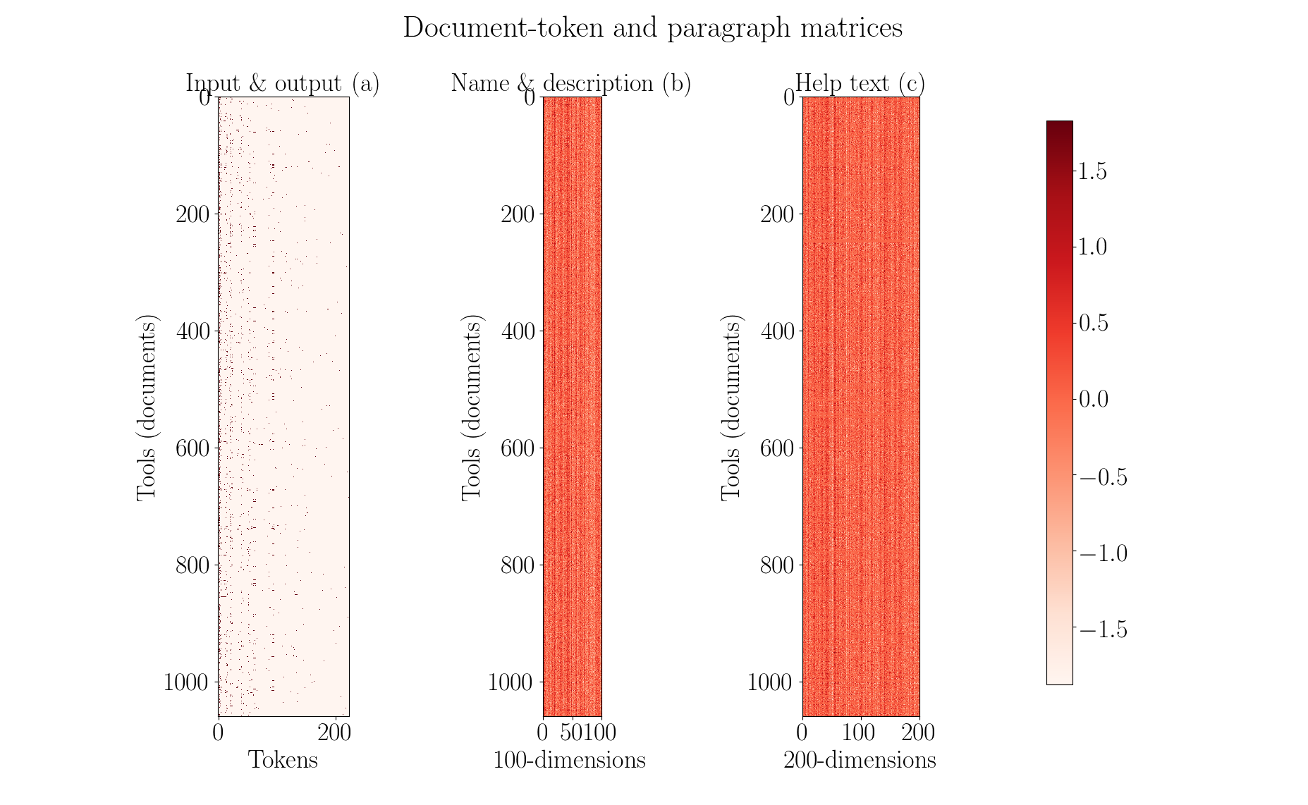

Slide 36

Optimisation
Gradient descent
Mean squared error
Initial learning rate - 0.05
Decay learning rate
Nesterov’s accelerated gradient

Slide 37
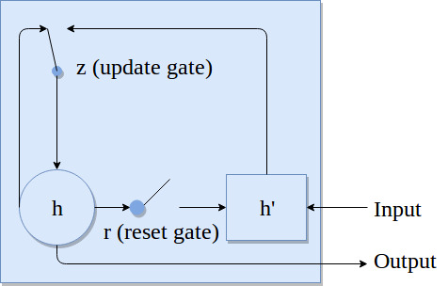



Recurrent neural network

Slide 38
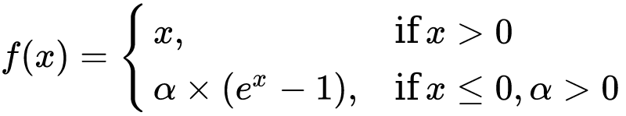
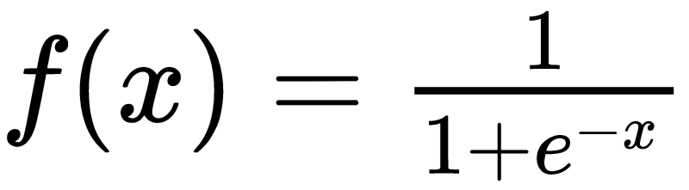
Recurrent neural network
One embedding layer, two hidden layer and one output layer
Recurrent layer activation - exponential linear unit
Output activation is sigmoid

Slide 39

Recurrent neural network
Optimiser - Root mean square propagation (rmsprop)
Binary cross-entropy loss

Slide 40
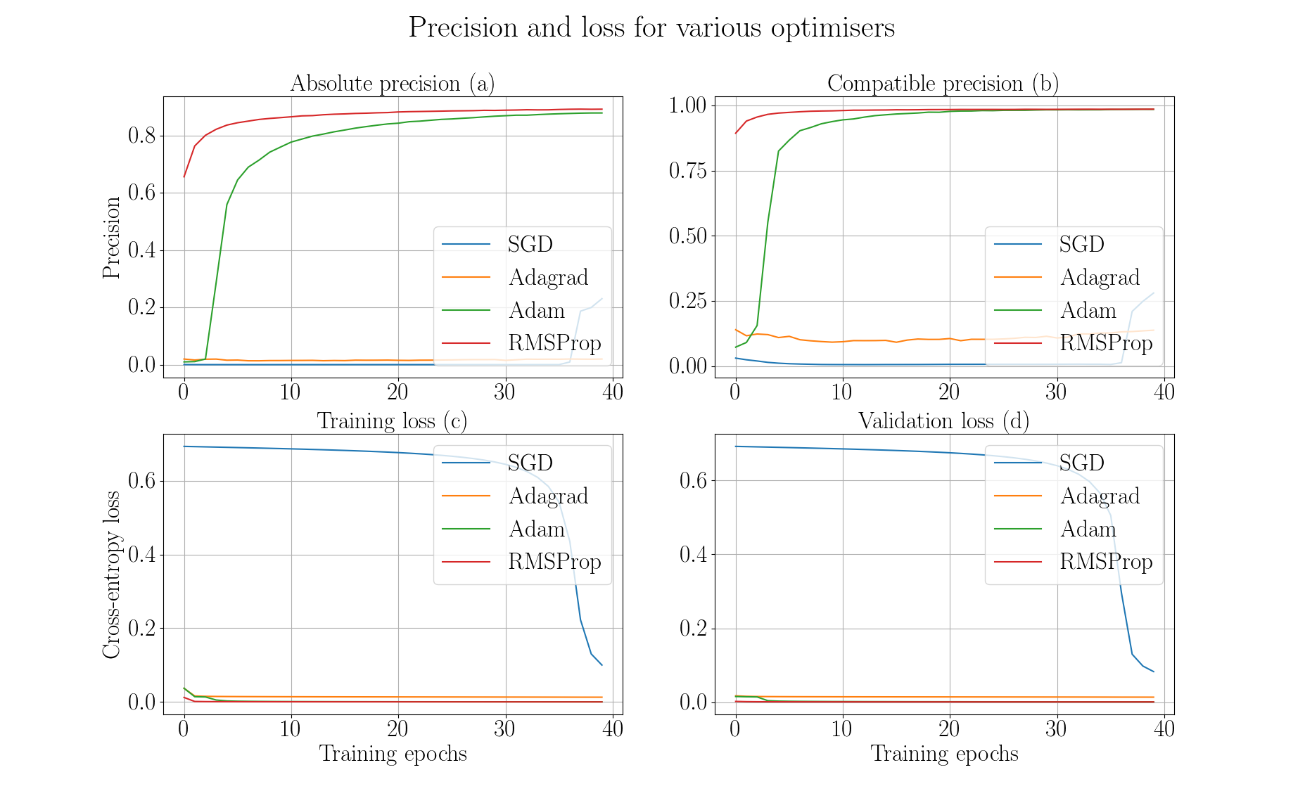

Slide 41
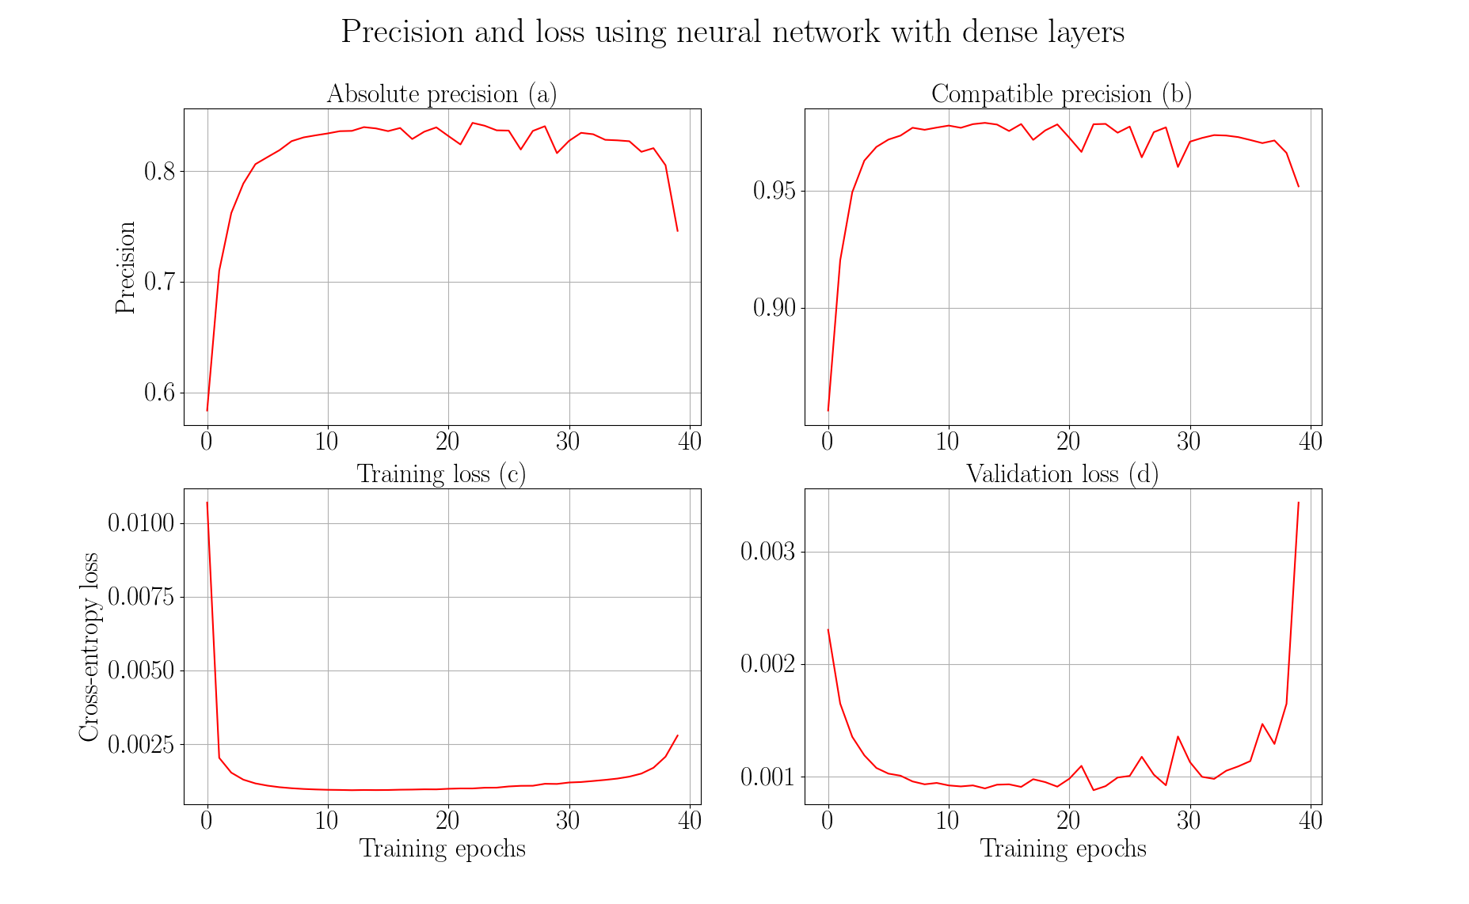

Slide 42
