Slide 1
Recommendation system for scientific tools and workflows
Master’s thesis
07/08/2018
Anup Kumar
Adviser: Dr. Björn Grüning

Slide 2
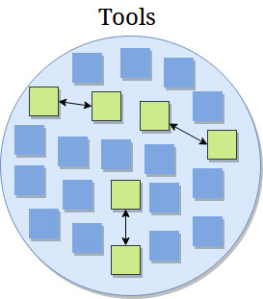
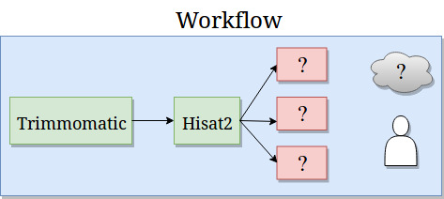
Motivation
Galaxy - biological data analysis
Tools and workflows
Large number of tools (> 1,000)
Complex workflows
Need recommendation system

Slide 3
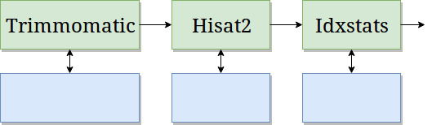
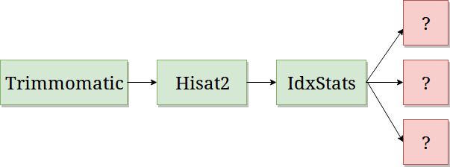
Recommendation system
Find similar scientific tools
2. Predict tools in workflows

Slide 4
Find similar scientific tools

Slide 5
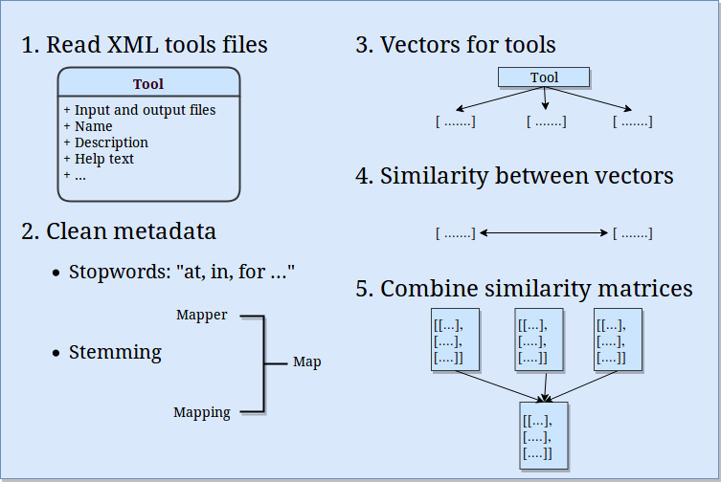

Slide 6
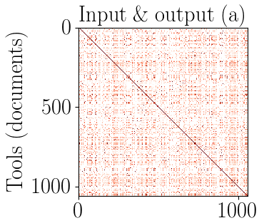

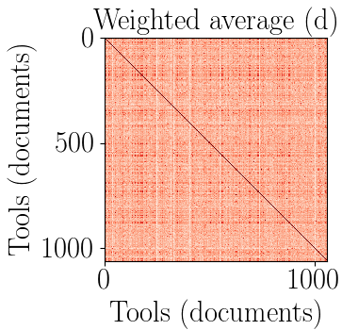
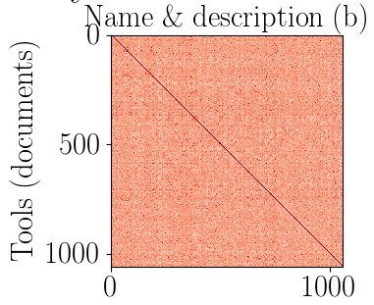
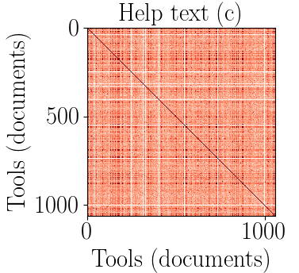
Combine similarity matrices

Slide 7
Optimisation
Gradient descent
Learn weights on similarity scores
Mean squared error
Each tool, three weights
Obtain a weighted average similarity matrix
True similarity is an array of 1.0
https://developers.google.com/machine-learning/crash-course/reducing-loss/gradient-descent

Slide 8
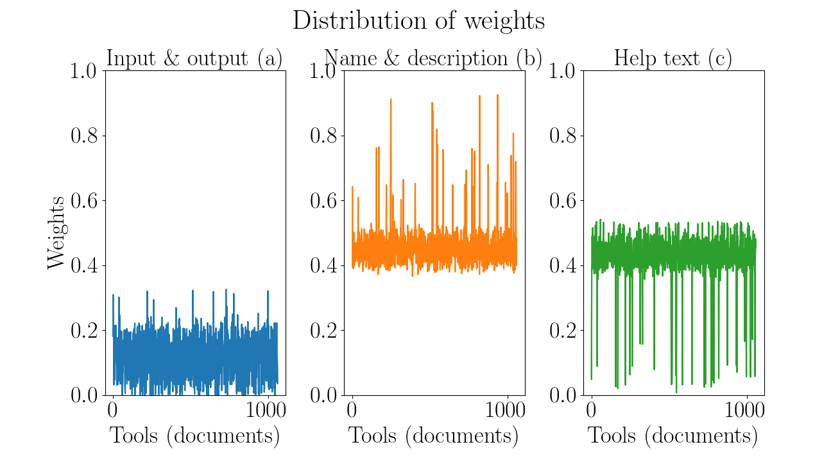

Slide 9
2. Predict tools in workflows

Slide 10
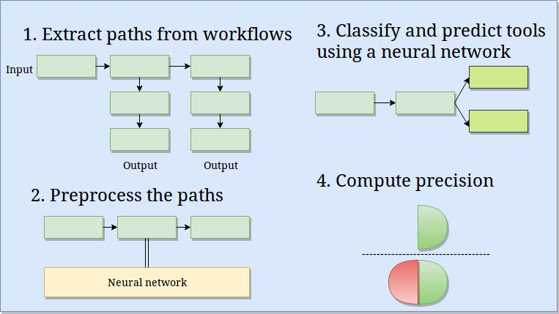

Slide 11
Workflows
Workflow - a directed acyclic graph
~ 193,000 workflows
900,000 paths (~ 167,000 unique)
Maximum 25 tools in a path
Directed acyclic graph: https://cran.r-project.org/web/packages/ggdag/vignettes/intro-to-dags.html
https://galaxyproject.org/learn/advanced-workflow/

Slide 12
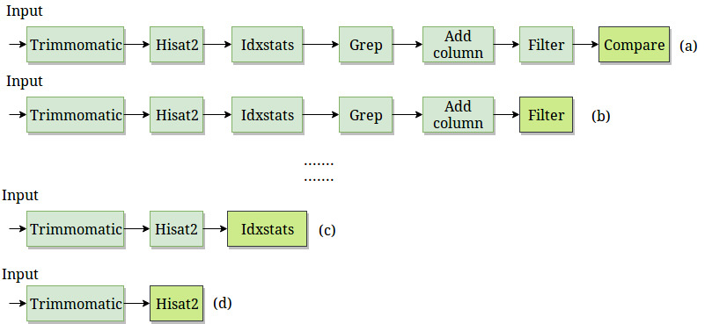
Workflow preprocessing
Decomposition
Last tool is a label

Slide 13
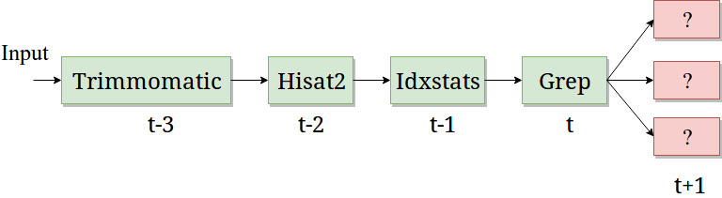
Recurrent neural network
Classifier to learn on sequential data
Multilabel, multiclass classification
Recurrent neural network - Gated recurrent units
Learn long-range dependencies
Recurrent neural network: https://arxiv.org/pdf/1412.3555.pdf
Gated recurrent units: https://arxiv.org/pdf/1412.3555v1.pdf

Slide 14
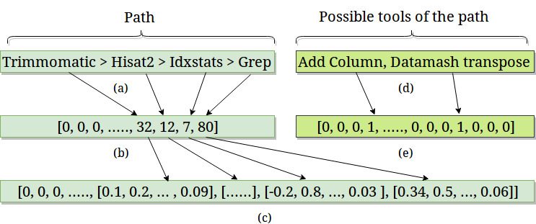
Embedding and label vectors
Dimensions:
Embedding - 512
Label vector - 1,800
Tool sequence - 25
Embedding layer: https://keras.io/layers/embeddings/

Slide 15
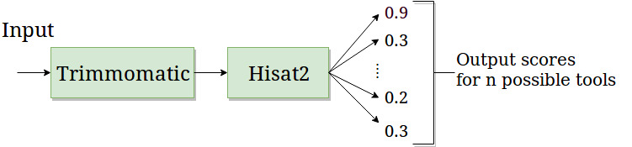
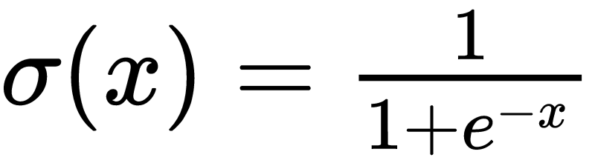
Prediction and precision
Score for each predicted tool
Sigmoid activation
Multiple possible tools for a path
Absolute precision
Compatible precision
Sigmoid: https://cs231n.github.io/neural-networks-1/

Slide 16
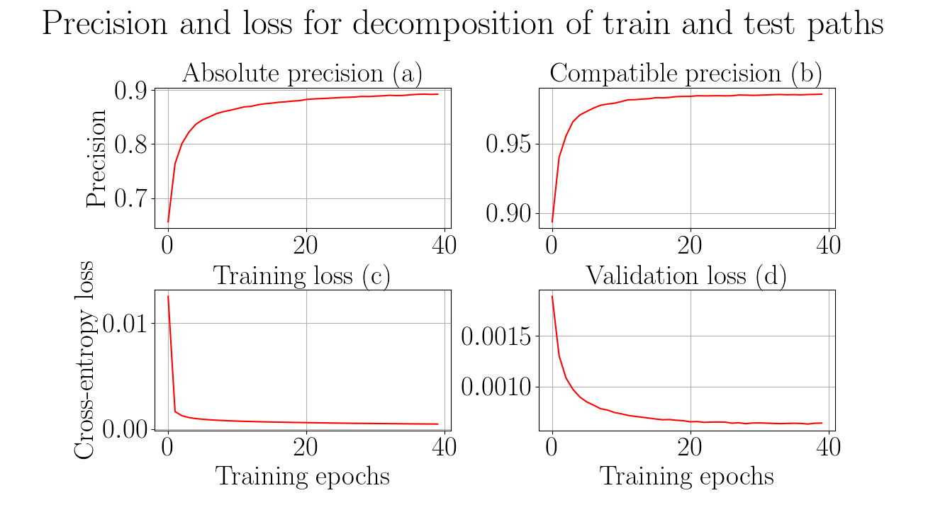

Slide 17
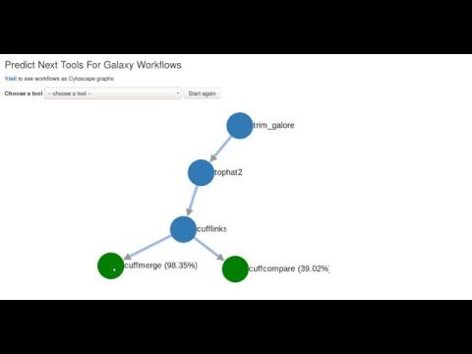

Slide 18
Conclusion and future work (part 1)
Collect and clean tools metadata (~ 1,050 tools)
Learn vector for each tool
Compute and combine similarity matrices
No true similarity
Run analysis on larger set of tools
Compute similar tools using workflows

Slide 19
Summary and conclusion (part 2)
Workflows - directed acyclic graphs (193,000)
Extract paths (167,000 unique) from workflows
Recurrent neural network (gated recurrent units)
Multilabel, multiclass classification
Absolute precision ~ 89%, compatible precision ~ 99% (~ 48 hrs)
More workflows, better precision
Recommendation system using similar and predicted tools

Slide 20
Future work (part 2)
Restore original distribution
Decay prediction over time
Oversample
Integrate into Galaxy

Slide 21
Thank you all!
Prof. Dr. Rolf Backofen
Prof. Dr. Wolfgang Hess
Dr. Björn Grüning
Dr. Anika Erxleben
Freiburg Galaxy team
Nate Coraor (Galaxy team, Penn State University)

Slide 22
Thank you for your attention
Questions?

Slide 23
Supplementary material

Slide 24
Stemming and stopwords
Stemming - converge all forms of a word into one basic form
“Operate, operating, operates, operation, operative, operatives, operational” into “oper” [1]
Stopwords - “a, about, above, would, could …” [2]
https://nlp.stanford.edu/IR-book/html/htmledition/stemming-and-lemmatization-1.html
https://www.ranks.nl/stopwords

Slide 25
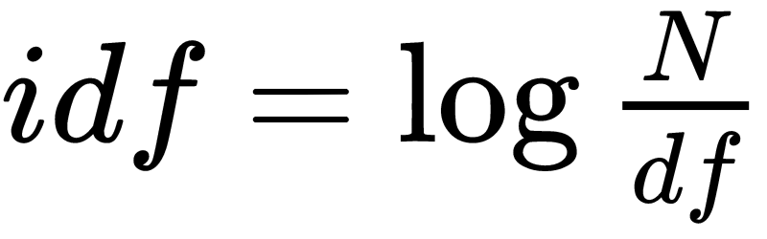
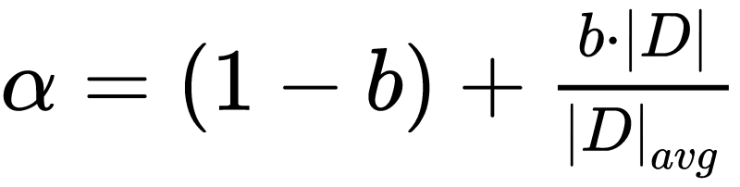
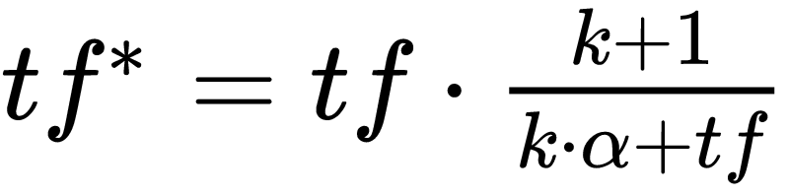
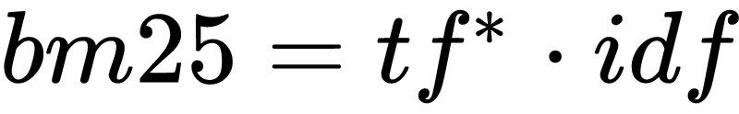
Bestmatch25 (bm25)
Token frequency (tf)
Document and inverted document frequency (idf)
https://dl.acm.org/citation.cfm?id=1704810
http://www.staff.city.ac.uk/~sb317/papers/foundations_bm25_review.pdf

Slide 26
Bestmatch25 (bm25) scores
Tools/Tokens | Regress | Linear | Gap | Mapper | Perform
LinearRegression | 5.22 | 4.1 | 0.0 | 0.0 | 3.84
LogisticRegression | 3.54 | 0.0 | 0.0 | 0.0 | 2.61
Tophat2 | 0.0 | 0.0 | 1.47 | 1.47 | 0.0
Hisat | 0.0 | 0.0 | 0.0 | 0.0 | 0.0

Slide 27

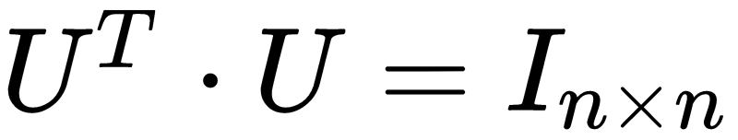
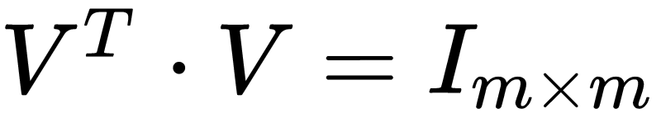
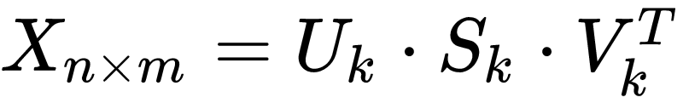
Latent Semantic Analysis
Document-token matrix (X)
Singular value decomposition
http://theory.stanford.edu/~tim/s15/l/l9.pdf

Slide 28

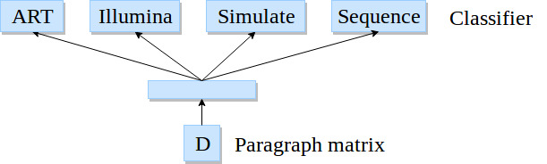
Paragraph vectors
Softmax classifier
Backpropagation
Stochastic gradient descent
Gensim*
800 iterations, 10 epochs
*https://radimrehurek.com/gensim/models/doc2vec.html
Image adapted from: https://cs.stanford.edu/~quocle/paragraph_vector.pdf

Slide 29
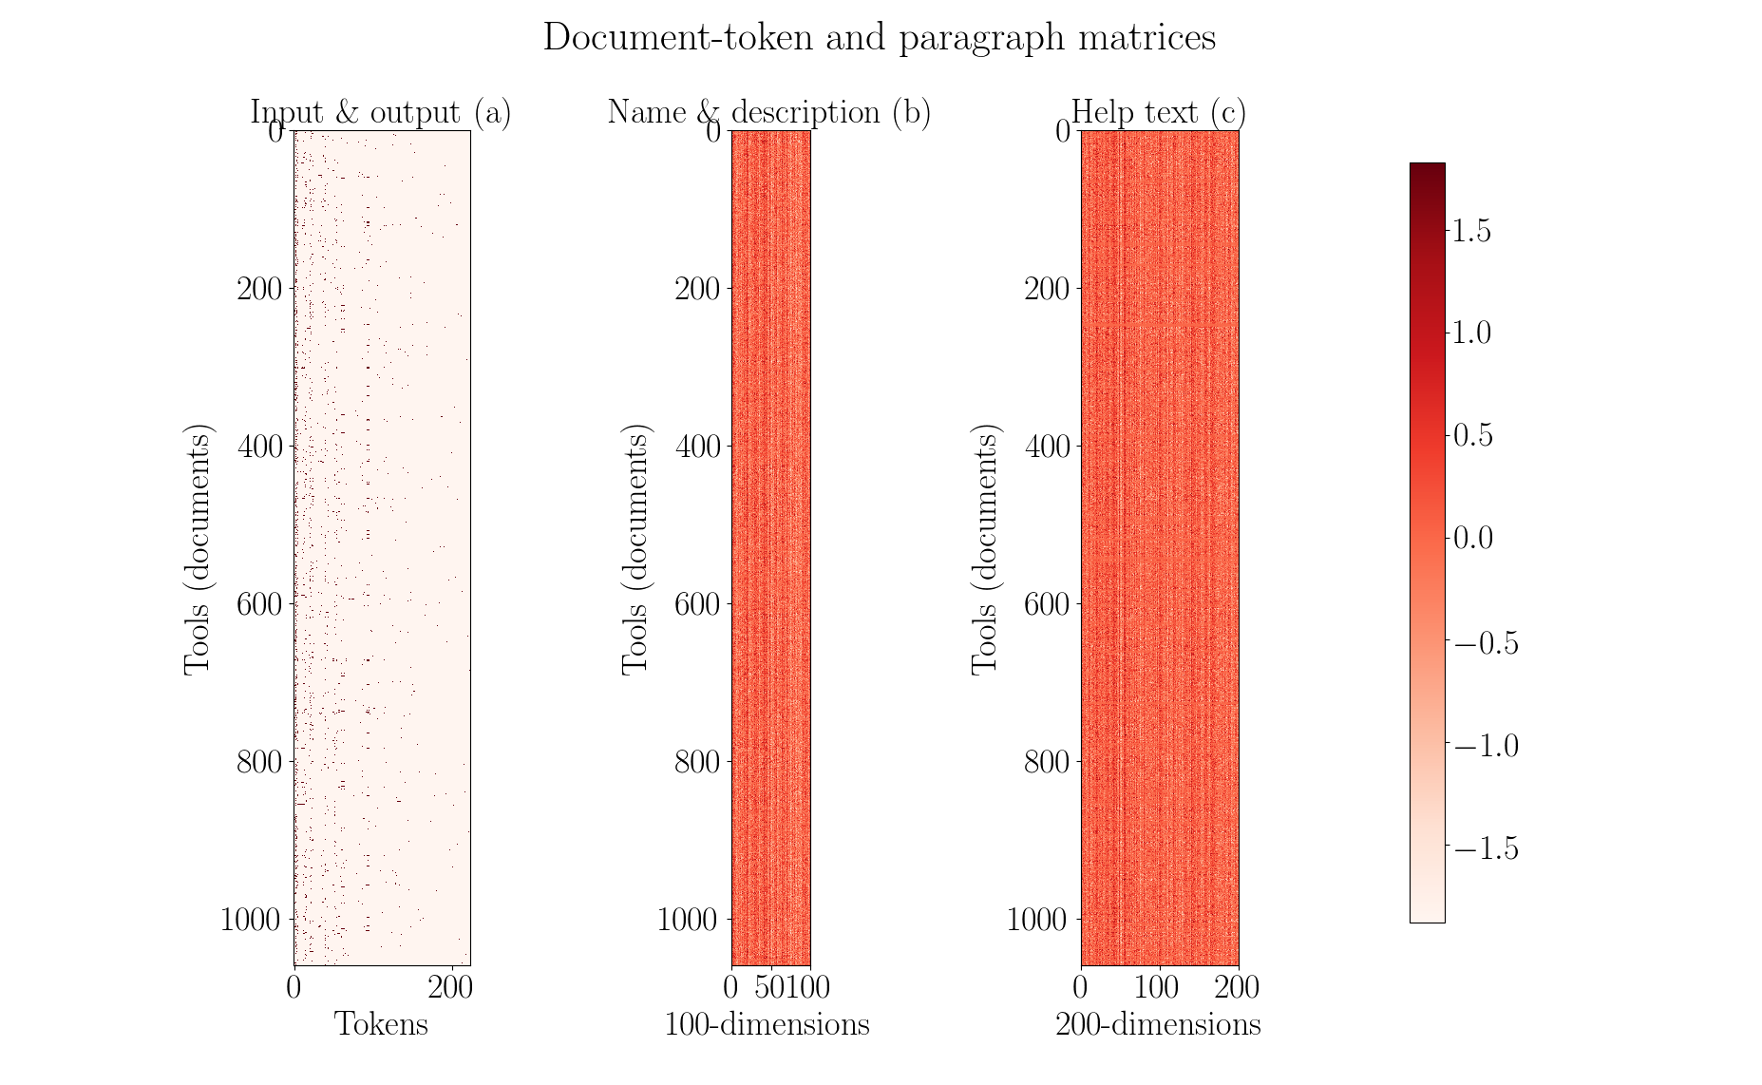

Slide 30

Optimisation
Gradient descent
Mean squared error
Initial learning rate - 0.05
Decay learning rate
Nesterov’s accelerated gradient
https://arxiv.org/pdf/1609.04747.pdf

Slide 31
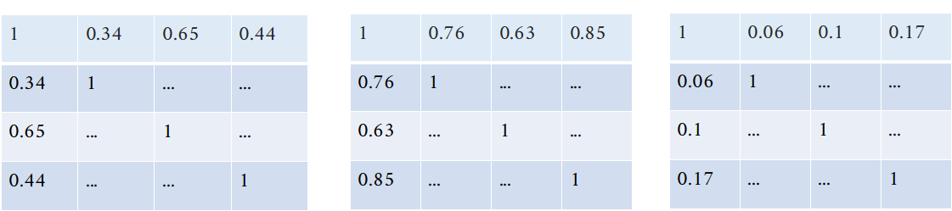
Optimisation

Slide 32
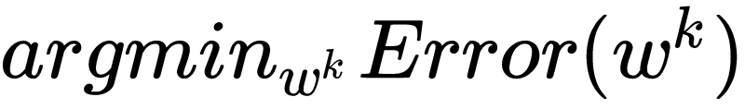
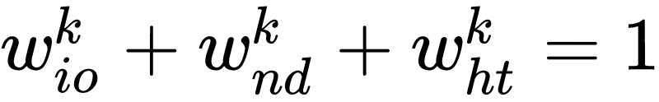
Optimisation

Slide 33

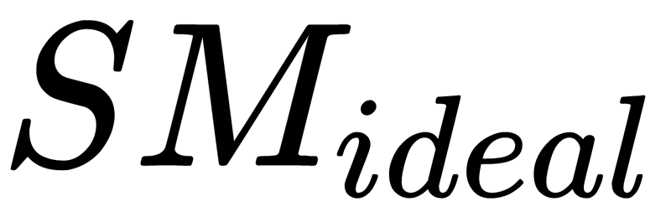
Optimisation
Gradient descent
Learn weights on similarity scores
Obtain a weighted average similarity matrix
…. (1)
…. (2)
…. (3)
is an array of 1.0
Gradient descent: https://developers.google.com/machine-learning/crash-course/reducing-loss/gradient-descent

Slide 34
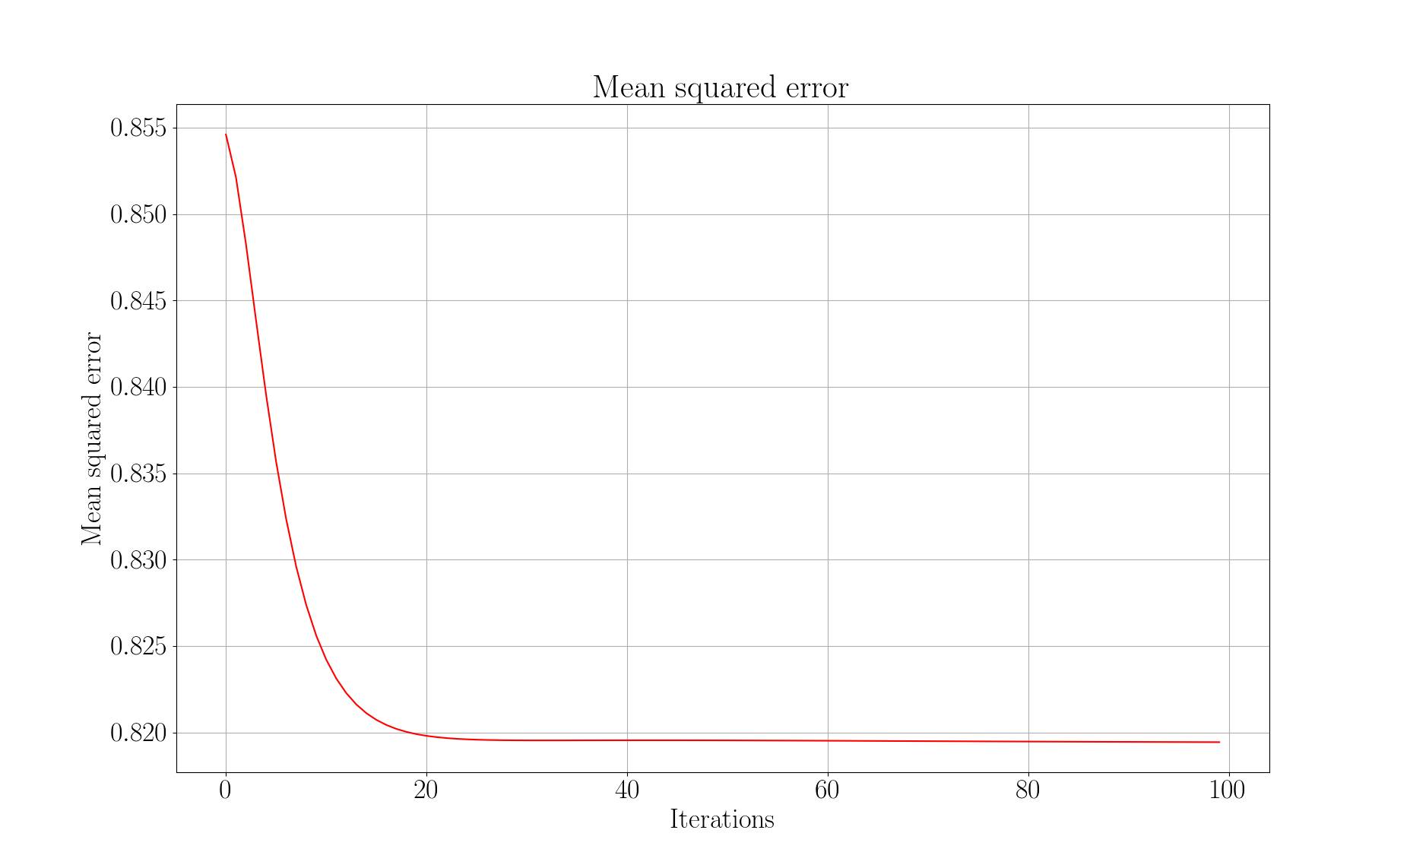

Slide 35
Visualisers
Paragraph vectors
Latent Semantic Analysis (5% of full-rank)

Slide 36
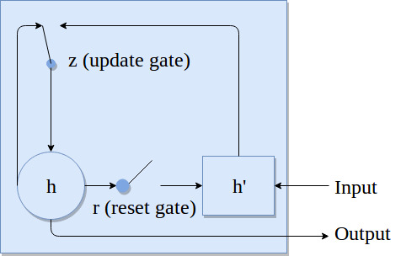



Recurrent neural network
RNN: https://arxiv.org/pdf/1412.3555.pdf

Slide 37
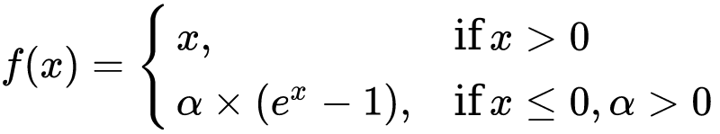
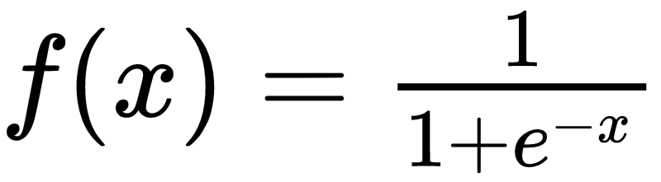
Recurrent neural network
One embedding layer, two hidden layer and one output layer
Recurrent layer activation - exponential linear unit
Output activation is sigmoid
Exponential linear units: https://arxiv.org/pdf/1511.07289.pdf

Slide 38

Recurrent neural network
Optimiser - Root mean square propagation (rmsprop)
Binary cross-entropy loss
RMSProp: https://arxiv.org/pdf/1609.04747.pdf
Binary cross-entropy: https://www.tensorflow.org/api_docs/python/tf/keras/losses/binary_crossentropy

Slide 39
Paths statistics
No decomposition:
Total paths (111,386), train paths (89,109) and test paths (22,277).
Decomposition:
Total paths (210,983), train paths (168,787) and test paths (42,196).

Slide 40
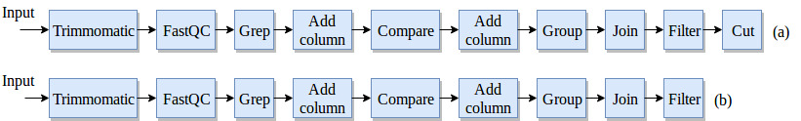
Workflow preprocessing
No decomposition
Last tool is a label

Slide 41
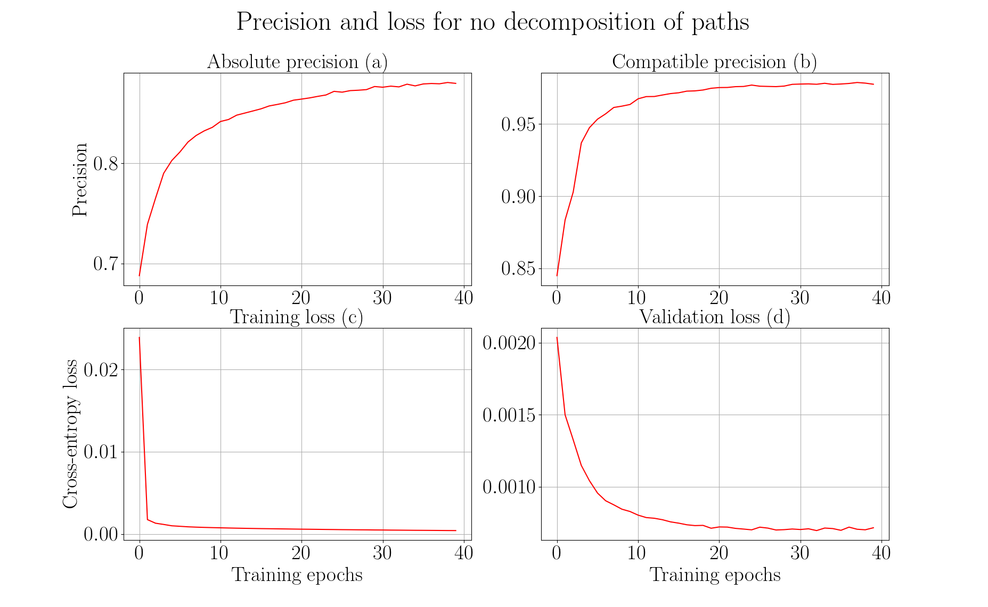

Slide 42
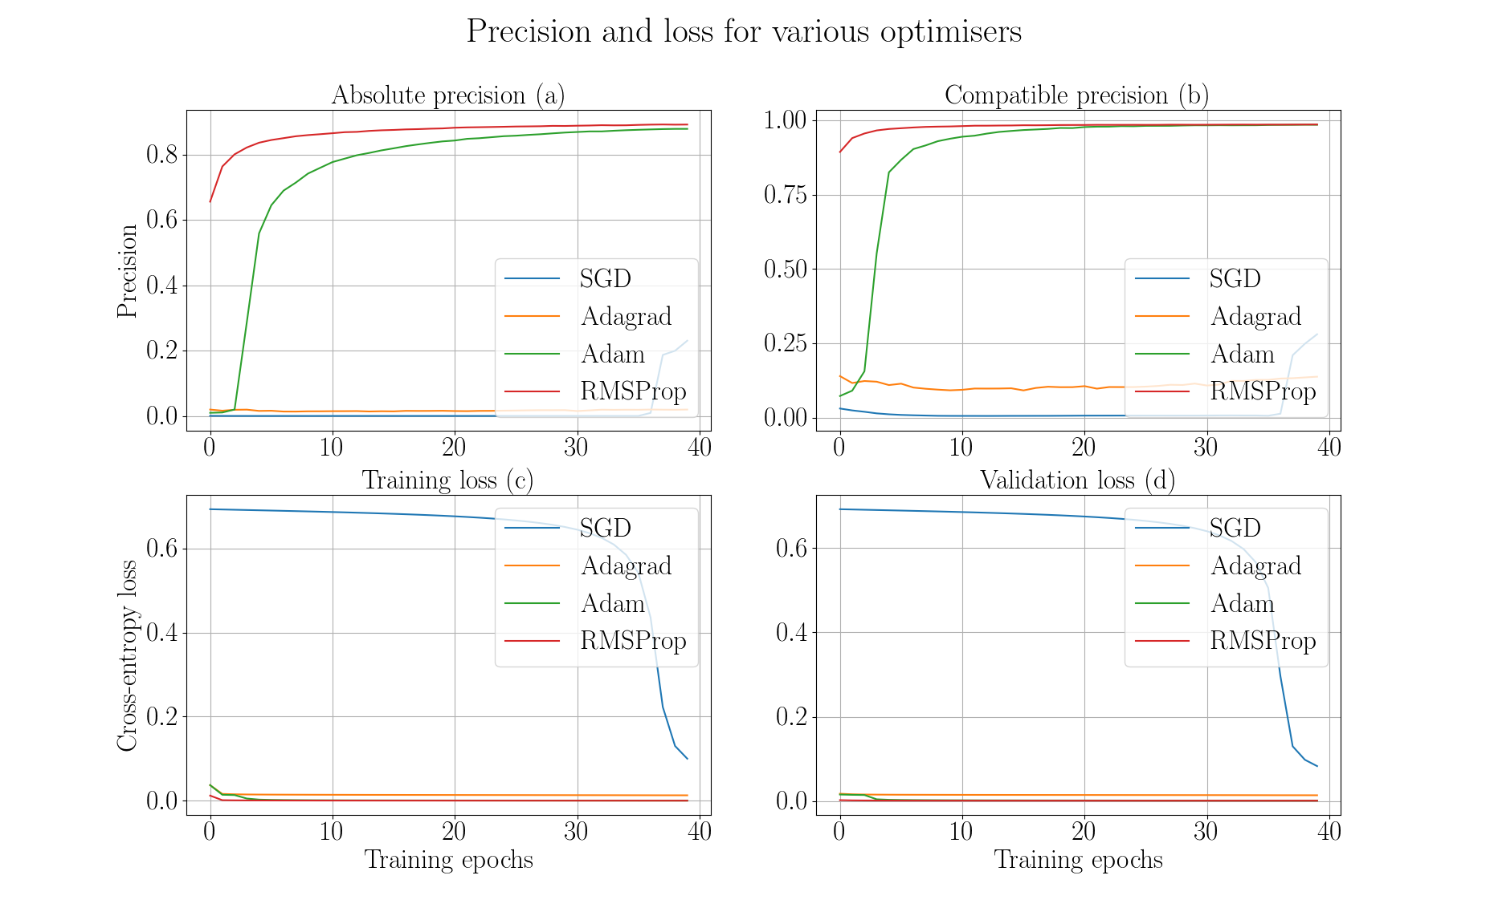

Slide 43
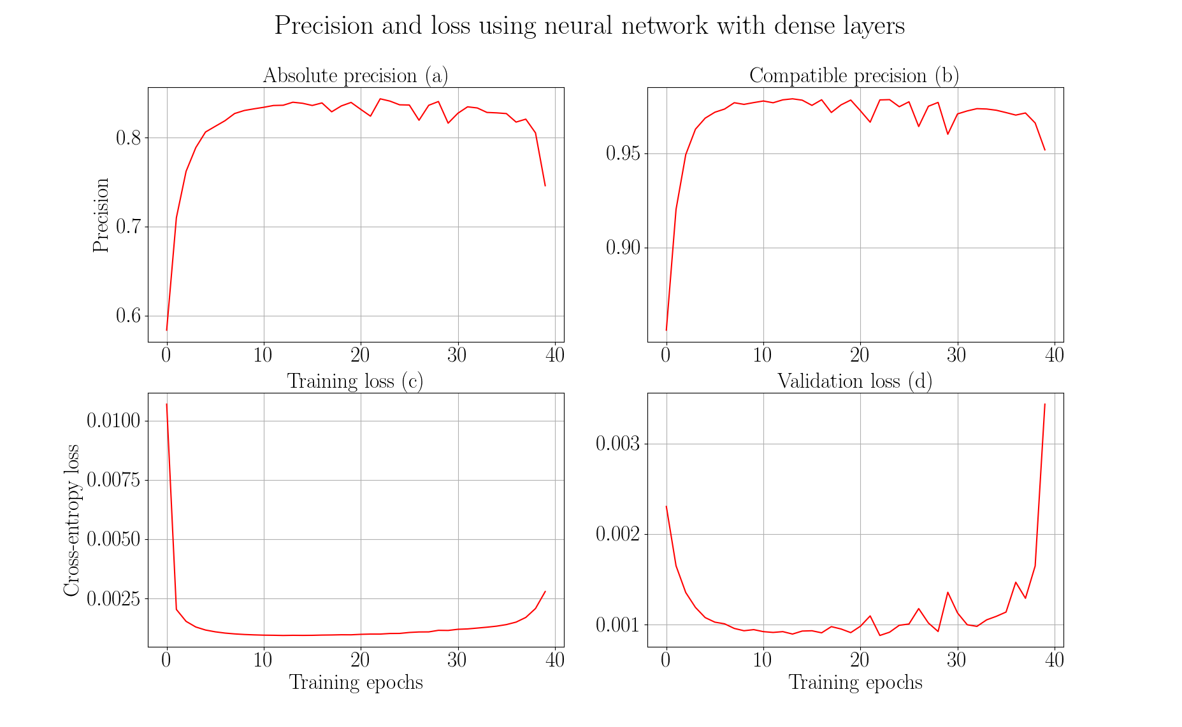

Slide 44
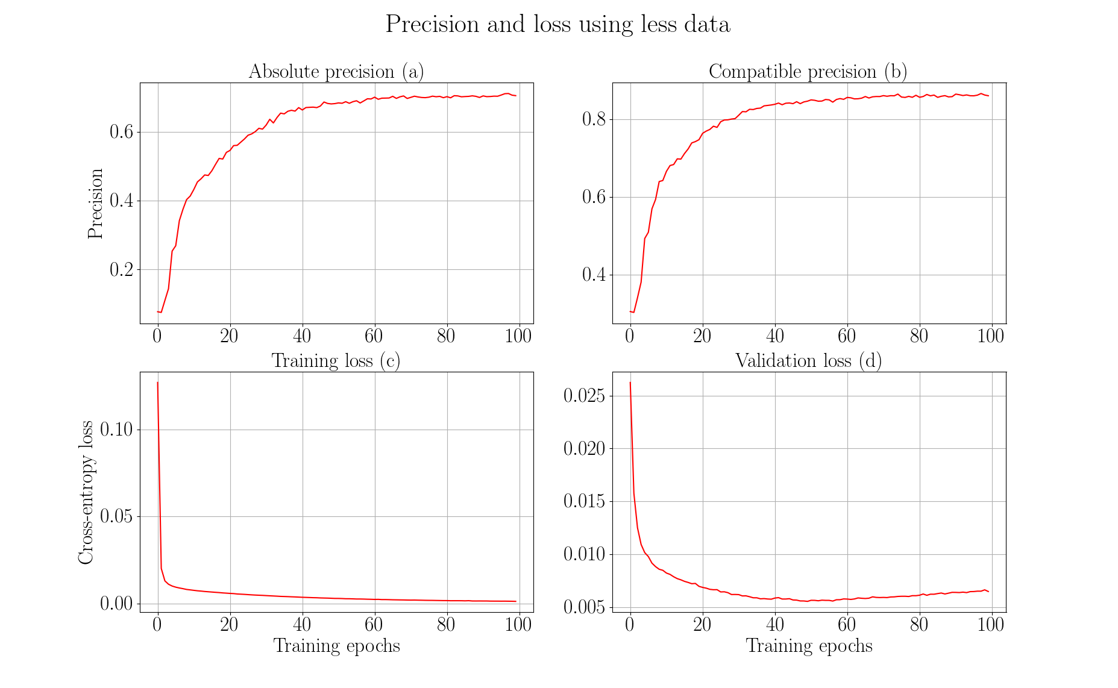

Slide 45
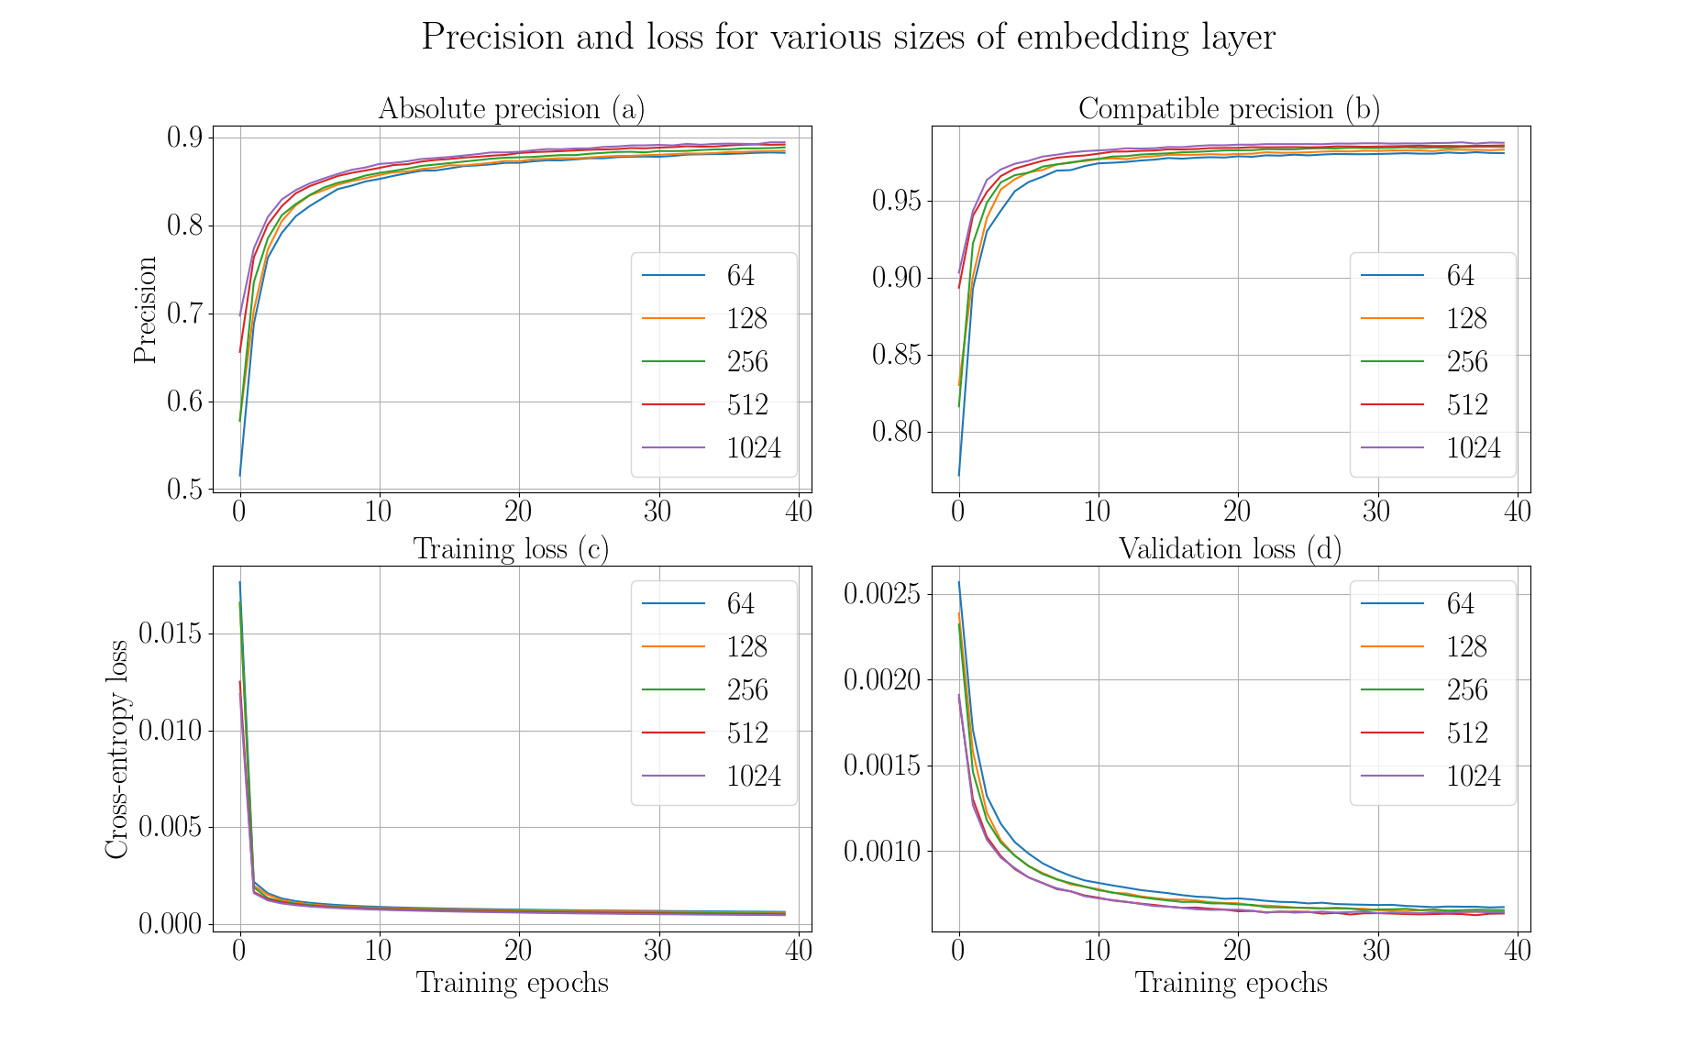

Slide 46
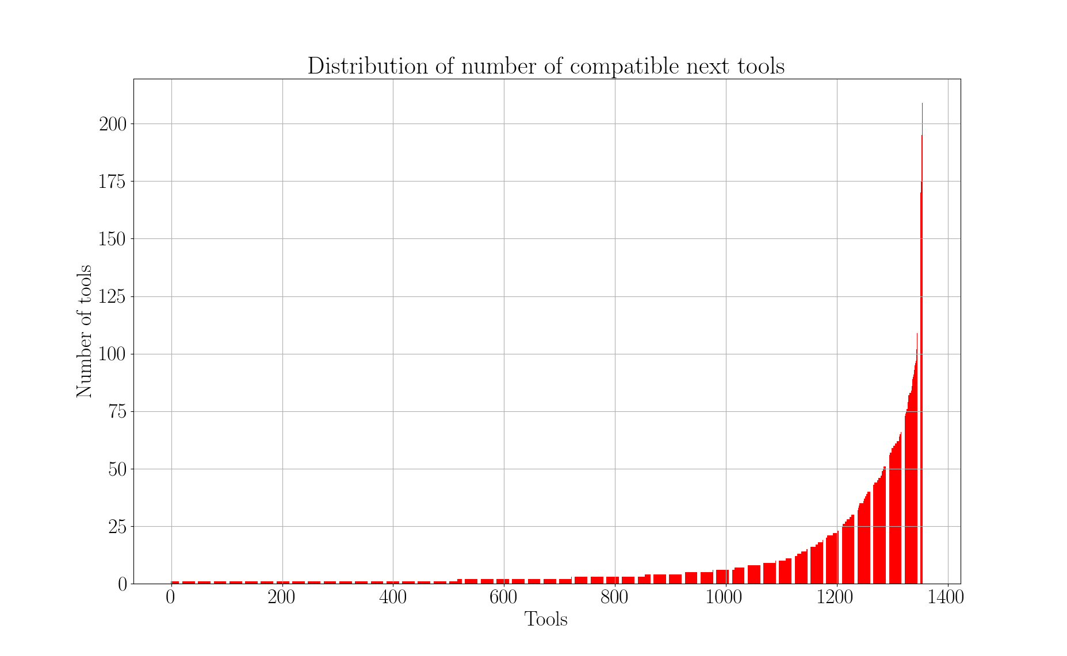

Slide 47
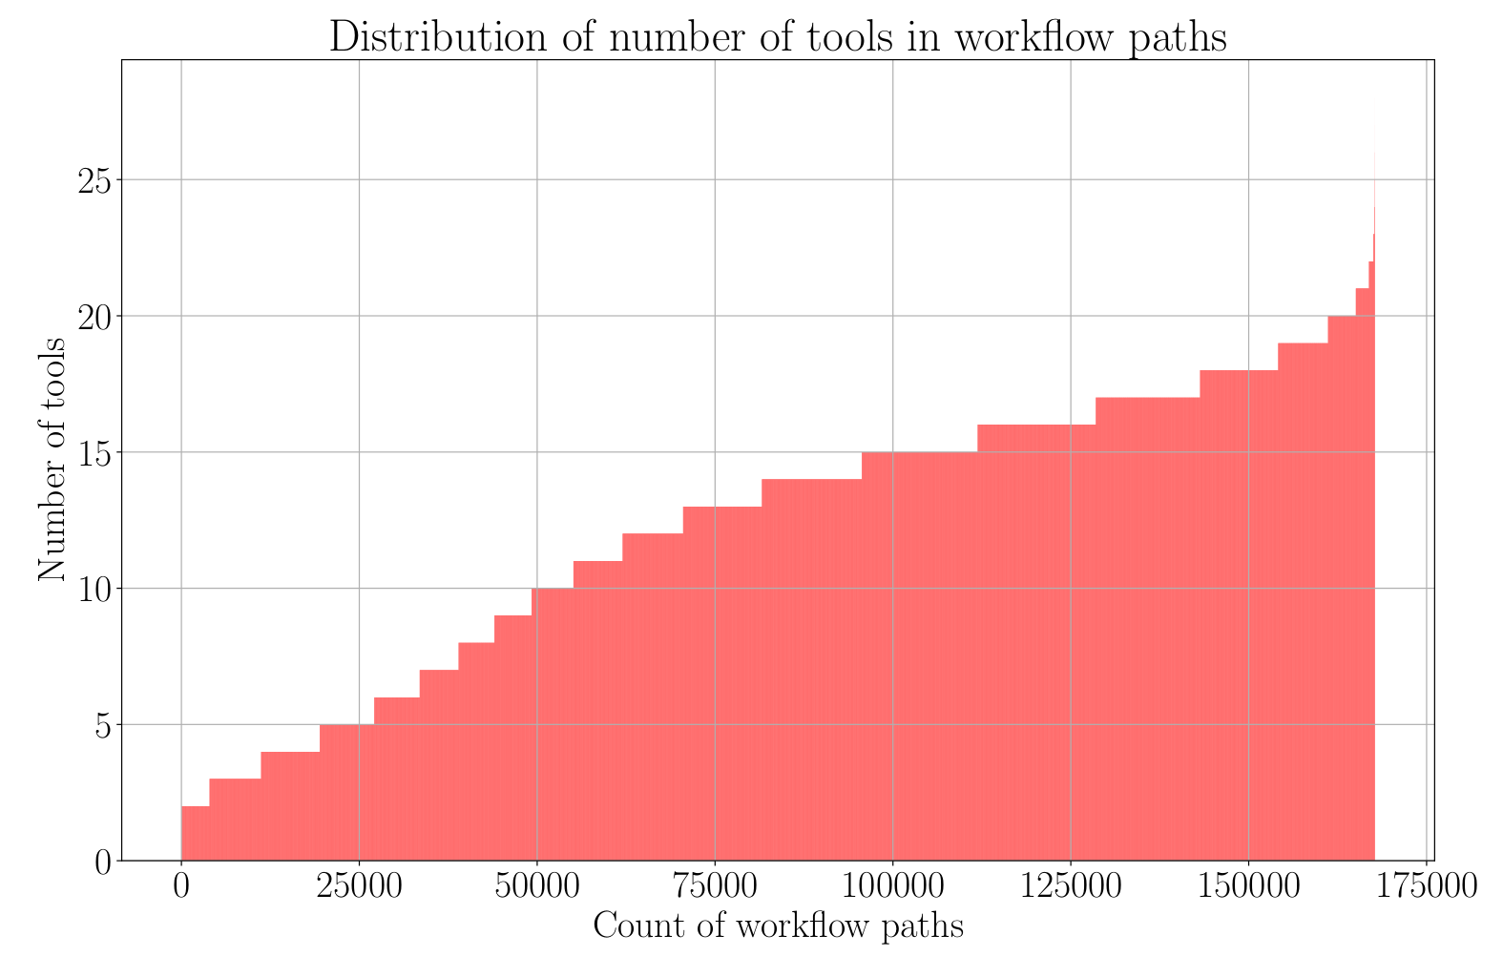

Slide 48
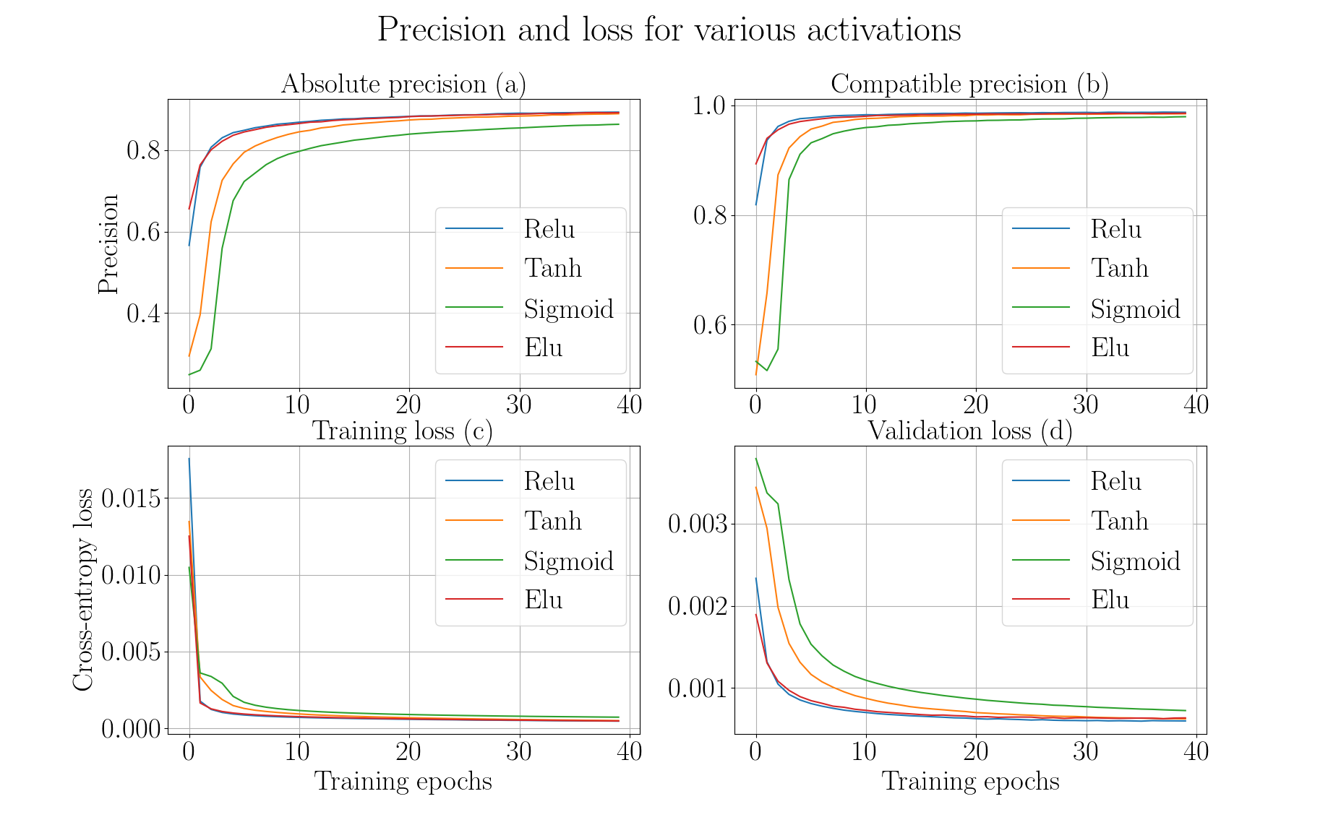

Slide 49
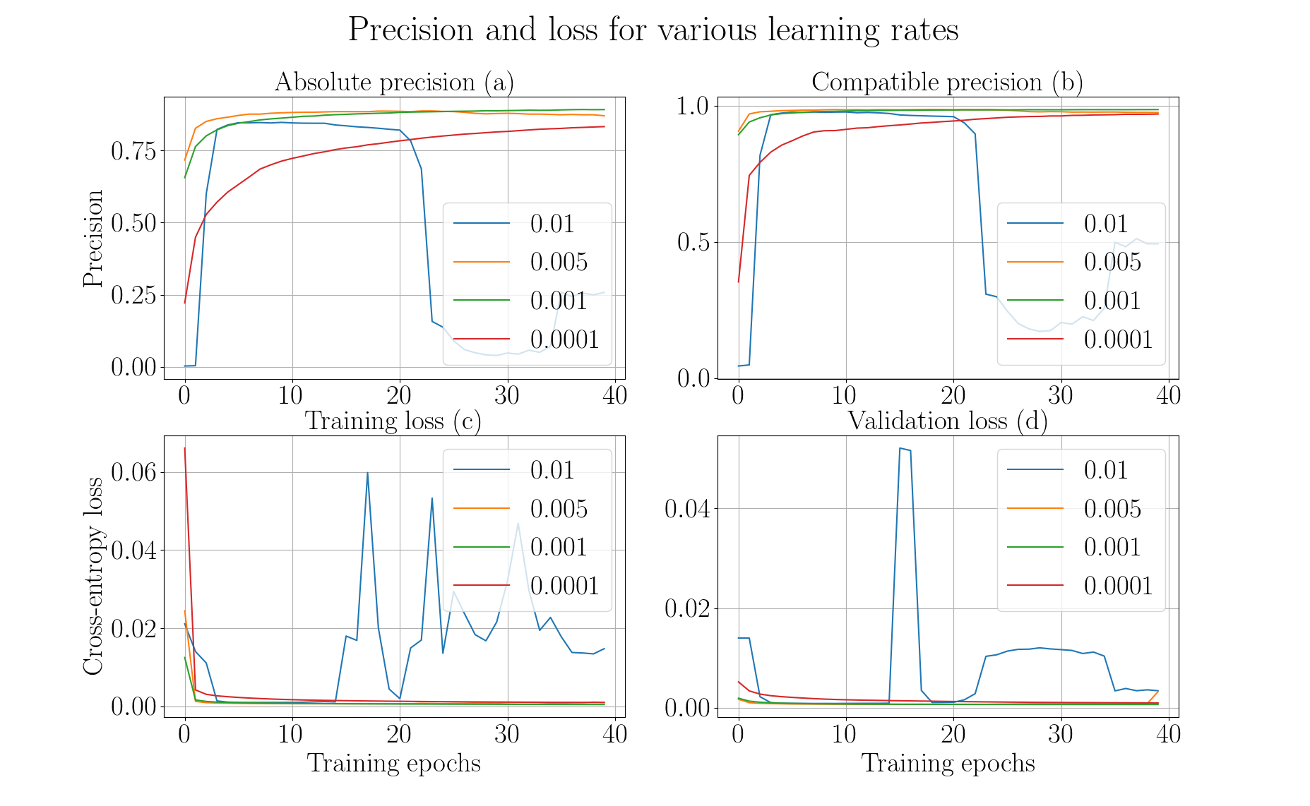

Slide 50
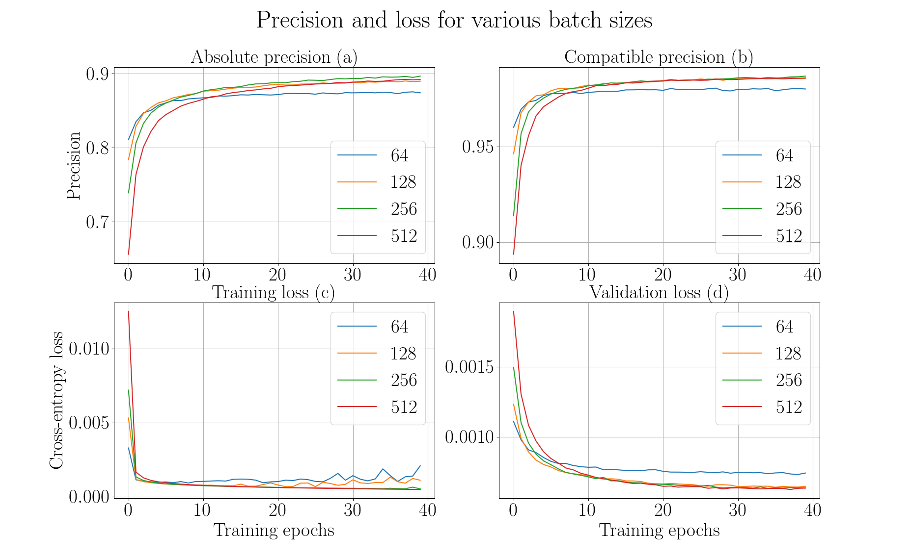

Slide 51
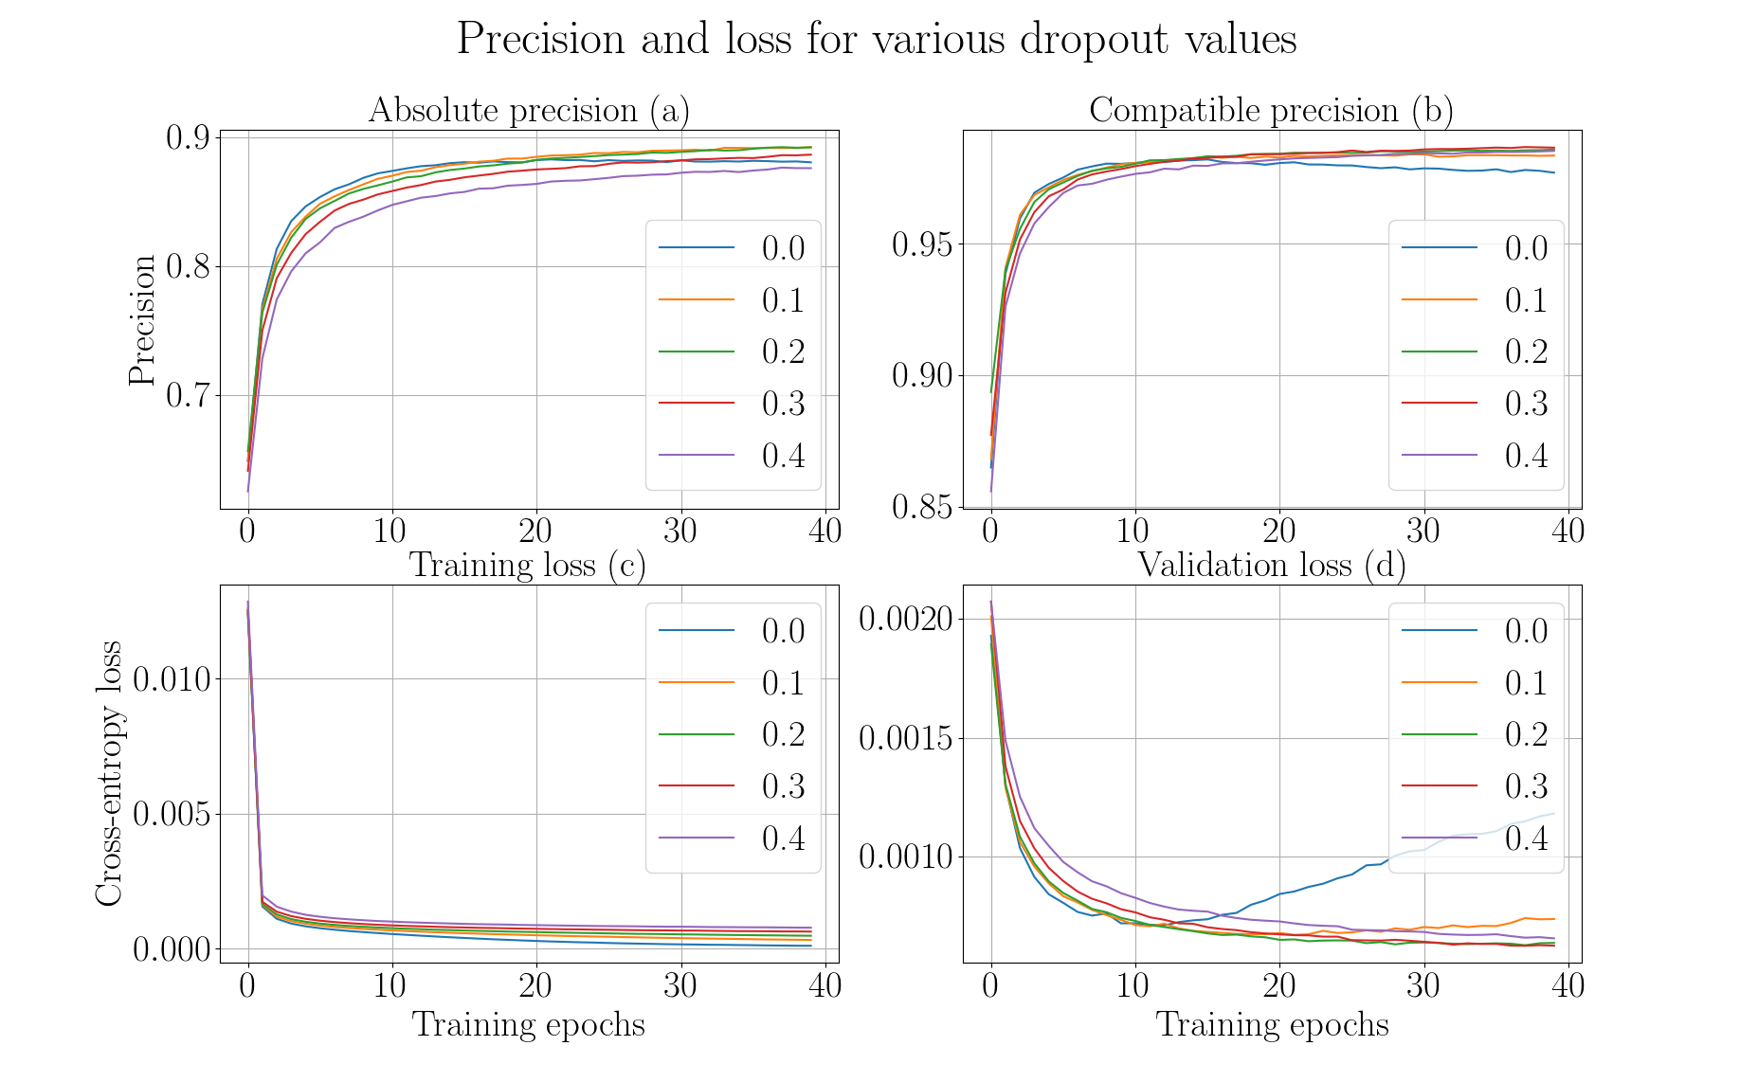

Slide 52
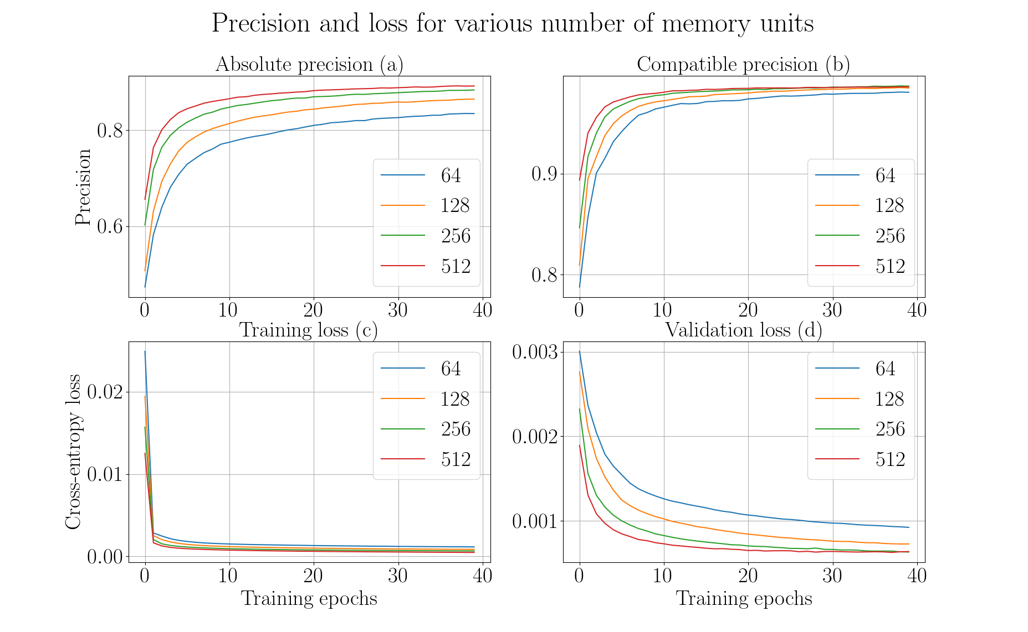

Slide 53
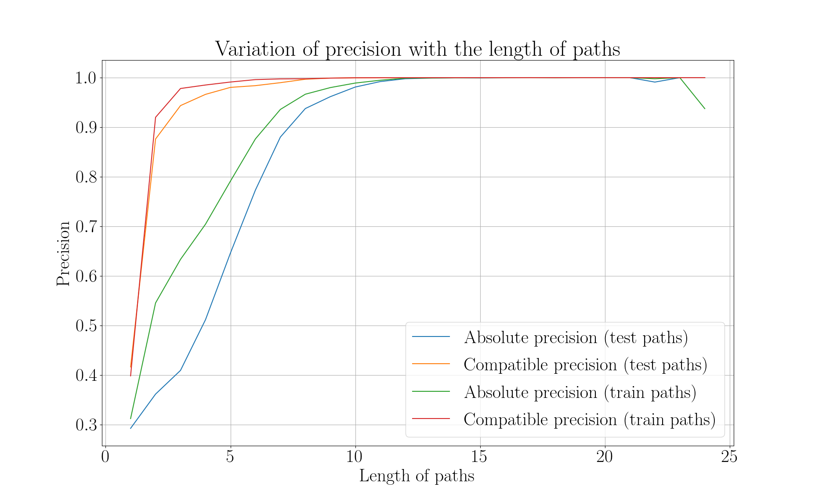

Slide 54
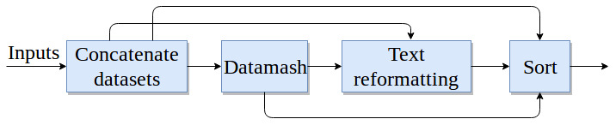
Higher order dependency
Not dependent only on immediate parent
Dependent on all previous tools
Higher order dependency: https://arxiv.org/pdf/1506.06268.pdf
https://arxiv.org/pdf/1508.03113.pdf

Slide 55
Bayesian network
Explain workflows
Predict missing nodes
Compute joint and conditional probabilities
High computational cost with large number of nodes
Prediction by probabilistic network is a hard problem
https://www.microsoft.com/en-us/research/uploads/prod/2004/01/Large-Sample-Learning-of-Bayesian-Networks-is-NP-Hard.pdf
https://www.sciencedirect.com/science/article/pii/000437029090060D

Slide 56
Hidden markov models
Transition and prior probabilities
Transition matrix is large
Current state depends only on previous state (first-order)
Higher number of parameters
Higher order markov models
https://arxiv.org/pdf/q-bio/0505002.pdf
https://pdfs.semanticscholar.org/8463/dfee2b46fa813069029149e8e80cec95659f.pdf
http://mlg.eng.cam.ac.uk/zoubin/papers/ijprai.pdf

Slide 57


Slide 58


