Slide 1
Recommendation system for scientific tools and workflows
Master thesis
Anup Kumar
Adviser: Dr. Björn Grüning

Slide 2
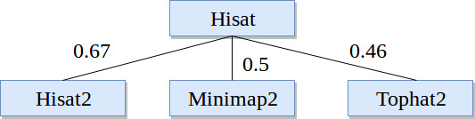
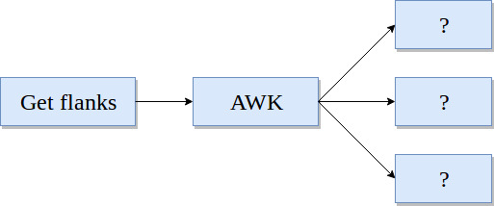
Recommendation system
Find similar scientific tools
2. Predict tools for workflows

Slide 3
Find similar scientific tools
Compute similarity among tools
Recommend similar tools
Replace a tool by its similar tool
Provide more options for data processing

Slide 4
Approach
Collect tools metadata (~ 1,050 tools)
Clean metadata - stemming and stopwords
Learn vectors for tools
Compute similarity among vectors
Combine similarity matrices

Slide 5
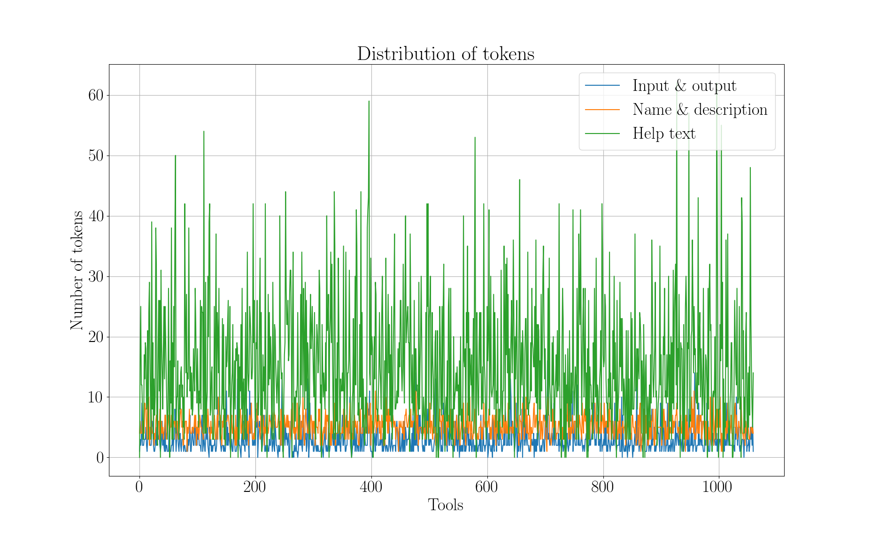
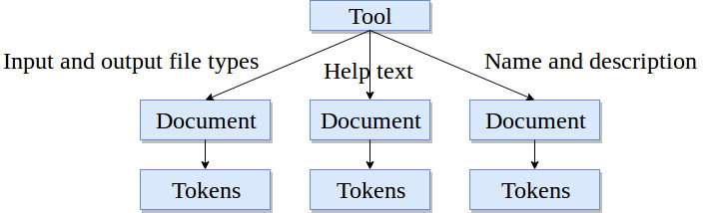
Tool, documents and tokens

Slide 6
Paragraph (document) vector
Neural network approach*
A dense vector for each paragraph
Similar tools have similar vectors
Encode variable length paragraphs
Each tool has three paragraphs (documents)
*https://cs.stanford.edu/~quocle/paragraph_vector.pdf
Input/output file types - https://dl.acm.org/citation.cfm?id=1704810 (bestmatch25)

Slide 7
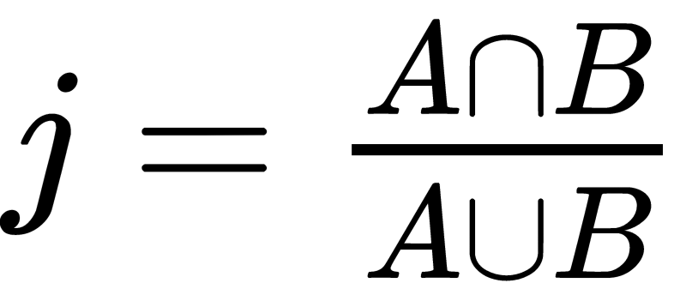
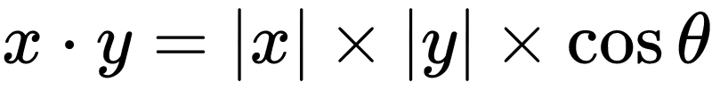
Similarity scores
Jaccard index (input and output file types)
Cosine angle (name and description and help text)
Compute similarity matrix
Three similarity matrices
Simple - average the matrices
Better - learn weights
Jaccard index: https://link.springer.com/article/10.1007/BF02365362
Cosine angle similarity: https://www.itl.nist.gov/div898/software/dataplot/refman2/auxillar/cosdist.htm

Slide 8

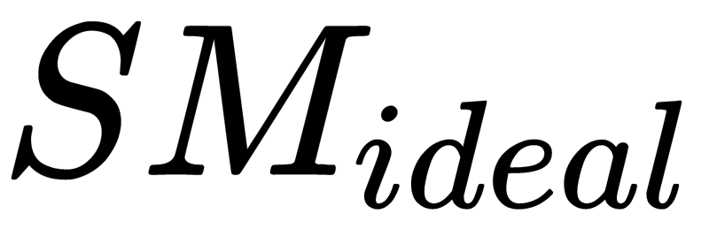
Optimisation
Gradient descent
Learn weights on similarity scores
Obtain a weighted average similarity matrix
is 1.0 as the maximum value of similarity measures can be at most 1.0
Gradient descent: https://developers.google.com/machine-learning/crash-course/reducing-loss/gradient-descent

Slide 9
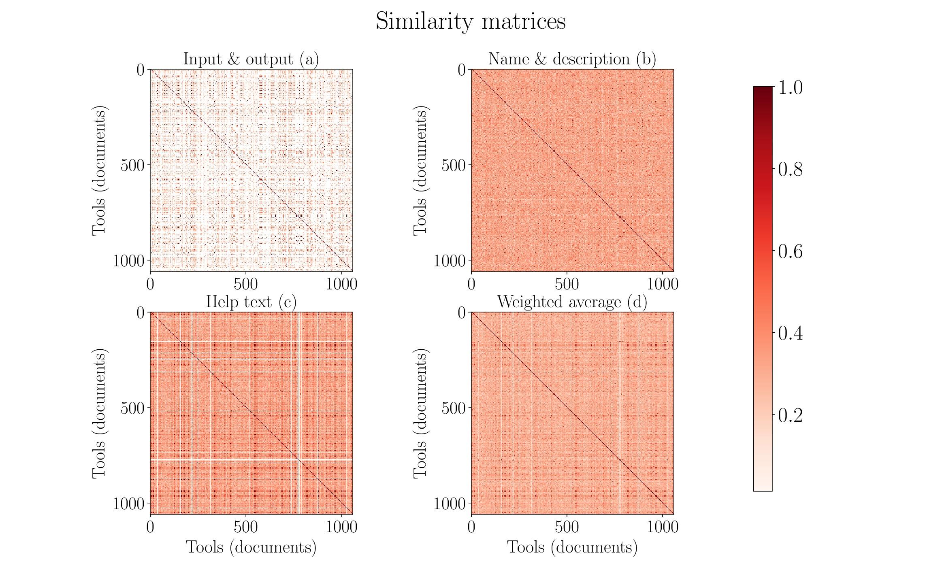

Slide 10
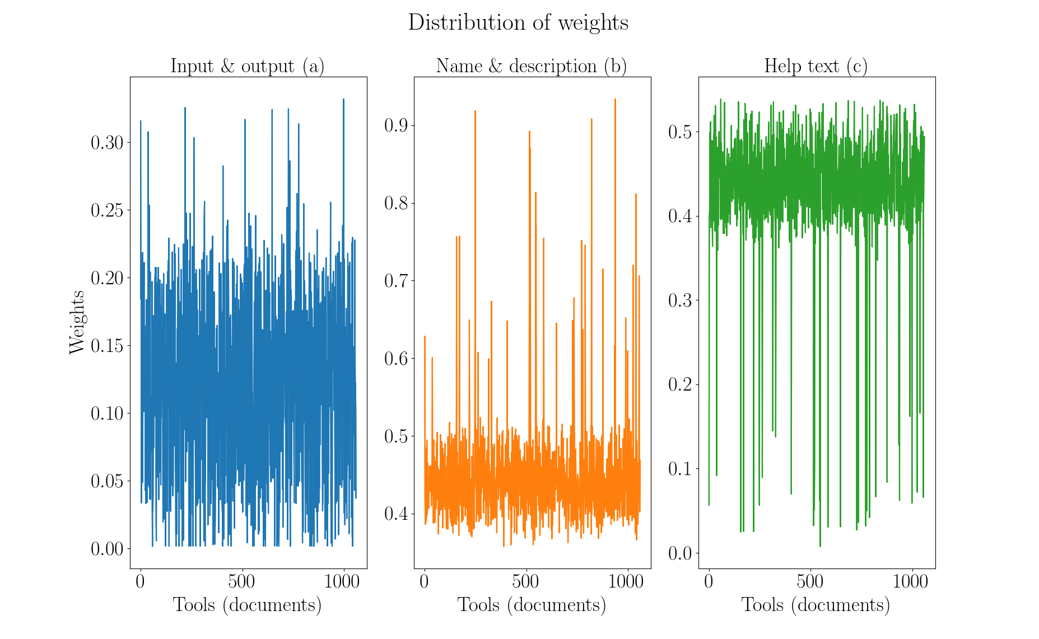

Slide 11
Summary and conclusion
Collect and clean tools metadata
Learn vector for each tool
Compute and combine similarity matrices
Less data for name and description attribute
No true similarity
Exclude low similarity values
Run analysis on larger set of tools
Compute similar tools using workflows

Slide 12
2. Predict tools in workflows
Tough to assemble workflows
Tools compatibility issues
Loss of computation time
Thousands of tools

Slide 13
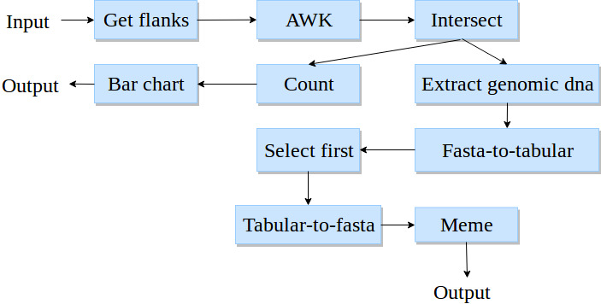
Workflows
Workflow - a directed acyclic graph
Paths in a workflow
193,000 workflows
900,000 paths
Maximum 25 tools in a path
Directed acyclic graph: https://cran.r-project.org/web/packages/ggdag/vignettes/intro-to-dags.html

Slide 14
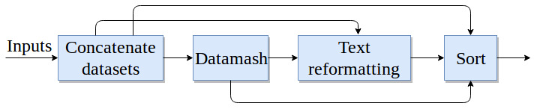
Higher order dependency
Not dependent only on immediate parent
Dependent on all previous tools
Higher order dependency: https://arxiv.org/pdf/1506.06268.pdf
https://arxiv.org/pdf/1508.03113.pdf

Slide 15
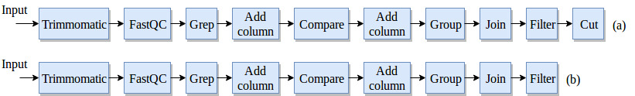
Workflow preprocessing
No decomposition

Slide 16
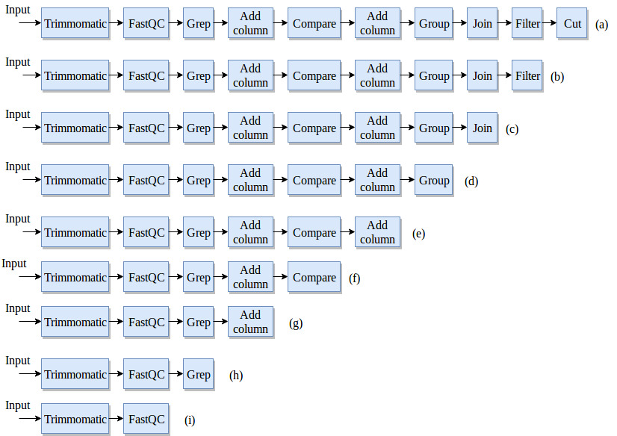
Workflow preprocessing
Keep first tool fixed

Slide 17
Recurrent neural network
Classifier to learn on sequential data
Multilabel, multiclass classification
Recurrent neural network - Gated recurrent units
Learn long-range dependencies
Two hidden layers, one embedding layer and one output layer
Cross-entropy loss
Root mean square propagation (rmsprop) optimiser
Sigmoid output activation
80% training paths, 20% test paths
Recurrent neural network: https://arxiv.org/pdf/1412.3555.pdf

Slide 18
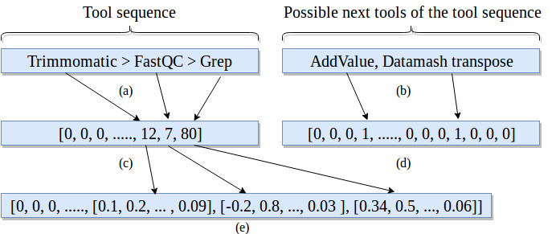
Embedding and label vectors
Embedding layer: https://keras.io/layers/embeddings/

Slide 19
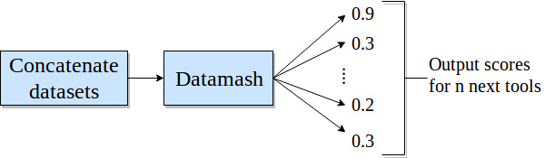
Precision and prediction
Absolute precision
Compatible precision

Slide 20
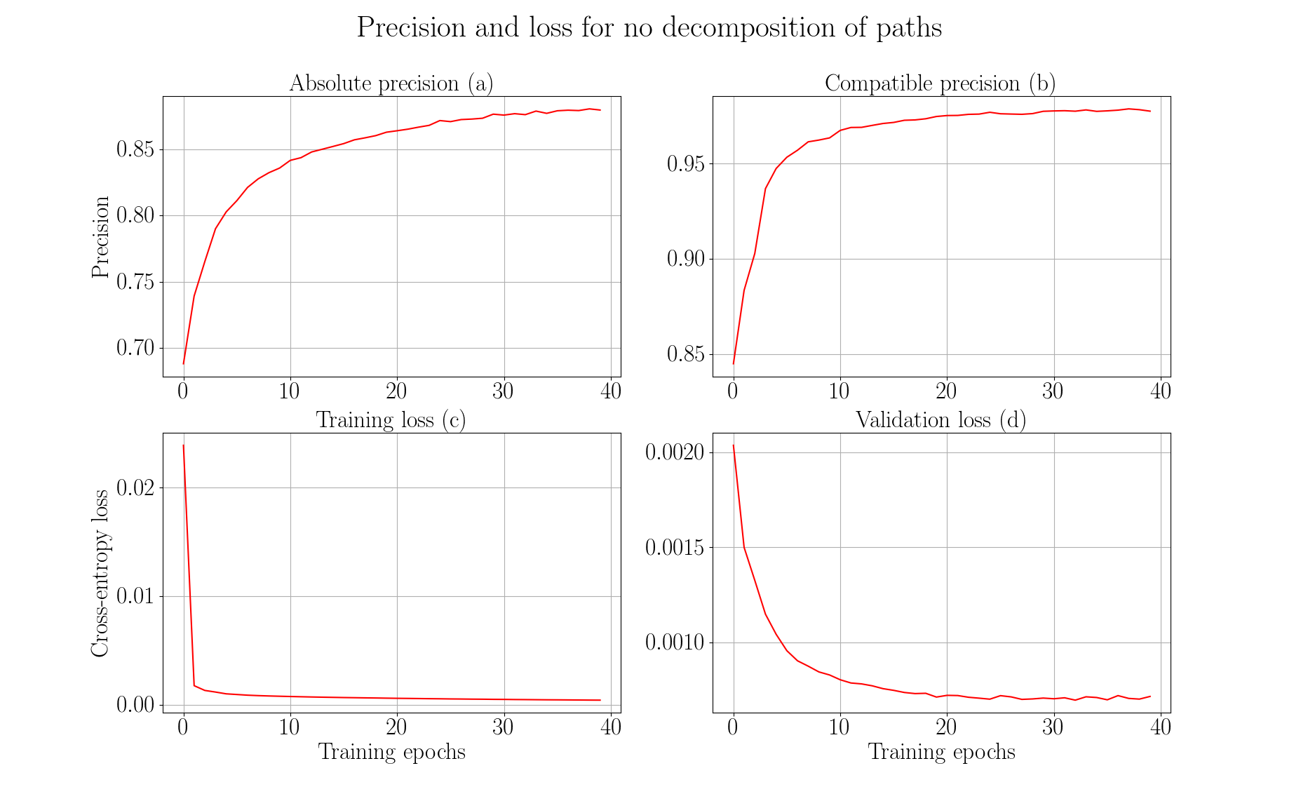

Slide 21
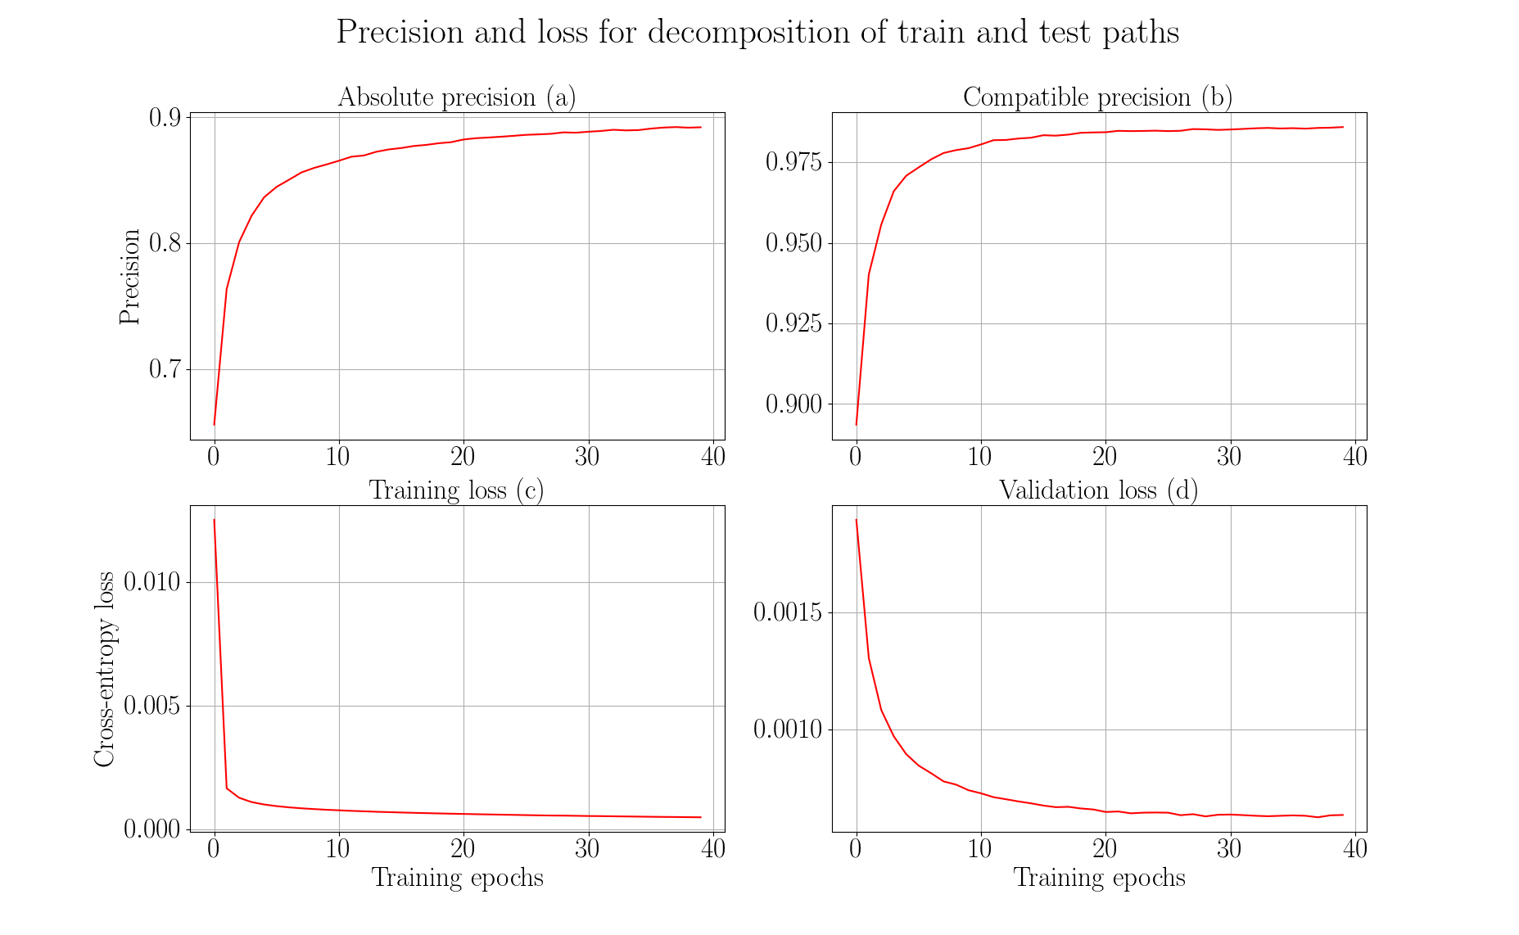

Slide 22
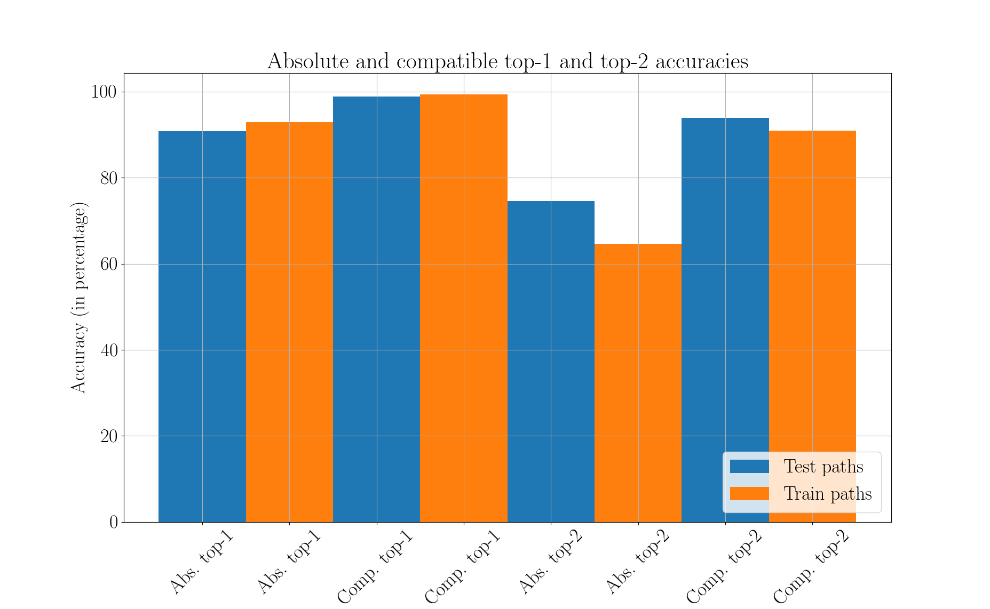

Slide 23
Summary and conclusion
Workflows are directed acyclic graphs (193, 000 workflows)
Extract paths from workflows
Learn long-range dependencies
Recurrent neural network (gated recurrent units)
Multilabel, multiclass classification
Absolute precision ~90%, compatible precision ~99%
More workflows, better results

Slide 24
Future work
Restore original distribution
Decay prediction over time
Integrate into Galaxy

Slide 25
Thank you for your attention
Questions?

Slide 26
Supplementary material

Slide 27
Stemming and stopwords
Stemming - converge all forms of a word into one basic form
“Operate, operating, operates, operation, operative, operatives, operational” into “oper” [1]
Stopwords - “a, about, above, would, could …” [2]
https://nlp.stanford.edu/IR-book/html/htmledition/stemming-and-lemmatization-1.html
https://www.ranks.nl/stopwords

Slide 28
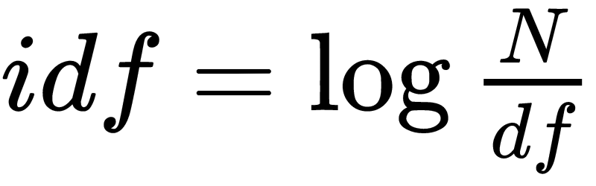
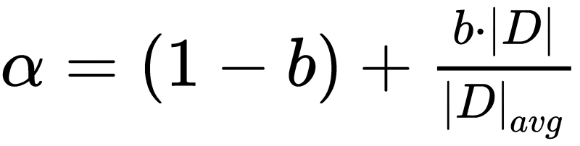
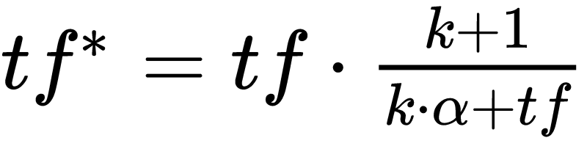
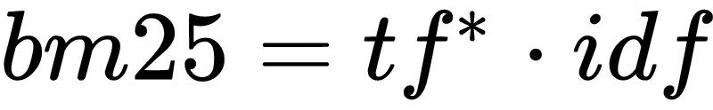
Bestmatch25 (bm25)
Token frequency (tf)
Document and inverted document frequency (idf)
https://dl.acm.org/citation.cfm?id=1704810
http://www.staff.city.ac.uk/~sb317/papers/foundations_bm25_review.pdf

Slide 29
Bestmatch25 (bm25) scores
Tools/Tokens | Regress | Linear | Gap | Mapper | Perform
LinearRegression | 5.22 | 4.1 | 0.0 | 0.0 | 3.84
LogisticRegression | 3.54 | 0.0 | 0.0 | 0.0 | 2.61
Tophat2 | 0.0 | 0.0 | 1.47 | 1.47 | 0.0
Hisat | 0.0 | 0.0 | 0.0 | 0.0 | 0.0

Slide 30

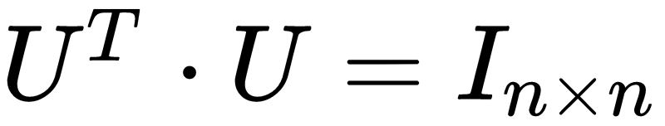
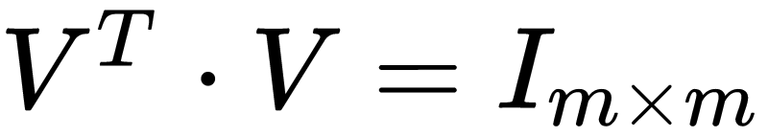
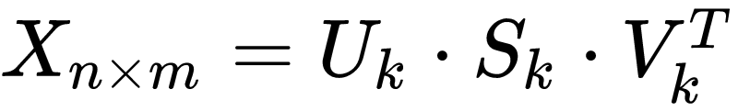
Latent Semantic Analysis
Document-token matrix (X)
Singular value decomposition

Slide 31

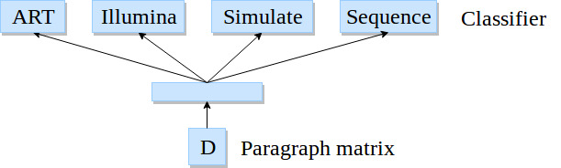
Paragraph vectors
Softmax classifier
Backpropagation
Stochastic gradient descent
Gensim*
*https://radimrehurek.com/gensim/models/doc2vec.html
Image adapted from: https://cs.stanford.edu/~quocle/paragraph_vector.pdf

Slide 32
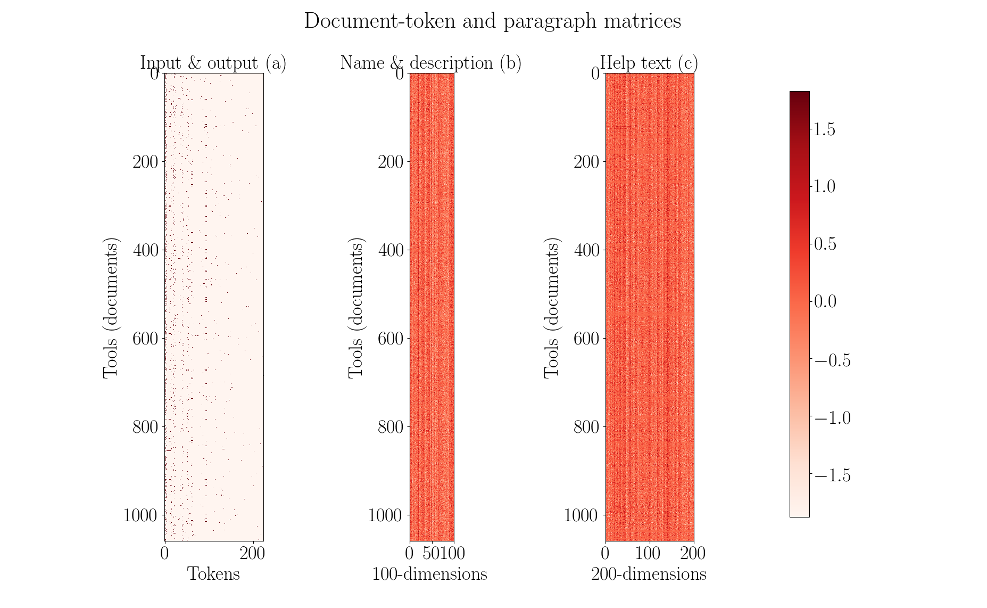

Slide 33

Optimisation
Gradient descent
Mean squared error
Initial learning rate - 0.05
Decay learning rate
Nesterov’s accelerated gradient

Slide 34
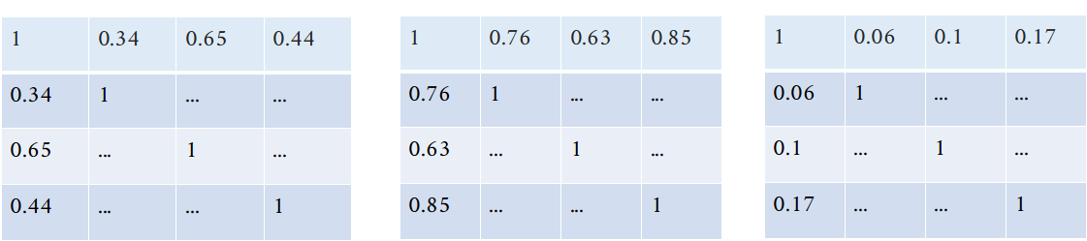
Optimisation

Slide 35
Visualisers
Paragraph vectors
Latent Semantic Analysis (5% of full-rank)

Slide 36
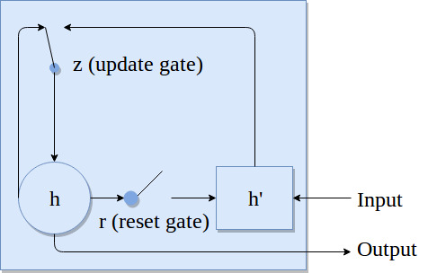



Recurrent neural network
RNN: https://arxiv.org/pdf/1412.3555.pdf

Slide 37
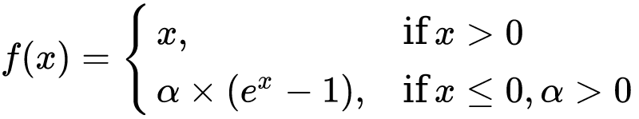
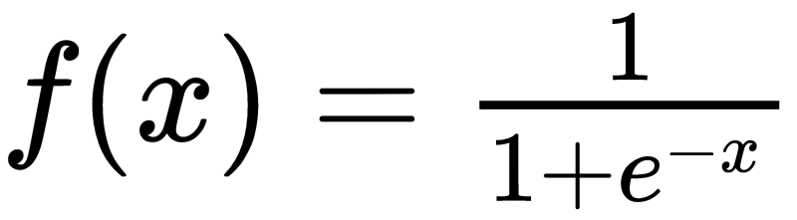
Recurrent neural network
One embedding layer, two hidden layer and one output layer
Recurrent layer activation - exponential linear unit
Output activation is sigmoid
Exponential linear units: https://arxiv.org/pdf/1511.07289.pdf

Slide 38

Recurrent neural network
Optimiser - Root mean square propagation (rmsprop)
Binary cross-entropy loss
RMSProp: https://arxiv.org/pdf/1609.04747.pdf
Binary cross-entropy: https://www.tensorflow.org/api_docs/python/tf/keras/losses/binary_crossentropy

Slide 39
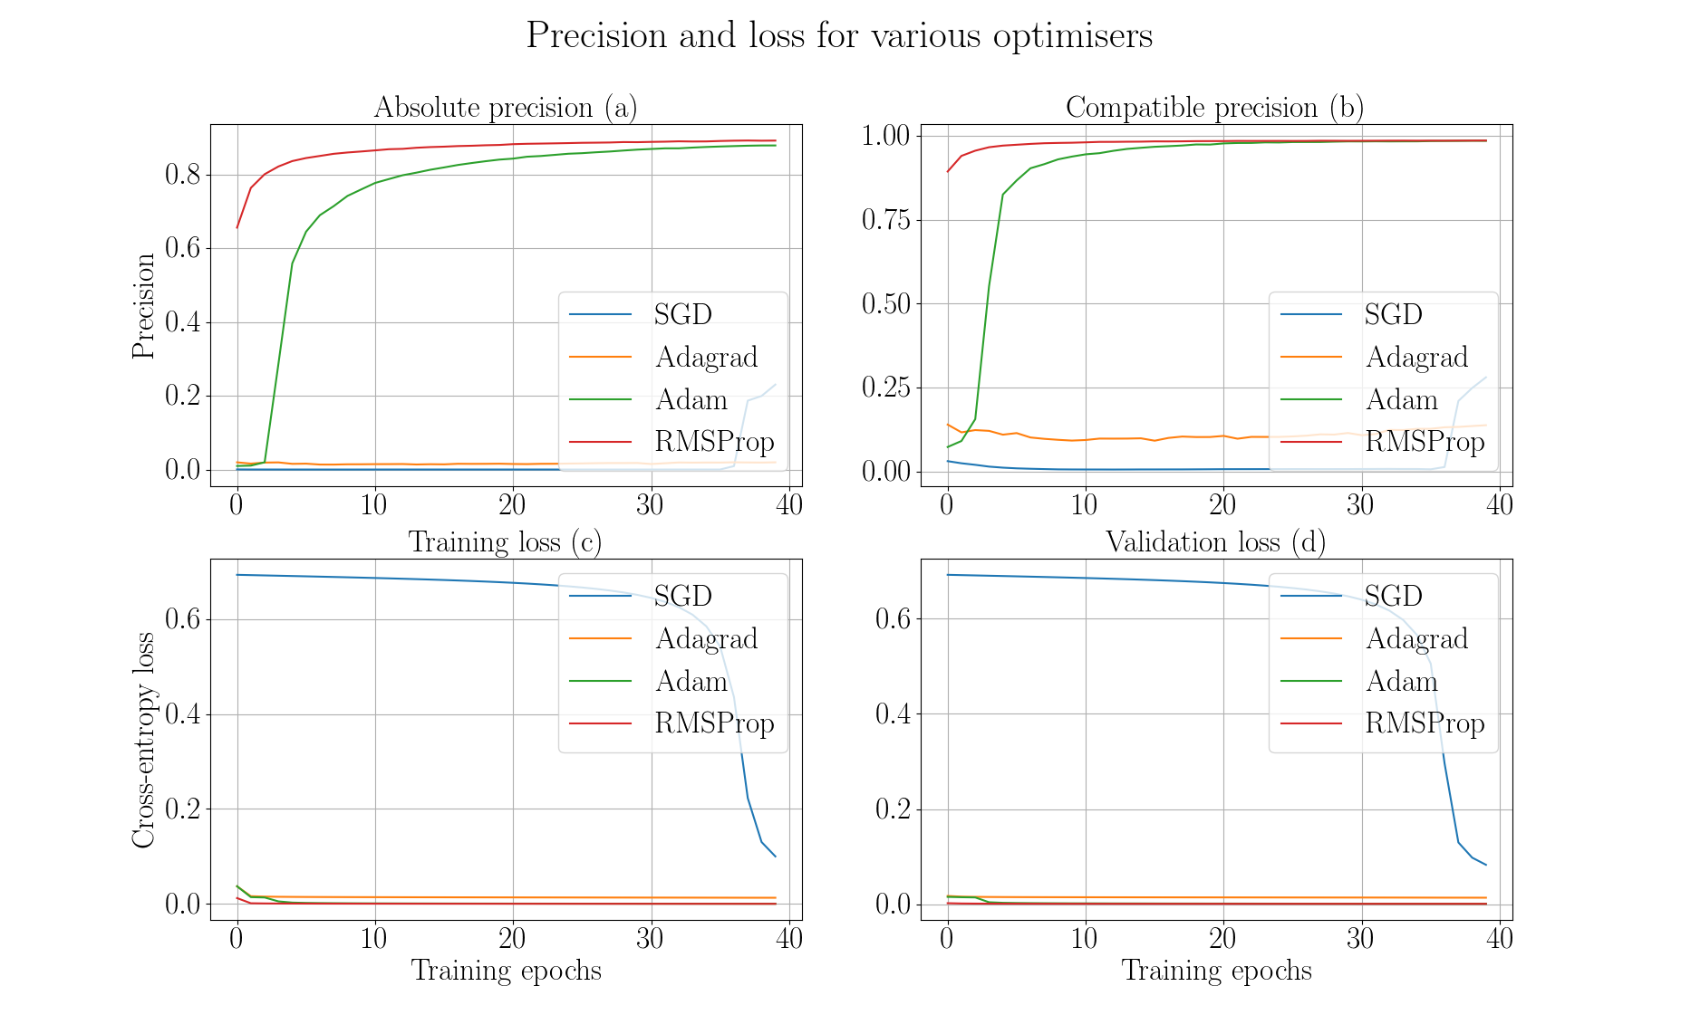

Slide 40
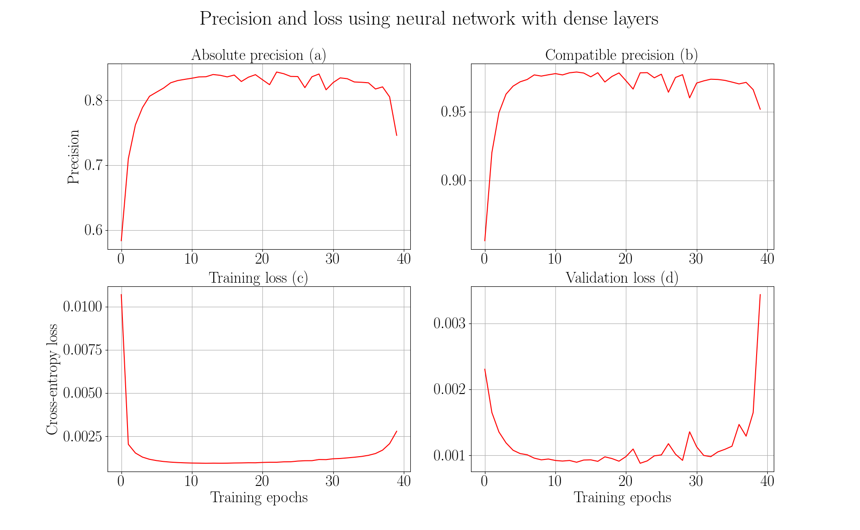

Slide 41
