Slide 1
Recommendation system for scientific tools and workflows
Anup Kumar
Adviser: Dr. Björn Grüning

Slide 2
Recommendation system
Find similar scientific tools
Predict tools for workflows
Hisat
0.67
0.46
0.5
Hisat2
Minimap2
Tophat2
?
Get flanks
AWK
?
?

Slide 3
Find similar scientific tools
Compute similarity among tools
Recommend similar tools
Replace a tool by its similar tool
Provide more options for data processing

Slide 4
Approach
Collect tools metadata
Three attributes - input and output files, name and description and help text
Clean metadata by stemming
Learn vectors for tools (tool-token matrix)
Tools/Tokens | Regress | Linear | Gap | Mapper | Perform
LinearRegression | 5.22 | 4.1 | 0.0 | 0.0 | 3.84
LogisticRegression | 3.54 | 0.0 | 0.0 | 0.0 | 2.61
Tophat2 | 0.0 | 0.0 | 1.47 | 1.47 | 0.0
Hisat | 0.0 | 0.0 | 0.0 | 0.0 | 0.0

Slide 5
Tool vector
Latent Semantic Analysis
Compute tool-token matrix using bestmatch25
Reduce ranks
Paragraph vector
Neural network approach
Similar tools have similar vectors

Slide 6
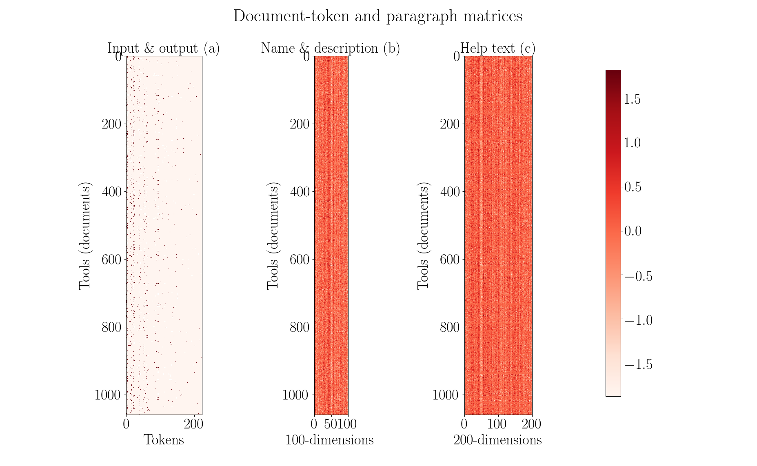

Slide 7
Similarity scores
Jaccard index (input and output files)
Cosine angle (name and description and help text)
Compute similarity matrix
Three similarity matrices

Slide 8

Optimisation
Learn weights on similarity scores
Obtain a weighted average similarity matrix

Slide 9
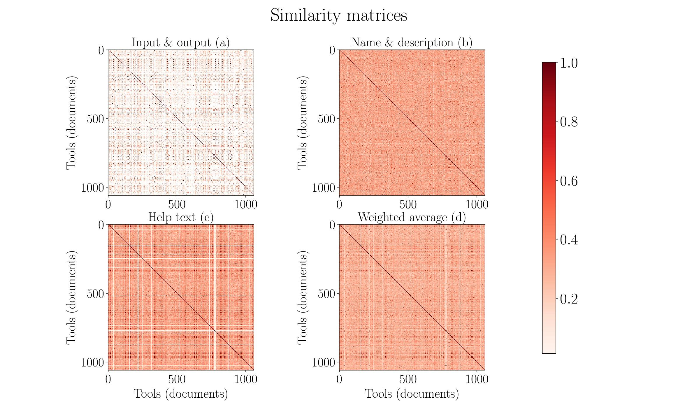

Slide 10
Summary
Collect tools metadata
Clean metadata
Learn vector for each tool
Get similarity matrix by applying similarity measures on vectors
Combine similarity matrices using optimisation

Slide 11
Conclusion and future work
Paragraph vector better than latent semantic analysis
No true similarity
Less data for name and description attribute

Slide 12
Predict tools in workflows
Tough to assemble workflows
Tools compatibility issues
Loss of computation time
Thousands of tools

Slide 13
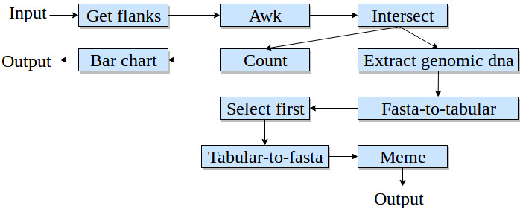
Workflow
Workflow - directed acyclic graph
Paths in workflow

Slide 14
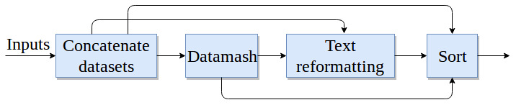
Higher order dependency
Not dependent only on immediate parent
Dependent on all previous tools

Slide 15
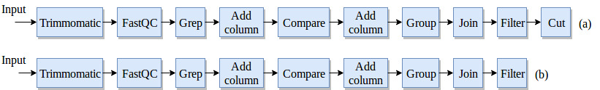
Workflow preprocessing
No decomposition

Slide 16
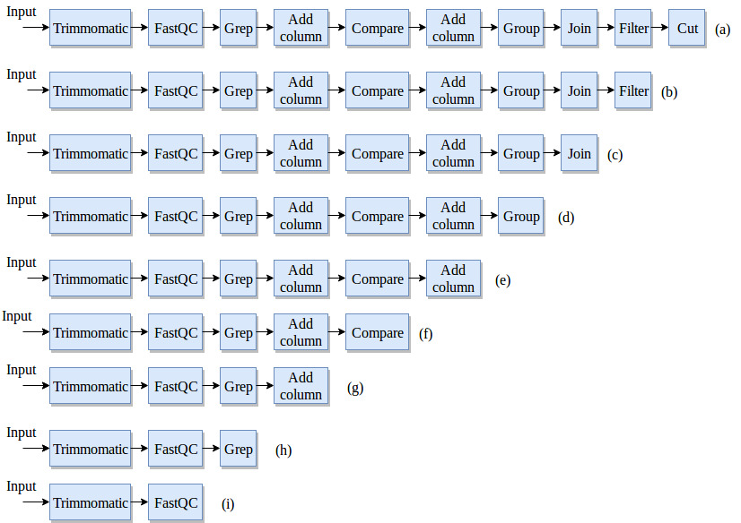
Workflow preprocessing
Keep first tool fixed

Slide 17

Recurrent neural network
Need a classifier to consume sequential data
Multilabel, multiclass classification
Recurrent neural network - Gated recurrent units
Learn long-range dependencies

Slide 18
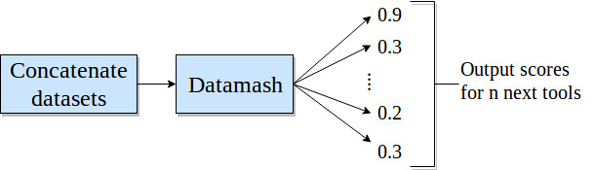
Precision and prediction
Absolute precision
Compatible precision

Slide 19
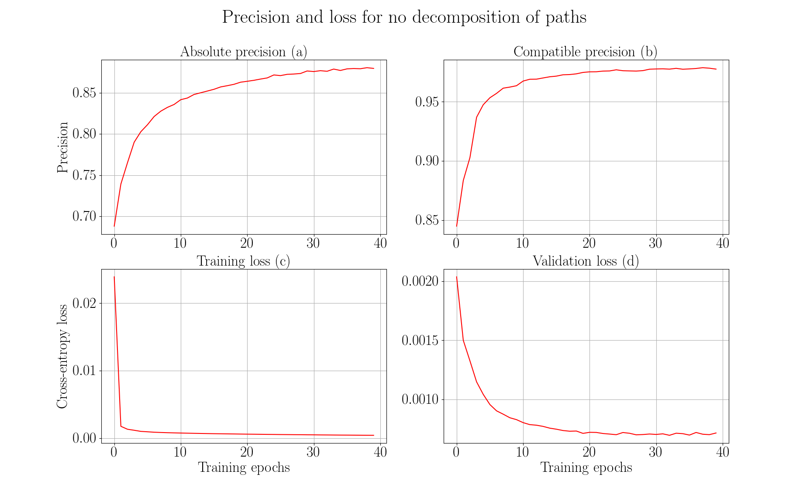

Slide 20
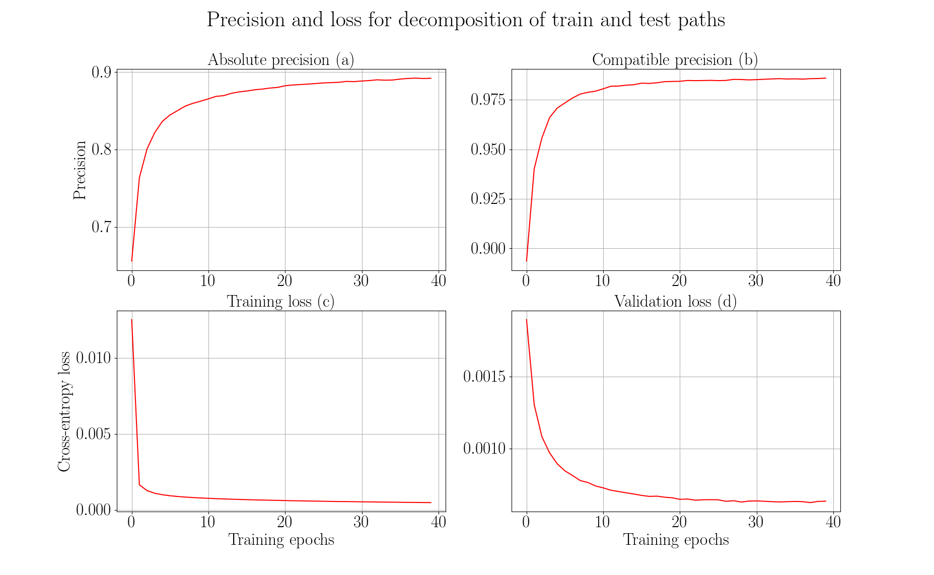

Slide 21
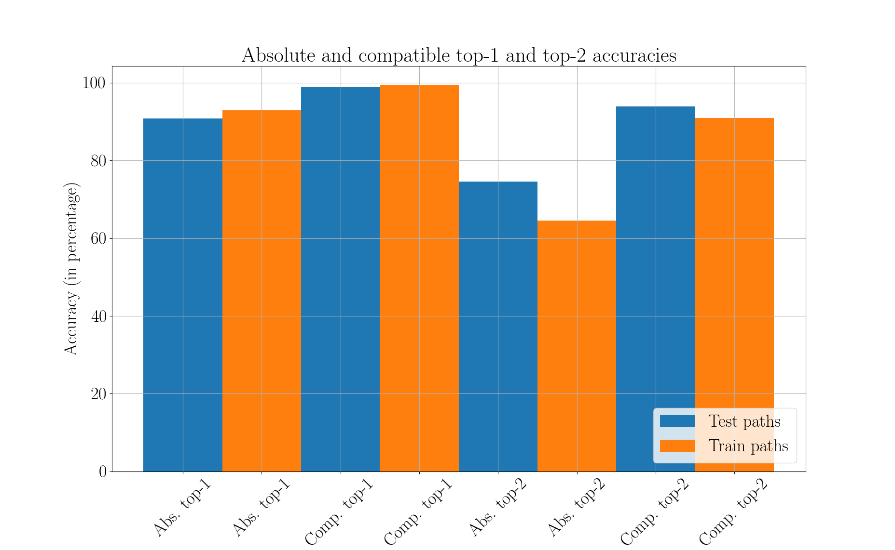

Slide 22
Summary
Workflows are directed acyclic graphs
Extract paths from workflows
Learn long-range dependencies in these paths
Use recurrent neural network (gated recurrent units) as a classifier
Multilabel, multiclass classification
Absolute and compatible precision

Slide 23
Conclusion and future work
Restore original distribution
Decay prediction over time
Integrate into Galaxy

Slide 24
Thank you for your attention
Questions?

