Slide 1
CI/CD
&
Why we should adopt it!!

Slide 2

What is CI\CD?
Continuous Integration: Development practice where developers integrate code into a shared repository frequently, preferably several times a day. Each time there is automated merging and compilation of the code, running unit test cases, static analysis of the code, and creation of an artefact.
Continous Deployment: Automated processess that provisions Infrastructure, sets up environment, uses automated testing to validate if changes to a codebase are correct and stable for immediate autonomous deployment to a production environment. Same process then deploys the artefact, promotes to production, and rollbacks if anything fails all without need of humar intervention.

Slide 3
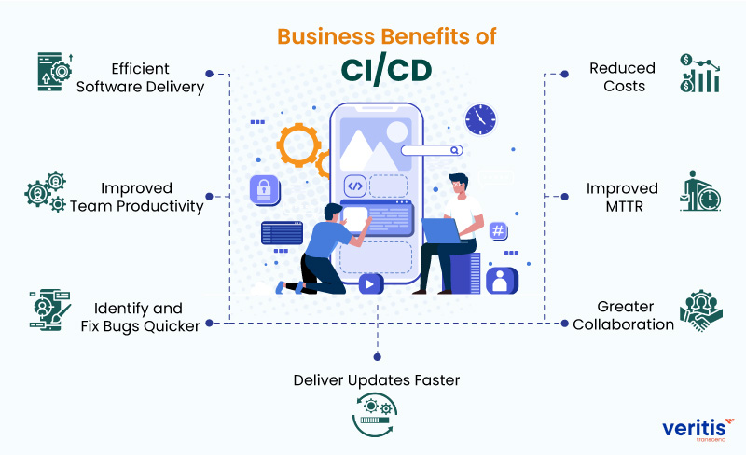
Benefits?
Repeatable Reliable Process
Automate Everything
Version Control Everything
Bring the Pain Forward
Build-in Quality
"Done" Means Released
Everyone is Responsible
Continuous Improvement
Shorter ‘Time to Market’
Optimisation of Humar resource capital
Optimisation of Infrastructure investments
Source : www.Veritis.com

Slide 4
Steps of CI/CD
Regularly merge and compile the code in shared repository.
Generate artefacts
Build
CI
Run unit test cases
Test
Static analysis of the code to check for quality and security.
Dependency checks
Analyze
Automated provisioning of infrastructure and its configuration.
Deployment of artefact to the proviosioned Infrastructure.
Deploy
Verify
Smoke tests
CD
Make the new product version live for customer use
Remove the previous version and in some cases infrastructure.
Promote
Rolback
Rollback to previous version in case of failures

Slide 5
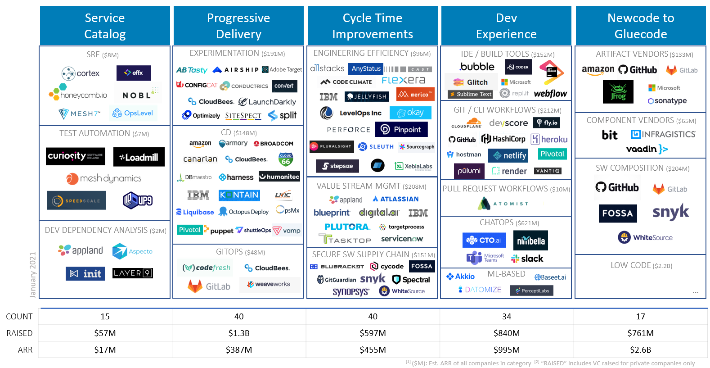
Companies Driving CI/CD and Devops
Source: https://cdn.substack.com/

