Slide 1
Microservices
What is a Service? | Introduction | The Monolithic

Slide 2

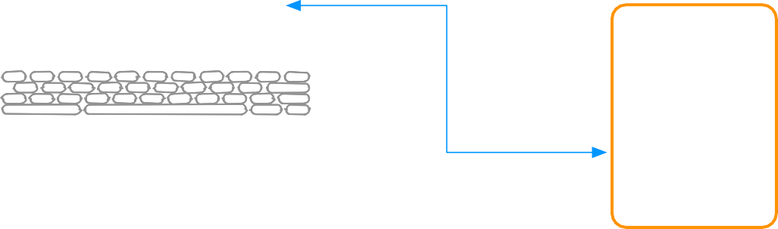


Microservices: What is a Service?
Account
Orders
Offers
Basket
Shopping website
Website
Account
Service
Database
Mobile App
Desktop App
Network

Slide 3


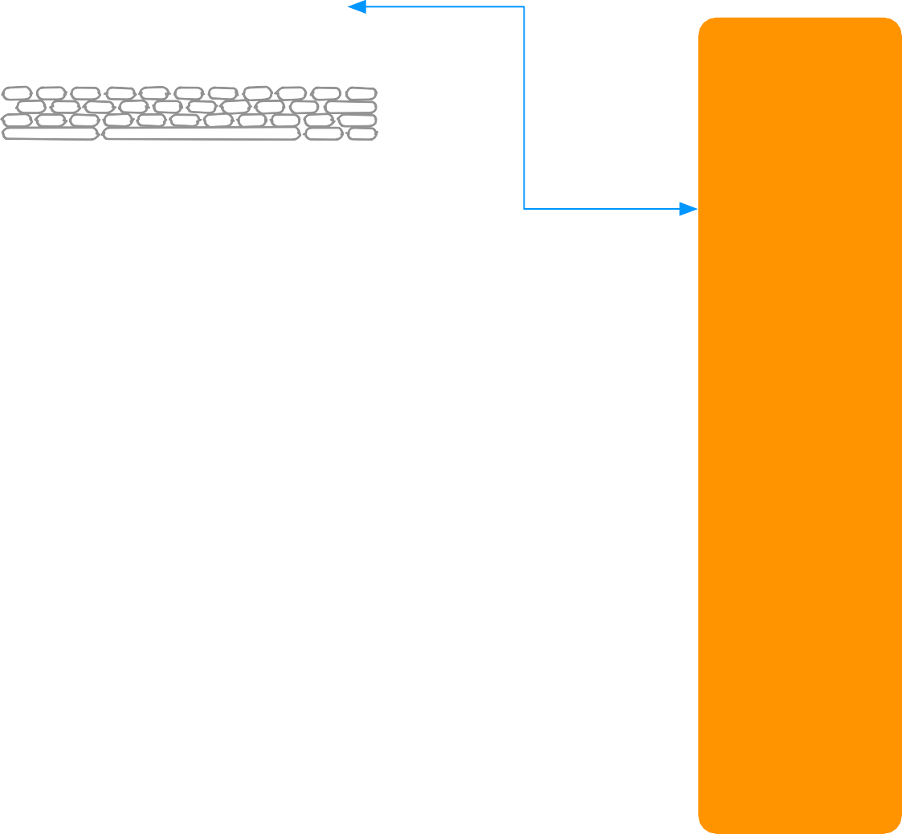







Microservices: What is a Service?
Account
Orders
Offers
Basket
Website
Server 1
Account
Load Balancer
Mobile App
Database Server
Server 2
Server 3
Desktop App
Network

Slide 4
Microservices: Introduction
•SOA done well
•Knowing how to size a service
•Traditional SOA resulted in monolithic services
•Micro sized services provide
UI
Service
Service
•Eﬃciently scalable applications
•Flexible applications
•High performance applications
•Application(s) powered by multiple services
•Small service with a single focus
•Lightweight communication mechanism
•Both client to service and service to service
•Technology agnostic API
•Independent data storage
•Independently changeable
•Independently deployable
•Distributed transactions
•Centralized tooling for management
Client
Service
Service

Slide 5

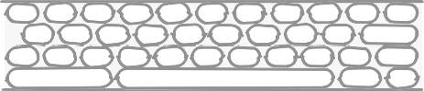
Microservices: Introduction
Shopping
Accounts Service
website
Promotions Service
Orders Service
Account
Orders
Internal Support website
Inventory Service
Offers
Basket
Products Service
Client
Internet
API
Gateway

Slide 6
Microservices
What is a Service? | Introduction | The Monolithic

Slide 7

Microservices: The Monolithic
•Typical enterprise application
•No restriction on size
•Large codebase
•Longer development times
•Challenging deployment
•Inaccessible features
•Fixed technology stack
•High levels of coupling
•Between modules
•Between services
•Failure could aﬀect whole system
•Scaling requires duplication of the whole
•Single service on server
•Minor change could result in complete rebuild
•Easy to replicate environment
Accounts
Shopping website
Account
Orders
Orders
Offers
Basket
Service
Promotions
Data Access
Database
Customer
Internal Support website
Inventory
Products
Internet

Slide 8
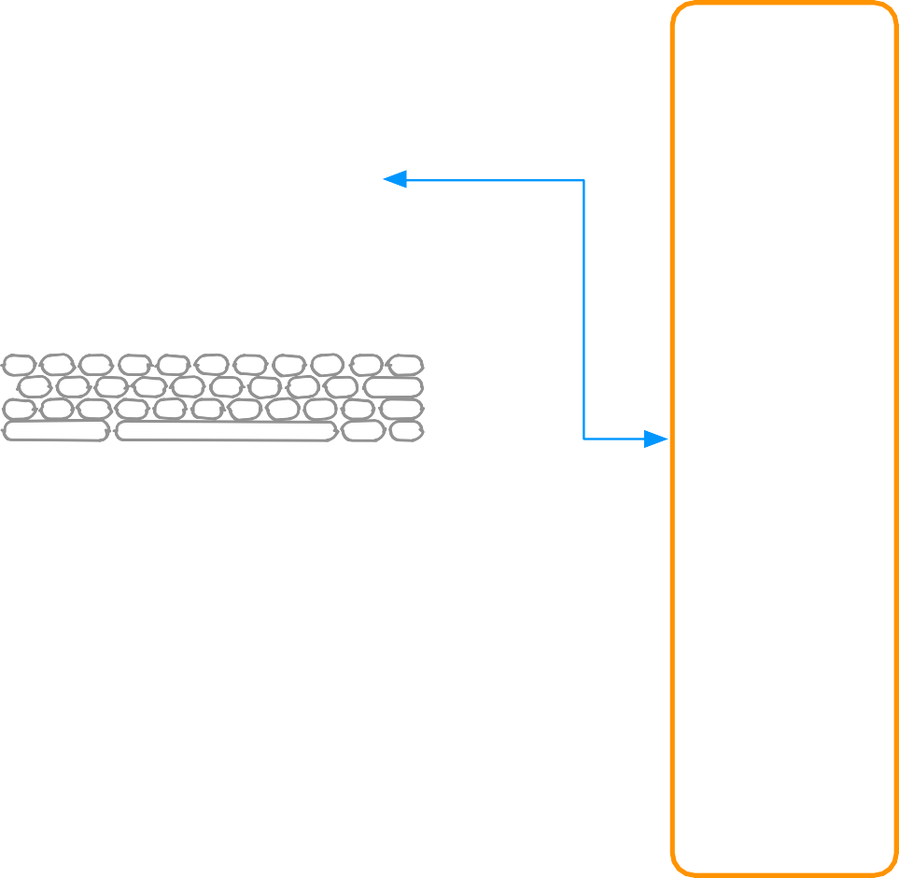
Microservices: The Monolithic
Accounts
Account
Orders
Orders
Offers
Basket
Shopping website
Promotions
Data Access
Database
Customer
Inventory
Products
Internet
UI
Layer
Business Layer
Data Layer

Slide 9

Emergence of Microservices : Why Now?
•Need to respond to change quickly
•Need for reliability
•Business domain-driven design
•Automated test tools
•Release and deployment tools
•On-demand hosting technology
•On-line cloud services
•Need to embrace new technology
•Asynchronous communication technology
•Simpler server side and client side technology
Shopping
Accounts Service
website
Promotions Service
Orders Service
Account
Orders
Internal Support website
Inventory Service
Offers
Basket
Products Service
Client
Internet
API
Gateway

Slide 10

Emergence of Microservices : Benefits
•Shorter development times
•Reliable and faster deployment
•Enables frequent updates
•Decouple the changeable parts
•Security
•Increased uptime
•Fast issue resolution
•Highly scalable and better performance
•Better ownership and knowledge
•Right technology
•Enables distributed teams
Shopping
Accounts Service
website
Promotions Service
Orders Service
Account
Orders
Internal Support website
Inventory Service
Offers
Basket
Products Service
Client
Internet
API
Gateway

Slide 11
Microservices Design Principles: Introduction
High Cohesion
Autonomous
Business Domain Centric
Resilience
Observable
Automation

Slide 12
Microservices Design Principles: High Cohesion
•Single focus
Accounts Service
•Single responsibility
•SOLID principle
•Only change for one reason
•Reason represents
•A business function
•A business domain
•Encapsulation principle
•OOP principle
•Easily rewritable code
•Why
•Scalability
•Flexibility
•Reliability
Postage Service
Orders Service
Stock Service
Products Service

Slide 13
Microservices Design Principles: Autonomous
•Loose coupling
•Honor contracts and interfaces
•Stateless
Independently changeable Independently deployable Backwards compatible Concurrent development
Accounts Service V1
Postage Service V6
Orders Service V3
Stock Service V4
Products Service V2

Slide 14













Design Principles: Business Domain Centric
•Service represents business function
•Accounts Department
•Postage calculator
•Scope of service
•Bounded context from DDD
•Identify boundaries\seams
•Shuﬄe code if required
•Group related code into a service
•Aim for high cohesion
•Responsive to business change
Accounts Service
Accounts Department
Orders Service
Orders Department
Products Service
Stock Department

Slide 15
Microservices Design Principles: Resilience
•Embrace failure
•Another service
•Specific connection
Accounts Service
•Third-party system
•Degrade functionality
•Default functionality
•Multiple instances
•Register on startup
•Deregister on failure
•Types of failure
•Exceptions\Errors
•Delays
•Unavailability
•Network issues
•Delay
•Unavailability
•Validate input
•Service to service
•Client to service
!
Postage Service
Orders Service
Stock Service
Products Service

Slide 16
Microservices Design Principles: Observable
•System Health
•Status
•Logs
•Errors
•Centralized monitoring
•Centralized logging
•Why
•Distributed transactions
•Quick problem solving
•Quick deployment requires feedback
•Data used for capacity planning
•Data used for scaling
•Whats actually used
•Monitor business data
Central Monitoring
Central Logging

Slide 17
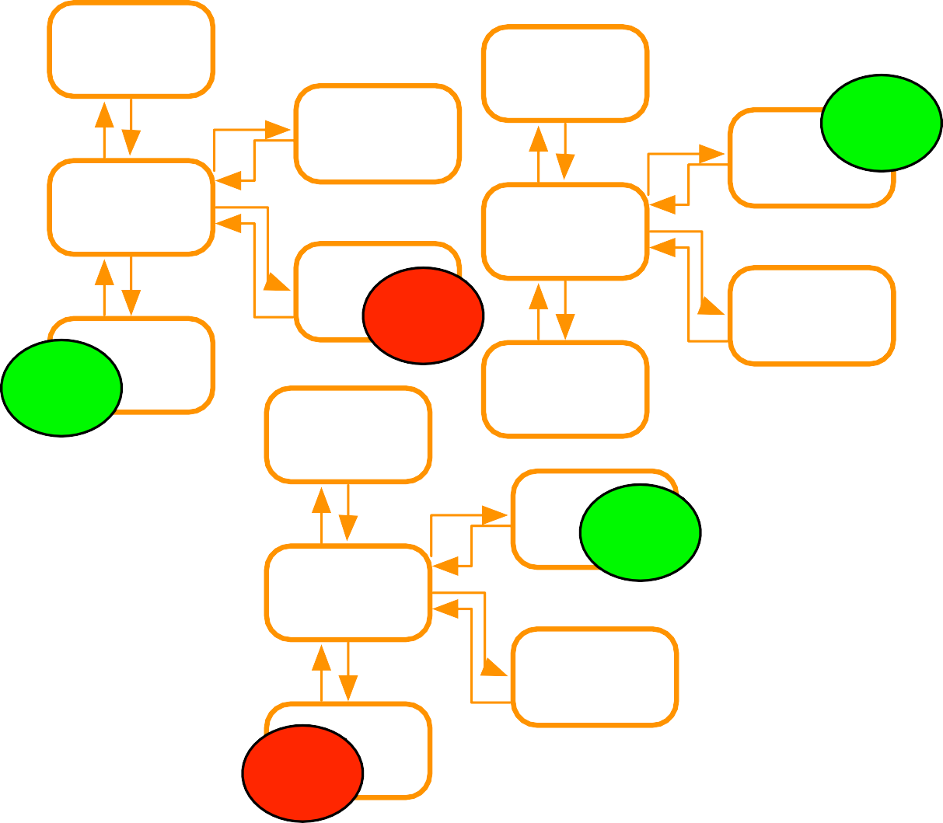
Microservices Design Principles: Automation
•Tools to reduce testing
•Manual regression testing
•Time taken on testing integration
✓
•Environment setup for testing
•Tools to provide quick feedback
•Integration feedback on check in
•Continous Integration
•Tools to provide quick deployment
•Pipeline to deployment
•Deployment ready status Automated deployment
•
X
✓
✓
Reliable deployment
Continuous Deployment
•Why
•
X
•Distributed system
•Multiple instances of services
•Manual integration testing too time consuming
•Manual deployment time consuming and unreliable

