Slide 1
Graphs

Slide 2
Introduction
Many structures involving real world situations can be conveniently represented on a paper by means of a diagram consisting of a set of points together with lines or curves joining some or all pairs of these points. Structures, thus defined are called graphs because they can be represented graphically on paper.
Ex. The points in a diagram could represent different cities in a country and a line joining two points indicate that there is a direct air service between two cities.

Slide 3
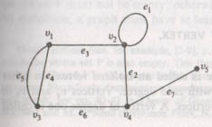
Graph
A graph G = (V, E) consists of a set of objects V = {v₁, v₂,…, v_{n}} called vertices (or nodes) and another set E = {e₁, e₂,…, e_{m}} of unordered pairs of vertices, called edges.
In a graph, vertices are represented by small circles or dots. Edges are represented by lines or curves.
v₁, v₂ are the end vertices of e₃.
An edge having same vertex as both its end vertices is called a loop or self-loop.
Edge e₁ is self loop.

Slide 4
If more than one edges are associated with a given pair of vertices, such edges are referred to as parallel edges.
In figure, there is a graph with 5 vertices and seven edges. e₁ is the loop. e₄ and e₅ are the parallel edges.
Incidence
If e is an edge between two vertices u and v of a graph, then the vertices u and v are said to be incident on e and e is incident to both u and v.
In given graph edge e₁, e₂ and e₃ are incident to v₂.
Vertex v₁ and v₂ are incident on e₃.
The order of a graph is the number of its vertices and its size is the number of its edges.
In given graph, Order = 5 and Size = 7.

Slide 5
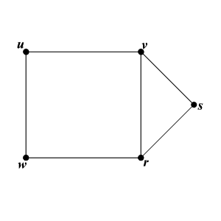
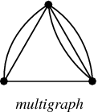
Simple Graph
A graph that has neither self-loops nor parallel edges is called a simple graph, otherwise it is referred to as general graph.
Multigraphs
Graphs that may have multiple edges connecting the same vertices are called multigraphs. If there are m different edges connecting to the same pair of vertices {u,v}, then {u,v} is called an edge of multiplicity m.

Slide 6
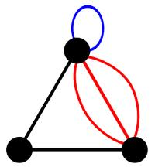
Pseudographs
Graphs that may include loops, and possibly multiple edges connecting the same pair of vertices, are called pseudographs.
Complete Graph
The complete graph K_{n}, is a graph with n vertices that contains exactly one edge between each pair of distinct vertices.
The graph K₁ with one vertex and no edge is known as the trivial graph.

Slide 7
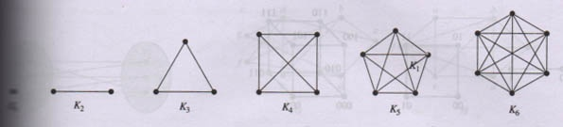
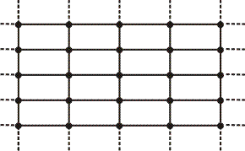
Finite & Infinite Graph
A graph with finite number of vertices as well as a finite number of edges is called a finite graph otherwise it called an infinite graph.

Slide 8
Two non-parallel edges are said to be adjacent if they are incident to a common vertex.
Ex. In given graph e₂ and e₇ are adjacent but e₂ and e₄ are not.
Two vertices u and v in an undirected graph G are called adjacent (or neighbors) if u and v are end vertices of the same edge.
Ex. In given graph vertex v₄ and v₅ are adjacent but v₁ and v₄ are not.

Slide 9
Degree
The degree of a vertex v_{i} in an undirected graph is the number of edges incident to v_{i}, with self-loop counted twice. The degree of the vertex is denoted by d(v_{i}).
Ex. In given graph d(v₁) = 3, d(v₂) = 4, d(v₃) = 3, d(v₄) = 3 and d(v₅) = 1.
The degree of a vertex is also referred to as its valency

Slide 10
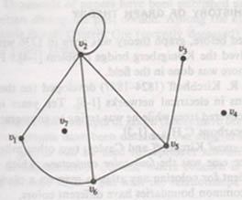
A vertex of degree zero is called isolated.
An isolated vertex is not adjacent to any vertex.
A vertex is pendant if it has degree one.
A pendant vertex is adjacent to exactly one other vertex.
Ex. vertex v₄ and v₇ are isolated and vertex v₃ is pendant vertex.

Slide 11
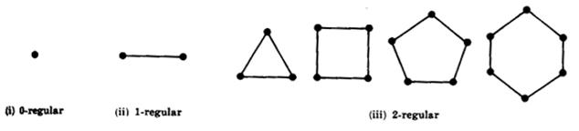
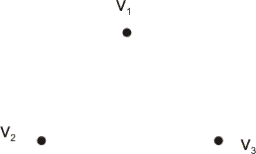
Regular Graph
A graph in which all vertices are of equal degree
If degree of all vertices in a regular graph is k, then graph is called k-regular.
Null Graph : A graph G = (V, E) is null if E = φ.
Every vertex in a null graph is isolated.

Slide 12
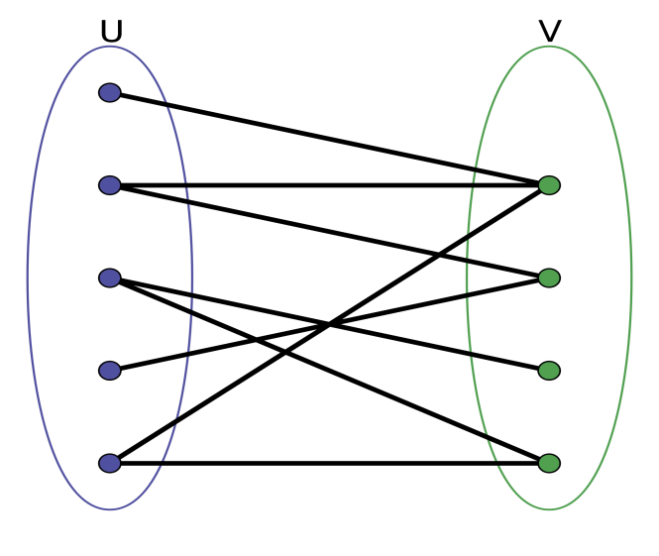
Bipartite Graph
A simple graph G is called bipartite if its vertex set V can be partitioned into two disjoint sets V₁ and V₂ such that every edge in the graph connects a vertex in V₁ and a vertex in V₂ i.e., no edge in G connects either two vertices in V₁ or two vertices in V₂.
It is represented as G = (V₁, V₂, E).
The pair (V₁, V₂) is called a bipartition of the vertex set V of G.

Slide 13
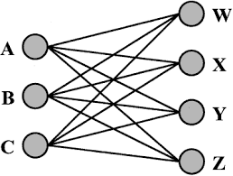
Complete Bipartite Graph
The complete bipartite graph K_{m,n} is the bipartite graph G = (V₁, V₂, E) with m vertices in V₁ and n vertices in V₂ in which there is an edge between every vertex in V₁ and every vertex in V₂.

Slide 14
Q. Find the number of edges in the complete graph
with n vertices.
Sol. Let K_{n} be a complete graph with n vertices
Let V = {1, 2, 3,…,n} be the vertex set of the graph
A vertex i can be selected in n ways.
There are exactly (n-1) edges between vertex i and the remaining (n-1) vertices.
Total number of edges = n(n-1)
Also, the edge joining vertices i and j is same as the edge joining j and i.
Hence, the number of edges in K_{n} = n(n-1)/2
Theorem : Prove that the maximum number of edges in a simple graph with n vertices is n(n-1)/2

Slide 15
Handshaking Theorem
The sum of the degrees of all vertices of a graph is twice the number of edges in it.
Proof : An edge that is not a loop contributes to the degrees of two distinct vertices.
A loop at a vertex contributes twice to the degree of that vertex.
∴ when the degrees of the vertices are added, each edge (whether it is a loop or not) is counted exactly two times.
Thus, the sum of the degrees is twice the number of edges.
Ex. d(v₁) + d(v₂) + d(v₃) + d(v₄) + d(v₅)
= 3 + 4 + 3 + 3 + 1 = 14 = 2 x 7

Slide 16

Theorem
Every graph has an even number of odd vertices.
or
The number of vertices of odd degree in a graph is always even.
Proof : Let the sum of degrees of odd vertices = x
Let the sum of degrees of even vertices = y,
which is even.
∵ sum of degrees of all vertices of a graph
= 2 . (number of edges), which is even
⇒ x + y is even ⇒ x is even [∵ y is even]
If p is the number of odd vertices,
then sum of p odd numbers = x
⇒ p is also even [∵ x is even]

Slide 17
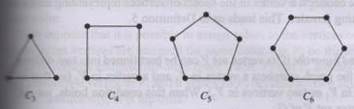
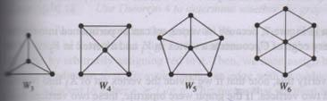
Cycles The cycle C_{n}, n ≥ 3, consists of n vertices 1, 2, …, n and edges {1, 2}, {2, 3}, …, {n-1, n}, and {n, 1}
Wheels Obtain a wheel W_{n} by adding a new vertex to the cycle C_{n}, and connect this vertex to each vertex in Cycle

Slide 18
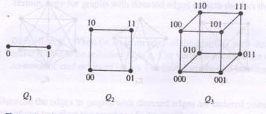
N-Cubes
The n-dimensional hypercube or n-cube, denoted by Q_{n} is the graph that has vertices representing the 2^{n} bit strings of length n.
Two vertices are adjacent if and only if the bit strings that they represent differ in exactly one bit position.
Q₃ can be constructed from Q₂

Slide 19
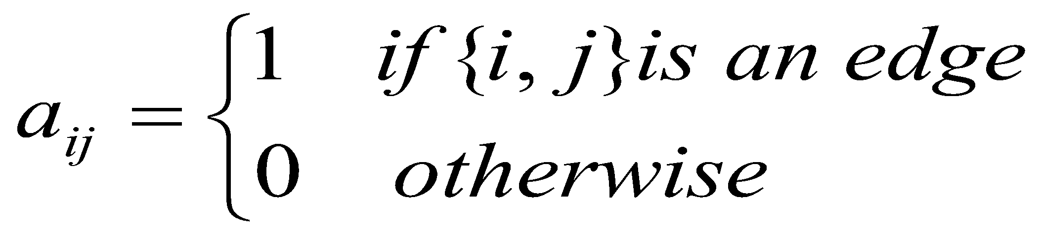
Representation of Graphs
Adjacency Matrix
Let G = (V, E) be a simple graph where |V| = n.
The adjacency matrix A = [aij] of G is n x n zero-one matrix where
Ex. Use an adjacency matrix to represent the graph

Slide 20
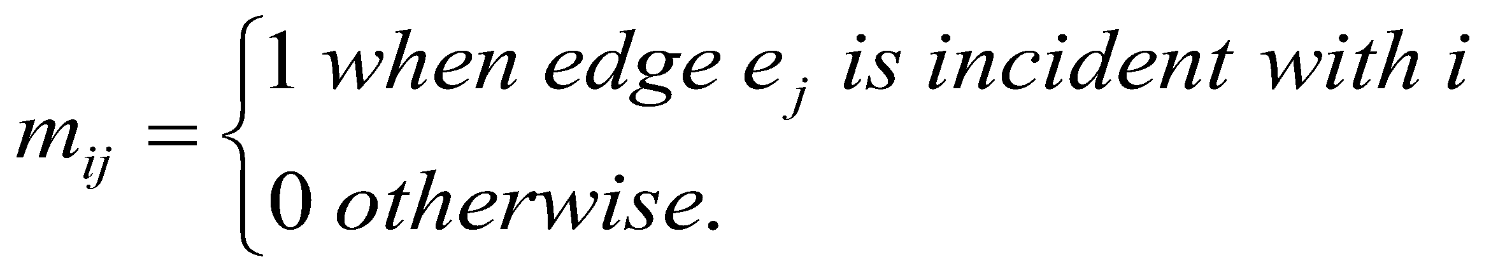
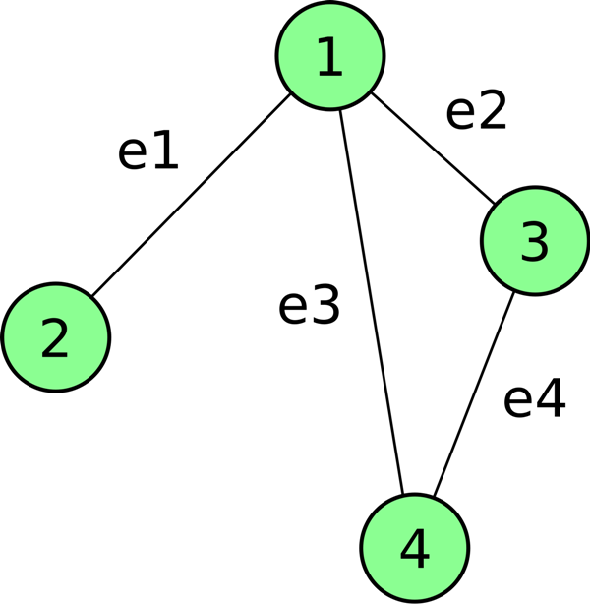
Incidence Matrix
Let G = (V, E) be a graph. Let 1, 2, …, n are the vertices and e₁, e₂, …, e_{m} are the edges of G.
Then the incidence matrix is the n x m matrix M = [m_{ij}] where
Ex. Represent the graph with an incidence matrix

Slide 21
Homomorphism & Isomorphism of Graphs
A graph homomorphism f from a graph G = (V, E) to a graph G’ = (V’, E’) written as f : G → G’, is a mapping f : V → V’ such that
{u, v} ∈ E ⇒ {f(u), f(v)} ∈ E’
The simple graphs G = (V, E) and G’ = (V’, E’) are isomorphic if there is a one-to-one and onto function f from V to V’ with the property that
a and b are adjacent in G iif f(a) and f(b) are adjacent in G’, for all a, b ∈ V.

Slide 22
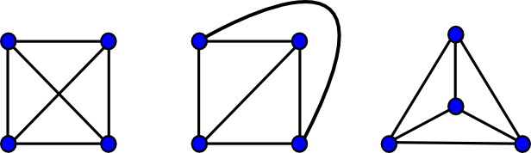
Isomorphism of Graphs
Two graphs G and G’ are said to be isomorphic if there is a one-to-one correspondence between their vertices and between their edges such that the incidence relationship is preserved.
Suppose that edge e is incident on vertices v₁ and v₂ in G; then the corresponding edge e’ in G’ must be incident on the vertices v₁′ and v₂′ that correspond to v₁ and v₂ respectively.

Slide 23
Except the labels of their vertices and edges, isomorphic graphs are the same graph, just drawn differently.
Two isomorphic graphs must have :
The same number of vertices
The same number of edges
An equal number of vertices with a given degree.
If any of the above three conditions is not satisfied,
then the graph will be not isomorphic.
But if above conditions are satisfied, it is not
necessary that graphs are isomorphic.

Slide 24
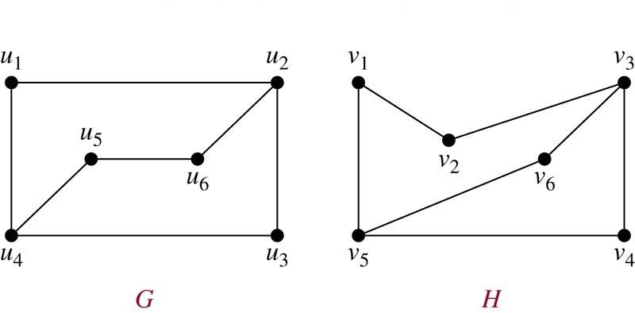
Ex. Show that the graphs are isomorphic to each other or not
1) No. of vertices in G & H = 6
2) No. of edges in G & H = 7
3) In graph G : 4 vertices have degree 2
2 vertices have degree 3
In graph H : 4 vertices have degree 2
2 vertices have degree 3
These conditions are necessary but not sufficient
f(u1)=v6, f(u2) =v3, f(u3) =v4, f(u4)=v5, f(u5)=v1, f(u6)=v2
To check whether f preserves edges, use adjacency matrix

Slide 25
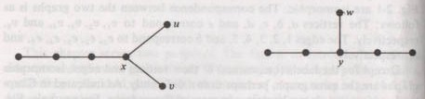
If the two graphs satisfy all the three conditions, yet they are not isomorphic
Vertex x must correspond to vertex y, because there is no other vertex of degree three.
Also, there is only one pendant vertex w adjacent to y, while there are two pendant vertices u and v adjacent to x.

Slide 26
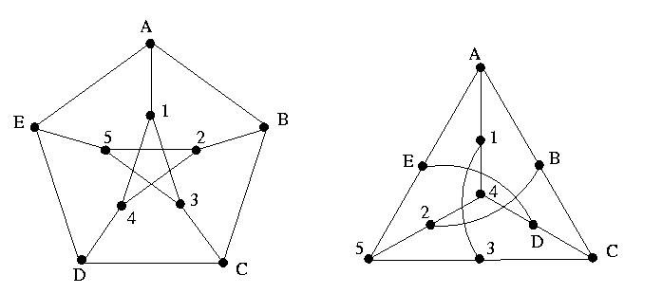
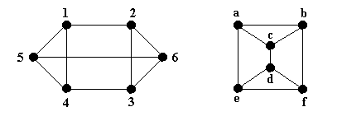
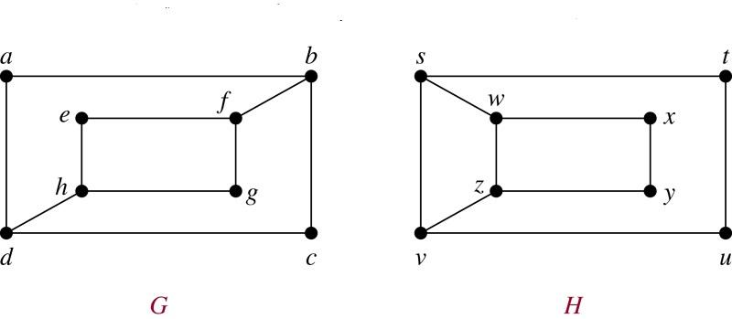
Ex. Show that following graphs are isomorphic or not.
1)
2)
3)

Slide 27
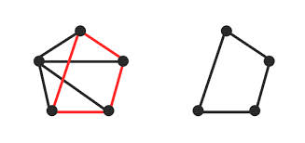
Subgraph
A graph g is said to be a subgraph of a graph G if all the vertices and all the edges of g are in G and each edge of g has the same end vertices as in G.
Every graph is its own subgraph.
A subgraph of a subgraph of G is a subgraph of G.
A single vertex in a graph G is a subgraph of G.
A single edge in G, together with its end vertices, is also a subgraph of G
g is subgraph of G
G
g

Slide 28
Walk
Let v and w be two vertices in a graph. A walk between v and w is a finite alternating sequence
v = v₀, e₁, v₁, e₂, v₂, e₃, …, e_{n}, v_{n} = w of vertices and edges such that each edge e_{i} in the sequence joins vertices v_{i-1} and v_{i}. The vertices and edges in a walk need not be distinct.
If the graph is simple, walk can be written as
v₀ - v₁ – v₂ - ..…- v_{n}
Two walks v₀, e₁, v₁, e₂, v₂, e₃, …, e_{n}, v_{n} and
u₀, f₁, u₁, f₂, u₂, f₃, …, f_{m}, u_{m} are equal if n = m,
v_{i} = u_{i} and e_{i} = f_{i} for 0 ≤ i ≤ n
Number of edges in a walk is called length of the walk

Slide 29
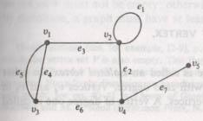
A walk, in which no edge is repeated, is called a trail.
Any walk in a graph G is a subgraph of G.
A closed walk in a graph is a walk between a vertex and itself, i.e. terminal vertices are same.
A walk which is not closed is called an open walk.
v2, e1, v2, e2, v4, e7, v5, e7, v4, e6, v3 is a walk
v2, e3, v1, e4, v3, e5, v1 is a trail

Slide 30
Path
The walk v = v₀, e₁, v₁, e₂, v₂, e₃, …, e_{n}, v_{n} = w in which the vertices v_{i} (0 ≤ i ≤ n) are all distinct, is called a path between v and w.
v2, e3, v1, e4, v3, e6, v4 is a path between v2 & v4
Vertices v and w are the terminal vertices and the other (n-1) vertices v_{i} (0 < i < n) are called the intermediate vertices.
Number of edges in a path is called length of path
An edge which is not a self-loop is a path of length 1 A self-loop can be included in a walk but not in a path

Slide 31
Circuit
A closed walk in which no edges repeat, is called a circuit.
v2, e3, v1, e4, v3, e6, v4, e2, v2 is a circuit
A circuit with no repeated vertices is called a cycle.
Ex. The closed walk v, e1, w, e2, v is a cycle
Ex. The closed walk v, e1, w, e1, v with no repeated intermediate vertices is not a cycle since it a not a circuit.

Slide 32
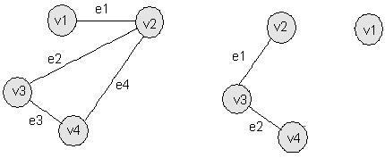
Connected & Disconnected Graph
A graph G is said to be connected if there is at least one path between every pair of vertices in G.
Otherwise, graph G is called disconnected.
Connected
Disconnected

Slide 33
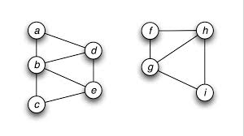
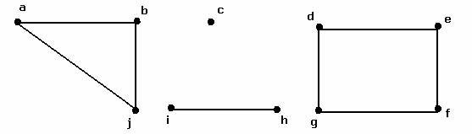
Components
A disconnected graph consists of two or more connected graphs. Each of these connected graphs is called a component.
A graph is connected if number of components is one.
Disconnected graph with two components
Disconnected graph with four components

Slide 34
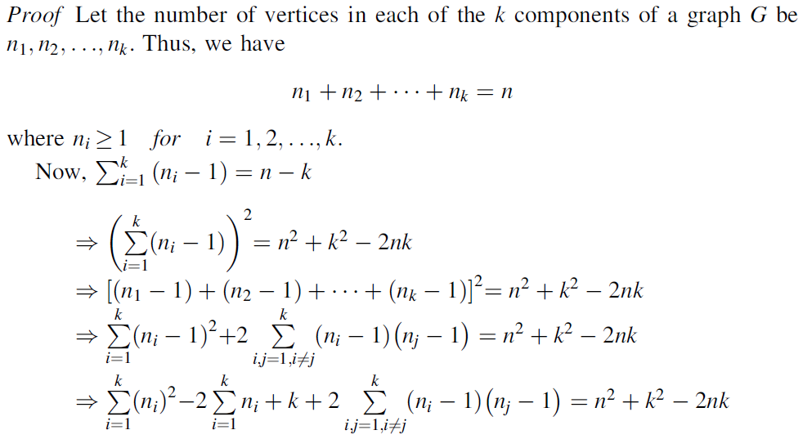
Theorem : Prove that a simple graph with n vertices and k components can have at most (n-k)(n-k+1)/2 edges.

Slide 35
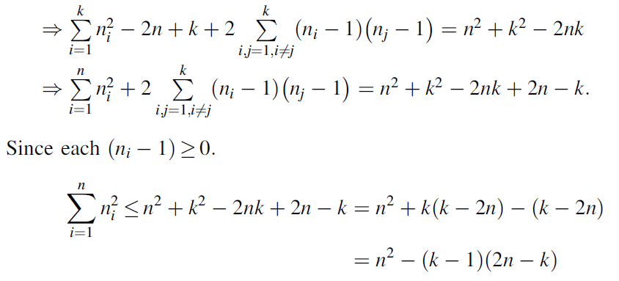

Slide 36
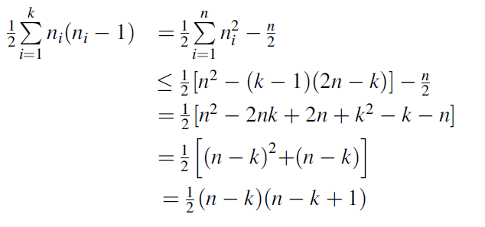
Now, the maximum number of edges in the ith component of G is n_{i} (n_{i} - 1)/2. Since the maximum number of edges in a simple graph with n vertices is n(n-1)/2 therefore, the maximum number of edges in G is

Slide 37
Euler Graph
A closed walk running through every edge of a graph G exactly once, is called an Euler Line
or
A circuit that contains all the edges of a graph is an Euler Circuit
A graph that consists of an Euler line or an Euler circuit is called an Euler graph
Since the Euler line contains all the edges of the graph, an Euler graph is always connected.

Slide 38
Euler Path
An Euler path is a path that visits every edge of a graph exactly once
Euler path starts and ends at different vertices
Also called Euler Trail or unicursal line or open Euler line
A graph is said to be semi-Euler or unicursal graph if it has an Euler path
If we add an edge between the initial and final vertices of an Euler path, we will get an Euler circuit

Slide 39
Euler-Hierholzer Theorem
A connected graph is an Euler graph iff all vertices are of even degree.
Proof : Necessary Condition
Suppose that a connected graph G is an Euler Graph
It contains an Euler line which is a closed walk tracing every edge exactly once
⇒ At every vertex v, this walk goes through two “new” edges incident on v – with one it ‘entered’ v and with the other ‘exited’. It is also true for the terminal vertex, as it ‘exited’ and ‘entered’ the same vertex at the beginning and end of the walk respectively.

Slide 40
⇒ The degree of each vertex is even
Sufficient Condition
Suppose that all the vertices are of even degree.
To prove that the connected graph G is Euler graph
Choose an arbitrary vertex v in graph G.
Now, we construct a walk starting at v and going through the edges of G such that no edge is traced more than once.
Since every vertex is of even degree, we can exit from every vertex we enter; the tracing can not stop at any vertex but at v.

Slide 41
Since v is also of even degree, we shall reach v when the tracing comes to an end.
If this closed walk h just traced, includes all the edges of G, then G is an Euler graph.
If not, remove all the edges of h from G and obtain a subgraph H of G formed by remaining edges.
Since all the vertices of G are of even degree, so the vertices of H are also of even degree.
Also, H must touch the closed walk h atleast at one vertex u [∵ G is connected]

Slide 42
Starting from u, we can again construct a new walk in graph H.
This walk in H must terminate at u
[∵ All vertices of H are of even degree]
This closed walk in H can be combined to h to form a new walk, which starts and ends at vertex v and has more edges than h.
This process can be repeated untill we obtain a closed walk that traverses all the edges of G
Hence G is an Euler graph

Slide 43
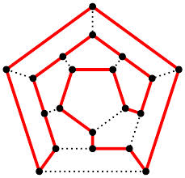
Hamiltonian Circuit
A Hamiltonian circuit in a connected graph is defined as a closed walk that traverses every vertex of G exactly once, except the starting vertex, at which the walk also terminates.
A circuit in a connected graph G is said to be Hamiltonian if it includes every vertex of G.
Hence a Hamiltonian circuit in a graph of n vertices consists of exactly n edges.

Slide 44
Hamiltonian Path
A path between two vertices in a connected graph is called Hamiltonian path if it passes through every vertex of the graph.
A graph that has a Hamiltonian circuit or cycle is called Hamiltonian graph.
The length of a Hamiltonian path in a connected graph of n vertices is n-1
Draw a graph that has Hamiltonian path but does not have Hamiltonian circuit
Complete graphs always have a Hamiltonian circuit.

Slide 45
Theorem : In a complete graph G of n vertices there are (n-1)/2 edge-disjoint Hamiltonian circuits, if n is an odd number ≥ 3.
Proof : A complete graph G of n vertices has n(n-1)/2 edges, and a Hamiltonian circuit in G consists of n edges.
Therefore, the number of edge-disjoint Hamiltonian circuits in G cannot exceed (n-1)/2. That there are (n-1)/2 edge-disjoint Hamiltonian circuits, when n is odd, can be shown as follows :

Slide 46
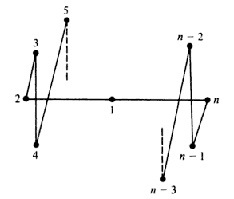
Keeping the vertices fixed on a circle, rotate the polygonal pattern clockwise by 360/(n-1), 2.360/(n-1), 3.360/(n-1), …, (n-3)/2.360/(n-1) degrees.
Observe that each rotation produces a Hamiltonian circuit that has no edge in common with any of the previous ones.
Thus we have (n-3)/2 new Hamiltonian circuits, all edge disjoint among themselves.
Hence the theorem.

Slide 47
Planar Graph
A graph is said to be planar if it is possible to draw it in a plane such that no two of its edges intersect except possibly at a vertex to which they both are incident.
A graph that can not be drawn on a plane without a crossover between its edges, is called non-planar.
A drawing of a geometric representation of a graph on a plane such that no edges intersect is called embedding. Also called plane representation of graph.

Slide 48
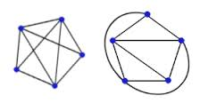
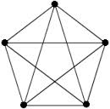
A graph G is planar if there exists a graph isomorphic to G that is embedded in a plane,
otherwise G is non-planar.
Non-planar Representation
Planar Representation
Non-planar Graph

Slide 49
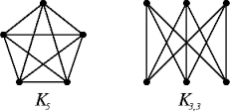
Kuratowski’s Two Graphs
First Graph Complete graph of five vertices K₅
Second Graph Regular connected graph with six vertices and nine edges K_{3,3}

Slide 50
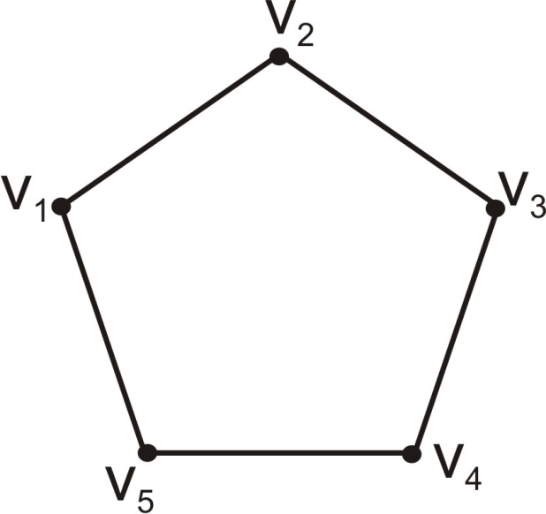
Theorem
The complete graph of five vertices is non-planar.
Proof
Let v₁, v₂, v₃, v₄ and v₅ be the five vertices of graph G
∵ In a complete graph, there is an edge between every pair of vertices.
We have a circuit
v₁ - v₂ - v₃ - v₄ - v₅ . This pentagon divides the plane of the paper into two regions, one inside and the other outside.

Slide 51
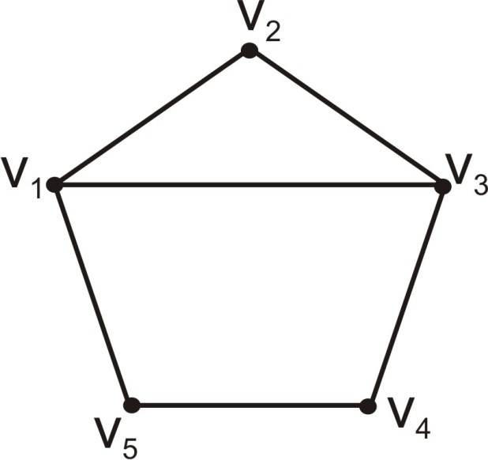
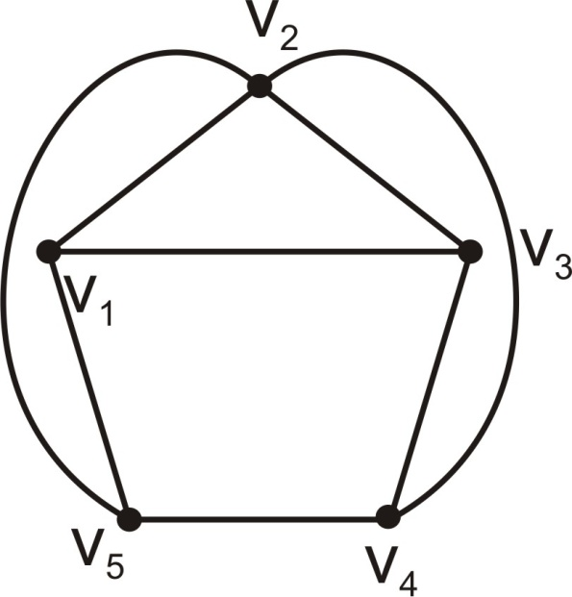
Suppose we draw an edge from v₁ to v₃ inside the pentagon.
Now we have to draw an edge from v₂ to v₄ and another edge from v₂ to v₅.
Since neither of these edges can be drawn inside the pentagon without crossing over the edge v₁v₃, we draw both these edges outside the pentagon.

Slide 52
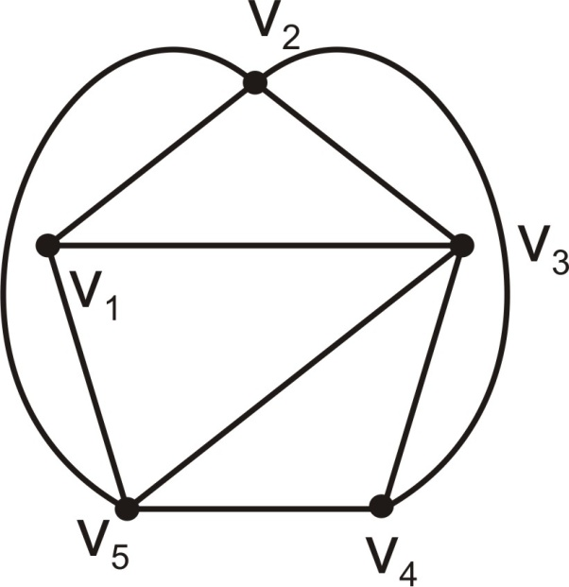
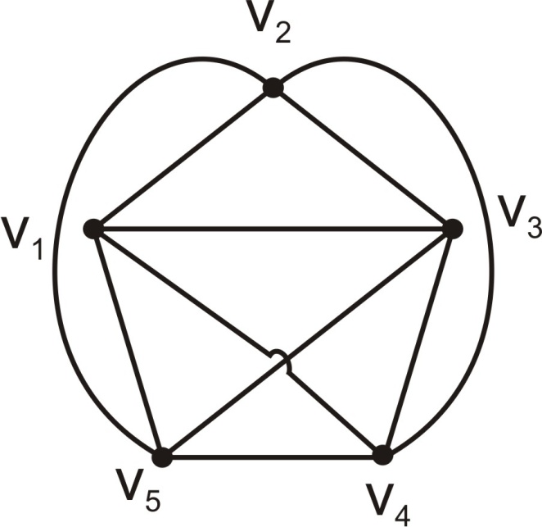
The edge connecting v₃ and v₅ can not be drawn outside the pentagon without crossing the edge v₂v₄.
∴ v₃ and v₅ have to be connected with an edge inside the pentagon.
Now, we have yet to draw an edge between v₁ and v₄.
This edge can not be placed inside or outside the pentagon without a crossover.
Thus, this graph can not be embedded in a plane.
Hence, it is nonplanar.

Slide 53
Theorem : Kuratowski’s second graph is non-planar.
Properties of Kuratowski’s Two Graphs
Both are non-planar graphs.
Both are regular graphs.
Removal of one edge or a vertex makes each a planar graph.
Kuratowski’s first graph is the non-planar graph with the smallest number of vertices, and Kuratowski’s second graph is the non-planar graph with the smallest number of edges.
Thus both are the simplest non-planar graphs.

Slide 54
Region
A plane representation of a graph divides the plane into regions (also called windows, faces or meshes)
A region is characterized by the set of edges (or the set of vertices) forming its boundary.
A region is not defined in a non-planar graph or even in a planar graph not embedded in a plane.

Slide 55
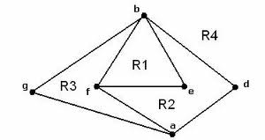
Infinite Region
The portion of the plane lying outside a graph embedded in a plane, called the infinite or unbounded or outer or exterior region.
Ex. Region R₄ is infinite
Characterized by a set of edges or vertices
By changing the embedding of a planar graph, we can change the infinite region

Slide 56
Euler’s Formula
A connected planar graph with n vertices and e edges has e – n + 2 regions.

Slide 57
Coloring
Painting all the vertices of a graph with colors such that no two adjacent vertices have the same color is called the proper coloring (or coloring) of a graph.
A graph in which every vertex has been assigned a color according to a proper coloring is called a properly colored graph.
Chromatic Number
A graph G that requires at least k different colors for its proper coloring, is called a k-chromatic graph, and the number k is called the chromatic number of G.

Slide 58
Observations
A graph consisting of only isolated vertices is 1-chromatic.
A graph with one or more edges (not a self-loop) is at least 2-chromatic.
A complete graph of n vertices is n-chromatic , as all its vertices are adjacent.
A graph consisting of simply one circuit with n ≥ 3 vertices is 2-chromatic if n is even and 3-chromatic if n is odd.
5) Every tree with two or more vertices is 2-chromatic
6) The chromatic number of every bipartite graph is 2

Slide 59
Theorem
Every tree with two or more vertices is 2-chromatic.
Proof
Let T be a rooted tree at vertex v.
Paint v with color 1. Paint all vertices adjacent to v with color 2.
Next, paint all vertices adjacent to these using color 1. Continue this process till every vertex in T has been painted.
Now in T, all vertices at odd distances from v have color 2, while v and vertices at even distances from v have color 1.

Slide 60
Now, along any path in T, the vertices are of alternating colors.
Since there is one and only one path between two vertices in a tree, no two adjacent vertices have the same color.
Thus, T has been properly colored with two colors .
A tree is 2-chromatic, but not every 2-chromatic graph is a tree.

