Slide 1

Catalyst
Launch tokens on what happens next.
Built on Meteora DBC, DAMM v2, DLMM · Event data from Panta
catalyst-event-launchpad.vercel.app · x.com/anur7ag
1 / 8
Notes:
Slide 1 · 0:00–0:15
Hi. This is Catalyst. It's a token launchpad on Solana, built on Meteora. It links a launch to a real-world event.

Slide 2
THE PROBLEM
Launchpads ignore the moment
01
02
03
Launches ride on real-world moments
Creators can dump when the hype peaks
Every launchpad rebuilds the same curve math
catalyst-event-launchpad.vercel.app · x.com/anur7ag
2 / 8
Notes:
Slide 2 · 0:15–0:45
Most token launches ride on a moment. A match. An election. A product launch. But the launchpad knows nothing about that moment. Creators can sell the day the hype peaks. And every new launchpad writes the same curve math again.

Slide 3
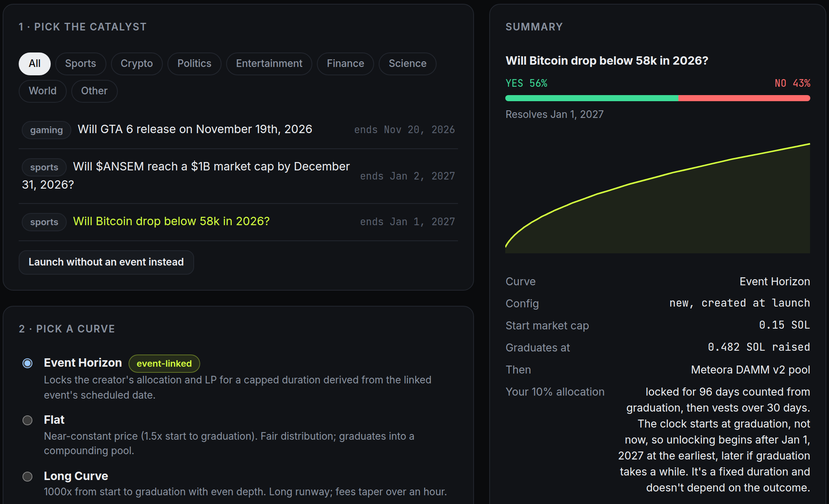
CATALYST
How it works
1
Pick a real event
2
Pick a curve preset
3
Launch in one or two approvals
Live app: /launch with a Panta event selected (Solana devnet)
catalyst-event-launchpad.vercel.app · x.com/anur7ag
3 / 8
Notes:
Slide 3 · 0:45–1:20
With Catalyst, you start by picking a real event. The list comes live from Panta. Then you pick a curve. Our Event Horizon curve locks the creator's ten percent share and their liquidity. The lock lasts about as long as the time until the event's date, up to two years. The clock starts when the curve graduates. The length is set when you launch, so it's written on-chain. Then you launch. On Event Horizon, that's two wallet approvals.

Slide 4
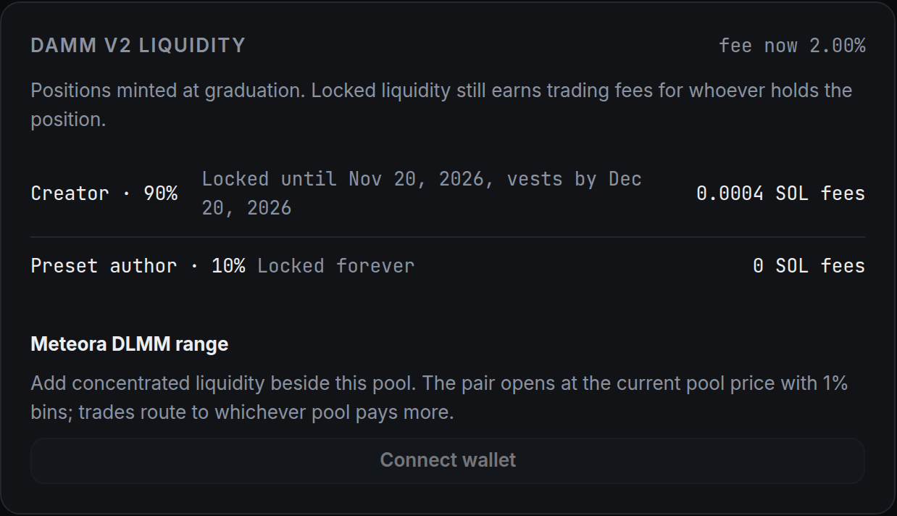
AFTER THE CURVE FILLS
Graduation, then real liquidity
DBC curve
DAMM v2 pool
DLMM range
Meteora bonding curve
Anyone can graduate it
Optional, beside the pool
Event Horizon: creator LP locked, still earning fees
Trades go to whichever pool pays more
Live: a graduated token's DAMM v2 positions
catalyst-event-launchpad.vercel.app · x.com/anur7ag
4 / 8
Notes:
Slide 4 · 1:20–1:45
When the curve fills, anyone can press graduate. The liquidity moves into a Meteora DAMM v2 pool. On Event Horizon, the creator's part stays locked but keeps earning fees. Holders can also open a DLMM range next to it. Trades go to whichever pool pays more.

Slide 5
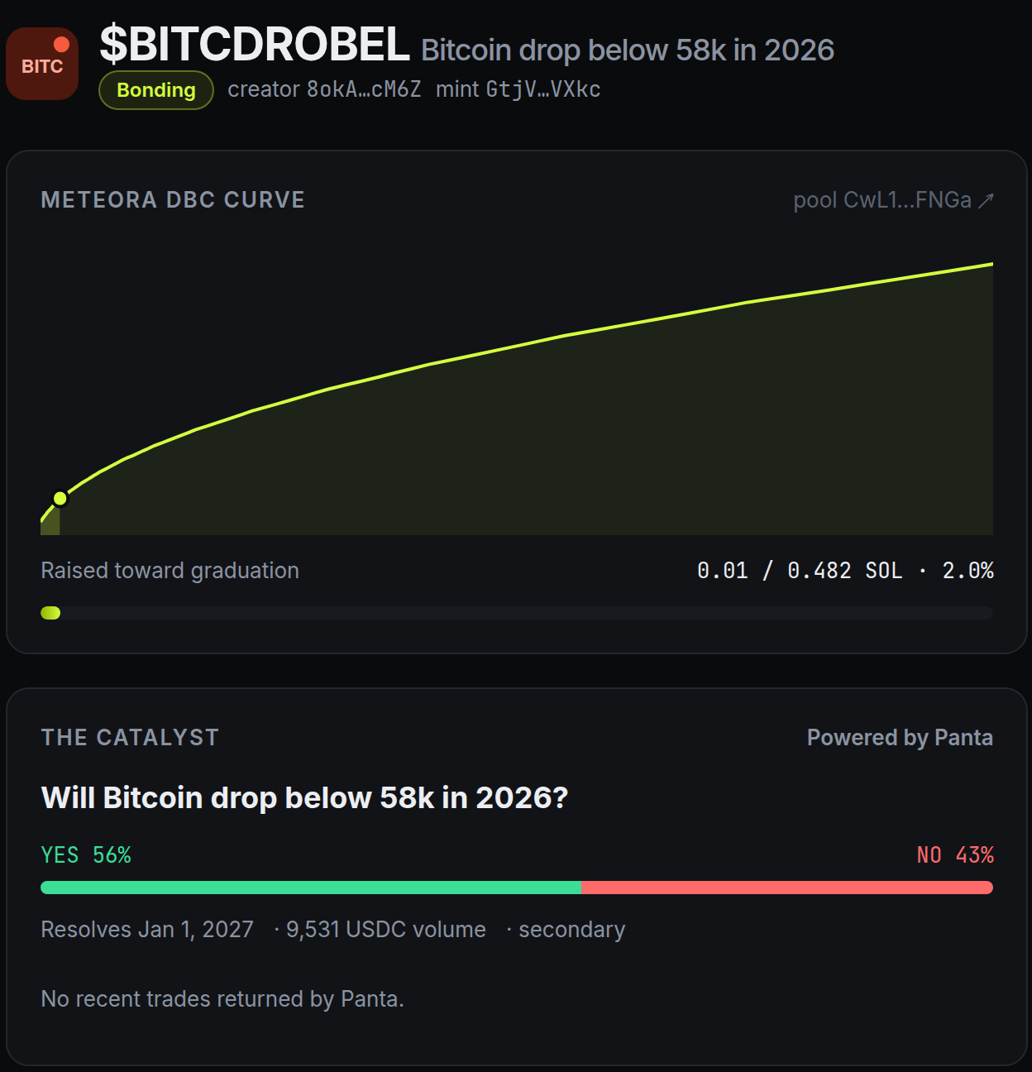
WHY METEORA + PANTA
No custom contract
Meteora
Curve, fees and locks live on-chain
Graduation and DLMM built in
Panta
Live events and dates, used as data
Live token page: Meteora curve + Panta event data
catalyst-event-launchpad.vercel.app · x.com/anur7ag
5 / 8
Notes:
Slide 5 · 1:45–2:05
Why Meteora? A DBC config lets us write the price curve, the fees and the locks on-chain. We don't need our own contract. Why Panta? Its API gives us real events, live odds and resolution dates. We use Panta as data. Catalyst doesn't take bets.

Slide 6
BUILT AND WORKING TODAY
Live on Solana devnet
4
30+
8
curve presets
automated tests
steps in the full
on-chain test
Launch, trading, graduation, locks, DLMM, presets all work. No users yet. That's next.
catalyst-event-launchpad.vercel.app · x.com/anur7ag
6 / 8
Notes:
Slide 6 · 2:05–2:20
Where are we? It's live on devnet today. Launch, curve trading, graduation, locked liquidity, DLMM routing and the preset marketplace all work. It has over thirty automated tests, plus one full on-chain run. We don't have users yet. That's next.

Slide 7
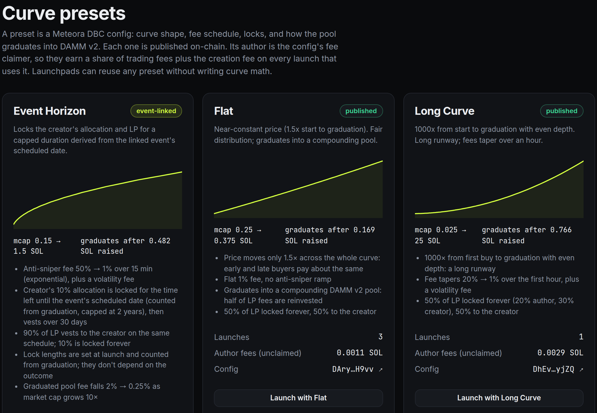
GO TO MARKET
India first
1
Community builders launch on shared presets
2
Preset authors earn fees on every launch
3
Start with Superteam India and hackathon groups
Live app: the preset marketplace (/presets)
catalyst-event-launchpad.vercel.app · x.com/anur7ag
7 / 8
Notes:
Slide 7 · 2:20–2:40
We're starting in India. The target is builders and communities who want to run launches, not traders. Anyone can publish their own copy of a curve preset. They earn a share of the fees on every launch that uses it. That gives community builders a reason to bring people in. We start with Superteam India and hackathon groups.

Slide 8
TEAM
The ask
Your photo here
1
Try Catalyst on devnet
2
Tell me which curves you'd use
3
Help take it to mainnet
Anurag Sharma
Solo builder · India
catalyst-event-launchpad.vercel.app
catalyst-event-launchpad.vercel.app · x.com/anur7ag
8 / 8
Notes:
Slide 8 · 2:40–2:50
I'm Anurag. I'm a solo builder from India. Please try Catalyst on devnet. Tell me which curves you'd use. And help me take it to mainnet. Thank you.

