Slide 1

Uber Supply-Demand Gap Analysis
Exploratory Data Analysis Project
Anuradha Menon

Slide 2
Project Overview
Identify Gaps
Uncover Peaks
Actionable Insights
Analyze Uber ride request data to identify supply-demand gaps.
Uncover peak hours and locations for unmet demand.
Provide actionable recommendations for driver allocation and customer experience.

Slide 3
Data Preparation & Cleaning
1
Timestamp Conversion
2
Status Standardization
Converted timestamps to datetime format for accurate temporal analysis.
Standardized ride status values (e.g., 'Completed', 'Cancelled', 'No Cars Available').
3
Missing Value Handling
4
Feature Extraction
Checked for and handled all missing values to ensure data integrity.
Extracted key features: date, hour, day of week, and time slot for deeper insights.

Slide 4
Key Insights from Analysis
Rush Hour Gaps
Airport Challenges
City Cancellations
Low Completion Rate
Largest supply-demand gap observed during early morning (5-9 AM) and evening rush hours (5-8 PM).
Frequent 'No Cars Available' occurrences for airport pickups during peak travel times.
Higher ride cancellation rates within the city during standard office hours (9 AM - 5 PM).
Only approximately 42% of all ride requests are successfully completed across the platform.

Slide 5
Actionable Recommendations
Driver Incentives
1
Offer targeted incentives for drivers undertaking airport pickups during identified peak demand periods.
Dynamic Surge Pricing
2
Implement dynamic surge pricing during high-gap periods to attract more drivers to underserved areas.
Enhanced Allocation Algorithms
3
Improve driver allocation algorithms to better predict demand hotspots and reposition drivers proactively.
User Notifications
4
Notify users about potential delays or lower availability during predicted peak times to manage expectations.

Slide 6
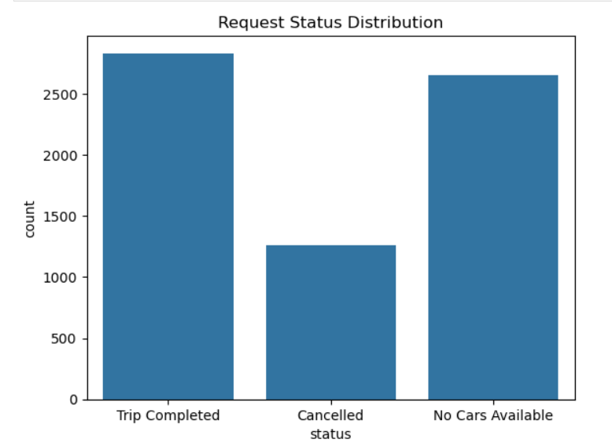
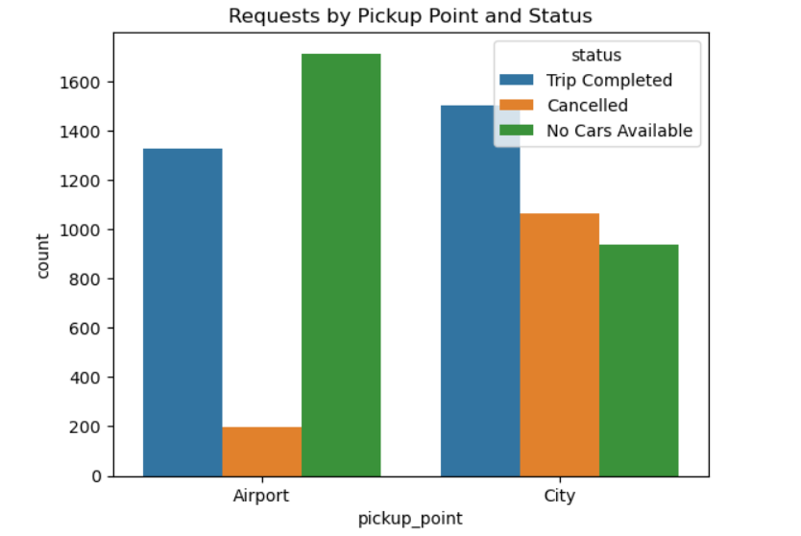
Visualizing the Gaps
Status Distribution:
Shows the overall breakdown of ride requests by status
(Completed, Cancelled, No Cars Available)
Key Insight: A significant portion of requests are not completed, indicating lost revenue
and customer dissatisfaction.
Requests by Pickup Point & Status :
Compares the number of requests and their outcomes (status) between
different pickup points (e.g., City vs. Airport).
Key Insight: Airport often has more "No Cars Available" while City may experience
more cancellations, guiding targeted operational strategies.
Hourly Demand-Supply Analysis: Illustrating how demand and supply fluctuate throughout the day.
Demand-Supply Gap Heatmaps: Geospatial visualization of where and when the largest gaps occur.

Slide 7
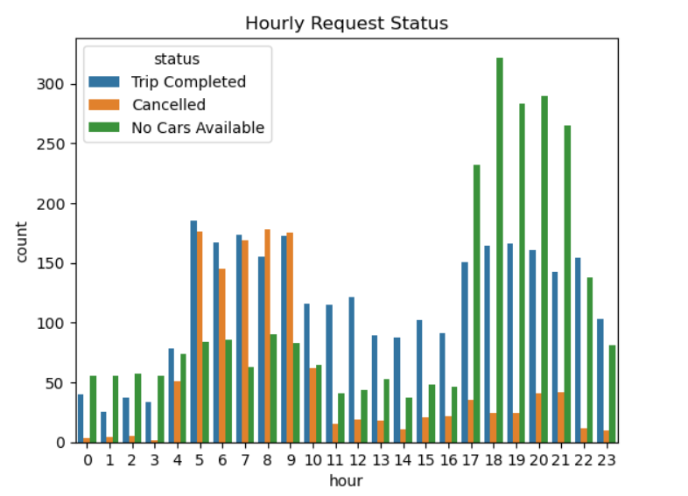
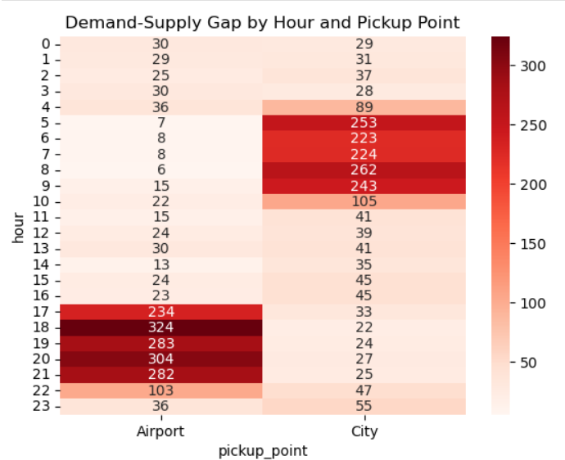
Visualizing the Gaps
Hourly Request Status (Demand-Supply by Hour):
Displays the number of requests for each hour of the day,
segmented by status.
Key Insight: Early morning and evening hours typically show the largest
supply-demand gaps.
Heatmap: Demand-Supply Gap by Hour and Pickup Point :
Visualizes the intensity of unmet demand (gap) across different
hours and pickup locations.
Key Insight: The gap is most severe at the airport during early morning and evening,
suggesting targeted driver incentives or operational changes.
Hourly Demand-Supply Analysis: Illustrating how demand and supply fluctuate throughout the day.
Demand-Supply Gap Heatmaps: Geospatial visualization of where and when the largest gaps occur.

Slide 8
Conclusion & Next Steps
Critical Gaps Identified
Data-Driven Solutions
Our analysis reveals critical supply-demand gaps, particularly during peak hours and at key locations.
Implementing data-driven recommendations can significantly reduce unmet demand and improve efficiency.
Improved Experience
Implement & Iterate
Better driver allocation and incentives will boost ride completion rates and enhance customer experience.
Next steps involve implementing these recommendations, continuous monitoring, and iterative refinement for optimal results.

