Slide 1
WinForms: GUI Programming in .NET
Notes:
6. WinForms
2003
© 2003 Microsoft

Slide 2
Objectives
“.NET supports two types of form-based apps, WinForms and WebForms. WinForms are the traditional, desktop GUI apps. The great news is that Visual Studio .NET enables quick, drag-and-drop construction of form-based applications…”
Event-driven, code-behind programming
Visual Studio .NET
WinForms
Controls
Notes:
6. WinForms
2003
© 2003 Microsoft

Slide 3
Part 1
Event-driven, code-behind programming…

Slide 4
Event-driven applications
Idea is very simple:
  individual user actions are translated into “events”
  events are passed, 1 by 1, to application for processing
  this is how most GUIs are programmed…
GUI App

Slide 5
GUI-based events
Mouse move
Mouse click
Mouse double-click
Key press
Button click
Menu selection
Change in focus
Window activation
etc.

Slide 6
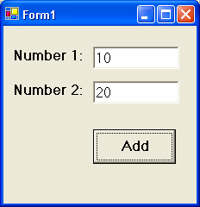
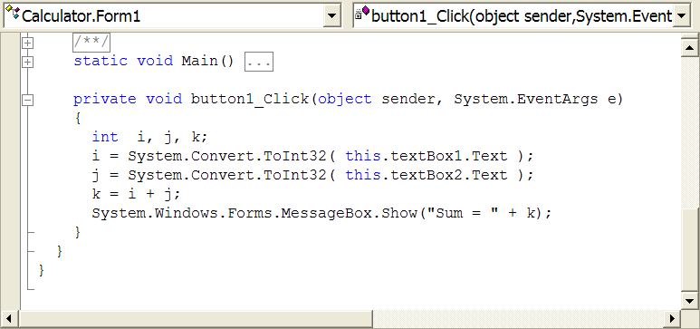
Code-behind
Events are handled by methods that live behind visual interface
  known as "code-behind"
  our job is to program these methods…

Slide 7
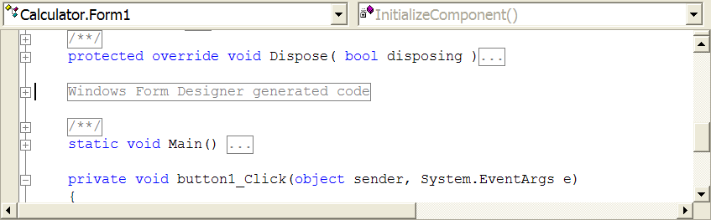
Call-backs
Events are a call from object back to us…
How is connection made?
  setup by code auto-generated by Visual Studio

Slide 8
Part 2
Visual Studio .NET…

Slide 9
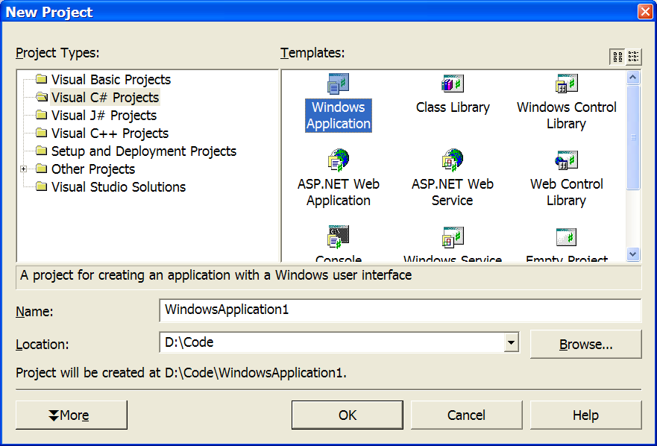
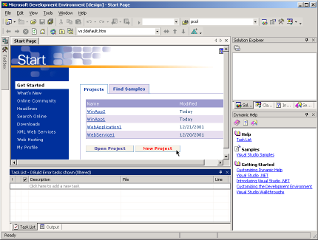
Visual Studio .NET (VS.NET)
A single IDE for all forms of .NET development
  from class libraries to form-based apps to web services
  and using C#, VB, C++, J#, etc.

Slide 10
Basic operation
Visual Studio operates in one of 3 modes:
  design
  run
  break
When in doubt, check the title bar of VS…
design
run
break
Notes:
6. WinForms
2003
© 2003 Microsoft

Slide 11
Example: a windowing application
GUI apps are based on the notion of forms and controls…
  a form represents a window
  a form contains 0 or more controls
  a control interacts with the user
Let's create a GUI app in a series of steps…
Notes:
6. WinForms
2003
© 2003 Microsoft

Slide 12
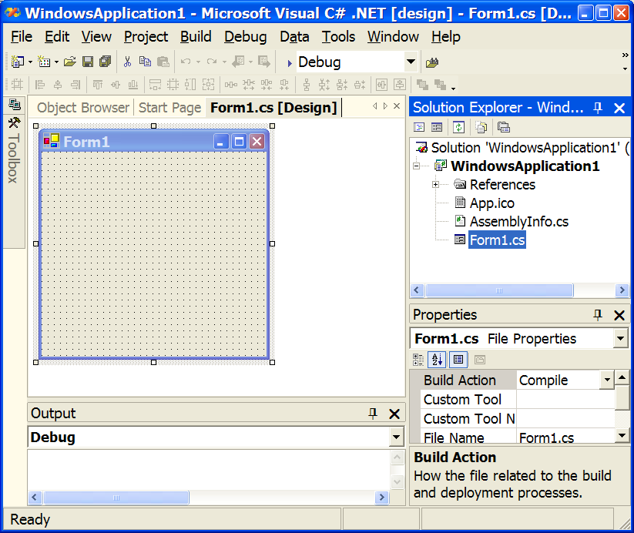
Step 1
Create a new project of type “Windows Application”
  a form will be created for you automatically…
Notes:
6. WinForms
2003
© 2003 Microsoft

Slide 13
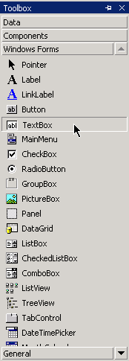
Step 2 — GUI design
Select desired controls from toolbox…
  hover mouse over toolbox to reveal
  drag-and-drop onto form
  position and resize control
Notes:
6. WinForms
2003
© 2003 Microsoft

Slide 14
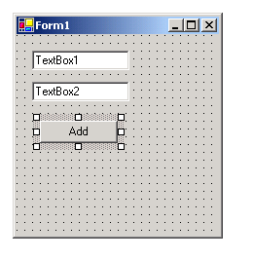
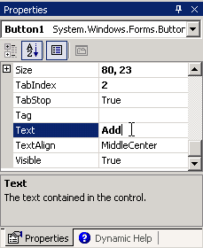
GUI design cont’d…
A simple calculator:
Position and configure controls
  click to select
  set properties via Properties window
Notes:
6. WinForms
2003
© 2003 Microsoft

Slide 15
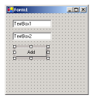
Step 3 — code design
“Code behind” the form…
Double-click the control you want to program
  reveals coding window
Notes:
6. WinForms
2003
© 2003 Microsoft

Slide 16
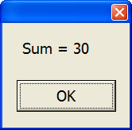
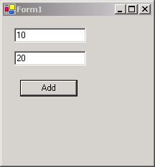
Step 4 — run mode
Run!
Notes:
6. WinForms
2003
© 2003 Microsoft

Slide 17
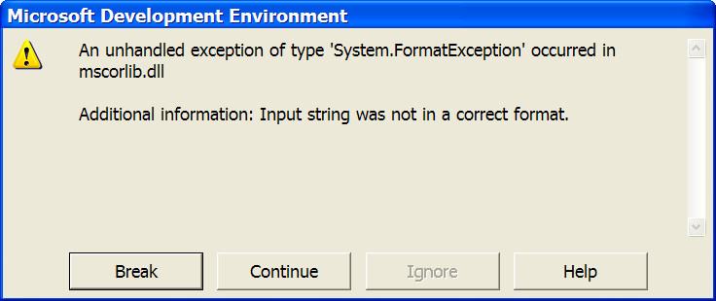
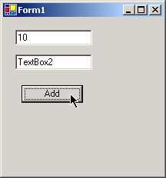
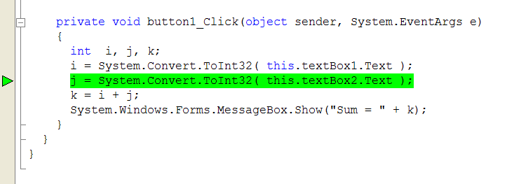
Break mode?
Easily triggered in this application via invalid input…
Notes:
6. WinForms
2003
© 2003 Microsoft

Slide 18
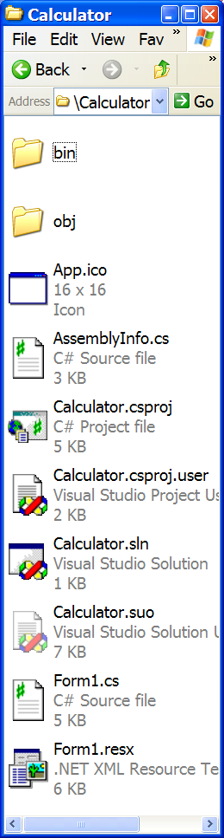
Working with Visual Studio
In Visual Studio, you work in terms
of source files, projects & solutions
Source files contain code
  end in .cs, .vb, etc.
Project files represent 1 assembly
  used by VS to keep track of source files
  all source files must be in the same language
  end in .csproj, .vbproj, etc.
Solution (*.sln) files keep track of projects
  so you can work on multiple projects
Notes:
6. WinForms
2003
© 2003 Microsoft

Slide 19
Part 3
WinForms…

Slide 20
WinForms
Another name for traditional, Windows-like
GUI applications
  vs. WebForms, which are web-based
Implemented using FCL
  hence portable to any .NET platform
Notes:
6. WinForms
2003
© 2003 Microsoft

Slide 21
Abstraction
FCL acts as a layer of abstraction
  separates WinForm app from underlying platform
instance of
FCL class
System.Windows.Forms.Form
object
CLR
Windows OS
Notes:
6. WinForms
2003
© 2003 Microsoft

Slide 22
Form properties
Form properties typically control visual appearance:
  AutoScroll
  BackgroundImage
  ControlBox
  FormBorderStyle (sizable?)
  Icon
  Location
  Size
  StartPosition
  Text (i.e. window's caption)
  WindowState (minimized, maximized, normal)
Form1 form;
form = new Form1();
form.WindowState = FormWindowState.Maximized;
form.Show();
Notes:
6. WinForms
2003
© 2003 Microsoft

Slide 23
Form methods
form.Hide();
.
.
.
form.Show();
Actions you can perform on a form:
  Activate: give this form the focus
  Close: close & release associated resources
  Hide: hide, but retain resources to show form later
  Refresh: redraw
  Show: make form visible on the screen, & activate
  ShowDialog: show modally
Notes:
6. WinForms
2003
© 2003 Microsoft

Slide 24
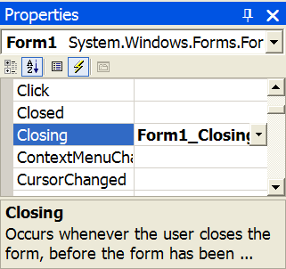
Form events
Events you can respond to:
  bring up properties window
  double-click on event name
  Load: occurs just before form is shown for first time
  Closing: occurs as form is being closed (ability to cancel)
  Closed: occurs as form is definitely being closed
  Resize: occurs after user resizes form
  Click: occurs when user clicks on form's background
  KeyPress: occurs when form has focus & user presses key
Notes:
6. WinForms
2003
© 2003 Microsoft

Slide 25
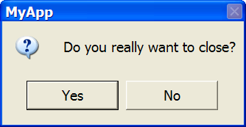
Example
Ask user before closing form:
private void Form1_Closing(object sender,
System.ComponentModel.CancelEventArgs e)
{
DialogResult r;
r = MessageBox.Show("Do you really want to close?",
"MyApp",
MessageBoxButtons.YesNo,
MessageBoxIcon.Question,
MessageBoxDefaultButton.Button1);
if (r == DialogResult.No)
e.Cancel = true;
}
Notes:
6. WinForms
2003
© 2003 Microsoft

Slide 26
Part 4
Controls…

Slide 27
Controls
User-interface objects on the form:
  labels
  buttons
  text boxes
  menus
  list & combo boxes
  option buttons
  check boxes
  etc.
Notes:
6. WinForms
2003
© 2003 Microsoft

Slide 28
Abstraction
Like forms, controls are based on classes in the FCL:
  System.Windows.Forms.Label
  System.Windows.Forms.TextBox
  System.Windows.Forms.Button
  etc.
Controls are instances of
these classes
object
object
object
object
object
object

Slide 29
Who creates all these objects?
Who is responsible for creating control instances?
  code is auto-generated by Visual Studio
  when form object is created, controls are then created…
Notes:
6. WinForms
2003
© 2003 Microsoft

Slide 30
Naming conventions
Set control's name via Name property
A common naming scheme is based on prefixes:
  cmdOK refers to a command button control
  lstNames refers to a list box control
  txtFirstName refers to a text box control

Slide 31
Labels
For static display of text
  used to label other things on the form
  used to display read-only results
Interesting properties:
  Text: what user sees
  Font: how he/she sees it

Slide 32
Command buttons
For the user to click & perform a task
Interesting properties:
  Text: what user sees
  Font: how he/she sees it
  Enabled: can it be clicked
Interesting events:
  Click: occurs when button is "pressed"
private void cmdAdd_Click(...)
{
int i, j, k;
i = System.Convert.ToInt32( this.txtNum1.Text );
j = System.Convert.ToInt32( this.txtNum2.Text );
k = i + j;
MessageBox.Show( "Sum = " + k.ToString() );
}

Slide 33
Text boxes
Most commonly used control!
  for displaying text
  for data entry
Lots of interesting features…

Slide 34
Text box properties
Basic properties:
  Text: denotes the entire contents of text box (a string)
  Modified: has text been modified by user? (True / False)
  ReadOnly: set if you want user to view text, but not modify
Do you want multi-line text boxes?
  MultiLine: True allows multiple lines of text
  Lines: array of strings, one for each line in text box
  ScrollBars: none, horizontal, vertical, or both

Slide 35
Text box events
Interesting events:
  Enter, Leave: occurs on change in focus
  KeyPress: occurs on ascii keypress
  KeyDown, KeyUp: occurs on any key combination
  TextChanged: occurs whenever text is modified
  Validating and Validated
    Validating gives you a chance to cancel on invalid input
Notes:
6. WinForms
2003
© 2003 Microsoft

Slide 36
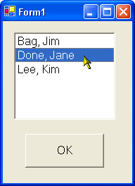
List Boxes
Great for displaying / maintaining list of data
  list of strings
  list of objects (list box calls ToString() to display)
Customer[] customers;
.
. // create & fill array with objects...
.
// display customers in list box
foreach (Customer c in customers)
this.listBox1.Items.Add(c);
// display name of selected customer (if any)
Customer c;
c = (Customer) this.listBox1.SelectedItem;
if (c == null)
return;
else
MessageBox.Show(c.Name);

Slide 37
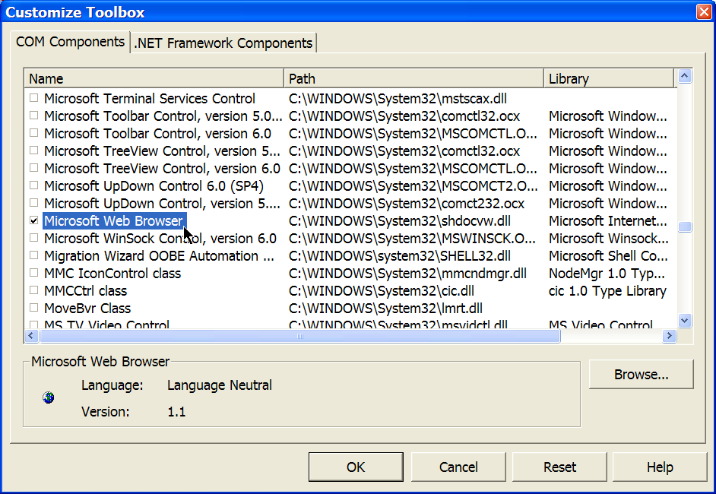
Just the tip of the iceberg…
Menus, dialogs, toolbars, etc.
Thousands of additional controls
  .NET and ActiveX
  right-click on Toolbox
  "Customize Toolbox"

Slide 38
Summary
Event-driven programming is very intuitive for GUI apps
Forms are the first step in GUI design
  each form represents a window on the screen
  form designer enables drag-and-drop GUI construction
Users interact primarily with form's controls
  labels, text boxes, buttons, etc.
  implies that GUI programming is control programming
Notes:
6. WinForms
2003
© 2003 Microsoft

Slide 39
References
Books:
  R. Grimes, "Developing Applications with Visual Studio .NET"
Best books on building GUIs are VB-based:
  J. Savage, "The VB.NET Coach" (introductory)
  F. Balena, "Programming Microsoft VB .NET (Core Reference)" (broad coverage, intermediate level)
Notes:
6. WinForms
2003
© 2003 Microsoft

Slide 40
Lab?
Work on lab #3, "WinForms"…

