Slide 1
Using Excel/VBA to Speed-up Daily Data Processing
An Introduction to VBA
Click Me to Start …

Slide 2
An Introduction to VBA
- Agenda
What is VBA
What is Object
How to Record Macro
VBA Editor Window
Example 1
VBA Fundamental
Create User Defined Functions (Example 2)
Work with Workbook & Worksheet
I/O with External Data Files (Example 3)
Capture Built-in Event (Example 4)

Slide 3
An Introduction to VBA
- What is VBA
An abbreviation for Visual Basic for Applications
Official name is "Visual Basic, Applications Edition."
VBA is Microsoft's common application programming (macro) language for Word, Excel, Access, etc.
Also being implemented in other Microsoft applications such as Visio and is at least partially implemented in some other applications such as AutoCAD...
VBA and VB have a lot in common, but they are different. VB is a programming language that lets you create standalone executable programs.

Slide 4
An Introduction to VBA
- What Can You Do With VBA
Write Macros to Automate Labor-Intensive and Repetitive Tasks
Create User-Defined Functions to Achieve Complicated Functionality
Create Standard Windows Menu/Tool Bars for Interface
Interact with Other Windows Programs (like Matlab)
I/O with External Files
Database Operation ….

Slide 5
An Introduction to VBA
- VBA- Object Based Programming Language
C++, Java, etc. are OOP (Object Oriented Programming) Language
VBA is an Object Based Programming Language
What is Object?

Slide 6
An Introduction to VBA
- VBA Object Based Programming Language
Concepts – Containers or Collections
  A Group of Similar Objects Share Common Properties, Methods and Events
  Such as Workbooks, Worksheets, etc.
  Worksheets is a collection of all the Worksheet objects in the specified or active workbook.
  Worksheets(1) refers to the 1st worksheet of current active workbook.
  Worksheets (“mooring”) refers to the worksheet named “mooring”.

Slide 7
An Introduction to VBA
- VBA Object Based Programming Language
Concepts – Objects
  Such as Worksheet, Workbook, Range, Cell, Chart, Name, etc.
  Worksheets(1) is an Object Referring to the First Sheet
  Range("A1:B15") is an Object Referring to a Range
  Cells(1,1) or Range(“A1”) is an Object Referring to Range “A1”

Slide 8
An Introduction to VBA
- VBA Object Based Programming Language
Concepts – Properties
  Properties are the Physical Characteristics of Objects and Can be Measured or Quantified.
  Properties for Collections
  - Worksheets.Count (Read Only)
  - Worksheets.Visible = True (Read and Write)
  Properties for Object
  - Range("A1:B15").Rows.Count (Read Only)
  - Range("A1:B15").Font.Bold = True (Read and Write)

Slide 9
An Introduction to VBA
- VBA Object Based Programming Language
Concepts – Methods
  Methods are the Actions that Can be Performed by Objects or on Objects
  Methods for Collections
  - Worksheets.Add
  - Worksheets.Delete
  Methods for Objects
  - Range("A1:B15").ClearContents
  - ActiveCell.Copy

Slide 10
An Introduction to VBA
- VBA Object Based Programming Language
Concepts – Events
  Objects Can Respond to Events, Such as Mouse Click, Double Click on a Cell, Active a Worksheet, Open/Close/Save a Workbook, etc.
  Worksheet Events –
    Such as Activate, Deactivate, Change, Selection Change, Before Double Click, etc.
  Workbook Events-
    Such as Activate, Deactivate, Open, Before Close, Before Saving, Before Print, New Sheet.

Slide 11
An Introduction to VBA
- VBA Object Based Programming Language
Concepts – Referring To
  Use brackets () to refer to member object
    Worksheets(“mooring”)
  Use dot . to refer to child object or object’s properties and methods
    Worksheets(“mooring”).Range(“A1:B3”).Font.Bold

Slide 12
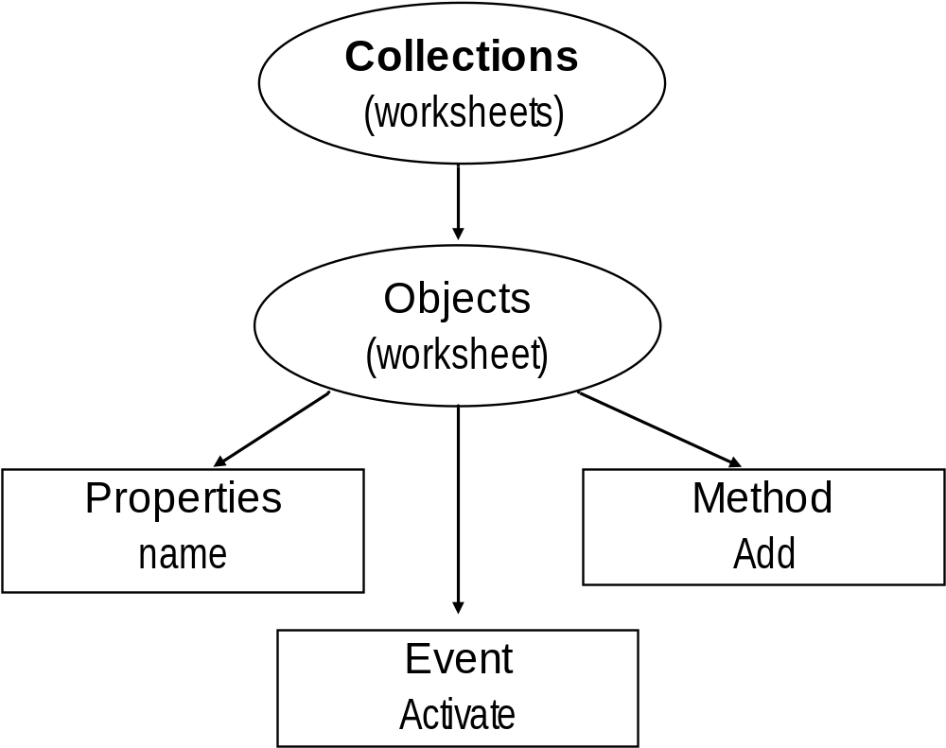
An Introduction to VBA
- VBA Object Based Programming Language
Concept
Summary

Slide 13
An Introduction to VBA
- VBA Object Based Programming Language
Understand Object Concepts
Workbooks("book1.xls").Worksheets("sheet1").Range("A1").Font.Bold = True
ActiveWorkbook.ActiveSheet.Cells(1, 1).ClearContents
Private Sub Workbook_Open()
MsgBox "Thank you for choosing VBA"
End Sub

Slide 14

An Introduction to VBA
- VBA Object Based Programming Language
Quiz 1
  Which of the following is not a valid Excel object
    i) ActiveWorkbook
    ii) ActiveSheet
    iii) ActiveCell
    iv) ActiveRange
A) None B) i C) iii D) iv

Slide 15
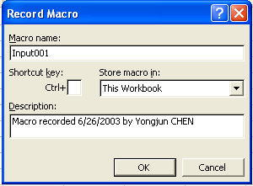
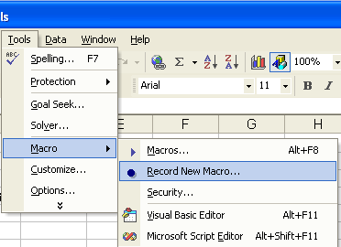
An Introduction to VBA
- First Step to VBA : Macros
Record Macro
  Similar to audio/video recorder
  Record all the steps you conduct and write them in VBA code
If macros are disabled when you start Excel, change the security level to medium

Slide 16
An Introduction to VBA
- First Step to VBA : Macros
Assign Macro to An Event
  Normally User Run Macros from VBA Edit Window – Unnecessary
  User Can Assign Macro to An Event, Normally a Button Click Event
  Easy to Execute and Easy to Remember
  Give a Good Name for The Button and Click the Button to Run the Macro

Slide 17
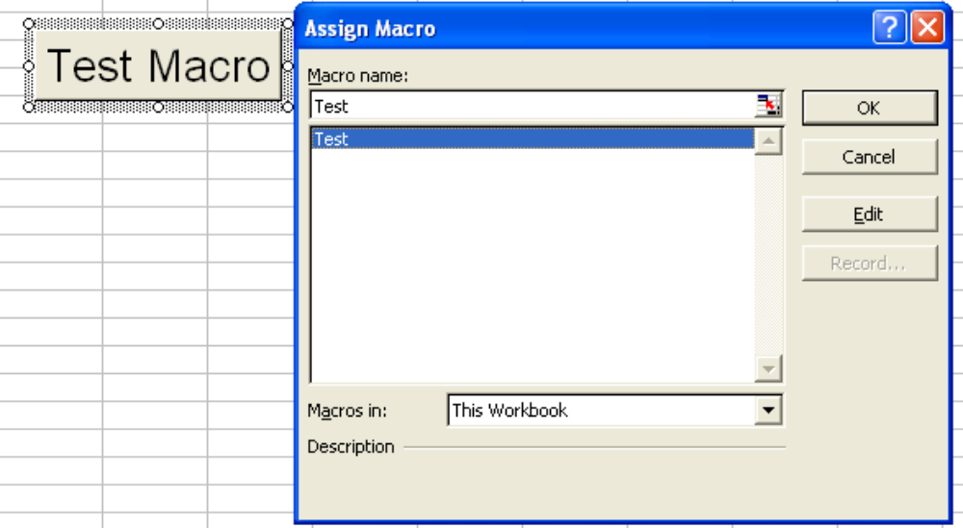
An Introduction to VBA
- First Step to VBA : Macros
Assign Macro to An Event

Slide 18
An Introduction to VBA
- Second Step to VBA : Edit Macro
VBA Editor Window
  Press Alt+F11 to Activate VBA Window
  Or Go to Menu Tools>Macros>Visual Basic Editor
  Project Explore Window
  Properties Window
  Code Window
  Tools>Options>Docking Window

Slide 19
An Introduction to VBA
- Second Step to VBA : Edit Macro
VBA Editor Window
  Use Tools/Options to Enable Auto Syntax Check, Auto List Members, etc.
  Use Tools/Properties to Protect Your Code with Password – You Must Remember the Password
  Insert Module, Procedure, Form

Slide 20
An Introduction to VBA
- Second Step to VBA : Edit Macro
Sample
  Record Macro
  Understand Macro
  Modify Macro
  Assign Macro to Button Click Event
See Demo

Slide 21
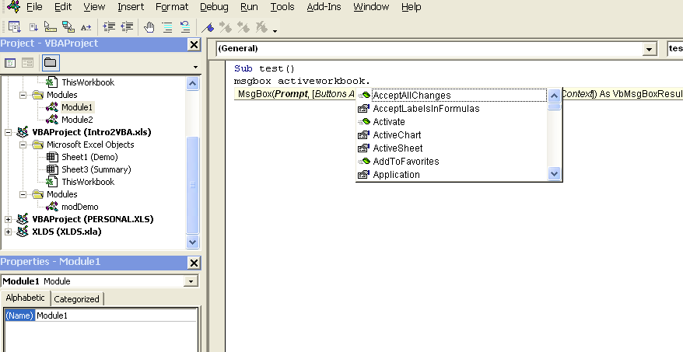
An Introduction to VBA
- Second Step to VBA : Edit Macro
Understand VBA Editor Window
Project window
Shows files, sheets and modules
Auto list member
Auto list data / parameter
Property window
Show properties of active object and let user to modify the properties
Code window
VBA codes are here.

Slide 22
An Introduction to VBA
- Second Step to VBA : Edit Macro
Quiz 2
  For the following four actions
    i) Type formula in another workbook/file
    ii) Change macro security level
    iii) Print another worksheet in the same workbook
    iv) Open a Word file
    What can not be recorded in a macro
A) ii only B) iv only C) ii & iv D) iii & iv

Slide 23
An Introduction to VBA
- Third Step to VBA : Write VBA Code
Fundamental of VBA
Variables: can be define explicit or implicit use dim statement
Constant use const pi =3.1415926
Function: pair of function … end function
Subroutine: pair of sub … end sub
Comment use single quotation ‘
Continuation use underline _
Use with … end with for object
Assign object use set and assign data variable use =

Slide 24
An Introduction to VBA
- Third Step to VBA : Write VBA Code
Fundamental of VBA
Decision Making use If… elseif…else…end if
Multiple Selection/Decision Making
  Select Case Var… Case A … Case B…Case Else… End Select
Loop use
  Do While … Loop Do … Loop Until
  For … Next For Each … Next
Array – dim Data(10) as integer , Val(2 to 8) as object

Slide 25
An Introduction to VBA
- Third Step to VBA : Write VBA Code
Fundamental of VBA
Function
  Public , Private, Return Value
  Parameter
Subroutine
  Public, Private, No Return Value
  Parameter

Slide 26
An Introduction to VBA
- Third Step to VBA : Write VBA Code
Understand Code
Worksheets("sheet1").Activate
Range("A1:A10").ClearContents
For i = 1 To 10
Range("A" & i) = i ^ 2
Next
Range("A1:A10").Font.Bold = True
For Each cl In Range("A1:A10")
If cl.Value < 25 Or cl.Value > 75 Then
cl.Font.Italic = True
Else
cl.Font.Underline = True
End If
Next
Msgbox “All done”
Make sheet1 active
Clear range A1:A10
Type 1,4,9,…100 in to range A1, A2, … A10
Set font to bold for all cells in the range
Make cell italic if the cell’s value is <25 or >75, otherwise underline
Display message “All done”

Slide 27
An Introduction to VBA
- Third Step to VBA : Write VBA Code
Quiz 3
  Function myTest(a as integer, b as integer) as integer
    myTest = a + b
    myTest = myTest + 1
    Range("D1").Value = myTest
    MsgBox "All done”
  End function
  Which statement will cause problem for myTest
A) 1st one B) 2nd one C) 3rd one D) 4th one

Slide 28
An Introduction to VBA
- Third Step to VBA : Write VBA Code
See Demo
Create User-Defined Functions
Public Function myFun(x As Integer, y As Integer) As Integer
myFun = x * y + x / y
End Function
Arguments
Return Value Type
Must start with Keyword “Function” and end with “End Function”
The return value must be assigned to the function name

Slide 29
An Introduction to VBA
- Third Step to VBA : Write VBA Code
' Refer A Workbook
Workbooks(1) ' Use Index
Workbooks("Results.Xls") ' Use Name
ActiveWorkbook ' Refers to the Active Workbook
' Create A New Workbook
Dim NewWkBk as Workbook
Set NewWkBk = Workbooks.Add
With NewWkBk
.Title = "Analysis Resultd"
.Subject = "Results for Analysis"
.SaveAs Filename:="Results.xls"
End With
Work
with
Workbook
Use With Statement
(faster)

Slide 30
An Introduction to VBA
- Third Step to VBA : Write VBA Code
' Open / Activate / Save /Close Workbook
Fname ="C:\AnalysisResutls\Results.xls"
Workbooks.Open(Fname)
Workbooks("Results.xls").Activate
Workbooks("Results.xls").Save
Workbooks("Results.xls").Close SaveChanges:=True ‘
' Loop All Open Workbooks
Dim wkbk As Workbook
For Each wkbk In Workbooks
  Msgbox "Workbook " & wkbk.Name & " Has " & Workbooks(k).Sheets.Count & " Sheets", vbInformation
Next
For Each Statement

Slide 31
An Introduction to VBA
- Third Step to VBA : Write VBA Code
Work
with
Worksheet
' Refer A Worksheet
Worksheets(1) ' Use Index Worksheets("Sheet1") ' Use Name ActiveWorksheet ' Active Worksheet
Workbooks("TestSht.xls").Worksheets("Sht2")
' Add /Activate/Delete A New Worksheet
Workbooks("TestSht.xls").Worksheets.Add
Sheets("NewSht").Activate
Workbooks(“A.xls").Sheets(“B").Activate
Sheets("NewSht").Delete

Slide 32
An Introduction to VBA
- Third Step to VBA : Write VBA Code
‘Rename / Extract A Worksheet
Workbooks("TestSht.xls").Sheets("NewSht").name = "NewSht2"
MsgBox "Current Sheet Name is " & ActiveSheet.Name
' Count Sheets
MsgBox "Current Workbook Has " & Sheets.Count & " sheets"
' Loop All Sheets
Dim sht As Worksheet
For Each sht In ActiveWorkbook.Sheets
MsgBox sht.Name & " A1 = " & Range(“A1").Value
Next

Slide 33
An Introduction to VBA
- Third Step to VBA : Write VBA Code
I/O with External Data Files
Sub Output00()
  Open ThisWorkbook.Path & "\test.dat" For Output As #1
  Print #1, "This is a test of using VBA to output results"
  Print #1, "The result is " & Worksheets(“Summary").Range(“A1").Value
  Print #1, "End of Test File"
  Close #1
End Sub

Slide 34
An Introduction to VBA
- Third Step to VBA : Write VBA Code
See Demo
I/O with External Data Files
Sub Input00()
  Dim tmpstr As String
  Open ThisWorkbook.Path & "\test.dat" For Input As #1
  Line Input #1, tmpstr
  Line Input #1, tmpstr
  Range(“A1").Value = tmpstr
  Close #1
End Sub

Slide 35
An Introduction to VBA
- Third Step to VBA : Write VBA Code
See Demo
Capture Built-In Event
Private Sub Workbook_BeforeSave (ByVal SaveAsUI As Boolean, Cancel As Boolean)
MsgBox “ …”
End Sub
Private Sub Worksheet_SelectionChange(ByVal Target As Range)
Msgbox “ …”
End Sub

Slide 36
An Introduction to VBA
- Third Step to VBA : Write VBA Code
Review/Understand of Our First Macro
Sub MySummarize()
'
' Modified from Summarize Macro
'
'1) Define variables - worksheet and file id
Dim sht As Worksheet, wkbk As Workbook
Dim ifile As Integer, sfile As String
'2) Assign variable: object use set and data use =
Set sht = Sheets.Add

Slide 37
An Introduction to VBA
- Third Step to VBA : Write VBA Code
Review/Understand of Our First Macro
With sht ' use with to speed up and save typing
.Name = "Summary2"
.Range("A1").Value = "Case Name"
.Range("A2") = "Case ID" ' default property is value
.Range("A3") = "Weight"
.Range("A4") = "XCG"
.Range("A5") = "YCG"
.Range("A6") = "ZCG"
.Range("A1:A6").Font.Bold = True
.Range("A1:A6").HorizontalAlignment = xlLeft

Slide 38
An Introduction to VBA
- Third Step to VBA : Write VBA Code
Review/Understand of Our First Macro
For ifile = 1 To 3 Step 1 ' loop all files
sfile = "Case" & ifile & ".xls" ' create file name
sfile = ThisWorkbook.Path & "\" & sfile ' specify file path
Set wkbk = Workbooks.Open(sfile) ' open file
wkbk.ActiveSheet.Range("B1:B6").Copy ' copy data
.Paste .Cells(1, ifile + 1) ' paste to this workbook
wkbk.Close SaveChanges:=False ' close file
Next
.Columns("A:D").AutoFit
End With
MsgBox "File Summarize are Done", vbInformation, "VBA Demo"

Slide 39
An Introduction to VBA
- Learning via Practice & Ask
Questions / Comments
Where to get help:
Use F1 key in VBA editor (like type keyword msgbox to search help)
Microsoft Users Excel Programming Discussion www.microsoft.com/office/community/en-us/default.mspx?dg=microsoft.public.excel.programming&lang=en&cr=US
http://www.excelforum.com/

