Slide 1

Analyzing Restaurant Trends, Cuisines, and Pricing in Indian Cities Through Web Scraping of Zomato

Slide 2
About me
Background ? (B-tech or M-tech)
B.Arch Graduate
Why you want to learn Data Science
I enjoy learning new things, and data science is a field that's always growing and changing. I want to add new skills like data analysis, programming, and machine learning to my skill set.
In architecture, we often make choices based on design principles. I'm excited to learn how to make decisions based on data, which can provide more precise and impactful results.
Any work experience
No, work experience
Share your linkedin and github profile urls
Anuradha Kilaparthi | LinkedIn
anuradhak0801 (Anuradha K) (github.com)

Slide 3
BUSINESS PROBLEM AND USE CASE DOMAIN
Business Problem:
In the crowded restaurant industry, it's important for restaurant owners, marketers, and food delivery platforms like Zomato to know what customers want. Understanding which cuisines are popular, how much people are willing to spend, and the latest trends can help them make better decisions about their menus, prices, and marketing efforts. By analyzing this data, they can offer what customers in different cities are looking for and stay ahead in the competition.
Use Case Domain: This project is part of the Food and Beverage (F&B) industry, focusing on restaurants. The insights from this analysis can help:
a. Restaurant owners find opportunities to improve their menus based on what’s missing in the market.
b. Marketers create focused advertising based on popular cuisines and how much people are willing to spend in different cities.
c. Food delivery platforms like Zomato improve their services by promoting popular restaurant options and enhancing customer satisfaction.

Slide 4
OBJECTIVE AND WEB SCRAPING DETAILS
Objective of the Project
The main goal of this project is to analyze restaurant data from Zomato to find out which cuisines are popular, what the average prices are, and other important details across different cities. The insights from this analysis will help businesses make better decisions to improve their menus, offer better customer experiences, and grow their business.
Web Scraping – Details (Websites, Processor you followed)
Websites: The data for this project is scraped from Zomato's website, specifically from pages listing restaurants in various cities.
Process Followed:
1. Finding the Right Pages:
First, identifying the URLs of Zomato's restaurant listings for each city.
2. Tools Used:
Selenium: Automates the browser to load the web pages and get the dynamic content.
BeautifulSoup: Parses the HTML and extracts needed information like restaurant names, cuisines, ratings, and price ranges.

Slide 5
WEB SCRAPING DETAILS AND SUMMARY
3. Extracting the Data:
Visiting each city's page, gathering the necessary data, and storing it in an organized format.
Making sure to go through all pages of listings to collect complete data.
4. Storing the Data:
The collected data is then put into a DataFrame for easy analysis.
Summary of the project:
The scraped data includes the following features:
Restaurant Name: The name of the restaurant.
Cuisine Type: The type of cuisine(s) offered by the restaurant.
City: The city in which the restaurant is located.
Rating: The average customer rating.
Price Range: The price range for two people.
Address: The physical location of the restaurant.
This data will be used for exploratory data analysis (EDA) to find trends and patterns.

Slide 6
EDA
Exploratory Data Analysis:
Data Cleaning Steps
Removing Duplicates: Getting rid of any repeated entries in the data.
Handling Missing Values: Fill in or remove any missing data points.
Correcting Inconsistencies: Fix any errors or inconsistencies, like misspelled names or wrong data formats.
Standardizing Data: Ensure all data follows the same format, like consistent measuring formats or price ranges.
Data Manipulation Steps
Creating New Columns: Adding new columns based on existing data, like sorting restaurants based on cuisines to group them into different categories of dining.
Grouping Data: Organize data into groups to analyze trends, like grouping restaurants by city or type of dining.
Sorting Data: Arrange data in a specific order, like sorting by highest ratings or most popular cuisines.

Slide 7
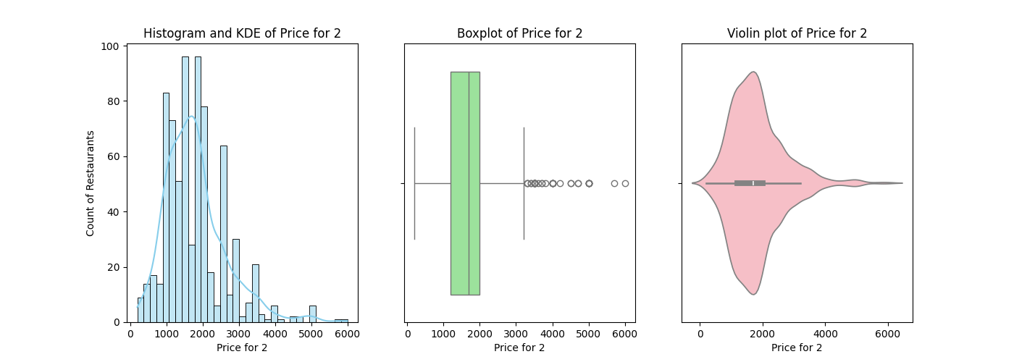
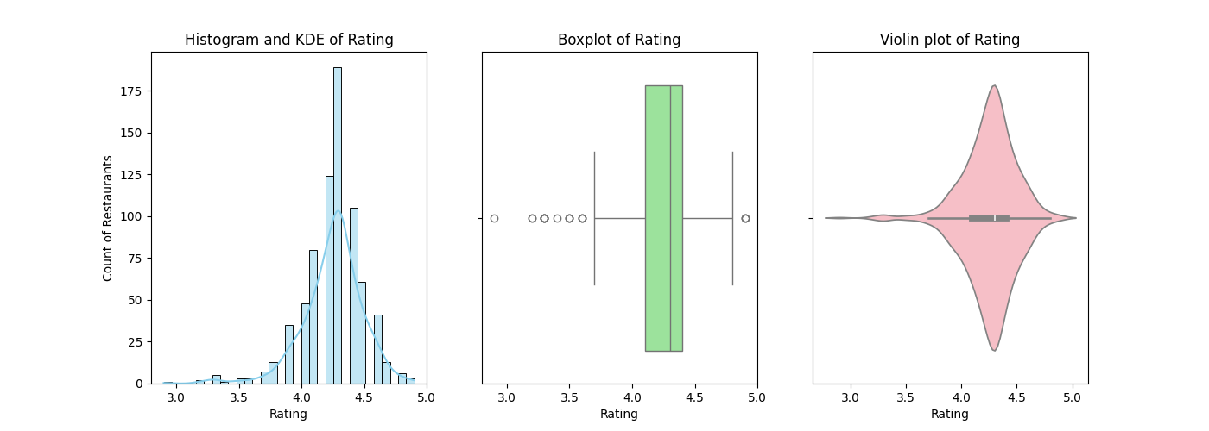
EDA
Univariate Analysis Steps:
Univariate – Numerical Analysis - Plots and Observations
Price for 2:
Rating:
Histogram and KDE plot (left)
Bimodal distribution, with peaks around 1500 and 2300.
The histogram is right-skewed, indicating that while most restaurants have prices between 1000 and 3000, a few have higher prices.
Box plot (middle)
There are several outliers on the higher end, with most data concentrated between 1000 and 3000.
The median line is closer to the lower quartile, suggesting that more than half of the data points are concentrated on the lower end of the interquartile range.
Violin plot (right)
Reveals the density of price distributions, showing two peaks.
The violin plot also indicates that there is a significant density of prices around the lower peak, suggesting that many restaurants fall into the lower price range.
Histogram and KDE plot (left)
Skewed to the right, most ratings are clustered around 4.2-4.5.
The peak near 4.25 suggests that many restaurants are rated around this score, with a gradual decline in frequency as the ratings increase or decrease from this point.
Box plot (middle)
Distribution is slightly skewed to the left with a concentration around 4.2 to 4.5.
There are a few outliers on the lower end of the rating scale, but they are minimal. The median is very close to the upper quartile, confirming that many ratings are high.
Violin plot (right)
Strong peak around 4.3.
The violin plot also displays a symmetrical distribution around the peak, suggesting that the ratings are relatively consistent with only a slight spread on either side of the peak.

Slide 8
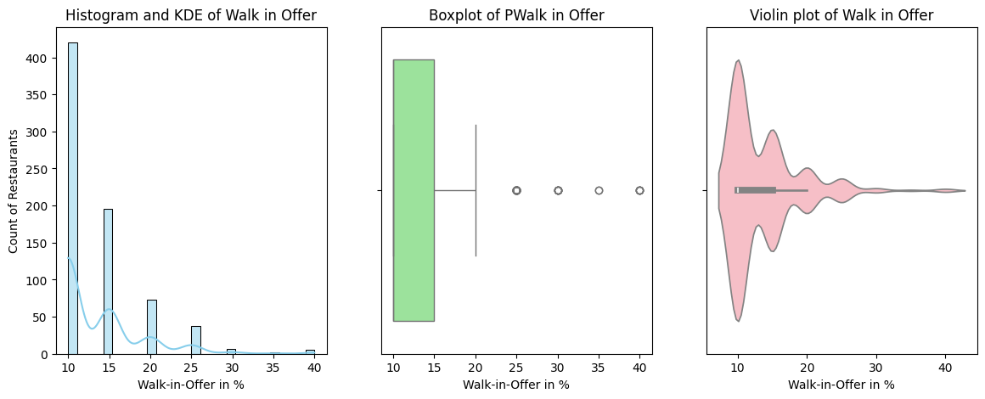
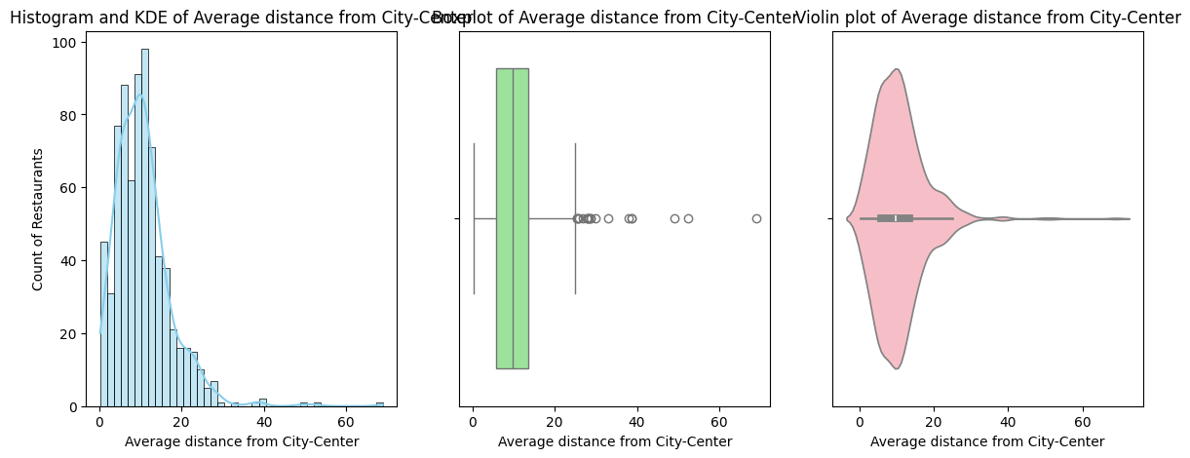
EDA
Univariate Analysis Steps:
Univariate – Numerical Analysis - Plots and Observations
Walk in Offer:
Average Distance from City-Center
Histogram and KDE plot (left)
Heavily centred around 10% with few variations.
Box plot (middle)
The majority of values hover around 10-15%, with few outliers.
Violin plot (right)
Dense around 10% with thinning density as the offer increases.
Histogram and KDE plot (left)
Right-skewed distribution, most restaurants are within 15 km of the city centre.
Box plot (middle)
Shows a broad distribution, with many outliers on the higher end.
Violin plot (right)
High density near the city centre with thinning as distance increases.

Slide 9
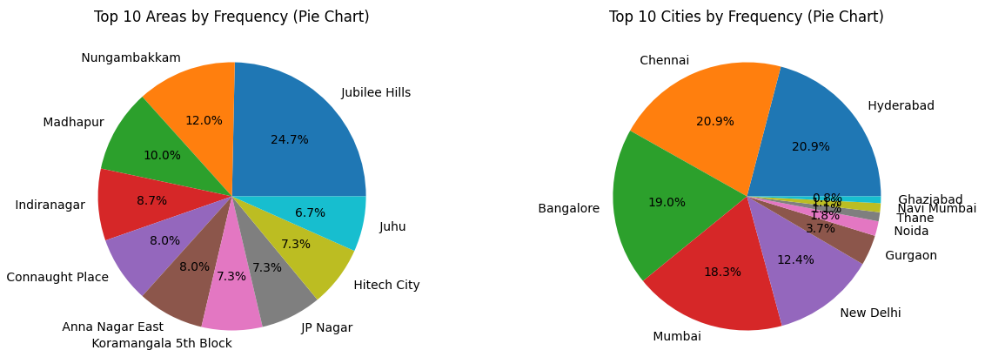
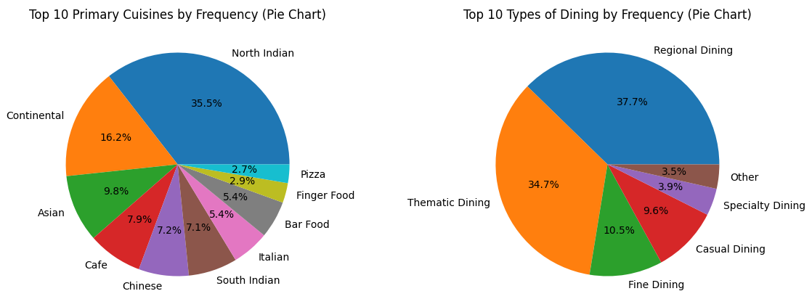
EDA
Univariate Analysis Steps:
Univariate – Categorical Analysis - Plots and Observations
Areas:
Areas like Jubilee Hills occupy a larger slice of the pie, while the remaining areas share smaller slices.
It visually demonstrates the disparity between the most frequent area (Jubilee Hills) and the others, highlighting the unequal distribution across different areas.
Cities:
The pie chart visually demonstrates that the top 5 cities make up a significant portion of the data, while the remaining cities contribute a much smaller percentage.
Primary Cuisine:
North Indian cuisine is the most frequently mentioned primary cuisine. This suggests that North Indian dishes are highly popular and potentially have a higher demand in the dining scene covered by the dataset.
Type of Dining:
Regional Dining and Thematic Dining occupy the largest slices of the pie, highlighting their dominance. The pie chart emphasizes how these top dining types contribute to the overall distribution.
It shows how that a few types of dining experiences make up the majority of the dataset, while the rest have smaller shares.

Slide 10
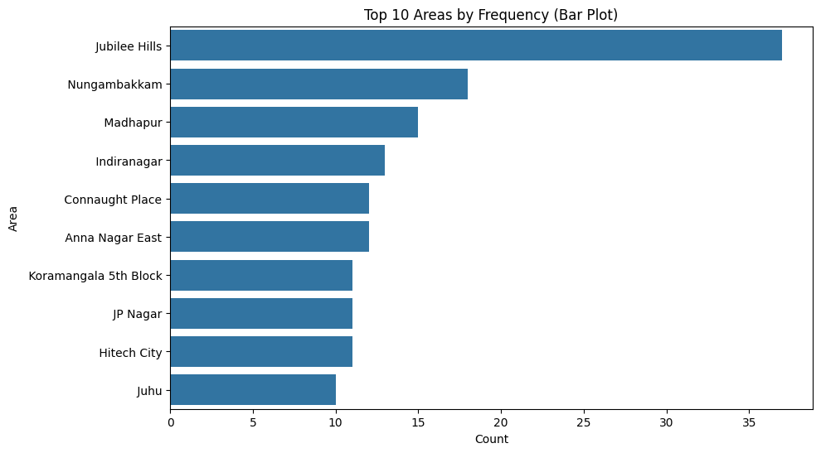
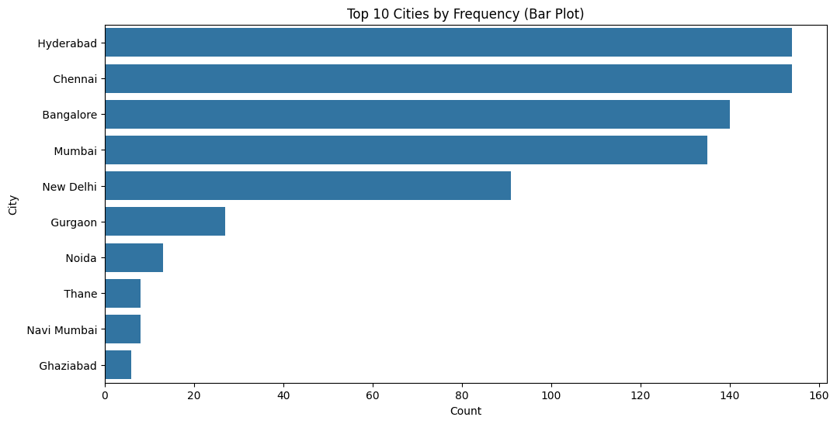
EDA
Univariate Analysis Steps:
Univariate – Categorical Analysis - Plots and Observations
Cities:
The plot shows the top 5 cities (Bangalore, Chennai, Hyderabad, Mumbai and New Delhi) dominating the bar plot.
These cities have nearly equal representation, with smaller cities having far fewer counts.
Areas:
The area Jubilee Hills has the highest count, followed by other areas like Nungambakkam, Connaught Place, and Madhapur.
This indicates that Jubilee Hills is a popular location within the dataset. The plot also shows a clear decline in frequency after the top few areas, suggesting that the distribution is somewhat concentrated in these top locations.

Slide 11
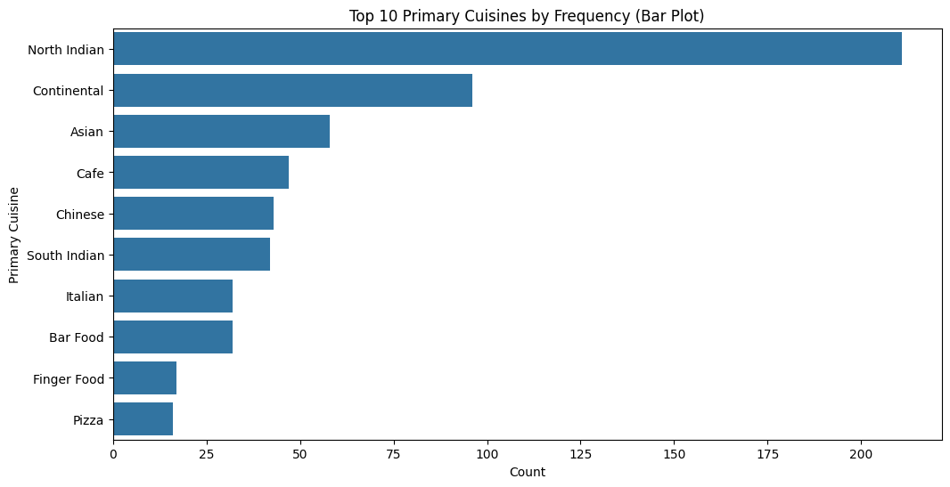
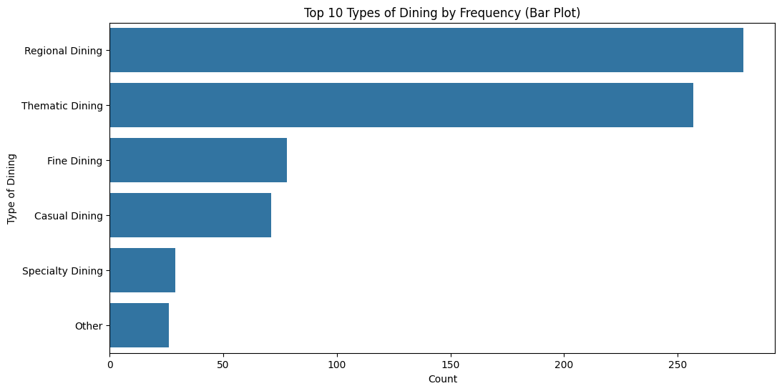
EDA
Univariate Analysis Steps:
Univariate – Categorical Analysis - Plots and Observations
Primary Cuisine:
North Indian cuisine is the most popular, with over 200 occurrences.
Continental cuisine is the second most popular, with around half the frequency of North Indian cuisine.
Asian cuisine ranks third, with about 50 occurrences.
A variety of cuisines like Café, Chinese, South Indian, Italian, Bar Food, Finger Food, and Pizza have moderate to low frequencies.
Finger Food and Pizza are the least common among the top 10, with fewer than 25 occurrences each.
Type pf Dining:
Regional Dining is the most popular dining type, with over 250 occurrences.
Thematic Dining is nearly as popular as Regional Dining, with just under 250 occurrences.
Fine Dining is slightly more common than Casual Dining, both having between 75 and 100 occurrences.
Specialty Dining and Other dining types are the least common, with fewer than 50 occurrences each.
There is a strong preference for Regional and Thematic Dining over other dining types.

Slide 12
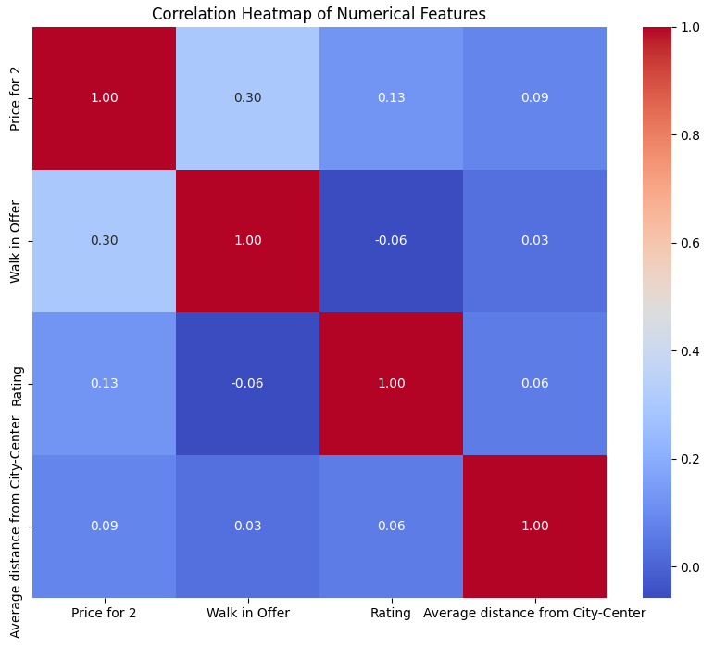
EDA
Bivariate Analysis Steps:
Bivariate – Numerical Vs. Numerical - Plots and Observations
Price for 2 and Walk in Offer: There is a weak positive correlation (0.30). As the price for two increases, there tends to be a slight increase in the likelihood of a walk-in offer.
Price for 2 and Rating: There is a very weak positive correlation (0.13). Higher prices for two have a minimal positive impact on restaurant ratings.
Price for 2 and Average distance from City-Centre: There is a very weak positive correlation (0.09). Restaurants slightly farther from the city centre tend to have marginally higher prices for two.
Walk in Offer and Rating: There is a very weak negative correlation (-0.06). Restaurants with walk-in offers tend to have slightly lower ratings, though the relationship is very weak.
Walk in Offer and Average distance from City-Centre: There is a very weak positive correlation (0.03). The farther a restaurant is from the city centre, the slightly more likely it is to offer walk-in deals.
Rating and Average distance from City-Centre: There is a very weak positive correlation (0.06). The distance from the city centre has a minimal positive influence on restaurant ratings.

Slide 13
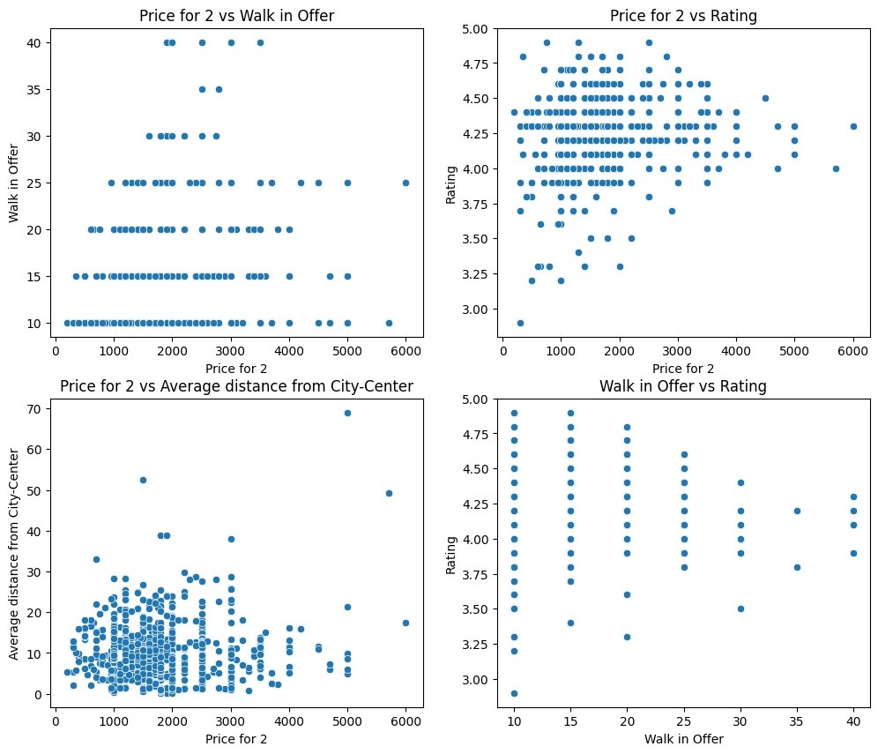
EDA
Bivariate Analysis Steps:
Bivariate – Numerical Vs. Numerical - Plots and Observations
Price for 2 vs. Walk in Offer: There is a slight upward trend, indicating a weak positive relationship, where higher prices for two people are generally associated with slightly higher walk-in offers.
Price for 2 vs. Rating: The plot shows a dispersed pattern with no clear trend, suggesting a very weak relationship between the price for two people and the restaurant's rating.
Price for 2 vs. Average Distance from City-Centre: The scatter plot shows a slight upward trend, indicating a very weak positive relationship, where restaurants farther from the city centre might charge slightly more for two people.
Walk in Offer vs. Rating: The plot shows a scattered pattern with no apparent trend, indicating a negligible relationship between walk-in offers and restaurant ratings.

Slide 14
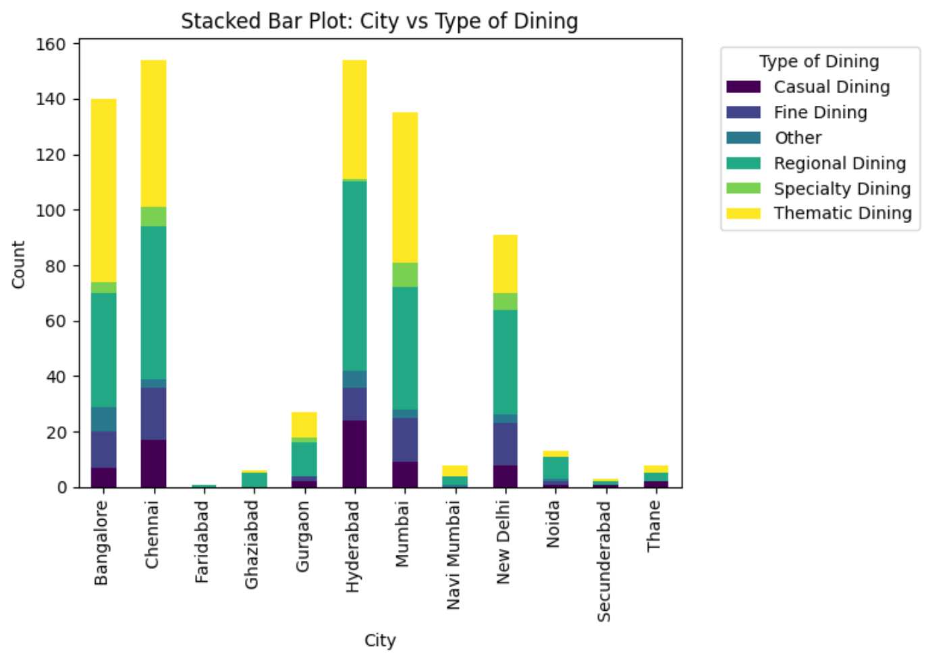
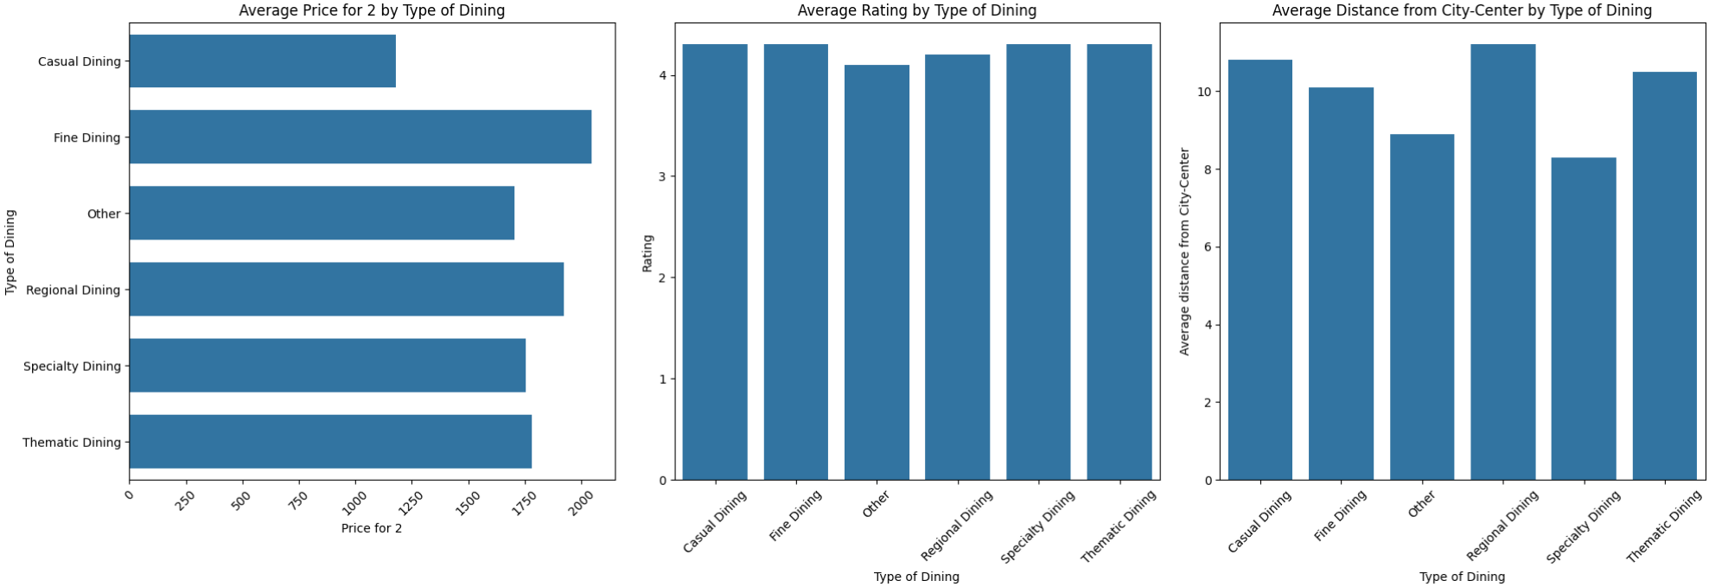
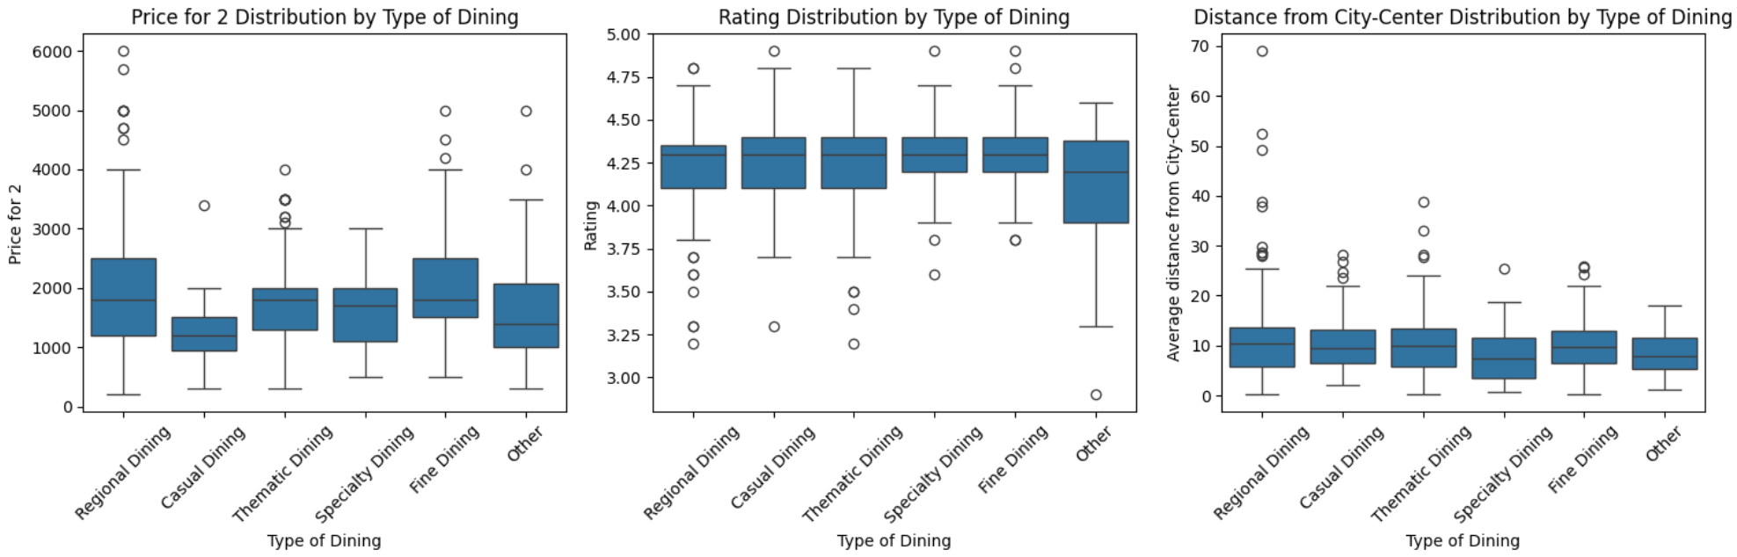
EDA
Bivariate – Categorical Vs. Categorical - Plot and Observations
Bivariate Analysis Steps:
Bivariate – Numerical Vs. Categorical - Plots and Observations
Average Price for 2 by Type of Dining: Fine Dining has the highest average price, while Casual Dining offers more affordable options.
Average Rating by Type of Dining: Fine Dining and Thematic Dining generally receive higher ratings, indicating better customer satisfaction.
Average Distance from City-Center by Type of Dining: Fine Dining and Specialty Dining are often located farther from the city center, whereas Casual and Regional Dining are closer.
Hyderabad, Chennai, and Bangalore have the highest diversity in dining types, particularly in thematic and regional dining.
Thematic dining is a dominant dining type across most major cities.
Specialty and regional dining are popular in urban areas like Mumbai and Hyderabad.
Smaller cities like Ghaziabad and Thane show fewer dining options with less diversity.
Casual and fine dining are less dominant compared to thematic and regional dining but are still significant in cities like Hyderabad and Mumbai.

Slide 15
Key Business Question
How can restaurant owners, marketers, and food delivery services (like Zomato) use data on what customers like (such as popular cuisines and spending habits) to improve their menus, prices, and marketing to attract more customers and stay competitive?
Conclusion (Key finding overall)
North Indian cuisine is the most popular among customers.
Fine dining is the most expensive option, while casual dining is more affordable.
Most restaurants have prices in a lower range, with only a few being more expensive.
There is no strong link between how much a meal costs and the restaurant's rating; higher prices don't always mean better ratings.

Slide 16
Your Experience/Challenges Working on Web Scraping – Data Analysis Project
Web Scraping Issues: It was tricky to scrape data from Zomato due to its dynamic content, and there was a risk of being blocked. We used tools like Selenium and BeautifulSoup to automate the data collection.
Data Quality Problems: The data had issues like missing information and duplicates, which needed to be fixed to ensure accurate results.
Data Analysis Challenges: I had to choose the right methods for analysing and visualizing the data to find useful insights.
Learning Experience: I gained hands-on experience with Python tools (like pandas and matplotlib) for working with data and creating visualizations.

Slide 17


Slide 18

THANK YOU

