Slide 1
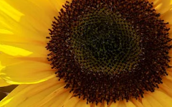
sunflower
The common sunflower is a species of large annul forb of the daisy family Asteraceae .
Begins and is planted , germinates.

Slide 2
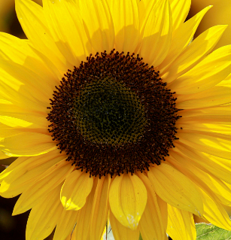
As the seeding grow s buds will form
.these will begin to unfold into petals

