Slide 1
Sales Business Dashboard Project
Interactive Sales Performance and Customer Insights Dashboard Report using Power BI
By: Anurag Aswal
Date: 09/08/2025

Slide 2
Objective
Goal: Provide business stakeholders with an interactive dashboard to monitor Sales, Profit, Growth, and Customer Performance.
Purpose:
Track business performance over time
Identify top-performing products, regions, and customers
Enable data-driven decision-making
Tools: Power BI

Slide 3
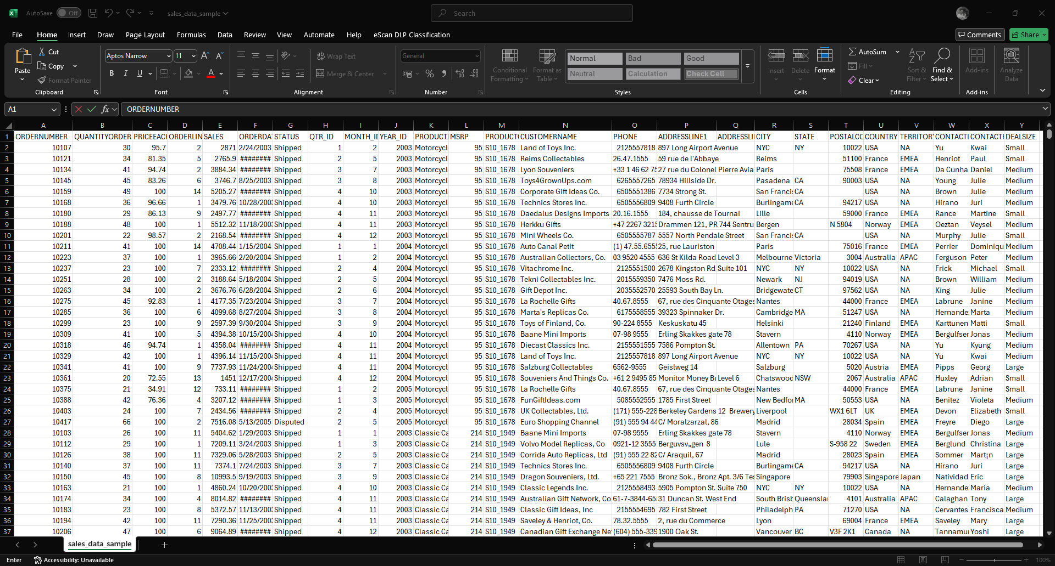
Dataset Summary
Source: Kaggle – Global Sales Data Sample (sales_data_sample.csv)

Slide 4
Key Metrics
Total Sales: $4.48M
Total Profit: $741.16K
Sales Growth : +117.38%
Top Country: USA ($3.4M)
Top Product Line: Classic Cars ($1.57M)
Top Customer: Mini Gifts Distributors Ltd. ($654K)

Slide 5
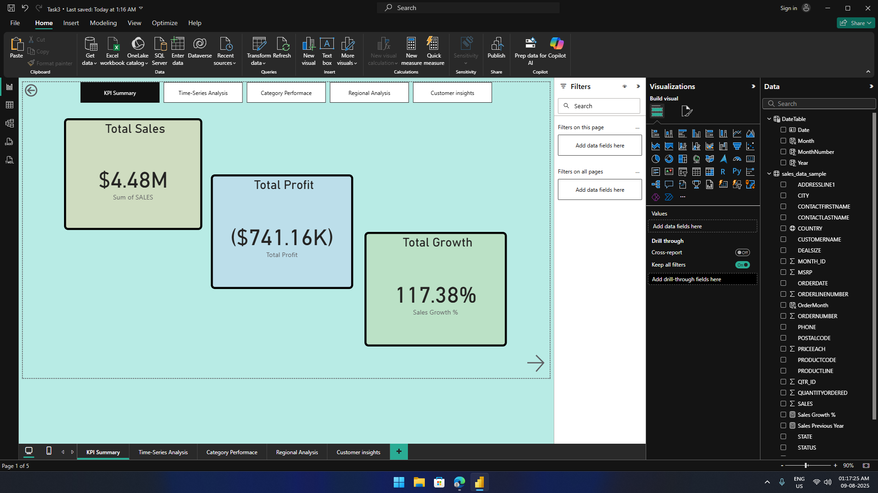
KPI Summary

Slide 6
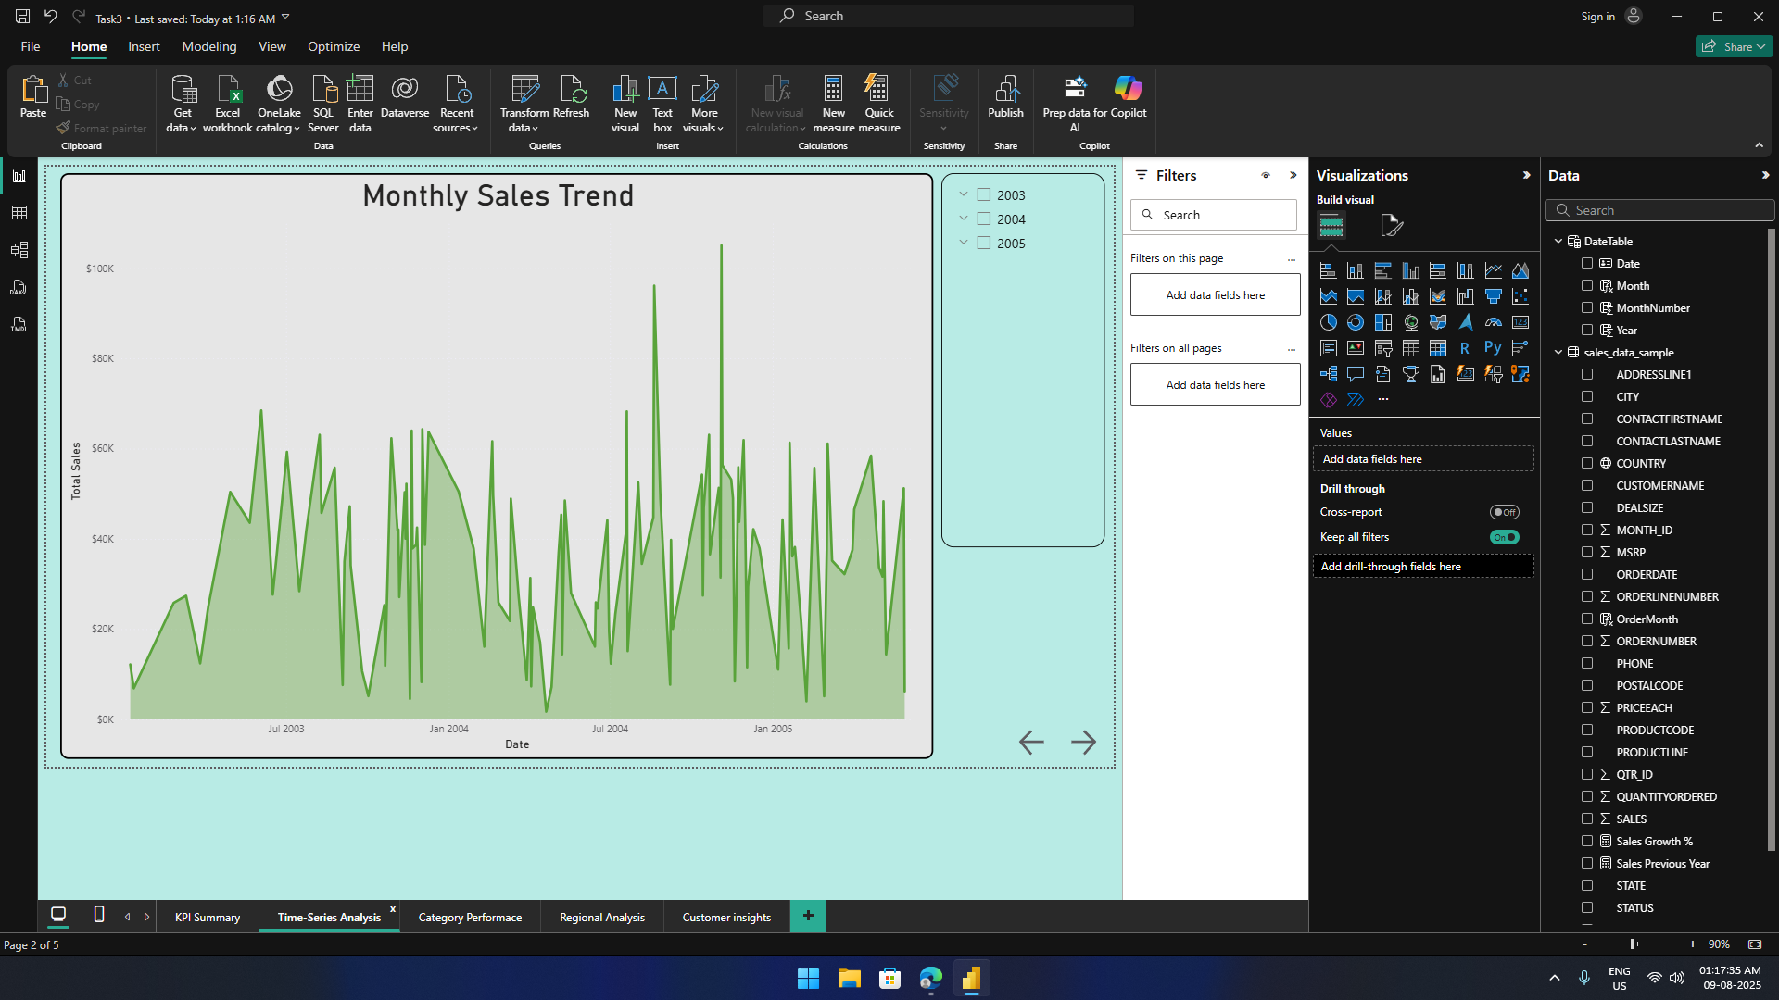
Time- Series Analysis
Insight:
Peak sales observed in Q4 every year (seasonal trend)
Dip in Q2 2004 due to order cancellations in key regions
Steady growth with minor fluctuations during off-peak months

Slide 7
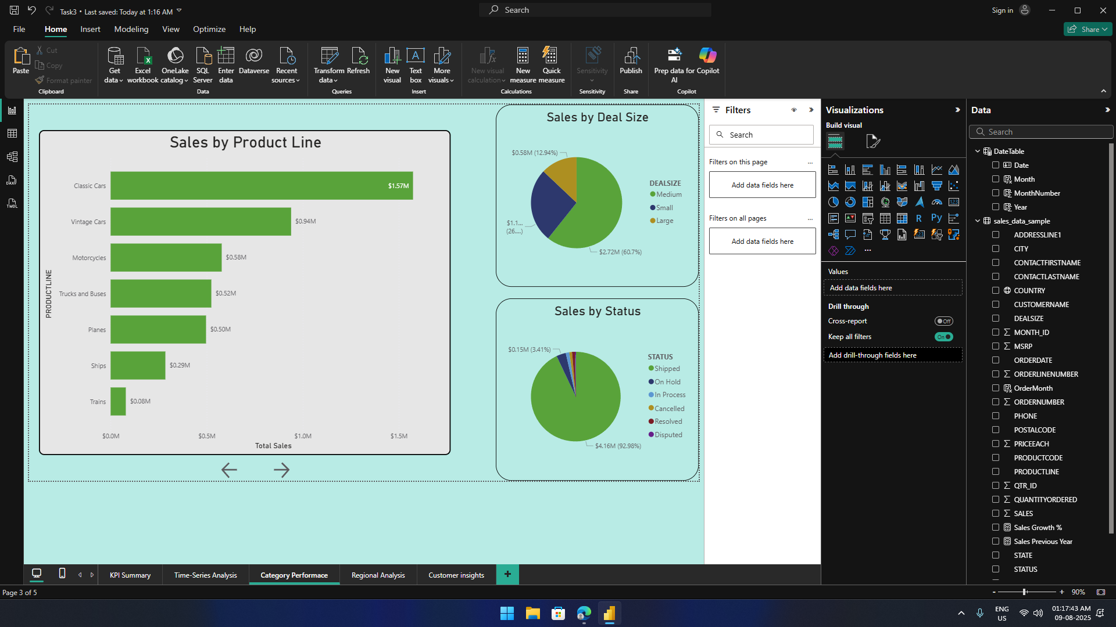
Category Performance
Insight:
Classic Cars & Vintage Cars generate ~60% of total revenue
Medium deal sizes contribute to 60% of sales value
Motorcycles have the highest YoY growth rate among categories

Slide 8
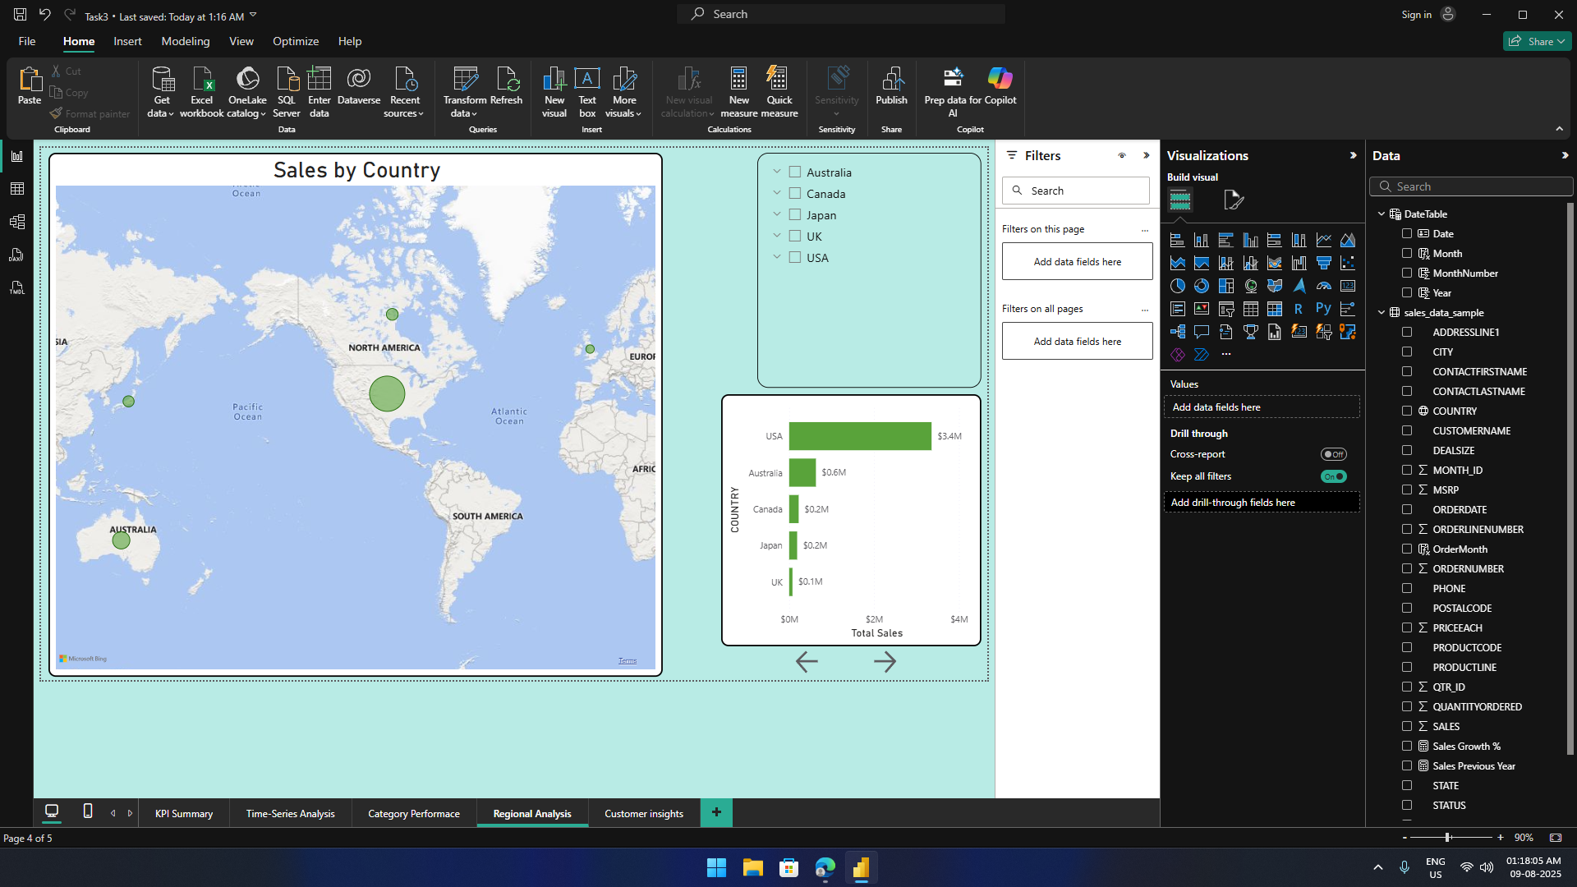
Regional Analysis
Insight:
USA, Australia, and Canada are top markets by revenue
APAC region showing fastest growth rate (esp. Japan & Australia)
Some markets (e.g., Sweden, Norway) have low penetration → potential expansion opportunities

Slide 9
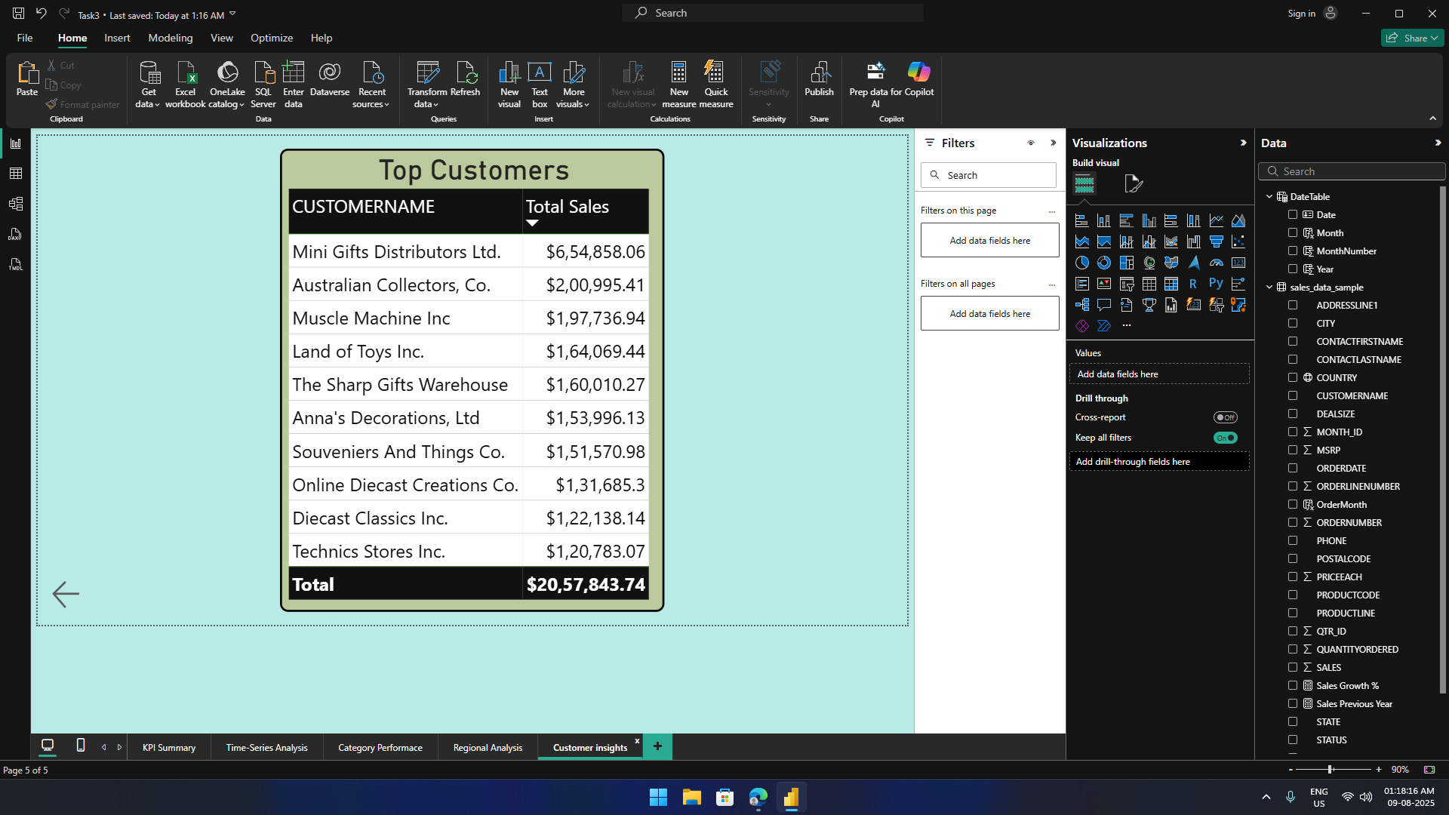
Customer Insights
Insight:
Top 10 customers account for ~38% of total sales
Mini Gifts Distributors Ltd. is the single largest buyer
Opportunity to upsell/cross-sell to mid-tier customers with steady purchase patterns

Slide 10
Actionable Recommendations
Focus Marketing on High Revenue Regions – USA, Australia, Canada
Expand APAC Operations – leverage growing demand
Stock Prioritization – Ensure Classic & Vintage Cars remain in inventory
Customer Retention Programs – loyalty benefits for top customers
Deal Size Strategy – Encourage medium-sized deals to upgrade to large-sized deals

Slide 11
THANK YOU
Contact: anurag.aswal.500@gmail.com

