Slide 1

Basic Details of the Team and Problem Statement
Smart India Hackathon 2023
Ministry/Organization Name/Student Innovation: Student
Innovation
PS Code: SIH14
Problem Statement Title: Student Innovation
Team Name: Interlinked
Team Leader Name: Sahil Agarwal
Institute Code (AISHE): U-0473
Institute Name: S.R.M IST
Theme Name: Travel and Tourism

Slide 2
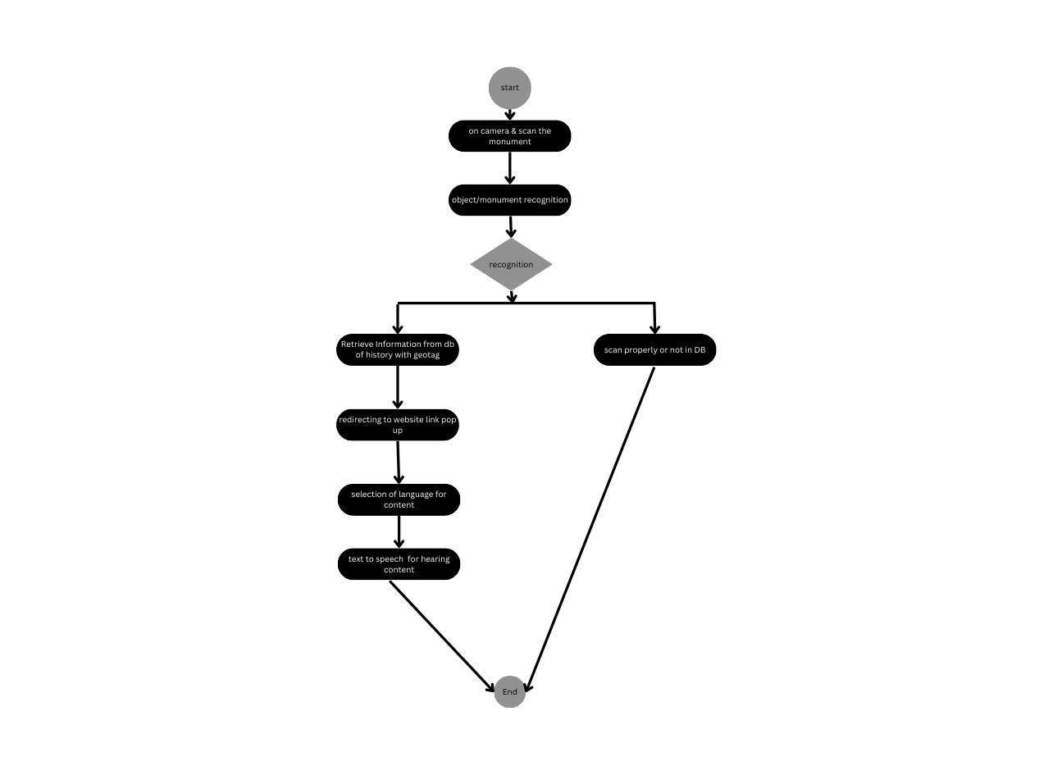
Idea/Approach Details
Describe your idea/Solution/Prototype here:
Our project is an innovative tourist app that utilizes Computer Vision and Augmented Reality to deliver real-time historical insights about monuments.
The solution involves a mobile app that recognizes monuments through a smartphone's camera, providing users with historical information on specific parts.
Users can explore monuments at their own pace , in their own comfortable language, gaining a deeper understanding of their cultural and historical significance .
This project aims to enrich tourism experiences, promoting cultural awareness and education, even we are using geolocation for tracking of monuments.
By seamlessly merging machine learning technology and 3d data along with cultural heritage, our app empowers travelers to engage with history in a unique way of interaction.
Describe your Technology stack here:
Computer vision
Deep learning
3d scanner for creating dataset
Python for backend and gui
Geolocation for geotagging
UI/UX ,CSS,JAVA,JAVASCRIPT,HTML(FRONTEND)

Slide 3
Idea/Approach Details
Describe your Use Cases here
Describe your Dependencies / Show stopper here
Enhanced sight seeing in tourism
Self guided tour
Multi lingual support
Geotagging for more accuracy
Real time monument identification
Text to speech for audio guided tour
Detailed artifact information which can save you money spent on guides
Model recognition accuracy is our main dependencies in this project as this is our core engine of this project to recognize monuments
Availability of data in database is the next main dependencies if monument which is scanned is not in the database then there will be no result for clients who are using it

Slide 4
Team Member Details
Team Leader Name: SAHILAGARWAL
Branch (Btech/Mtech/PhD etc): Btech Stream ( CSE ):CSE Year: III
Team Member 1 Name: PRATIK KUMAR
Branch (Btech/Mtech/PhD etc):Btech Stream (CSE ):CSE Year: III
Team Member 2 Name:ARYA NARONE
Branch (Btech/Mtech/PhD etc):Btech Stream (CSE ):CSE Year: III
Team Member 3 Name:KANCHINADHAM HARSHITH
Branch (Btech/Mtech/PhD etc):Btech Stream ( CSE ):CSE Year: III
Team Member 4 Name: ADARSH
Branch (Btech/Mtech/PhD etc):Btech Stream (CSE ):CSE Year: III
Team Member 5 Name: SRIDURGESH
Branch (Btech/Mtech/PhD etc):Btech Stream ( CSE ):CSE Year: III
Team Mentor 1 Name: DR.R.RAJKUMAR
Category (Academic/Industry): Academic Expertise : AR/VR Domain Experience (in years):
Team Mentor 2 Name: Type Your Name Here
Category (Academic/Industry):Academic Expertise : CV Domain Experience (in years):

Slide 5
Important Pointers
Please ensure below pointers are met while
Kindly keep the maximum slides limit to 4 pages
All the topics should be utilized for description of your idea
Try to avoid paragraphs and post your idea in points
Keep your explanation precisely and easy to understand
Idea should be unique and novel. If it has a business potential more weightage will be given.
Apart from this PPT abstract of your idea will be asked separately while submitting
You need to save the file in PDF and upload the same on portal. No PPT, Word Doc or any other format will be supported
You can delete this slide (Important Pointers) when you upload the details of your idea on SIH portal.

