Slide 1


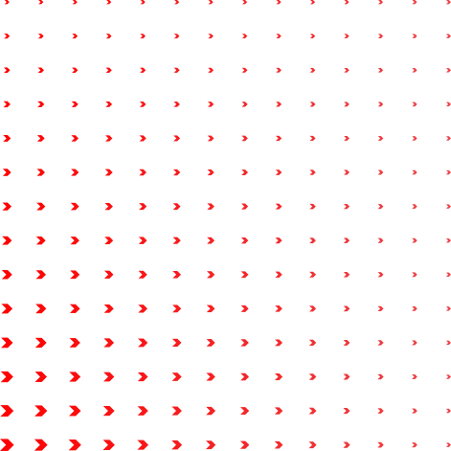
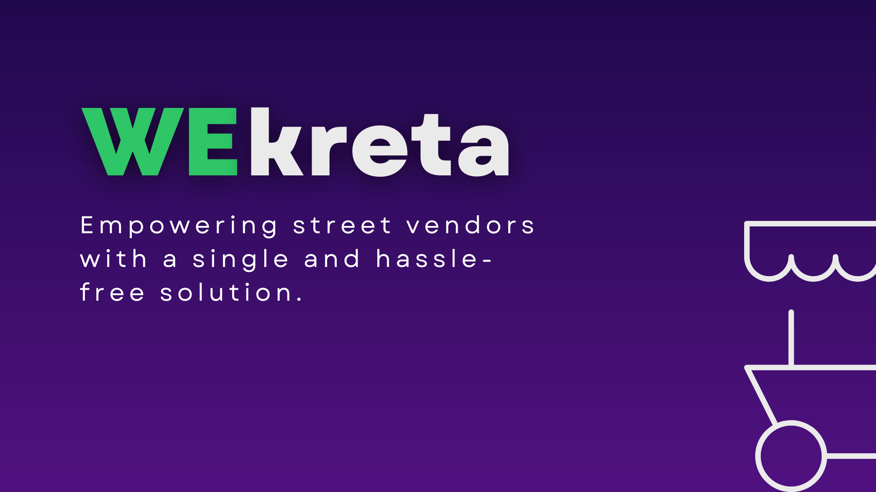

WEkreta / Tech Thela
BREAKING NEWS
NEWS REPORT
LIVE
AI-POWERED PHYGITAL COMMERCE FOR INDIA'S 10 MILLION STREET PUSHCARTS
Voice-First WhatsApp AI (Zero Typing) • 30-Min Mohalla Batching • Real-Time OpenStreetMap Telemetry
GDG Hackathon 2026 • "Bridge The Gap"

Slide 2


🛑 GAP #1: THE DIGITAL LITERACY & TYPING WALL
• Zero Typing Capability: 80%+ street vendors have low or regional literacy; complex seller apps with forms and English SKUs cause a 100% bounce rate.
• Voice-Only Communication: Vendors operate exclusively through WhatsApp voice notes and phone calls.
• Extortionate Take-Rates: Dark-store apps (Zepto/Blinkit) charge 25-30% commissions, completely locking out small street vendors operating on 12-15% margins.
THE NEWS
2 CRITICAL GAPS IN INDIA'S $100B STREET ECONOMY
🛰️ GAP #2: THE TELEMETRY INVISIBILITY TRAP
• Moving Carts are Invisible: Customers wanting fresh vegetables have no way to know if a thela is 50 meters away or 2 kilometers away.
• 2.5 Hours Lost Daily: Vendors waste hours aimlessly calling out in residential lanes hoping someone will buy before vegetables spoil.
• Zero Demand Forecasting: Vendors have no intelligence on which street or college gate has peak demand right now.
Why choose the convenience of a click or the confidence of physical touch when shopping can offer both? In a world moving to 10-minute dark stores, 10 million street thelas shouldn't be left behind.
💡 THE WEKRETA SOLUTION: Ambient WhatsApp Voice Ingestion (Zero-Typing) + Live OpenStreetMap Telemetry + 30-Min Mohalla Batching!

Slide 3
KEY QUESTIONS
WHO?
10M Street Pushcart Vendors & Urban Mohalla Households
WHEN?
Real-Time On-Demand (sub-10m) & 1-Day Advance Orders (7% Off)
WHAT?
Ambient WhatsApp Voice Bot (Zero-Typing) + Live Thela Map
WHY?
0% Vendor Fee vs 25% Dark-Store Cut + 100% Farm-Fresh Vegetables
WHERE?
Hyperlocal Indian Mohallas (1.5 km Geofence Delivery Radius)
HOW?
Spoken Voice Audio ➔ Gemini 2.5 Flash ➔ 30-Min Mohalla Batching

Slide 4

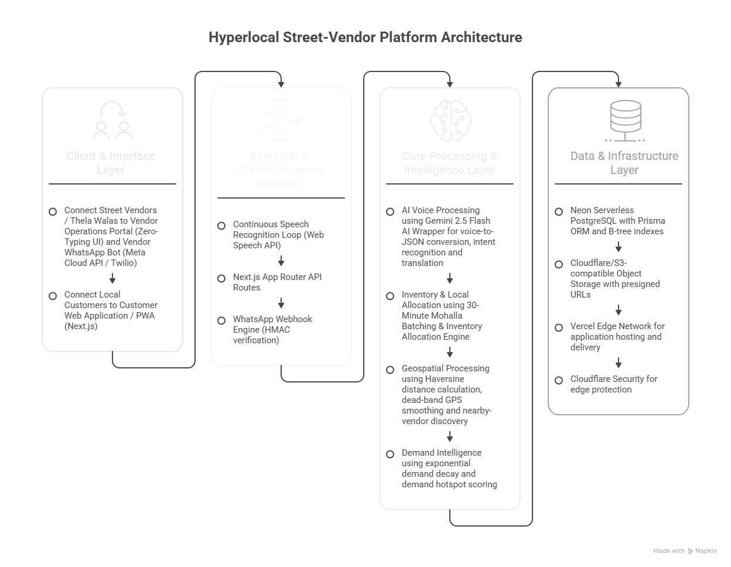

SYSTEM ARCHITECTURE & END-TO-END NAPKIN PIPELINE
Visual Process Blueprint: From Spoken Hindi Voice Note ➔ Gemini 2.5 AI ➔ 30-Min Mohalla Batching ➔ Doorstep Delivery
STAGE 1
🎙️ VOICE INGESTION
• Input Method: Continuous Web Speech API loop or WhatsApp Voice Note (.ogg).
• Webhook Router: Meta Cloud API / Twilio with HMAC token verification.
• Zero Typing: Vendor simply speaks in Hindi, Hinglish, or regional dialect.
STAGE 2
🧠 GEMINI 2.5 FLASH AI
• LLM Ingestion: Gemini 2.5 Flash API parses unstructured speech in 600ms.
• Structured Output: Converts speech into JSON { name, price, unit }.
• Vendor Safety: Vendor confirms with 1-tap 'Sahi Hai?' before saving to DB.
STAGE 3
📦 30-MIN MOHALLA BATCH
• Spatio-Temporal: Orders grouped within 1.5 km core delivery geofence.
• Inventory Match: Greedy allocation matches 100% single-vendor carts.
• Instant WhatsApp: Vendor receives interactive WhatsApp Accept/Reject buttons.
STAGE 4
📍 OPEN MAP & NEON DB
• Zero-Cost Mapping: Leaflet + OpenStreetMap ($0 vs $580/1k Google Maps).
• GPS Filtering: Dead-band Kalman filter eliminates telemetry jitter.
• Persistence: Neon Serverless PostgreSQL (Prisma 6.4 ORM, B-Tree indexes).
⚡ 600ms AI Turnaround
Google Gemini 2.5 Flash extracts JSON prices from voice notes in real time.
💰 ₹0.0003 API Cost
Extremely low per-listing cost enables 100% free vendor onboarding forever.
📉 94% OPEX Reduction
Zero paid Google Maps SDK keys. Completely powered by OpenStreetMap.

Slide 5
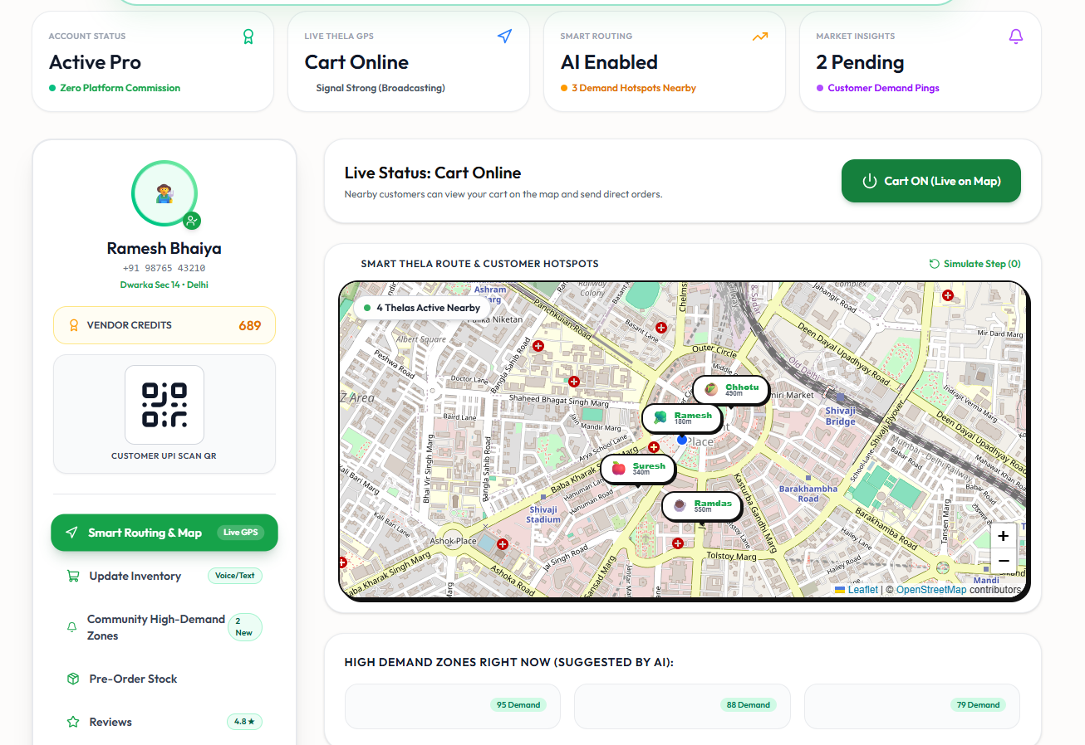
THE FUTURE
PHASE 1 (LIVE NOW)
🚀 Phygital Mohalla MVP
• WhatsApp Voice Ingestion: Hands-free Hindi/Hinglish speech to catalog.
• Live Moving Cart Map: OpenStreetMap real-time GPS presence.
• 30-Min Mohalla Batching: 1.5 km core delivery clustering.
• Calibrated Pricing: 5% flat convenience + 7% advance pre-order discount.
PHASE 2 (COMING SOON)
🥬 Mandi Bulk Wholesale Pooling
• Cooperative Purchasing: Pushcart vendors pool orders directly from Azadpur Mandi.
• Eliminate Intermediaries: Saves vendors 12-15% on wholesale vegetable procurement.
• Price Prediction: Gemini predicts evening mandi price drops.
• Quality Assurance: Direct farm-to-thela verified freshness grade.
PHASE 3 (SCALE)
🏙️ 100,000 Pushcarts Across Bharat
• Pan-India Expansion: Tier 1 & Tier 2 cities using PostGIS GiST spatial indexing.
• Multilingual AI: Voice support for Bhojpuri, Tamil, Bengali, Telugu & Marathi.
• Micro-Credit Scoring: Verified digital order history unlocks collateral-free micro-loans.
• Formal Economy Bridge: Street vendors enter official banking & UPI ecosystems.
WEkreta transforms street commerce from an analog survival struggle into an ambient, highly profitable, phygital network — empowering 10 million vendors without displacing them.

Slide 6

IMPACT
🎯 UNIT ECONOMICS FLASH
▸ Avg Order Value: ₹300 Cart
▸ Gross Take Rate: 5% (₹15/Order)
▸ Software Tech Cost: ₹0.0003 (Gemini)
▸ Software Margin: 99.8% Gross
▸ Vendor Fee: ₹0 Forever
▸ Delivery Radius: 1.5 km Geofence
▸ Customer Saving: 20-30% vs Zepto
INCOME BOOST
+35% to 40% Daily Income jump by eliminating 2.5 hours of dead-mileage roaming
CALIBRATED PRICING
5% flat convenience fee + 7% early-bird discount for 1-day advance morning pre-orders
Predictable morning procurement reduces vegetable inventory spoilage to under 3%
ZERO PLATFORM CUT
₹0 daily vendor listing fee — small pushcart vendors retain 100% of their street margins
ZERO EMISSIONS
Local pushcarts & cycle-rickshaws replace polluting diesel vans for last-500m deliveries

Slide 7
WEkreta
WEKRETA: THE PHYGITAL FUTURE
WEKRETA: THE PHYGITAL FUTURE
🐧 HACKATHON BLOOPER OF THE YEAR: "Antarctica Me Dhaniya Bechta Thela"
A missing noWrap: true on Leaflet tiles caused a coordinate overflow that flung Ramesh Bhaiya's cart 12,450 km away to Antarctica (-75° S) to sell vegetables to penguins! We fixed it with noWrap: true and strict Delhi geofence locking.
🚀 LIVE SYSTEM DEMO: http://localhost:3000 | WhatsApp Bot Simulator: /whatsapp | GitHub: anurag-maurya-ece/gdghack
team.wekreta@gdghack.dev | GDG Hackathon 2026

