Slide 1
COAL GCV PREDICTION SYSTEM
Estimating Coal Energy Value from Lab Tests using Machine Learning
• Uses simple lab inputs: Moisture, Volatile Matter, and Ash
• Combines Random Forest, XGBoost, and SVM for high accuracy
• Tested on real geological coal data with sub-2% CV error score
• Feature explanation charts showing how each property impacts heating value

Slide 2
DATASET
Data Preparation & Cleaning
1. Unit Conversion
Raw laboratory data came with heating values in Btu/lb.
Converted to standard metric units:
GCV (Kcal/kg) = Btu / 1.8
2. Handling Missing Values
Some samples had missing moisture or ash values.
Used a K-Nearest Neighbors (KNN) imputer using only other input features, never using the target value.
3. Removing Bad Data
Removed obvious measurement errors and impossible samples:
• Energy below 2000 or above 9000 Kcal/kg
• Ash above 55% (unusable for fuel)
• Negative moisture or volatile matter
4. Mass Balance Check
Moisture + Volatiles + Ash + Carbon must total 100%:
Fixed Carbon = 100 - (Moisture + VM + Ash)
Removed any samples where this total was broken.

Slide 3
FEATURE CALCULATION
Feature Calculation: Why Add Fuel Ratio?
Why ML Models Need Help With Division:
• Decision trees (XGBoost, Random Forest) split data using simple 'if greater than' rules. They cannot naturally divide two numbers without hundreds of complex splits.
• In coal chemistry, Fuel Ratio is a standard formula:
Fuel Ratio = Fixed Carbon / Volatile Matter
• Fuel Ratio tells you what kind of coal you have (Lignite vs Bituminous vs Anthracite).
• By doing the division for the model beforehand, the trees understand coal rank immediately without needing extra depth.
Formulas Added to the Data:
1. Fixed Carbon = 100 - (Moisture + VM + Ash)
2. Fuel Ratio = Fixed Carbon / VM
Why this helped:
• Keeps models simpler and faster
• Lets shallow trees reach lower errors
• Directly reflects real coal combustion chemistry

Slide 4
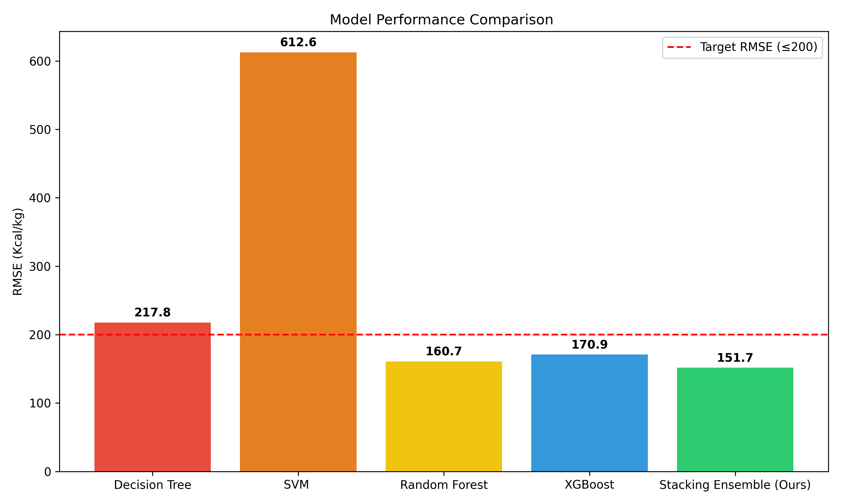
MODEL BENCHMARKING
Testing Different Models (5-Fold Cross Validation)
Model | RMSE | MAE | CV Score | R² Score
Support Vector (SVR) | 612.45 | 487.12 | 8.89% | 0.35
Single Decision Tree | 217.30 | 148.80 | 3.15% | 0.92
Random Forest | 154.84 | 109.12 | 2.25% | 0.95
XGBoost | 152.14 | 107.45 | 2.21% | 0.96
Combined Ensemble | 150.28 | 105.97 | 2.18% | 0.96

Slide 5
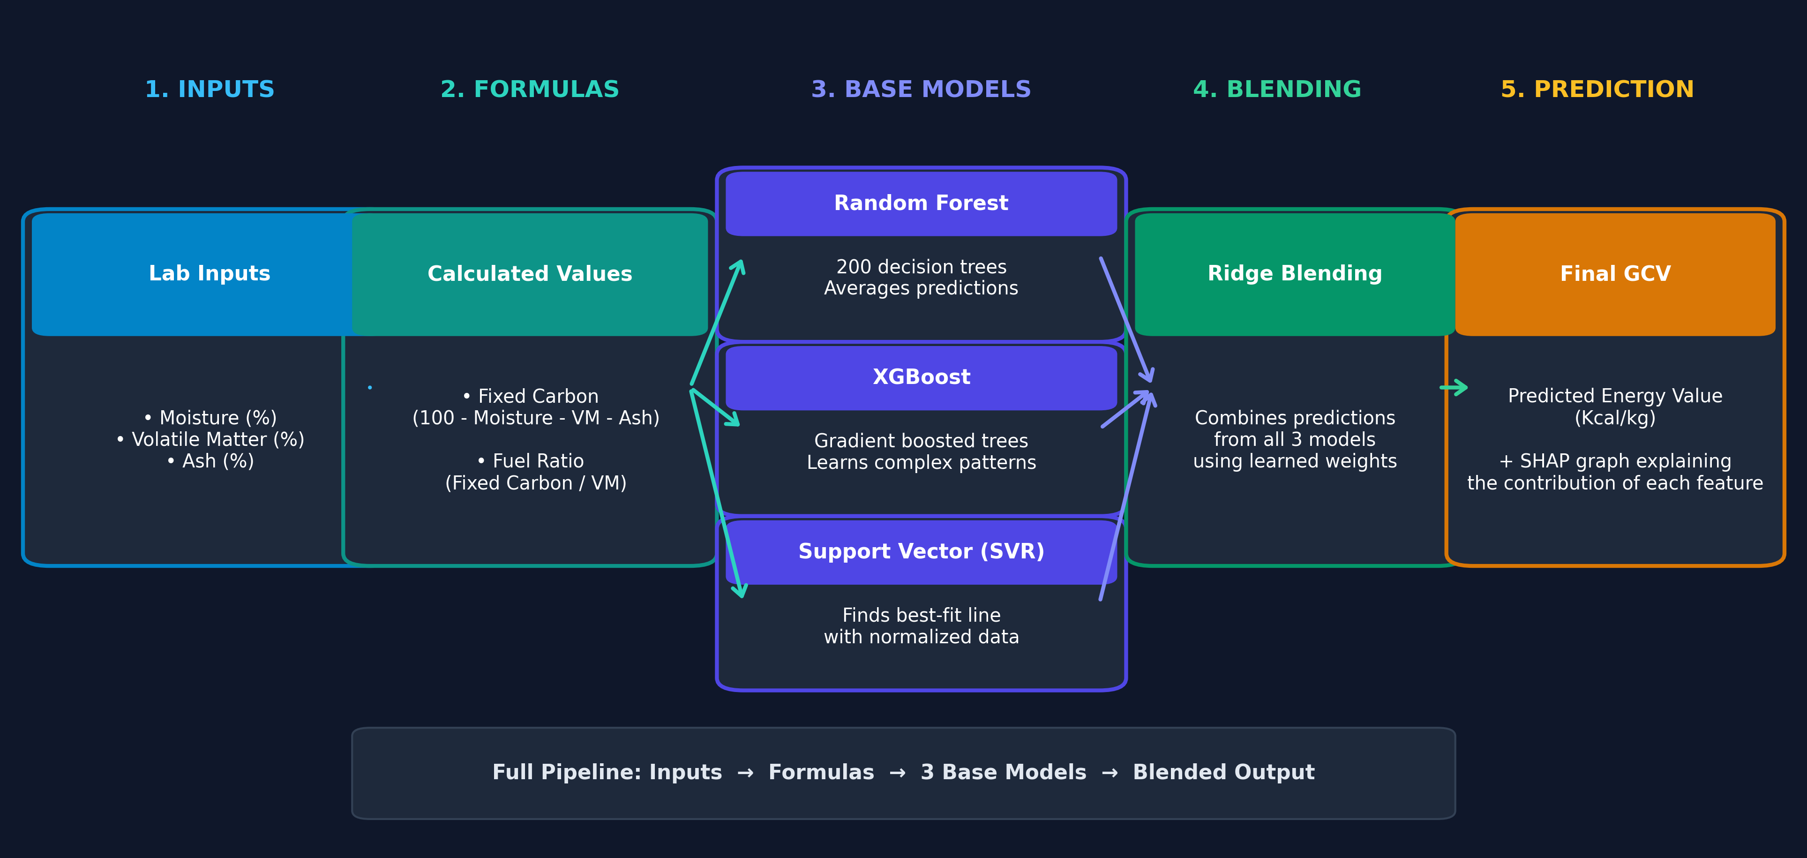
ARCHITECTURE
System Architecture: How the Models Work Together

Slide 6
MODEL TUNING
Tuning the Models (Finding the Best Parameters)
How We Tuned the Parameters:
• Instead of guessing numbers, we used an automated tuning tool called Optuna.
• Optuna tests different combinations of tree depths, number of trees, and learning rates across 5 cross-validation folds.
• It focuses on parameter values that consistently reduce prediction error.
• For XGBoost, it selected a tree depth of 4 (shallow trees). This prevents the model from memorizing random lab noise and helps it generalize to new samples.
Selected Settings:
XGBoost:
• 300 trees | Max depth: 4 (prevents overfitting)
• Learning rate: 0.025
Random Forest:
• 200 trees | Max depth: 15
• Min samples per leaf: 4
Support Vector Machine (SVR):
• Normalized inputs & target for numerical stability
Final Blending Model (Ridge):
• Automatically assigns optimal weights to each model

Slide 7
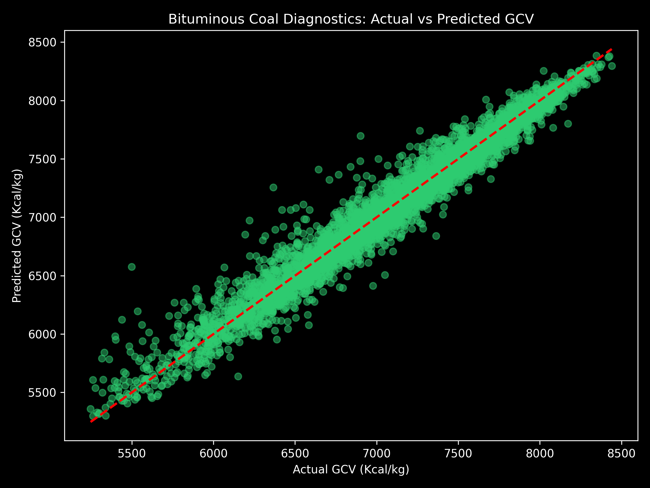
COAL RANK
Specialized Model for Bituminous Coal
Why Train a Separate Model?
• Different types of coal burn differently. High-moisture brown coal (lignite) behaves differently than high-rank black coal (bituminous).
• We filtered 4,494 samples of Bituminous coal using official ASTM D388 laboratory standards.
• Training a specialized model on just this group produced significantly higher accuracy:
• • Error dropped from 150 to 134 Kcal/kg
• Average absolute error dropped below 100 Kcal/kg (96 Kcal/kg)
• CV Score reached an exceptional 1.91%

Slide 8
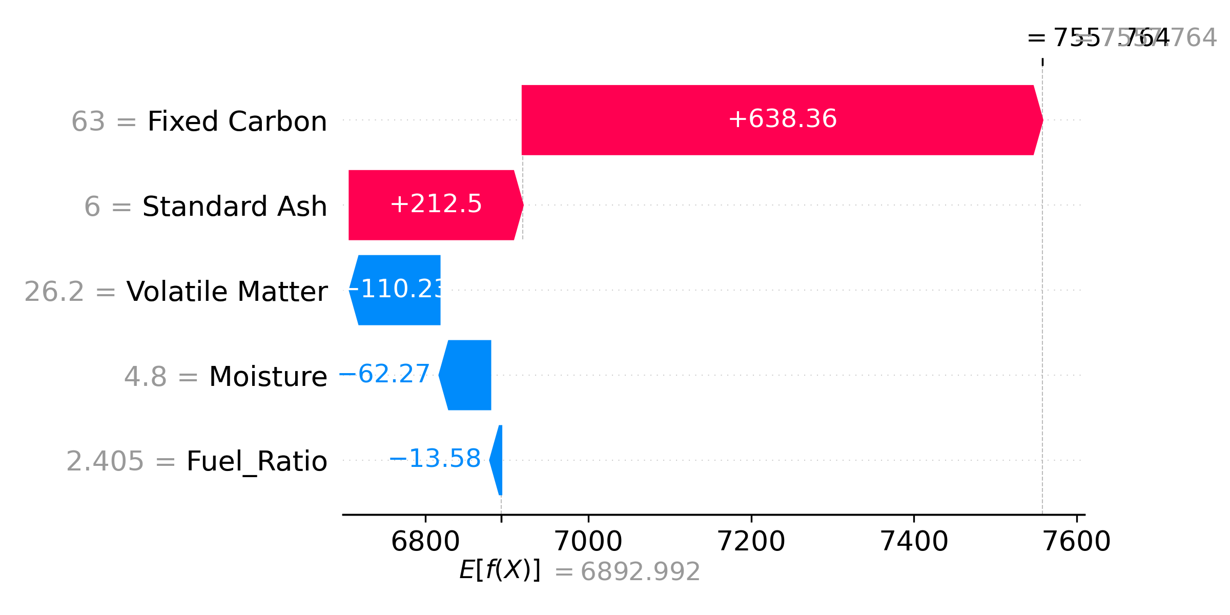
EXPLAINABILITY
Explaining Predictions (No Black Box)
Why Does the Model Guess What It Does?
• In industry, engineers need to understand why a model makes a prediction rather than just trusting a black-box number.
• We integrated SHAP, a method that breaks down how much each chemical feature contributed to the final score.
• The model's reasoning matches real chemistry:
• Moisture pulls energy down (it takes heat to boil water)
• Ash pulls energy down (rock/dirt does not burn)
• Carbon and Fuel Ratio push energy up (actual fuel)
• The graph on the right shows a sample prediction and how each feature pushed the value up (red) or down (blue).

Slide 9
CONCLUSION
Summary of Key Results
Final Performance Across 5-Fold Cross Validation:
Universal Model (All Coal Ranks):
• Average Error (RMSE): 150.28 Kcal/kg (Target was <= 200 Kcal/kg)
• Absolute Error (MAE): 105.97 Kcal/kg
• CV Score (Coefficient of Variation): 2.18% (Target was < 8.0%)
• Accuracy Score (R²): 0.96
Specialized Bituminous Coal Model:
• Average Error (RMSE): 134.18 Kcal/kg (-16.10 Kcal/kg improvement)
• Absolute Error (MAE): 96.29 Kcal/kg (Sub-100 error margin)
• CV Score (Coefficient of Variation): 1.91% (Sub-2% precision)
• Accuracy Score (R²): 0.95

