Slide 1
Federated Learning:
Secure or Not?
Anurag Ramesh
10/13/2026
ECE 59500 Project
Purdue University

Slide 2
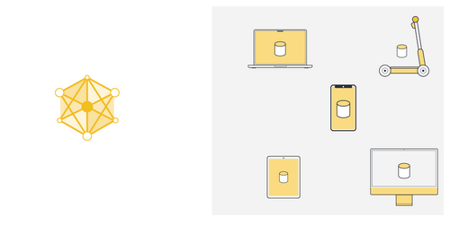
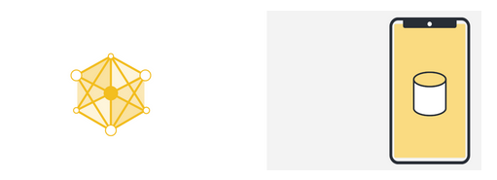
Standard Machine Learning
Model trained using a single source of data
Multiple sources for the same data class
https://flower.ai/docs/framework/tutorial-series-what-is-federated-learning.html#federated-learning

Slide 3
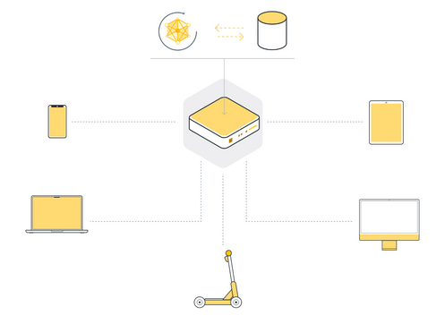
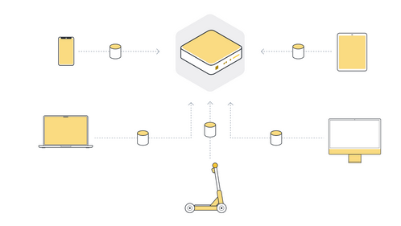
Standard Machine Learning
Data collected in a centralized server
Model trained using central server data
https://flower.ai/docs/framework/tutorial-series-what-is-federated-learning.html#federated-learning

Slide 4
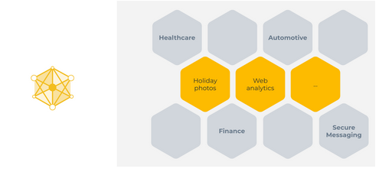
Standard Machine Learning: Limitations
There are many reasons why the centralized machine learning approach does not work:
Regulations
User Preference
Data Volume
Examples where centralized machine learning does not work include:
Sensitive healthcare data
Financial information from different organizations
Users care about privacy!!
https://flower.ai/docs/framework/tutorial-series-what-is-federated-learning.html#federated-learning

Slide 5
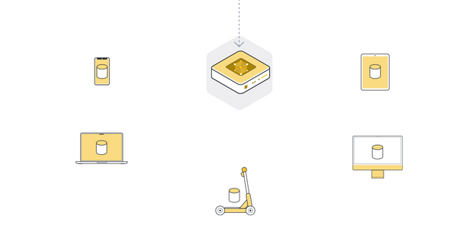
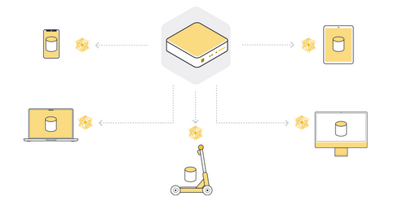
Federated Learning
Federated Learning simply reverses this approach. It enables machine learning on distributed data by moving the training to the data, instead of moving the data to the training.
Send model to connected organizations/devices (client nodes)
Train model locally on the data of each client node
https://flower.ai/docs/framework/tutorial-series-what-is-federated-learning.html#federated-learning
Notes:
Federated Learning simply reverses this approach. It enables machine learning on distributed data by moving the training to the data, instead of moving the data to the training.

Slide 6
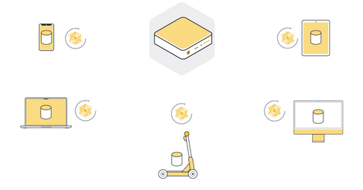
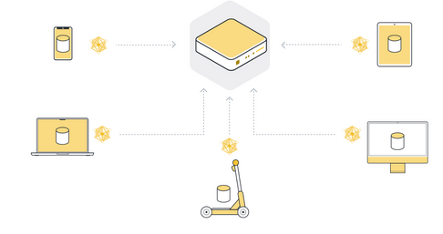
Federated Learning
Federated Learning simply reverses this approach. It enables machine learning on distributed data by moving the training to the data, instead of moving the data to the training.
Return model updates back to the server
Aggregate model updates into a new global model (Federated Averaging)
https://flower.ai/docs/framework/tutorial-series-what-is-federated-learning.html#federated-learning
Notes:
Federated Learning simply reverses this approach. It enables machine learning on distributed data by moving the training to the data, instead of moving the data to the training.

Slide 7
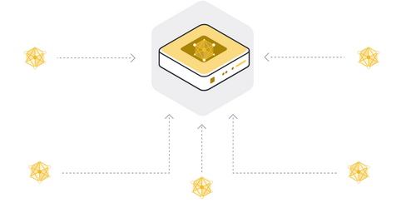
Federated Learning
Federated Learning simply reverses this approach. It enables machine learning on distributed data by moving the training to the data, instead of moving the data to the training.
Repeat steps 1 to 4 until the model converges
Also called 1 round of FL
https://flower.ai/docs/framework/tutorial-series-what-is-federated-learning.html#federated-learning
Notes:
Federated Learning simply reverses this approach. It enables machine learning on distributed data by moving the training to the data, instead of moving the data to the training.

Slide 8
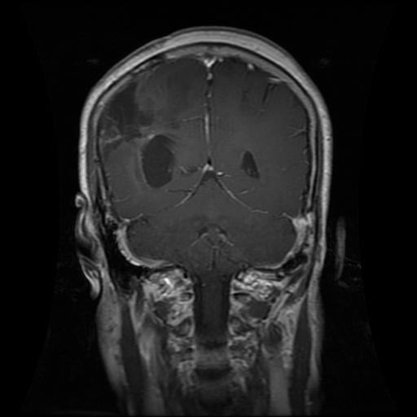
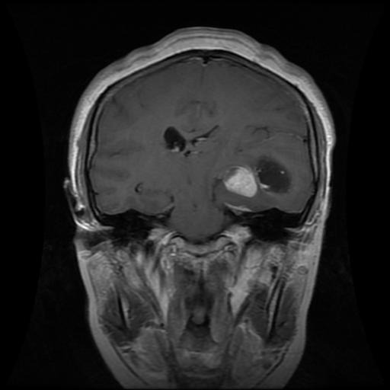
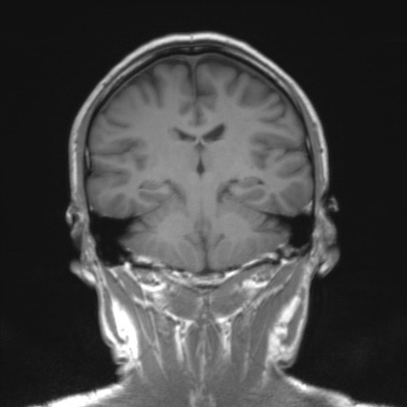
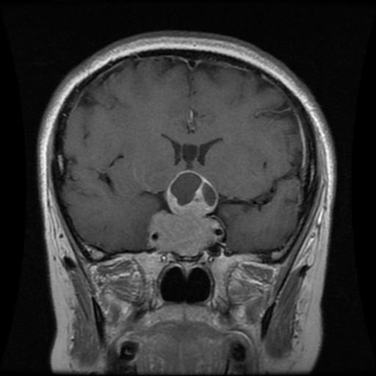
Security Of Federated Learning
We know that FL is privacy-preserving. But what about security? Let’s perform an experiment
Brain Tumor MRI – Dataset from Kaggle. Each type has images captured in four different angles. One of them is presented here
Glioma
Meningioma
No Tumor
Pituitary
https://www.kaggle.com/datasets/masoudnickparvar/brain-tumor-mri-dataset
Notes:
Federated Learning simply reverses this approach. It enables machine learning on distributed data by moving the training to the data, instead of moving the data to the training.

Slide 9
Data Distribution and Model Training
Three simulated hospitals train one tumour classifier with Flower federated averaging.
Data: 5,712 training scans split IID across the 3 clients; 1,311 held-out test scans
Input: 64 × 64 grayscale, small enough to encrypt every weight each round
Model: 2-layer CNN with 0.53 M parameters
Training: 10 rounds, 2 local epochs per round (Adam)
Round 7 is a capture round: each client sends one SGD step on one image (FedSGD)
A non-IID split (one tumour type per client) is implemented; the results shown use IID
3
clients (hospitals)
10
federated rounds
0.53 M
model parameters
93.5 %
test accuracy (plaintext)
Brain Tumor MRI dataset (Kaggle, Nickparvar) · Flower federated learning framework
Notes:
Three hospitals hold disjoint parts of the Kaggle brain-tumour MRI set. We train one CNN with federated averaging for 10 rounds. The images are 64 by 64 grayscale so that every weight can be encrypted each round. Round 7 is the round the server attacks: clients send a single SGD step on one image.

Slide 10
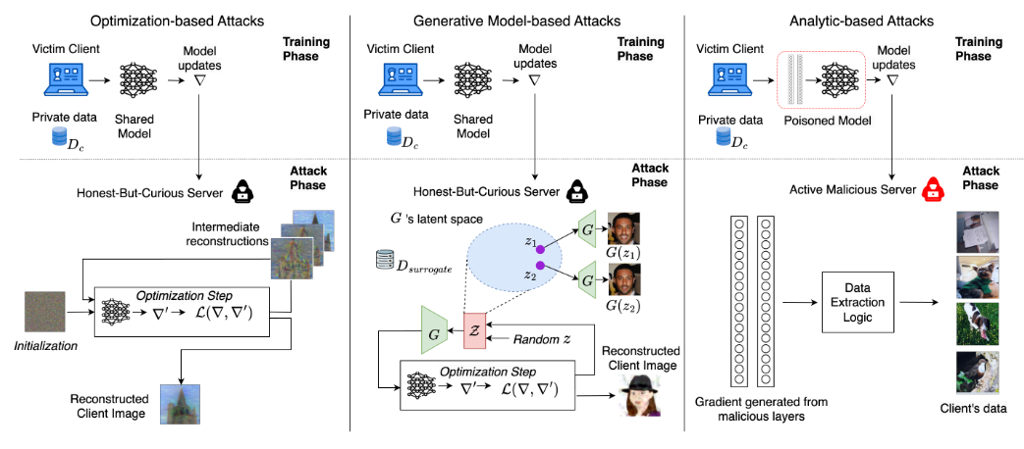
Security Threat: Gradient Inversion Attack
GIAs operate directly during the training process by exploiting shared updates to reconstruct complete
training samples.
https://www.usenix.org/system/files/usenixsecurity25-carletti.pdf
Notes:
Federated Learning simply reverses this approach. It enables machine learning on distributed data by moving the training to the data, instead of moving the data to the training.

Slide 11
Previous Work on GIA
2019
2020
2020
Ours
DLG
Zhu, Liu, Han · NeurIPS
Optimizes a dummy image and label until their gradient matches the shared one (L‑BFGS, Euclidean distance)
iDLG
Zhao, Mopuri, Bilen
Reads the true label directly from the last layer's gradient, so only the image is optimized
Inverting Gradients
Geiping et al. · NeurIPS
Cosine-similarity matching plus a total-variation image prior; works on trained networks
This work
ECE 59500 project
Combines the iDLG label, the exact input of the first fully connected layer, and cosine + TV matching, on brain MRI
Zhu et al., NeurIPS 2019 · Zhao et al., arXiv:2001.02610 · Geiping et al., NeurIPS 2020 · Carletti et al., USENIX Security 2025
Notes:
Gradient inversion started with DLG, which optimizes a fake image and label until their gradient matches. iDLG showed the label can be read off the last layer's gradient. Geiping et al. switched to cosine similarity with a total-variation prior. Our attack combines these with the exact recovery of the first fully connected layer's input.

Slide 12
How the Server Attacks One Update
1
Recover the gradient
$$g=\frac{w_{global}−w_{client}}{η}$$
the client took exactly one SGD step
What the server knows
The global weights it sent
The weights the client returned
The round's settings, which it chose: one SGD step, one image, step size 0.01
Not the image, and not the label
2
Recover the label (iDLG)
$$\hat{y}=\underset{c}{argmin}\frac{∂ℒ}{∂b_{c}}$$
only the true class's bias gradient is negative
Recover the features
3
$$h=\frac{{\left(∇_{b}ℒ\right)}^{⊤}∇_{W}ℒ}{{\left\|∇_{b}ℒ\right\|}^{2}}$$
input of the first FC layer, exact for one image
4
Recover the image
ϕ(x): first FC layer's input for the dummy image x · TV: total variation
$$\min_{x}\left[1−cos\left(∇_{θ}ℒ(x,\hat{y}),g\right)+\frac{{\left\|ϕ(x)−h\right\|}^{2}}{{\left\|h\right\|}^{2}}+λ_{TV}TV(x)\right]$$
Zhao et al., arXiv:2001.02610 · Geiping et al., NeurIPS 2020 · code: src/gia_attack.py
Notes:
The server is honest but curious: it follows the protocol but looks at what it receives. Because the client took exactly one SGD step, the difference between the weights it sent and the weights it got back is the gradient times the step size. From that gradient it reads the label, recovers the first fully connected layer's input exactly, and then optimizes an image whose gradient matches.

Slide 13
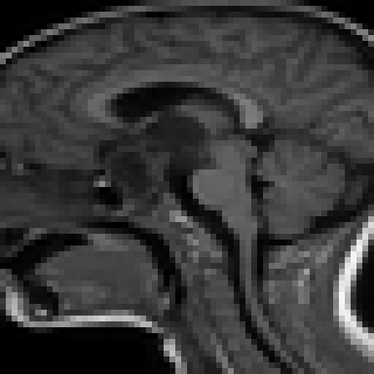
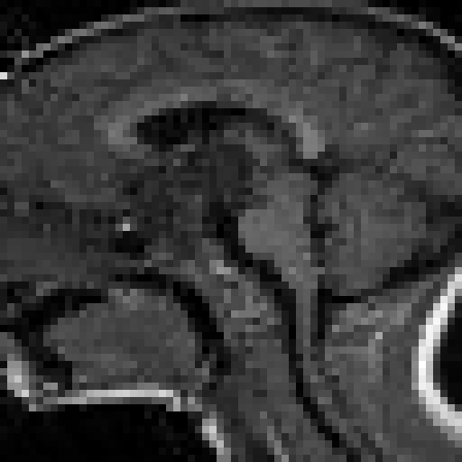
Results: Gradient Inversion on Plaintext FL
26.9 dB
PSNR against the real scan
0.83
SSIM (1.0 = identical)
No tumor
label recovered, correctly
42 s on a laptop CPU
Client 0's private scan (round 7)
Server's reconstruction, from the update alone
Results: src/FL_Privacy_Attacks_MRI.ipynb · the attacker never sees the real scan; it is used only to score
Notes:
This is the update from client 0 in the capture round. On the left the private scan, on the right what the server rebuilt from the update alone. PSNR 26.9 dB and SSIM 0.83 against the real scan, and the label is recovered correctly. It took about 40 seconds on a laptop CPU.

Slide 14
Enhancing Security: Fully Homomorphic Encryption
CLIENT · secret key
Encrypt the update
SERVER · public key only
Average the ciphertexts
CLIENT · secret key
Decrypt the new model
Every weight is packed into CKKS ciphertexts, 4,096 values each
$$Enc(w)=\sum_{k}{\frac{n_{k}}{n}}Enc(w_{k})$$
Clients share one key pair and decrypt the global model to keep training
One scalar multiply per update, then additions. Nothing is decrypted.
CKKS
scheme (TenSEAL)
8,192
polynomial degree N
142
ciphertexts per update
45.3 MB
upload per client per round
Other defences: differential privacy (noise on updates) and secure aggregation (masked updates).
Cheon, Kim, Kim, Song, CKKS, ASIACRYPT 2017 · TenSEAL: github.com/OpenMined/TenSEAL
Notes:
With CKKS, each client encrypts its whole update under a shared public key. The server only ever holds ciphertexts and the public key; it computes the weighted average homomorphically and sends back a ciphertext. Only clients, who hold the secret key, can decrypt. Each update becomes 142 ciphertexts, about 45 MB.

Slide 15
Results: Fully Homomorphic Encryption
93.5 % → 93.2 %
test accuracy, plaintext → FHE
2.0 → 45.3 MB
upload per client per round (22×)
100 → 120 s
training time, 10 rounds
Results: src/FL_Privacy_Attacks_MRI.ipynb (3 clients, IID, 10 rounds, CPU)
Notes:
Encryption does not change learning: the two curves track each other, and the final test accuracy is 93.5 percent in plaintext and 93.2 with FHE. The cost is communication, 22 times more upload per round, and about 20 percent more training time.

Slide 16
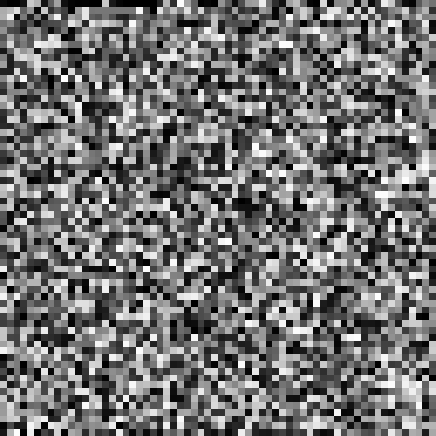
Results: Gradient Inversion Under FHE
Client 0's private scan
Plaintext FL: rebuilt (PSNR 26.9 dB)
FHE FL: 45.3 MB of CKKS ciphertext
Server's decrypt attempt: ValueError: the current context of the tensor doesn't hold a secret_key
Results: src/FL_Privacy_Attacks_MRI.ipynb · right panel: the first 4,096 bytes of client 0's first ciphertext
Notes:
Same private scan, same capture round, now with encryption. The plaintext server rebuilt the scan; the FHE server holds only ciphertext, shown here as raw bytes, and TenSEAL refuses to decrypt it because the server's context has no secret key. There is nothing to invert.

Slide 17
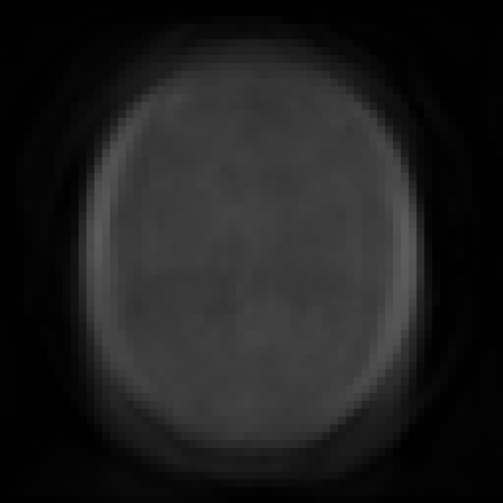
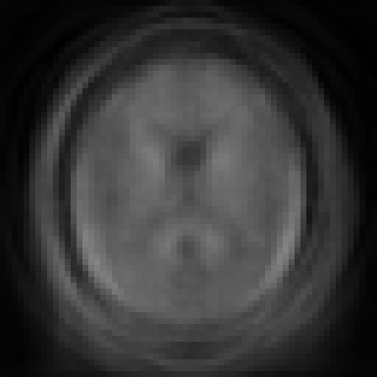
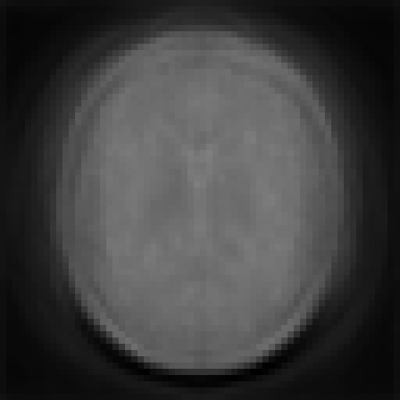
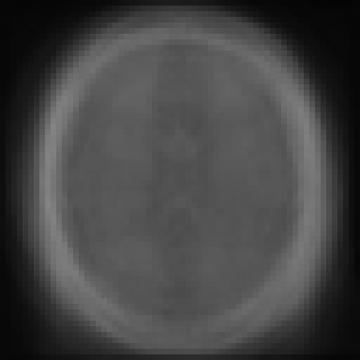
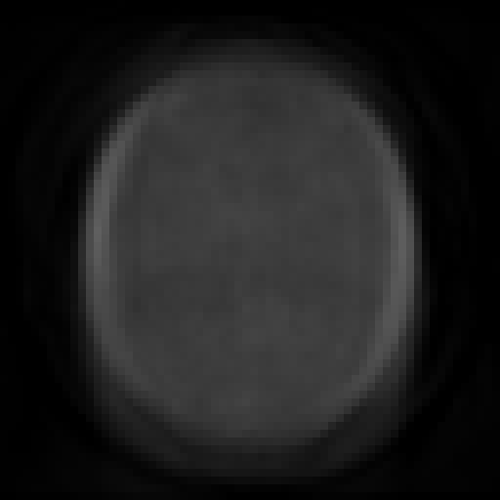
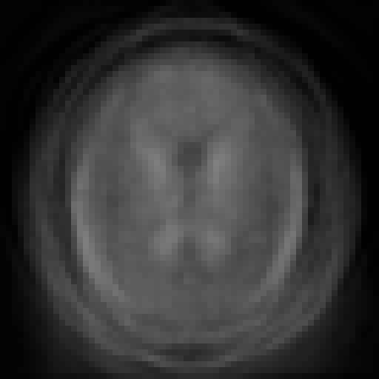


Model Inversion Still Works Under FHE
Glioma
Meningioma
No tumor
Pituitary
Attack accuracy
independent classifier
3 / 4 plaintext
4 / 4 FHE
Clients decrypt the final model to use it, so FHE no longer applies.
These are class prototypes, not specific patients.
Plaintext FL
✓ glioma
✗ no tumor
✓ no tumor
✓ pituitary
FHE FL
✓ glioma
✓ meningioma
✓ no tumor
✓ pituitary
Zhang et al., The Secret Revealer, CVPR 2020 · prior: PCA of the held-out Testing scans · Results: src/FL_Privacy_Attacks_MRI.ipynb
Notes:
After training, every client decrypts the final model to use it, so encryption no longer protects it. Searching a PCA space of public scans for images the model assigns to each class gives these prototypes. An independent classifier recognizes 3 of 4 from the plaintext model and 4 of 4 from the FHE model, which shows the leak is the same either way. They are class prototypes, not specific patients.

Slide 18
Conclusion
1
2
3
Plaintext FL leaks the data
A single-image update let the server rebuild a private MRI scan (PSNR 26.9 dB, label correct).
CKKS stops the server
It averages ciphertexts it cannot read. Accuracy holds (93.2 % vs 93.5 %); uploads grow 22×.
FHE ends at the final model
Clients decrypt the model, and model inversion recovers class prototypes from both.
Limitations and next steps
One shared key: a client colluding with the server can decrypt; threshold or multi-key HE would close that gap
Shown for one-image FedSGD updates; multi-epoch FedAvg updates leak far less to this attack
Protect the released model as well, for example with differential privacy during training
Code and results: github.com/anurag-r20/Quantum-Federated-Learning
Notes:
Three takeaways. Plaintext federated learning leaks: one update was enough to rebuild a scan. CKKS encryption stops the server at no cost in accuracy but 22 times more communication. And FHE stops at the final model, which still leaks class information. Next steps: avoid the single shared key and add differential privacy for the released model.

