Slide 1
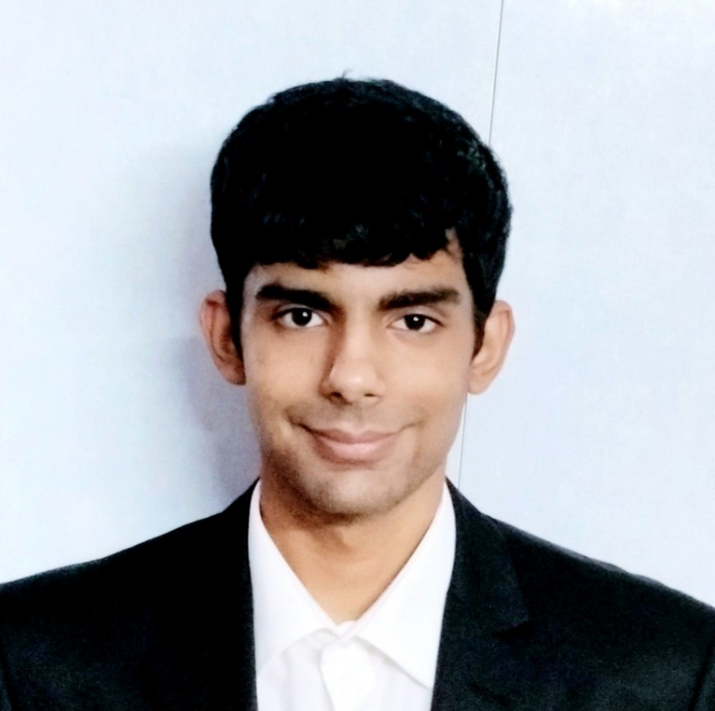


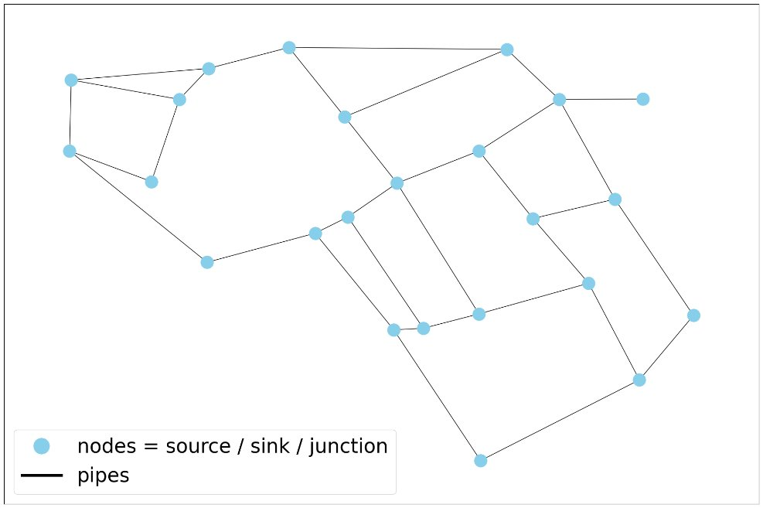
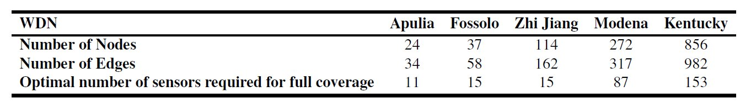


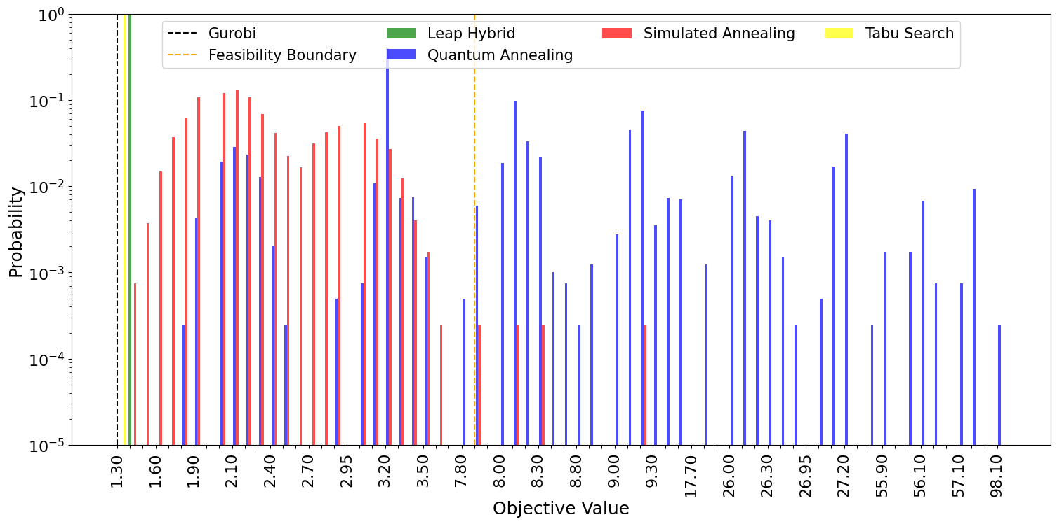
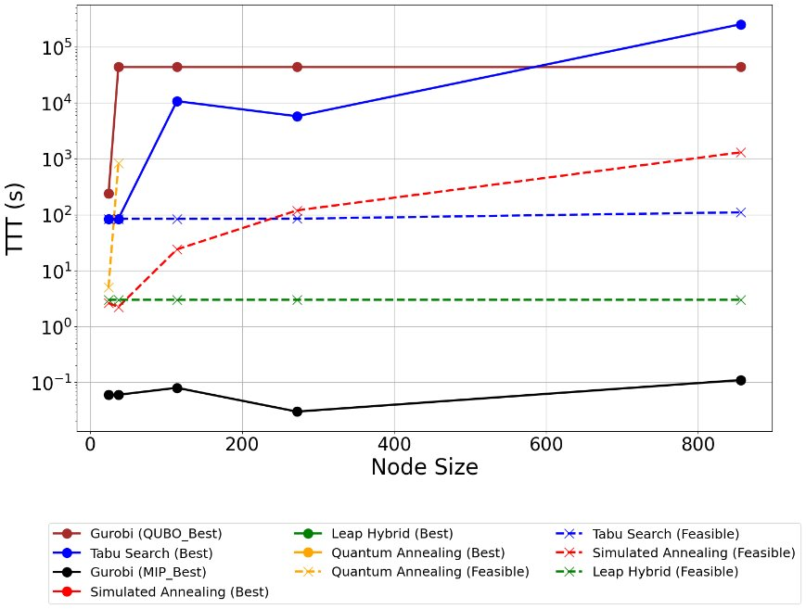
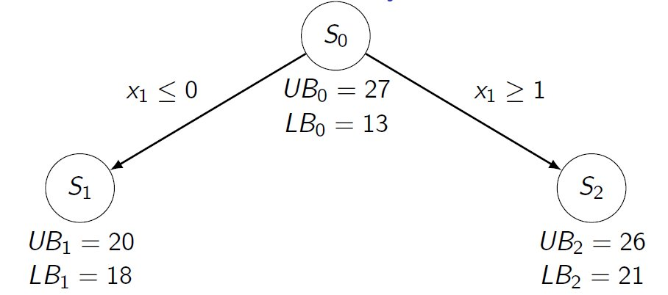
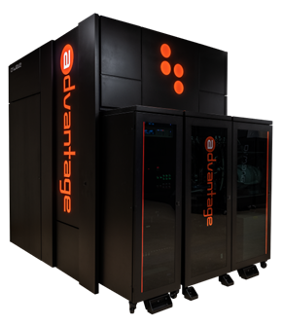
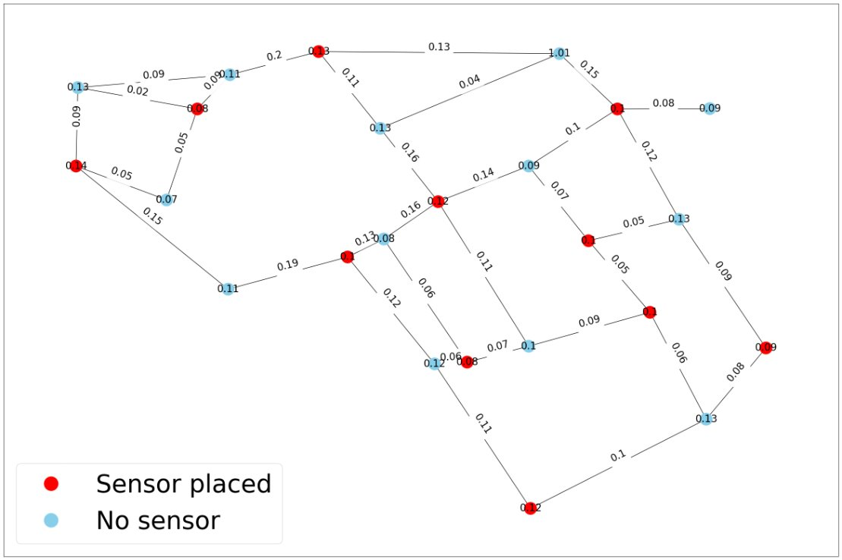
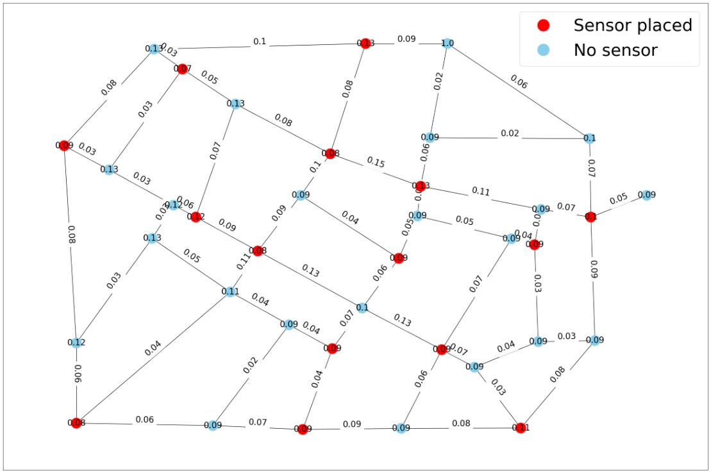
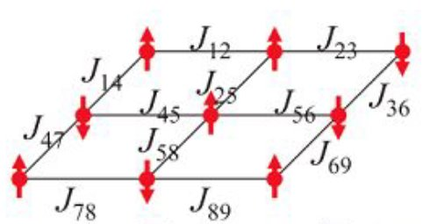
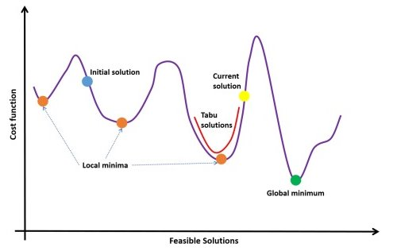
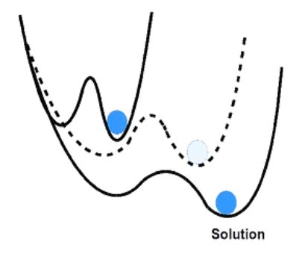
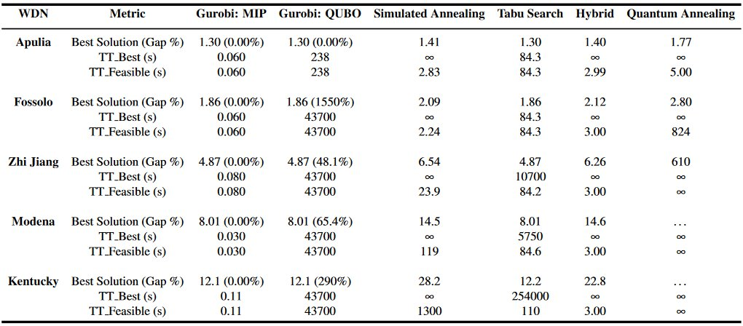
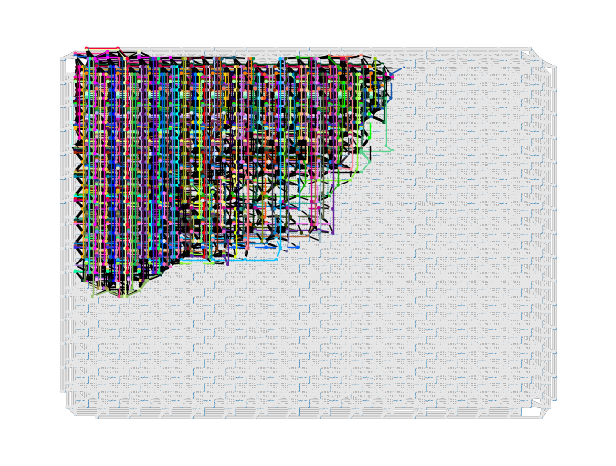
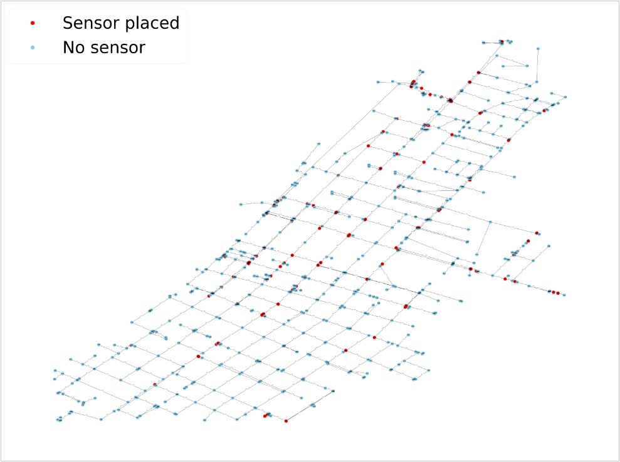
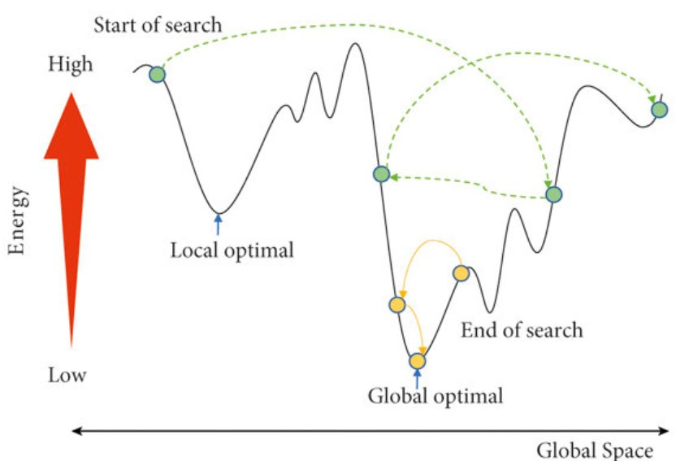
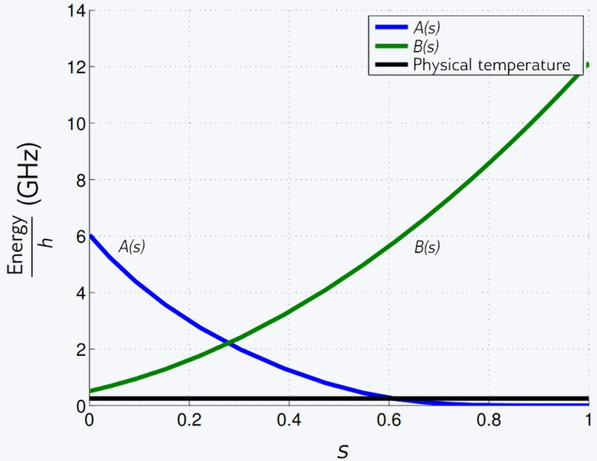
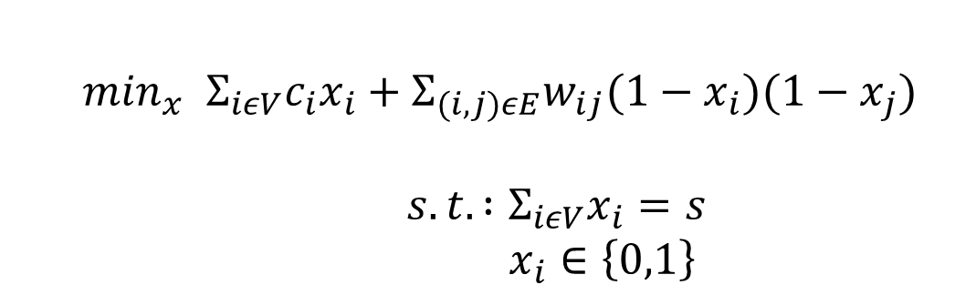

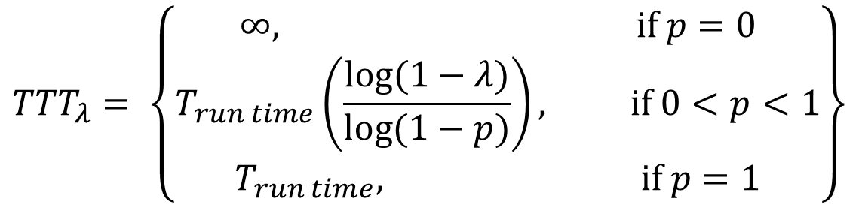
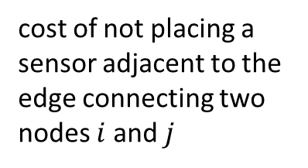

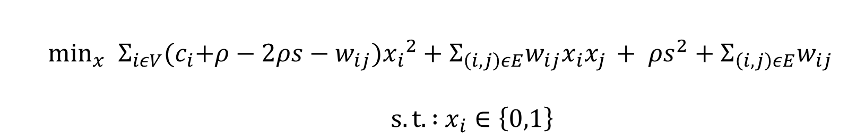
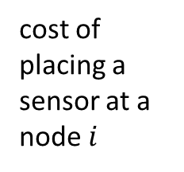
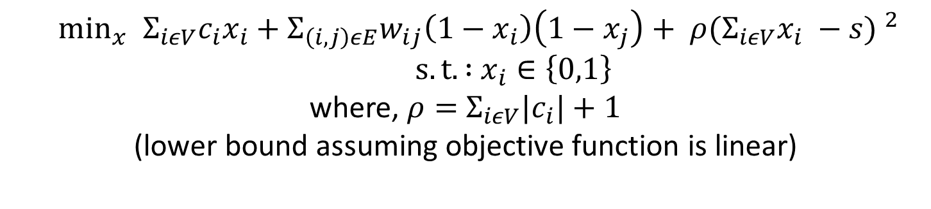

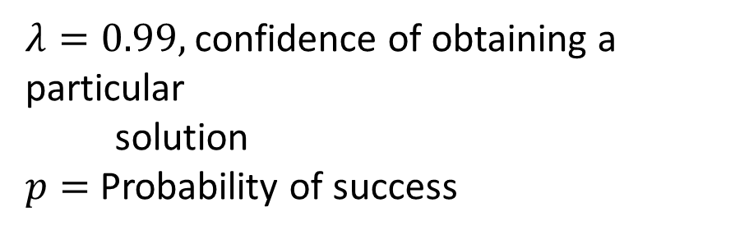
Optimizing Sensor Placement in Real Water Distribution Networks using Classical
and Quantum Optimization Algorithms
Anurag Ramesh ª , David E. Bernal Neira ª
ª Purdue University
f
Motivation and Problem Statement
Optimization Formulations
Performance Metrics
f
Water distribution systems are networks that connect nodes (or vertices) with pipes (or edges) to deliver water to customers ^{[2]}.
Therefore, leaks in Water Distribution Networks (WDNs) can result in substantial economic losses and squander essential resources ^{[1]}.
To effectively monitor WDNs to prevent failures, heavy strategic placing of pressure sensors is crucial.
In this work, the optimal sensor placement problem is first formulated as a Mixed Integer Program (MIP) ^{[1]}
To reformulate the MIP into a Quadratic Unconstrained Binary Optimization (QUBO) problem, the constraint is penalized and incorporated into the objective function
Expanding and simplifying terms, we have the QUBO problem as follows:
The QUBO problem is the native formulation for the Quantum Annealer
Performance Metrics
Time To Target (TTT)
Objective Solution
TT_Best
($≤$1$\%$ Gurobi)
TT_Best
(≤1% Gurobi)
TT_Feasible
Best
Feasible
cost of placing a sensor at a node $i$
cost of not placing a sensor adjacent to the edge connecting two nodes $i$ and $j$
binary decision variable
Measures the time taken to obtain the solution with 99% confidence.
$$\min_{x}{ }Σ_{iεV}c_{i}x_{i}+Σ_{(i,j)εE}w_{ij}(1−x_{i})(1−x_{j})$$
$s.t. :Σ_{iεV}x_{i}=s$
$x_{i}∈\left\{0,1\right\}$
$${TTT}_{λ}= \left\{\begin{aligned}∞, if p=0 \\ T_{run time}\left(\frac{log(1−λ)}{log(1−p)}\right), if 0<p<1 \\ T_{run time}, if p=1\end{aligned}\right\}$$
total number of sensors
(predefined)
$$\min_{x}{ }Σ_{iεV}c_{i}x_{i}+Σ_{\left(i,j\right)εE}w_{ij}\left(1−x_{i}\right)\left(1−x_{j}\right)+ ρ{(Σ_{iεV}x_{i} −s) }^{2}$$
$s.t. :$ $x_{i}∈\left\{0,1\right\}$
where, $ρ=$ $Σ_{iεV}{|c}_{i}|+1$
(lower bound assuming objective function is linear)
$λ=0.99,$confidence of obtaining a particular
solution
$p=$ Probability of success
Scalar penalty constant
Apulia WDN ^{[4]}
$$\min_{x}{ }Σ_{iεV}{(c}_{i}+ρ−2ρs−w_{ij}){x_{i}}^{2}+Σ_{\left(i,j\right)εE}w_{ij}x_{i}x_{j }+ ρs^{2}+Σ_{\left(i,j\right)εE}w_{ij}$$
$s.t. :$ $x_{i}∈\left\{0,1\right\}$
In this work, the optimal sensor placement in WDN’s is represented as a graph optimization problem $G(V,E)$ where $V$ represents the nodes in the WDN, and $E$ represents the pipes connecting the nodes.
Identifying critical nodes and edges in the WDN can improve fault detection and response as well as prioritization of upgrades and maintenance. Moreover, this will ensure that sensors are placed near the critical components of the network.
To achieve the above, the edge betweenness and node degree centrality metrics are used.
The edge betweenness centrality metric is defined as^{[2]}:
$$w_{ij}^{l}=Σ_{i≠l≠j∈V} \frac{{ σ}_{i,j(l)}}{{ σ}_{i,j}}$$
The node degree centrality metric is defined as ^{[2]}:
$$C_{D}=\frac{\deg\left(i\right)}{N−1}$$
Networkx ^{[10]} is used (https://networkx.github.io/) for network models and graphs.
Many exact and heuristic solvers exist for solving optimal sensor placement problem in WDNs.​
The current literature lacks comprehensive performance comparisons of these optimization solvers based on the performance metrics
To compare the performance of five different optimization solvers:​
Gurobi31, (Exact solver)​
dwave-neal Simulated Annealing sampler​
dwave-tabu Tabu Search Sampler​
D-Wave Leap Hybrid Quantum-Classical solver​
D-Wave Advantage 4.1 Quantum Annealer
in achieving the best objective solution and Time to Target (TTT) when solving the optimal sensor placement problem in real Water Distribution Networks (WDNs).​
Results
F`
f
Optimization Methods
Branch and Bound ^{[10]}
D-Wave Advantage 4.1 ^{[8]}
Fossolo WDN , s = 37 ^{[4]}
$$H_{final}$$
Embedding for Zhi Jiang WDN on
D-Wave Advantage 4.1 Nodes = 114
Apulia WDN with weights, s = 11 ^{[4]}
Adiabatic Evolution ^{[13]}
f
Conclusions
References
Tabu Search ^{[12]}
f
Kentucky WDN , s = 153 ^{[4]}
Gurobi is the most effective solver among other solvers irrespective of the WDN size so far.​
Heuristic methods like Tabu Search are valuable alternatives and show promise for large-scale problems.​
The Hybrid solver primarily relies on classical techniques to solve larger problem sizes.​
Quantum Annealing, while novel and innovative, struggles with large-scale problems.​
S. Speziali et al., "Solving Sensor Placement Problems In Real Water Distribution Networks Using Adiabatic Quantum Computation," 2021 IEEE International Conference on Quantum Computing and Engineering (QCE), Broomfield, CO, USA, 2021, pp. 463-464, https://doi.org/10.1109/QCE52317.2021.00079
Giustolisi, O., Ridolfi, L., & Simone, A. (2019). Tailoring centrality metrics for water distribution networks. Water Resources Research, 55, 2348–2369. https://doi.org/10.1029/2018WR023966
A B Finnila, M A Gomez, C Sebenik, C Stenson, and J D Doll. Quantum annealing: a new method for minimizing multidimensional functions, 1994.
S Kirkpatrick, C D Gelatt, and M P Vecchi. Optimization by Simulated Annealing, 1983.URL https://www.science.org.
Hall, Ashley, "01 Apulia" (2021). International Systems. 1. https://uknowledge.uky.edu/wdst_international/1
Dandy, Graeme, "03 Fossolo" (2016). International Systems. 3. https://uknowledge.uky.edu/wdst_international/3
https://www.gurobi.com/documentation/current/refman/index.html
https://www.dwavesys.com
Rieffel, E.G. and Polak, W.H., 2011. Quantum computing: A gentle introduction. MIT Press.
Wolsey, L. A., Integer programming. John Wiley & Sons,. 2020.
Yang, Li., Research on Logistics Distribution Vehicle Path Optimization Based on Simulated Annealing Algorithm. Advances in Multimedia. 2022.​
José Brandão, A tabu search algorithm for the heterogeneous fixed fleet vehicle routing problem, Computers & Operations Research, 2011.
Tameem Albash and Daniel A. Lidar, Adiabatic quantum computation, Rev. Mod. Phys., 2018​
$${H\left(s\right)=A(s)H}_{init}+B\left(s\right)H_{final}$$
Heuristic Solvers
Simulated Annealing ^{[4, 11]}
Annealing Schedule ^{[8]}
CQT Meeting 2024 | November 13-14, 2024, | Indiana University, Bloomington, IN

