Slide 1

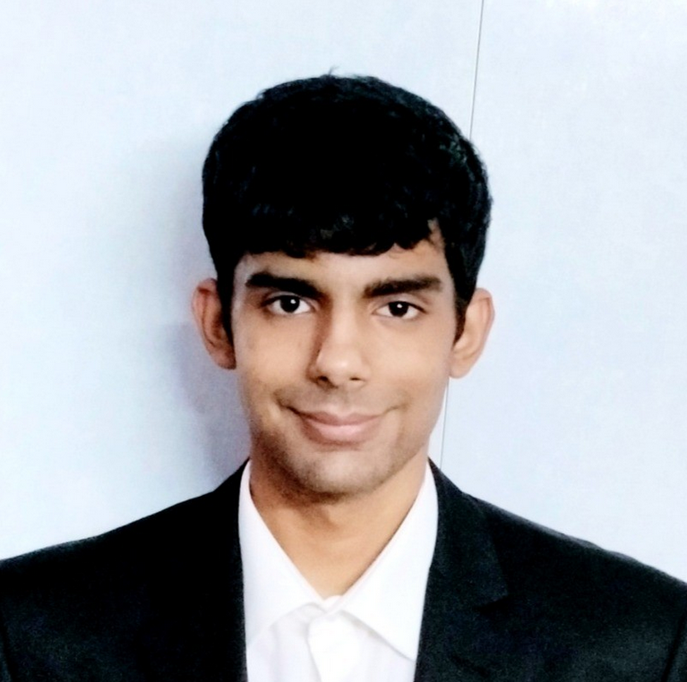




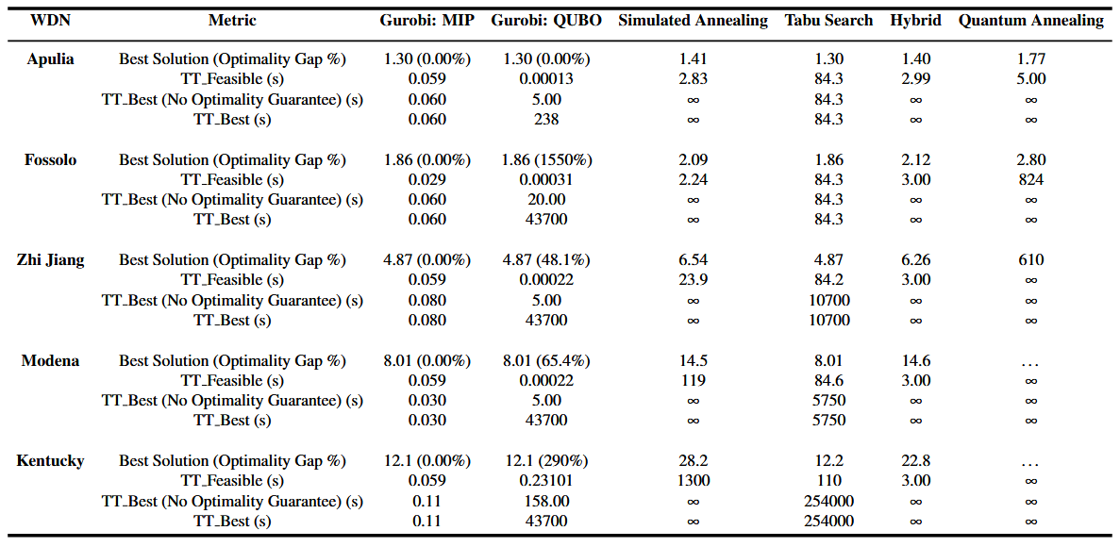
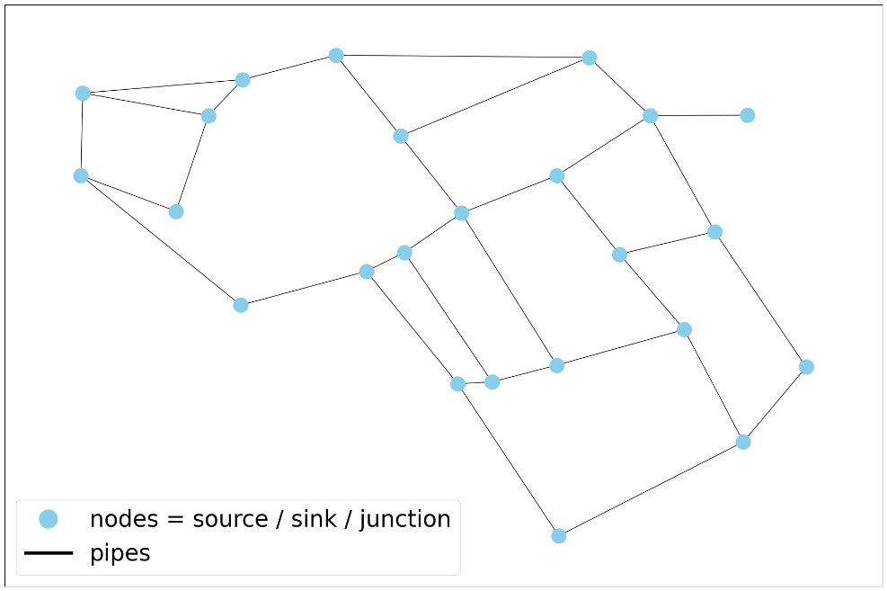
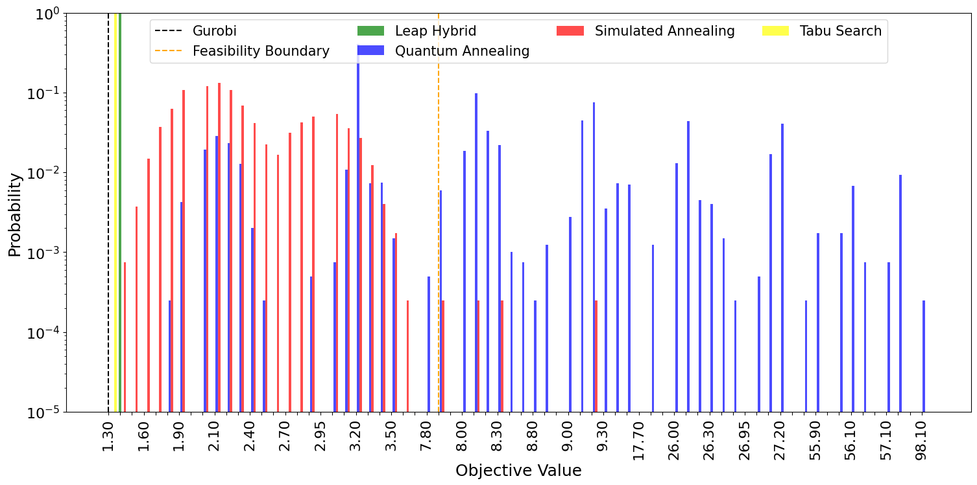
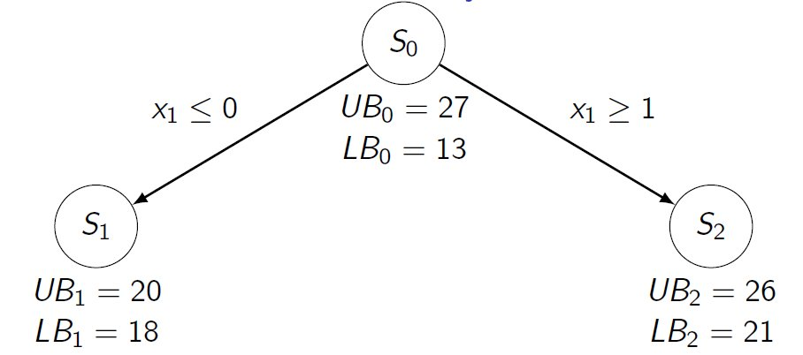
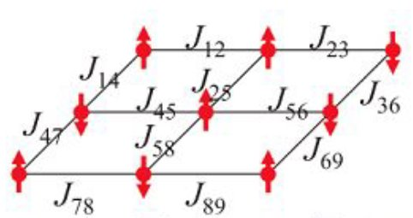
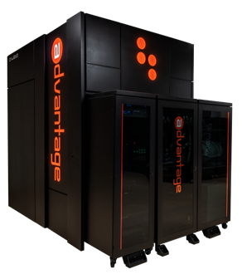
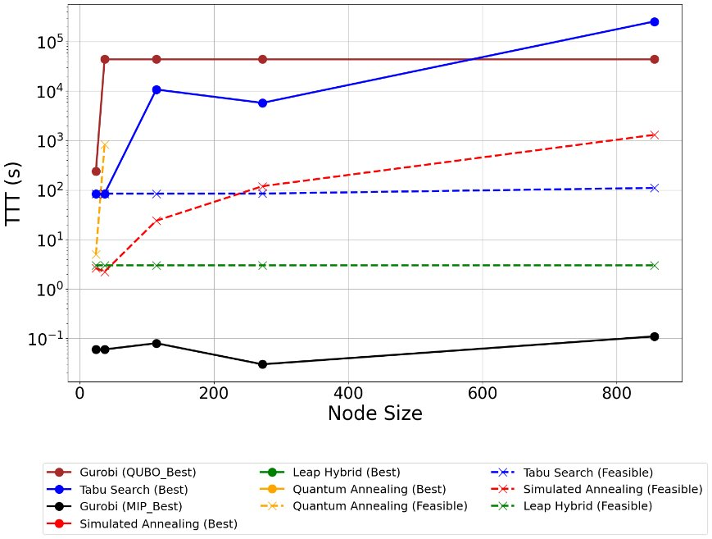
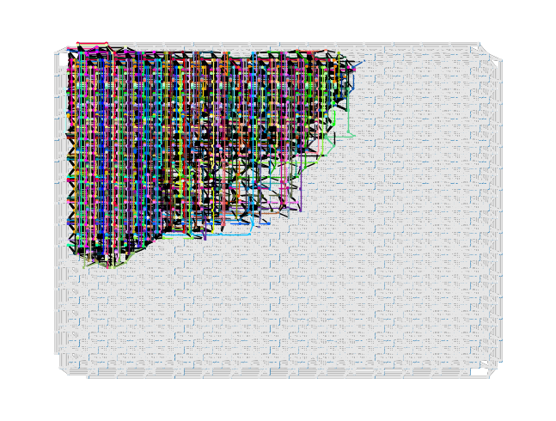
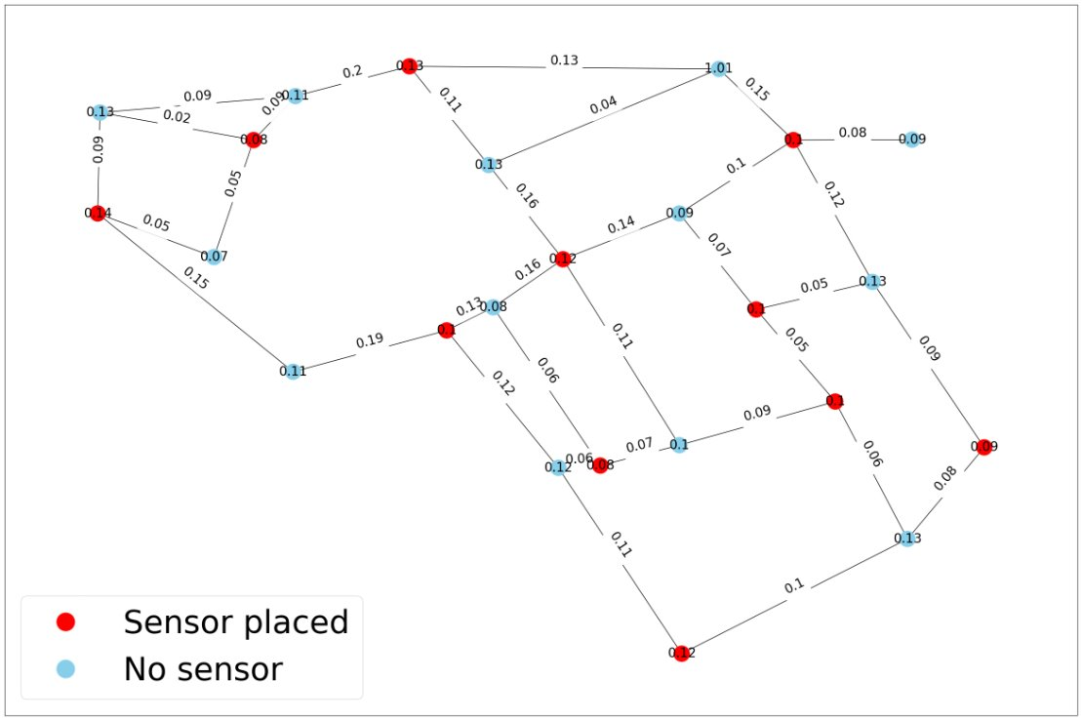
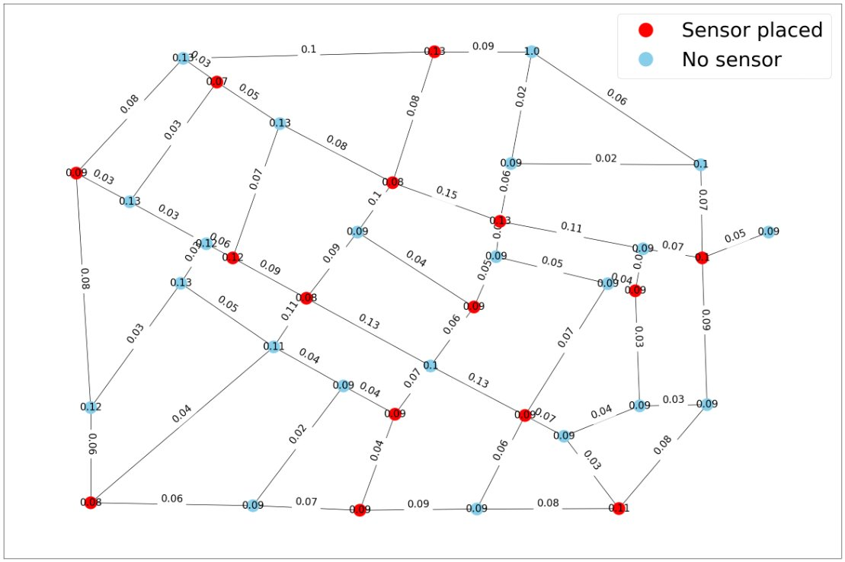
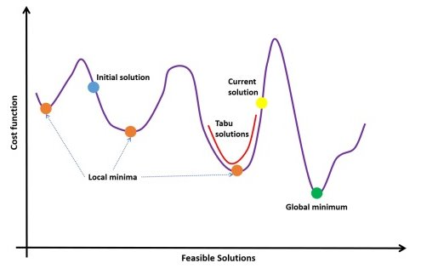
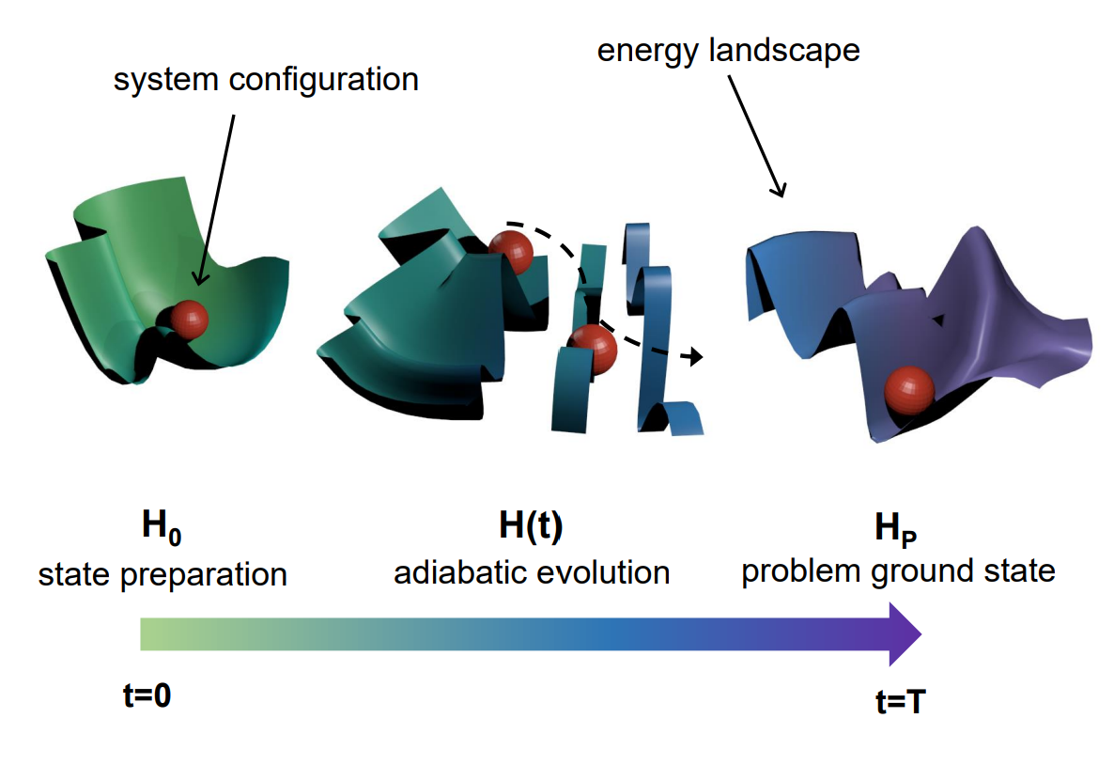
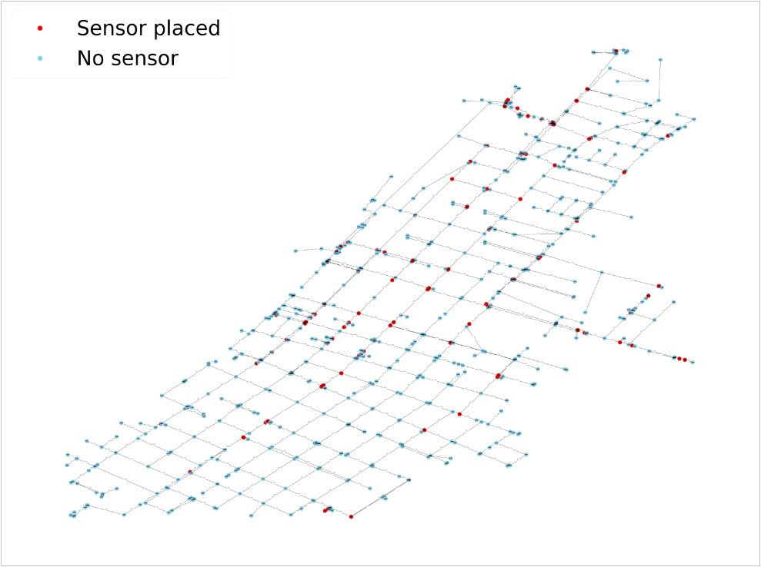
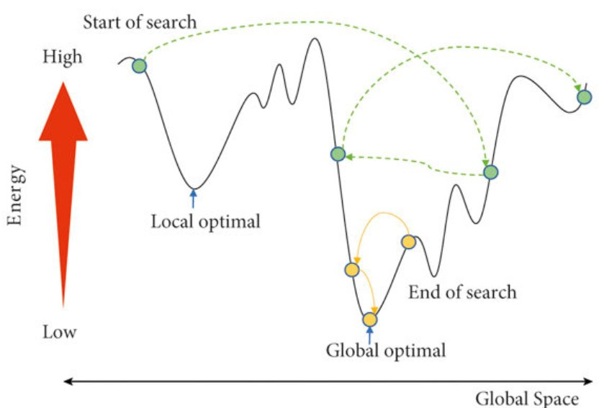
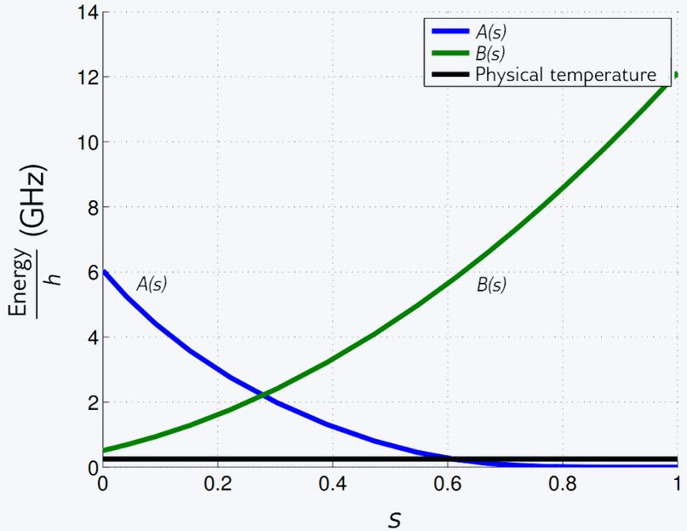

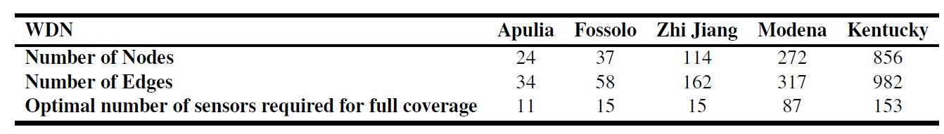
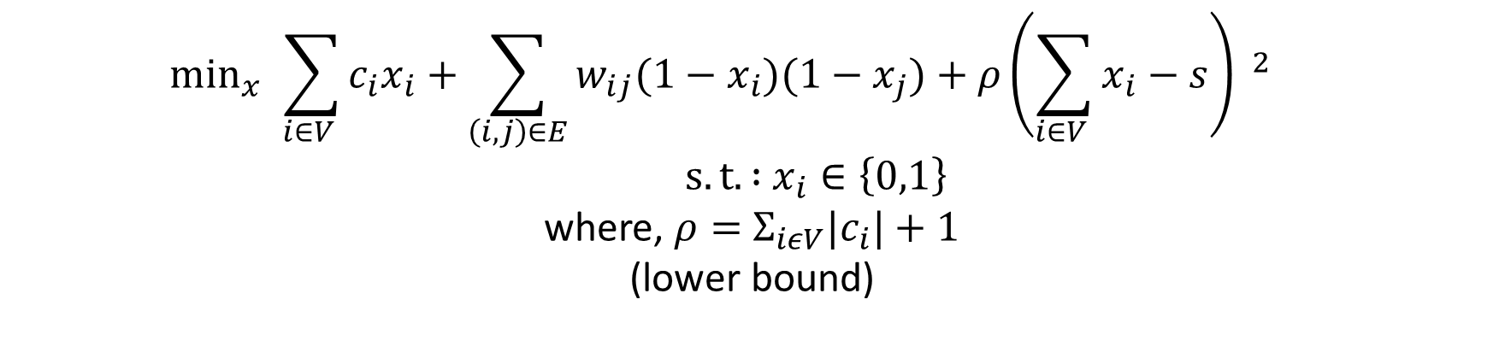
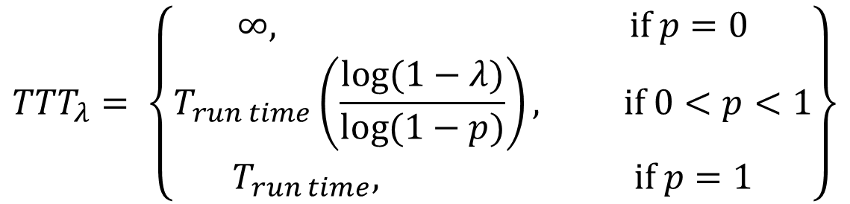
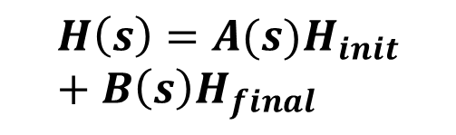

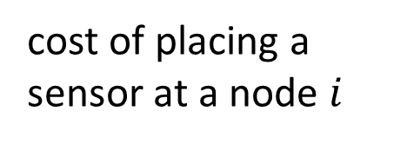
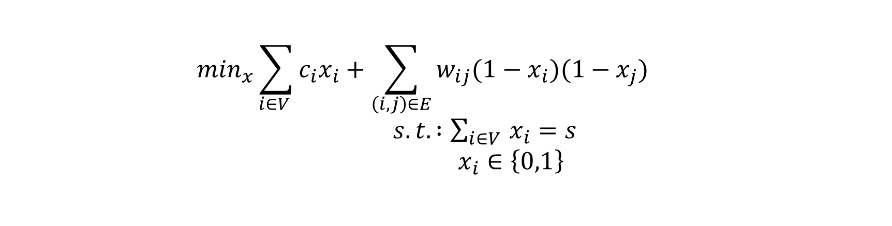
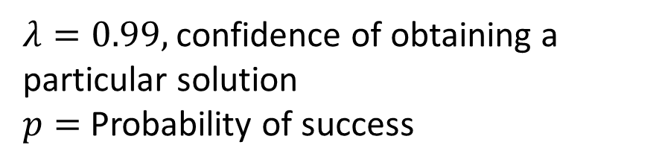
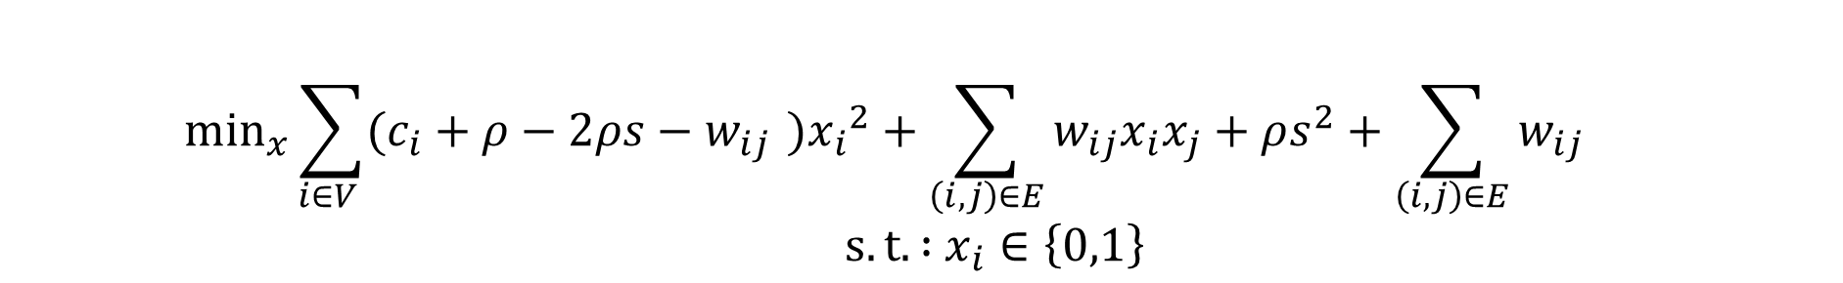
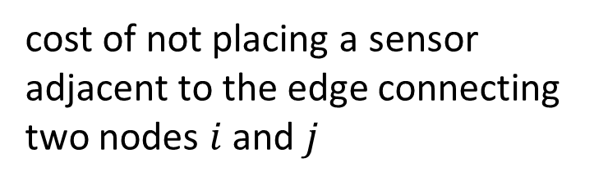
Quadratic Knapsack Problem : A QUBO Based Approach for
Optimal Sensor Placement in Water Distribution Networks
                Anurag Ramesh, David E. Bernal Neira
Davidson School of Chemical Engineering, Purdue University
Motivation and Problem Statement
Optimization Formulations
Results
f
f
Water distribution systems are networks that connect nodes (or vertices) with pipes (or edges) to deliver water to customers ^{[2]}.
Therefore, leaks in Water Distribution Networks (WDNs) can result in substantial economic losses and squander essential resources ^{[1]}.
To effectively monitor WDNs to prevent failures, heavy strategic placing of pressure sensors is crucial.
In this work, the optimal sensor placement problem is first formulated as a Mixed Integer Program (MIP) ^{[1]}
To reformulate the MIP into a Quadratic Unconstrained Binary Optimization (QUBO) problem, the constraint is penalized and incorporated into the objective function
Expanding and simplifying terms, we have the QUBO problem as follows:
The QUBO problem is the native formulation for the Quantum Annealer
cost of placing a sensor at a node $i$
cost of not placing a sensor adjacent to the edge connecting two nodes $i$ and $j$
binary decision variable
  $$\min_{x}\sum_{i∈V }{c_{i}x_{i}+\sum_{\left(i,j\right)∈E}{w_{ij}(1−x_{i})(1−x_{j})}}{ }$$
  $s.t. :\sum_{i∈V }{x_{i}}=s$
  $x_{i}∈\left\{0,1\right\}$
total number of sensors (predefined)
  $$\min_{x}{ }\sum_{i∈V }{c_{i}x_{i}+\sum_{\left(i,j\right)∈E}{w_{ij}(1−x_{i})(1−x_{j})}}+ρ{\left(\sum_{i∈V }{x_{i}}−s\right) }^{2}$$
  $s.t. :$ $x_{i}∈\left\{0,1\right\}$
where, $ρ=$ $Σ_{iεV}{|c}_{i}|+1$
(lower bound)
Apulia WDN ^{[4]}
Scalar penalty constant
  $$\min_{x}\sum_{i∈V }{(c_{i}+ρ−2ρs−w_{ij}}{ }){x_{i}}^{2}+\sum_{\left(i,j\right)∈E}{w_{ij}x_{i}x_{j}}+ρs^{2}+\sum_{\left(i,j\right)∈E}{w_{ij}}$$
  $s.t. :$ $x_{i}∈\left\{0,1\right\}$
In this work, the optimal sensor placement in WDN’s is represented as a graph optimization problem $G(V,E)$ where $V$ represents the nodes in the WDN, and $E$ represents the pipes connecting the nodes.
Identifying critical nodes and edges in the WDN can improve fault detection and response as well as prioritization of upgrades and maintenance. Moreover, this will ensure that sensors are placed near the critical components of the network.
To achieve the above, the edge betweenness and node degree centrality metrics are used.
The edge betweenness centrality metric is defined as^{[2]}:
$$w_{ij}^{l}=Σ_{i≠l≠j∈V} \frac{{ σ}_{i,j(l)}}{{ σ}_{i,j}}$$
The node degree centrality metric is defined as ^{[2]}:
$$C_{D}=\frac{\deg\left(i\right)}{N−1}$$
To compare the performance of five different optimization solvers:​
  Gurobi, (Exact solver)​
  dwave-neal Simulated Annealing sampler​
  dwave-tabu Tabu Search Sampler​
  D-Wave Leap Hybrid Quantum-Classical solver​
  D-Wave Advantage 4.1 Quantum Annealer
in achieving the best objective solution and Time to Target (TTT) when solving the optimal sensor placement problem in real Water Distribution Networks (WDNs).​
Embedding for Zhi Jiang WDN on
D-Wave Advantage 4.1 Nodes = 114
F`
Optimization Methods
Branch and Bound ^{[10]}
D-Wave Advantage 4.1 ^{[8]}
Adiabatic Evolution ^{[13]}
Fossolo WDN , s = 37 ^{[4]}
Tabu Search ^{[12]}
Embedding for Zhi Jiang WDN on
D-Wave Advantage 4.1 Nodes = 114
$${H\left(s\right)=A(s)H}_{init}+B\left(s\right)H_{final}$$
Apulia WDN with weights, s = 11 ^{[4]}
f
f
Conclusions & Future Work
References
Kentucky WDN , s = 153 ^{[4]}
Simulated Annealing ^{[4, 11]}
Quantum Annealing Schedule ^{[8]}
QR to Code
Gurobi’s MIP formulation remains the most effective solver in terms of optimality guarantees, regardless of WDN size.
Tabu Search yielded the next best near-global optimal solution, followed by Simulated Annealing. While both Simulated and Quantum Annealing found feasible solutions, most samples from Quantum Annealing were infeasible, constrained by the feasibility boundary.
The Hybrid solver mainly uses classical techniques and performs better on larger problem instances.
Future work will explore decomposition methods, such as graph partitioning via divide-and-conquer, to address scalability.
Other quantum optimization methods, including QAOA, will be benchmarked using decomposition strategies and GPU acceleration.
S. Speziali et al., "Solving Sensor Placement Problems In Real Water Distribution Networks Using Adiabatic Quantum Computation," 2021 IEEE International Conference on Quantum Computing and Engineering (QCE), Broomfield, CO, USA, 2021, pp. 463-464, https://doi.org/10.1109/QCE52317.2021.00079
Giustolisi, O., Ridolfi, L., & Simone, A. (2019). Tailoring centrality metrics for water distribution networks. Water Resources Research, 55, 2348–2369. https://doi.org/10.1029/2018WR023966
A B Finnila, M A Gomez, C Sebenik, C Stenson, and J D Doll. Quantum annealing: a new method for minimizing multidimensional functions, 1994.
S Kirkpatrick, C D Gelatt, and M P Vecchi. Optimization by Simulated Annealing, 1983.URL https://www.science.org.
Hall, Ashley, "01 Apulia" (2021). International Systems. 1.
https://uknowledge.uky.edu/wdst_international/1
Dandy, Graeme, "03 Fossolo" (2016). International Systems. 3.
https://uknowledge.uky.edu/wdst_international/3
https://www.gurobi.com/documentation/current/refman/index.html
https://www.dwavesys.com
Rieffel, E.G. and Polak, W.H., 2011. Quantum computing: A gentle introduction. MIT Press.
Wolsey, L. A., Integer programming. John Wiley & Sons,. 2020.
Yang, Li., Research on Logistics Distribution Vehicle Path Optimization Based on Simulated Annealing Algorithm. Advances in Multimedia. 2022.​
José Brandão, A tabu search algorithm for the heterogeneous fixed fleet vehicle routing problem, Computers & Operations Research, 2011
Tameem Albash and Daniel A. Lidar, Adiabatic quantum computation, Rev. Mod. Phys., 2018​
.
Acknowledgement.
We gratefully acknowledge the Center for Quantum Technologies at Purdue University for their financial support of this work.. We also thank Gurobi Optimization (version 11.0.2) for providing a free academic license, and D-Wave for granting access to their quantum computing platform.
Performance Metrics
f
Heuristic Solvers
Performance Metrics
Time To Target (TTT)
Objective Solution
TT_Best ($≤1\%$ Gurobi optimum)
TT_Best (≤1% Gurobi optimum)
TT_Feasible
Best
Feasible
Measures the time taken to obtain the solution with 99% confidence.
$${TTT}_{λ}= \left\{\begin{aligned}∞, if p=0 \\ T_{run time}\left(\frac{log(1−λ)}{log(1−p)}\right), if 0<p<1 \\ T_{run time}, if p=1\end{aligned}\right\}$$
$λ=0.99,$confidence of obtaining a particular solution
$p=$ Probability of success
2025 AiChE Annual Meeting | November 4, 2025 | Boston, Massachusetts

