Slide 1
STRINGS – “Python”

Slide 2
CONTENT:
String – Definition
Properties of strings
Accessing of strings
String methods
Escape Characters

Slide 3
Strings:
These are in general a data type having sequence of characters present inside a single quote ‘ ’ , or double quote “ ”, or triple quote ‘“ ’’’
Definition:
Like many other popular programming languages, strings in Python are arrays of bytes representing Unicode characters. However, Python does not have a character data type, a single character is simply a string with a length of 1.
Ex., ‘aBc*@_12’ , “ a b C @ 123” , ‘“ @AbC*123_ . ’’’
Note: here characters includes space too

Slide 4
RULES FOR WRITING A STRING
we can use numbers 0–9
we can use alphabets a-z or A-Z
we can use special symbols including space !@#$%^&*_.

Slide 5
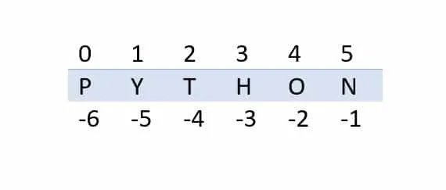
PROPERTIES OF STRING:
Strings are immutable. We can not manipulate the strings.
they can hold sequence of characters using, alphabets, numbers, symbols including space.
inside a string each character contains a INDEX value.
Index value starts from 0, 1,…………………..
We are having 2 types of INDEX VALUES.
Positive indexing which reads all the characters in a string from left to right starting with 0,1,…….
Negative indexing which reads all the characters in a string from right to left starting with -1,-2,……..

Slide 6
How to access characters in a string
Accessing is divided in to 2 types:
Single character accessing also known as INDEXING.
Multiple character accessing also known as SLICING.

Slide 7
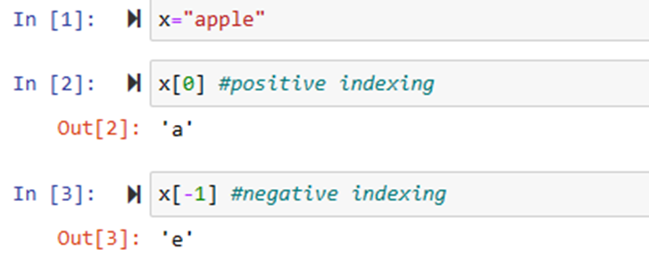
INDEXING :
Definition: In Python, indexing refers to the process of accessing a specific element in a sequence, such as a string or list, using its position or index number.
Syntax: Variable.name[Index_value]
Types of indexing :
Positive indexing - we use the positive
index value to access the character
2. Negative indexing - we use the negative
index value to do the same.

Slide 8
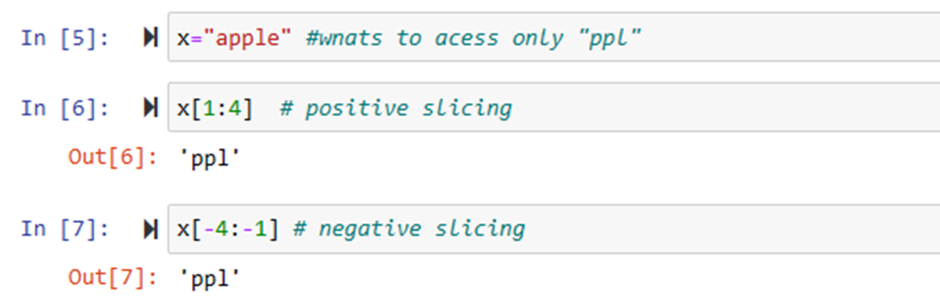
SLICING:
Definition: it is a function, “slice []” which returns a slice object.
We can get a range of characters by using the slicing & it is about obtaining a sub-string from given string by slicing it respectively from start to end .
Syntax : variable.name[starting index : ending index].
Slicing is of 2 types:
Positive slicing
Negative slicing

Slide 9
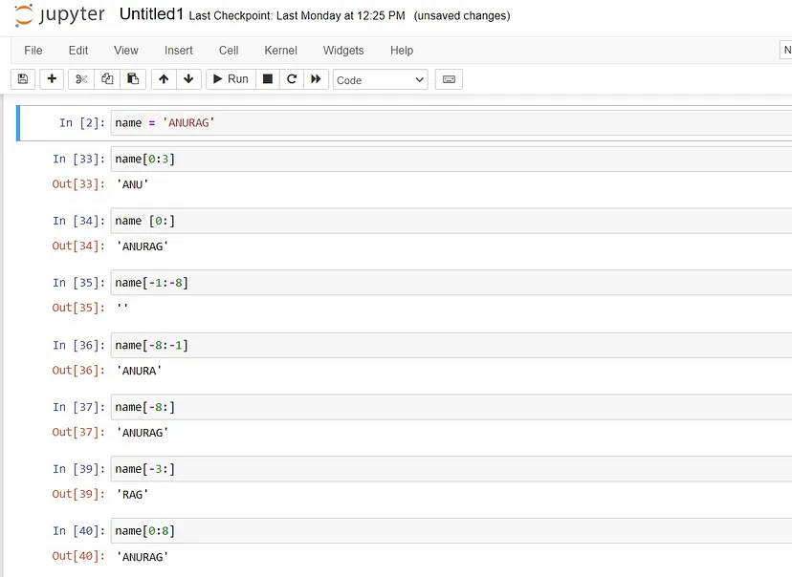
FEW EXAMPLES ON SLICING

Slide 10
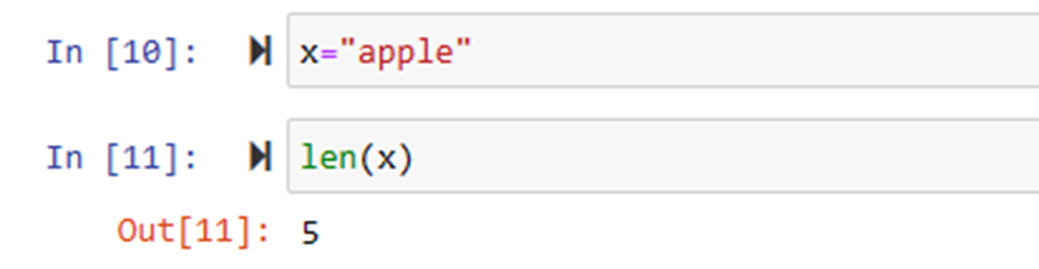
LENGTH FUNCTION
To know the length of sequential data we use built in function called length. It represented as len( ).
syntax: len(variable_name).
Note: length of an empty string is zero
Len(“”)=0
Thing to Note:
To concatenate the two different strings, we use the ‘+’ symbol.
For duplicating a string, we use the ‘*’ symbol.

Slide 11
STRING METHODS
A method is a function that “belongs to” an object.
Syntax: variable. Method()
Let’s get into the methods we perform on string.
Here comes the question, Since strings are immutable then how methods can be performed on string??
We perform methods on the string which gives a new string as an output but no way effects the actual string assigned to a variable.

Slide 12
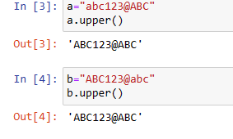
upper() - - is a string method used to convert all the lower case letters/alphabets to upper case and gives a new string .
Syntax : variable_name.upper()

Slide 13
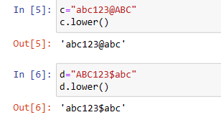
lower() - - is a string method used to convert all the upper case letters/alphabets to lower case and gives a new string .
Syntax : variable_name.lower()

Slide 14
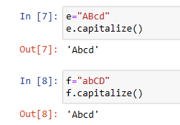
capitalize() - - is a string method used to capitalize the first letter in the string and rest all the characters to lower case().
If there exists a character other than alphabets then the first character gets no change and remaining all characters converts to lower case.
Syntax : variable_name.capitalize()

Slide 15
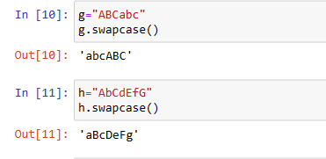
swapcase() - - It is a method used to convert upper case alphabets to lower case and lower case alphabets to upper case in a string.
Syntax: variable_name.swapcase()

Slide 16
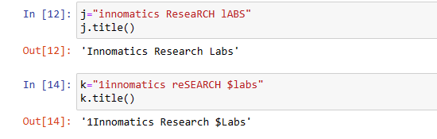
title() - - This method is used to convert each letter of the word in the string to upper case and rest all the letters to lower case.
Syntax: Variable_name.title()

Slide 17
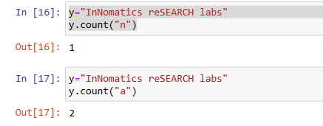
count() - - is a method used to count how many times a sequence of characters are present in a string.
Syntax: variable_name.count()

Slide 18
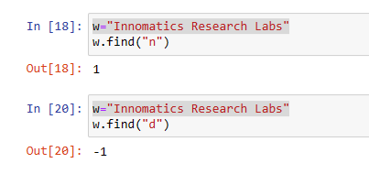
find() - - is a method by using which we can find the index value of the character or a sequence of characters at first instance or occurrence in a string.
Syntax: variable_name.find()

Slide 19
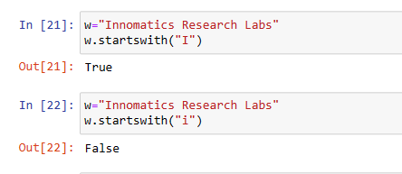
startswith() - - This method checks whether the string starts with the specific characters.
This method returns in Boolean data type i.e., either returns True or False.
Syntax: variable_name.startswith(“give the required specific characters”)

Slide 20
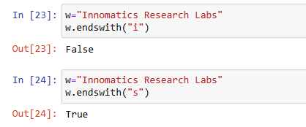
endswith() - - This method checks whether the string ends with the specific characters.
This method returns in Boolean data type i.e., either returns True or False.
Syntax: variable_name.endswith(“give the required specific characters”)

Slide 21
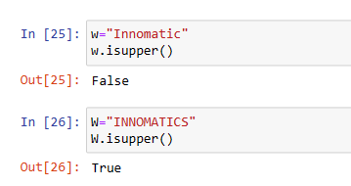
isupper() - - This method checks whether the string is in upper case or not.
This method returns in Boolean data type i.e., either returns True or False.
Syntax: variable_name.isupper()

Slide 22
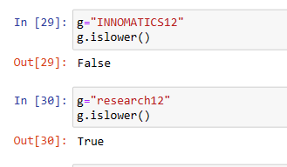
islower() - - This method checks whether the string is in lower case or not.
This method returns in Boolean data type i.e., either returns True or False.
Syntax: variable_name.islower()

Slide 23
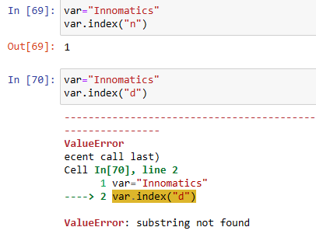
index(): - - This method is used to search the specified value in the string.
If it is found it returns the index value or position.
If it is not found it returns the error named “ValueError:substring is not found”.
Syntax: variable_name.index()

Slide 24
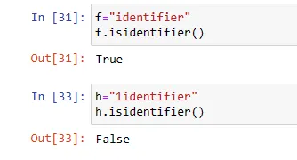
isidentifier() - - It is used check whether the given string can be used as a identifier or not.
It returns the boolean value.
Syntax: variable_name.isidentifier()

Slide 25
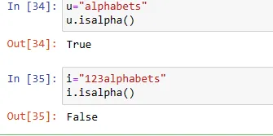
isalpha() - - It is used to check whether the string contains only alphabets or not.
Syntax: variable_name.isalpha()

Slide 26
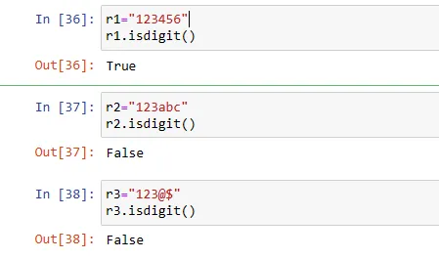
isdigit() - - It is used check if the string contains only numbers(integers).
Syntax: variable_name.isdigit()

Slide 27
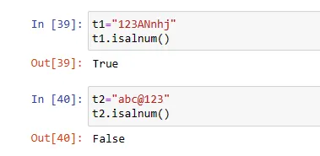
isalnum() - - This method is used to check if the string contains only integers or alphabets.
Syntax: variable_name.isalnum()

Slide 28
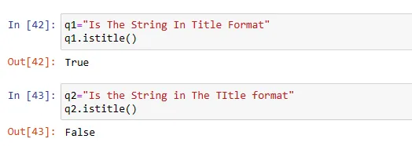
istitle() - - It is used to check if the string is in title format.
Syntax: variable_name.istitle()

Slide 29
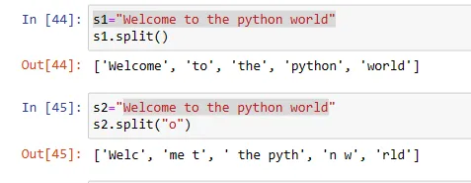
split() - - It is used to split the string into substring by using any specified separator present in the string.
By default the split() assumes the separator as space.
Syntax: variable_name.split()

Slide 30
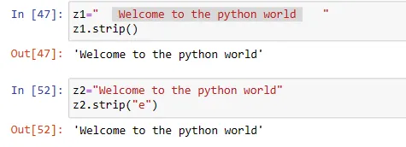
strip() - - It is used to remove any white space(spaces) from the starting or ending of the string.
But not the spaces present between the string.
Syntax: variable_name.strip()

Slide 31
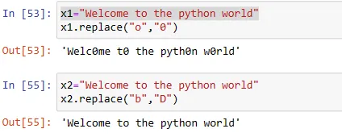
replace() - - It is used to replace a single or a sequence of characters with another character in the string.
Syntax: variable_name.replace()

Slide 32
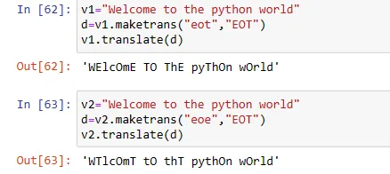
maketrans() - - It is used to create a mapping table that can be used with translate(), which helps replacing the multiple characters at once.
ASCII value: Foe each character a asci value is assigned, which will be converted to binary value.
Ex: Input: ord(“a”) output: 97, Input: bin(97) 0uput:ob1100001
Syntax: variable_name.maketrans()
translate() - - It returns the translated string.
Syntax: variable_name.translate()

Slide 33
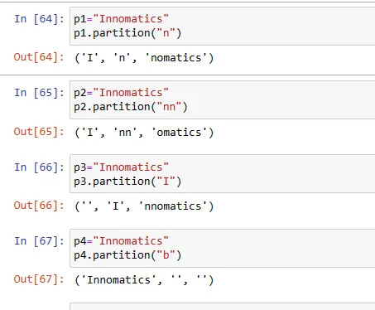
partition() - - This method is used to split the string into three parts.
It contains 3 parts namely
before the split values
the split value
after the split value.
Syntax: variable_name.partition()

Slide 34
ESCAPE CHARACTERS
These are some characters or elements which can not be inserted in a single, double, triple quote.
Ex: ‘, ‘’, ‘’’
Hence we use escape characters.
It is a “\” - Back slash symbol followed by the character which you want to insert.
Types of escape characters.
\n – New line (creates new string)
\b – Back space (deletes the space)
\t – tab space (adds space)

