Slide 1
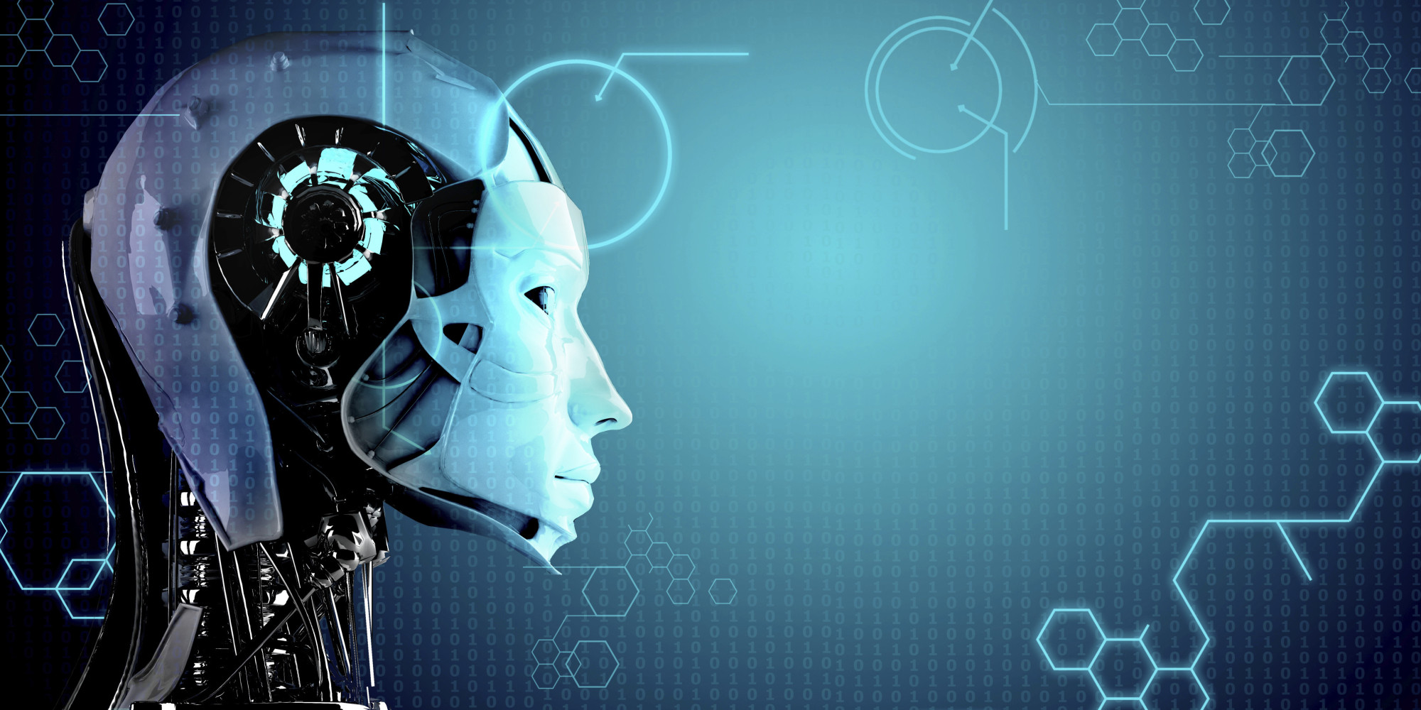
How Artificial Intelligence Will Make Technology Disappear

Slide 2
Artificial Intelligence
The theory and development of computer systems able to perform tasks normally requiring human intelligence, such as visual perception, speech recognition, decision-making, and translation between languages

Slide 3
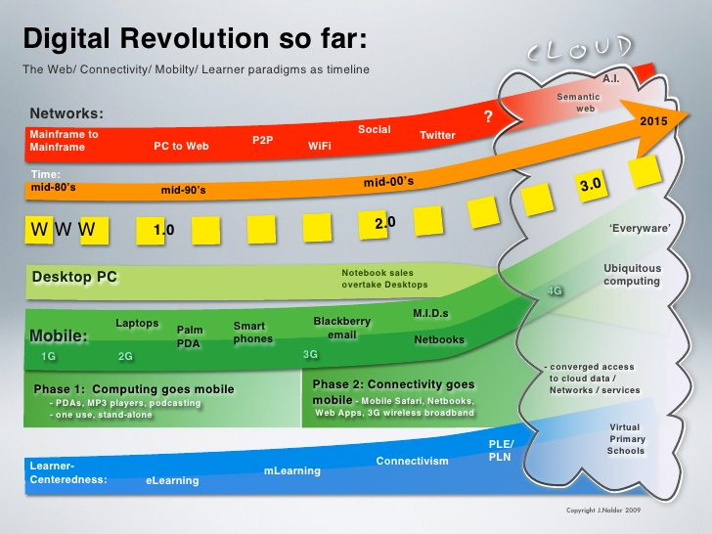

Slide 4
The Digital Revolution
How did this happen?
Back in 1990, we didn’t have any connected devices. This was the “unplugged” era.
Around 1995, the Internet started taking off, and our computers became connected.
10 years later, we entered the mobile era. This time, it is not 1, but 3 devices that are connected: a computer, a phone, and a tablet.
In 2015, we are officially entering what is called the “Internet of Things” era. That’s when your watch, fridge, car and lamps are connected. It is expected that there will be more than 100 billion connected devices by 2025, or 14 for every person on this planet.
Just imagine what it will feel like to interact manually and receive notifications simultaneously on 14 devices.. That’s definitely not the future we were promised!
There is hope though. There is hope that Artificial Intelligence will fix this.

Slide 5
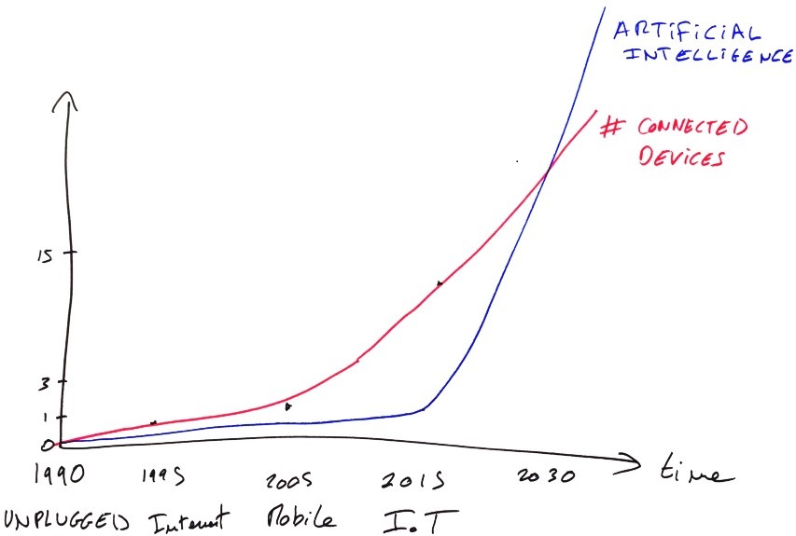
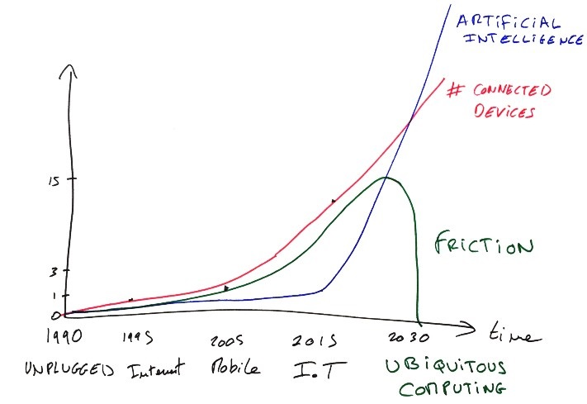
NEW ERA
Taking the connected devices curve, and subtracting the one for A.I., we see that the overall friction keeps increasing over the next few years until the point where A.I. becomes so capable that this friction flips around and quickly disappears. In this era, called “Ubiquitous Computing”, adding new connected devices does not add friction, it actually adds value!

Slide 6
For Example :-
Smart Routing of Notifications.
Smart Traffic Light Management
Home Monitoring
Destination Prediction
Smart Alarm-Clock
Predicted Passenger Flow

Slide 7
All the previous examples are consequences of having ubiquitous computing!
By the time this happens, technology will have become so deeply integrated in our lives and ourselves that we simply won’t notice it anymore.
Intelligence will have made technology disappear from our consciousness, and the world will feel unplugged again.

Slide 8
Historic Example : Electricity
Back In The 1800s
Tangible
Expensive
Current Scenario
Cheaper
More Reliable
Hard to Produce
Dangerous
Safer
Ubiquitous

Slide 9
Context-Awareness
Building this ubiquitous computing future relies on giving devices the ability to sense and react to the current context, which is called “context-awareness”.
A good way to think about it is through the combination of 4 layers:
Device Layer
Individual Layer
Social Layer
Environmental Layer

Slide 10
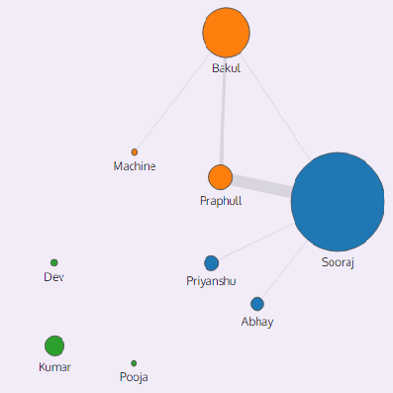
For example, to model the social layer, we can look at the emails that were sent and received by someone, which gives us an indication of social connection strength between a group of people

Slide 11
InterPlay Between Layers
Geo-Location Monitoring
User Specific Module
Timeline Of Places
Timeline Of Places
Accelerometer Pattern
Transportation Mode
Transportation Mode
Population Flow Of City
Aggregated

Slide 12
Conclusion
If we combine all these different layers — personal, social, environmental — we can recreate a highly contextualized timeline of what we have been doing throughout the day, which in turn enables us to predict what our intentions are.

Slide 13
References
www.google.com
www.wikipedia.com
www.medium.com
www.youtube.com
www.tedxecolepolytechnique.com

Slide 14
Thank You
Created By: Anurag Saraswat , Anubhav Shrivastav ,Deepanshu Hudda, Devashish Vats

