Slide 1

Prepared By :
Animesh Kumar - 1451017
Anurag Kumar - 1451020
Krishna Dahal - 14510
Sumit Saurav - 1451010

Slide 2
INTRODUCTION
A social network to ask questions and to answer them interactively.
Will also provide a platform to conduct surveys, gather opinions on trending matters,etc.
Will have a specific section where questions can be answered only with two options: Yes or No.
Matters that are ignored by media can be brought to the concern of the Government, individuals or NGOs.
Debates can be done on various trending topics or by topics created by a user. The privacy of the individual is kept a secret.

Slide 3

USERS
Anonymous User :
Can vote a question without registering.
Will have access to the trending section.

Slide 4

USERS
Registered User :
Can answer Yes Or No questions anonymously.
They will have access to comments section.
Can follow certain users, questions or topics.
They will have access to debate section.
They can ask questions.
News feeds are displayed on the basis of their area of interest.
They can see what’s trending right now.

Slide 5

USERS
Premium User :

Slide 6
KEY FEATURES
Anonymously/non-anonymously asking questions.
Anonymously voting for a question.
Stats and analytics for a question based on gender, location, age etc.
Anonymous chat/debate on a topic.
Showing questions based on user’s interest.
Sharing opinion with other users.
“Trending” section to show questions that are trending right now.

Slide 7
SOURCES OF REVENUE
ADVERTISEMENTS:
User specific ads
Reachability of ads depends on the plan

Slide 8
SOURCES OF REVENUE
PREMIUM MEMBERSHIP:
They will have all the facilities of the a registered user.
They can get stats on the basis of location, gender, age group, etc.
They can see the percentage of positive and negative reviews or opinions.
They can conduct surveys.

Slide 9
SOURCES OF REVENUE
PREMIUM MEMBERSHIP:
Who can be premium members?
NGOs
Newpapers
Startup Companies
Government Surveys
Individual Companies or Institutions

Slide 10

COMPETITORS
Petitions for the issues of the country and the society.
Anyone can start a petition.
Users can sign and share a petition to show support for it.
Once a petition reaches a certain number of signs, the decision makers (the Government, big corporates etc.) can respond to the petition
Victory is declared when there is a solution.

Slide 11
COMPETITORS
How is Pollster better/different than Change.org
No petitions. Just Yes/No type questions.
No debate feature on Change.org.
Detailed statistics for the questions posted.

Slide 12

COMPETITORS
Portal for asking questions.
Users can ask questions to raise a particular issue as well.
Users can upvote and answer a question.

Slide 13
COMPETITORS
How is Pollster better/different than Quora
Pollster isn’t about learning. It’s about knowing people’s views and bringing a change.
No option for starting a debate.
No feature for analytics of a question.

Slide 14
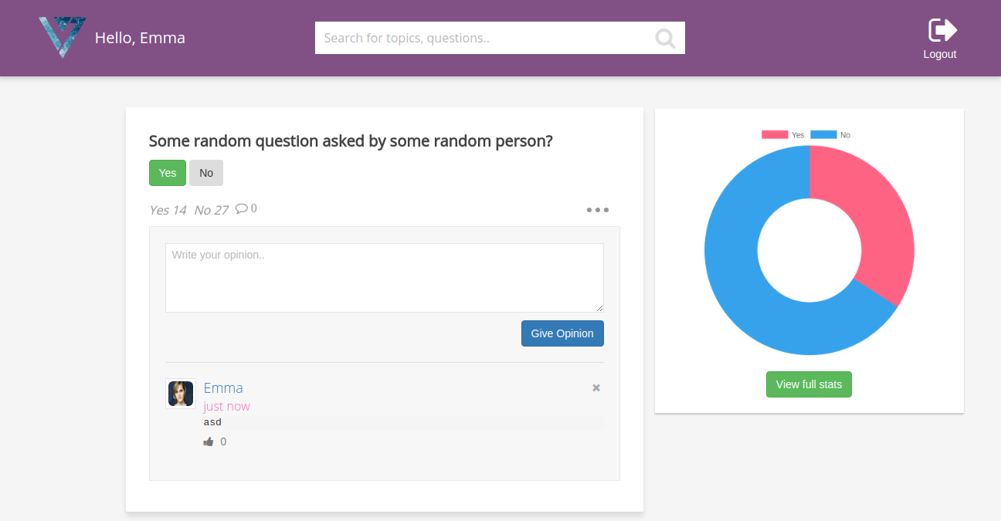
Question statistics

Slide 15
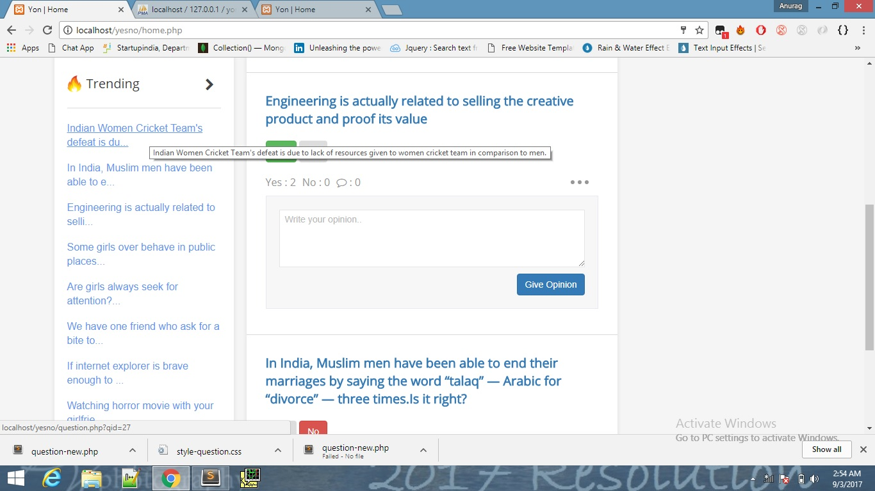
Trending Questions

Slide 16
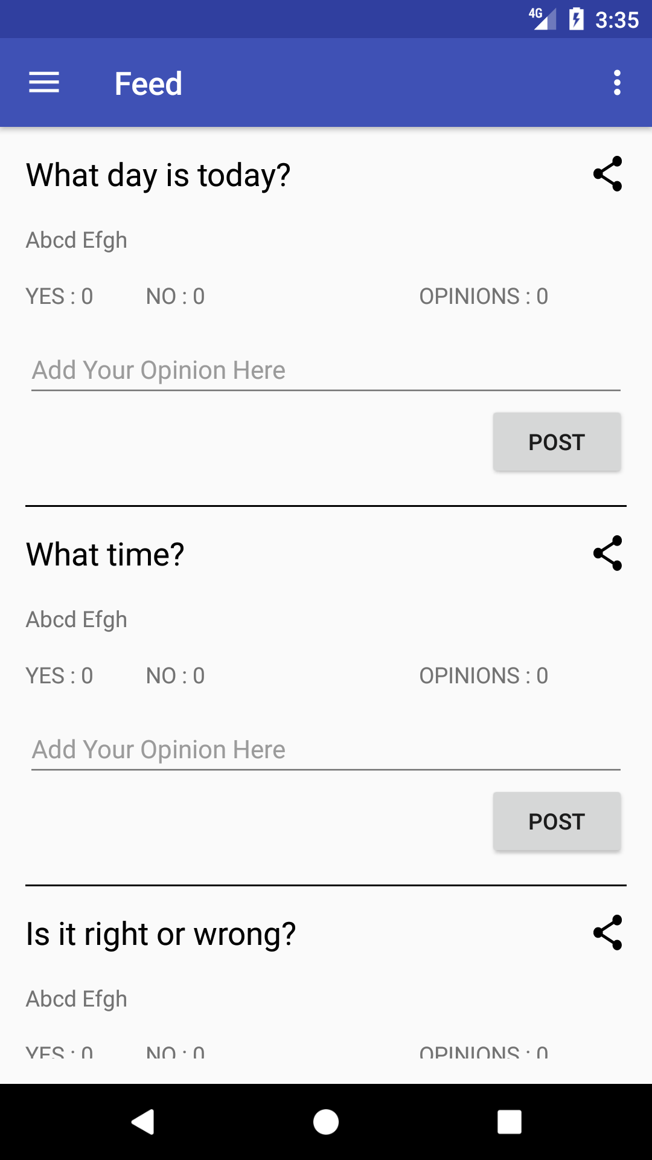
News feed from Pollster App

Slide 17
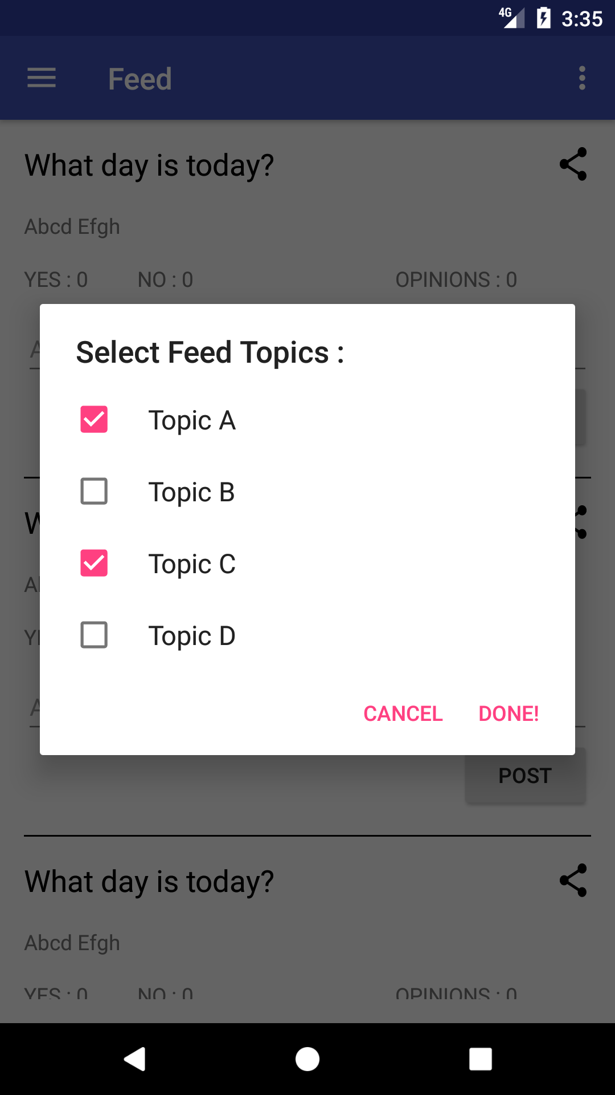
Selecting topics

Slide 18
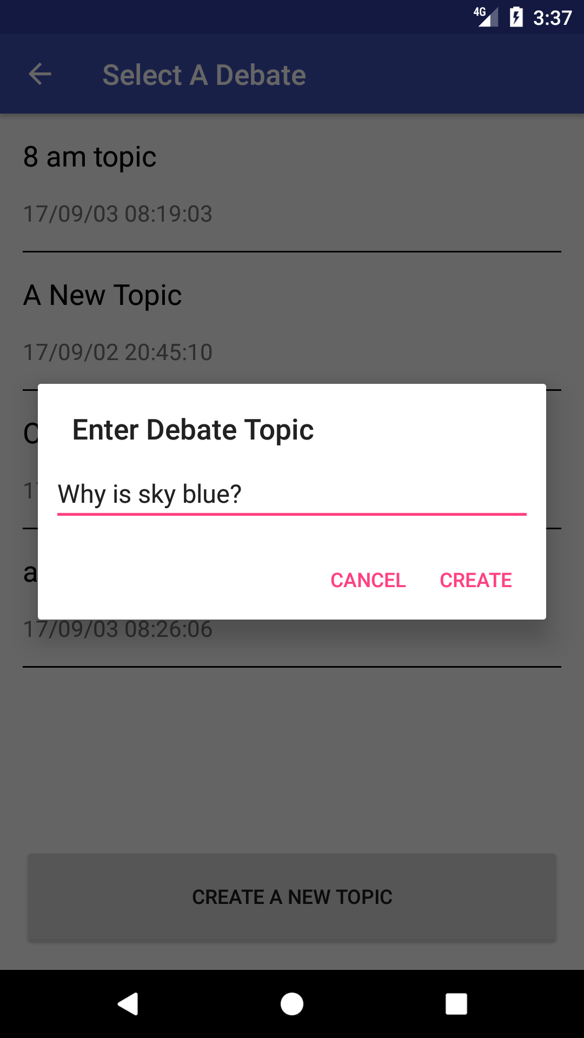
Starting a debate

Slide 19
Next 5 years' vision
With growing users, we will be able to complete a survey within few days insted of several months.
Sensitive issues can be raised without disclosing one’s identity and may thus bring a change.
NGOs will have a good platform to get the knowledge of problems prevailing in the society.
Students can make use of the platform for learning (which although isn’t our main focus).
Newspaper can get people's reaction on a topic in very less time.

Slide 20
Thank you! Questions?

