Slide 1
Investopedia
Anurag Gate Bhakti Mehta Sanjana Bothale

Slide 2
Problem Statement
We are a consultancy firm, Investopedia, hired by Pennywise who are looking forward to invest in cryptocurrency in 2018. We are hired to give them some insights about the market sentiment and help them in making a model to predict the prices of Bitcoin, Ripple and Ethereum.

Slide 3



About Cryptocurrency
A cryptocurrency (or crypto currency) is a digital asset designed to work as a medium of exchange that uses cryptography to secure its transactions, to control the creation of additional units, and to verify the transfer of assets. Cryptocurrencies use decentralized control as opposed to centralized electronic money and central banking systems

Slide 4
BlockChain (Relevance): The decentralized control of each cryptocurrency works through a blockchain, which is a public transaction database, functioning as a distributed ledger. The validity of each cryptocurrency's coins is provided by a blockchain. A blockchain is a continuously growing list of records, called blocks, which are linked and secured using cryptography. It is "an open, distributed ledger that can record transactions between two parties efficiently and in a verifiable and permanent way".
About Cryptocurrency

Slide 5
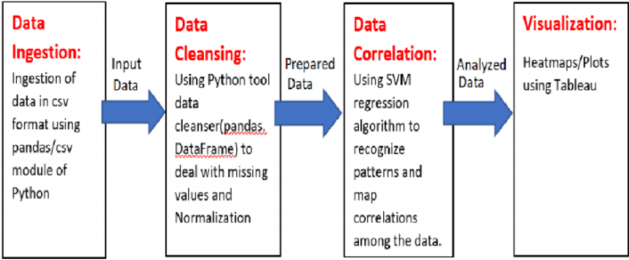
Our Pipeline

Slide 6
Features considered for predicting the value of coins: Date, Name, High, Low, Open, Close, Volume, Market-Capital, Positive and Negative crypto market news
Features

Slide 7
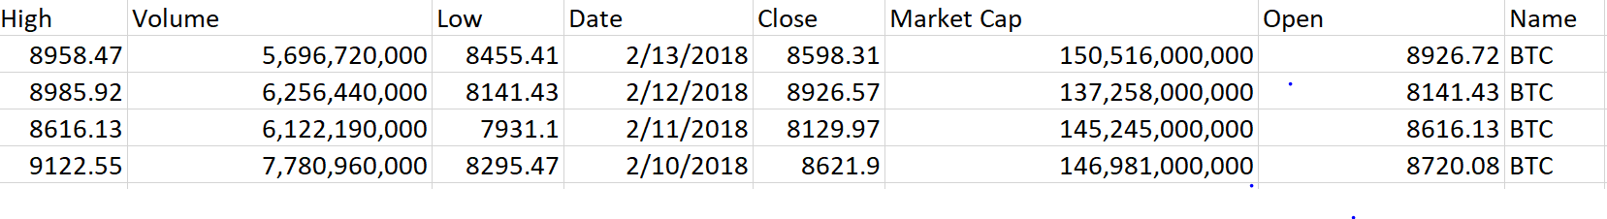
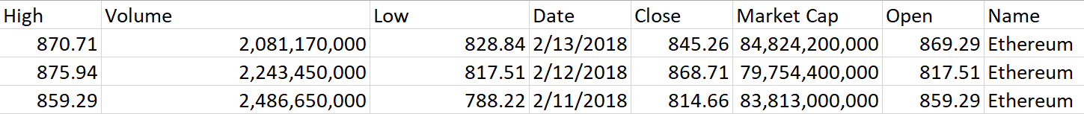
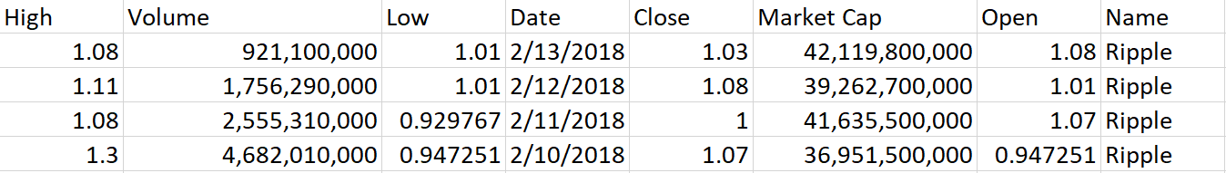

Data Ingestion:
Bitcoin
Ethereum
Ripple
CSV file with Historical Data of 3 cryptocurrency (Bitcoin,Ethereum ,Ripple)

Slide 8

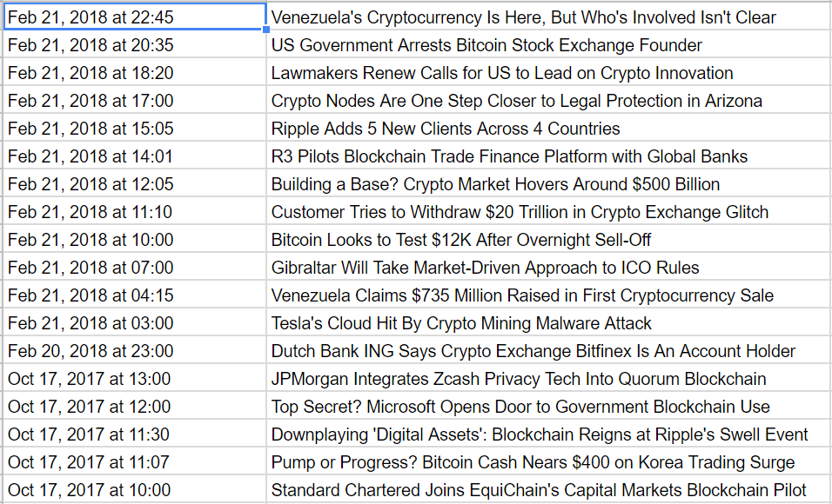
Data Ingestion:
Geo Political Data scrapped from coindesk.com using scrappy

Slide 9
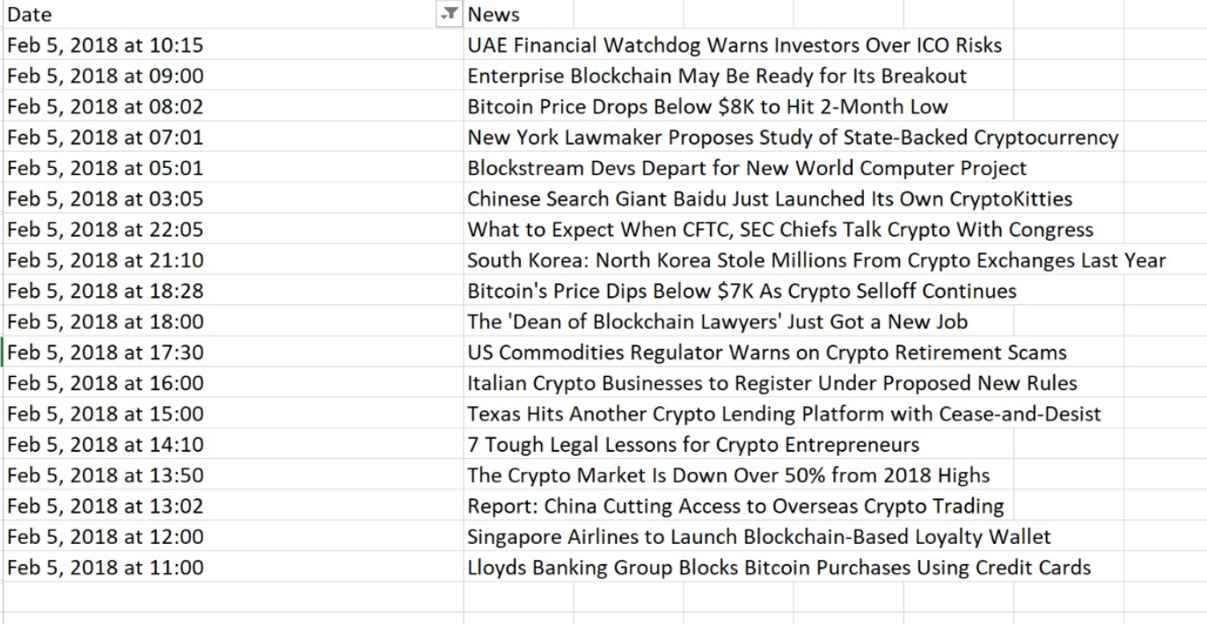
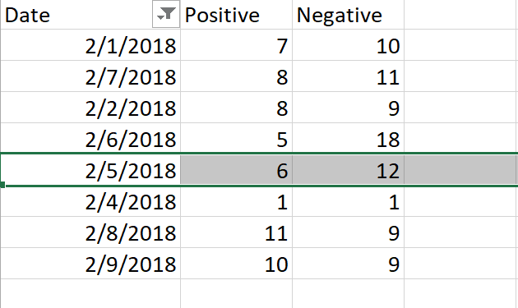
Before
After
Before
After
Data Cleansing :
Sentiment Analysis – Using Naïve Bayes

Slide 10
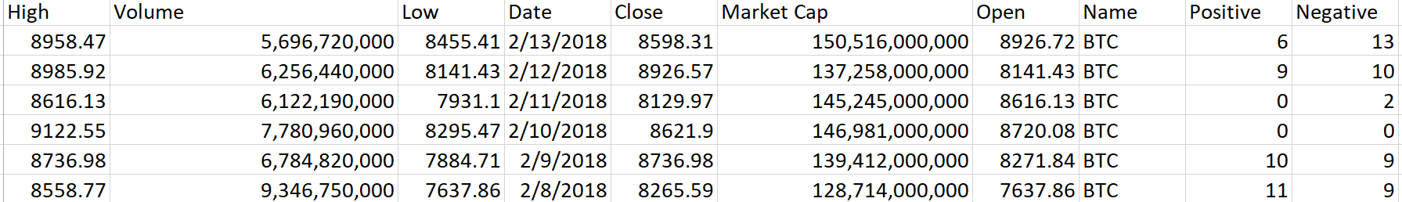
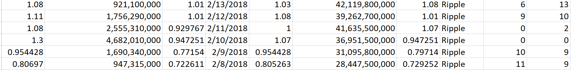
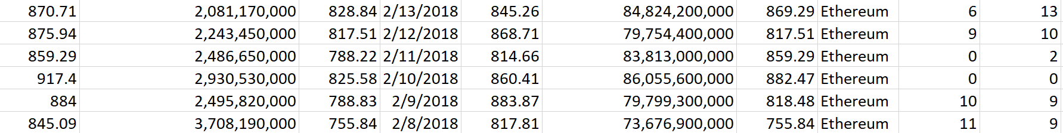
Data Cleansing :
Merging analysed News data and Coin data on a particular date.

Slide 11
Cryptocurrencies have seen a lot of variation in their volumes of trading and prices over the years.
Thus, Our Data consists of wide range of values.
For accurate prediction of cryptocurrency prices, it was essential to normalize the data and narrow down the range of volume, market capital as well as the prices.
We Normalized the data using Map
Data Normalization:
Data Normalized using
pandas Map function

Slide 12
Before investing in cryptocurrency we want our client to have an idea about the risks involved in the crypto markets. Thus, we have extracted a few insights from the data about the volatility and trends in the crypto market.
Risk Analysis

Slide 13
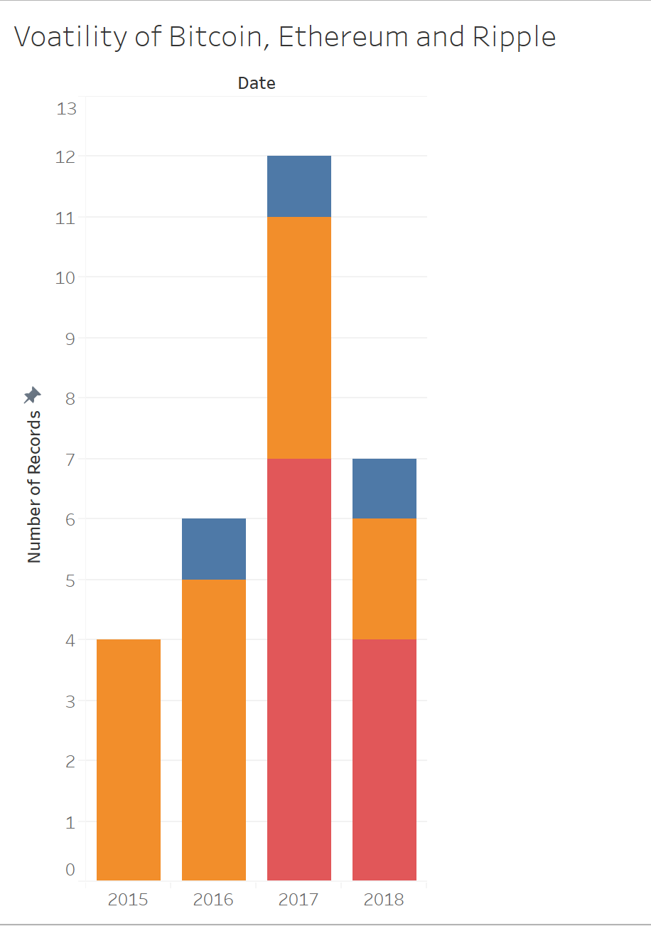
One of the important factors that should be considered before investing in cryptocurrency is the volatility of cryptocurrency market. Volatility means that an asset is risky to hold—on any given day, its value may go up or down substantially. Our Analysis: Bitcoin is the Least volatile amongst the three.
Volatility of Bitcoin, Etherium and Ripple
Volatility

Slide 14
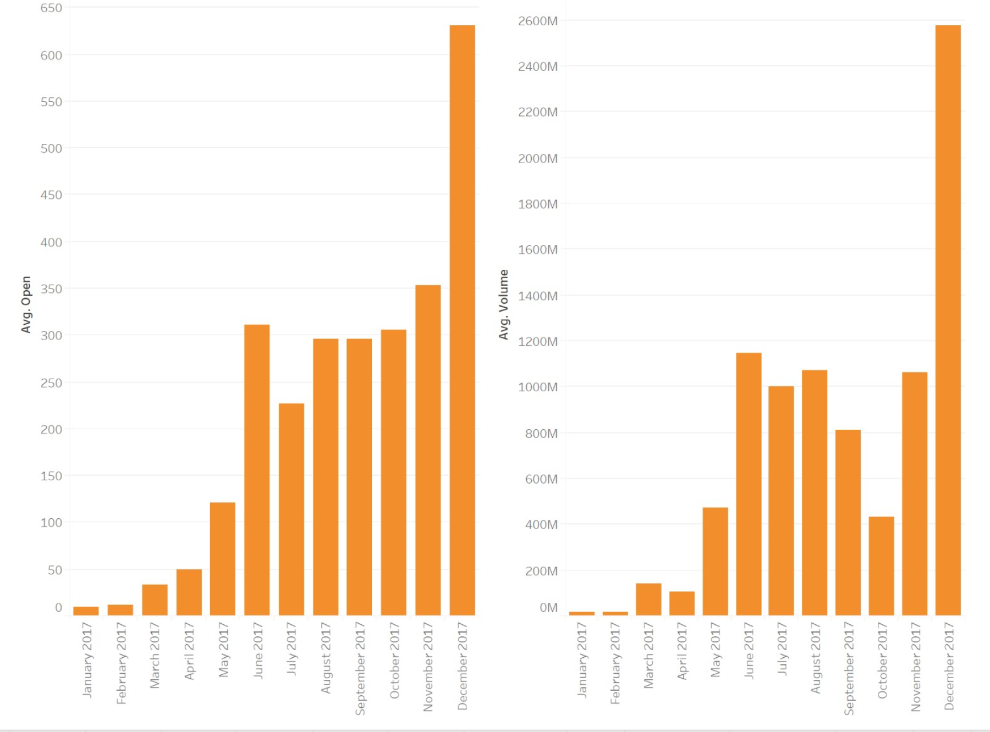
Confirming Price Movements With Volume Oscillators : Simple but Powerful When volume is low, but gains and losses are big, the professionals tend to get overly excited about a possible turn in market direction. That's because without strong volume, a market move is not valid. stock moving up or down on low volume is usually a warning sign: proceed with caution. It may mean a move you cannot trust: market uncertainty, manipulation or a thinly traded, volatile stock. An artificial over-valuation that will lead to a sudden downward correction constitutes a bubble. Our Analysis: The Movements in price do not confirm with the Volume oscillations from July 2017 –October 2017
Ethereum

Slide 15
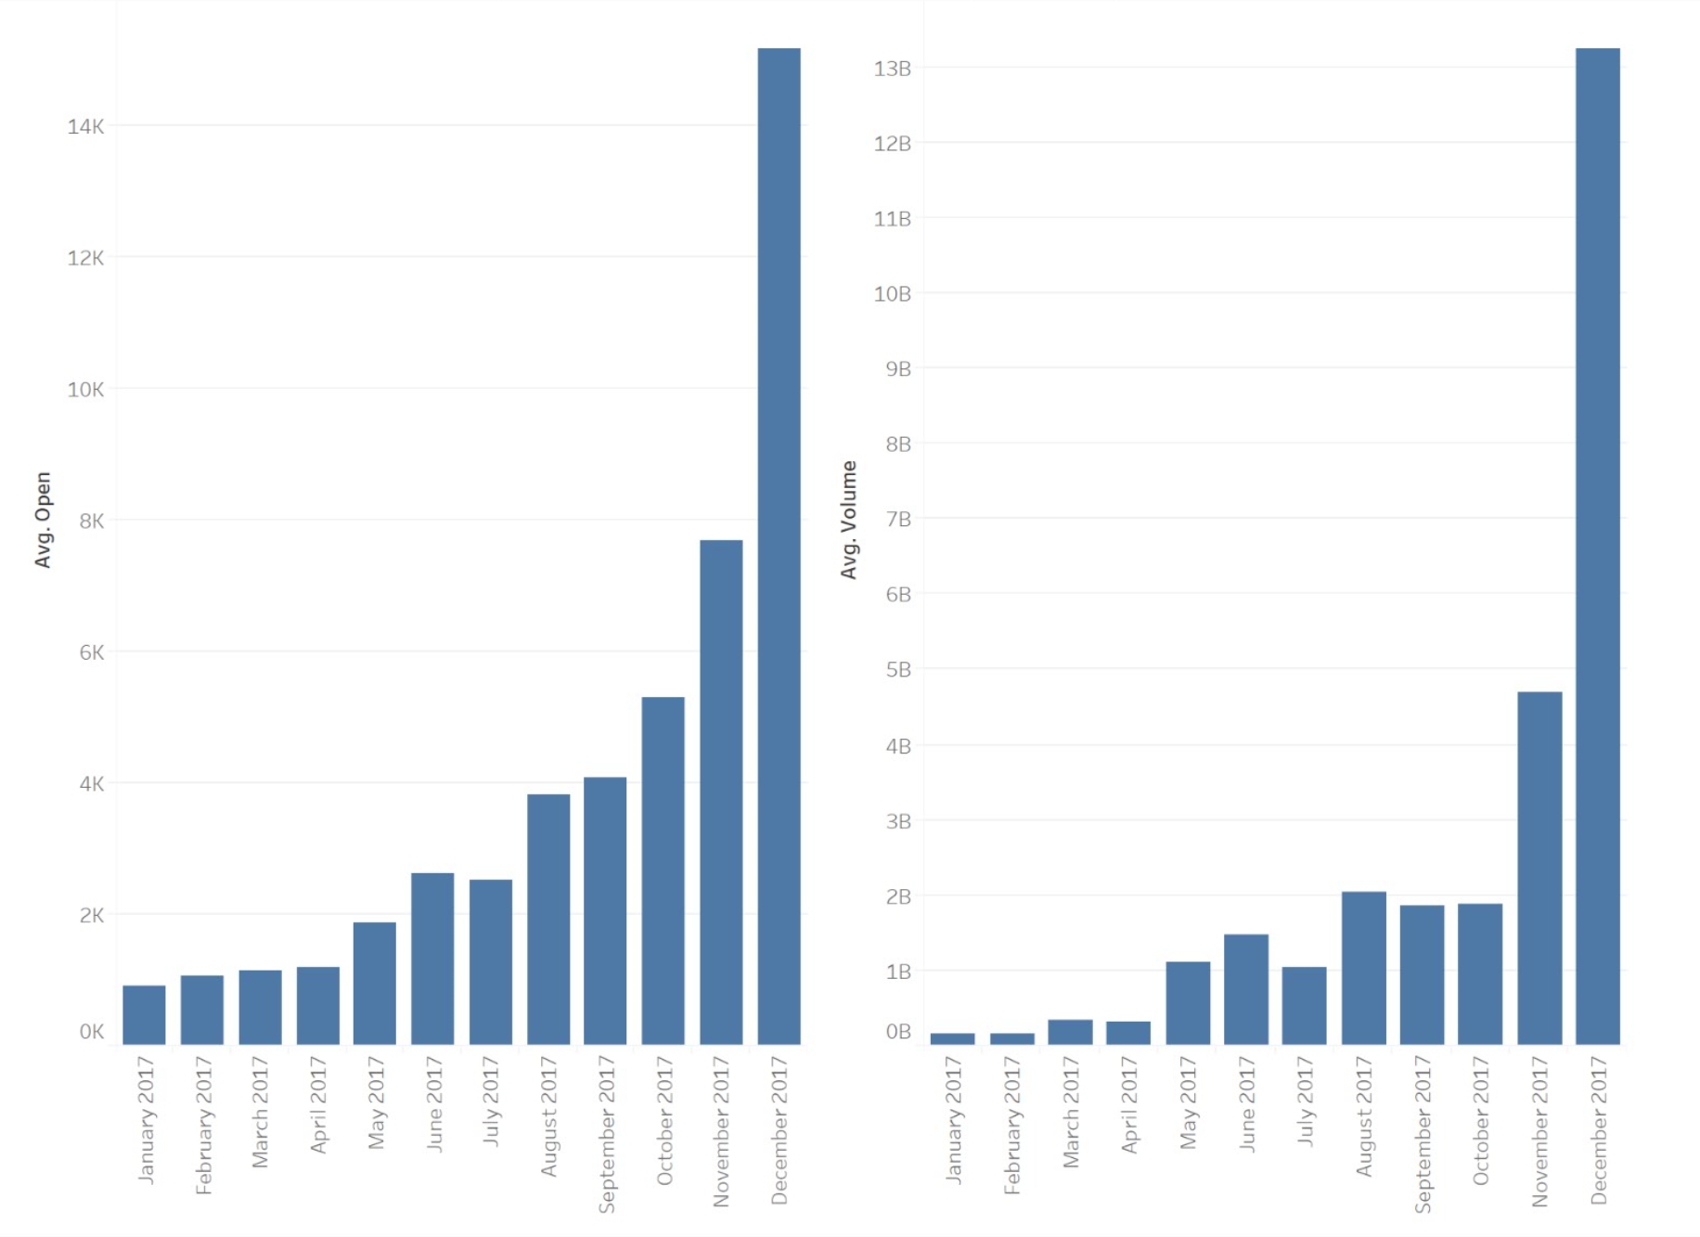
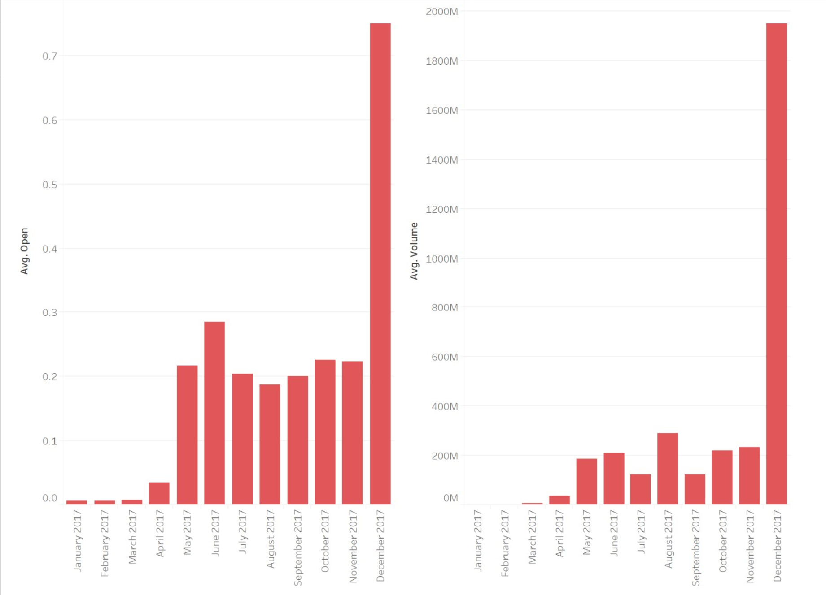
Bitcoin
Ripple

Slide 16
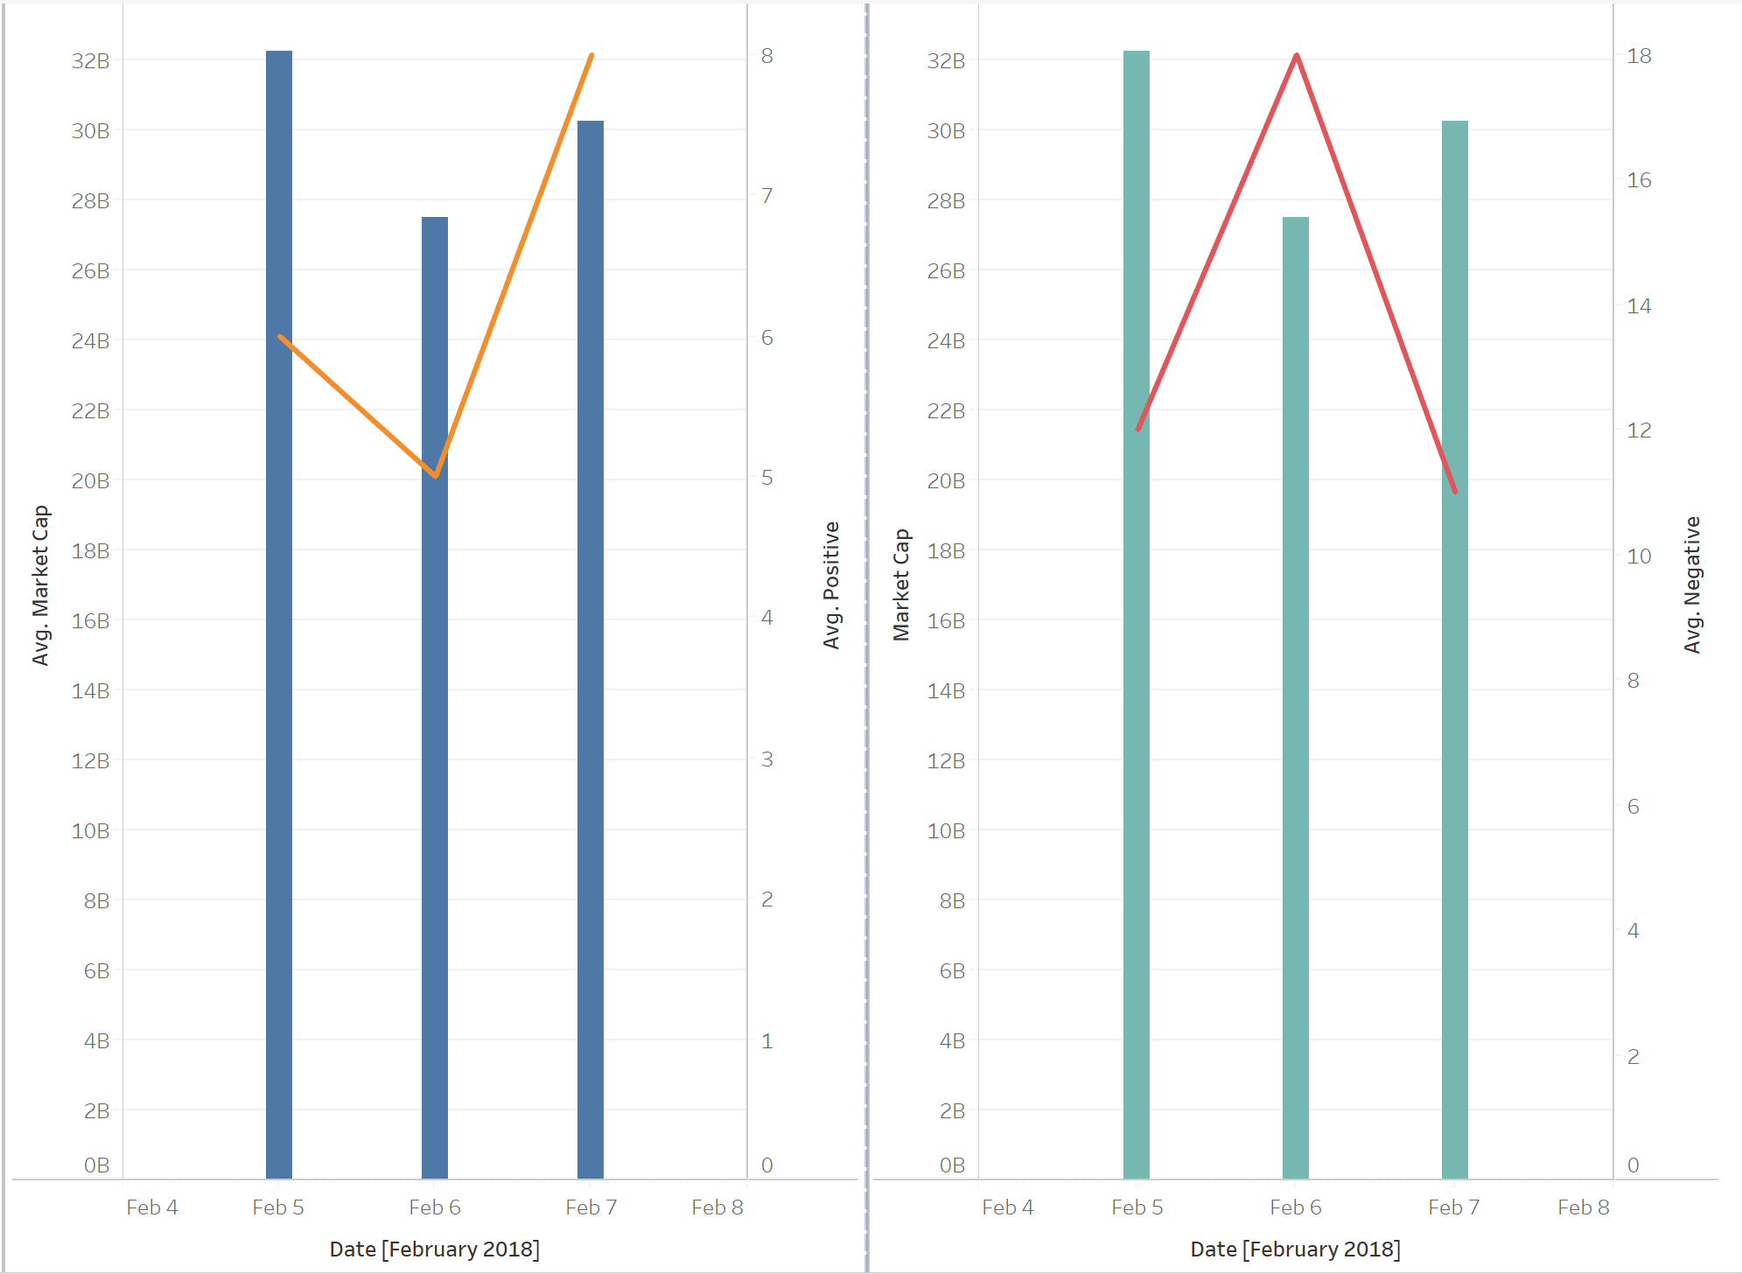
As we can see, on 6th Feb, the market sentiment is negative, we can see a dip in the Market Capital and on 7th Feb the overall Market Sentiment is Positive and corresponding change is visible on Market Capital. Our Analysis : Ethereum is affected comparatively more than the other two cryptocurrencies. Ethereum : 15.21 decrease 11.71 increase Bitcoin : 14.72 increase 9.9 decrease Ripple : 14.63 decrease 9.85 increase
Market Sentiment

Slide 17
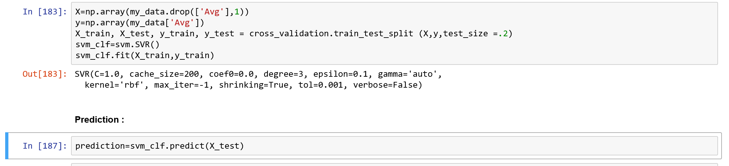
For creating the prediction model we have used Support Vector Machine Regression Algorithm.
Why this algorithm?
Regression Algorithm because we are predicting a quantitative value
Non-linear Data
Time-Series Data
Prediction

Slide 18
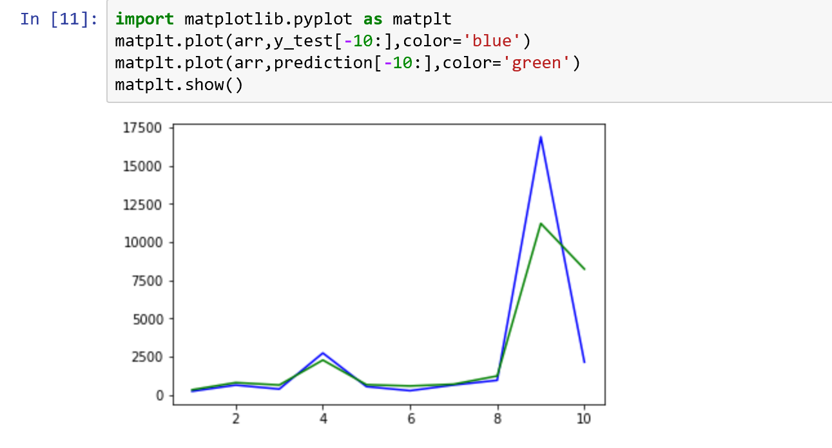
To Understand the efficiency and accuracy of our model, we used 20% of our data as test data and predicted the price for these test values.
Using sklearn’s score function we evaluated the accuracy of our Model which is around 95%.
We plotted our predictions and the Test Dataset Values using Matplotlib.
Prediction Accuracy

Slide 19

Thank You

