Slide 1
Project Seminar Review- 1
TEAM NO – 12
Guide: Dr. Burgula Kezia Rani
Anurag Sahu 1602-19-737-127
Deepak Ramnath 1602-19-737-130

Slide 2
Drone Detection using Computer vision
Problem Statement:
Drones/unmanned aerial vehicles (UAVs) have recently grown in popularity due to their inexpensive cost and widespread commercial use. The increased use of drones raises the possibility that they may be employed in illicit activities such as terrorism. Thus, drone monitoring and automated detection are critical for protecting restricted areas or special zones from illicit drone operations.
Solution:
Using Yolo alogorithm with image enhancement and enhancing the interlayer connection in CNN we can increase the accuracy and speed of drone detection.
Domain: Image Processing & Deep learning

Slide 3

YOLO-V3 based real-time drone detection algorithm
Authors: Hamid R. Alsanad , Amin Z Sadik, Osman Nuri Ucan, Muhammad Ilyas
Publisher: Springer Year Of Publication: 2022
Methodology: Improvement to the structure of YOLO-V3 Network, enhance the interlayer connection of CNNs, improvement to the YOLO-V3 multi-scale detection by expanding the three-scale detection to four-scale detection
Pros: Improvements to the network structure of YOLOV3, Multiscale detection of YOLO-V3, algorithm has good robustness to drone detection
Cons: Struggles to detect close objects because each grid can propose only 2 bounding boxes

Slide 4
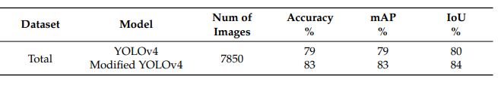
A Modified YOLOv4 Deep Learning Network for Vision-Based UAV Recognition
Authors: Farzaneh Dadrass Javan, Farhad Samadzadegan, Mehrnaz Gholamshahi
Publisher: MDPI Year of Publication: 2022
Proposed Methodology: In the first step, the input data was prepared to be ready to enter the proposed network. In the second step, the model was trained to recognize the drones, and the weight file obtained for the testing phase was generated. In the third step, the network was tested to observe how it worked; and, in the last step, the proposed deep learning network was evaluated using evaluation metrics
PROS: recognizing different drone types
and differentiating them with the birds,
increased recognition accuracy.
Cons: takes a lot of computational time. Not suitable for real time drone detection.

Slide 5
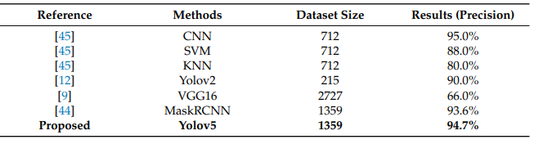
Detection of Unauthorized Unmanned Aerial Vehicles UsingYOLOv5 and Transfer Learning
Authors: Nader Al-Qubaydhi, Abdulrahman Alenezi, Turki Alanazi, Abdulrahman Senyor
Publisher Name: MDPI Year Of Publication: 2022
Methodology: Using of YOLOV5 for drone detection.
Pros: YOLOv5’s memory occupancy is
better than MaskRCNN’s. YOLOv5 also
has the benefit of being able to
recognize distant or tiny items
Cons: not bale to detect drones properly in challenging and deadest scenarios.
Future Work: To test this method to a larger dataset to demonstrate the effectiveness of the YOLOv5 with including the challenging scenarios.

Slide 6
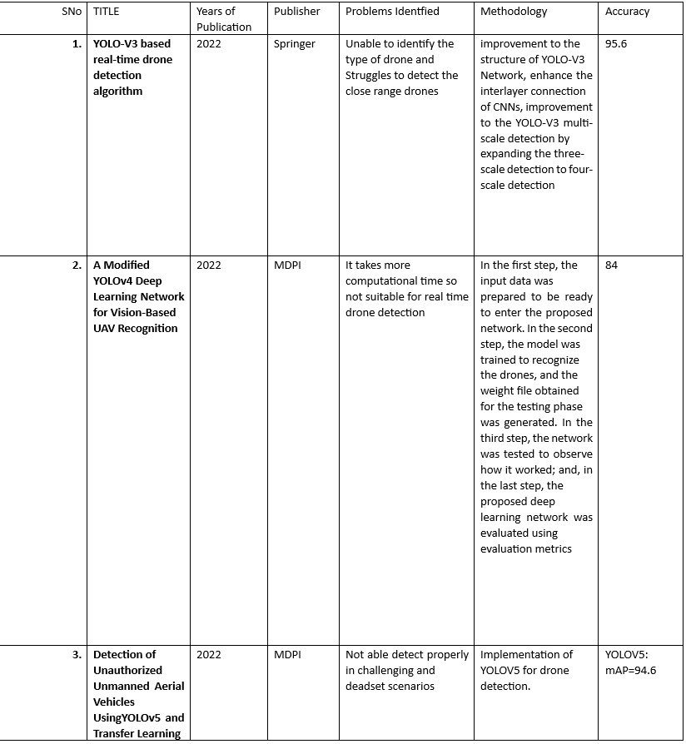
Survey table:

Slide 7
Resources identified
Datasets:
https://github.com/dasmehdix/drone-dataset
Source Code:
https://github.com/ultralytics/yolov5

Slide 8
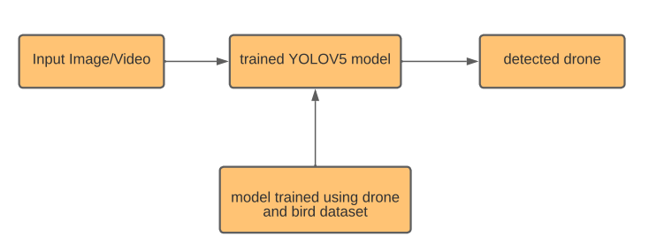
Workflow

Slide 9
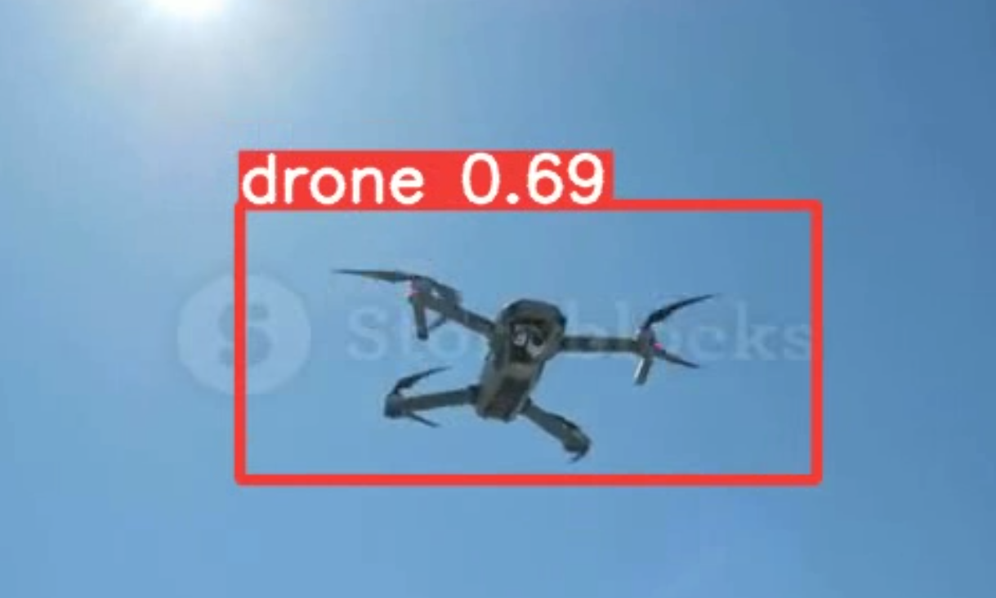
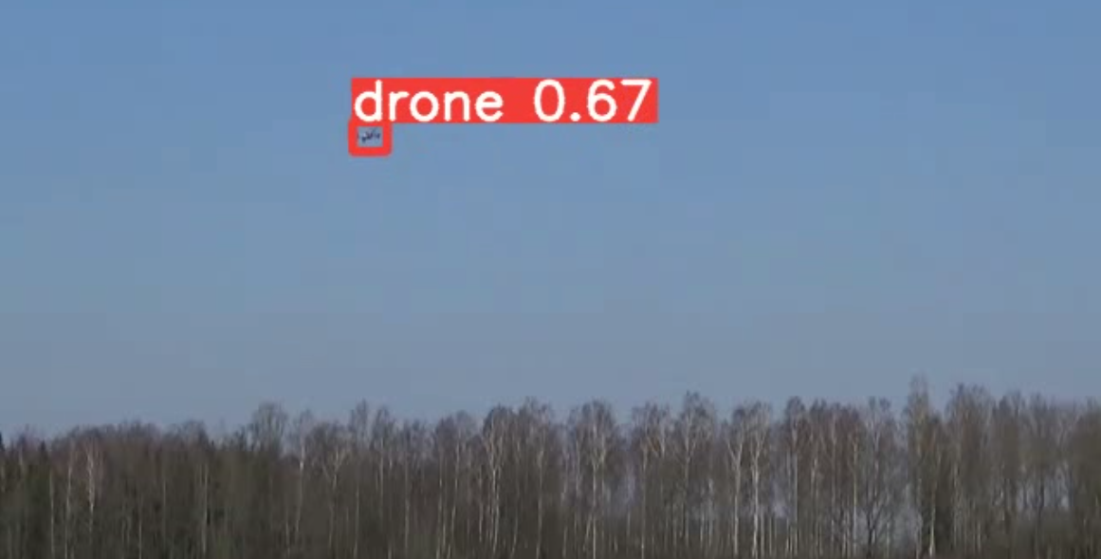
Results

Slide 10
Thank You

