Slide 1
Scalable Video Encoders (SVC) to
Realize Network-adaptive Bandwidth Demands
FF-MPEG is a publicly available SVC software tool to
generate variable BW video bit streams
SVCs are useful for “reactive control” algorithms such as AIMD
In the absence of knowledge about the bandwidth availability along a
network path carrying video data, AIMD reacts to BW congestion in
the network path by a repetitive execution of the following steps:
--- Rapidly reduce the video send-rates until congestion is relieved;
--- Cautiously increase the video send-rates until either a desired QoS
is achieved or the BW congestion sets in again (whichever is earlier).

Slide 2
Iterative procedure for adjustment of send rate
[available bandwidth along network path is not known]
Additive Increase Multiplicative Decrease (AIMD)
[C.Diot, V.Bhargavan, INFOCOM 1993-94]
In each ‘loss reporting’ interval:
λ(new) = λ(cur) - β.L when L > δh,
where β > 0
λ(new) = λ(cur) + α when L < δl,
where α > 0
λ(new): new send rate of video
λ(cur): current send rate of video
L: observed packet loss rate; β, α: constants
δl, δh: Acceptable loss thresholds [δl < δh to avoid ping-pong effect]
^^ Each execution of this procedure constitutes a “control iteration”
^^ A sequence iterations that lead to a steady-state in bandwidth allocation
(when the flow specs changes or a set of new flows are admitted)
constitutes a “control round”
rate adjustment
actions
decrease
increase
0
δl
δh
observed
packet loss L

Slide 3
Adjustment of quantization parameter (QP) to control video bit-rate
Take a macro-block and encode it with a certain QP
Low QP ➔ distortion (D) in comparison
to the original image will be low,
but the bit rate (R) will be high
Choose a high QP
➔ distortion will be high, but the bit-rate will be low
high
Increasing
scene complexity
bit rate
generated
0
low
high
QP
higher QP ➔
(increased distortion
& reduced quality)
As quantization QP → 0(+), encoder rate λ → 251 mbps
[lossless compression ➔ best visual-quality]
Higher QP ➔ lower bit rate (and hence lower visual-quality)
Typical range of QP used during no congestion: 28-35
visual-quality (VQ) is a user-oriented
subjective parameter
➔ can be categorized in decreasing order, say:
[BEST, BEST(-), BETTER, GOOD(+), GOOD, GOOD(-), BAD]
Internal structure of H.264 video encoder (typical)
compressed
video data
bit-stream
(for storage,
transmission)
raw
video
Encoder
Smoothing
buffer
QP
bit-rate
scene
complexity
estimate
.
.
Rate
controller
demanded
bit rate
Experimental results collected on sample video sources
(with FF-MPEG software) show rate burstiness and variability

Slide 4


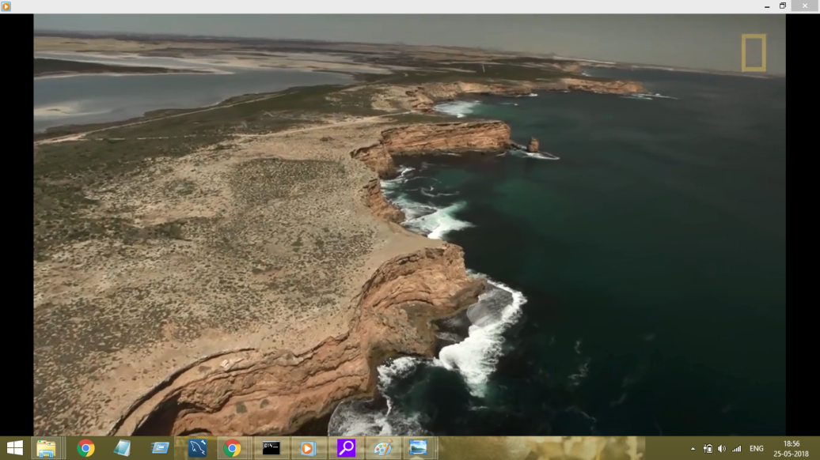
Bit-rate generated
by video encoder
(λ in kbps)
same degree
of motion in
scene content
less
motion
Source-1: QP=26, visual_quality = GOOD
500
(sample case of
source 0)
x
x
x
400
x
x
x
300
x
x
x
x
x
x
x
x
x
x
200
x
x
x
x
x
averaged over
1-sec intervals
x
long-term average
(over 5-sec intervals)
x
100
900 video frames (H.264) played out @ 25 fps
x
45
QP
x
x
x
x
Source-2: QP=28, visual_quality = BETTER
x
x
x
x
x
x
x
x
x
x
x
40
x
x
x
x
x
x
x
35
0
0
2
4
6
8
12
16
20
28
36
TIME in secs
3250
y
source-3
3000
2500
source-2
y
source-1
z
o
z
2000
source-0
y
Source-3: QP=28, visual_quality = BETTER
bit-rate λ generated by encoder
(kilobits/sec)
x
o
z
y
1500
x
o
z
y
x
o
z
1000
x
o
x
y
x
z
500
x
o
z
y
o
z
250
x
x
x
y
o
5
10
20
30
40
50
quantization parameter (QP)

Slide 5
EDSI
Virtualized network function (NFV) for
BW adaptive end-to-end video transport
EDSI
Dx
λ’ = BAVT (λ,Bav*)
serves
Dx,Dy
source
Vc
. .
. .
FAM
(AIMD-source)
receiver proxy
(AIMD-sink)
network
attachment
point
Dy
λ’c
transport path over
cloud network (say, TCP)
serves
Dz
source
Va
L = net(λ,Bav*)
compressed
video data flow
λ’a
. .
. .
delivery &
rendering
N wireless receivers
c1
c2
aggregate send rate λ’
Dz
λ’b
serves
Du
source
Vb
“end-to-end packet loss”
signaling (L)
Du
[equipped with H.264
encode capability]
. .
. .
signaling of encoder
run-time parameters
[quantization,
bit_rate, . .]
signaling of
encoder meta-data
[codec_type,
frame_rate, . .]
packet flow (for
video downloads)
[equipped with H.264
decode capability]
reduced signaling overhead: Ο(N)
FAM: flow aggregation module
(packet mux/demux,
AIMD-based rate control, . .)
AIMD-computed aggregate data send rate λ’ (bps) over
one or more control epochs such that L < δ : say, δ=0.007
λ’ is determined from the
current send rate λ and available bandwidth Bav*
λ’ is split as λ’a , λ’b , λ’c at sink end-point
EDSI: end-user device
signaling interface

Slide 6
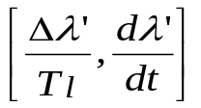


Bav*
available bandwidth on
transport connection
Sample timing scenario of AIMD on aggregated flows
bx
BW
depletion
0 < by <bx
rate jitter:
by
0
1
2
3
4
5
6
10
15
20
22
TIME
(iteration #s)
send rate λ’
desired
send rate λ
λ’(x)
steady-state
detection by
algorithm
limit-cycle
time
convergence
detection latency
Tc=9
Tl=4
For base values for β, α
λ’(y)
congestion-relief
λ’
λ
low ; medium
λ’(x)
higher β during congestion relief;
Steady-state: β is reduced to base value;
α is lower than base value
higher β during congestion relief;
no change in α
(no differentiation of steady-state
and congestion-relief state)
Tc=10
λ’(y)
medium
high
Tl=4
congestion-relief
λ’
λ
higher β during congestion relief;
Steady-state: β is reduced to base value;
no change in α
λ’(x)
higher β during congestion relief;
Steady-state: β is reduced to base value;
α is increased from base value
Tc=10
λ’(y)
medium ; medium
Tl=2
high ; medium
congestion-relief
Tl=3

Slide 7
User-participatory control of video send rates
f1
H.264-encoded
data flow (say)
f2
“last-mile”
. .
. .
.
.
send data packets into
core transport network
access network
Mechanism to detect
bandwidth-hogging users,
and evict them from session
f-N
AIMD protocol peers
.
.
λ:
user-level attempted
data flow rate (aggregated)
sustainable rate λ’ < λ
. .
. .
flow
aggregation
point
runs on
end-user device
DASHBOARD
‘fuel-gauge’-type of BW
availability indicator
[visual display]
current
send rate
λi”
Max. budgeted
rate λi’
next
display
software stubs
Min. acceptable rate
λi(min)
current
display
set reference
parameters to use
video encoder & network bandwidth
REDUCE
QoS space
GUI-internal
mapping
0.0
1.0
IMPROVE
SLIDING BAR
FOR CONTROL
OK
cancel
USER-ASSISTED CONTROL OF
VIDEO DATA FLOW & NETWORK BW
(including “LAST-MILE” segment)

