Slide 1
Optimizing Edge Detection: A Comparative Study of Sobel Algorithm Performance Across CPU, GPU, and Hybrid Computing Environments
PARALLEL PROGRAMMING (CSE -3261) MINI PROJECT REPORT
Anurag Nayak- 210905016
Adruti Onam- 210905190
Kushala Sarada- 210905189

Slide 2
Introduction
Edge detection crucial for computer vision, Sobel algorithm fundamental for identifying transitions in visual data.
Computational intensity of Sobel algorithm challenges CPU-based methods, especially for high-resolution or real-time processing.
CUDA offers accelerated image processing through GPU parallelism, ideal for small-scale tasks fitting within GPU memory.
For large-scale tasks exceeding GPU memory or benefiting from distributed computing, MPI-CUDA combination advantageous.
MPI facilitates communication between nodes, distributing workload across multiple GPUs/machines.
MPI-CUDA beneficial for highly parallel, large datasets in scientific computing, data analysis, and simulations.

Slide 3
Problem Statement
The objective of this study is to evaluate and compare the performance of the Sobel edge detection algorithm across different computing environments: CPU, GPU using CUDA, and a hybrid approach combining CUDA with MPI (Message Passing Interface). The focus is to determine the most efficient method for processing images of varying sizes, particularly large-scale images, which pose significant computational challenges. The study seeks to:
Assess the Performance: Quantitatively measure processing times and efficiency on traditional CPU, single GPU with CUDA, and distributed CUDA-MPI system.
Analyze Scalability for Large Images:Investigate scalability of each environment with increasing image sizes, particularly focusing on the exponential time increase observed in traditional CUDA implementations.
Demonstrate the Advantages of Hybrid Computing: Provide empirical evidence supporting the hypothesis that hybrid MPI+CUDA environments maintain consistent processing times across all image sizes, contrasting with standalone CUDA on large images.
Contribution: Conclusive findings to deepen understanding of effective computing strategies for image processing tasks, especially Sobel edge detection, and highlight benefits of hybrid computing for handling large-scale datasets efficiently.

Slide 4
Why Sobel Edge Detection?
The Sobel edge detection algorithm efficiently identifies edges in real-time applications by calculating gradients using horizontal and vertical convolution masks. Its sensitivity to image intensity variations enables precise edge highlighting, crucial for tasks like object detection and image segmentation. With a straightforward computational model, it's highly amenable to parallel processing optimizations, especially on GPUs via CUDA. This significantly boosts performance and applicability in high-demand real-time processing scenarios.

Slide 5
Methodology & Implementation
Experimental Setup:
Hardware Specifications:High-end multi-core processor for CPU, NVIDIA CUDA-capable GPU for GPU, and a hybrid environment integrating multiple GPUs and CPUs via CUDA and MPI.
Software Configurations: Standard C++ for CPU, CUDA for GPU parallel processing, and MPI for communication in the hybrid model.
CPU Environment:
Sequential processing of Sobel algorithm.
Time-consuming for large datasets.
GPU (CUDA) Environment:
Parallelized gradient calculation using CUDA kernels.
Utilizes GPU's parallel cores.
Optimizations: shared memory usage, minimizing global memory access.
Significant reduction in processing time.
Hybrid (CUDA, MPI) Environment:
Combines CUDA for GPU parallelism, OpenMP for CPU multi-threading, MPI for distributed computing.
Optimized Sobel operation.

Slide 6
Results and Analysis
CPU Performance: The sequential processing nature of CPUs inherently limits their speed for tasks such as Sobel edge detection, which benefit from parallelization. CPUs struggle with heavy computational loads, especially when dealing with large images or real-time processing due to their limited cores.
GPU (CUDA) Performance: GPUs excel in parallel processing, markedly reducing computation time for the Sobel algorithm. CUDA efficiently harnesses the multitude of cores in GPUs, offering substantial performance gains over CPUs. This parallelism is especially advantageous for image processing tasks, enabling real-time edge detection even in high-resolution images.
Hybrid (MPI+CUDA) Performance: This approach combines the strengths of GPU parallelism with MPI's distributed computing capabilities. By distributing tasks across multiple CPUs and GPUs, this environment achieves exceptional scalability and efficiency, particularly for large datasets or complex image processing tasks. It represents the apex of current computational strategies, optimizing both speed and workload distribution. Hence, it emerges as the most effective method, particularly for scalable, distributed computing tasks in image processing.

Slide 7

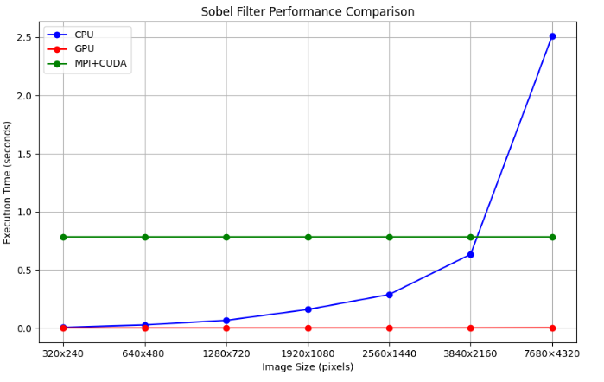
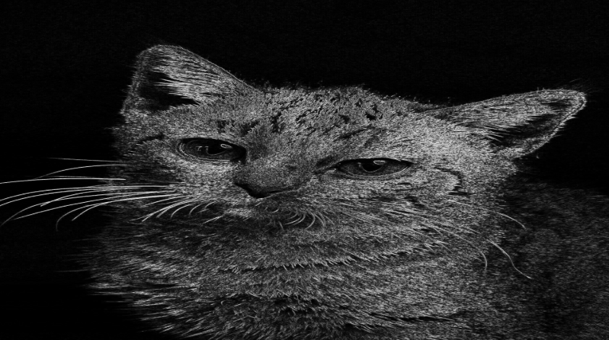
Fig: Image used
Fig:Output Image

Slide 8
Literature Review
Parallel Image Processing Based on CUDA
https://ieeexplore.ieee.org/abstract/document/4722322
Performance evaluation of image processing algorithms on the GPU
https://www.sciencedirect.com/science/article/abs/pii/S1047847708001792?casa_token=zc9PYkwEbkgAAAAA:uCsCeB826mcsok6tv6jc4Zpbpev7iwg6xj1VDfwqqOILrFJ2DHYnZWw9UbgoTuAgmHTed4mVHcU
An MPI–CUDA library for image processing on HPC architectures
https://www.sciencedirect.com/science/article/pii/S0377042714002374
Object oriented framework for CUDA based image processing
https://ieeexplore.ieee.org/abstract/document/6398223
Fast Morphological Image Processing Open-Source Extensions for GPU Processing With CUDA
https://ieeexplore.ieee.org/abstract/document/6218162

Slide 9
Parallel implementation of Sobel filter using CUDA
https://ieeexplore.ieee.org/abstract/document/8075658
Parallel edge detection by SOBEL algorithm using CUDA C
https://ieeexplore.ieee.org/abstract/document/7509360
Efficient implementation of Sobel edge detection algorithm on CPU, GPU and FPGA
https://www.inderscienceonline.com/doi/abs/10.1504/IJAMC.2014.060506
Time Performance Comparison between GPU and CPU Computing By Implementing an Edge-Detection Algorithm Using Sobel Filter
https://webbut.unitbv.ro/index.php/Series_I/article/view/1084
A Heterogeneous Implementation of the Sobel Edge Detection Filter Using OpenCL
https://ieeexplore.ieee.org/abstract/document/9200249

Slide 10
An improved Sobel edge detection
https://ieeexplore.ieee.org/abstract/document/5563693
Design of an image edge detection filter using the Sobel operator
https://ieeexplore.ieee.org/abstract/document/996
A Descriptive Algorithm for Sobel Image Edge Detection
https://www.researchgate.net/publication/320655135_A_Descriptive_Algorithm_for_Sobel_Image_Edge_Detection
Bitmap Image Processing and Edge Detection Using Sobel Algorithm and Multi-Threaded Parallel Techniques
https://ieeexplore.ieee.org/document/9655978
Image Edge Detection Based on Sobel with Morphology
https://ieeexplore.ieee.org/document/9586895

Slide 11
Conclusion
The comparative study on Sobel edge detection algorithm performance across CPU, GPU (CUDA), and hybrid (CUDA+MPI) platforms provides valuable insights. It confirms the superiority of GPU-based and hybrid computing approaches over traditional CPU methods in both performance and efficiency. Specifically, GPUs (CUDA) exhibit remarkable efficiency in edge detection tasks, significantly reducing computation times compared to CPUs, owing to their parallel processing power.
Moreover, the investigation into the hybrid MPI+CUDA approach underscores its advantages for processing large-scale images. Unlike standalone CUDA, which experiences exponential increases in processing time with image size, MPI+CUDA maintains consistent performance across all image sizes. This is due to MPI's distributed computing model, which effectively manages large datasets by distributing workload across multiple GPUs and nodes. This scalability renders MPI+CUDA particularly suitable for high-volume image processing tasks, achieving parallel efficiency without the performance bottlenecks seen in single-GPU setups.

Slide 12
Future Enhancements
Explore Other Algorithms: Analyze additional image processing algorithms beyond Sobel edge detection to understand GPU and hybrid MPI+CUDA system performance better. Algorithms like Gaussian blur and Canny edge detection offer insights into parallel computing framework efficiency.
Integrate Advanced GPU Technologies: Utilize newer GPU models and features to optimize image processing tasks. This includes leveraging tensor cores for AI-based analysis and exploring real-time ray tracing's impact on processing speed and fidelity.
Optimize Parallel Computing Strategies: Refine data distribution and load balancing techniques in MPI+CUDA systems to maximize resource utilization and minimize processing times. Develop adaptive algorithms that dynamically adjust to available hardware resources for more efficient image processing.

