Slide 1
Machine Learning
Machine Learning:
a tour through some favorite results, directions, and open problems
Machine Learning:
a 1-semester course in 2 hrs
Avrim Blum
Carnegie Mellon University
Your guide:
(no tipping)
[FOCS 2003 tutorial]

Slide 2
Philosophy of the tour
A set of topics with:
nice/clean theory.
relation to other TOC issues / tools have potential use in other TOC areas.
good open problems.
useful in practice
I know something about it.

Slide 3
Itinerary
Preparation: Basic concept learning setting (learning from examples)
Stop 1:Batch learning:Algs&Sample complexity (why am I trying to optimize on data I’ve seen: why should this carry over to the future?)
Stop 2:Online learning (expert advice and other problems)
Stop 3:SQ and Fourier (strong complexity results)
Stop 4:Current “hot” practical issues.
Emphasize connections to other TOC areas/issues (incl apx algs, online algs, auctions, complexity, crypto)

Slide 4
The concept learning setting
Imagine learning algorithm trying to decide which loan applicants are bad credit risks.
Might represent each person by n features. (e.g., income range, debt load, employment history, etc.)
Take sample S of data, labeled according to whether they were/weren’t good risks.
Goal of algorithm is to use data seen so far produce good prediction rule (a “hypothesis”) h(x) for future data.

Slide 5
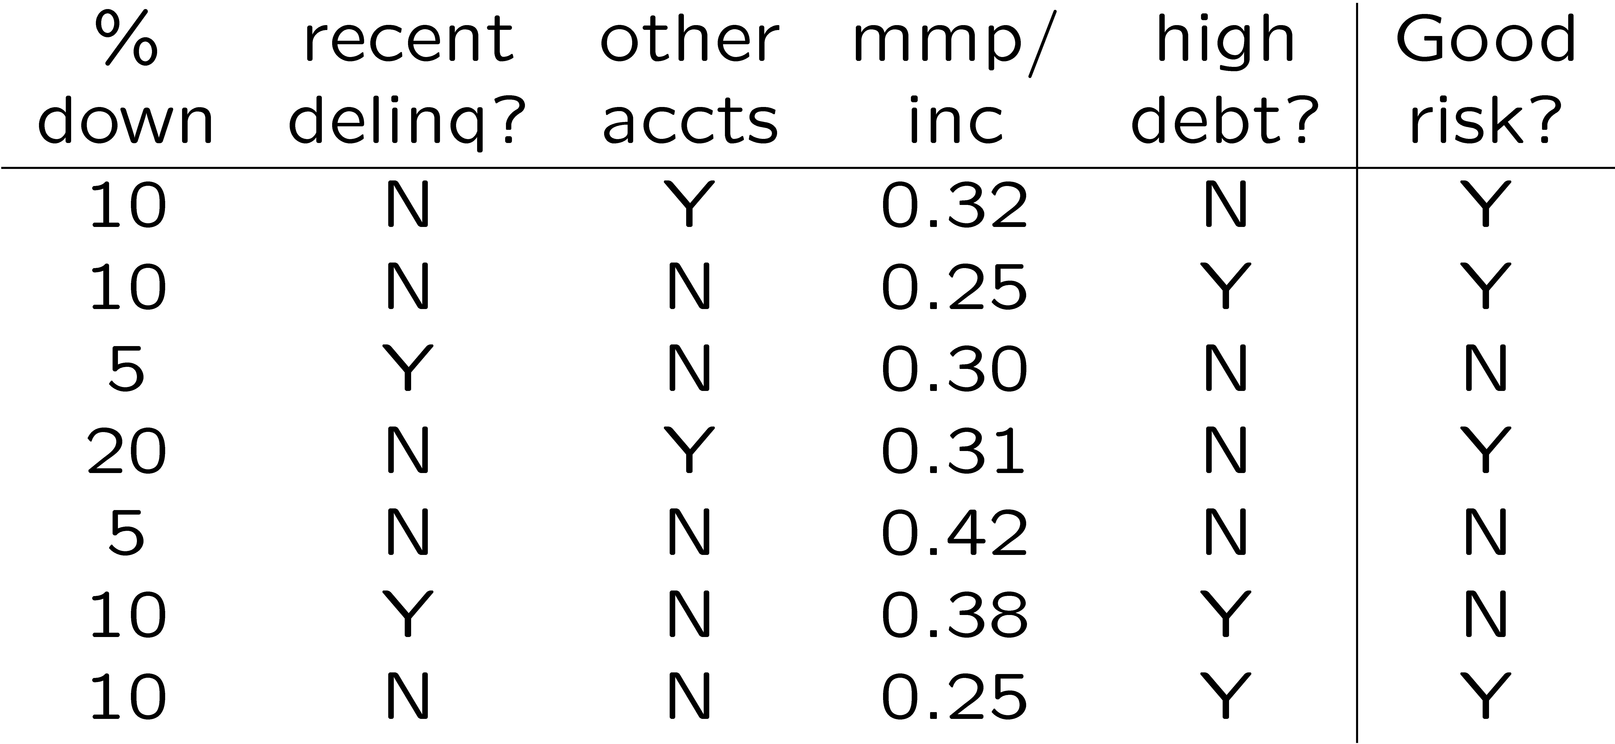
The concept learning setting
E.g.,
Given this data, some reasonable rules might be:
Predict YES iff (!recent delinq) AND (%down > 5).
Predict YES iff 100*[mmp/inc] – 1*[%down] < 25.
...

Slide 6
Big questions
(A) How might we automatically generate rules that do well on observed data?
(B) What kind of confidence do we have that they will do well in the future?
Or, in reverse order,
What to optimize? [sample complexity]
How to optimize it? [algorithms]

Slide 7
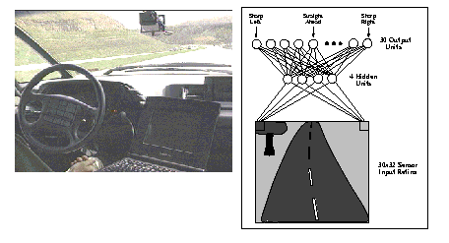
Power of basic paradigm
Lots of problems solved by converting to basic “concept learning from structured data” setting.
E.g., document classification
  convert to bag-of-words
  LTFs do well
E.g., driving a car
  convert image into features.
  Use neural net with several outputs.

Slide 8
Stop 1: PAC model: Algs & sample complexity

Slide 9
Natural formalization (PAC)
Alg is given sample S = {(x,y)} presumed to be drawn from some distribution D over instance space X, labeled by some target function f.
Alg does optimization over S to produce some hypothesis h.
Goal is for h to be close to f over D.
Allow failure with small prob δ (to allow for chance that S is not representative).

Slide 10
Basic PAC learning defn
A concept class is a set of functions, together with a representation of them.
Alg A PAC-learns concept class C by hypothesis class H if for any target f in C, any distrib D over X, any ε, δ > 0,
  A uses at most poly(n,1/ε,1/δ,size(f)) examples and running time.
  With probability 1-δ, A produces h in H of error at most ε.
accuracy
confidence

Slide 11
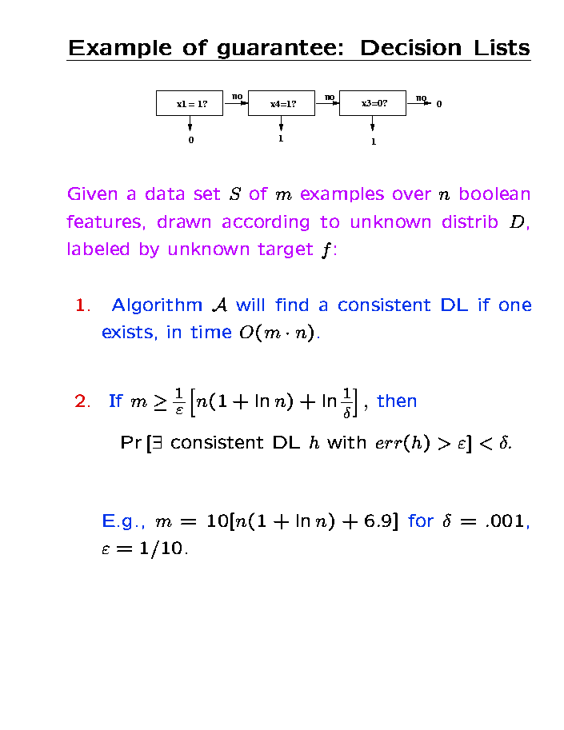
Example of guarantee: Decision Lists
Given a dataset S of m examples over n boolean features, drawn according to unknown distrib D, labeled by unknown target f:
Algorithm A will find a consistent DL if one exists, in time O(mn).
If m > (1/ε)[n(2+ln n) + ln(1/δ)], then
Pr[exists consistent DL h with err(h) > ε] < δ.
Notes:
An example of a typical kind of guarantee we might prove. See why it gives us the PAC condition: if target is a DL, then alg will find one. Furthermore, with prob at least 1-delta, there are no bad consistent DLs, so consistency by itself is enough to ensure error rate is at most epsilon. Let’s now see how we can get each of them, starting with #1.

Slide 12
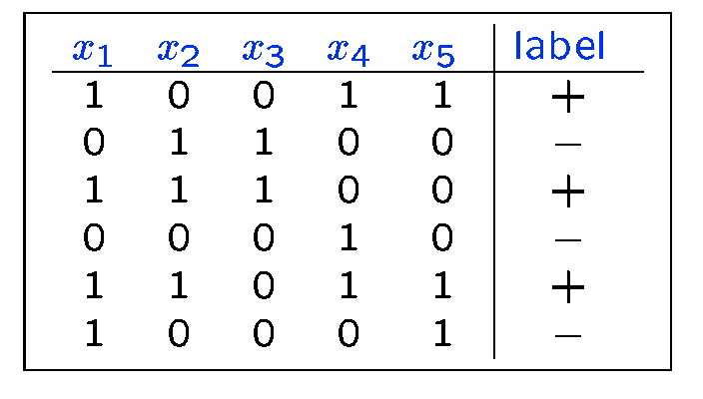
How can we find a consistent DL?
if (x₁=0) then -, else
if (x₂=1) then +, else
if (x₄=1) then +, else -

Slide 13
Decision List algorithm
Start with empty list.
Find if-then rule consistent with data.
  (and satisfied by at least one example)
Put rule at bottom of list so far, and cross off examples covered. Repeat until no examples remain.
If algorithm fails, then:
  No DL consistent with remaining data.
  So, no DL consistent with original data.
OK, fine. Now why should we expect it to do well on future data?

Slide 14
Confidence/sample-complexity
Consider some hypothesis h with err(h) > ε.
Chance that h survives m examples is at most (1-ε)^{m}.
Number of DLs over n Boolean features is at most n!4^{n}. (for each feature there are 4 possible rules, and no feature will appear more than once)
) Pr[some DL h with err(h)>ε is consistent] < n!4^{n}(1-ε)^{m}.
This is < δ for m > (1/ε)[n(2+ln n) + ln(1/δ)]

Slide 15
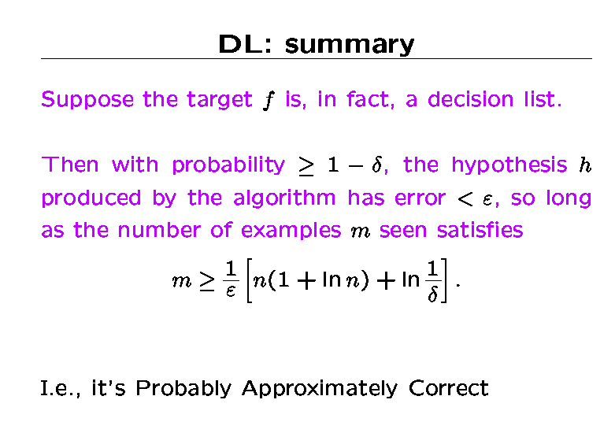
2

Slide 16
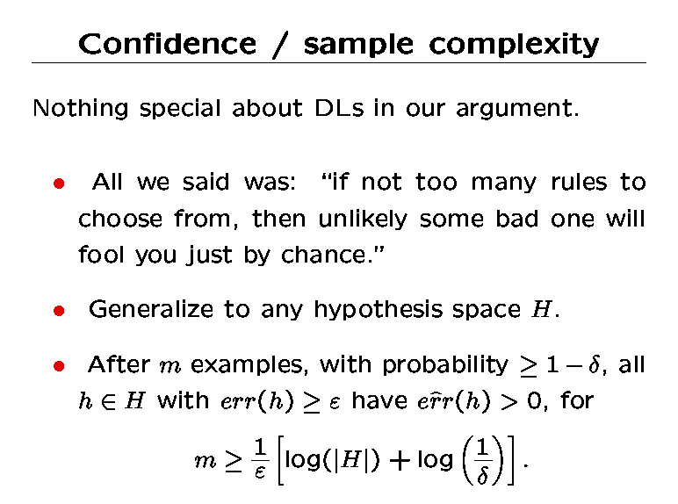

Slide 17
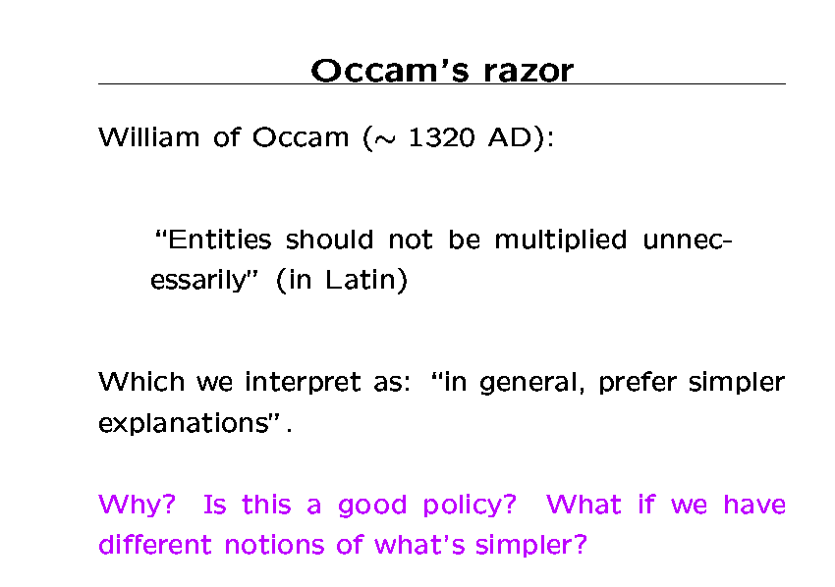

Slide 18
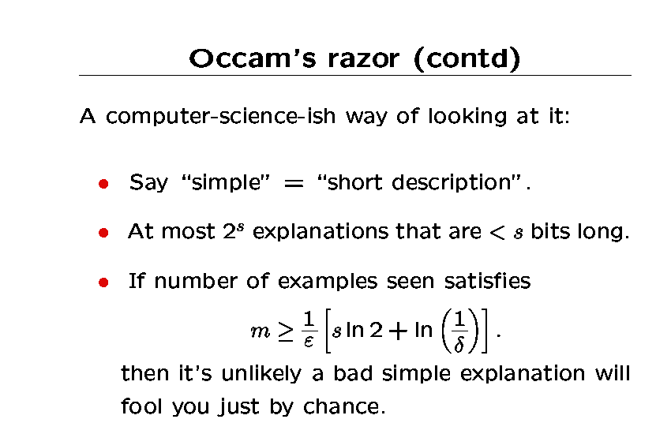

Slide 19
Occam’s razor (contd)²
Nice interpretation:
Even if we have different notions of what’s simpler (e.g., different representation languages), we can both use Occam’s razor.
Of course, there’s no guarantee there will be a short explanation for the data. That depends on your representation.

Slide 20
Where are we now?
Introduced PAC model. Showed class of decision lists learnable by decision list hypotheses.
Saw Occam’s razor argument.
Implications:
  If we view cost of examples as comparable to cost of computation, then don’t have to worry about cost of data since just need ~ 1/ε examples per bit we output.
  But, in practice, costs often wildly different, so sample-complexity issues are crucial.

Slide 21
What’s next
Stop 1(a): a few more words about sample complexity.
Stop 1(b): a few more words about algorithmic issues.
Stop 1(c): some of my favorite open problems.

Slide 22
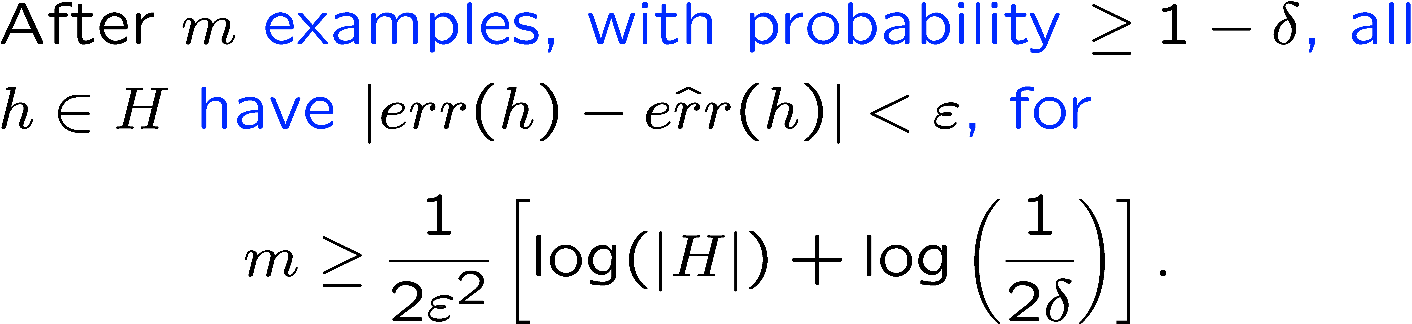
More on sample complexity
Bounds so far are for “realizable case”. (when we expect there will be a perfect rule). They say whp if true error > ε then empirical error > 0.
More generally, might want to say whp all rules have empirical error near to true error.
“uniform convergence”
Gives hope for local optimization over training data.
Notes:
Using Hoeffding bounds.

Slide 23
Tighter measures of size(H)
Suppose we want to separate data using a line in the plane.
+
+
−
+
+
−
−
−
There are infinitely-many linear separators, but not that many really different ones.
In hindsight, only O(m²) ways of separating our given m points.
Notes:
One direction of improvement on the previous bounds is in getting tighter measures of the size of the hypothesis space.

Slide 24
Neat fact
Can replace |H| with # ways of splitting 2m points in the bounds.
# ways of splitting = O(m^{VC-dim(H)}). (VC-dimension is the largest number d of points that can be split in all 2^{d} ways.)
We then take the log, so this shows the number of examples needed is only linear in VC-dim(H).
Notes:
I like to think of the main fact here as the first point. VC-dim just happens to be a convenient way of upper-bounding it.

Slide 25
Proof sketch
Step 1: imagine we draw m training examples and m test examples.
  Then, Pr[exists h that looks good on train, bad on test]
  > ½Pr[some bad h looks good on train]
  (so can show 2nd is small by proving 1st is small)
Step 2: make even worse on ourselves by allowing adversary to pick 2m points. Randomize over partition into m train and m test.
Step 3: But now we’re back in finite case. Can argue like Occam, over the splits of the sample.
Can view result as allowing description language to depend on unlabeled double sample.
Notes:
Step 1: if some bad hyp h looks good on training set, then at least 50/50 chance will look bad on test set (in fact can make ½ as close to 1 as we like depending on our defn of “bad”. So, given that 2nd event happens, there’s at least a 50/50 chance the 1st event will happen too.

Slide 26
Other related nice bounds
Margin bounds.
  Nice connection to Johnson-Lindenstrauss too.
PAC-Bayes bounds.
  Can view Occam as saying for any prob dist P over H, we can be confident in h_{i} if it is consistent with ε⁻¹[log(1/p_{i}) + log(1/δ)] samples. (basically allowing h_{i} to fool us with prob δp_{i})
  What if no individual h_{i} that’s consistent has high enough p_{i}, but there are several that together have a high sum of p_{i}’s? Then can randomize over them to get bounds as if was one hyp with combined probs.
Subsample (“compression”) bounds
Notes:
“margin” = “margin of error”

Slide 27
What’s next
Stop 1(a): a few more words about sample complexity.
Stop 1(b): a few more words about algorithmic issues.
Stop 1(c): some of my favorite open problems.

Slide 28
Algorithmic/model issues
PAC model talks of learning C by H.
If H=C then learning is NP-hard if consistency problem is NP-hard.
  May not be clear if difficulty is due to C or H.
To look at “how inherently hard is C to predict?”, let H = poly time programs. Then hardness is more cryptographic.
To use hard learning problem for crypto, need to be hard for “random” fns in C.

Slide 29
Algorithmic/model issues
PAC model talks of learning C by H.
In practice, most natural to fix H, allow C to be arbitrary. (After all, H is under our control, but target function isn’t).
Try to find reasonable h in H if one exists. Usually hard to say anything positive theoretically.

Slide 30
Algorithmic/model issues
PAC model talks of ε and δ. (high prob, high acc)
Get same set of learnable concepts if fix ε=1/4, δ = ½. (reasonable prob, reasonable acc)
Or, ε = ½ - 1/poly, δ = 1 – 1/poly. (With 1/poly chance we do slightly better than random guessing). “weak learning”.
Result for δ is easy to see. Result for ε is Boosting. [Schapire, Freund & Schapire]
  Boosting results are really nice (both theoretically and practically). Involves re-weighting sample and rerunning algorithm. But not going to talk about....
Notes:
PAC model talks of getting high accuracy whp. Same set if ask for modest accuracy with reasonable probability. Or even barely-better-than-guessing accuracy with non-negligible probability

Slide 31
Algorithmic/model issues
What about adding extra power to alg?
“Membership query” model: learner can ask for f(x) for examples x of its construction.
  adds significant power.
  allows for more interesting algorithms.
  but rare in practice. Esp because “target function” is really a fiction.
What is often possible in practice is “active learning”. Have large unlabeled sample and alg may choose among these.

Slide 32
Open Problems
Learning functions of r relevant variables.
Learning “almost-OR” functions.
Learning DLs over string-valued features.
Learning Monotone DNF over uniform.

Slide 33
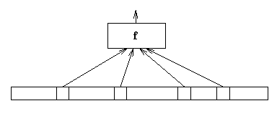
Learning functions of r variables
Examples in {0,1}^{n}. Uniform distribution.
But only r of these n bits are relevant.
Target is arbitrary function of these r.
Q1: learn in poly time for r = O(log n)?
Note: this is special case of “Are DNF learnable over uniform dist?” and “Are decision trees learnable over uniform dist?”

Slide 34
Learning functions of r variables
Examples in {0,1}^{n}. Uniform distribution.
But only r of these n bits are relevant.
Target is arbitrary function of these r.
Q1: learn in poly time for r = O(log n)?
Note 2: this is easy if we allow Membership Queries.

Slide 35
Learning functions of r variables
Examples in {0,1}^{n}. Uniform distribution.
But only r of these n bits are relevant.
Target is arbitrary function of these r.
Q2: How about r = loglog(n)?
Now can assume we know truth-table, since only n possibilities.

Slide 36
Learning functions of r variables
Examples in {0,1}^{n}. Uniform distribution.
But only r of these n bits are relevant.
Target is arbitrary function of these r.
Q2: How about n^{o(r)} or even n^{r/2}?
Best known is recent [MOS] result of ~ n^{0.7r}.

Slide 37
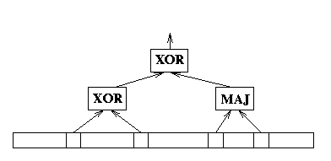
Example of hard-looking function
Pick two sets A,B.
Target is maj(A) XOR parity(B).

Slide 38
Open Problems
Learning functions of r relevant variables.
Learning “almost-OR” functions.
Learning DLs over string-valued features.
Learning Monotone DNF over uniform.

Slide 39
Learning “almost-OR” functions
Suppose target f has the property that it is close to an OR function over D.
  for some OR f’, Pr_{x}[f(x) != f’(x)] < 1%.
Can we get error < 49%? ½-1/n^{k}? (in poly time)
If we replace “OR” with “XOR”, and require H=C, then [Hastad] shows ½ - ε is NP-hard.
[Note: new hardness result of Dinur, Guruswami, and Khot on Set-Cover implies our problem is NP-hard if we require hyp to be an OR-function *and* require 1-sided error (we must get all positives correct, and at least 1% of negatives correct)]

Slide 40
Possibly easier version
Suppose really two functions, f and g:
  f is an OR function.
  g is arbitrary.
  Example drawn from D. With probability 99%, gets labeled by f, with probability 1%, gets labeled by g.
Potentially easier since adversary has less control. Still open though.
However, if require g = 1-f, then this is random noise model, and problem is easy. (even if you raise noise rate to 49%).

Slide 41
Open Problems
Learning functions of r relevant variables.
Learning “almost-OR” functions.
Learning DLs over string-valued features.
Learning Monotone DNF over uniform.

Slide 42
Learning Decision Lists revisited
What if features were string-valued rather than boolean valued? [also known as “infinite attribute model”]
E.g., x = (hello, how, are, you).
Target is a decision list, like:
  if (x₁ = “hello”) then +, else if (x₂ = “joe”) then -, else if (x₁ = “aargh”) then +, else -.
Can we learn in time poly(n, size(f))?
    (Previous alg may produce hyp that grows linearly with size of data set.)

Slide 43
Open Problems
Learning functions of r relevant variables.
Learning “almost-OR” functions.
Learning DLs over string-valued features.
Learning Monotone DNF over uniform.

Slide 44
Learning Monotone DNF over uniform
Uniform distribution on {0,1}^{n}.
Target is a monotone DNF formula.
Can you learn with error rate < 25%?
It’s known how to achieve error rate ½ - O(n^{-1/2}) [weak learning] [BBL]
It’s known how to strong-learn if the number of terms is small: 2^{p(log n)} [S]
But it’s not known how to strong-learn in general.

Slide 45
Stop 2: online learning

Slide 46
Basic setting
View learning as a sequence of trials.
In each trial, algorithm is given x, asked to predict f, and then is told the correct value.
Make no assumptions about how examples are chosen.
Goal is to minimize number of mistakes.
Note: can no longer talk about # examples needed to converge. Instead, we focus on number of mistakes. Need to “learn from our mistakes”.

Slide 47
Simple example: learning an OR fn
Suppose features are boolean: X = {0,1}^{n}.
Target is an OR function, like x₃ v x₉ v x₁₂, with no noise.
Can we find an on-line strategy that makes at most n mistakes?
Sure.
  Start with h(x) = x₁ v x₂ v ... v x_{n}
  Invariant: {vars in h} contains {vars in f }
  Mistake on negative: throw out vars in h set to 1 in x. Maintains invariant and decreases |h| by 1.
  No mistakes on postives. So at most n mistakes total.

Slide 48
Simple example: learning an OR fn
Algorithm makes at most n mistakes.
No deterministic alg can do better:
1 0 0 0 0 0 0 + or − ?
0 1 0 0 0 0 0 + or − ?
0 0 1 0 0 0 0 + or − ?
0 0 0 1 0 0 0 + or − ?
...

Slide 49
More general class: LTFs
Target is a vector (a₁, ... a_{n}) and threshold t.
Example x \in {0,1}^{n} is positive if a₁x₁ + ... + a_{n}x_{n} > t, else is negative.
An OR function is the case a_{i} \in {0,1}, t=1.
Q: can you guarantee at most poly(n,size(f)) mistakes?
Yes. Use the ellipsoid algorithm.
Examples seen so far form a set of linear constraints. (reversing usual use of “a” and “x” in LP)
Center of ellipsoid is hypothesis.
Mistake can be viewed as output of separation oracle.
Notes:
In this oracle model, you can’t do better than # mistakes = # bits, even for 1-dimension. E.g., 0 is negative, 1 is positive. What is ½? If positive, then what is ¼? etc...

Slide 50
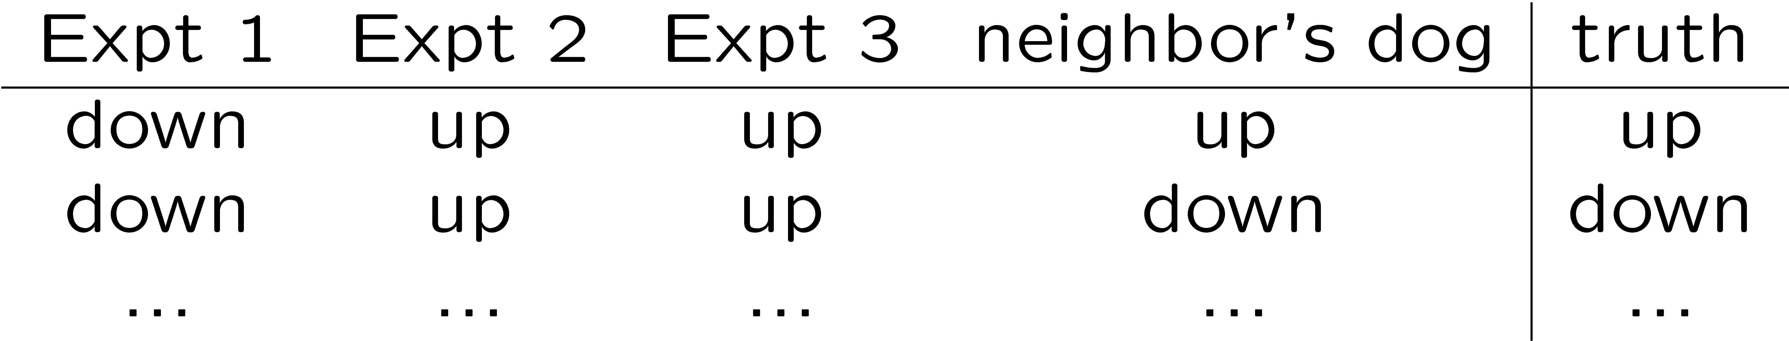
Using “expert” advice
Say we want to predict the stock market.
We solicit n “experts” for their advice. (Will the market go up or down?)
We then want to use their advice somehow to make our prediction. E.g.,
Rough question: What's a good strategy for using their opinions, given that in advance we don't know which is best?
[“expert” ´ someone with an opinion. Not necessarily someone who knows anything.]

Slide 51
Simpler question
We have n “experts”.
One of these is perfect (never makes a mistake). We just don’t know which one.
Can we find a strategy that makes no more than lg(n) mistakes?
Answer: sure. Just take majority vote over all experts that have been correct so far. Called “halving algorithm”.
Followup question: what if we have a “prior” p over the experts. Can we make no more than lg(1/p_{i}) mistakes, where expert i is the perfect one?
Sure, just take weighted vote according to p.

Slide 52
Relation to concept learning
If computation time is no object, can have one “expert” per concept in C.
If target in C, then number of mistakes at most lg(|C|).
More generally, for any description language, number of mistakes is at most number of bits to write down f.

Slide 53
Back to expert-advice
What if no expert is perfect? Goal is to do nearly as well as the best one in hindsight.
Strategy #1:
Iterated halving algorithm. Same as before, but once we've crossed off all the experts, restart from the beginning.
Makes at most log(n)*OPT mistakes, where OPT is # mistakes of the best expert in hindsight.
Seems wasteful. Constantly forgetting what we've “learned”. Can we do better?
Yes.

Slide 54
Weighted Majority Algorithm
Intuition: Making a mistake doesn't completely disqualify an expert. So, instead of crossing off, just lower its weight.
Weighted Majority Alg:
  Start with all experts having weight 1.
  Predict based on weighted majority vote.
  Penalize mistakes by cutting weight in half.

Slide 55
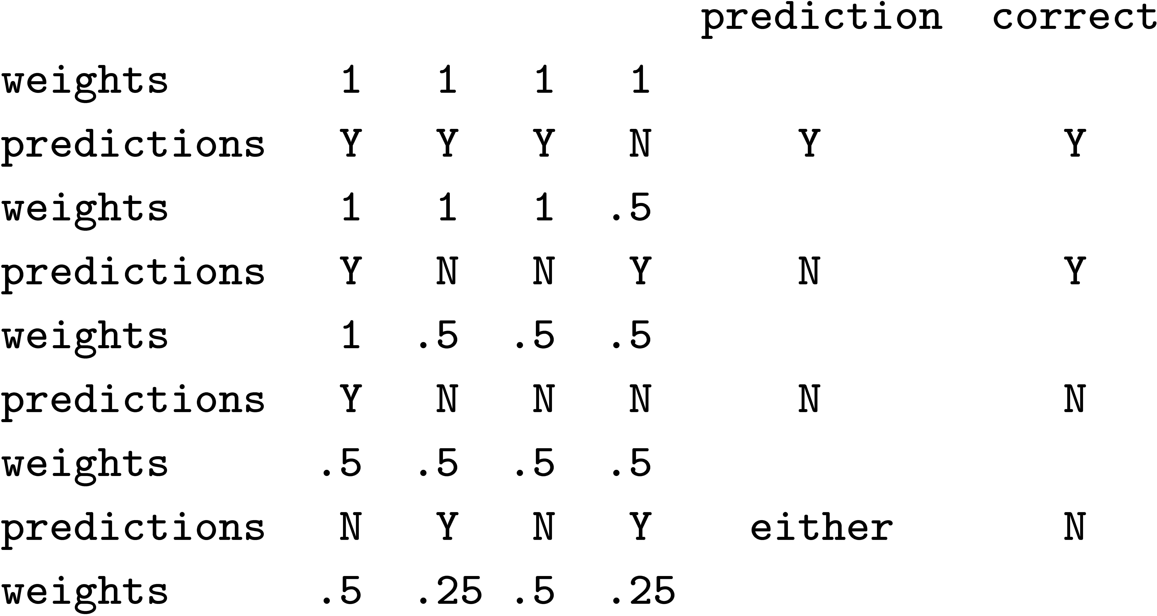
Weighted Majority Algorithm
Weighted Majority Alg:
  Start with all experts having weight 1.
  Predict based on weighted majority vote.
  Penalize mistakes by cutting weight in half.
Example:

Slide 56
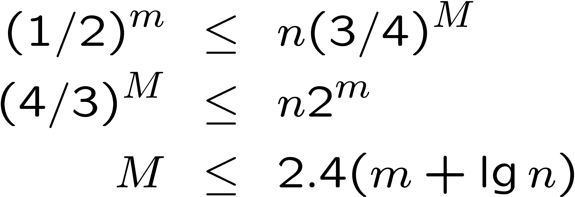
Analysis: do nearly as well as best expert in hindsight
M = # mistakes we've made so far.
m = # mistakes best expert has made so far.
W = total weight (starts at n).
After each mistake, W drops by at least 25%.
So, after M mistakes, W is at most n(3/4)^{M}.
Weight of best expert is (1/2)^{m}. So,
constant comp. ratio

Slide 57
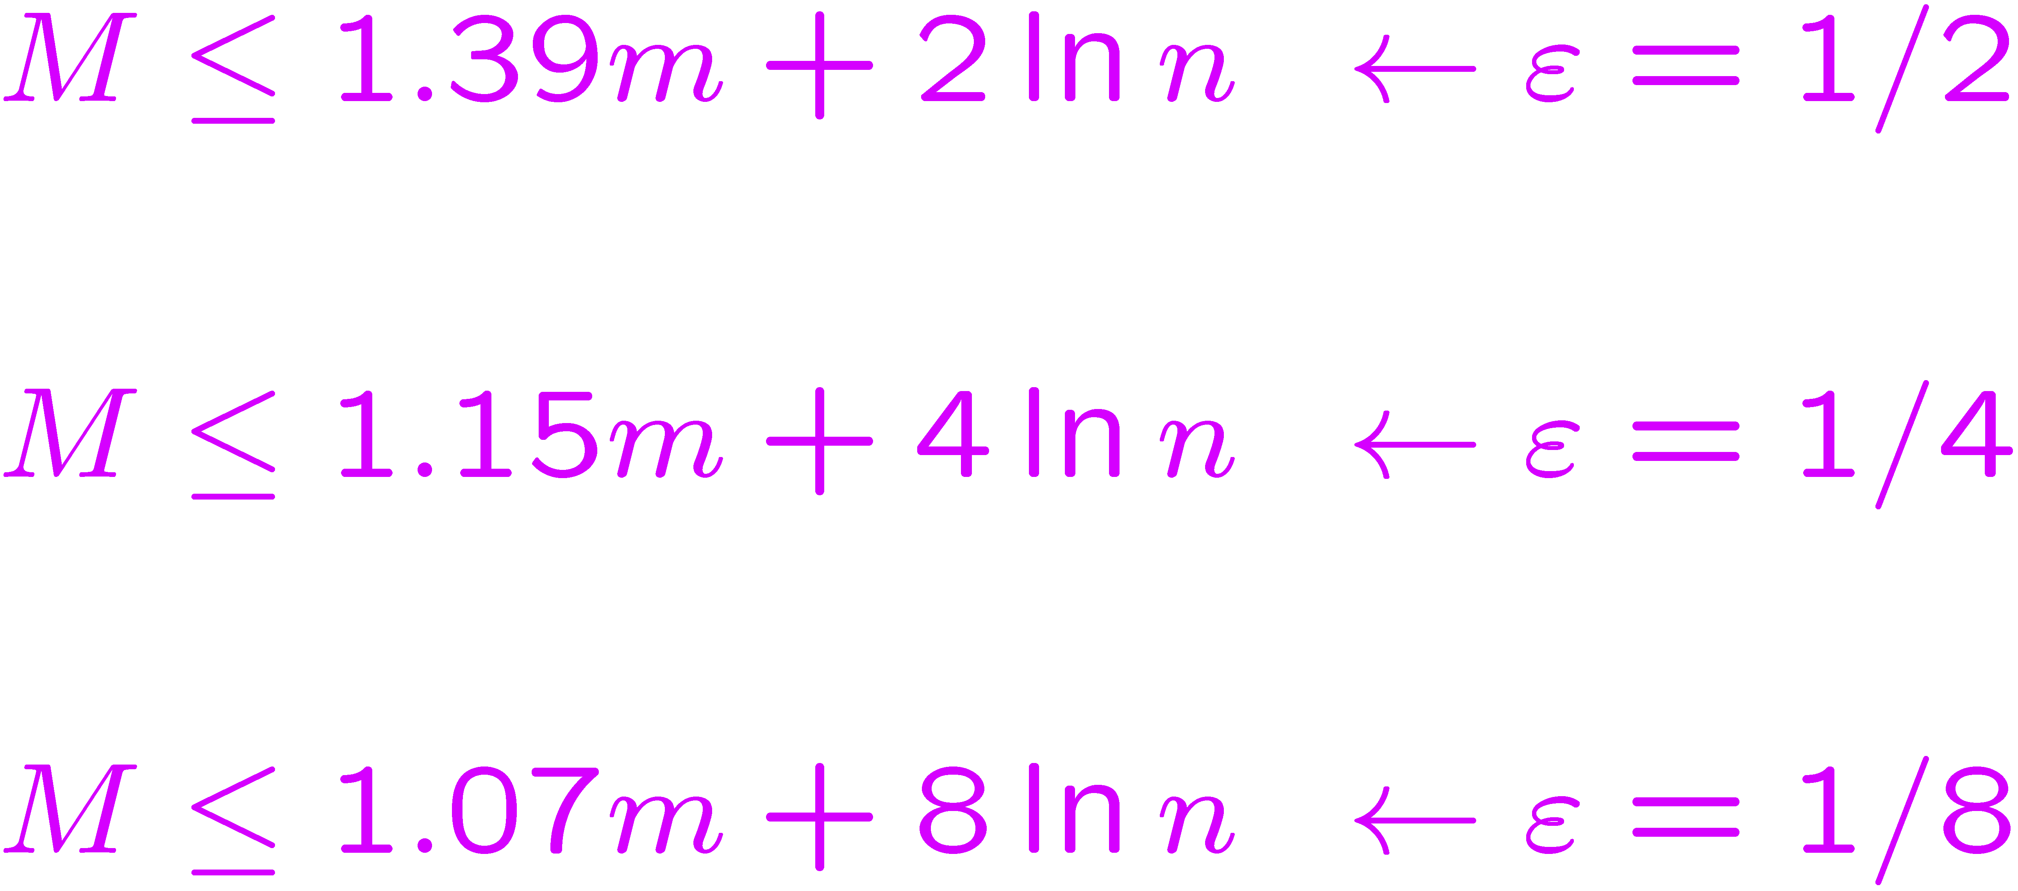
Randomized Weighted Majority
2.4(m + lg n) not so good if the best expert makes a mistake 20% of the time. Can we do better? Yes.
Instead of taking majority vote, use weights as probabilities. (e.g., if 70% on up, 30% on down, then pick 70:30) Idea: smooth out the worst case.
Also, generalize ½ to 1- ε.
unlike most C.R.s or apx bounds, numbers are pretty good.
Notes:
M = Expected number of mistakes.

Slide 58
Analysis
Say at time t we have fraction F_{t} of weight on experts that made mistake.
So, we have probability F_{t} of making a mistake, and we remove an εF_{t} fraction of the total weight.
  W_{final} = n(1-ε F₁)(1 - ε F₂)...
  ln(W_{final}) = ln(n) + ∑_{t} [ln(1 - ε F_{t})] · ln(n) - ε ∑_{t} F_{t}
    (using ln(1-x) < -x)
= ln(n) - ε M. (∑ F_{t} = E[# mistakes])
If best expert makes m mistakes, then ln(W_{final}) > ln((1-ε)^{m}).
Now solve: ln(n) - ε M > m ln(1-ε).

Slide 59
A fun application
n buckets. (Think of as startup companies.)
You are standing in one of them.
At each time step, a ball falls into one of the buckets. If it's your bucket, you get $1.
Then you can choose to move if you want
Game ends when fullest bucket has d balls.
This is hopeless if an opponent is tossing the balls based on knowing where you are(n't). However, say sequence of balls is predetermined (but unknown).
Randomized WM will guarantee you an expected gain of at least d – (2d log n)^{1/2}.
[Multiply weight by 1+ε whenever ball falls in, ε = (d/log n)^{1/2}.]

Slide 60
Summarizing
Can be (1+ε)-competitive with best expert in hindsight, with additive ε⁻¹log(n).
If have prior, can replace additive term with ε⁻¹log(1/p_{i}). [ε⁻¹ x number of bits]
Often written in terms of additive loss. If running T time steps, set epsilon to get additive loss (2T log n)^{1/2}

Slide 61
What can we use this for?
Can use to combine multiple algorithms to do nearly as well as best in hindsight.
  E.g., online auctions: one expert per price level.
Play repeated game to do nearly as well as best strategy in hindsight (which is at least as good as minimax optimal).
Extensions: “bandit problem”, movement costs.

Slide 62
What about if “n” is large?
Bounds still good even if #experts is very large.
  adaptive search trees: one expert per tree.
  online path planning: one expert per path.
  online linear programming: one expert per corner.
Nice recent results [KV][Z] on ways to get these bounds efficiently for these types of problems.

Slide 63
Stop 3: SQ learning and Fourier analysis

Slide 64
What are the goals of complexity theory?
We’d like to prove w/o assumptions that no polynomial-time algorithm can solve some natural problem (like one in NP).
Barring that, how about an algorithm with one arm tied behind its back?
How about both arms behind back, while hopping on one foot? (like AC⁰ ckts)
How often do you find yourself saying: “drat, there’s no way
my alg is going to succeed because it’s an AC⁰ ckt”?

Slide 65
What are the goals of complexity theory?
We’d like to prove w/o assumptions that no polynomial-time algorithm can solve some natural problem (like one in NP).
Barring that, how about an algorithm with one arm tied behind its back?
How about both arms behind back, while hopping on one foot? (like AC⁰ ckts)
(Of course, there’s been phenomenal success in showing how mild-looking assumptions can have enormous consequences)

Slide 66
SQ and Fourier analysis
We will define a paradigm for using data that nearly all learning algorithms satisfy or can be cast into. (“Statistical Queries”)
Use Fourier analysis to prove without assumptions they cannot learn certain natural classes in poly time.
  E.g., decision trees, parity functions, log(n)-relevant-var function.

Slide 67
The Statistical Query model
PAC model, but algorithm no longer has access to individual labeled examples.
Instead, algorithm may ask “what is the probability a labeled example would have property P?” Gets answer back up to error τ.
Think of this as asking for statistics about a poly-size sample S.
Formally, P must be poly-time computable, and τ > 1/poly(...).
Also assume alg knows underlying dist D.

Slide 68
Most algorithms can be cast in this framework
E.g., list-and-cross-off OR-function alg:
Ask for Pr[f(x)=0 & x_{i} = 1] with τ = ε/2n.
  (i.e., what’s the chance we’d cross it off)
Cross off all x_{i} with Pr[..] > ε/2n.
What’s left will include all correct variables.
Might include some incorrect ones too, but they will introduce at most ε/n error each.

Slide 69
Most algorithms can be cast in this framework
E.g., typical local-optimization algorithm:
Given current hypothesis h.
Asks for err(h) = Pr[h(x) != f(x)].
Then asks: “what if I make small change z or tweak parameter w, does it get better?”

Slide 70
Most algorithms can be cast in this framework
Original motivation of model: algorithms that behave this way can automatically be made tolerant to random classification noise. [Kearns]
In fact, only recently were examples shown of (non-SQ) alg to learn something with noise that is not learnable by SQs.
What I like: can get very good handle on what can/cannot be learned in this model.

Slide 71
Fourier analysis of finite fns
Let’s write pos, neg as +1, -1.
Think of a fn f:{0,1}^{n}! {-1,+1} as vector:
Nice properties:
<f,f> = ∑_{x} Pr_{D}(x)f(x)f(x) = 1.
<f,g> = ∑_{x} Pr_{D}(x)f(x)g(x)
= Pr_{D}[f(x) = g(x)] – Pr_{D}[f(x) != g(x)].
“orthogonal” = “pairwise uncorrelated”. E.g., under uniform dist, all 2^{n} parity functions are orthogonal (so they form a basis).
Notes:
Vector has 2^n entries.

Slide 72
SQ dimension
SQ dimension of a concept class C, over distr D, is the size of the largest subset S of C of “nearly orthogonal” functions:
  For all f,g in S, |<f,g>| < 1/|S|.
If SQ-dim(C) = poly(...) then you can weak-learn over D in SQ model. [non-uniform alg]
If SQ-dim(C) > poly(...) then you can’t weak-learn over D in SQ model.
Notes:
For the positive direction here, we’re assuming functions in C are poly-time computable...

Slide 73
Positive direction
If SQ-dim(C) = poly(...) then you can weak-learn over D in SQ model.
  SQ dimension of a concept class C, over distr D, is the size of the largest subset S of C such that for all f,g in S, |<f,g>| < 1/|S|.
  So, just hard-code S = {h₁,...,h_{|S|}} into the learning alg.
  Ask for correlation of h_{i} with target for all h_{i}in S
  One of them must have at least 1/|S| correlation
Notes:
This is a statistical query: what is prob a random example has label agreeing with h_i.

Slide 74
Negative direction
If SQ-dim(C) > poly(...) then you can’t weak-learn over D in SQ model.
Slightly over-simplified proof sketch:
  Show that any statistical query can be converted to asking for correlation of target with some unit-length vector q, up to +/- 1/poly.
  So, suppose C has > poly(...) orthogonal functions.
  query q can have correlation ε with at most 1/ε² of them.
  If only ask poly many queries, can only knock out negligible fraction. If target is random from S, then whp all queries can be answered with 0.

Slide 75
Implications
Parity functions have SQ-dim 2^{n}, so can’t learn by SQ.
Decision trees contain {Parity functions of size log(n)}. n^{log n} of them, so can’t learn by SQ.
Same for “functions of log(n) relevant variables.”

Slide 76
Stop 4: Current “hot” practical issues

Slide 77
Current “hot” practical issues
Learning from labeled and unlabeled data.
Nonlinear embeddings.
MDPs and stochastic games.
Adaptive programs and environments.
Kernels, comp bio, many others, ... [not going to talk about]

Slide 78
Learning from labeled and unlabeled data
Often unlabeled data is cheap, labeled data is expensive. Can unlabeled data help?
Rough answer: unlabeled data can suggest which hyps are a-priori more reasonable.
  E.g., linear separators that don’t go through clusters.
  E.g., data with pair-wise relationships (vertices in a graph): hyps that are good cuts or good ratio-cuts.
  Using unlabeled data to order your hypotheses.
Algorithmically, can use to bootstrap.
  E.g., co-training if two different sources of info. (e.g., words on page; words pointing to page)

Slide 79
Nonlinear embeddings
Often the “real” dimensionality of data is a lot smaller than the space we’re using.
But might not be just a linear embedding.
Want a nonlinear projection that unrolls the manifold.
E.g., one approach: take a lot of data, draw nearest-neighbor graph, use to project.

Slide 80
MDPs and stochastic games.
Robot learning to act in its environment.
  Think of a directed graph where edges have rewards and a probability distribution over endpoints. (MDP)
Robot learning to act in environment with other agents who have their own agendas.
  Stochastic game.

Slide 81
Adaptive programs and environments
Can machine learning be a first-class part of a programming language?
  E.g., easy to write code with parameters that get optimized to the user’s needs.
Can systems/environments be built that adapt, suggest, help, etc.
Mostly crude (paperclip) or just talk right now...

Slide 82
References
[need to fill in...]
For more information, there is a web site for the area as a whole at www.learningtheory.org, with pointers to survey articles, course notes, tutorials, and textbooks.

