Slide 1
MICROSOFT FABRIC · DEEP DIVE AND DEMO
Toronto Community Housing
Arrears and vacancy, end to end — from source extract to the decision a caseworker actually makes.
Thursday 27 August 2026 · 2 hours · Demonstration-led

Slide 2
ITEM 1
What we want you to leave with
A WORKING PICTURE
A CONFIRMED LIST
• Fabric shown, not described
• Anchored to arrears and vacancy, not a generic retail demo
• Every number on screen traceable to a row
• What has to be in place before kickoff
• An owner and a date against each item
• The kickoff date itself
The technical and security questions should surface today, not in the first sprint.

Slide 3
AGENDA
Two hours
1–2
Objectives and where the engagement stands
15 min
3
Fabric orientation — the platform in one picture
10 min
4
Demo: landing TCHC data in OneLake
20 min
5
Demo: medallion architecture in practice
20 min
6
Demo: from curated data to a decision
20 min
7
Security, privacy and data protection
15 min
8
Governance, capacity and operations
10 min
9–10
Open questions, and the pre-kickoff checklist
10 min
Sixty of the hundred and twenty minutes are live demo. Questions are welcome throughout.

Slide 4
ITEM 3
The platform in one picture
OneLake
Lakehouse Warehouse
Data Factory
Semantic model
Power BI
One tenant-wide data lake. One copy. Open Delta Parquet.
Where the data lives and is shaped. Spark or T-SQL, same storage.
Pipelines and dataflows that bring the data in and orchestrate it.
The shared definition of a measure. Direct Lake, no second copy.
Where a decision actually gets made.
What this engagement uses:
all five. What it does not touch today — Real-Time Intelligence, Copilot and data agents, and migration of the existing Power BI estate.

Slide 5
DEMO 1 · ITEM 4 · 20 MINUTES
Landing TCHC data in OneLake
Shortcut, mirroring, pipeline, dataflow, gateway — which one fits which TCHC source system, and what each costs you.

Slide 6
ITEM 4
Five ways in, and what each is for
OPTION
FITS
SHOWN LIVE
Shortcut
Data already in ADLS or another lakehouse. No copy, no latency.
Yes
Mirroring
A supported source database, replicated continuously.
No — needs a source
Data Factory pipeline
A system with an API or database, on a schedule.
Yes
Dataflow Gen2
Low-code shaping, for a Power Query audience.
Discussion
On-prem / VNet gateway
Whichever TCHC systems are not internet-reachable.
No — needs a host
Mirroring and the gateway need something on TCHC's side that does not exist yet. Architecture conversation today, not demo.

Slide 7
DEMO 2 · ITEM 5 · 20 MINUTES
The medallion, on live data
Bronze is what arrived, including its problems. Silver is what we are willing to stand behind. Gold is what a decision can rest on.

Slide 8
ITEM 5
What Silver actually has to fix
Two date formats
dd/mm from the property system, mm/dd from finance
Money as text
"$1,234.56" arrives as a string
Five spellings, two concepts
RGI · rgi · Rent-Geared-to-Income · Market · MARKET
A re-sent batch
The extract ran twice; receipt_id deduplicates it
Receipts for unknown accounts
Quarantined, never dropped
Work orders with no unit
Quarantined, never dropped
Quarantine, not deletion.
Silently dropping an orphan receipt makes arrears read higher than it is, and nobody downstream can tell it happened.

Slide 9
DEMO 3 · ITEM 6 · 20 MINUTES
From curated data to a decision
The closest view of what the MVP looks like. This is also where the modelling decisions start to matter.

Slide 10
ITEM 6
Arrears is a calculation, not a column
THE EASY VERSION
WHAT WE DO
This month's charge minus this month's payment. A household that pays two weeks late every month looks permanently in arrears. One that missed a month last year and never made it up looks fine.
Receipts settle the oldest outstanding charge first, because that is how a rent account actually settles. The aging bucket follows the oldest charge still carrying a balance.
Both wrong answers reach a caseworker.
One sends a collections letter to somebody who is current. The other misses a household that has been sliding for a year.

Slide 11
ITEM 6
Direct Lake, Import, DirectQuery
Direct Lake
Import
DirectQuery
Reads the Delta files directly. No import. No refresh schedule. No second copy.
A copy held in memory. Fastest queries, but a refresh schedule and a latency.
Every query goes to the source. Always current, slowest, and it puts reporting load on the source.
WHAT WE USE
Direct Lake is why the medallion and the semantic layer are not two projects.
When the pipeline writes, the model sees it. The trade is one operational edge: replace a table rather than append to it and the model needs rebinding, not just refreshing.

Slide 12
ITEM 7
Security, privacy and data protection
ACCESS
PROTECTION AND NETWORK
• Workspace roles — Admin, Member, Contributor, Viewer
• OneLake data access roles — folder level, so Gold without Bronze
• Row-level security — a caseworker sees their portfolio, a director sees all
• Object-level security — hide a column or a table from a role entirely
• Sensitivity labels via Purview, travelling with exports
• Entra ID groups as the single place access is granted
• Private endpoints — a design decision with your network team, early
• Tenant data in the dev environment — live, masked, or synthetic
A question back to you:
does the development environment use live, masked, or synthetic tenant data? Everything you will see today is synthetic. That is the safest default, and it should be a decision rather than an omission.

Slide 13
ITEM 8
Governance, capacity and operations
Domains and workspaces
One workspace per environment per domain is the usual starting shape. Decide the naming convention before the first workspace, not the fifth.
Purview
Lineage across OneLake, so “where did this number come from” has an answer that is not a person.
Capacity
F-SKUs are a shared pool. Interactive queries and background jobs draw on the same units, and Fabric smooths bursts. The Capacity Metrics app shows what is actually consuming.
Git and deployment pipelines
This entire demo is in a repository — notebooks, pipeline, model and report. Deployment pipelines promote between workspaces.
We are not quoting an F-SKU today. It depends on volume, refresh pattern and concurrency, and none of those are known yet.

Slide 14
BEYOND THIS ENGAGEMENT
Where the AI piece fits
Out of scope for the MVP, and worth deciding deliberately rather than drifting into.
ASK THE DATA
EXPLAIN THE DATA
DECIDE WITH THE DATA
A Fabric data agent over the Gold layer. “Which buildings carry the most balance over ninety days?” in plain language, against the same measures the report uses.
A monthly arrears briefing, written from the pipeline's own numbers. The model never calculates. It renders what Gold produced, and every figure cites the row it came from.
Ranking households for contact. This stops being a technology question. Arrears touches somebody's housing, and that needs governance before it needs a model.
Closest to ready
Built twice, elsewhere
Not without a policy owner
The guardrail that matters here.
A household with a balance, a household we hold no data for, and a household outside the extract are three different things. Only the first is a finding. Any layer that lets them collapse into one list will eventually put the wrong name on it.

Slide 15
BEYOND THIS ENGAGEMENT
What the AI piece actually costs you
Two tenant switches, not one
A Fabric data agent needs Copilot and Azure AI enabled, and separately needs data permitted to leave the capacity's geography for processing. For an Ontario housing provider the second is a residency decision, not a checkbox.
Grounding is engineering, not prompting
The pipeline decides what the model may see, and hands it a bounded evidence envelope. That work sits in the Gold layer and the contract between them — which is why it comes after the MVP, not instead of it.
Validate the contract, not just the values
In an earlier build, an agent given no evidence returned a perfectly valid document citing a source that did not exist. Schema validation passed it. Only a second, independent check caught it.
A refusal has to be expressible
If the only valid answer shape is an answer, a model will invent one. It needs a lawful way to return nothing.
None of this is a reason not to do it. It is the reason to do the medallion and the semantic model first.

Slide 16
ITEM 10
Pre-kickoff checklist
An owner and a date against each, before we leave the room.
TCHC product owner named, with allocation confirmed for the engagement
owner
date
Fabric capacity decision — F-SKU size, reservation, Microsoft-hosted or TCHC tenant
owner
date
Azure subscription, Entra ID groups, administrative access for environment build
owner
date
Source system access for arrears and vacancy, plus a gateway host if required
owner
date
Azure DevOps or GitHub project available to the delivery team
owner
date
Development environment data — live, masked, or synthetic
owner
date
Security and privacy review slot booked inside the first two weeks
owner
date
Kickoff: week of 14 September 2026

Slide 17
WHAT WE ARE ASKING FOR
The two answers that shape everything else
Which system is the system of record for arrears balances, and which for unit vacancy — and what integration surface each one offers.
How current the data has to be for the decision the business actually makes. Daily, intraday, or near real time.

Slide 18
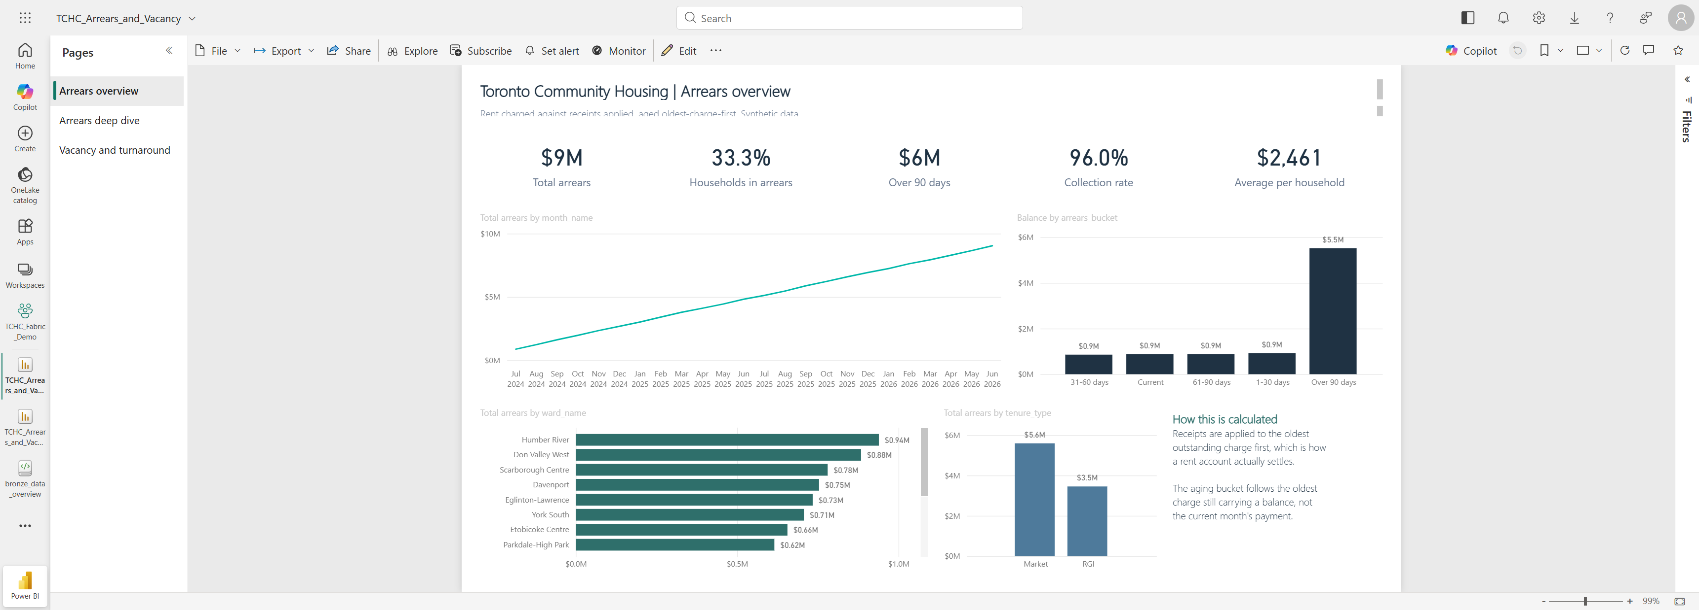
APPENDIX · REPORT PAGE 1
Arrears overview — portfolio position, trend, aging, concentration
Synthetic data. 120 buildings, 10,568 units, 24 months.

Slide 19
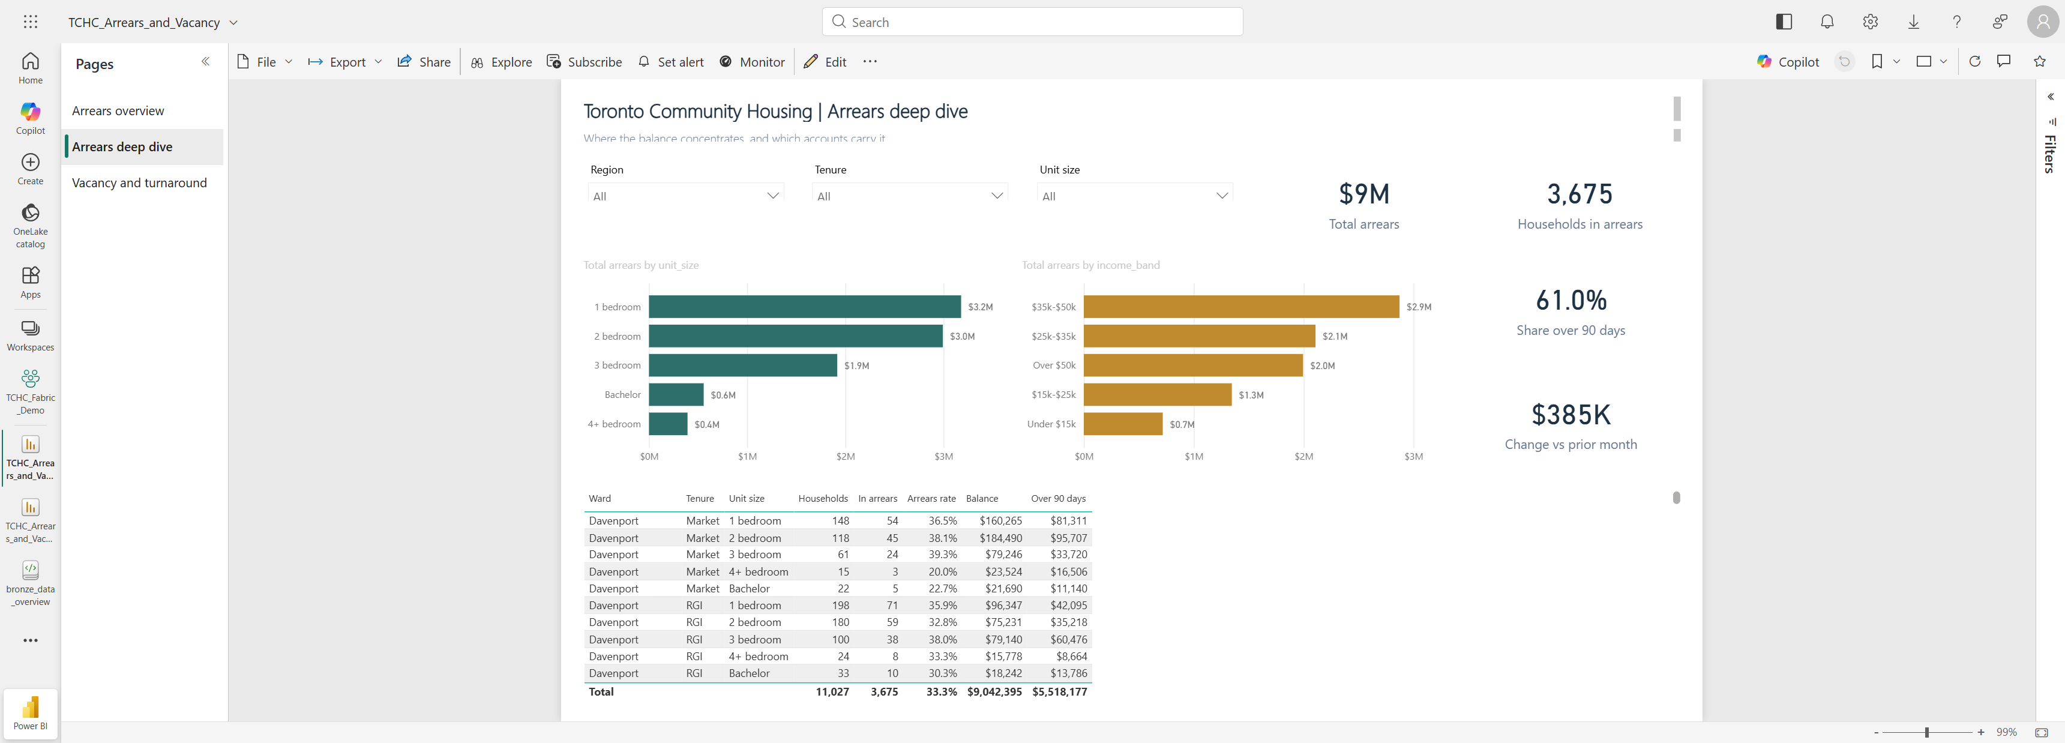
APPENDIX · REPORT PAGE 2
Arrears deep dive — where the balance sits, and the caseload table
Synthetic data. 120 buildings, 10,568 units, 24 months.

Slide 20

APPENDIX · REPORT PAGE 3
Vacancy and turnaround — vacancy, revenue forgone, turnaround days
Synthetic data. 120 buildings, 10,568 units, 24 months.

