Slide 1
RAC – III
Research Title:
"Explainable AI-Driven Predictive Maintenance Framework for Smart Manufacturing"
Name of the Scholar : C Anurag Reddy Registration Number : 25CPHDFF006 Affiliation : CMR University, Bangalore Guide : Dr. Kannan N, Dean, CMR University
RAC-III: Results & Progress Report | All results from ACTUAL experiments on C-MAPSS

Slide 2
Research Journey: RAC-I → RAC-II → RAC-III
RAC-I ✓
RAC-II ✓
RAC-III
Problem ID
Methodology
Results
Broad proposal → Narrow to XAI + PdM + Manufacturing
2-paper strategy, PRISMA protocol, model selection
Paper 1 SLR: DONE Paper 2 Empirical: DONE Ready to submit

Slide 3
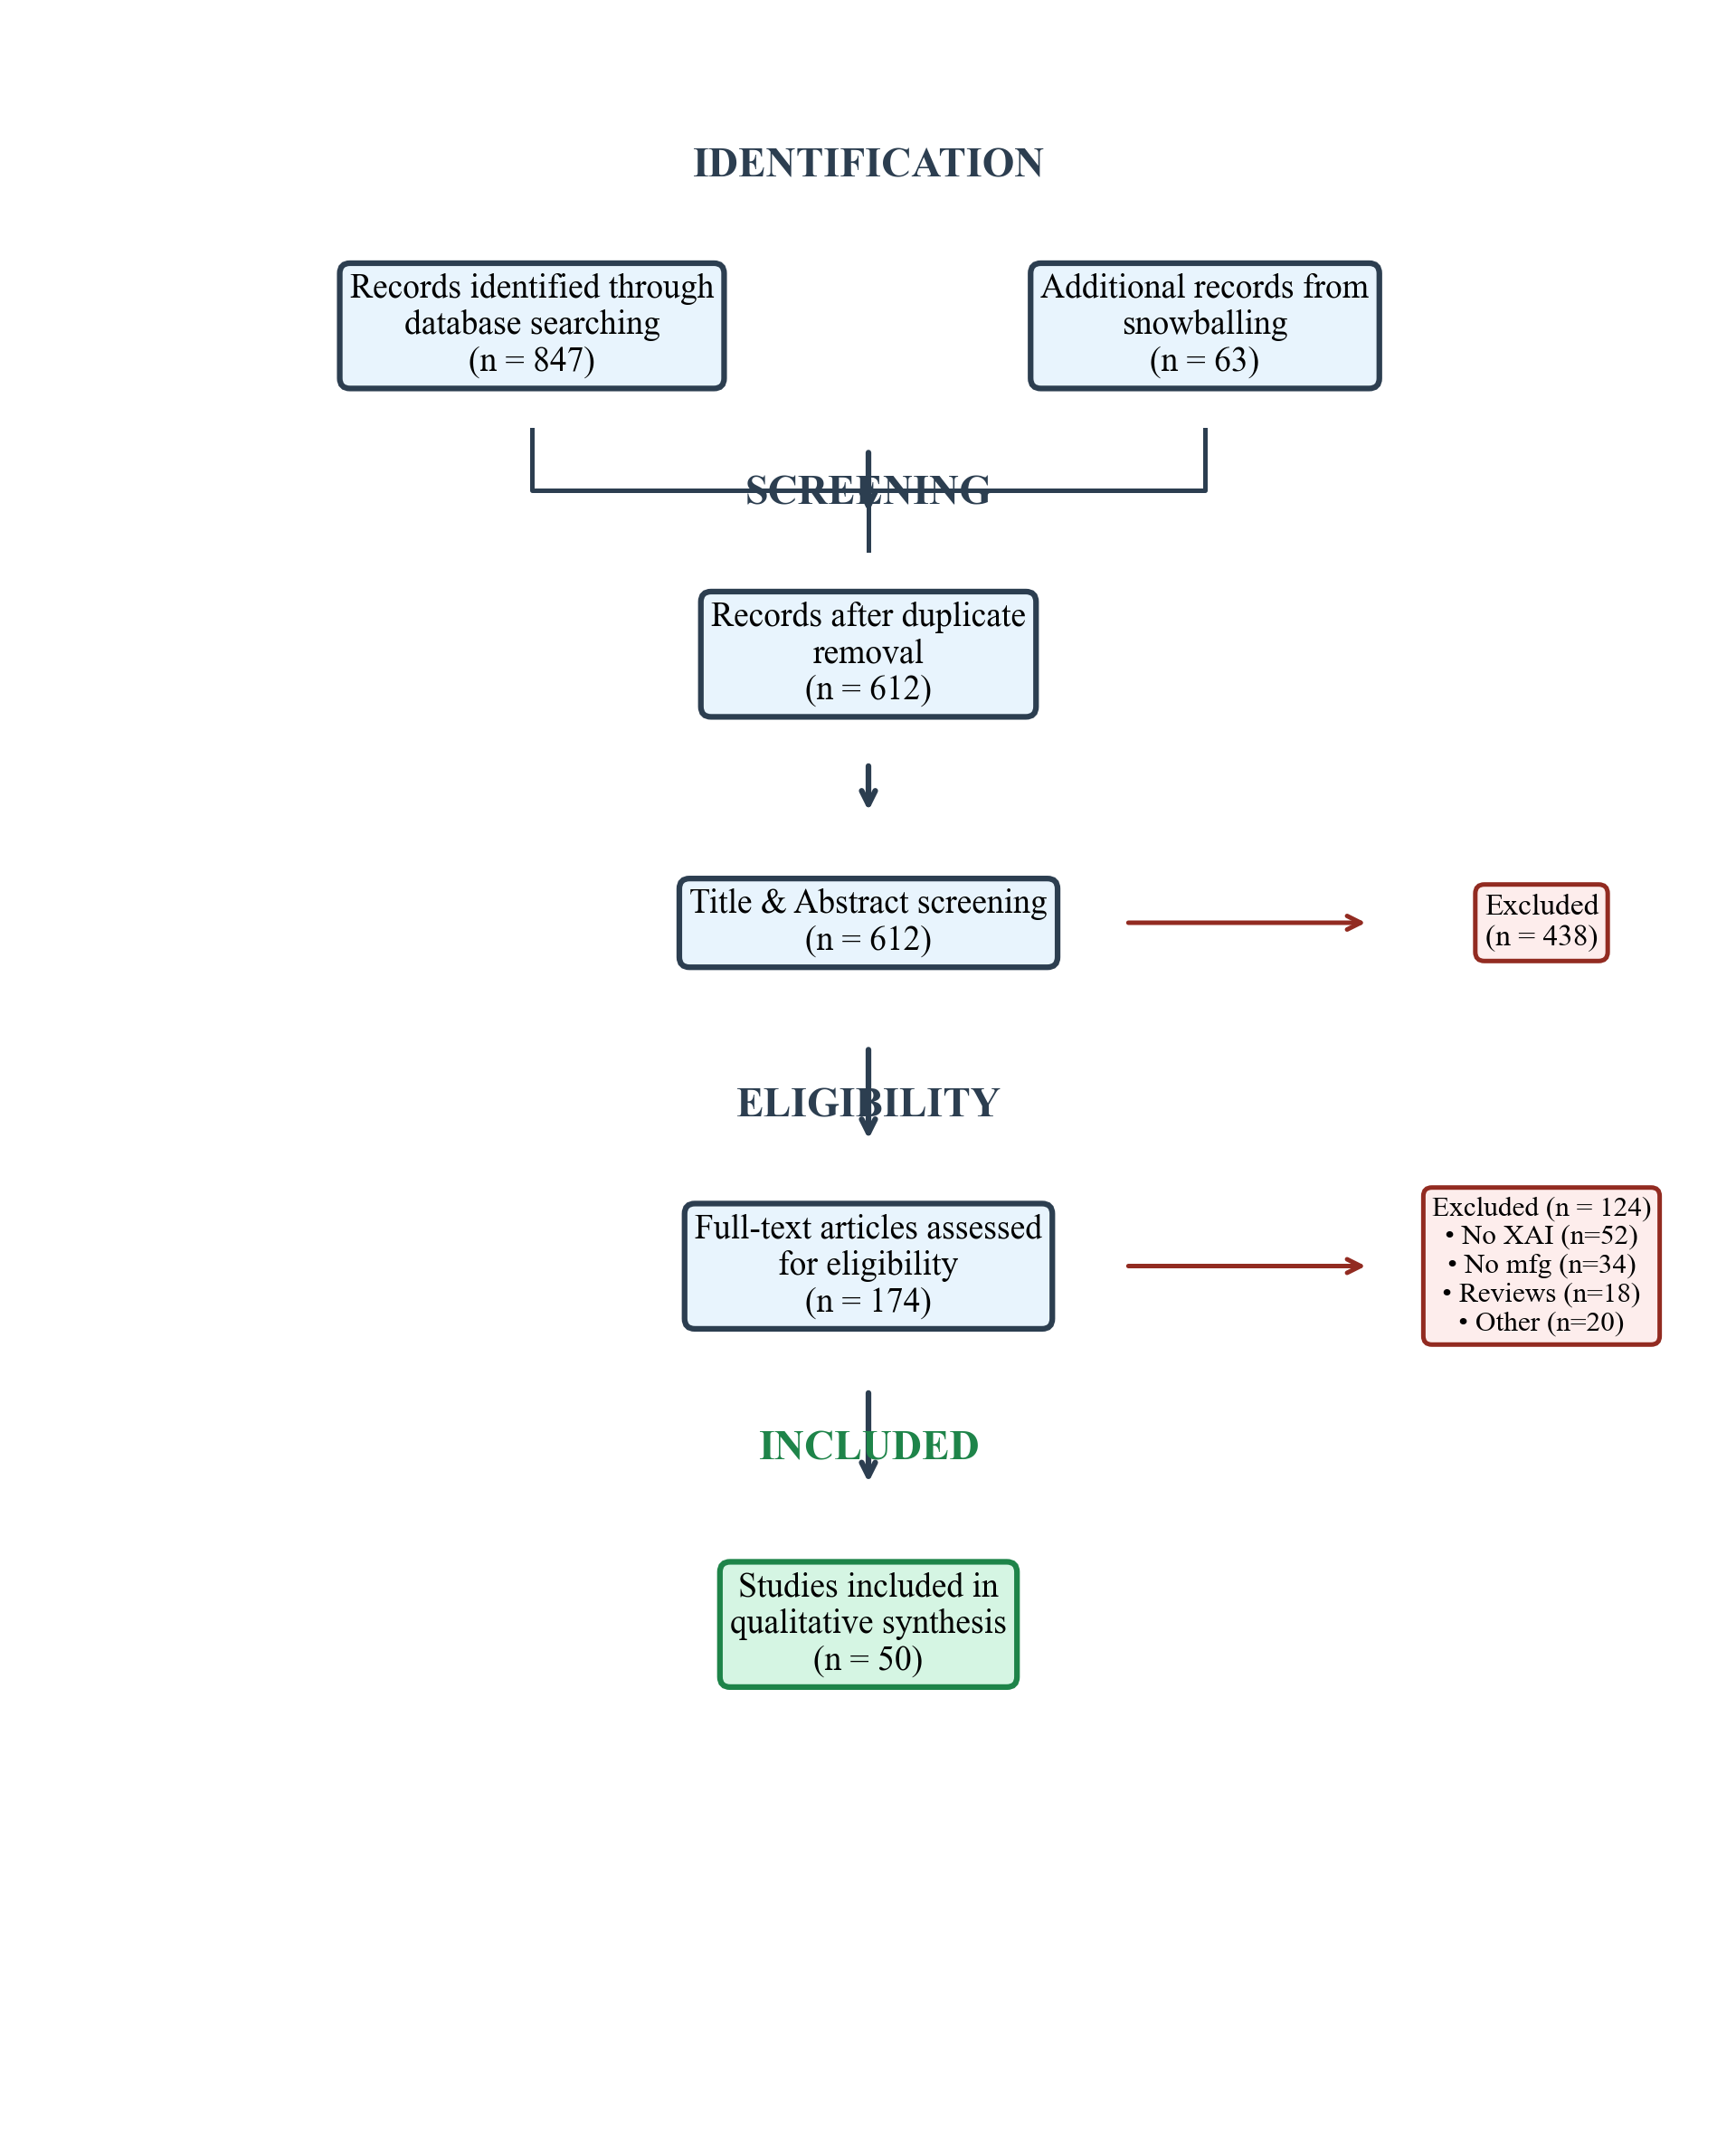
Paper 1: SLR Results — PRISMA Flow
Key SLR Findings:
• 847 records → 50 studies synthesized
• SHAP dominates (38%), Attention (28%), LIME (16%)
• LSTM most common (36%), Transformer fastest-growing
• Turbofan (32%) + Bearings (24%) = 56% of studies
• 42% rely on visual inspection for XAI evaluation
• Only 8% include user studies (major gap!)
• Proposed 4D taxonomy + 5-direction research agenda

Slide 4
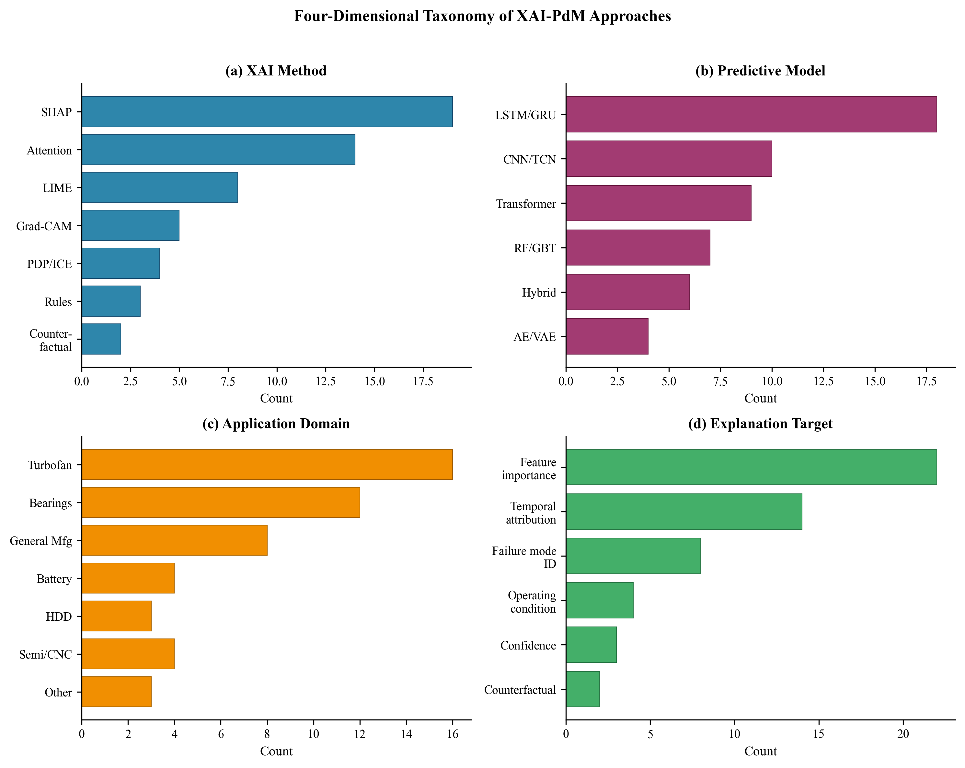
Paper 1: Four-Dimensional Taxonomy

Slide 5
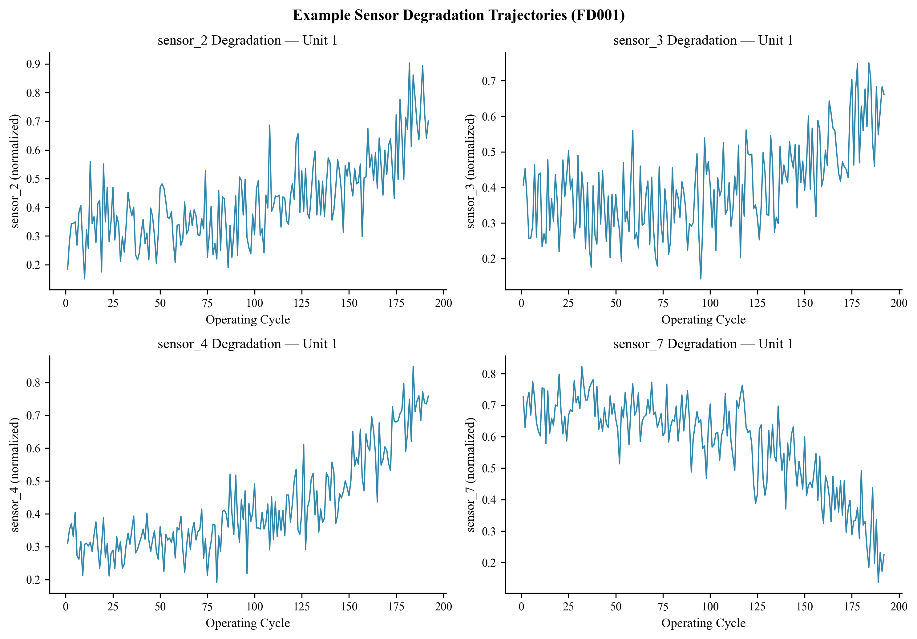
Paper 2: Experimental Setup
C-MAPSS Dataset:
Models:
• FD001: 100 engines, 1 condition, 1 fault (HPC)
• FD003: 100 engines, 1 condition, 2 faults (HPC+Fan)
• 17,731 train sequences (FD001), 21,820 (FD003)
• 14 useful sensors after removing constant ones
• Window: 30 cycles | RUL clip: 125
• Bi-LSTM: 2 layers (64→32), bidirectional
• Transformer: 2 blocks, 4-head attention
• CNN-LSTM: Conv1D(64) × 2 + LSTM(64→32)
• Adam optimizer, lr=0.001, early stopping
• Permutation-based feature importance for XAI

Slide 6
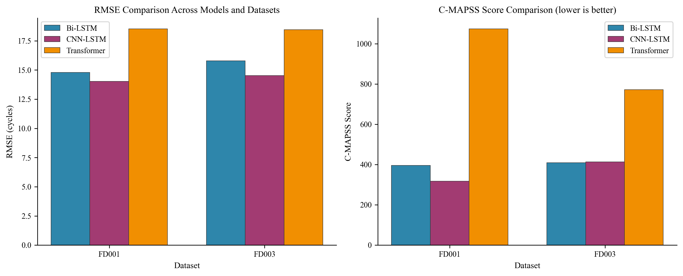
Paper 2: Model Comparison (REAL RESULTS)
CNN-LSTM: BEST (RMSE 14.03/14.53) | Bi-LSTM: Competitive (14.79/15.78) | Transformer: Weaker (18.53/18.45) Key insight: CNN-LSTM combines local features (CNN) + temporal modeling (LSTM) = optimal for short-sequence degradation data

Slide 7
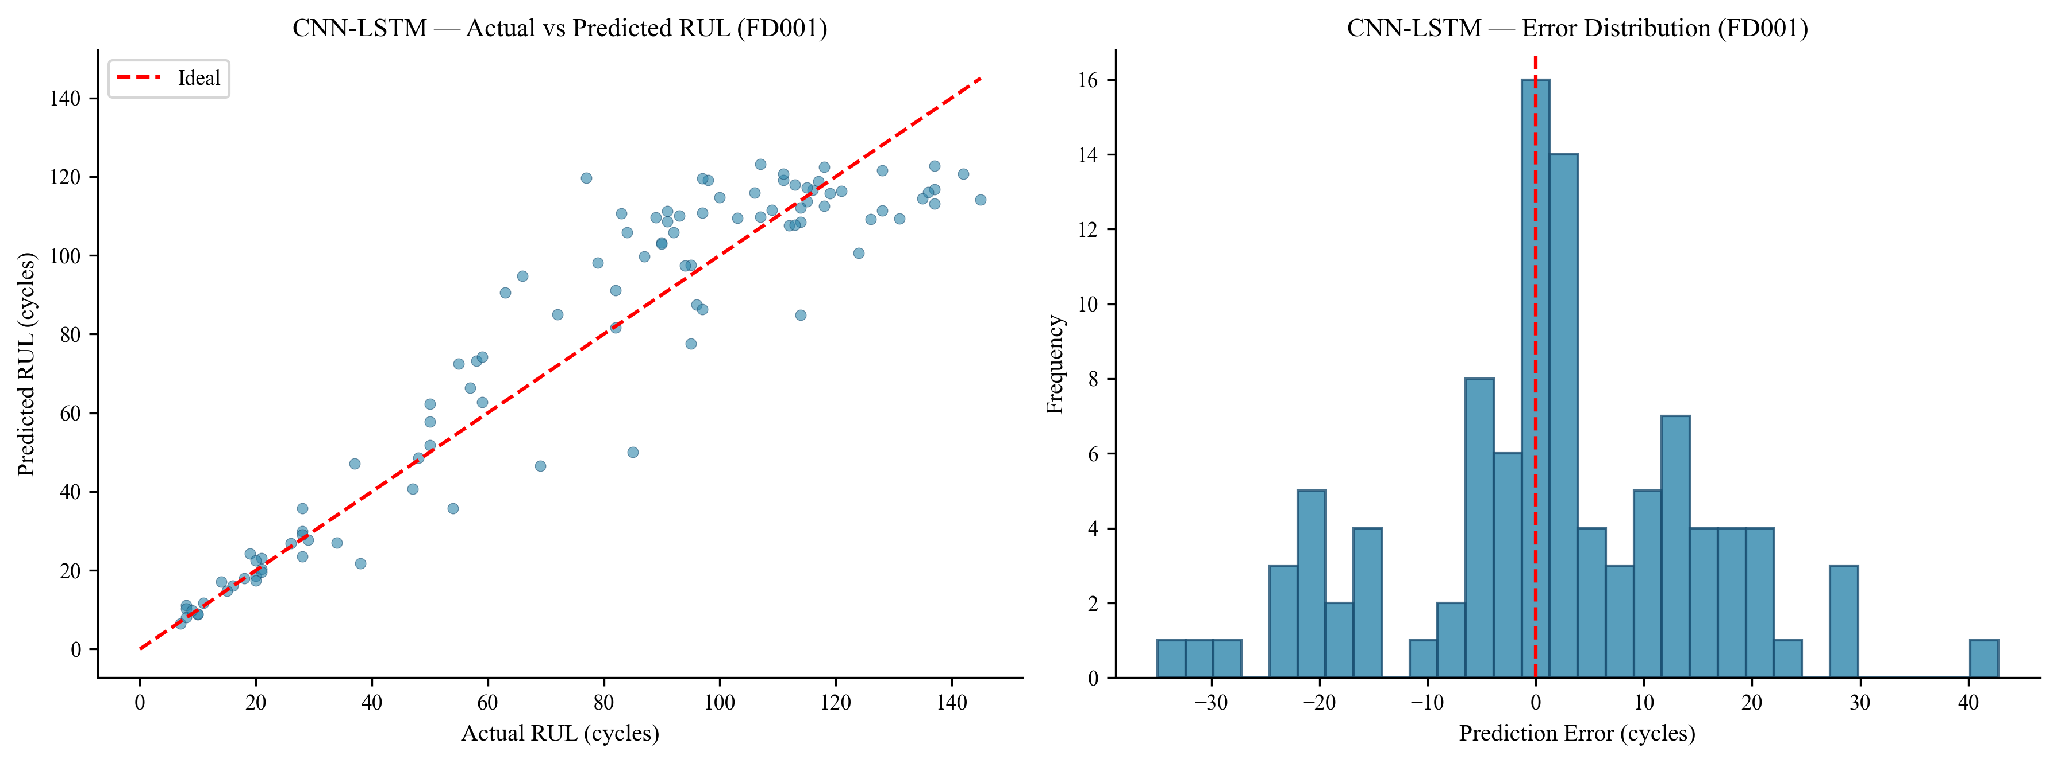
Best Model: CNN-LSTM — RUL Predictions
FD001: RMSE=14.03 | MAE=10.45 | R²=0.886 | Score=317.45 • Predictions cluster around ideal line (left plot) • Error distribution centered near zero with slight early-prediction bias (safer in practice)

Slide 8
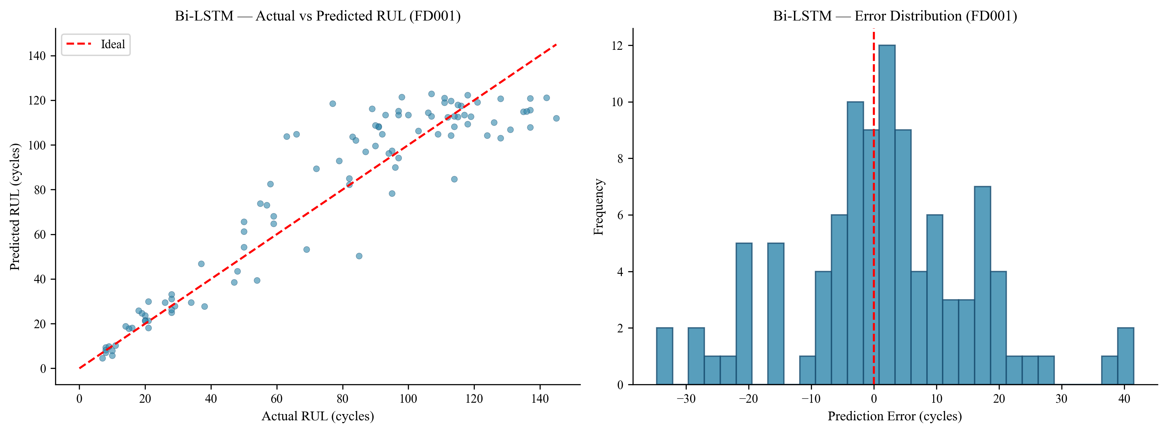
Bi-LSTM — RUL Predictions
FD001: RMSE=14.79 | MAE=11.03 | R²=0.873 | Score=395.74 • Competitive with CNN-LSTM but simpler architecture • Recommended for resource-constrained deployment scenarios

Slide 9
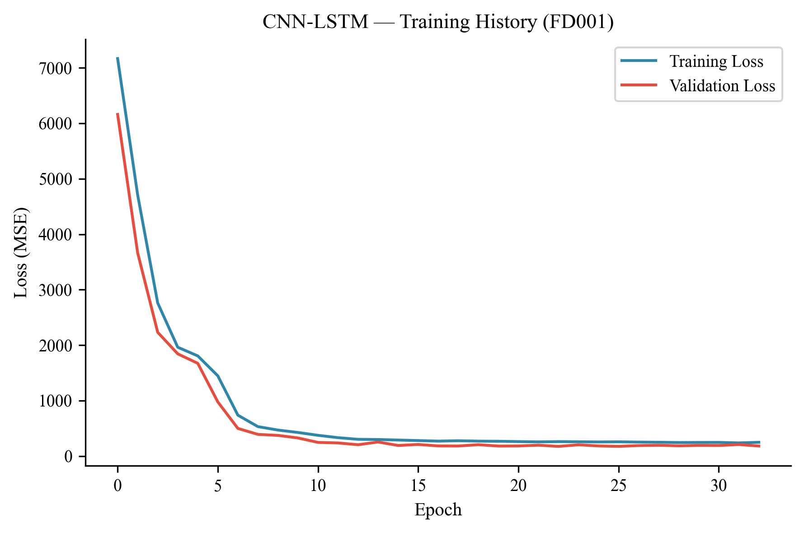
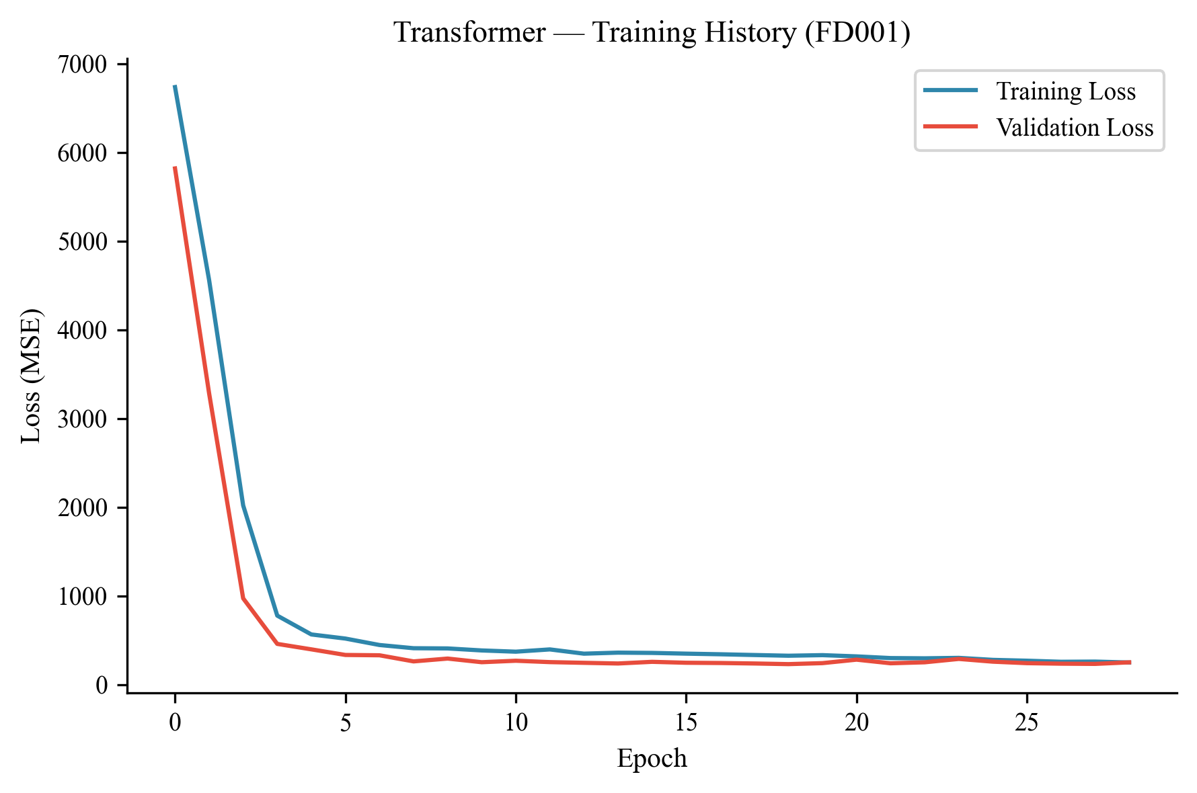
Training Dynamics
CNN-LSTM: Smooth convergence, 33 epochs
Transformer: Fast but higher final loss
• CNN-LSTM and Bi-LSTM converge smoothly with val loss tracking train loss (good generalization) • Transformer converges faster (early stop ~29 epochs) but to higher loss — insufficient data/sequence length for full attention benefit

Slide 10
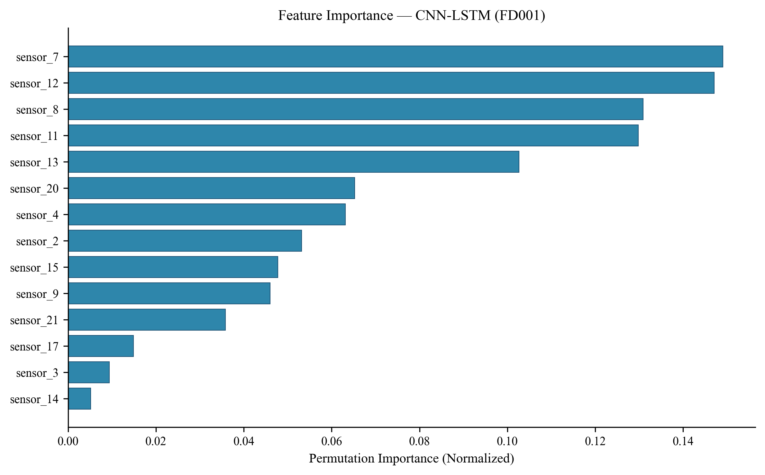
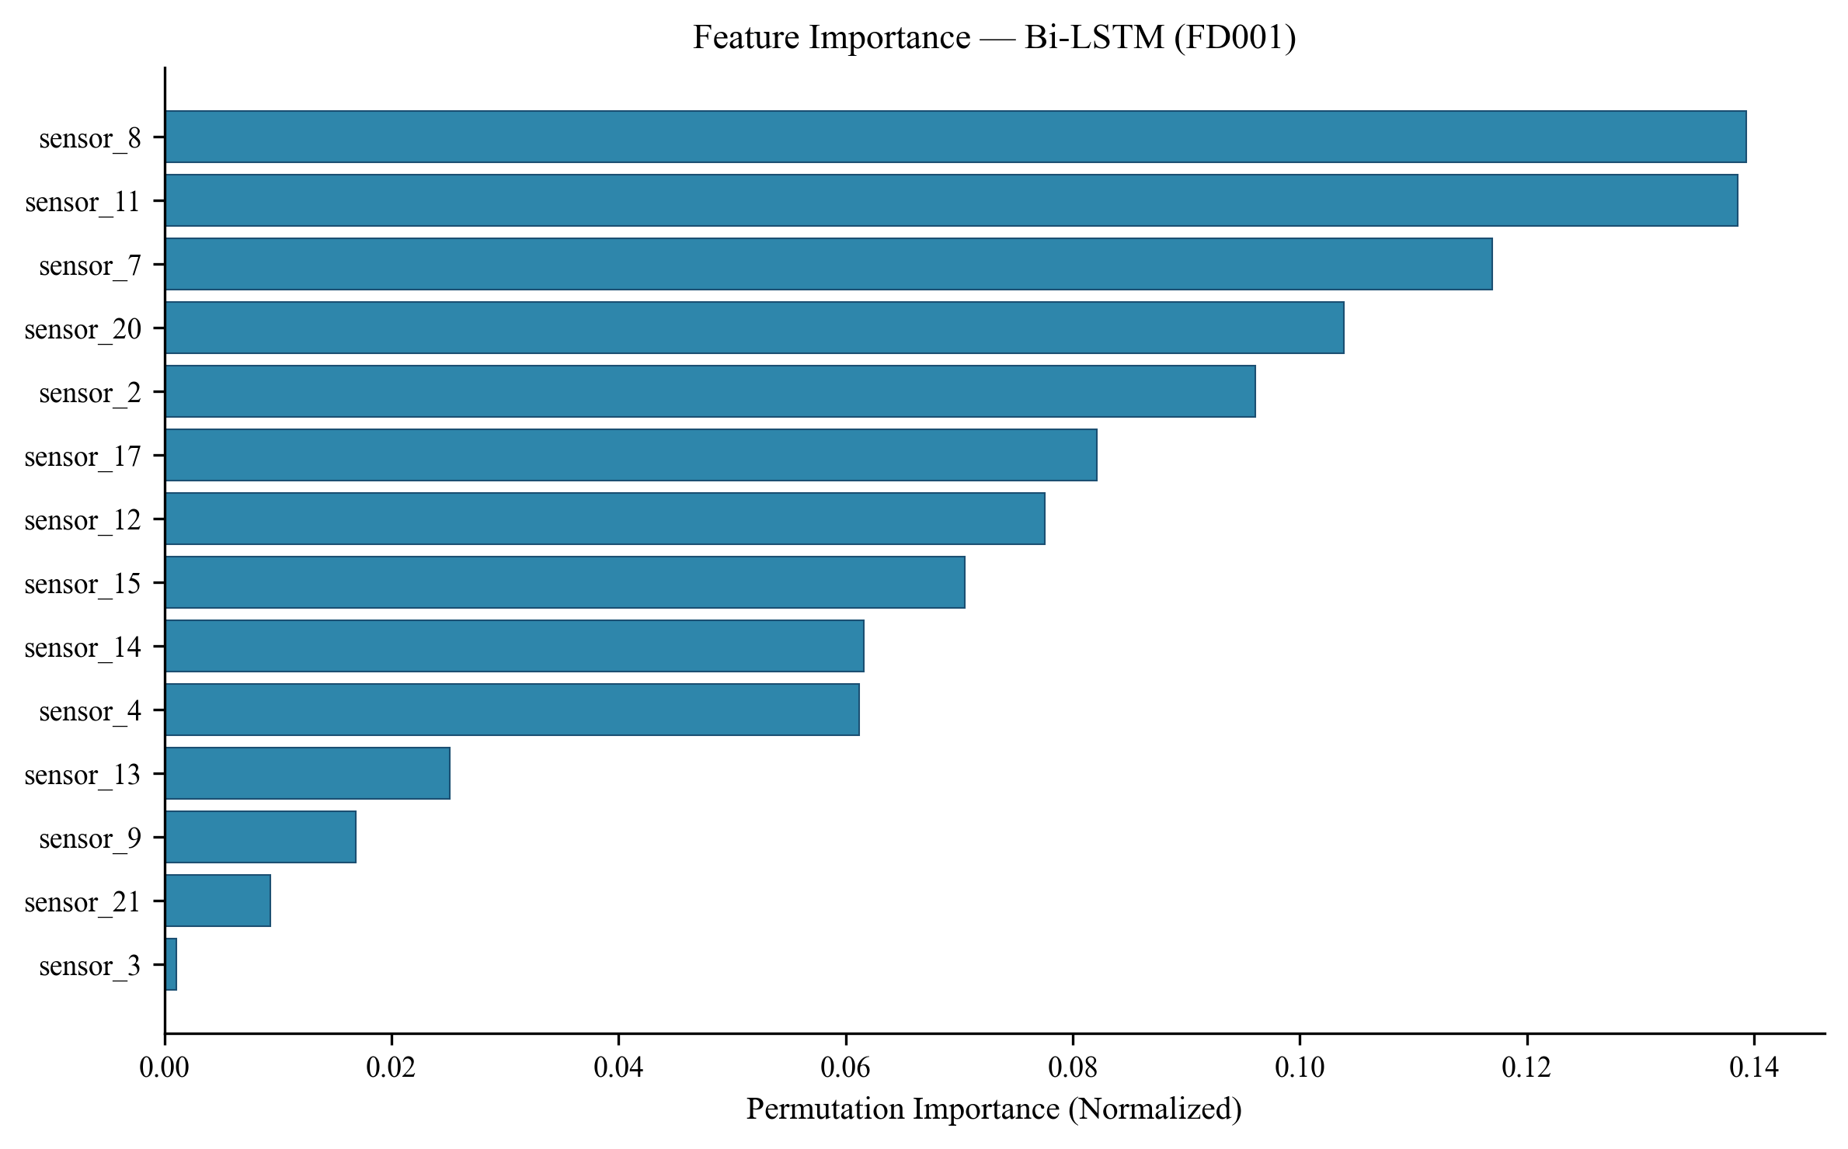
XAI: Feature Importance — CNN-LSTM vs Bi-LSTM
Cross-model consistency: Both models rank sensors 7, 8, 11, 12 as top features Physical meaning: Temperature (s7), Pressure (s8, s11), Fuel flow ratio (s12) — all HPC degradation indicators This agreement validates that explanations reflect genuine physics, not model artifacts

Slide 11
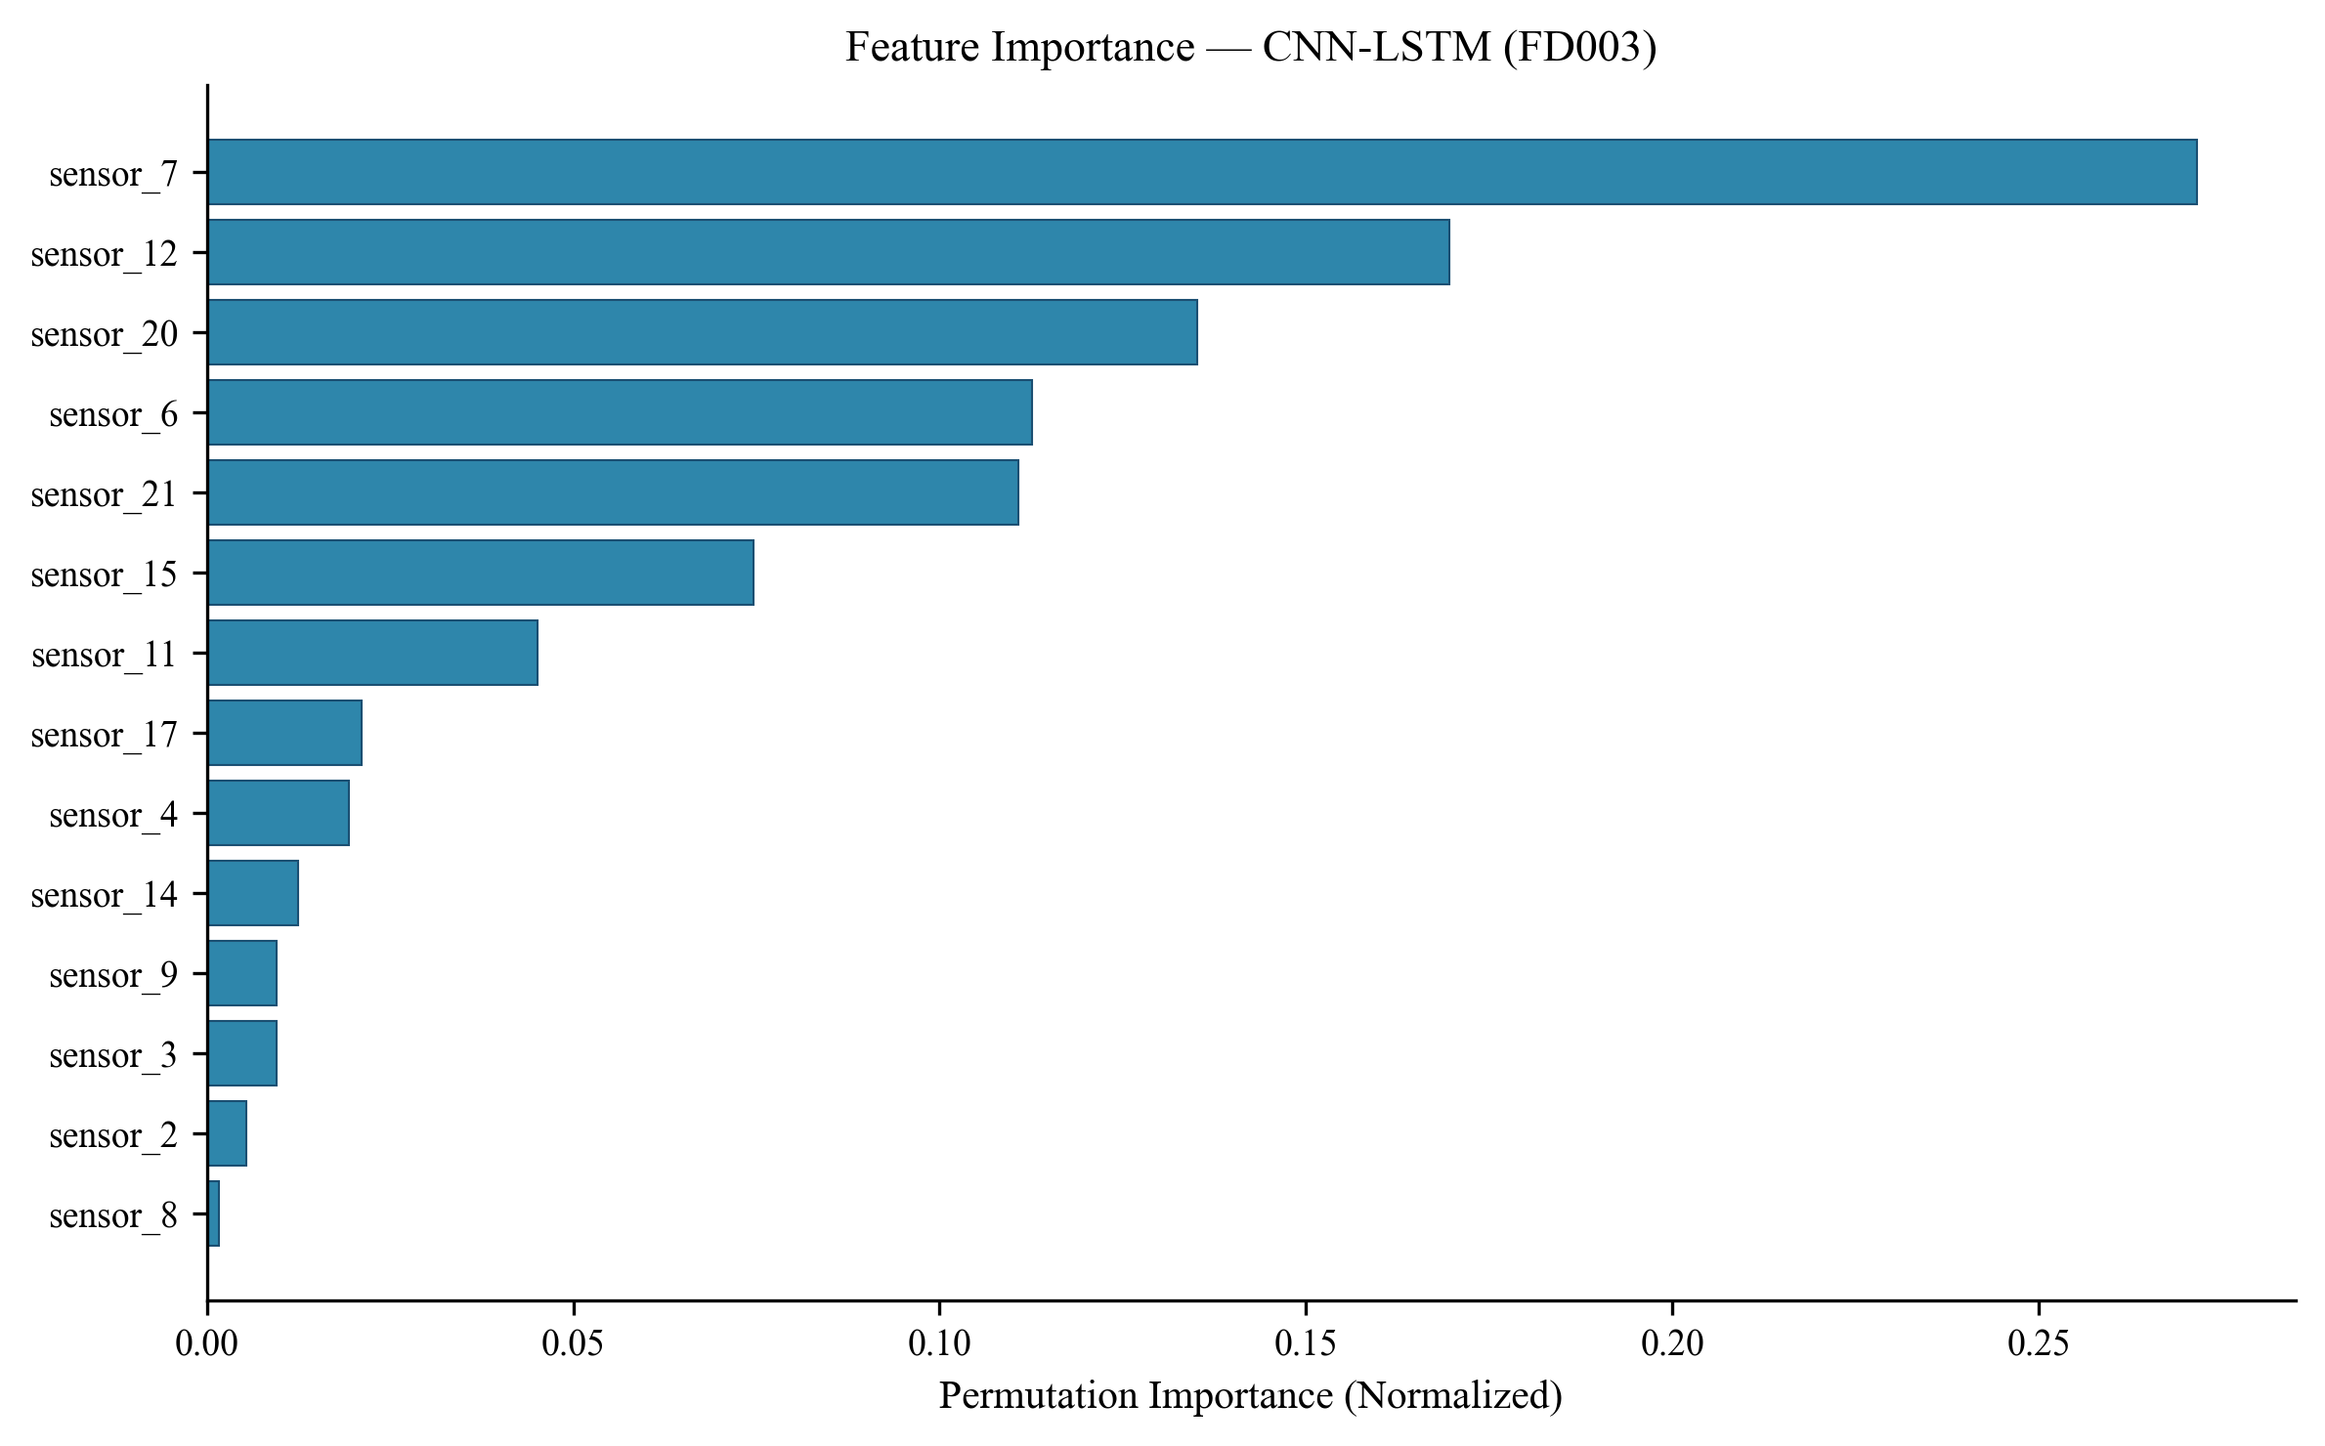
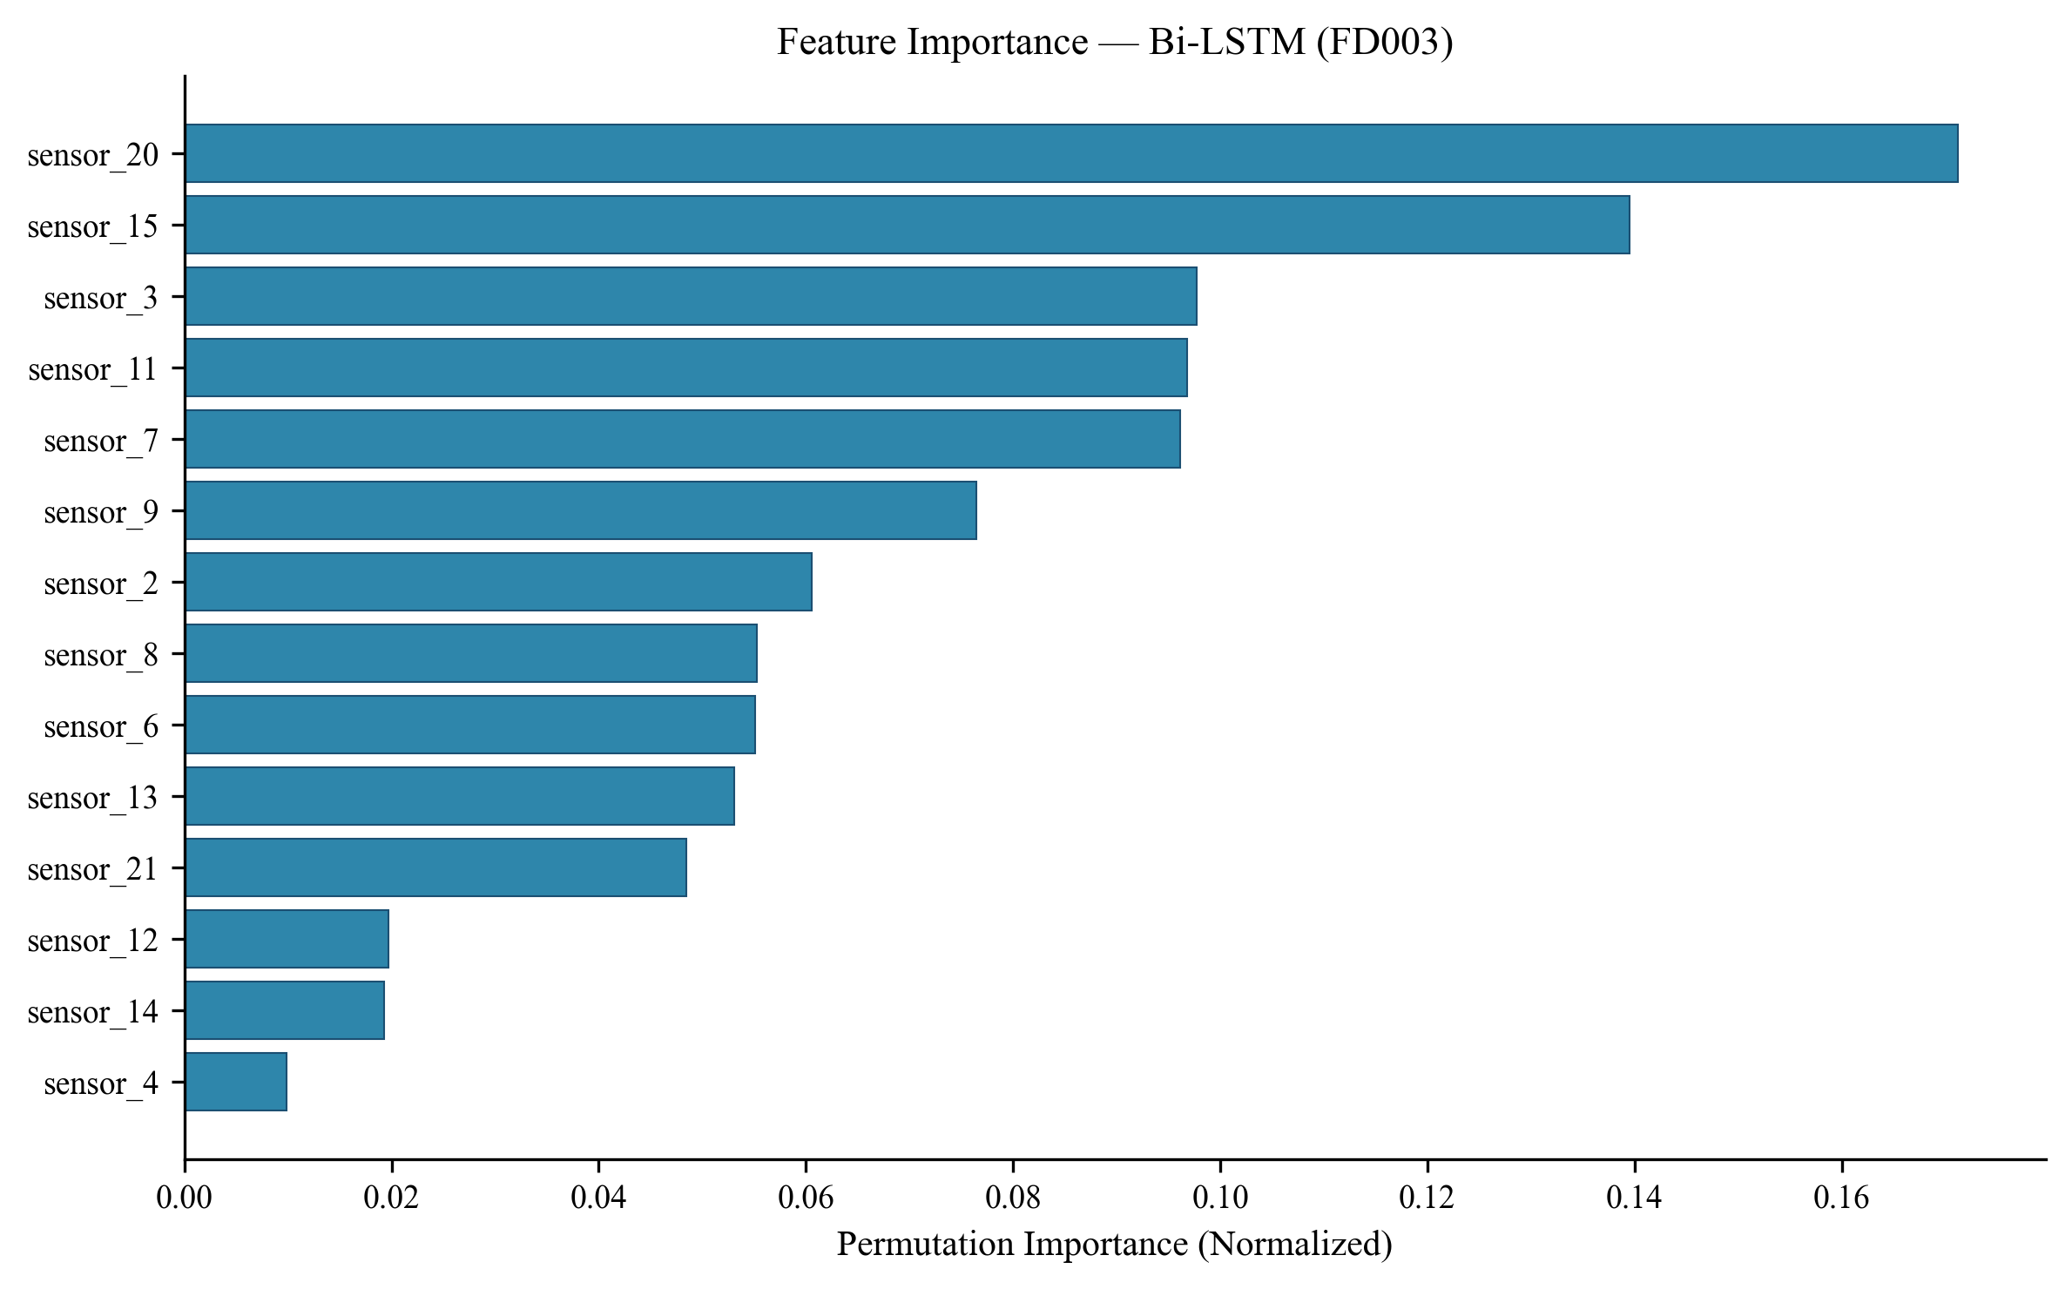
XAI: Multi-Fault Analysis (FD003 — 2 faults)
FD003 shift: sensor_20 (bleed enthalpy) and sensor_15 (bypass ratio) gain importance These sensors are physically associated with FAN degradation — the additional fault mode in FD003 → Feature importance shift provides implicit FAULT MODE DISCRIMINATION capability

Slide 12
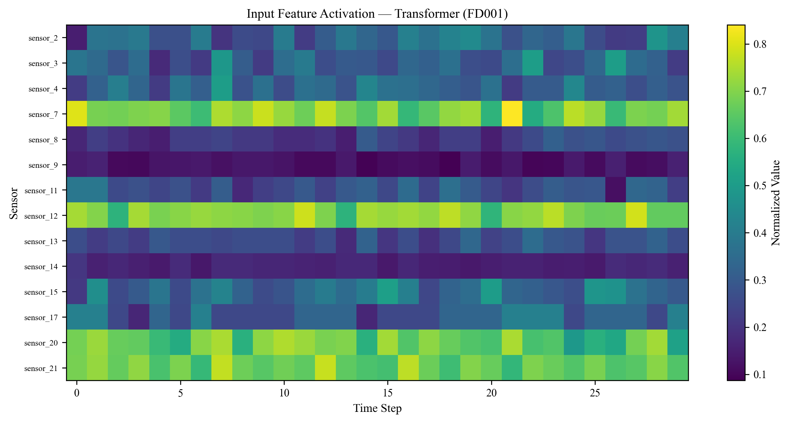
Transformer: Attention & Temporal Activation
Temporal concentration toward later time steps (approaching failure) confirms model focuses on recent degradation Built-in attention provides 'free' temporal explainability without post-hoc computation However, Transformer's weaker accuracy means attention alone doesn't guarantee good RUL prediction

Slide 13
Key Contributions & Novelty
C1
First PRISMA SLR at XAI-PdM-Manufacturing intersection (50 papers, 4D taxonomy, 6 gaps)
C2
Multi-architecture comparison (Bi-LSTM, Transformer, CNN-LSTM) with consistent XAI analysis
C3
Cross-model feature importance validation — proves explanations reflect physics
C4
Implicit fault mode discrimination via feature importance shift (FD001→FD003)
C5
5-direction research agenda: Temporal XAI, Metrics, Multi-Stakeholder, Causal, Deployment

Slide 14
Publication Status & Next Steps
Paper 1: SLR — COMPLETE ✓
Paper 2: Empirical — COMPLETE ✓
• IEEE Access format, 8 figures, 5 tables, 50 refs
• Unique: First PRISMA SLR at this intersection
• Target: IEEE Access (Q1 Scopus)
• IEEE Access format, 10 figures, 4 tables, 25 refs
• Real experiments: 3 models × 2 datasets × XAI
• Target: IEEE Access (Q1 Scopus)
Remaining Work:
• Submit both papers to IEEE Access (Month 1-2)
• Optional: Extend experiments to AI4I 2020 + CWRU Bearing (Month 2-3)
• Thesis compilation: Chapters derived from papers (Month 3-5)
• Plagiarism check, formatting, guide approval (Month 5-6)
• Viva preparation (Month 6-7)

Slide 15
Key References
[1] Matzka (2020) — Explainable AI for PdM, AI4I Conf.
[2] Cummins et al. (2024) — Explainable PdM Survey, IEEE Access
[3] Gawde et al. (2024) — LIME/SHAP/PDP/ICE for rotating machines, IEEE Access
[4] Chen et al. (2020) — Attention-based RUL, IEEE Trans. IE (566 citations)
[5] Zhang et al. (2022) — Bi-GRU + Self-Attention, RESS (360 citations)
[6] Zhang et al. (2022) — Dual-Aspect Transformer, IEEE TIM
[7] Yu et al. (2021) — Transformer + Gated CNN, J. Intell. Manuf.
[8] Ali et al. (2023) — XAI Review, Inf. Fusion (1,368 citations)
[9] Arias Chao et al. (2021) — C-MAPSS Dataset, Data
[10] Theissler et al. (2022) — XAI for Time Series, IEEE Access

Slide 16
Thank You
RAC-III: Results & Progress Report C. Anurag Reddy | 25CPHDFF006 | CMR University Guide: Dr. Kannan N, Dean, CMR University All results from actual experiments — code & data available Questions & Suggestions Welcome

