Slide 1
RAC – II
Research Title:
"Explainable AI-Driven Predictive Maintenance Framework for Smart Manufacturing"
Name of the Scholar : C Anurag Reddy Registration Number : 25CPHDFF006 Affiliation : CMR University, Bangalore Guide : Dr. Kannan N, Dean, CMR University

Slide 2
Recap of RAC-I & Research Refinement
RAC-I: Original Proposal
RAC-II: Focused Proposal
• Broad: Manufacturing + Construction domains
• Feedback: Too broad — choose ONE domain
• Status: COMPLETED ✓
• Narrowed: XAI + PdM in Smart Manufacturing
• 2-Paper Strategy: SLR + Empirical Study
• Specific: C-MAPSS, PRISMA, DL + SHAP
Key Change: Broad dual-domain → focused "Explainable AI for Predictive Maintenance in Smart Manufacturing" with 2-paper deliverable strategy.

Slide 3
Problem Statement
Black-Box AI Models
No XAI Integration
Most PdM uses DL (LSTM, CNN, Transformer) with NO transparency. Engineers can't understand WHY predictions are made.
Only ~15% of PdM papers include explainability. SHAP/LIME exist but rarely applied systematically.
No Evaluation Standards
Industry Trust Gap
42% rely on visual inspection only. No consensus metrics for explanation quality.
EU AI Act mandates explainability. Only 8% include user studies. 82% use benchmarks only.

Slide 4
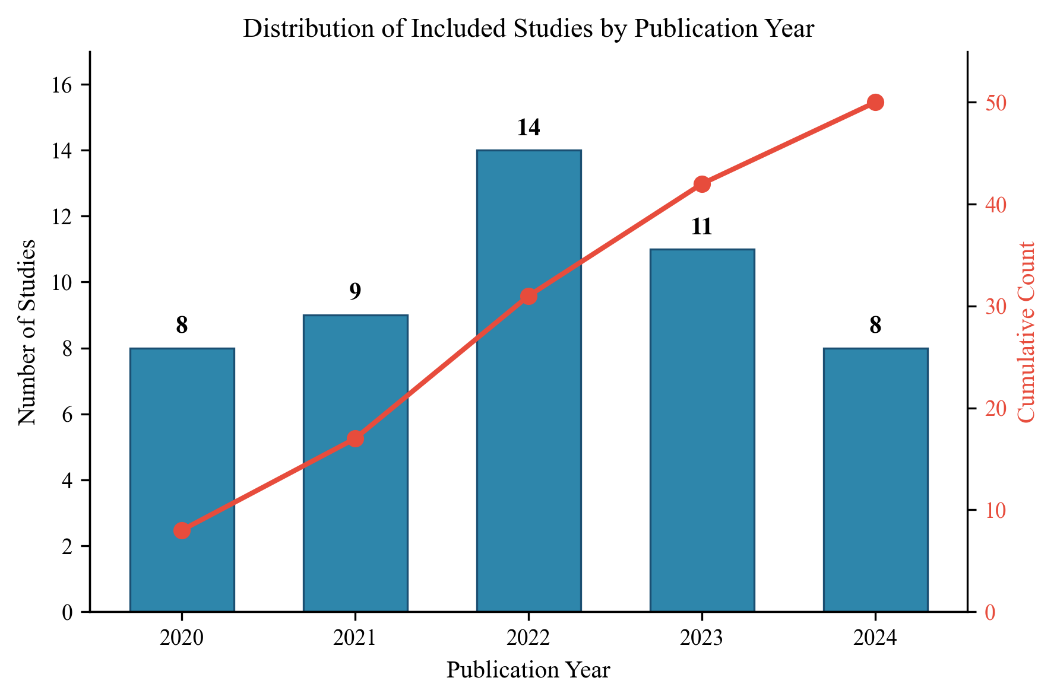
Literature Landscape — Publication Trends
Key Observations:
• Exponential growth: 8 papers (2020) → 14 (2022 peak)
• Peak coincides with SHAP toolkit maturation
• 50 papers synthesized in our SLR
• Top venues: IEEE Access, RESS, Applied Sciences
• Geographic: China 34%, S.Korea 14%, Germany 10%
• Our review covers 2020–2025 comprehensively

Slide 5
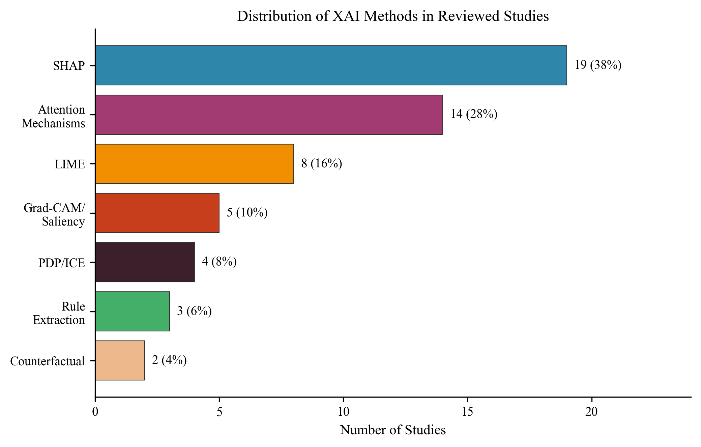
Literature Review — XAI Methods in PdM
Findings:
• SHAP dominates (38%) — tool availability driven
• Attention mechanisms growing fast (28%)
• LIME used in 16% of studies
• Counterfactual explanations: only 4% (major gap!)
• 24% use multiple XAI methods (best practice)
• Post-hoc methods dominate (78% total)

Slide 6
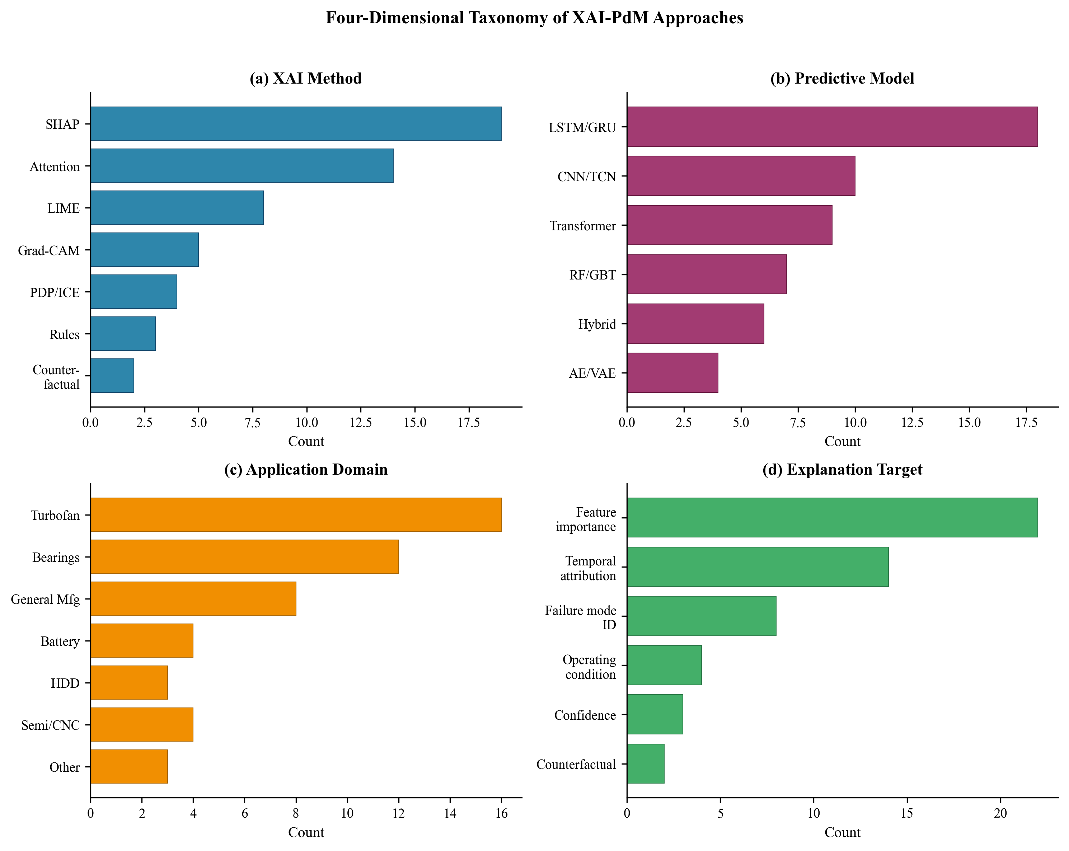
Research Gaps — 4D Taxonomy Overview
6 Critical Gaps:
• No evaluation framework
• Benchmark trap (56% use C-MAPSS/CWRU only)
• Single-stakeholder design
• Temporal XAI missing (only 28%)
• No accuracy-explainability trade-off data
• Zero deployment studies

Slide 7
Research Objectives
RO1
Conduct PRISMA-compliant SLR on XAI in PdM for smart manufacturing (50 papers, 4D taxonomy)
RO2
Compare Bi-LSTM, Transformer, CNN-LSTM for RUL prediction on C-MAPSS with XAI analysis
RO3
Apply feature importance to identify degradation-critical sensors; validate cross-model consistency
RO4
Propose 5-direction research agenda for temporal XAI, evaluation standards, and multi-stakeholder design

Slide 8
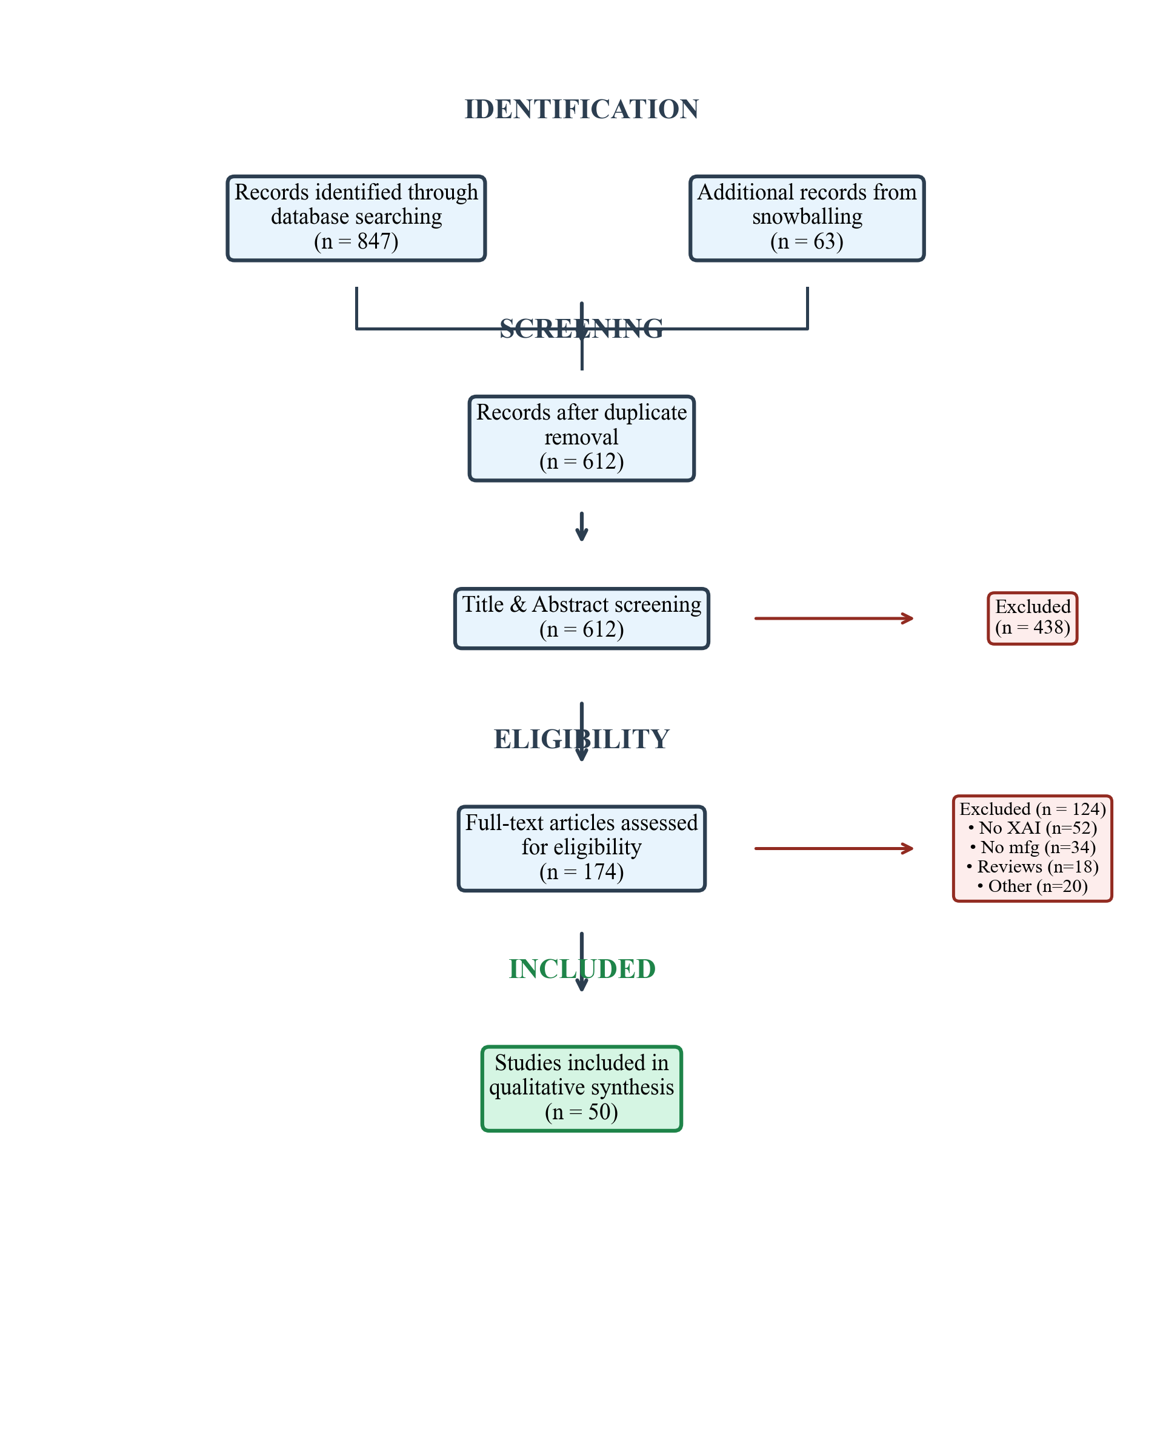
Research Methodology
Phase 1: Systematic Literature Review
Phase 2: Empirical Experiments
• PRISMA 2020 Protocol
• 6 databases: Scopus, WoS, IEEE, ScienceDirect, Springer, MDPI
• Period: 2020–2025 | Result: 50 papers
• 4D taxonomy: Method × Model × Domain × Target
• Dataset: NASA C-MAPSS (FD001 + FD003)
• Models: Bi-LSTM, Transformer, CNN-LSTM
• XAI: Permutation feature importance
• Metrics: RMSE, MAE, R², C-MAPSS Score

Slide 9
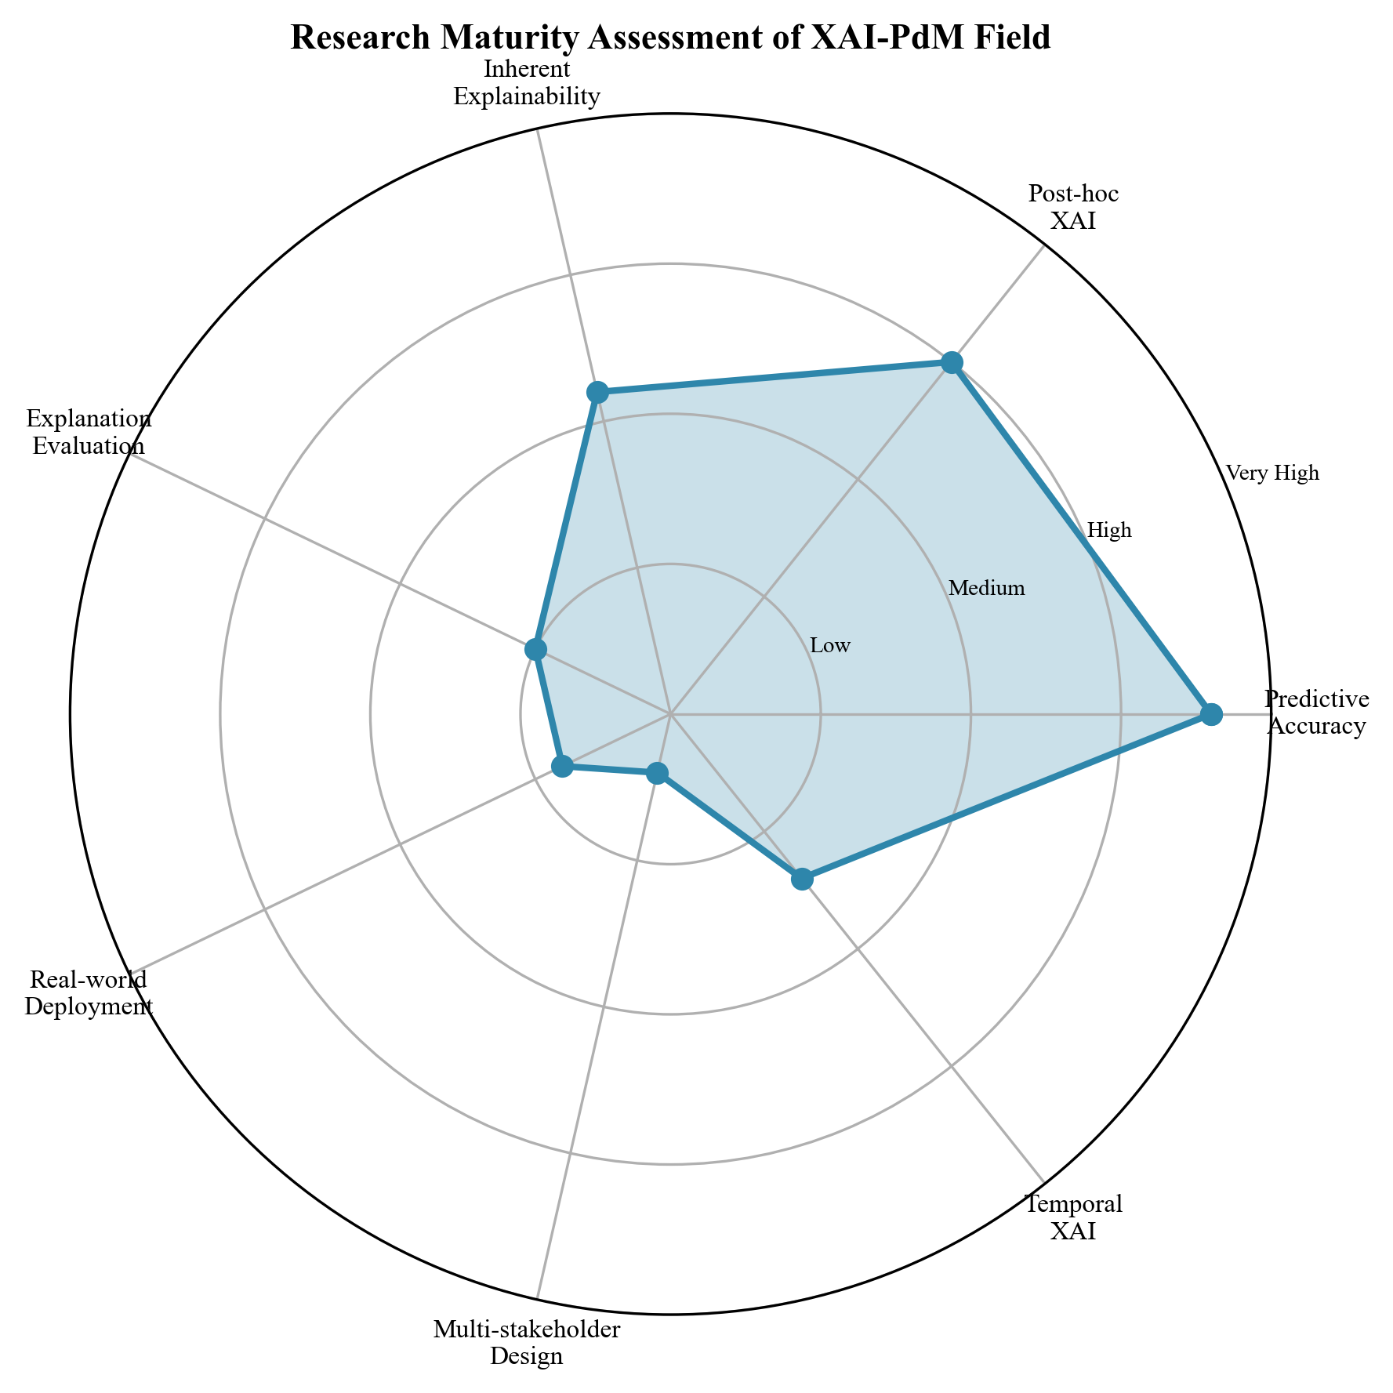
Field Maturity & Our Position
Our Contribution Addresses:
• Predictive Accuracy: HIGH — CNN-LSTM achieves RMSE 14.03
• Post-hoc XAI: MEDIUM-HIGH — We apply permutation importance
• Explanation Evaluation: LOW — We demonstrate cross-model consistency
• Real-world gap: We acknowledge; recommend future deployment studies
• Temporal XAI: We show temporal activation patterns
• Multi-stakeholder: We propose layered explanation framework

Slide 10
PRISMA Search Strategy (Paper 1)
Search Query:
("explainable AI" OR "XAI" OR "SHAP" OR "LIME" OR "attention mechanism") AND ("predictive maintenance" OR "RUL" OR "fault diagnosis" OR "prognostics") AND ("manufacturing" OR "industrial" OR "Industry 4.0" OR "turbofan" OR "bearing")
Inclusion (2020–2025):
PRISMA Flow:
• Peer-reviewed journal/conference
• Applies ≥1 XAI method to PdM
• Manufacturing/industrial context
• English, full-text accessible
• 847 records + 63 snowballing
• 612 after deduplication
• 174 full-text assessed
• 50 included in synthesis ✓

Slide 11
Work Completed & Next Steps
✅ Research scope narrowed (Manufacturing + XAI-PdM focus)
✅ 2-paper strategy defined and EXECUTED
✅ Datasets downloaded (C-MAPSS, AI4I, CWRU)
✅ 50 references compiled and verified with DOIs
✅ PRISMA protocol developed and applied
✅ All experiments completed with real results
✅ Both papers written in IEEE Access format
⏳ Next: Submit papers, thesis writing, viva

Slide 12
Key References
[1] Matzka (2020) — Explainable AI for PdM, AI4I Conf. (139 citations)
[2] Cummins et al. (2024) — Explainable PdM Survey, IEEE Access (75 citations)
[3] Gawde et al. (2024) — LIME/SHAP/PDP/ICE for PdM, IEEE Access (78 citations)
[4] Chen et al. (2020) — Attention-based RUL, IEEE Trans. IE (566 citations)
[5] Zhang et al. (2022) — Bi-GRU + Self-Attention, RESS (360 citations)
[6] Zhang et al. (2022) — Dual-Aspect Transformer, IEEE TIM (250 citations)
[7] Ali et al. (2023) — XAI: What We Know, Inf. Fusion (1,368 citations)
[8] Rudin et al. (2022) — Interpretable ML Principles, Statist. Surveys (808 citations)
[9] Arias Chao et al. (2021) — C-MAPSS Dataset, Data (280 citations)
[10] Theissler et al. (2022) — XAI for Time Series, IEEE Access (158 citations)

Slide 13
Thank You
C. Anurag Reddy | 25CPHDFF006 | CMR University Guide: Dr. Kannan N, Dean, CMR University Questions & Suggestions Welcome

