Slide 1

MEDICAL MANAGEMENT SYSTEM
Submitted by
Name : Anurag Koundal
ID : 1911985070
Submitted to
Mr. Mukesh kumar
Mr. Mananjay

Slide 2
Introduction
This online medical management system is used in healthcare system the main use of medical management system is to provide data of the hospital.
This project consists of frontend in angular and backend in spring boot.
To switch between different pages i have used routing in angular to provide different paths.
For connectivity between database and spring boot backend i have used hibernate through jpa.
Hibernate is a orm tool which is used to create entries of tables in database through some sort of annotations.

Slide 3
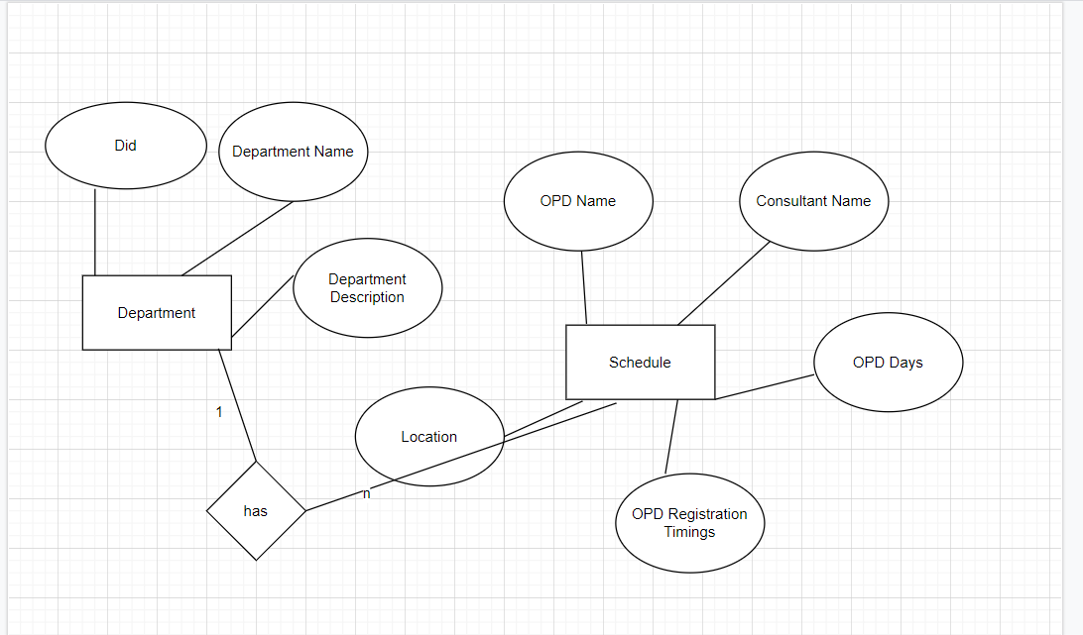
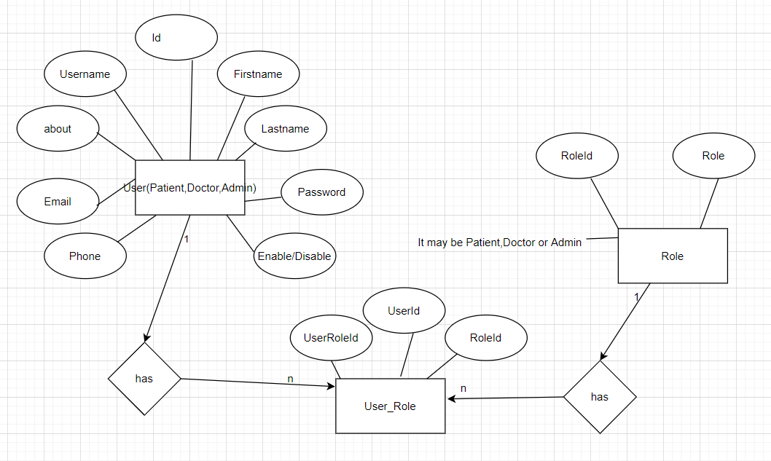
ER DIAGRAM

Slide 4
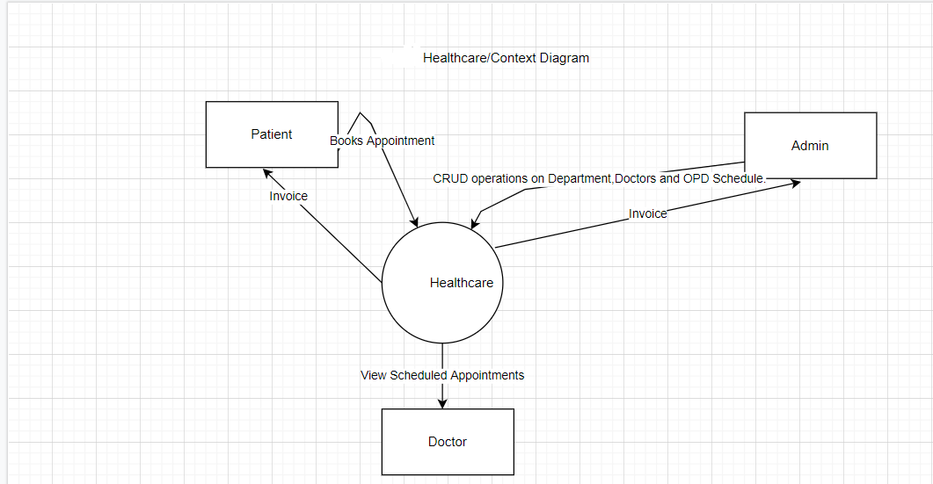
DFD diagram (level 0)

Slide 5
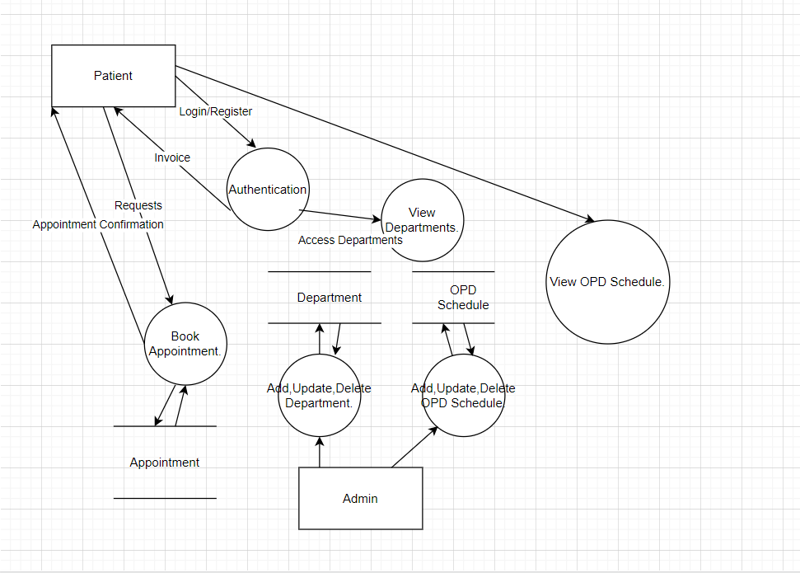
DFD diagram (level 1)

Slide 6
Tools and technologies
For Backend Spring Boot is a Java framework . It provides an easier and faster way to set up, configure, and run both simple and web-based applications.
For Frontend Angular (JavaScript framework)
For Database MySQL
Server Tomcat

Slide 7
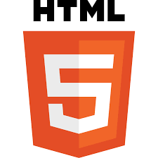

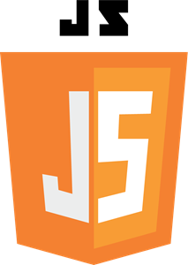


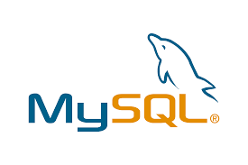


Slide 8
MySQL Database
MySQL is an open source relational database management system. For Word Press sites, that means it helps you store all your blog posts, users, plugin information, etc. It stores that information in separate “tables” and connects it with “keys”, which is why it's relational.

Slide 9
Spring Boot
In short, spring boot is the combination of spring framework and embedded servers.
We should use spring boot framework because:
It contains powerful database transaction management capabilities.
It simplifies integration with other java frameworks like jpa /hibernate orm, struts, etc.
It reduces the cost and development time of the application.

Slide 10
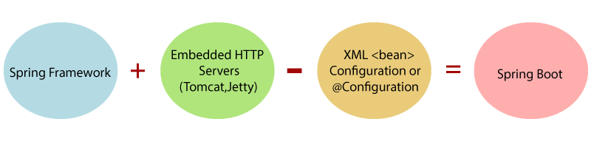

Slide 11
Spring Boot Technologies
Spring security
Tomcat server
Jpa
Hibernate
MySQL driver (for connecting with database)

Slide 12
JPA
The java persistence API (JPA) is a specification of java. It is used to persist data between java object and relational database. JPA acts as a bridge between object-oriented domain models and relational database systems.
As jpa is just a specification, it doesn't perform any operation by itself.

Slide 13
Hibernate
Hibernate is an orm (object relational mapper) tool that is used for interacting with different kinds of databases.

Slide 14
Angular (for Frontend)
Angular is a platform and framework for building single-page client applications using HTML and typescript . angular is written in typescript. It implements core and optional functionality as a set of typescript libraries that you import into your applications.

Slide 15
Angular Technologies
Interceptor
Angular material
Bootstrap 5
Font awesome
Flat icons
Google font
Routing

Slide 16
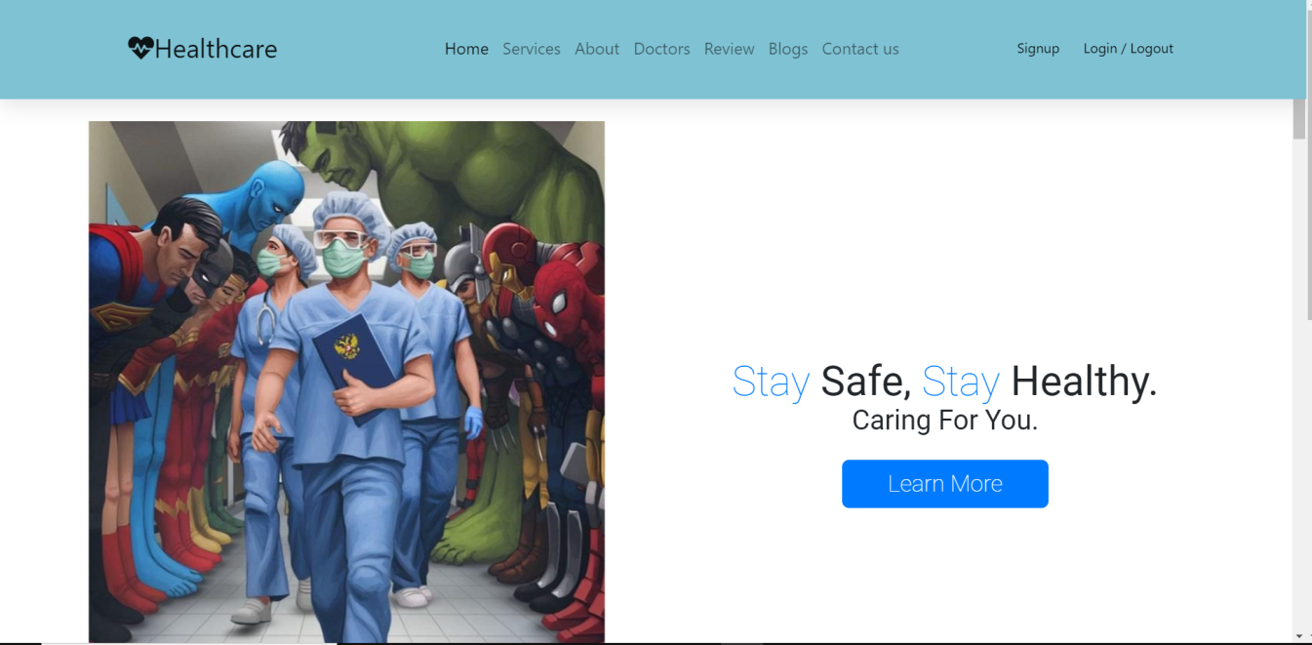
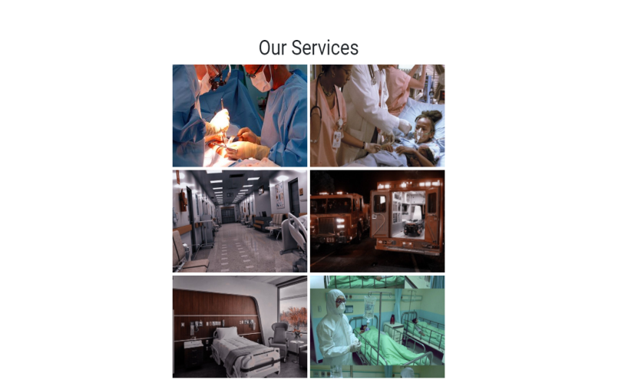
SCREENsHOTS OF PROJECT

Slide 17
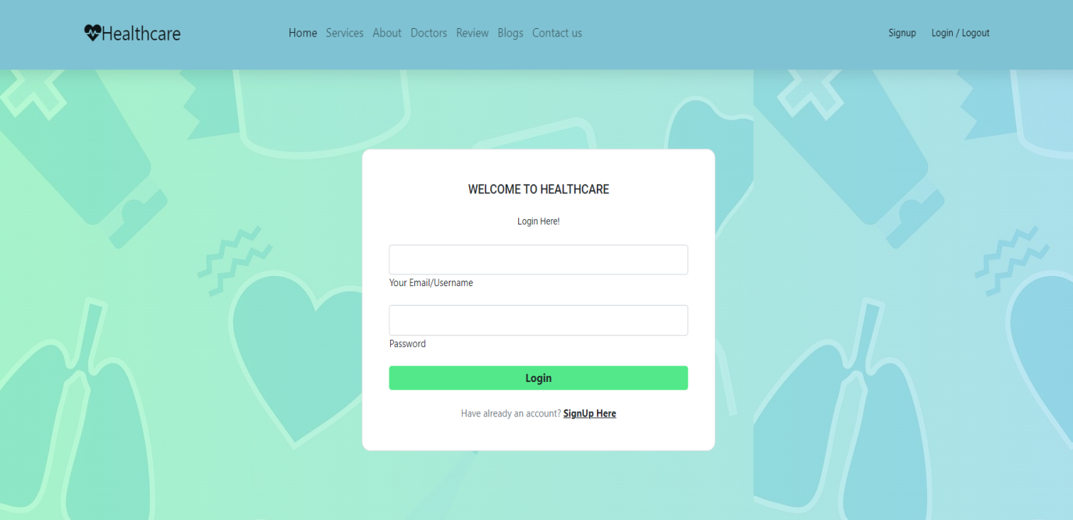
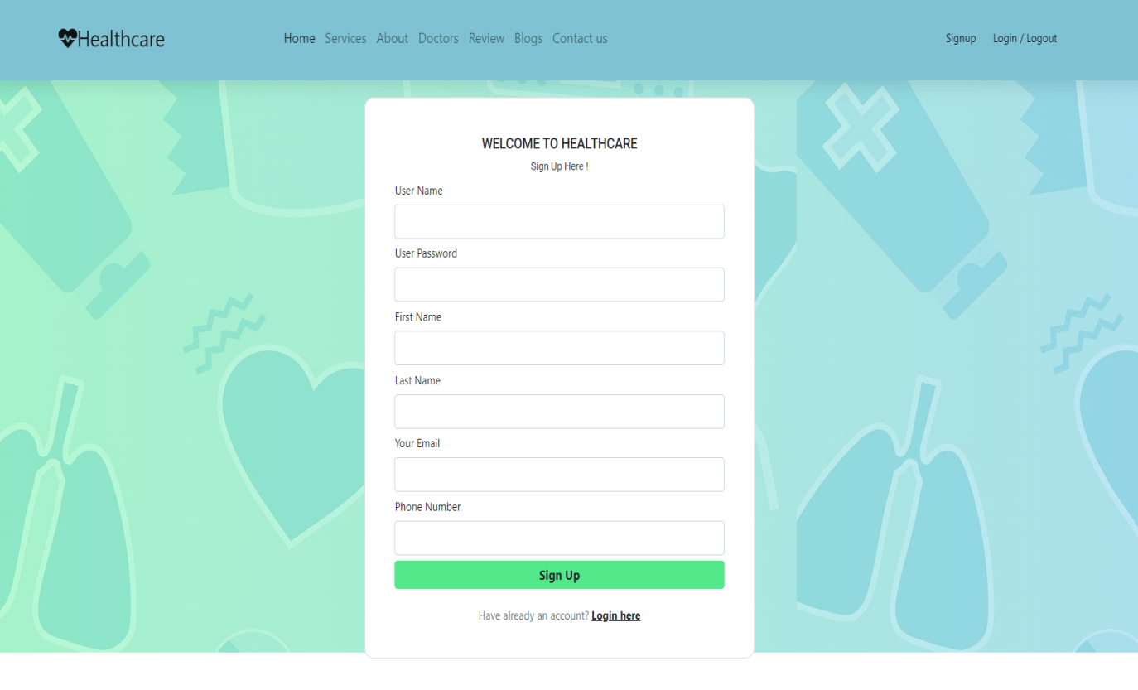

Slide 18
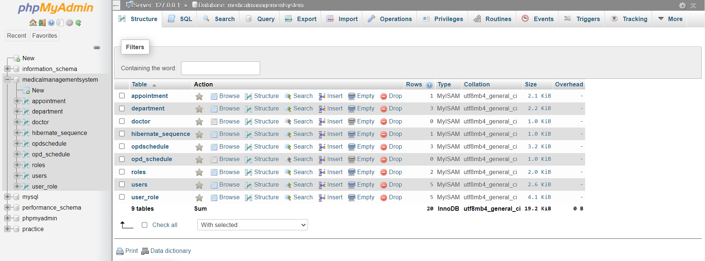
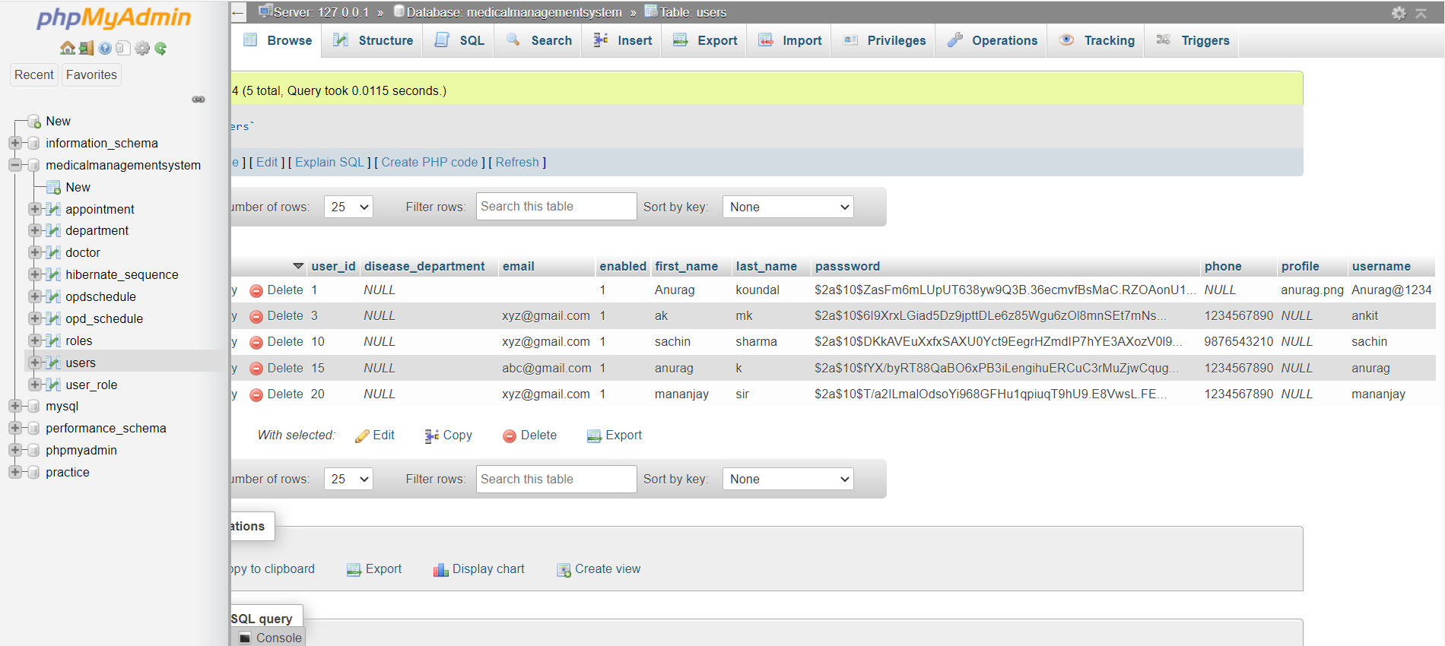

Slide 19
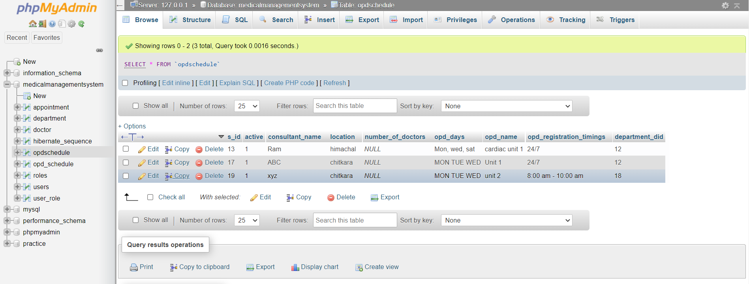
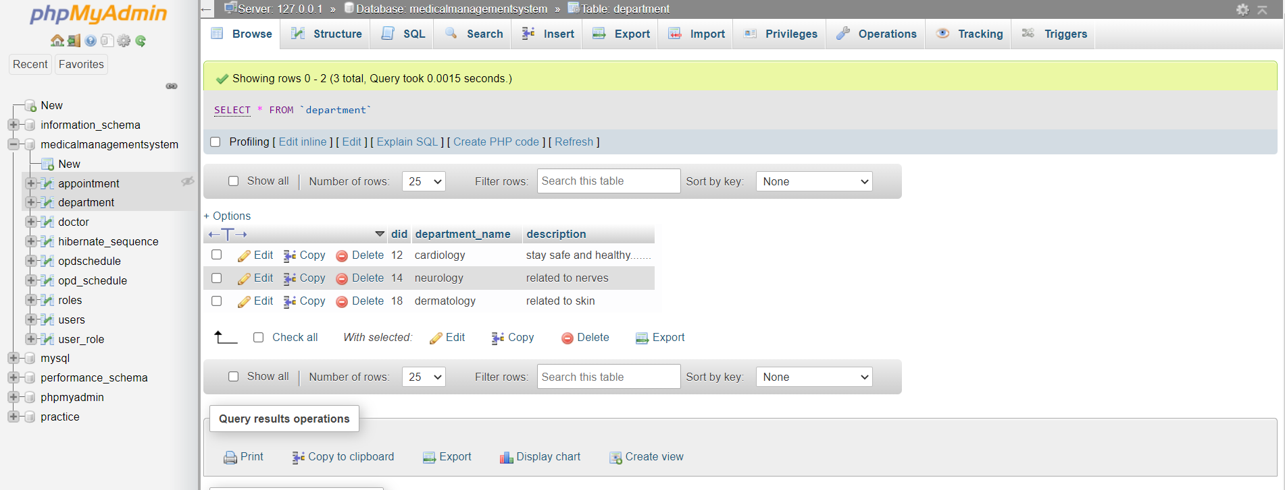

Slide 20
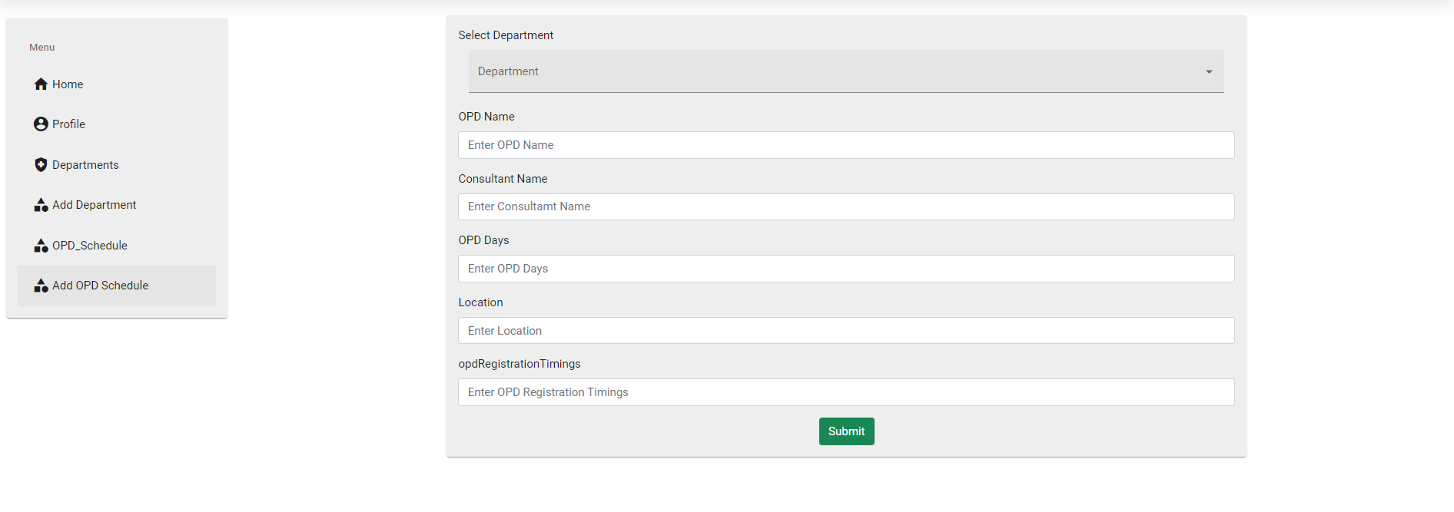
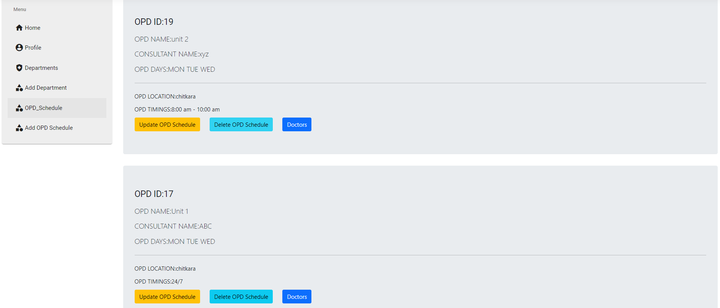

Slide 21
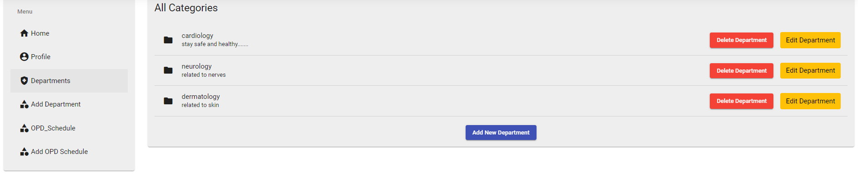
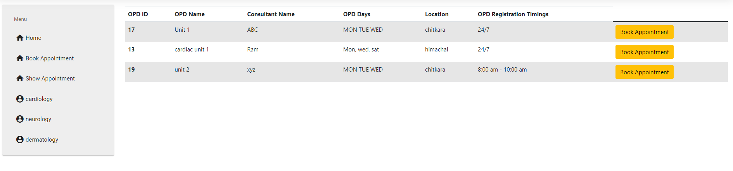

Slide 22
Conclusion
Implemented the basic create , read , update and delete functionalities and I will keep adding new functionalities in this project in future .

Slide 23
Future Scope
Deploy this project on live server (like hostinger or godaddy etc).
Add doctor dashboard so that a particular doctor can approve or decline the appointment .
Add mobile sms service to send otp and appointment status to the patients.
Add payment gateway in this project after appointment confirmation.

Slide 24
References
You tube
Stackoverflow
Github
W3 schools
Google

Slide 25


