Slide 1
Elasticsearch

Slide 2
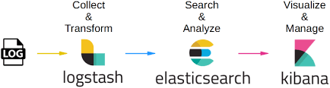


Elasticsearch Logstash Kibana stack:
ELK stack for collecting analyzing and visualization of data
Shield for securing elasticsearch, it can be integrated with external user management tools such as LDAP.
Beats : Acts as a Data shipper collecting data from hundreds of machines and transferring them to elasticsearch. Most commonly used are
FileBeat – Gets logs and files from different servers and push it to logstash for further processing.
MetricBeat – For gathering information about system metrics for any Operating System

Slide 3
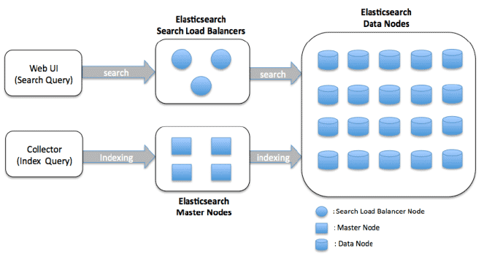
Architecture of Elasticsearch:

Slide 4
Type of Nodes:
Data nodes : They hold the shards that contain the documents you have indexed.
Data nodes handle data related operations like CRUD, search, and aggregations.
These operations are I/O-, memory-, and CPU-intensive.
Master Nodes:
The master node is responsible for lightweight cluster-wide actions such as creating or deleting an
index, tracking which nodes are part of the cluster, and deciding which shards to allocate to which nodes.
Search Load Balancer/ Coordinating Node:
The coordinating node forwards the request to the data nodes which hold the data. Each data node executes the
request locally and returns its results to the coordinating node. In the gather phase, the coordinating node
reduces each data node’s results into a single global result.

Slide 5
Elasticsearch Node Building Blocks
Index
Indexes are set of similar documents.
Identified by a name (that must be all lowercase)
It is used to refer to the index when performing indexing, search, update, and delete operations against the documents in it.
Ex index of Customer data.
It’s a logical partition of an index.
Generally a type has documents with similar fields.
Document physically reside inside a index but it should always in set to a Type.
Ex for a Customer data we can have a type as User Login details and another as Purchase Info.
Type
Document
Its basic unit of data.
This document is expressed in JSON (JavaScript Object Notation).
One Index/Type can have many documents.
Ex {“Name”: “John”}
Field
It is the smallest unit inside a document.
Its in the form of Key/Value pair.
A set of Key and Value surrounded with curly braces make a JSON.
Ex “Name” : “John”

Slide 6
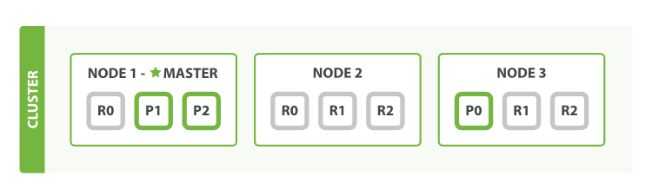
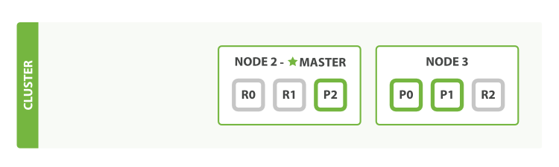
Initial State:
We have 3 nodes and Node 1 is Master node.
Each Cluster must have a master node to function properly.
Action:
If we delete Node 1 which is master node.
Final State:
The first thing that happens is the nodes elect a new
master: Node 2.
Primary shards 1 and 2 were lost when we killed Node 1, and our
index cannot function properly if it is missing primary shards
Next as a complete copy of the two lost primary shards exists on
other nodes, so the first thing that the new master node
will do is to promote the replicas of these shards on Node 2 and
Node 3 to be primaries, putting us back into cluster
health yellow.

Slide 7
Failover Mechanism:
Node 1 Master node
Node 1
Search Request
Search Request
Node 2
Master Node Node 2
Node 3
Node 3
Blue Node - Active Red Node - Inactive

Slide 8
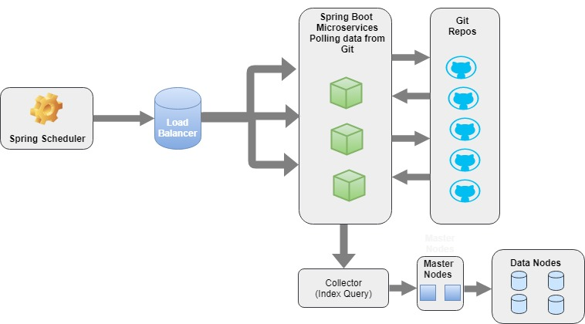
Indexing Git Repository:

Slide 9
JSON :built from the jgit code
The Branch detail
{
“BranchUrl":"https://github.com/anurag6063/HelloWorld.git"
"Target": "Ref[refs/remotes/origin/master=5f3de83058534a517fd3970d89d6e3d526d674ff]",
"Branch": "SymbolicRef[refs/remotes/origin/HEAD -> refs/remotes/origin/master]",
"Target Name": "refs/remotes/origin/master",
"Branch Name": "5f3de83058534a517fd3970d89d6e3d526d674ff“
}
{
“BranchUrl":"https://github.com/anurag6063/HelloWorld.git"
"Target": "Ref[refs/remotes/origin/readme-edits=]",
"Branch": "Ref[refs/remotes/origin/readme-edits=]",
"Target Name": "refs/remotes/origin/readme-edits",
"Branch Name": "b408f8039a50c26365d923ce85653917c6b330fc“
}

Slide 10
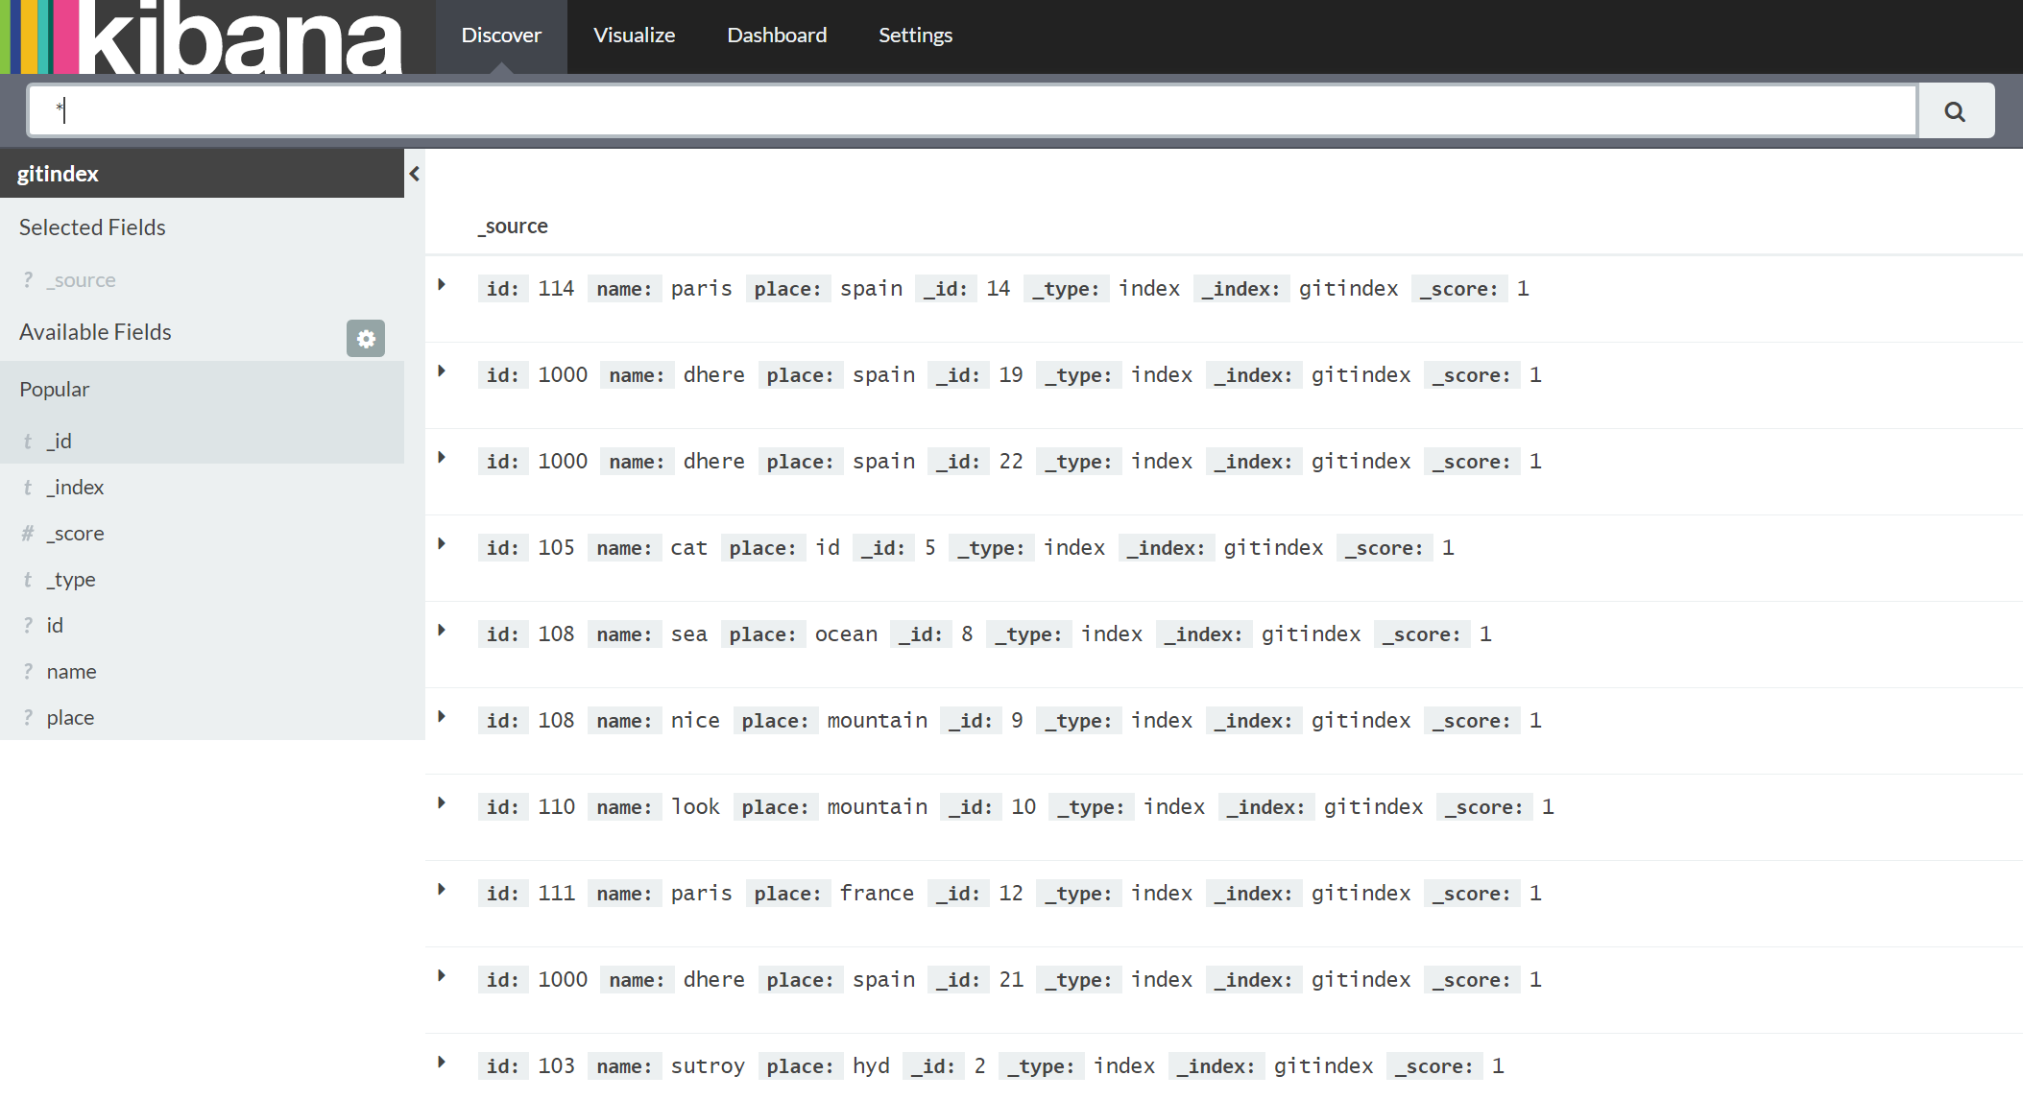
Report generation using Kibana:
Post installing reporting patches open Kibana and map it to existing elasticsearch index to see all the data of the index in Discover page.

Slide 11
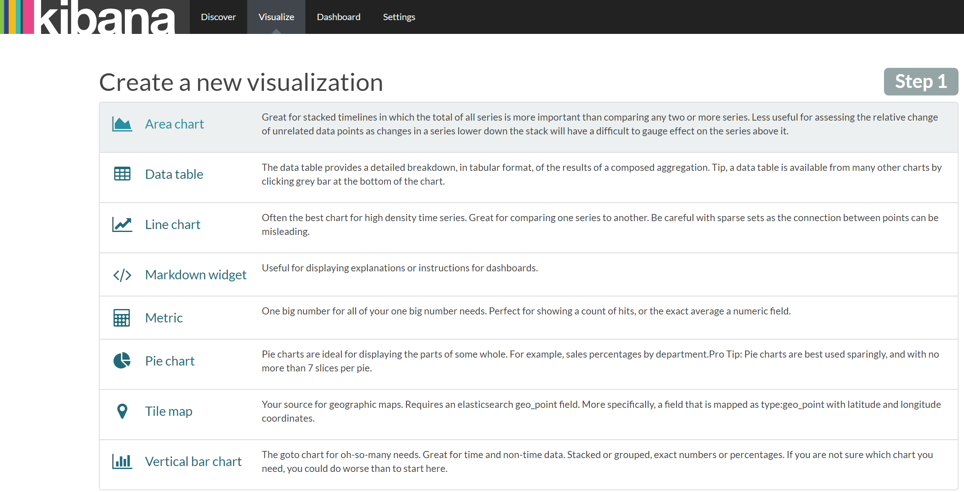
Different types of data representation models available.

Slide 12
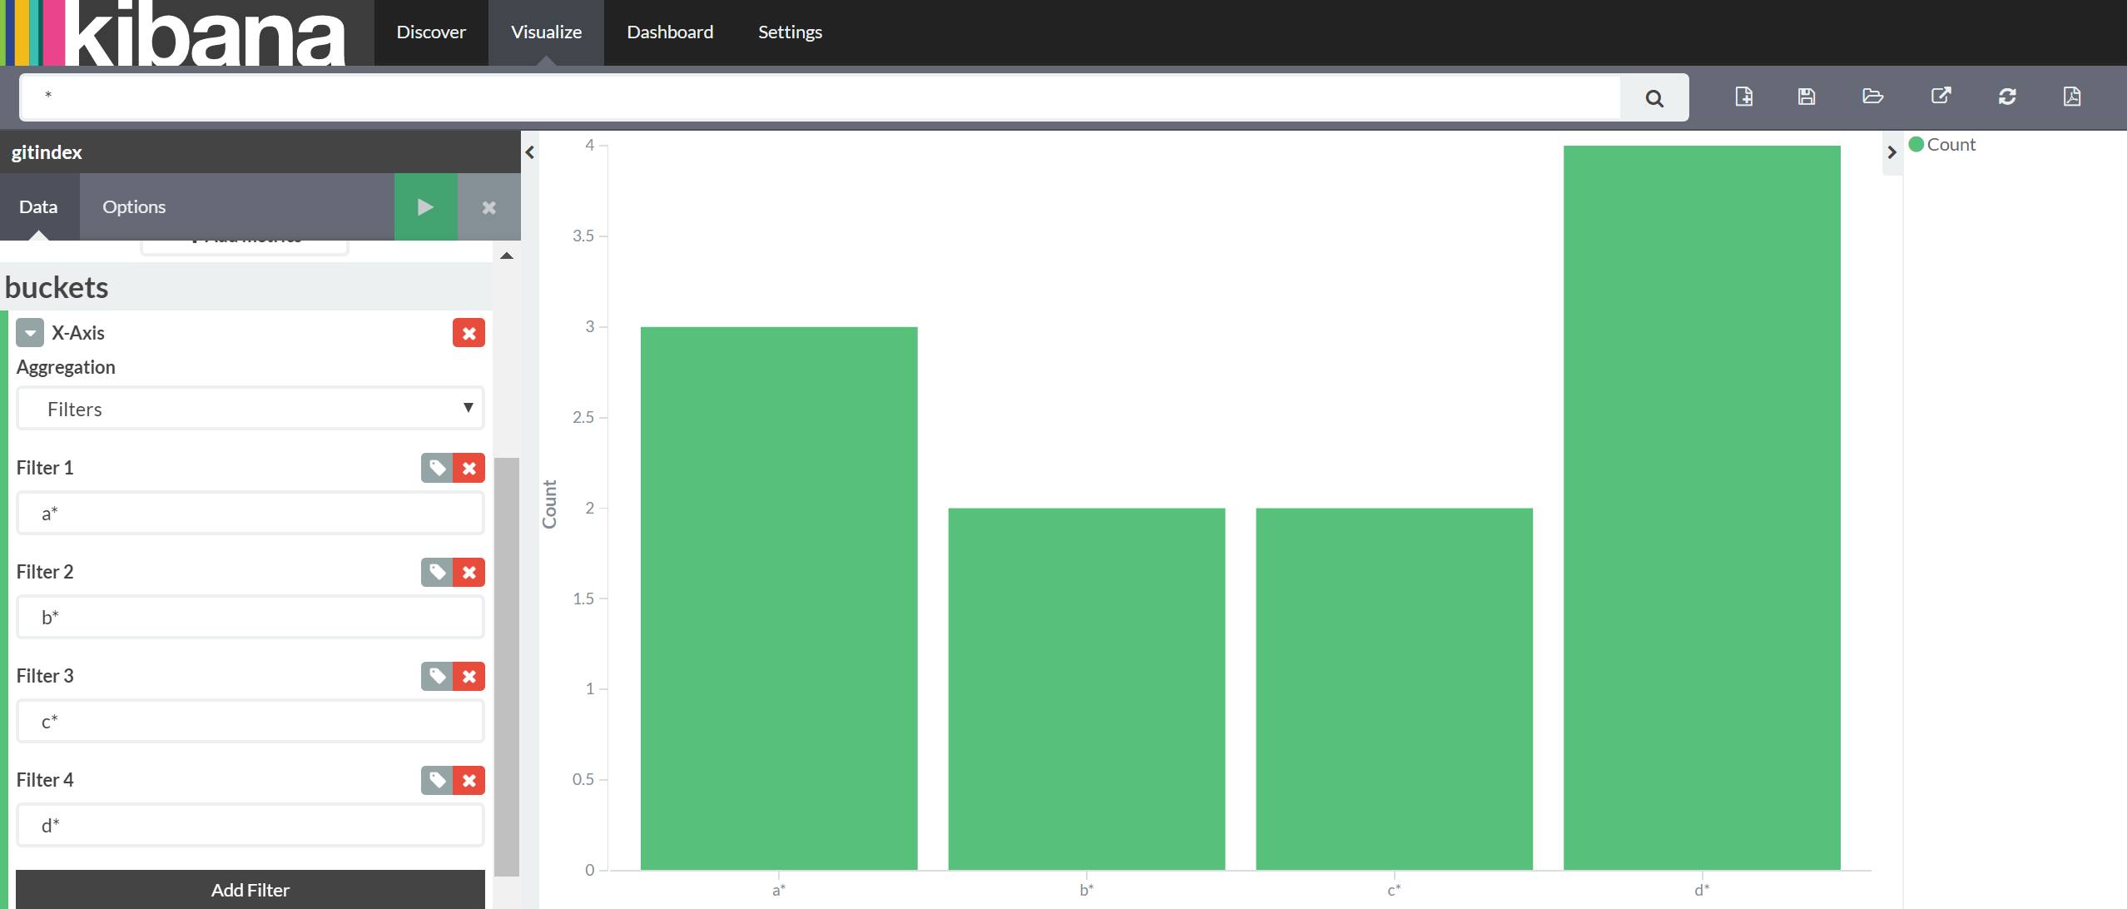
Sample vertical Bar Chart:
Finding no of names field starting with particular alphabet.
Note: After creating a graph save it with a particular name. A set of graphs can be added in a Dashboard.

Slide 13
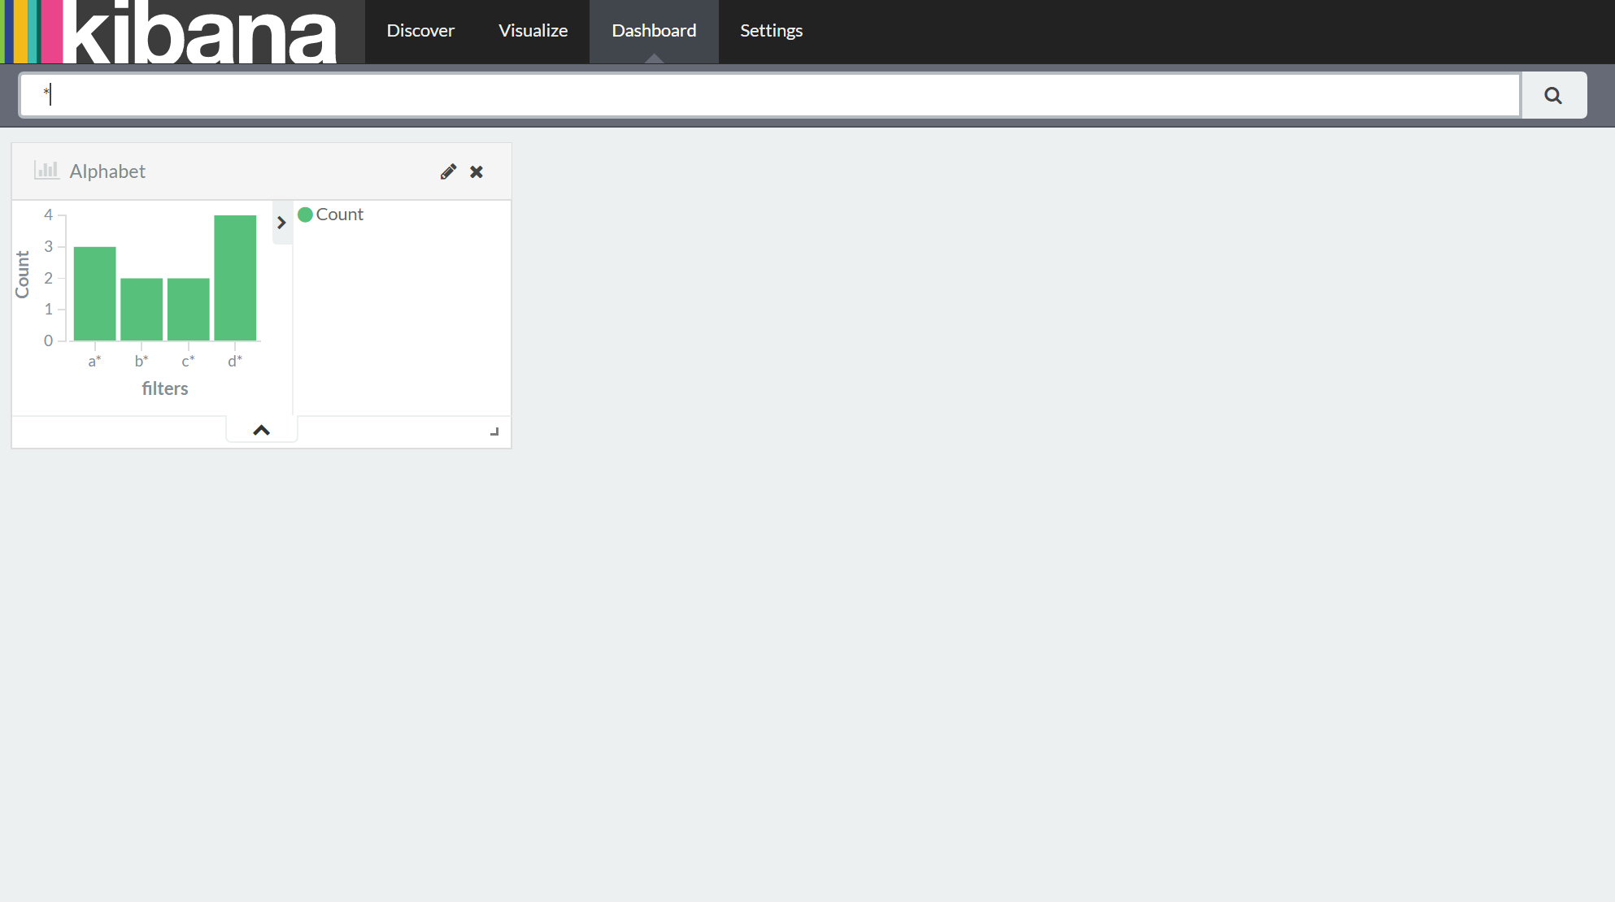
After creating different Data representation models and add it in Dashboard.

