Slide 1
Elasticsearch
Vinodh

Slide 2
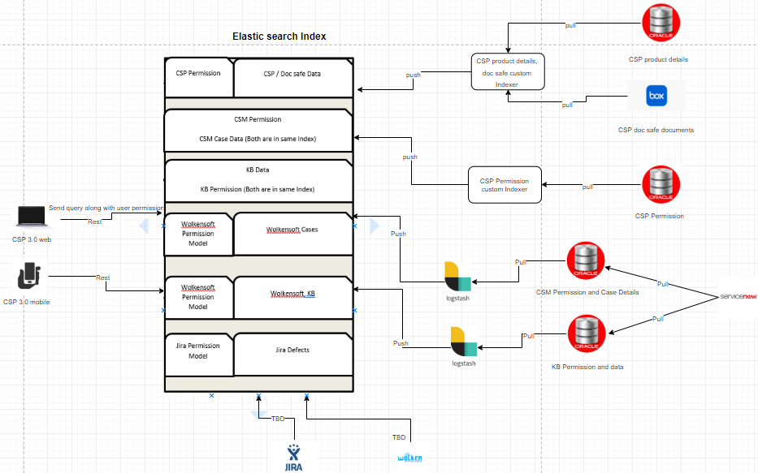
Elasticsearch CSP Architecture

Slide 3
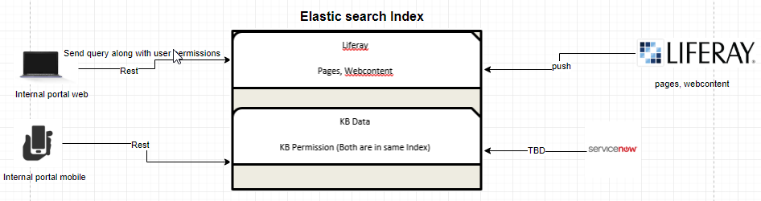
Elasticsearch Internal Portal Architecture

Slide 4
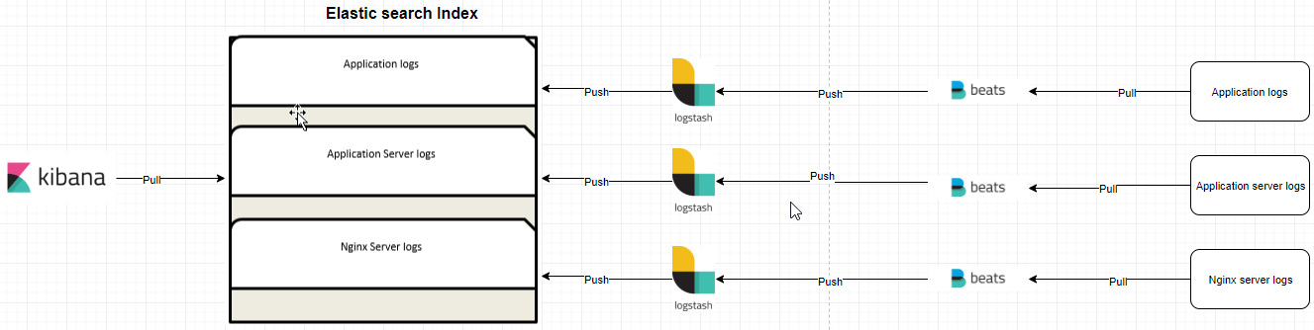
Elasticsearch Log monitoring Architecture

Slide 5
Thank You

