Slide 1
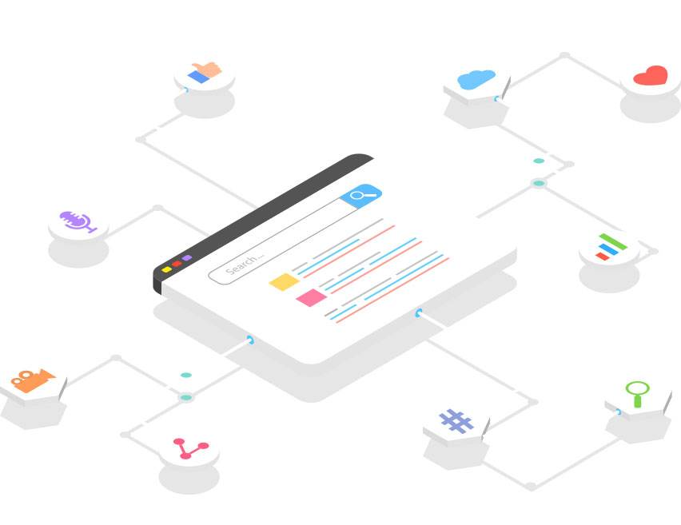

Enterprise Search
Role Based Full Text Search Engine
Issue
50 million docs sitting as source of information. With disk size of ~700 GB data.
Need to convert raw data to information. This drives quick and informed decision.
Need to search across various unstructured/different data in the blink of the eye. Search results from various sources tend to give a wholesome view of data making it more worthy.
Approach
Index all the documents and make use of full text searching using Elasticsearch and Microservices.
Pull documents from all the sources like Box, JIRA, Web Pages, XML Docs etc.
Parse the files, document and make an indexable doc ready to be searched.
Expose API to enable full text search, fuzzy search (Lenient towards spelling mistakes), autocompletion (Suggest keywords based on historical intention of user ), Analytics (Visualize data in bar charts, Venn diagram and time series data in timelion getting real time feedback of your data).
Challenges
Large and varied documents. Web Page – XML (Daily) Box ( PDF, PPT etc.) – Spring Batch using TIKA. (Daily) XML – Filebeat (One Time) Logs – Filebeat Elasticsearch (Real Time) DB – Logstash and Ruby (5 mins) API – JSON data (Real Time, Push Mechanism, Web Hook)
Key Metrics
Search million of documents in milliseconds
10x less time to search a document
Scale with size and have high availability using cluster of nodes
Have indexed document as source to get insights from data when original source gets decommissioned.

Slide 2
Huge Files: Box contains files in varied format and size. Spring Batch with large RAM used to index the document. Searching a huge field slowed down the inverted index so we split the field in array and store as an inner object. Fetch modified to not fetch the whole JSON.
Slow XML processing: Researched different tech stack (Shell, Filebeat, Spring Batch) with sample docs and zeroed on Shell Scripting and Filebeat.
Having updated docs and debugging missed updates.
Key Metrics
Lessons
Research and planning is important. Weighed options w.r.t technology, index mapping and processing service request and did POC.
Design to operate and maintain.
Good to simplify few good to have features to avoid complexity initially.
Prefer configuration over coding. Till we have a very specific use case.
Each team member should be expert in a module but should know the whole application flow.
Outcomes
Quick, smart and relevant search upon all the indexed documents and make use of full text searching. This searches only document the user has access to.
Any update in the source of document gets reflected on a scheduled/real time basis in the search result.
Search for text based on different source. The results can still be narrowed down based of keywords called filters.
It will take 10x less time to search a document.
Create smart dashboard using Kibana. Analyze data, get real time insights into data
1000 files/min processed Filebeat.
7 different data sources indexed.
Zero downtime
Snapshots and Disaster Recovery implemented.

Slide 3
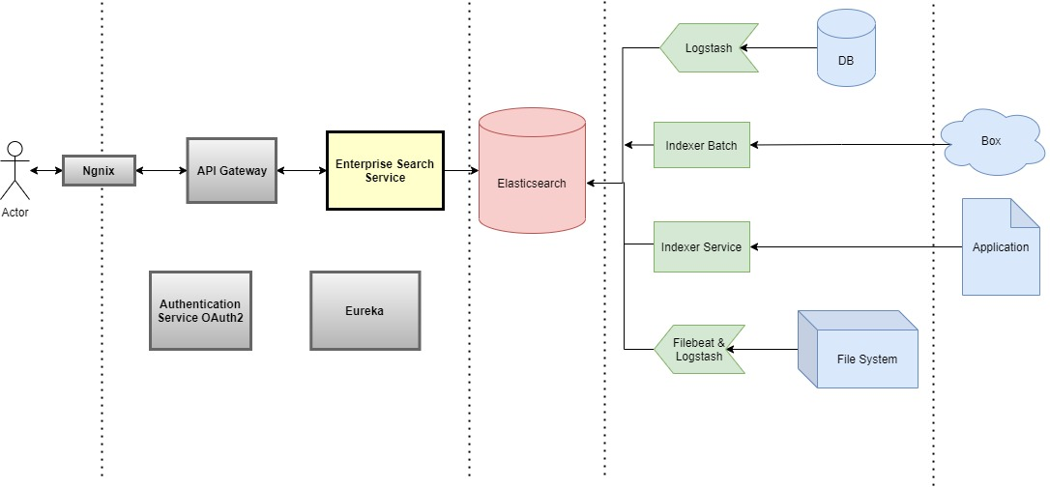
High Level Architecture

