Slide 1
TOPIC: FACE MASK DETECTION USING YOLO ALGORITHM
BY :
ANURAG TRIPATHI-A12405117001(7ECE2)

Slide 2
MOTIVATION AND OBJECTIVE
MANDATORY FACE MASK RULES ARE BECOMING MORE COMMON IN PUBLIC SETTINGS AROUND THE WORLD.
THERE ARE GROWING SCIENTIFIC EVIDENCE SUPPORTING THE EFFECTIVENESS OF FACE MASK WEARING ON REDUCING THE SPREAD OF COVID-19.
THE OBJECTIVE OF THIS WORK IS TO DEVELOP A DEEP LEARNING MODEL WHICH DETECTS WHETHER A PERSON IS WEARING A FACE MASK OR NOT WEARING A FACE MASK.

Slide 3
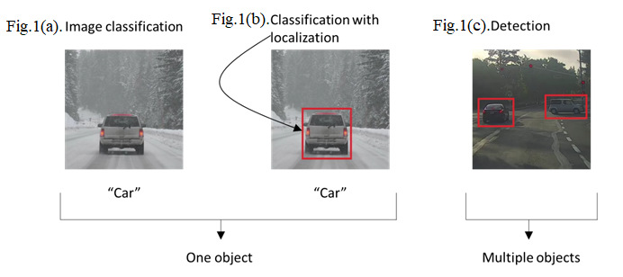
WORK DONE
WE HAVE DONE THE FOLLOWING IMPLEMENTATION, AS YOLO WAS IMPLEMENTED ON DARKNET (IN C LANGUAGE), AND MOST OF THE CODING FOR IT WAS DONE BY IMPORTING REPOSITORIES , THEREFORE WE HAVE DONE THE FOLLOWING:-
HARD CODING OUR OWN CNN MODEL.
CODE BY IMPORTING MODULES. (VGG 16 AND RESNET152)
BY GITHUB REPOS. (YOLO)

Slide 4
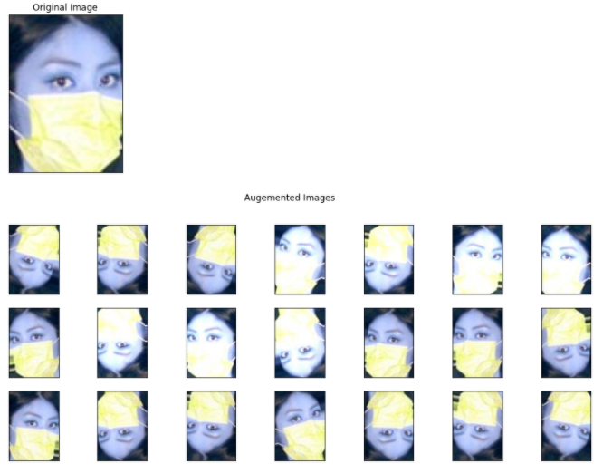
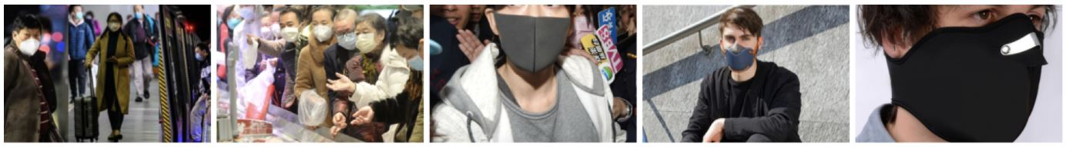
DATASET USED
KAGGLE FACE MASK DETECTION DATASET. (LICENSE ;CC0:PUBLIC DOMAIN).
NUMBER OF IMAGES: 3833 IMAGES
NUMBER OF CLASSES : 2 – WITH MASK AND WITHOUT MASK
THE DATASET USED WAS SPLIT INTO 80-20 RATIO.
WE HAVE ALSO PERFORMED IMAGE AUGMENTATION TO INCREASE THE DATASET

Slide 5
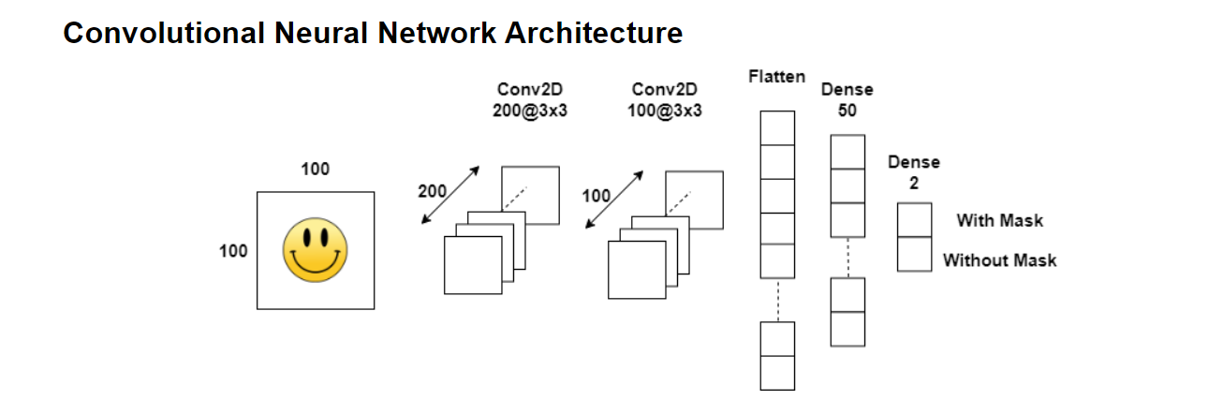
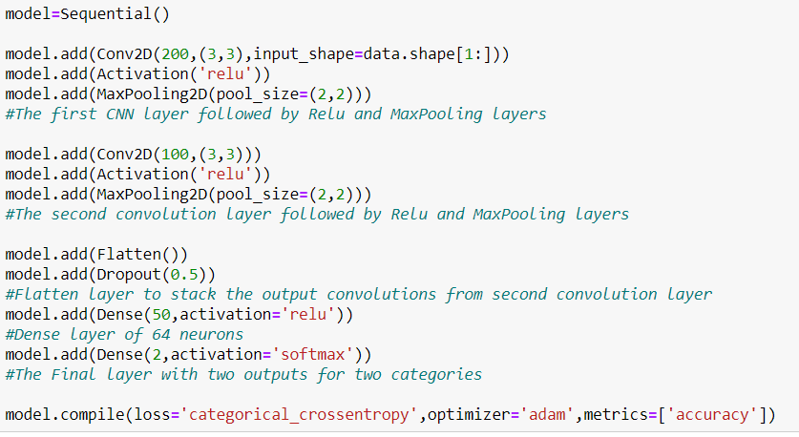
SIMPLE CNN
WE HAVE HARDCODED A SIMPLE CNN MODEL WHICH CONSISTS OF 2 CONVOLUTIONAL LAYERS FOLLOWED BY 2 DENSE LAYERS

Slide 6
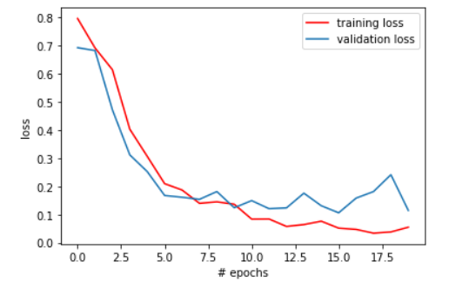
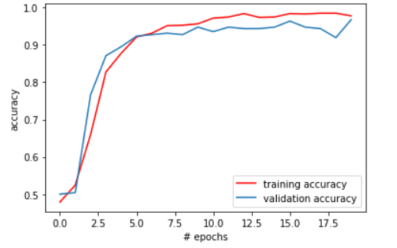
RESULT FOR THIS MODEL

Slide 7
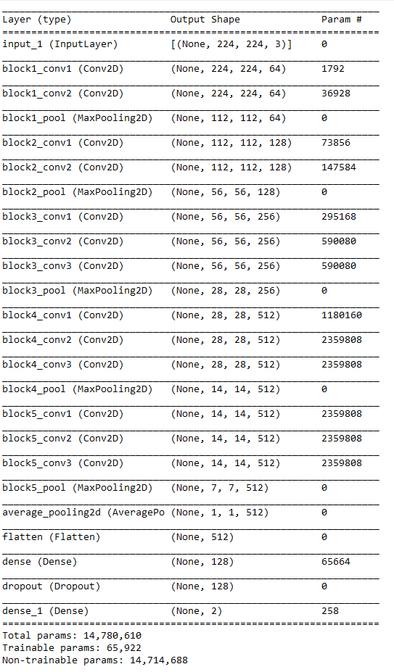
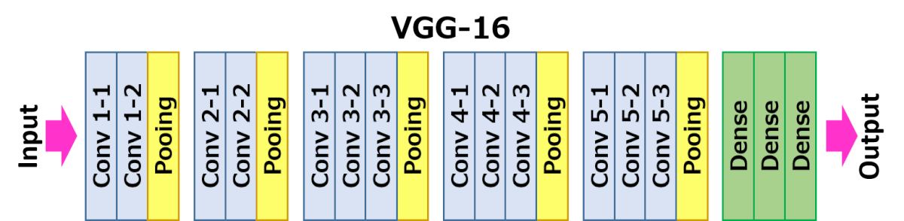
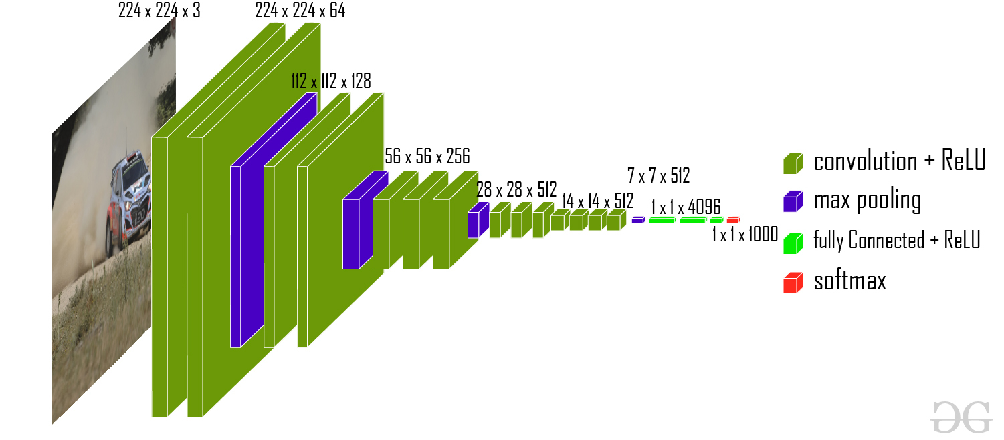
VGG 16
MULTIPLE STACKED SMALL SIZED KERNELS.
IN VGG 16, ALL THE CONV LAYERS AND MAX POOLING LAYERS HAVE THE SAME DIMENSIONS.
16 LAYERS (13 CONV, 3 DENSE)
CONV LAYERS = 3 X 3, S=1 🡪 TO BRING OUT BEST REPRESENTATION AND INFORMATION.
MAX_POOL = 2X2, S=1

Slide 8
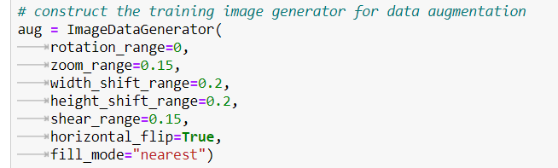
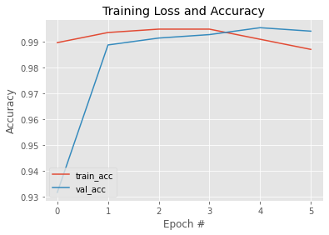
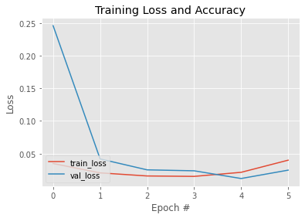
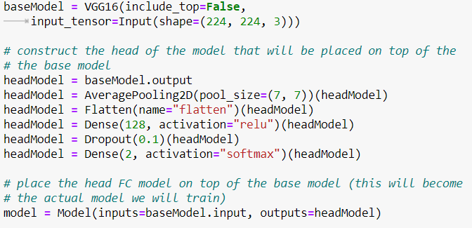
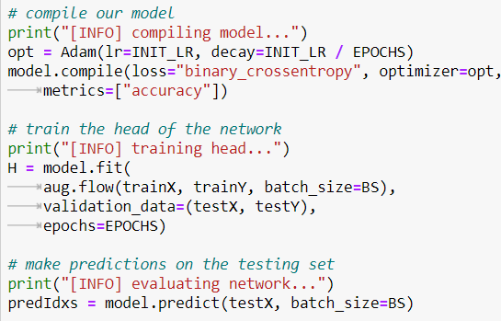
CODE FOR VGG 16

Slide 9
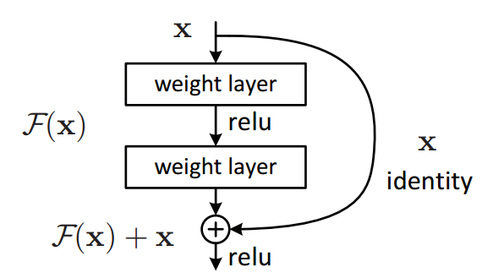
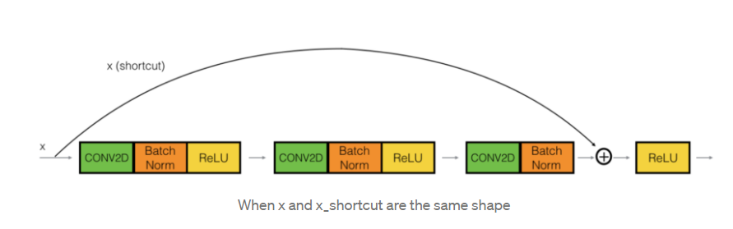
RESNET 152
THE RESIDUAL NETWORKS WERE INTRODUCED TO WITH THE KEY FEATURES BEING:-
SKIP CONNECTIONS
HEAVY BATCH NORMALIZATION
THEY WERE SUCCESSFUL IN REDUCE THE DEGRADATION IN DEEPER MODEL AND ALSO COUNTERED THE PROBLEM OF VANISHING GRADIENT WHICH AROSE WITH IT.

Slide 10
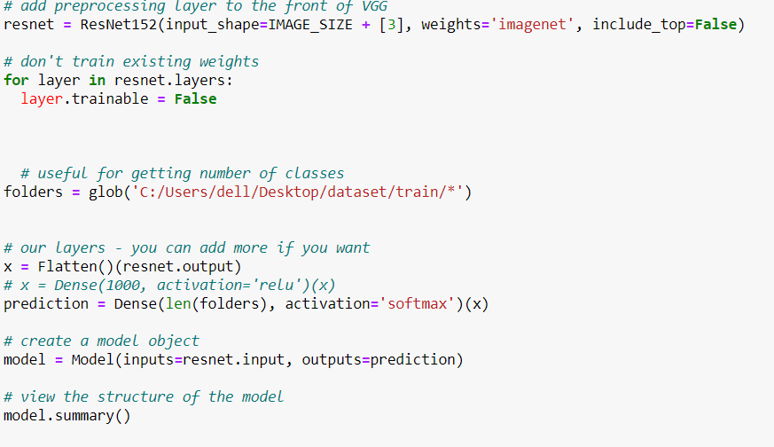
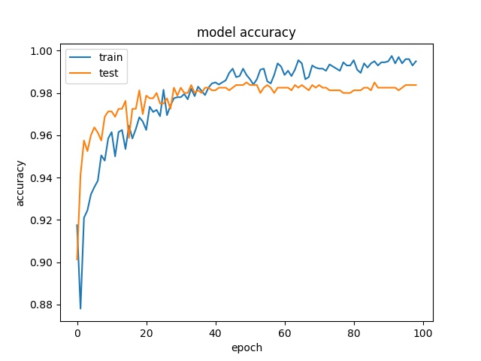
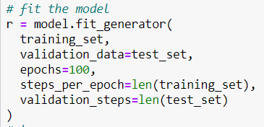
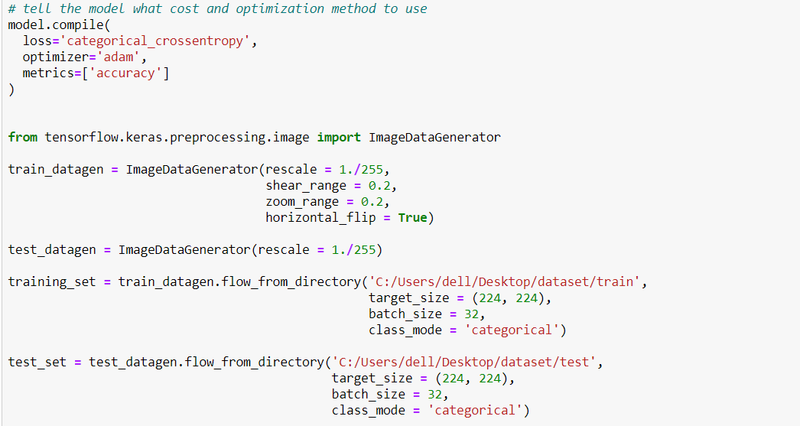
CODE AND RESULTS OBTAINED

Slide 11
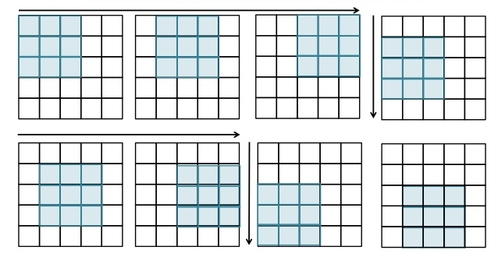
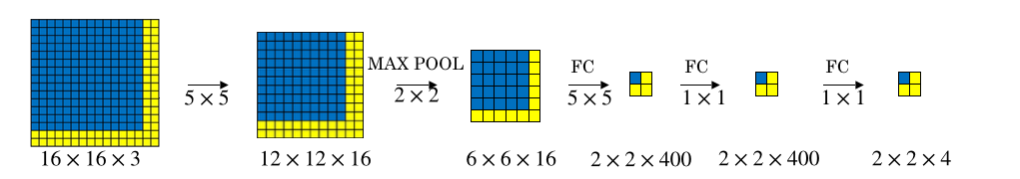
YOLO ALGORITHM
WHY YOLO?
YOLO WAS INTRODUCED BECAUSE THE EXISTING SYSTEM, WHICH IS SLIDING WINDOW, HAD THE FOLLOWING SHORTCOMINGS: -
TIME TAKING
COMPUTATIONALLY EXPENSIVE
YOLO (YOU ONLY LOOK ONCE), SENDS THE ENTIRE IMAGE AT ONCE, AND THE PREDICTION IS MADE IN ONE GO.

Slide 12
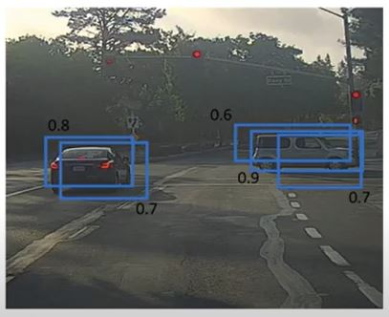
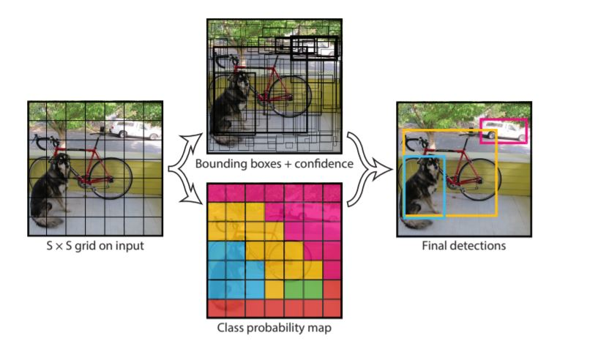
HOW DOES YOLO WORK?
IN YOLO EACH IMAGE IS DIVIDED INTO GRID CELLS, AND EACH CELL HAS BOUNDING BOXES ASSOCIATED WITH IT.
THESE BOXES ARE SUPPRESSED BY NON MAX SUPPRESSION BY THE PRINCIPLE OF IOU (INTERSECTION OVER UNION)

Slide 13
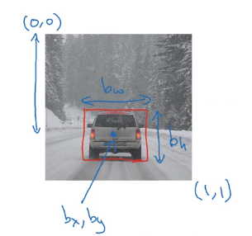
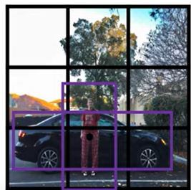
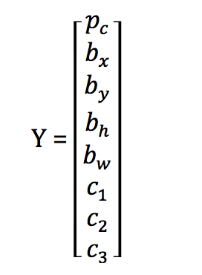
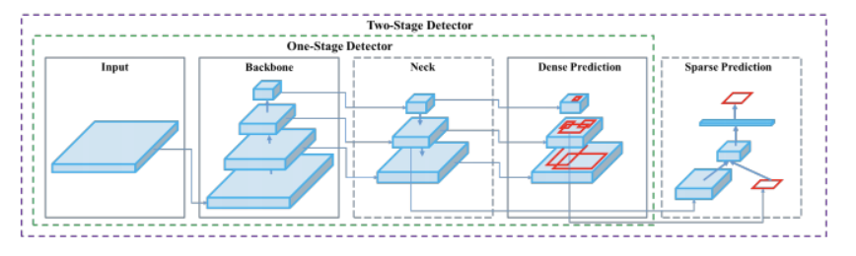
ARCHITECTURE

Slide 14
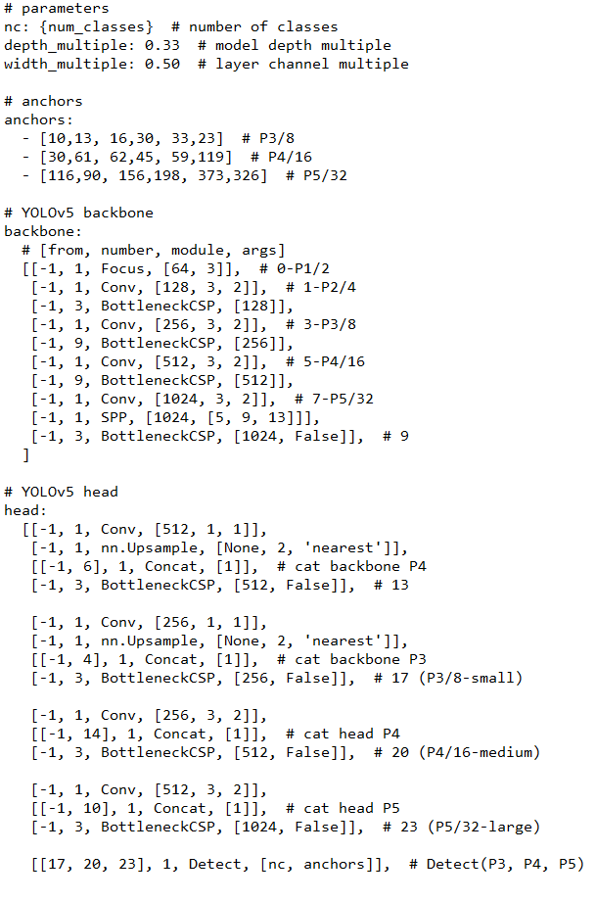
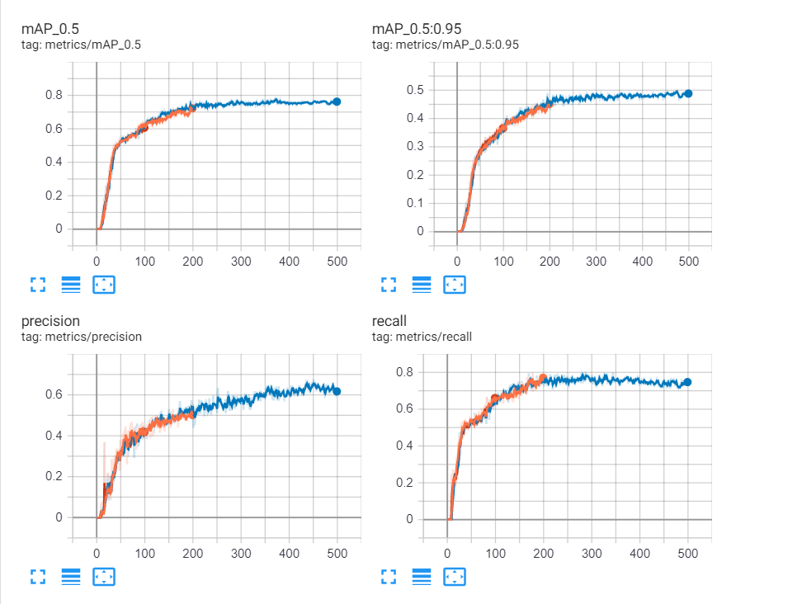
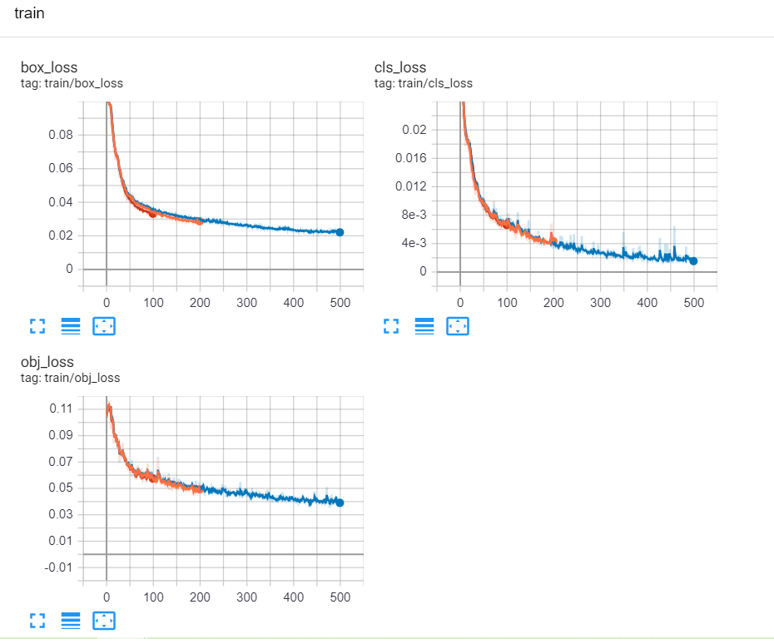
RESULTS OBTAINED
mAP (mean average precision) is the average of AP. In some context, we compute the AP for each class and average them. But in some context, they mean the same thing

Slide 15
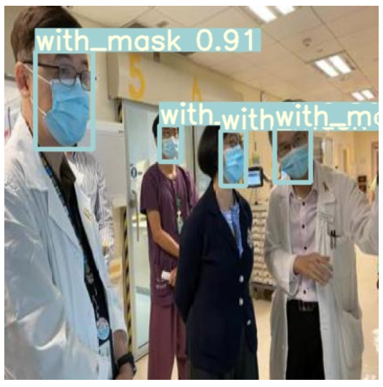
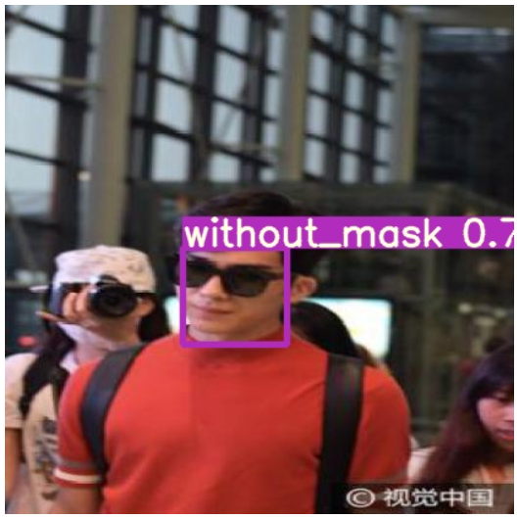
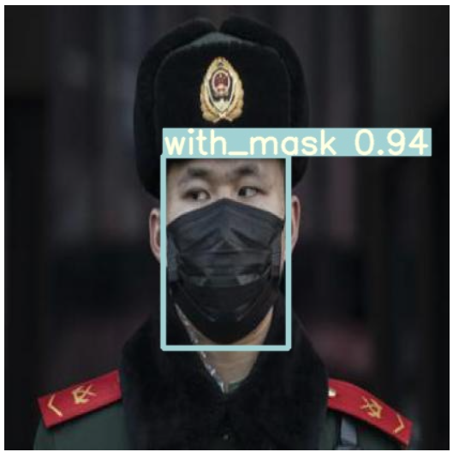
RESULTS OBTAINED

Slide 16
REFRENCES
[1]. C. LIU, Y. TAO, J. LIANG, K. LI AND Y. CHEN, "OBJECT DETECTION BASED ON YOLO NETWORK," 2018 IEEE 4TH INFORMATION TECHNOLOGY AND MECHATRONICS ENGINEERING CONFERENCE (ITOEC), CHONGQING, CHINA, 2018, PP. 799-803, DOI: 10.1109/ITOEC.2018.8740604.
[2] J. REDMON, S. DIVVALA, R. GIRSHICK AND A. FARHADI, "YOU ONLY LOOK ONCE: UNIFIED, REAL-TIME OBJECT DETECTION," 2016 IEEE CONFERENCE ON COMPUTER VISION AND PATTERN RECOGNITION (CVPR), LAS VEGAS, NV, 2016, PP. 779-788, DOI: 10.1109/CVPR.2016.91.
[3] H. QASSIM, A. VERMA AND D. FEINZIMER, "COMPRESSED RESIDUAL-VGG16 CNN MODEL FOR BIG DATA PLACES IMAGE RECOGNITION," 2018 IEEE 8TH ANNUAL COMPUTING AND COMMUNICATION WORKSHOP AND CONFERENCE (CCWC), LAS VEGAS, NV, 2018, PP. 169-175, DOI: 10.1109/CCWC.2018.8301729.
[4] K. HE, X. ZHANG, S. REN AND J. SUN, "DEEP RESIDUAL LEARNING FOR IMAGE RECOGNITION," 2016 IEEE CONFERENCE ON COMPUTER VISION AND PATTERN RECOGNITION (CVPR), LAS VEGAS, NV, 2016, PP. 770-778, DOI: 10.1109/CVPR.2016.90

