Slide 1
Frequency domain filtering
Anurag Tripathi
A12405117001

Slide 2
Content
Key Points
Understanding with visualization
Basics of Filtering in the Frequency Domain
Some Basic Filters & Their Function
Ideal L.P.F
Butterworth Lowpass Filters (BLPFs) with order n
Gaussian Lowpass Filters (GLPFs)
Sharpening Frequency Domain Filter
High pass Filters Spatial Representations
The Laplacian in the Frequency Domain

Slide 3
Key Points for frequency domain
Frequency domain is less in demand
Mainly used for one filter : HOMOMORPHIC FILTERING
HOMOMORPHIC FILTERING: Designed for medical images
Ques: Why do we use DFT for transformation of time domain to frequency domain?
Ans: Periodicity property of Fourier series
In Fourier transformation, imaginary components is discarded.
In time domain, we have lots of complexity (time consumption is more), which means B.W. requirement will be large. This is why we use freq. domain.

Slide 4
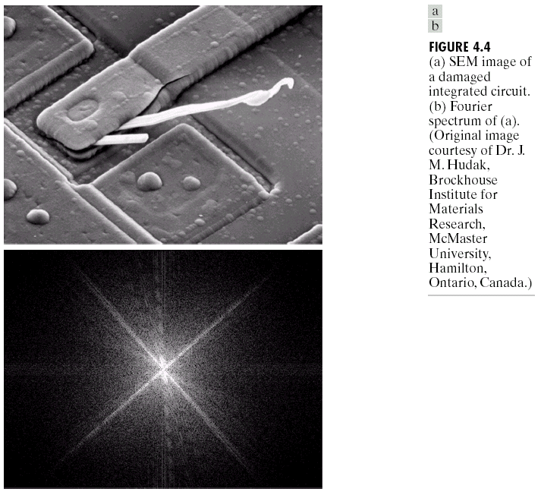
(A) (B)
Frequency is directly related to rate of change. The frequency of fast varying components in an image is higher than slowly varying components.

Slide 5
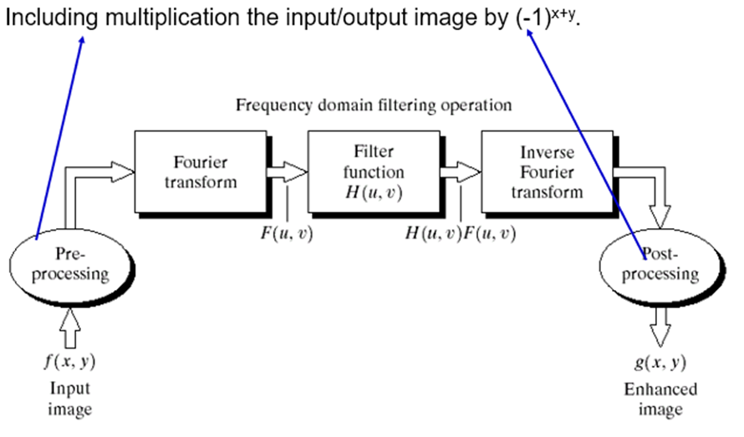
Basics of Filtering in the Frequency Domain

Slide 6
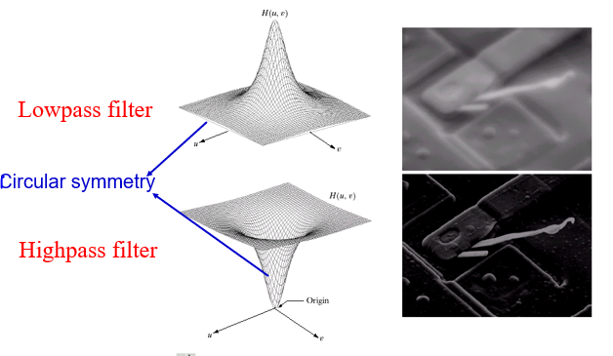
Some Basic Filters & Their Function

Slide 7
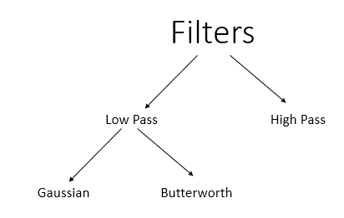
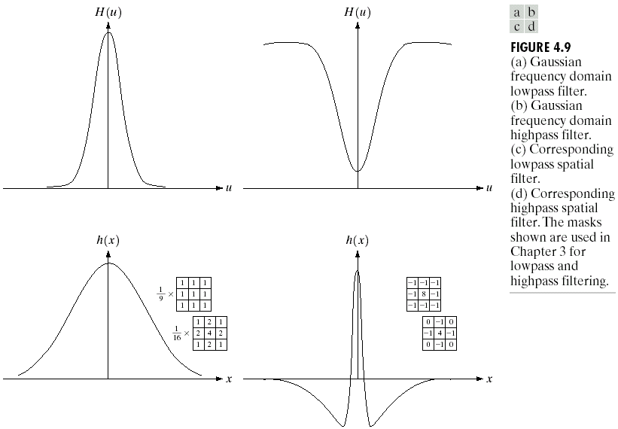
Ideal lowpass filter
Butterworth lowpass filter
Gaussian lowpass filter
7x7>5x5>3x3 : performs much faster.
But we cant compromise with image quality.

Slide 8
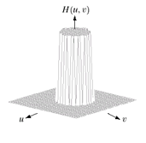
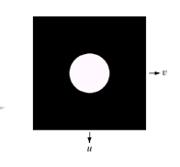
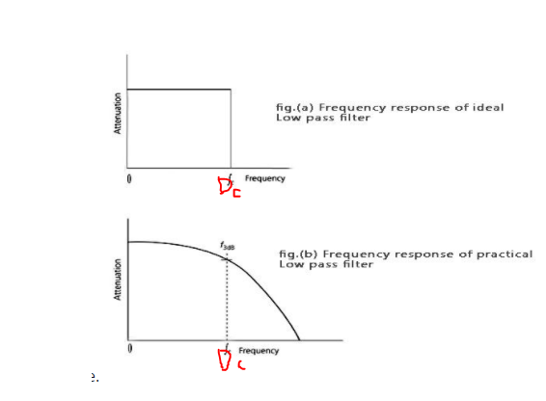
Ideal L.P.F
The simplest lowpass filter is a filter that “cuts off” all high-frequency components of the Fourier transform that are at a distance greater than a specified distance D₀ from the origin of the transform.
The transfer function of an ideal lowpass filter
where D(u,v) : the distance from point (u,v) to the center of ther frequency rectangle (M/2, N/2)

Slide 9
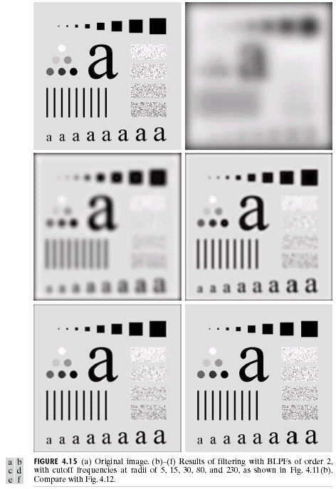
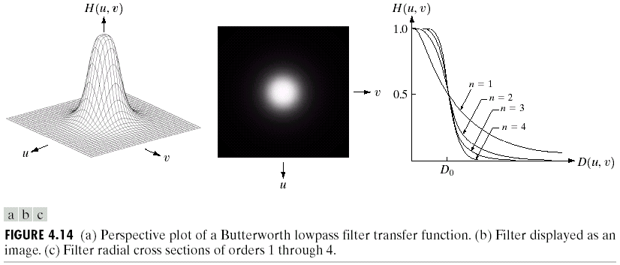
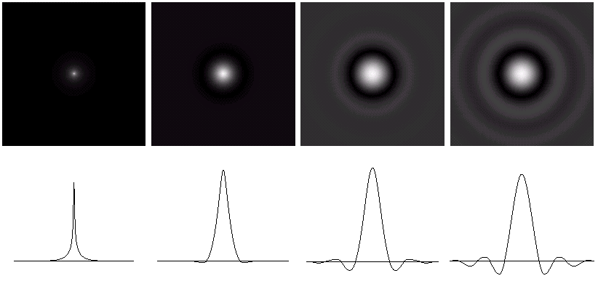
Butterworth Lowpass Filters (BLPFs) with order n
n=2
D₀=5,15,30,80,and 230

Slide 10
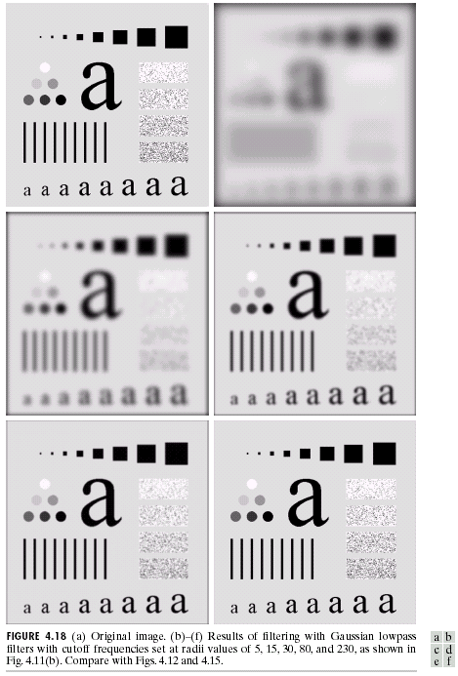
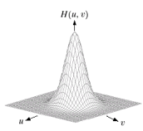
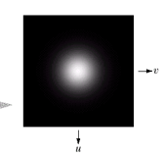
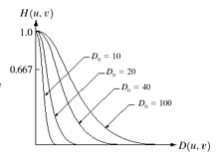
Gaussian Lowpass Filters (GLPFs)
D₀=5,15,30,80,and 230

Slide 11
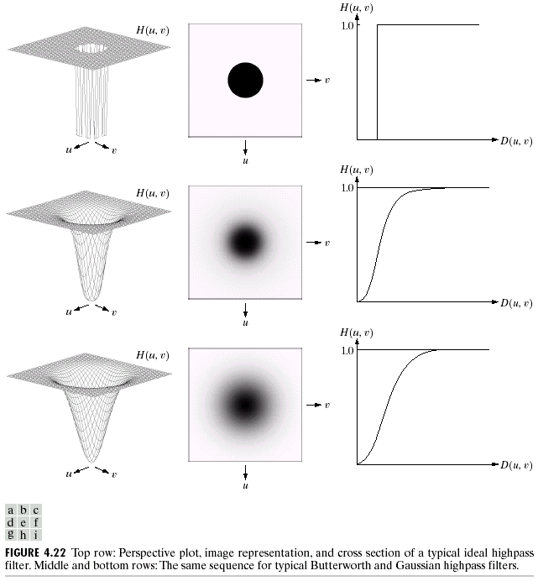
Sharpening Frequency Domain Filter
Ideal highpass filter
Butterworth highpass filter
Gaussian highpass filter

Slide 12
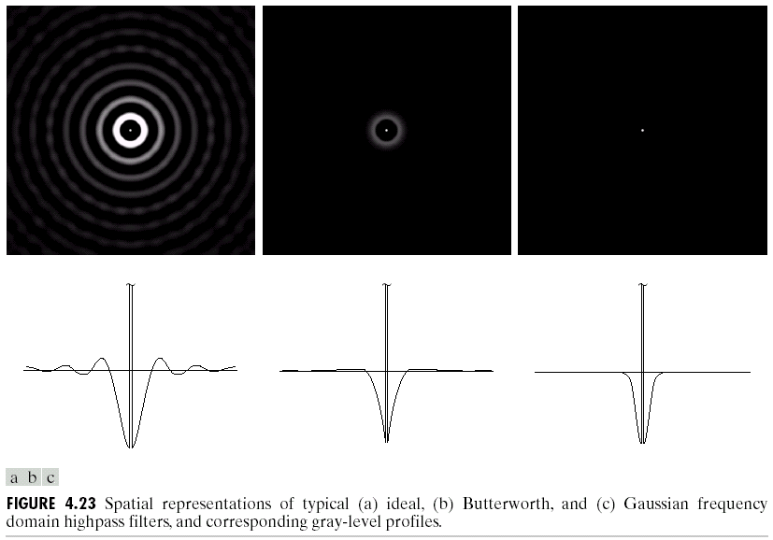
High pass Filters Spatial Representations

Slide 13
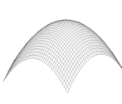
The Laplacian in the Frequency Domain
The FT of n-order differential of a function f(x) is
3D plot pf Laplacian in the freq domain
For a two-dimensional function f(x,y), it can be shown that
So, Laplacian can be implemented in the frequency domain by using the filter
Shift the center to (M/2, N/2) and obtain
We have the following Fourier transform pairs

Slide 14
Thank You

