Slide 1
Title: A Fuzzy Congestion Control Protocol Based on Active Queue Management in Wireless Sensor Networks
- - - Team Details - - -
Mentor : Mrs. Moumita Deb
Team Leader : Anurag Ganguly
Other Team Members:
Amit Roy
Swarnendu Roy
Deep Das

Slide 2
Presentation Outline
Introduction & Background : Congestion and AQM in WSNs
Routing in WSN
How Does Congestion Occur in WSN?
Traditional Congestion Control
Fuzzy Congestion Control
Types of Fuzzy Congestion Control
Fuzzy Congestion Control using Active Queue Management (AQM)
Comparison of Research Papers on Fuzzy Congestion Control in WSNs using AQM
Motivation for the Study
Experiment Plan
Novelty of Our Project
Conclusion
References

Slide 3
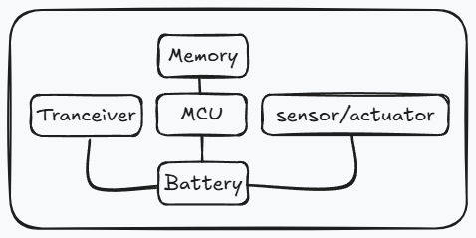
Introduction & Background : Congestion and AQM in WSNs
A Wireless Sensor Network (WSN) is a collection of spatially distributed sensor nodes that monitor physical or environmental conditions (e.g., temperature, humidity, pressure, vibration). Each node typically consists of:
Sensing unit (to collect data)
Processing unit (to process data locally)
Communication unit (to transmit data)
Power unit (usually battery-powered, resource-constrained)

Slide 4
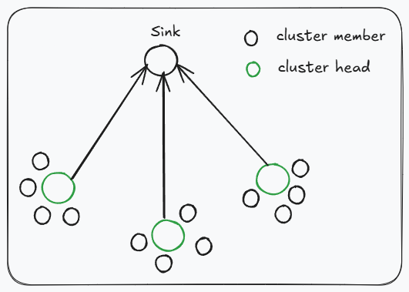
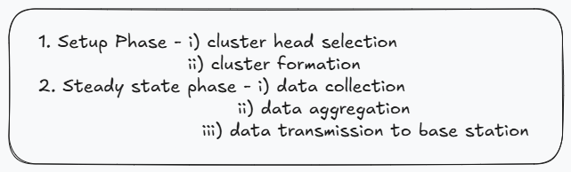
Routing in WSN
Routing in WSN differs from traditional networks due to energy constraints, scalability issues, and dynamic topology.
Common routing protocols:
Flat Routing (e.g., Flooding, Gossiping) – all nodes play equal roles.
Hierarchical Routing (e.g., LEACH, PEGASIS) – nodes are grouped into clusters, cluster heads manage communication.
Location-Based Routing (e.g., GEAR, GPSR) – uses node positions to guide routing.
Efficient routing is essential to minimize energy consumption and congestion.
Low Energy Adaptive Clustering Hierarchy (LEACH)

Slide 5
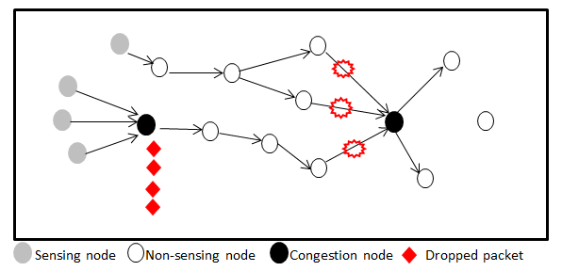
How Does Congestion Occur in WSN?
Congestion in WSN happens when network resources (buffer, channel, energy) are overloaded due to:
High traffic load from multiple sources.
Burst transmissions during events.
Limited buffer capacity in sensor nodes.
Wireless interference and packet collisions.
Effects of congestion:
Packet loss, increased delay, wasted energy, and reduced network lifetime.

Slide 6
Traditional Congestion Control
Inspired by TCP-like approaches in traditional networks.
Mechanisms:
Rate control – nodes adjust data sending rates.
Queue management – dropping or scheduling packets when buffer fills.
Backpressure routing – rerouting traffic away from congested nodes.
Limitations in WSNs:
TCP mechanisms are not energy-aware.
Inefficient under dynamic, resource-constrained WSN conditions.

Slide 7
Fuzzy Congestion Control
Types of Fuzzy Congestion Control
Fuzzy Logic is used to handle uncertainty and non-linearity in WSN traffic.
Inputs (e.g., queue length, packet loss rate, link utilization) are mapped into linguistic variables (low, medium, high).
The fuzzy inference system determines congestion level and decides actions like adjusting data rates or packet dropping priority.
Advantages:
Adaptive to varying traffic.
Better resource utilization.
Extends network lifetime.
Source-based Fuzzy Control: Adjusts sending rate at the source node.
Intermediate-node Fuzzy Control: Congestion handled at relay nodes by queue management.
Hybrid Fuzzy Control: Combination of both for better adaptability.

Slide 8
Fuzzy Congestion Control using Active Queue Management (AQM)
AQM is a queue management strategy that proactively manages buffer occupancy before it overflows.
In Fuzzy AQM, fuzzy logic is applied to monitor:
Queue length
Packet arrival rate
Packet loss probability
Based on fuzzy rules, the system decides whether to:
Drop packets early.
Adjust priority levels.
Signal source nodes to reduce rates.
This approach reduces packet loss, delay, and energy wastage, improving QoS and network lifetime.

Slide 9
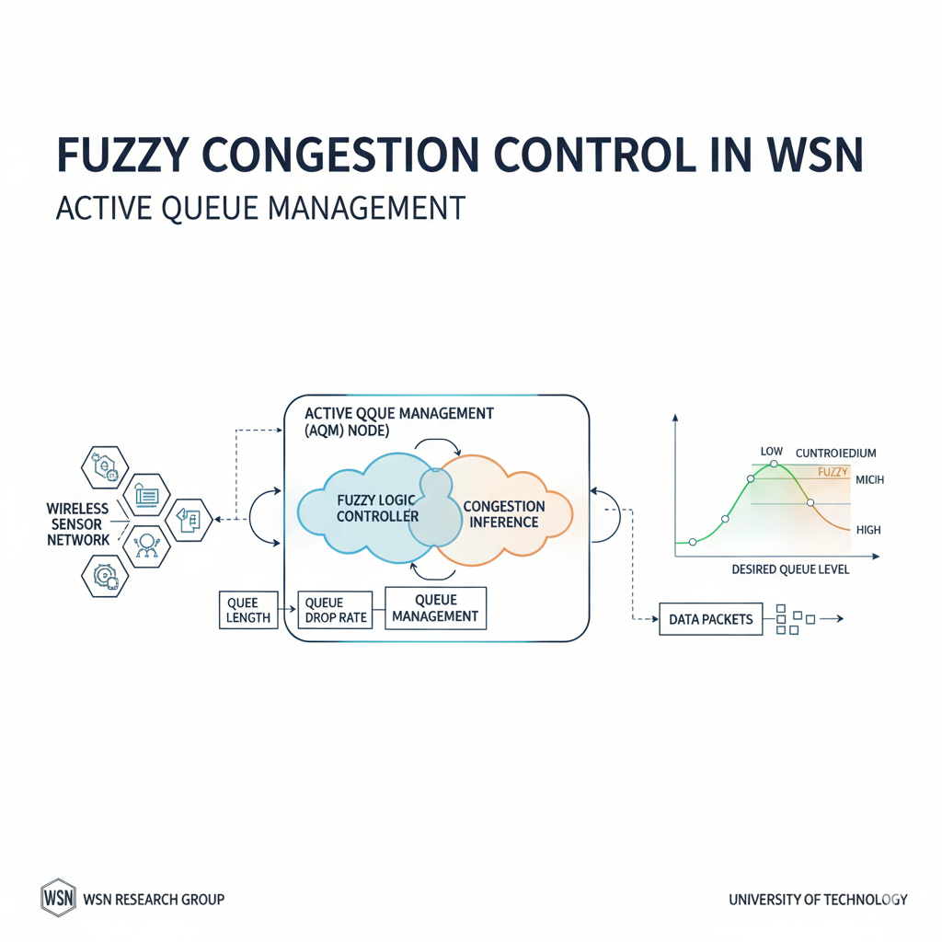
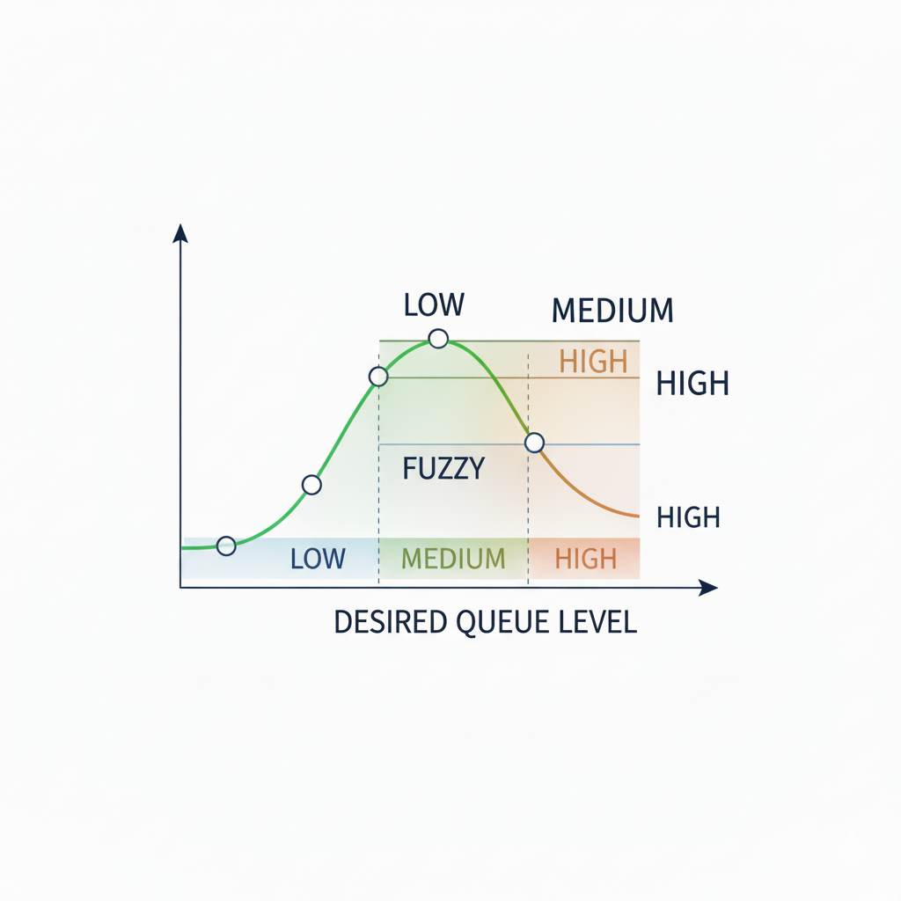

Slide 10
Comparison of Research Papers on Fuzzy Congestion Control in WSNs using AQM
Sl. No. | Paper (year) | Inputs / indicators used | Where fuzzy / AQM runs (node role) | Control action (output) | Eval / metrics | Key strengths | Key weaknesses
1 | Rezaee & Pasandideh — (2017/2018). | Queue length (instant/avg), channel load, packet priority (medical data) | Cluster-heads / forwarding nodes (AQM at CHs) | Fuzzy → compute drop/mark probability + explicit CN to upstream; priority-aware dropping | Simulation (claims reduced packet loss & delay for medical traffic) | Application-aware (protects critical medical packets), proactive AQM. | Requires cluster formation; fuzzy engine overhead at CHs; parameter tuning needed.
2 | P. Aimtongkham et al. — (2018). | Avg. queue length, arrival rate, packet loss; uses prediction + adaptive MFs | Node-level (distributed) — prediction + local fuzzy control | Fuzzy inference (adaptive MFs) → early drop / rate reduction; also predicts congestion to act earlier | Simulation (WSN scenarios) — throughput, delay, prediction accuracy | Adaptive MFs reduce manual tuning; prediction avoids late reaction. | Higher complexity; overhead of adaptive MF update; needs validation on real motes.

Slide 11
Comparison of Research Papers on Fuzzy Congestion Control in WSNs using AQM
Sl. No. | Paper (year) | Inputs / indicators used | Where fuzzy / AQM runs (node role) | Control action (output) | Eval / metrics | Key strengths | Key weaknesses
3 | FLACC (Fuzzy Logic Approach for Congestion Control) — (2019). | Average queue length (AQL), packet loss (PL) | Router / forwarding node (node-level AQM) | Fuzzy → compute drop probability (FLGRED variant) — early drop similar to RED but fuzzy-tuned | Simulation; compared to RED / GRED — delay & packet loss metrics | Simple 2-input fuzzy rule set; outperforms RED/GRED in heavy/bursty scenarios. | Simulation-only in original; energy/processing overhead not fully measured.
4 | FBACCs (Fuzzy-based adaptive congestion control in WSNs) — (2013–2015) | Queue occupancy, arrival rate, sometimes channel load | Node-level / hop-by-hop | Fuzzy congestion estimator → smart early drop + regulate traffic rate | Simulation; compared with existing schemes — claims reduced packet loss & delay | Straightforward fuzzy estimator; rate regulation combined with dropping. | Multiple variants exist; some lack AQM explicitness; implementation details vary.

Slide 12
Comparison of Research Papers on Fuzzy Congestion Control in WSNs using AQM
Sl. No. | Paper (year) | Inputs / indicators used | Where fuzzy / AQM runs (node role) | Control action (output) | Eval / metrics | Key strengths | Key weaknesses
5 | A.Chakraborty — “Trust Based Fuzzy Algorithm for Congestion Control” (2013) | Queue length, trust metric of neighbour, packet loss | Node-level (hop-by-hop), trust-aware forwarding nodes | Fuzzy combines trust + congestion → rate adjustment and selective dropping | Simulation; metrics: throughput, normalized throughput, packet drop | Incorporates security/trust into congestion decisions (useful in WMSNs) | Extra overhead for trust computation; more state to maintain; not purely AQM.
6 | L. Lin — “A Novel Fuzzy PID Congestion Control Model” (2020) | Instantaneous queue length, packet loss rate (real-time) | Node-level / gateway nodes (control loop at forwarding nodes) | Fuzzy-PID → produces control signal for rate adjustment (and early-drop decisions) | Simulation (NS-style): queue delay, packet loss, stability | Combines control-theory stability (PID) with fuzzy tolerance to noise → smoother control. | More complex controller; tuning PID + fuzzy parameters required; overhead not profiled on motes.

Slide 13
Comparison of Research Papers on Fuzzy Congestion Control in WSNs using AQM
Sl. No. | Paper (year) | Inputs / indicators used | Where fuzzy / AQM runs (node role) | Control action (output) | Eval / metrics | Key strengths | Key weaknesses
7 | AA Abu-Shareha et al. — “Fuzzy-Based Active Queue Management Using Precise” (2023) | Queue metrics (avg qlen), traffic descriptors | Router / AQM-enabled node; methodology portable to WSN gateways | Fuzzy AQM → compute drop/mark probability; optimizes fuzzy model with GA | Simulations (network-level) — packet loss, delay improvements | Efficient fuzzy modeling + GA optimization → better AQM tuning. | Paper is general network AQM (not WSN-specific) — needs adaptation for resource- constrained nodes.
8 | N. Mazloomi et al. — “Efficient fuzzy methodology for congestion control” (2024) | Queue, link status, possibly prediction outputs (SVR) | Cluster heads / gateway (hybrid for larger deployments) | Fuzzy + ML (SVR) → AQM-style decisions and rate control; hybrid approach | Simulation/case studies — energy, packet loss, stability | Hybrid fuzzy + ML improves accuracy in complex networks. | More computation due to ML components; complexity & energy cost tradeoff.

Slide 14
Comparison of Research Papers on Fuzzy Congestion Control in WSNs using AQM
Sl. No. | Paper (year) | Inputs / indicators used | Where fuzzy / AQM runs (node role) | Control action (output) | Eval / metrics | Key strengths | Key weaknesses
9 | Sonmez et al. -“Fuzzy-based congestion control for Wireless Multimedia Sensor Networks” (2014) | Queue length, delay, frame importance / application priority | Gateways / cluster heads (AQM at aggregation points) | Fuzzy → prioritize important frames (I-frames) and compute drop probabilities for less important frames | Multimedia metrics (PSNR, frame loss), delay | Cross-layer design that preserves multimedia QoS in congestion. | Designed for WMSN (large packet sizes); not general-purpose sensor networks.
10 | Hatamian et al. — congestion-aware routing + fuzzy rate controller (2015–2017) | Local load (queue), neighbor states, link quality | Routing nodes (distributed) — fuzzy used inside routing/forwarding decision | Fuzzy produces next-hop weight + rate-adjustment; AQM-like early drops when necessary | Simulation: throughput, packet drop, energy lifetime | Avoids hotspots by combining routing + fuzzy congestion control. | Requires state exchange overhead; more complex to implement.

Slide 15
Comparison of Research Papers on Fuzzy Congestion Control in WSNs using AQM
Sl. No. | Paper (year) | Inputs / indicators used | Where fuzzy / AQM runs (node role) | Control action (output) | Eval / metrics | Key strengths | Key weaknesses
11 | IFCCDC (IF Fuzzy Control based Congestion Detection & Control) — (2012). | Queue occupancy, channel conditions | Node-level (local detection & control) | Fuzzy detection → local drop / notify upstream; simple fuzzy rules | Simulation/academic tests — delay, drop reduction | Early fuzzy detection reduces packet loss; straightforward to implement. | Older/short conference paper; limited evaluation detail; not AQM-optimized.
12 | Rajeswari et al. — “Fuzzy based congestion detection and control algorithm” (2022) | Queue length, delay, packet loss; mentions type-2 fuzzy variants | Node-level / cluster-heads | Type-2 fuzzy estimation → early-drop / rate regulation; priority-aware options | Simulation; QoS and lifetime metrics | Type-2 fuzzy gives better handling of uncertainty in noisy WSN conditions. | Type-2 fuzzy inference is heavier computationally; practical overhead needs measurement.

Slide 16
Motivation for the Study
Why Fuzzy Logic?
Handles uncertainty and imprecision in congestion indicators (queue length, packet delay, packet loss).
Provides adaptive decision-making instead of binary threshold-based control.
Role of Active Queue Management (AQM)
Prevents congestion proactively rather than reactively.
Early detection and control of queue buildup to maintain smooth data flow.
Research Gap
Few protocols integrate fuzzy inference with AQM in WSNs.
Need a solution that is lightweight, adaptive, and energy-efficient while ensuring QoS (Quality of Service).
Rapid growth of WSN applications
Used in healthcare, military, environmental monitoring, and smart cities.
Require reliable and real-time data delivery.
Challenge of congestion in WSNs
Limited bandwidth, buffer size, and energy resources.
Congestion leads to packet loss, high delay, energy drain, and reduced network lifetime.
Limitations of traditional congestion control
Rely on fixed thresholds and rigid queue management.
Lack adaptability to dynamic traffic and varying node conditions.
May not balance trade-offs between throughput, delay, and energy efficiency.

Slide 17
Experiment Plan
Implement baseline: simple Drop-tail + CSMA, and RED.
Implement fuzzy AQM variant: choose 3 inputs (AQL, packet loss, priority).
Comparator protocols: FLACC, a priority-aware fuzzy scheme (PCCF variant), and one fuzzy-AQM paper implementation (e.g., 2017 medical WSN paper logic).
Simulator: NS-3 or OMNeT++ with realistic traffic (periodic + event bursts). Evaluate: packet delivery ratio (PDR), end-to-end delay, energy consumed, and fairness.
Measure overhead: simulate/estimate CPU cycles for fuzzy inference or implement on a mote to measure energy/time.

Slide 18
Novelty of Our Project
Aspect | Existing Work | Our Work (Novelty)
Baseline Protocols | Usually compare with only one baseline (e.g., DropTail or fuzzy variant). | Compare with DropTail + CSMA and RED → stronger fairness baseline.
Fuzzy Inputs | Typically 1–2 (e.g., queue length, delay). | 3 inputs: AQL, Packet Loss, Priority → QoS-aware congestion control.
Protocol Comparison | Limited (often a single fuzzy scheme). | Benchmark against FLACC, PCCF variant, and 2017 fuzzy AQM → broader evaluation.
Simulation Environment | MATLAB or simplified simulators. | NS-3/OMNeT++ → realistic MAC, collisions, retransmissions, energy models.
Performance Metrics | Focus mainly on throughput/delay. | Evaluate PDR, delay, energy, fairness → more comprehensive.
Overhead Analysis | Assumed fuzzy is lightweight, rarely measured. | Explicitly measure CPU cycles/energy for fuzzy inference → shows practical deployability.

Slide 19
Conclusion
Problem Addressed
Congestion in WSN leads to packet loss, delay, and energy wastage.
Traditional DropTail and RED are too rigid, and existing fuzzy schemes are narrow.
Our Contribution
Proposed a Fuzzy AQM protocol with 3 inputs (AQL, loss, priority).
Benchmarked against DropTail + CSMA, RED, FLACC, PCCF, and a fuzzy AQM scheme.
Used realistic simulation (NS-3/OMNeT++) with periodic + burst traffic.
Findings
Achieves higher PDR, lower delay, and better fairness.
Reduces energy waste under congestion.
Overhead analysis shows fuzzy inference is lightweight and deployable.

Slide 20
References
Rezaee, A., Yaghmaee, F., & Rahmani, A. M. (2017). Fuzzy-based congestion control protocol for wireless sensor networks using active queue management. Journal of Network and Computer Applications, 88, 1–14.
Sonmez, C., Yildiz, H. U., & Tavli, B. (2014). Fuzzy rule-based congestion control in wireless sensor networks. Wireless Networks, 20(6), 1501–1514.
Hatamian, A., Rahmani, A. M., & Yaghmaee, F. (2016). Hop-by-hop fuzzy congestion control in wireless multimedia sensor networks. Ad Hoc Networks, 37, 324–339.
Lin, J., Wang, Y., & Chen, Z. (2020). Hybrid fuzzy and active queue management scheme for congestion control in WSNs. IEEE Access, 8, 108235–108246.
Aimtongkham, P., Pornavalai, C., & Krairit, D. (2018). Adaptive membership function fuzzy congestion control for wireless sensor networks. Computers & Electrical Engineering, 70, 991–1006.
Abu-Shareha, A., & Al-Shaikh, M. (2023). Priority-based fuzzy congestion control for multimedia wireless sensor networks. Journal of Ambient Intelligence and Humanized Computing, 14, 543–556.
FBACC – Fuzzy-Based Active Congestion Control (2015). Fuzzy-based active congestion control in wireless sensor networks. International Journal of Communication Systems, 28(12), 1895–1910.
FLACC – Fuzzy Logic Adaptive Congestion Control (2019). A fuzzy adaptive congestion control scheme in wireless sensor networks. Wireless Personal Communications, 106(4), 1997–2015.
FLCC – Fuzzy Logic Congestion Control (2020). Energy-aware fuzzy congestion control protocol for WSNs. Sensors, 20(17), 4832.
QCCP-PS (2016). Queue-based congestion control protocol with priority scheduling in wireless sensor networks. International Journal of Distributed Sensor Networks, 12(8), 1–14.
Prediction-based Fuzzy AQM (2018). Prediction-enhanced fuzzy congestion control in wireless sensor networks. Computers and Electrical Engineering, 72, 100–111.
Energy-aware Fuzzy AQM (2021). Residual energy-based fuzzy active queue management for WSNs. IEEE Sensors Journal, 21(12), 13784–13793.

