Slide 1
SCROOGE
Group Members:
Paras Kumar Meena ( RIT2012008 )
Pratul Tiwari ( RIT2012021 )
Jitendra Mohan ( RIT2012036 )
Prashant Kumar ( RIT2012056 )
Rajat Rajput ( RIT2012086 )
Under the Supervision of:
Dr. Vrijendra Singh

Slide 2
Introduction
In today’s era the most common way any person would buy something is through e-commerce.
E-commerce (also written as e-Commerce, eCommerce or similar variants), short for electronic commerce, is trading in products or services using computer networks, such as the Internet.
So with the advent of e-commerce there is huge increment in the user base and also with increasing business there is increase in e-commerce websites for examples Flipkart, Amazon etc.

Slide 3
What is SCROOGE ?
SCROOGE is the name of our project which is basically an android application.
It is an utility application which will let the user know the price of certain product on all (or most of the ) e-commerce websites.
It also provide the facility of marking certain product as favourite and it will let the user know if price go down.
User can view history to quickly access previous searches.
User can suggest any good link on social platforms.

Slide 4
MOTIVATION
The aim behind our project is to help the users crack a better deal by saving both time and money.
Existing apps with similar functionalities like JUNGLEE are not giving satisfiable results.

Slide 5
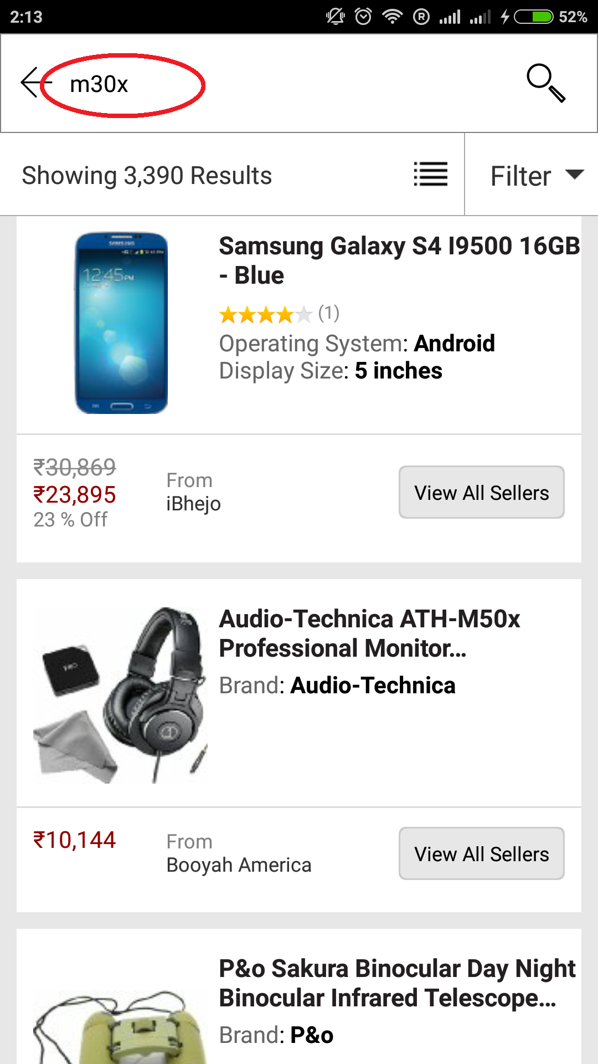
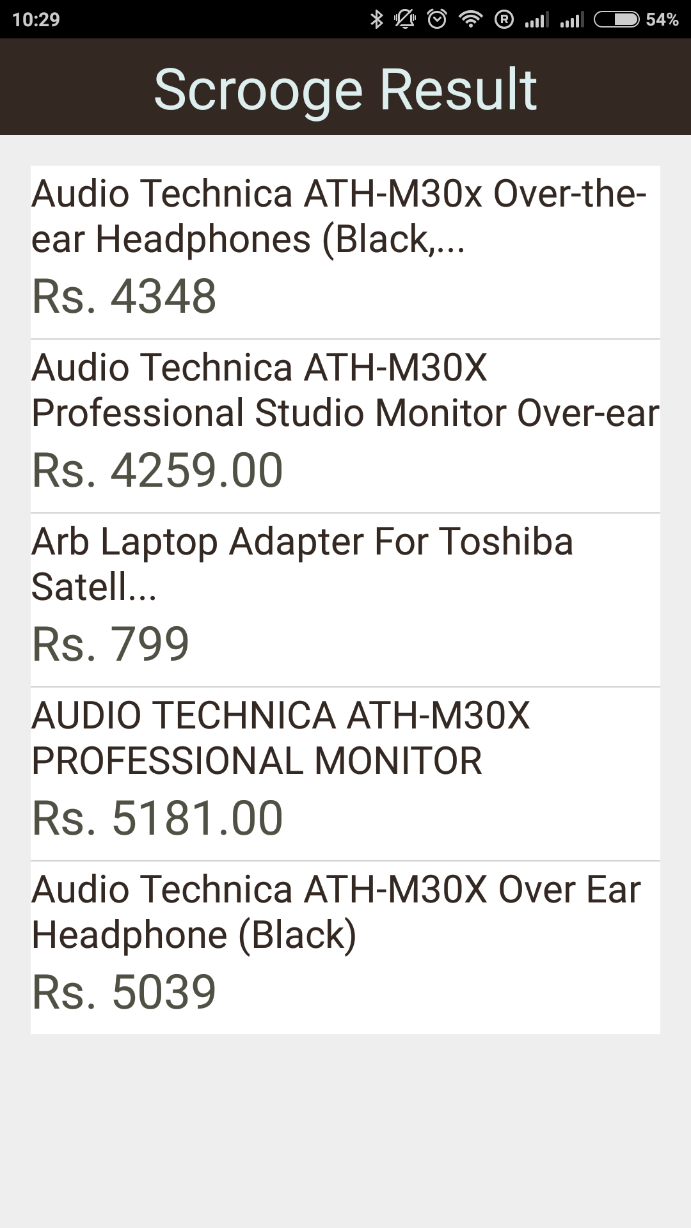
Result from JUNGLEE for m30x
Results from SCROOGE for m30x

Slide 6
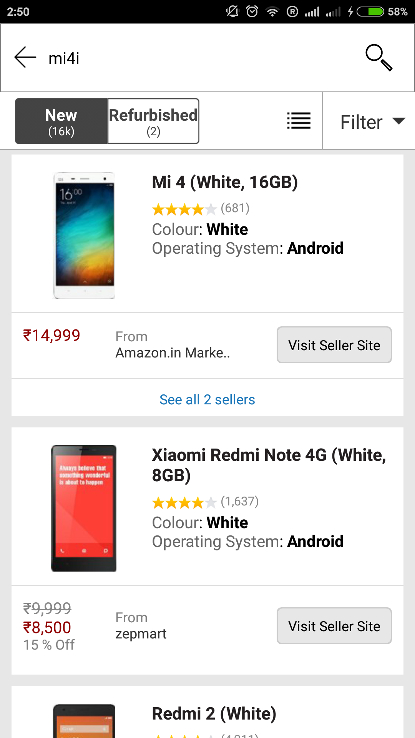
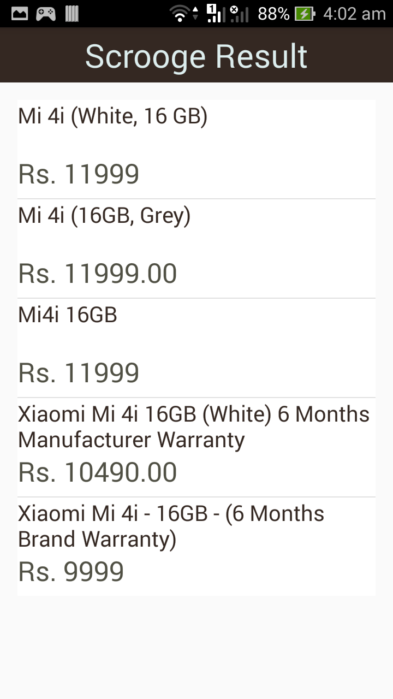
Results from JUNGLEE for mi4i
Results from SCROOGE for mi4i

Slide 7
Design
Structural Design
Class Diagram
Behavioral Design
Use Case Diagram
Activity Diagram

Slide 8
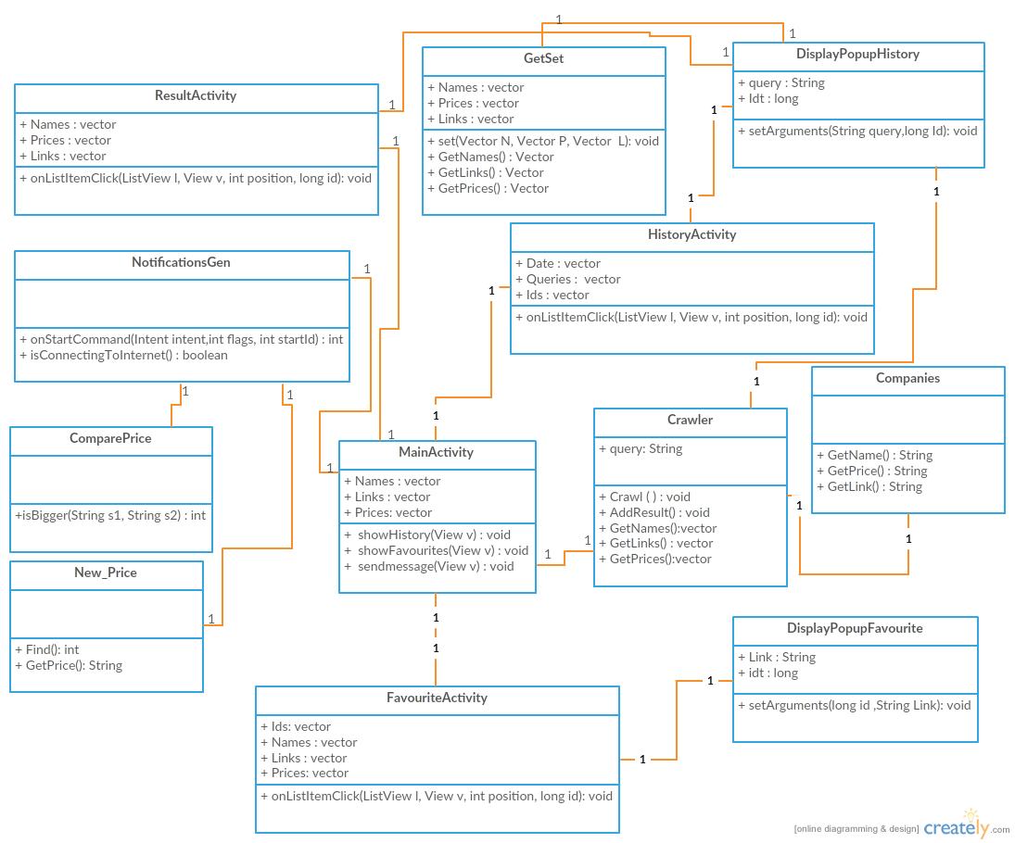
Class Diagram

Slide 9
Technologies used
Android Studio
Java
SQLite
Background Services
XML
Jsoup

Slide 10
Web Scraping
What Is Web Scraping
Web scraping is the process of automatically collecting information from the World Wide Web.
It is a field with active developments sharing a common goal with the semantic web vision.
Technology used
Jsoup : Java HTML Parser

Slide 11
Implemented classes for Web Scraping
Crawl
Companies
New Price

Slide 12
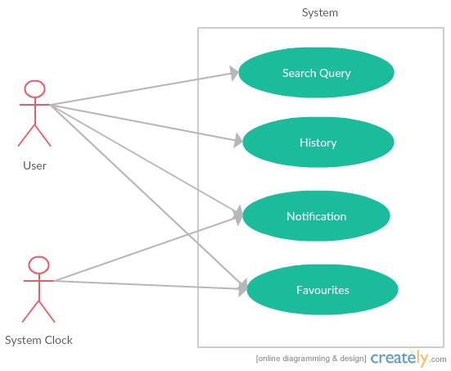
Use Case Diagram

Slide 13
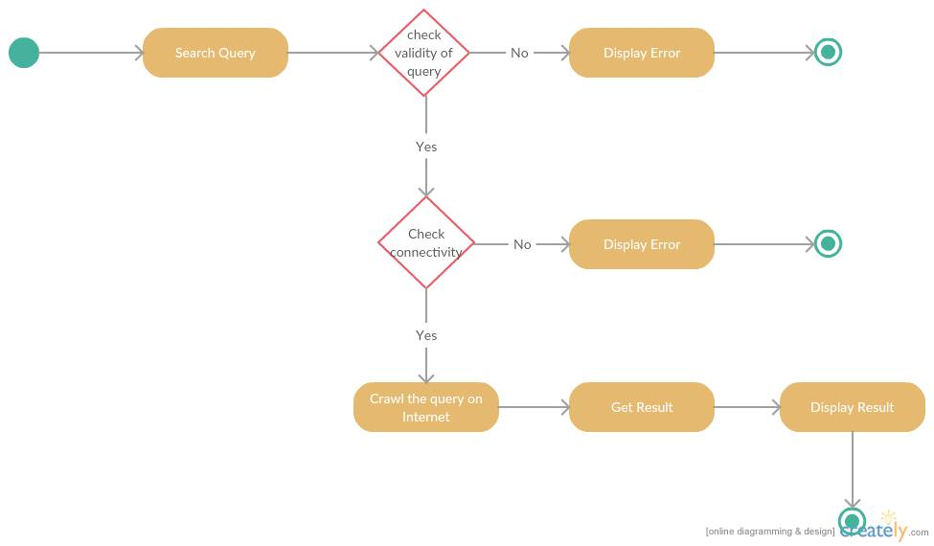
Activity Diagram(Search Request)

Slide 14
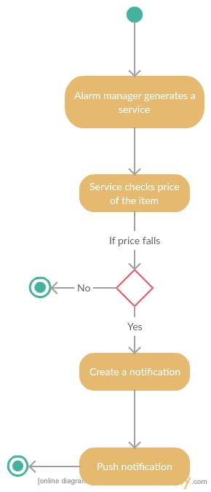
Activity Diagram(Favourite)

Slide 15
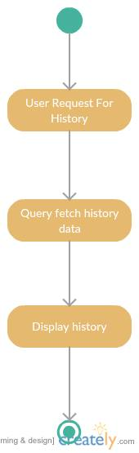
Activity Diagram(History)

Slide 16
Work done:
Implementation:
Actual implementation of the application on the basis of the above design is completed
Testing:
Testing of the application is completed.
Afterwards we will work on flexibility issues and improvement of UI and search result quality

Slide 17
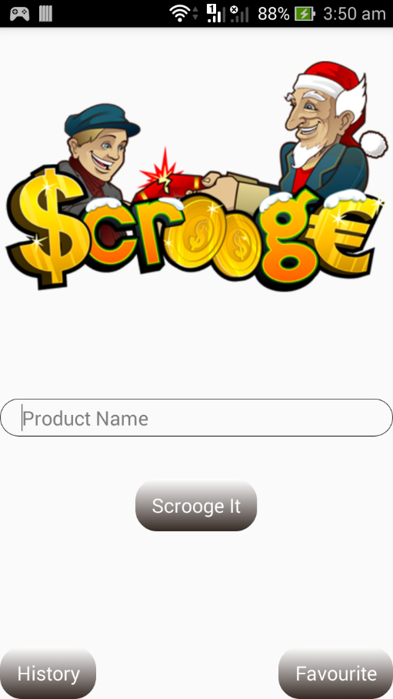
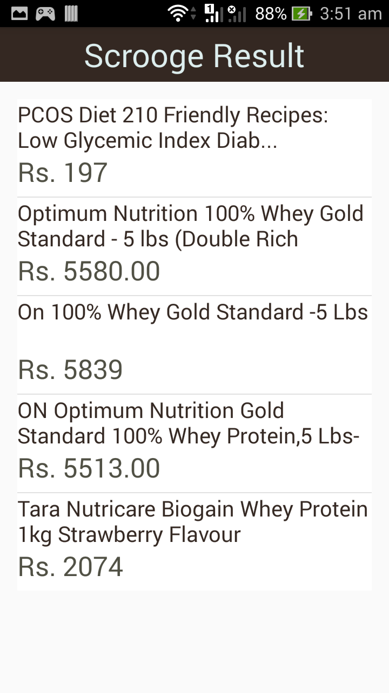
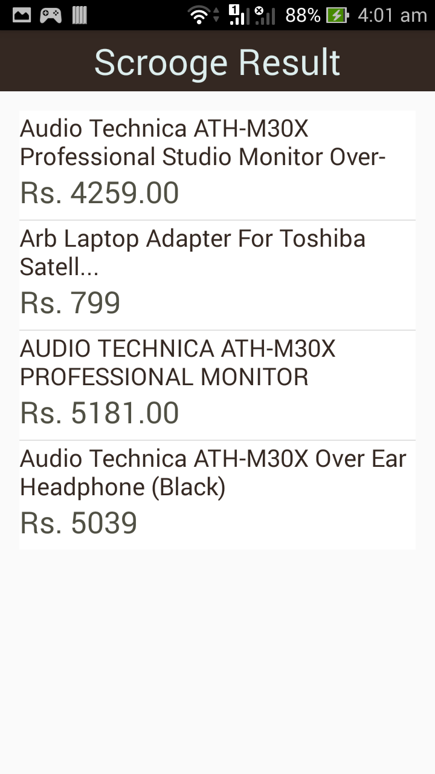
Working of the application(main page and search results)

Slide 18
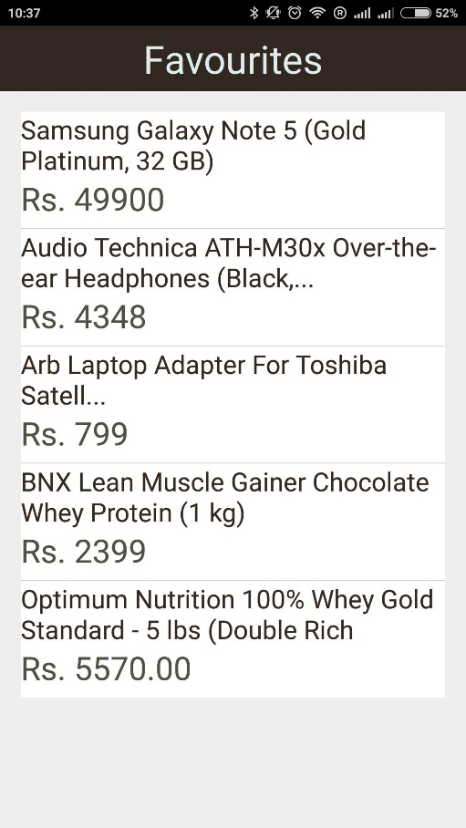
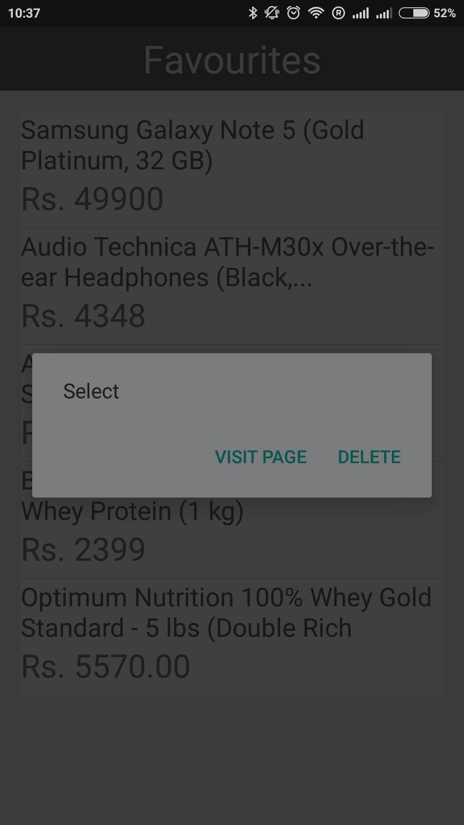
Favourites

Slide 19
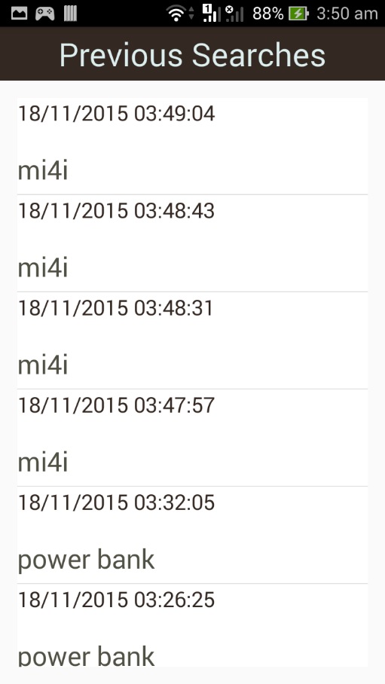
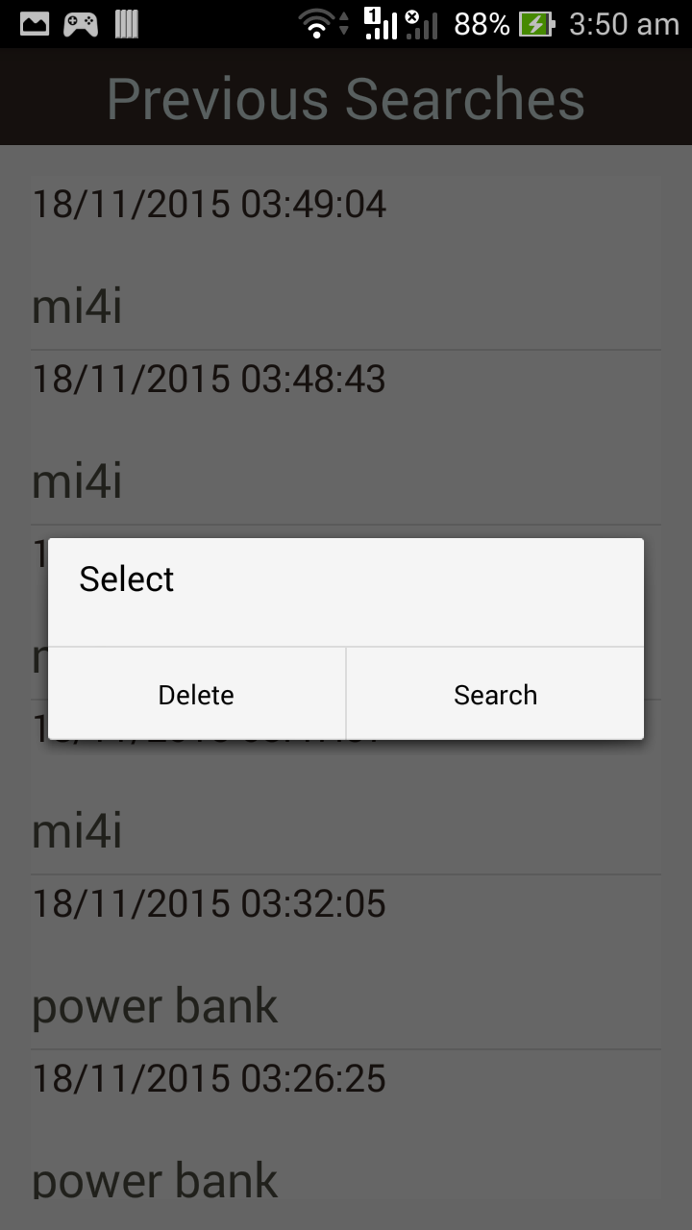
Saved history

Slide 20
Work to be done in Future
Improving user interface
Adding more sites
Improving search results.

