Slide 1
B.Tech Physics
Chapter 1
Theory of Relativity
Lecture 1.2

Slide 2
Absolute frame of reference :
Under Galilean transformations the laws of mechanics are invariant
while the Maxwell equations are not. Thus the velocity of light
will be different for different observers moving with different uniform
velocities.
It was thought that there must exist a preferred inertial frame known
as absolute frame in which velocity of light will be exactly equal
to 3*10⁸ m/s and will be same in all directions as the frame is at
absolute rest.
Now we consider such absolute frame of reference.
Now we measure the velocity of light in this frame from some inertial
Frame which is moving with uniform velocity v.
The velocity of light will be c+v or c-v depending upon the direction.
motion.

Slide 3
Michelson and Morley performed an experiment to check above
Points.
But they failed to detect any change in velocity of light.
So final conclusion was that there is no absolute frame and
all motions are relative.

Slide 4
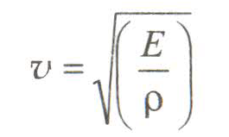
The Ether Hypothesis:
The phenomenon such as interference, diffraction or polarisation
establish that the light is a wave motion. According to wave theory,
light require a medium for propagation.
The velocity of wave through medium is given by
where E and ρ are elasticity and density respectively of the medium.
Since the velocity of light is quite large it means the medium should
Have high elasticity and low density.

Slide 5
With the acceptance of the wave theory of light, it was thought that
The entire space of the universe including vacuum is filled with a
Hypothetical light transmitting medium called ether.
The ether was supposed to be invisible, massless, perfectly
Transparent, perfectly non-resistive and have high elasticity and
low density.
All bodies including earth moves through this hypothetical medium.
In this way ether provide a fixed frame of reference.
This frame is called ether frame or rest frame or absolute frame of
reference.
We know that the velocity is not invariant under Galilean
transformations. This means velocity of light will also be different
in different frame having different relative velocity. So if earth is in
motion w.r.t ether then velocity of light should be direction
dependent.

Slide 6
To detect the change in the velocity of light due to relative motion
between ether and earth Michelson and Morley
Performed an experiment using Michelson Interferometer.

Slide 7
Michelson Morley Experiment:
Objective: The main objective of conducting the above experiment
was to confirm the existence of a stationary frame of reference i.e.
Ether frame.
Experimental Arrangement: The experimental arrangement is
Shown in figure. The light from a monochromatic extended source
S after being rendered parallel by a conducting lens L, falls on the
Semi silvered glass plate G which is inclined at 45⁰
to the beam.
It is then divided into two parts. One is reflected from the semi
Silvered surface G and give rise to ray 1 and this ray travel towards
mirror M₁. The other is transmitted ray 2, which travel towards
mirror M₂.

Slide 8
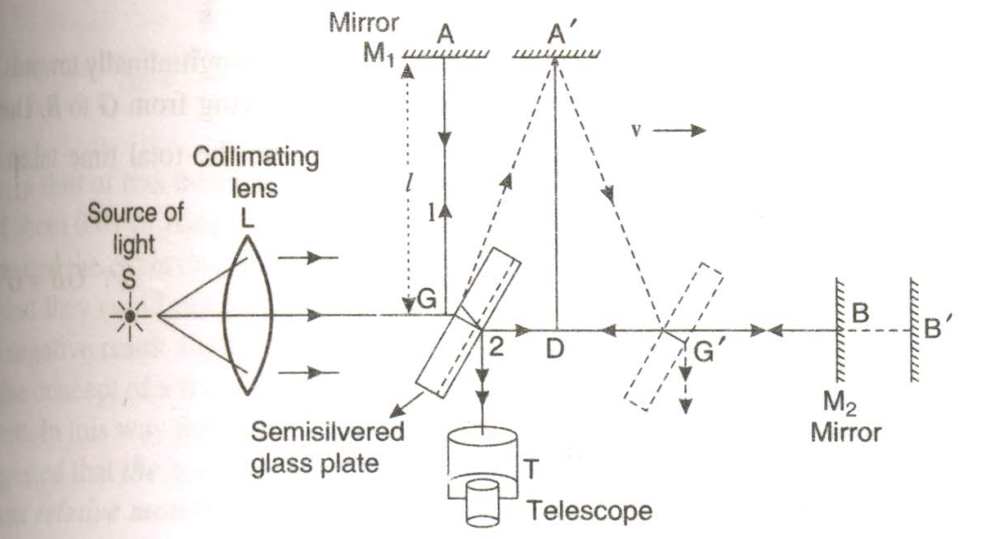

Slide 9
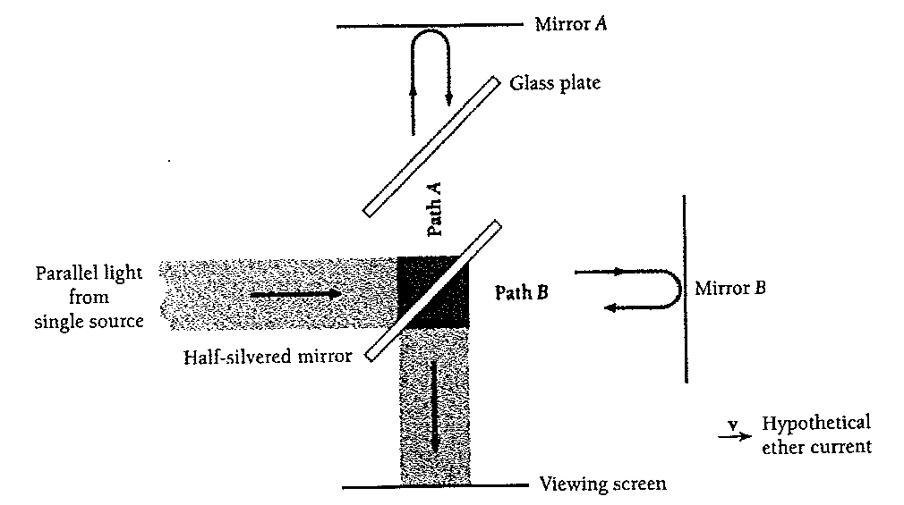

Slide 10
The two rays falls normally on mirrors M₁ and M₂ respectively
and are reflected back along their paths. The reflected ray again
meet at the semi-silvered surface of glass plate G and
enter the telescope.
In telescope interference pattern is obtained. The optical distances
of the mirrors M₁ and M₂ from G are made equal with the help
of a compensating plate.
If the apparatus is at rest in the ether, the two reflected rays would
take equal time to return the glass plate G. But actually the whole
apparatus is moving along with the earth.
Let us suppose that the direction of motion of earth is in the direction of initial beam. Therefore, the whole apparatus is moving
with earth is in the direction of the initial beam. Therefore, the
whole apparatus is moving with earth through ether with a

Slide 11
velocity, say v. Due to the motion of the earth, the optical paths
traversed by both the rays are not the same. The reason is that
reflections at mirrors M₁ and M₂ do not take place at A and B but
take place at A’ and B’ respectively. Thus the times taken by the two
rays to travel to the mirrors and back to G will be different in this case.
Theory:
Let the two mirrors M₁ and M₂ are at equal distance l from the glass
Plate G. Further let c and v be the velocities of light and apparatus or
Earth respectively.
It is obvious from fig that the reflected ray 1 from glass plate G strikes
the mirror M₁ at A’ due to motion of the earth.

Slide 12

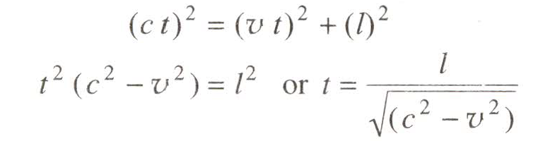
The total path of the ray from G to A’ and back will be GA’G’.
From ∆GA’D
- ------(1)
If t be the time taken by the ray to move from G to A’, then
From Eq. (1), we have

Slide 13
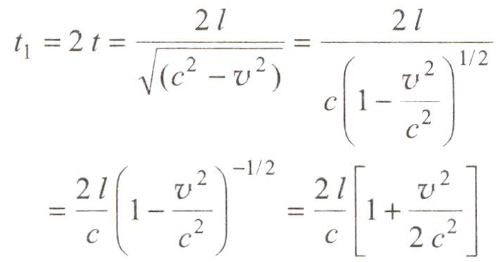
If t₁ be the time taken by the ray
to travel whole path GA’G’, then
------------(2)

Slide 14
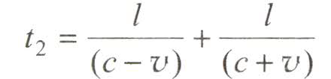
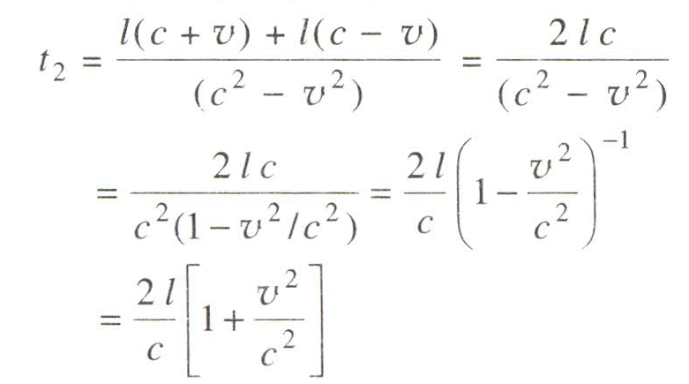
Now we consider the case of transmitted
ray 2. This ray is moving longitudinally
towards mirror M₂ . It has velocity (c-v)
relative to apparatus when it moves from
G to B. During the return journey
velocity is (c+v).
If t₂ be the total time taken by the
longitudinal ray to reach G’, then
------------(3)
------------------------(3)

Slide 15
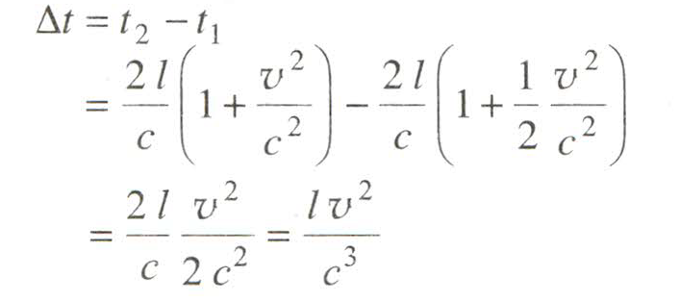
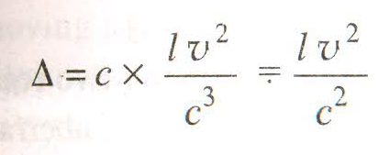
The difference in times of travel of longitudinal and transverse
Journey is,
------------(4)
Optical path difference between two rays is given by,
Optical path difference = velocity ˟∆t = c*∆t

Slide 16

The experiment was performed in the two steps.
First step was as shown in fig (1).
In 2nd step apparatus was turned through 90⁰ .
When apparatus was turned through 90⁰, the positions of two mirror
changed .
Now the path difference is in opposite directions i.e. path difference is
-
The resultant path difference is,
- - = 2

Slide 17

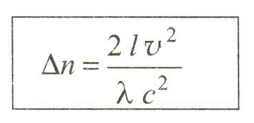
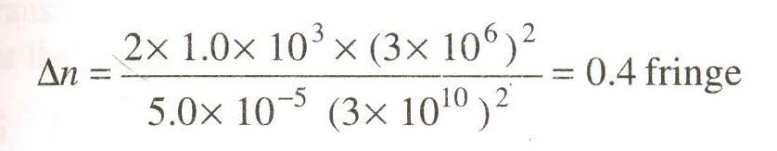
Change in optical path difference of λ corresponds to shift of one fringe.
Thus path difference 2 corresponds to fringe shift .
Now using data
l (length of arm) = 1.0 * 10³ cm,
λ = 5 *10⁻⁵ cm (wavelength of light)
v = 3*10⁶ cm/sec (velocity of earth around sun) and c = 3*10¹⁰ cm/sec
Change in fringe shift

Slide 18
Thus we expect a shift of less than half due to 90⁰ rotation.
But actually a shift of about 0.01 of fringe was obtained.
The experiment was repeated at different points of earth’s surface
and in different season but null or negative results were obtained.
The experiment lead to total rejection of ether hypothesis.
This suggested that the speed of light in vacuum is same in all frame
of reference which are in relative motion.

Slide 19
Exercise:
1. Discuss the explanations of negative result of Michelson.
Morley experiment using
Ether drag hypothesis
Fitzgerald Lorentz contraction hypothesis
Light velocity Hypothesis
Einstein’s Explanation
2. Discuss significance of negative results.

