Slide 1

SPRINT(Smart Precision Remote Irrigation Network Technology)
A Remote and Timer-Controlled Spraying System for Precision Agriculture
BTECH PROJECT
Under the Supervision of
Dr. Yashna Sharma
Assistant Professor
Submitted By:
Anurag Kumar(2K22/EC/046)
Chirag Sikriwal (2K22/EC/075)
Devayush Devandra(2K22/EC/088)

Slide 2

Introduction
Welcome to the presentation on SPRINT, a remote and timer-controlled smart spraying system designed to revolutionise precision agriculture. This system addresses critical challenges in traditional farming practices, offering an automated, efficient, and sustainable solution for applying water, fertilisers, and pesticides.
Join us as we explore the problem statement, the innovative technology behind SPRINT, and its potential to transform agricultural operations in India and beyond.

Slide 3




Background and Need
Manual Spraying Inefficiencies
Smart Technology Benefits
Traditional methods are imprecise, leading to overuse or underuse of resources, inconsistent coverage, and potential health hazards from chemical exposure.
Automated solutions reduce manual labour, improve resource utilisation, and enhance overall crop health and yield.
IoT for Remote Control
Integrating IoT allows for real-time, remote operation and monitoring, making farming practices more efficient and accessible.

Slide 4


Why This Project?
Agricultural Labour Shortage
Inconsistent Resource Use
Addressing the increasing difficulty in finding and retaining labour for manual farming tasks in both rural and urban settings.
Tackling the challenges of irregular and inefficient application of water and agrochemicals, which impacts crop health and yield.
Tech Intervention Opportunity
Leveraging affordable IoT technologies like the ESP-01 to bring intelligent automation within reach of every farmer.

Slide 5
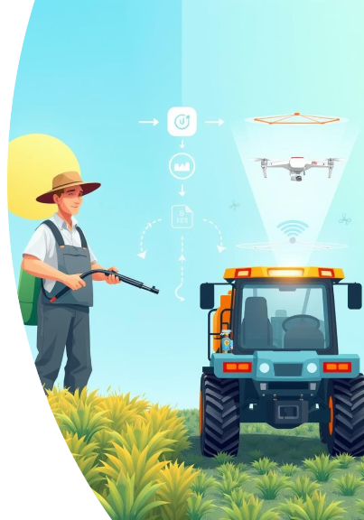




Motivation Behind SPRINT
Precision Application
Addresses the need for timely, measured, and efficient application of water and agrochemicals, overcoming inconsistencies of manual methods.
Time & Cost Efficiency
Provides a scalable solution for both rural and urban farmers, saving time and reducing operational costs.
Leveraging IoT
Utilises low-cost Wi-Fi microcontrollers and cloud platforms like Firebase for intelligent, remote automation.
Sustainability
Promotes precision farming to optimise resource use, conserve water, and minimise environmental impact.

Slide 6
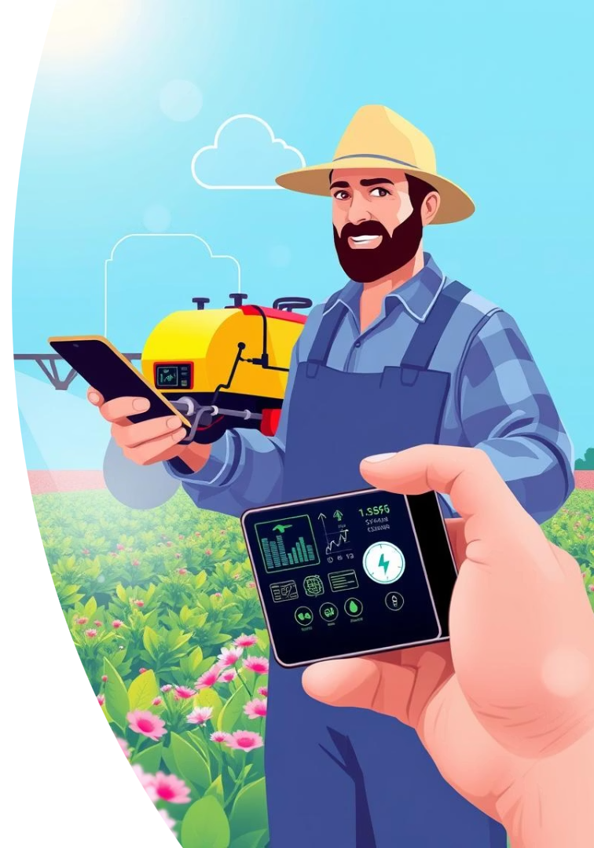




System Goals and Outcomes
Remote Mobile-Based Control
Control the system from anywhere via a custom Android application.
Cloud Integration (Firebase)
Real-time communication and data synchronisation with Firebase.
Easy Installation and Use
User-friendly setup and operation for diverse agricultural settings.
Expandability with Sensors and Automation
Future-proof design for integration with environmental sensors and weather APIs.

Slide 7
Related Work
The rapid integration of IoT in agriculture has led to significant developments in smart irrigation and automation systems. Various microcontroller-based solutions have been explored for precision farming, aiming to reduce resource wastage, improve crop yield, and minimise labour requirements.
Existing Solutions
The Gap
Use of NodeMCU or ESP8266 modules to control actuators via mobile applications.
While existing solutions offer partial automation, there's a need for a low-cost, compact, and modular spraying solution specifically designed for small-scale farms and urban farming scenarios like terrace gardens. Traditional timer-based systems are rigid and lack adaptability to dynamic agricultural needs, often leading to resource wastage.
Integration of Firebase Realtime Database for real-time data monitoring and remote control.
Deployment of solenoid valves and relay modules for automating liquid dispensing.
Development of mobile-based graphical interfaces using platforms such as MIT App Inventor, Android Studio, or custom-built apps.

Slide 8



Core Technologies
The SPRINT leverages several core technologies to achieve remote and automated control. At its heart is the ESP-01 Wi-Fi Microcontroller, enabling seamless wireless communication. Firebase Realtime Database acts as the cloud backend, facilitating real-time data exchange and command execution.
A custom Android application provides the user interface for remote operation. Physical actuation is managed by solenoid valves, a pressure pump, and relay modules, ensuring precise and controlled dispensing of liquids. These components collectively form a robust and efficient smart farming solution.
ESP-01 Wi-Fi Microcontroller
Firebase Realtime Database
The central processing unit for wireless communication and control.
Cloud-based backend for real-time data synchronisation and command storage.
Android App
Solenoid Valve, Pressure Pump, Relay Modules
User interface for remote operation and system monitoring.
Actuation components for controlled liquid dispensing.

Slide 9

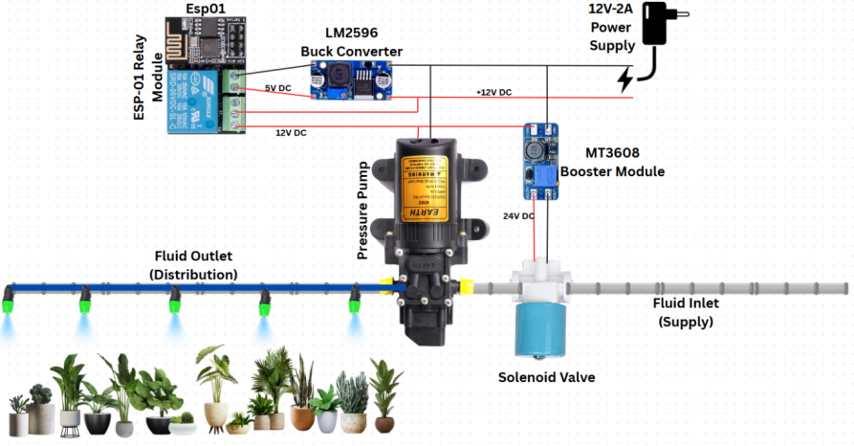




System Overview
The SPRINT integrates hardware and software components for remote, automated liquid dispensing. The Android mobile app sends commands to Firebase, which then updates the ESP-01 microcontroller. The ESP-01 interprets these commands to activate the relay module, controlling the solenoid valve and pressure pump.
This setup ensures real-time control and eliminates the need for manual timers. The system is designed for adaptability, allowing future integration with environmental sensors and weather-based automation for enhanced precision agriculture.
Mobile App
User initiates commands.
Firebase
Receives and stores commands.
ESP-01 (Wi-Fi)
Fetches commands from Firebase.
Relay Module
Switches power to components.
Solenoid Valve / Pressure Pump
Dispenses liquid to target area.

Slide 10
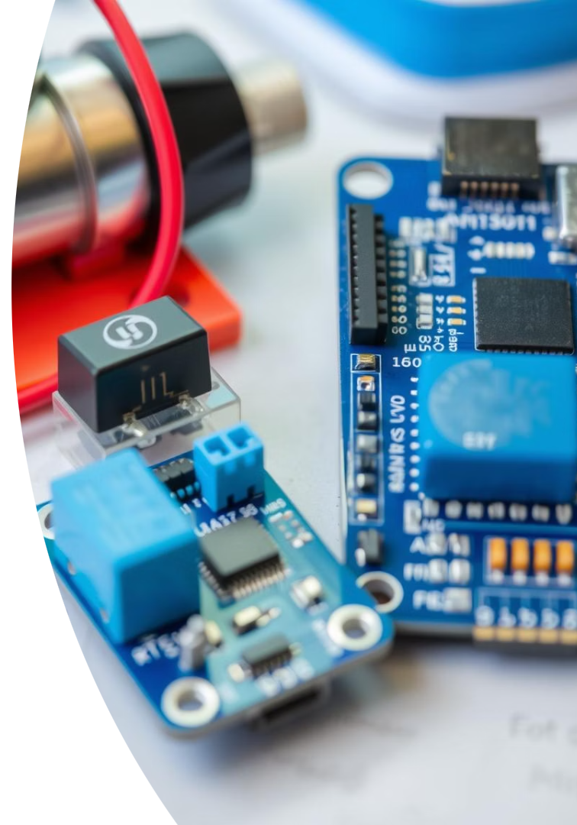
Key Components Used
The SPRINT relies on a selection of key hardware components to achieve its automated functionality. The ESP-01 microcontroller serves as the core control unit, processing commands and managing operations. A relay module is crucial for safely switching power to higher voltage devices.
The system incorporates a 12V DC pressure pump for effective water pressurisation and a solenoid valve for precise liquid flow control. These components are chosen for their reliability, cost-effectiveness, and suitability for agricultural applications.
ESP-01
WiFi MCU
Core control unit
Relay
Switch
Controls power to pump/valve
Pump
12V DC
Water pressurisation
Valve
Solenoid
Liquid control

Slide 11




Power Management
Effective power management is critical for the SPRINT reliability. A 12V DC adapter serves as the main power source. To ensure stable operation for all components, voltage regulation is implemented using both buck and boost converters.
An LM2596 buck converter steps down the 12V input to 3.3V for the ESP-01 microcontroller, protecting it from overvoltage. An MT3608 boost converter steps up the voltage to 24V for the solenoid valve, ensuring optimal performance. Separate power lines are maintained for the pump and ESP to prevent interference and ensure consistent power delivery.
12V DC Adapter
LM2596 Buck Converter
MT3608 Boost Converter
Separate Power Lines
Main power source.
Regulates 12V to 3.3V for ESP-01.
Boosts 12V to 24V for solenoid valve.
Ensures stable power to pump and ESP.

Slide 12
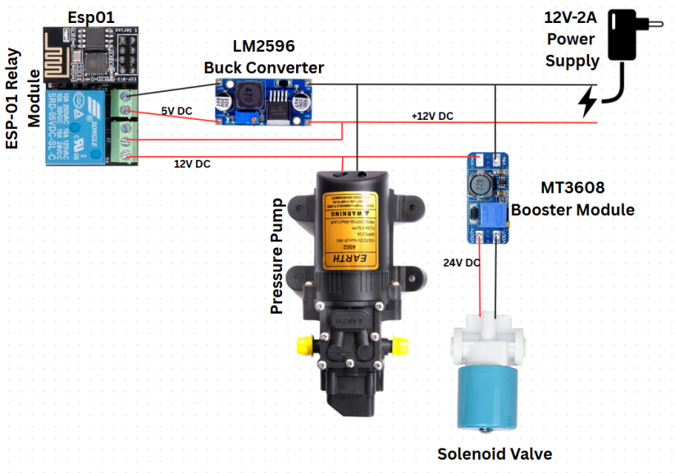
Internal Circuit Diagram

Slide 13






Working Principle of SPRINT
User Command
User initiates spraying via the mobile app (e.g., "Start Spraying").
Firebase Update
The command updates a specific key in the Firebase Realtime Database.
ESP-01 Data Polling
ESP-01 continuously monitors Firebase, fetching new values in real-time.
Logical Decision
Microcontroller decides to activate GPIO pin based on the received value.
Relay Activation
Relay module energises pressure pump and solenoid valve simultaneously.
Spraying Process
System sprays until a "stop" command is sent or timeout occurs.

Slide 14






Advantages of the Proposed Model
Cost-Effective
Real-Time Cloud Control
Utilises inexpensive components and open-source libraries, making it economically viable for various implementations.
Firebase integration ensures immediate remote actuation with negligible delay, ideal for time-sensitive operations.
Wireless Operation
Scalability
Operable from anywhere with internet access, perfect for remote farms and greenhouse management.
Modular design allows future integration with soil moisture, temperature, humidity, and rain sensors for condition-based spraying.
Energy Efficiency
User-Friendly Interface
Consumes minimal power in idle states, with potential for solar adaptation, reducing operational costs.
Intuitive mobile app requires no technical expertise, displaying connectivity status, control buttons, and real-time feedback.

Slide 15








Challenges in Implementation
Wi-Fi Connectivity
Ensuring stable internet access in rural agricultural fields for Firebase communication.
Limited Memory
ESP-01's constrained memory requires careful optimisation for memory-intensive operations.
Power Stability
Inconsistent power in rural areas necessitates voltage regulators to prevent resets or failures.
Cloud Dependency
System relies solely on internet availability, making it inoperative during connectivity loss.

Slide 16
Future Scope and Enhancements
Sensor Integration
Adding soil moisture, temperature, and humidity sensors for automatic, condition-based spraying, optimising water conservation.
Weather API Integration
Accessing real-time weather forecasts to prevent spraying during rainfall or unfavourable conditions, ensuring resource efficiency.
Solar Power Integration
Incorporating solar panels for off-grid operation, making the system ideal for remote fields lacking reliable power infrastructure.
Offline Local Control
Introducing fallback options like Bluetooth or physical pushbuttons for control during internet outages, enhancing system resilience.
Mobile App Enhancement
Upgrading the mobile interface with graphical dashboards, voice command support, multi-zone control, and scheduled spraying features.

