Slide 1
CMPT 733 Data Preparation
Slides by:
Jiannan Wang
https://www.cs.sfu.ca/~jnwang/

Slide 2
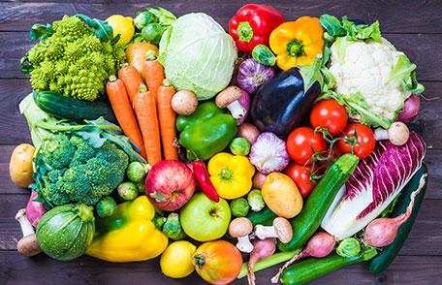
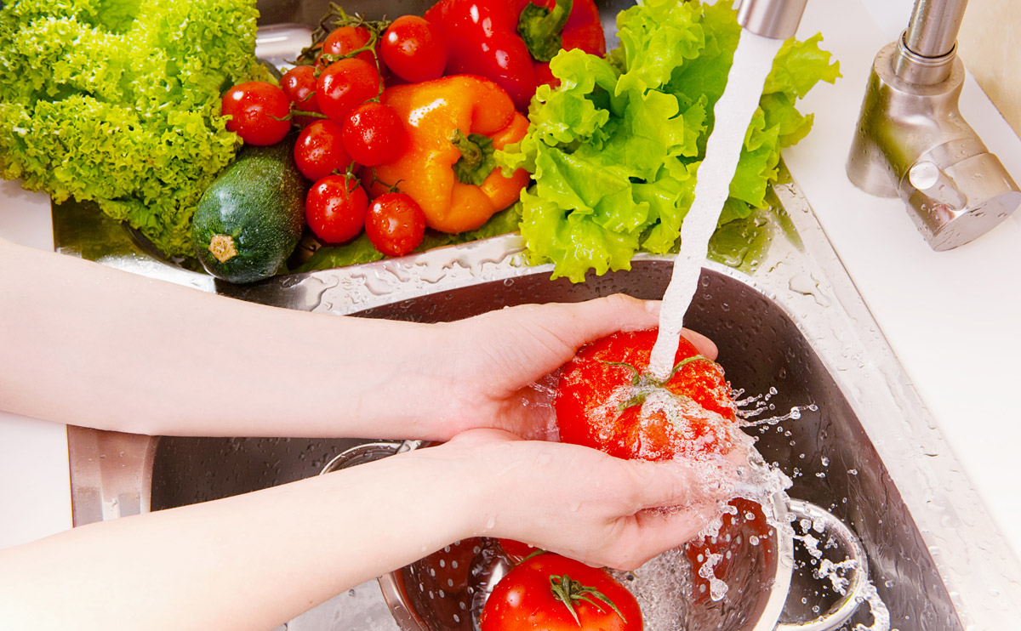
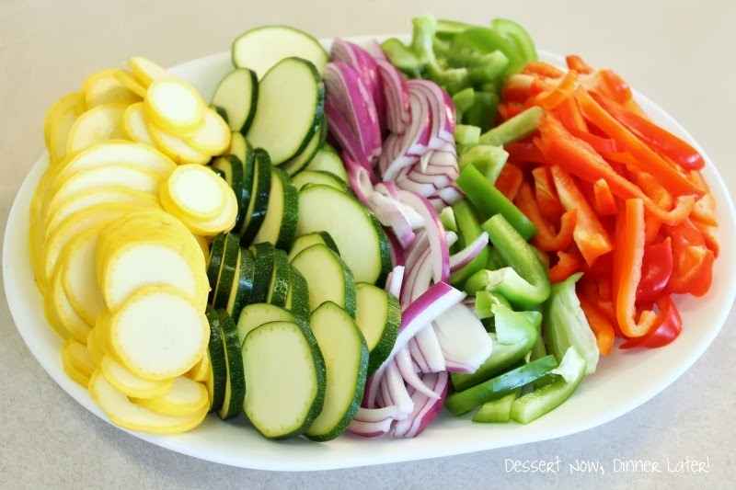
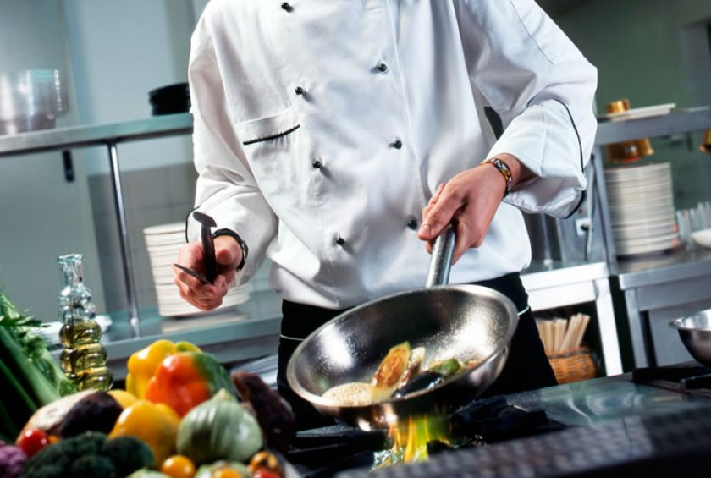
Data Preparation is the Bottleneck!
Doing data science is like cooking
Collection
Cleaning
Integration
Analysis
How much time will be spent on the preparation?

Slide 3
Outline
Data Collection
Data Cleaning
Data Integration

Slide 4
Outline
Data Collection
Where to collect
How to collect
Data Cleaning
Data Integration

Slide 5
Where to Collect?
Internal Data
Application Database (Tabular Data)
System Logs (Text Files)
Documents (Word, Excel, PDF)
Multimedia Data (Video, Audio, Image)

Slide 6
Where to Collect?
External Data
Web Pages
Web Service (https://www.programmableweb.com/)
Open Data (data.vancouver.ca, www.data.gov)
Knowledge Base (Wikidata, Freebase)

Slide 7
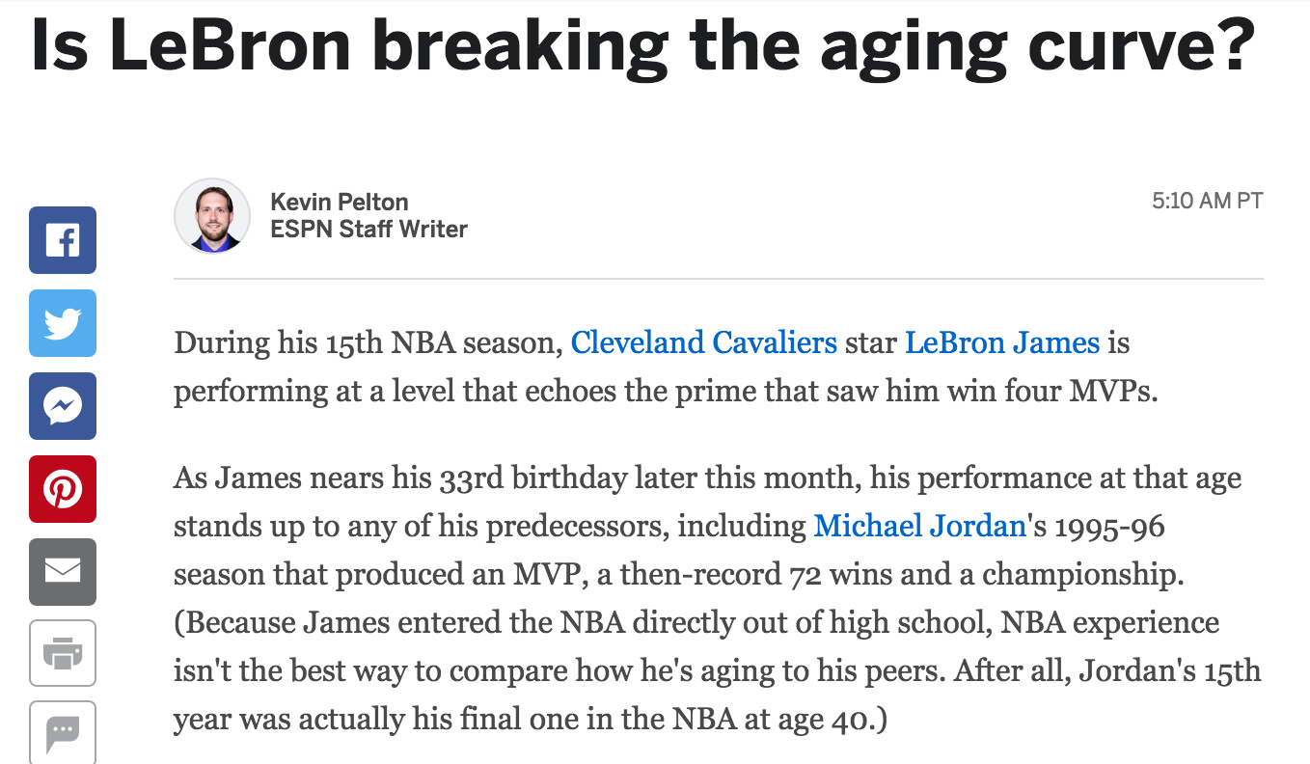
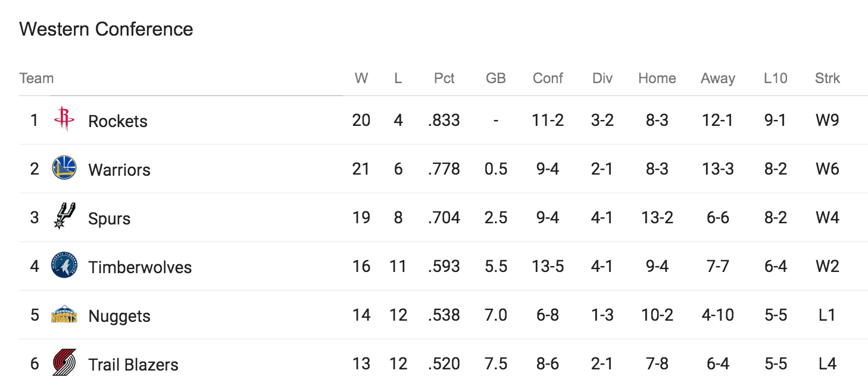
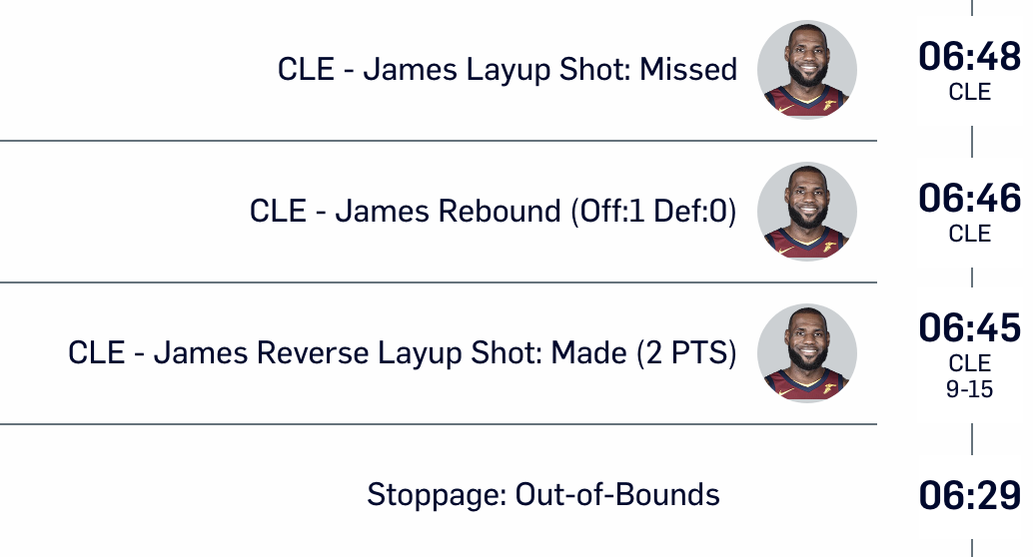
Data Classification
Data
Structured
Semi-structured
Unstructured

Slide 8
Challenges
Data Discovery
How to find related data?
Data Privacy
How to protect user privacy?
Security
How to avoid a data breach?
Domain knowledge
Information retrieval skills
Data masking
Differential privacy
Follow data access rules
Encrypt highly confidential data

Slide 9
Getting Data
From CSV Files
From JSON Files
From the Web
From HDFS
From Databases
From S3
From Web APIs

Slide 10
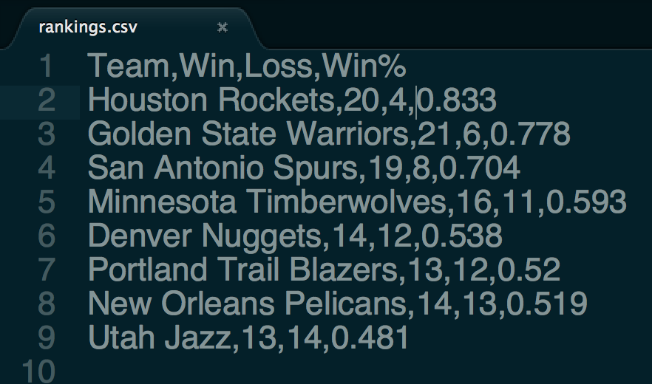
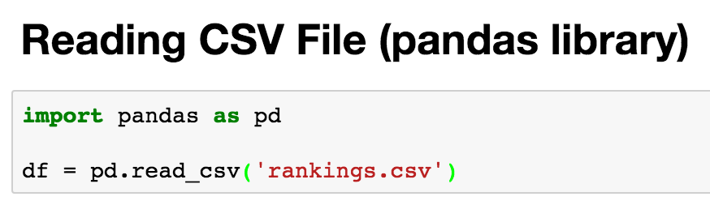
Load Data From CSV Files
CSV is a file format for storing tabular data

Slide 11
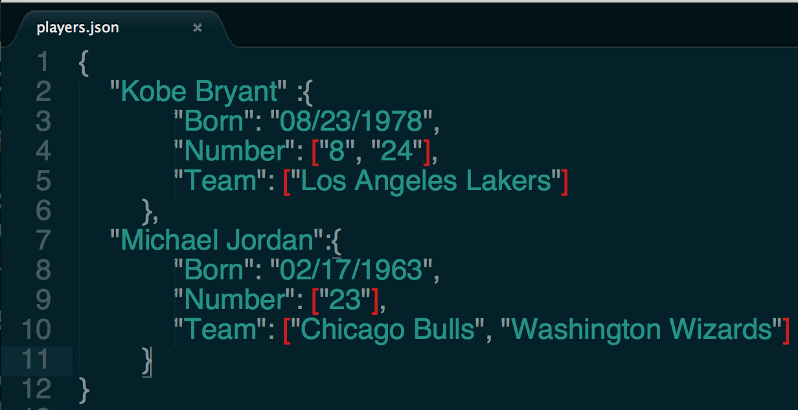
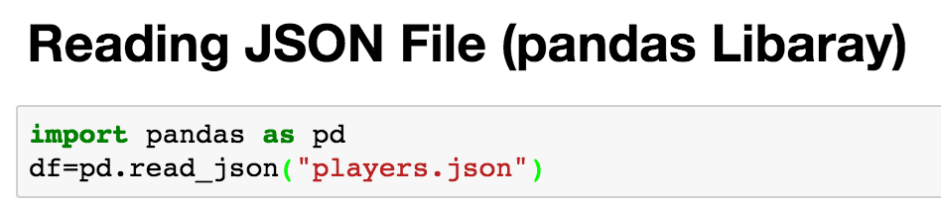
Load Data From JSON Files
JSON is a file format for storing nested data (array, dict)

Slide 12
Web Scraping
Open web pages
urllib2 (https://docs.python.org/2/library/urllib2.html)
request (http://docs.python-requests.org/en/master/)
Parse web pages
Beautiful Soup (https://www.crummy.com/software/BeautifulSoup/)
lxml (http://lxml.de/)
Putting everything together
Scrapy (https://scrapy.org/)

Slide 13
Before you scrape
Check to see if CSV, JSON, or XML version of an HTML page are available – better to use those
Check to see if there is a Python library that provides structured access (e.g., tweetPy)
Check that you have permission to scrape
From “Deb Nolan. Web Scraping & XML/Xpath”

Slide 14

If you do scrape
Be careful to not to overburden the site with your requests
Test code on small requests
Save the results of each request so you don’t have to repeat the request unnecessarily
CAPTCHA
From “Deb Nolan. Web Scraping & XML/Xpath”

Slide 15
Outline
Data Collection
Data Cleaning
Dirty Data Problems
Data Cleaning Tools
Example: Outlier Detection
Data Integration

Slide 16
Dirty Data Problems
From Stanford Data Integration Course:
Parsing text into fields (separator issues)
Missing required field (e.g. key field)
Different representations (iphone 2 vs iphone 2nd generation)
Fields too long (get truncated)
Formatting issues – especially dates
Outliers (age = 120)

Slide 17
Data Cleaning Tools
Python
Missing Data (Pandas)
Deduplication (Dedup)
OpenRefine
Open-source Software (http://openrefine.org)
OpenRefine as a Service (RefinePro)
Data Wrangler
The Stanford/Berkeley Wrangler research project
Commercialized (Trifacta)

Slide 18
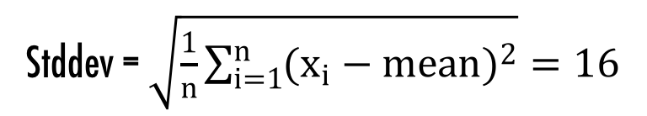

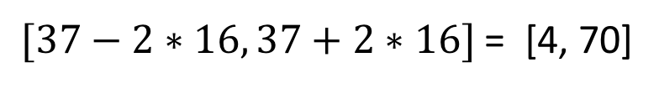
Outlier Detection
The ages of employees in a US company
1 20 21 21 22 26 33 35 36 37 39 42 45 47 54 57 61 62
Mean = $\frac{1}{n}\sum_{i=1}^{n}{x_{i}=37}$
$[37−2∗16, 37+2∗16]$ = [4, 70]
Stddev = $\sqrt{\frac{1}{n}\sum_{i=1}^{n}{{(x_{i}−mean)}^{2}}}=16$

Slide 19
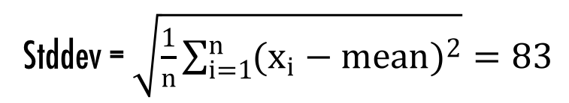

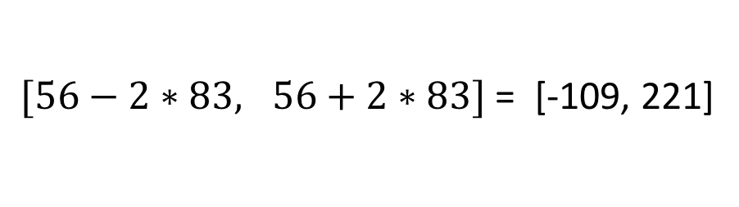
Outlier Detection
The ages of employees in a US company
1 20 21 21 22 26 33 35 36 37 39 42 45 47 54 57 61 62 400
Mean = $\frac{1}{n}\sum_{i=1}^{n}{x_{i}=56}$
$[56−2∗83, 56+2∗83]$ = [-109, 221]
Stddev = $\sqrt{\frac{1}{n}\sum_{i=1}^{n}{{(x_{i}−mean)}^{2}}}=83$

Slide 20
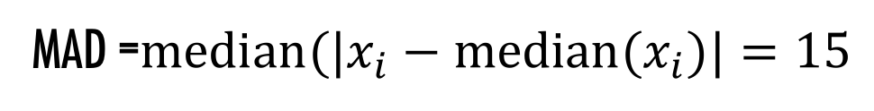
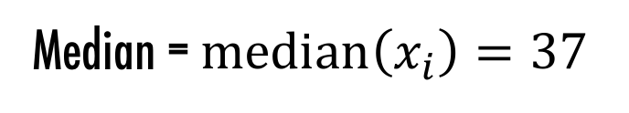
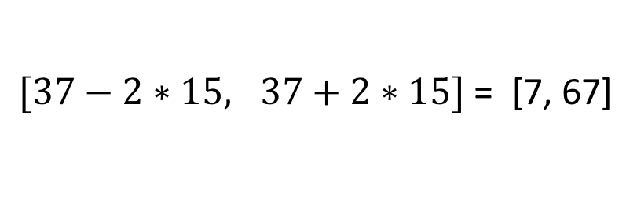
Outlier Detection
The ages of employees in a US company
1 20 21 21 22 26 33 35 36 37 39 42 45 47 54 57 61 62 400
Median = $median\left(x_{i}\right)=37$
$[37−2∗15, 37+2∗15]$ = [7, 67]
MAD =$median(|x_{i}−median(x_{i})|=15$

Slide 21
Outline
Data Collection
Data Cleaning
Data Integration
Data Integration Problem
Three Steps (Schema Matching, Entity Resolution, Data Fusion)
Example: Entity Resolution

Slide 22
Data Integration Problem
Data Source 1 (from CourSys)
Data Source 2 (from survey)
First Name | Last Name | Mark
Michael | Jordan | 50
Kobe | Bryant | 48
Name | Background
Mike Jordan | C++, CS, 4 years
Kobe Bryant | Business, 2 years
Data Integration???
Name | Mark | Background
Michael Jordan | 50 | C++, CS, 4 years
Kobe Bryant | 48 | Business, 2 years
Integrated Data

Slide 23
Data Integration: Three Steps
Schema Mapping
Creating a global schema
Mapping local schemas to the global schema
Entity Resolution
You will learn this in detail later
Data Fusion
Resolving conflicts based on some confidence scores
Want to know more?
Anhai Doan, Alon Y. Halevy, Zachary Ives. Principles of Data Integration. Morgan Kaufmann Publishers, 2012.

Slide 24
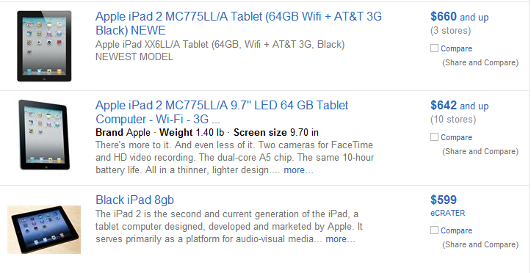
Entity Resolution

Slide 25
Output of Entity Resolution
ID | Product Name | Price
r₁ | iPad Two 16GB WiFi White | $490
r₂ | iPad 2nd generation 16GB WiFi White | $469
r₃ | iPhone 4th generation White 16GB | $545
r₄ | Apple iPhone 3rd generation Black 16GB | $375
r₅ | Apple iPhone 4 16GB White | $520
(r₁, r₂)
, (r₃, r₅)

Slide 26
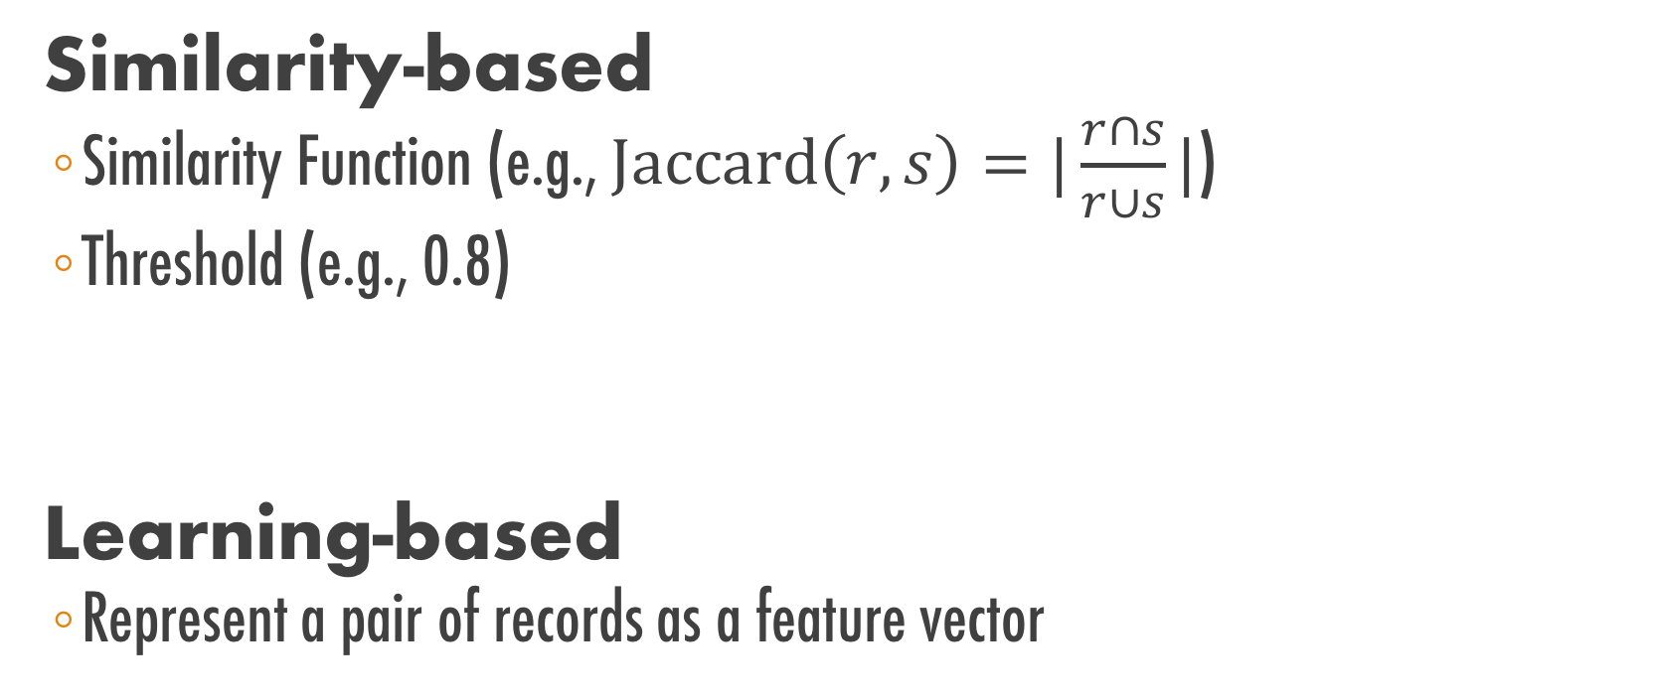
Entity Resolution Techniques
Similarity-based
Similarity Function (e.g., $\text{Jaccard}\left(r, s\right)=|\frac{r∩s}{r∪s}|$)
Threshold (e.g., 0.8)
Learning-based
Represent a pair of records as a feature vector
Jaccard(r1, r2) = 0.9 ≥ 0.8 Matching
Jaccard(r4, r8) = 0.1 < 0.8 Non-matching

Slide 27

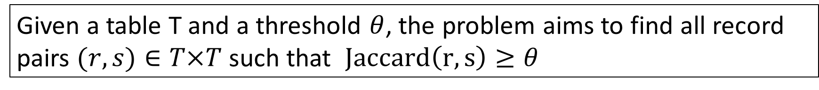
Similarity-based
Suppose the similarity function is Jaccard.
Problem Definition
Given a table T and a threshold $θ$, the problem aims to find all record pairs $(r,s)∈T×T$ such that $Jaccard\left(r, s\right)≥θ$
The naïve solution needs $n^{2}$ comparisons

Slide 28
Filtering-and-Verification
Step 1. Filtering
Removing obviously dissimilar pairs
Step 2. Verification
Computing Jaccard similarity only for the survived pairs

Slide 29
How Does Filtering Work?
What are “obviously dissimilar pairs”?
Two records are obviously dissimilar if they do not share any word.
In this case, their Jaccard similarity is zero, thus they will not be returned as a result and can be safely filtered.
How can we efficiently return the record pairs that share at least one word?
To help you understand the solution, let’s first consider a simplified version of the problem, which assumes that each record only contains one word
Notes:
obviously dissimilar pairs

Slide 30
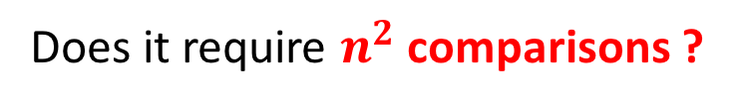
A simplified version
Suppose each record has only one word. Write an SQL query to do the filtering.
r₁
Apple
Apple
Banana
Orange
Banana
SELECT T1.id, T2.id
FROM Table T1, Table T2
WHERE T1.word = T2.word and T1.id < T2.id
r₂
r₃
r₄
r₅
Does it require $n^{2}$ comparisons ?
Output: (r1, r2), (r3, r5)

Slide 31
A general case
Suppose each record can have multiple words.
r₁
Apple
Orange
Apple
Banana
Orange
Apple
Banana
r₁
r₁
Apple, Orange
Apple
Banana
Orange, Apple
Banana
r₂
This new table can be thought of as the inverted index of the old table.
r₂
r₃
Flatten
Run the previous SQL on this new table and remove redundant pairs.
r₃
r₄
r₄
r₄
r₅
r₅

Slide 32
Not satisfied with efficiency?
Exploring stronger filter conditions
Filter the record pairs that share zero token
Filter the record pairs that share one token
….
Filter the record pairs that share k tokens
Challenges
How to develop efficient filter algorithms for these stronger conditions?
Jiannan Wang, Guoliang Li, Jianhua Feng.
Can We Beat The Prefix Filtering? An Adaptive Framework for Similarity Join and Search. SIGMOD 2012:85-96.

Slide 33
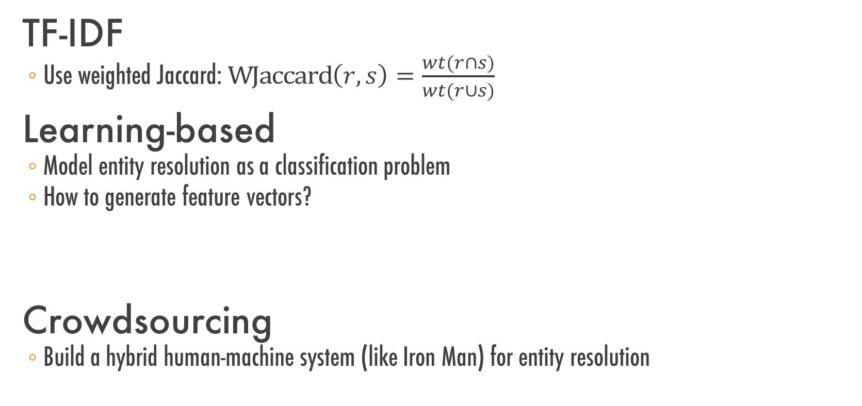
Not satisfied with result quality?
TF-IDF
Use weighted Jaccard: $\text{WJaccard}\left(r, s\right)=\frac{wt(r∩s)}{wt(r∪s)}$
Learning-based
Model entity resolution as a classification problem
How to generate feature vectors?
Crowdsourcing
Build a hybrid human-machine system (like Iron Man) for entity resolution
M. Bilenko and R. J. Mooney. Adaptive duplicate detection using learnable string similarity measures. In KDD, pages 39–48, 2003

Slide 34
Summary
Data Collection
Where to collect, How to Collect
Data Cleaning
Dirty Data Problems, Data-cleaning tools
Data Integration
Schema Mapping, Entity Resolution, Data Fusion

Slide 35
Plan for a 1–year Data Strategy
Group 1,2. SFU President Office
Group 3,4. BC Government
Group 5,6. Justin Trudeau Campaign Team
Group 7,8. Vancouver Hockey Team
Group 9,10. BC Children's Hospital

