Slide 1
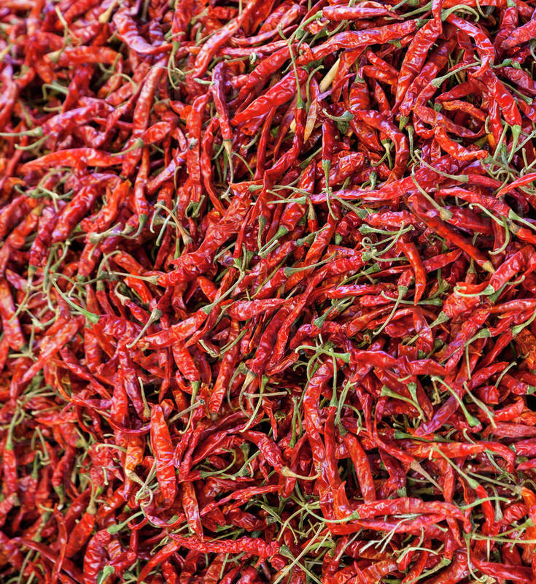
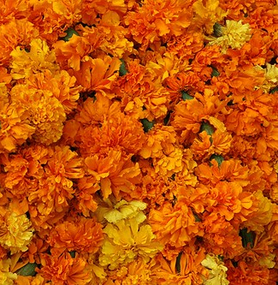
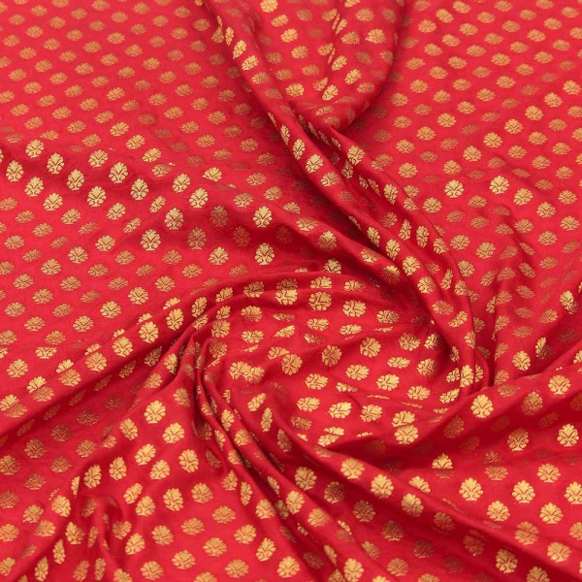
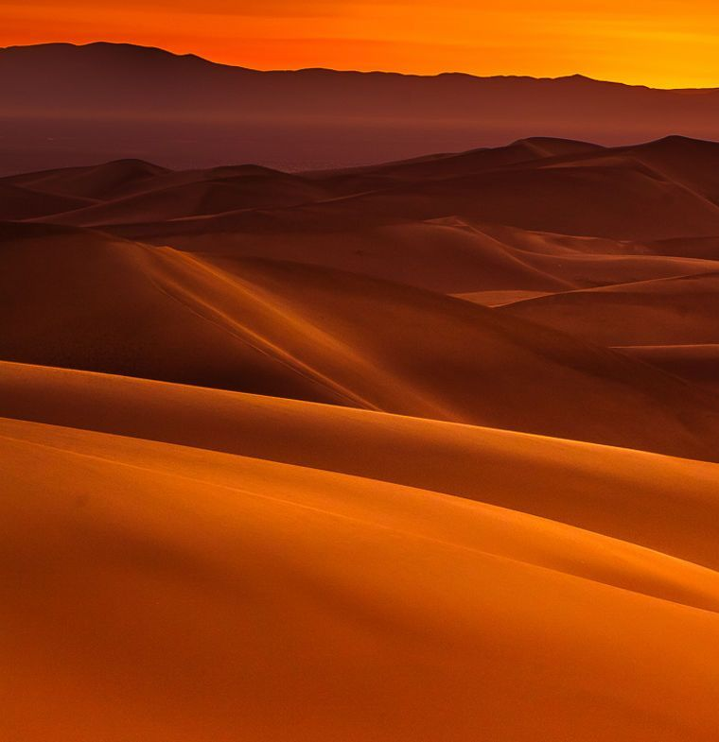
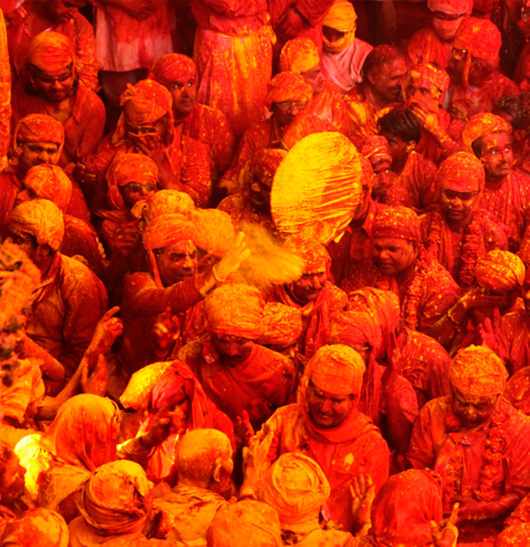
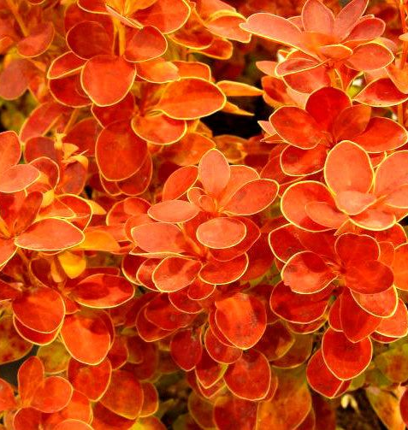

 | CMPT 767 – Visualization Week 1 Date: 10th September 2019 Name: Anurag Bejju (301369375) Theme: Shades of red Inspiration for this week’s journal: I wanted to collect pictures that where in shades of red as well as depicted the essence of my home country India. I wanted to show case a palate that was natural as well as say a story about my culture and heritage.
Pic 1: Bright red Indian chillies |  |  |  | Pic 7: Beautiful marigold flowers
Pic 2: Red embroidered Indian Fabric | Pic 3: Thar Desert | Pic 4: Festival of color Holi | Pic 5: Magnificent flora and fauna | Pic 6: Delicious butter chicken

