Slide 1
IILM UNIVERSITY
STUDENT DETAILS
GREATER NOIDA, UTTAR PRADESH
Anurag Betal
Roll No.: 2410030182
B.Tech (Computer Science & Engineering)
AICTE – EDUSKILLS VIRTUAL INTERNSHIP
Advanced Robotics Using AI and IoT
8-Week Virtual Internship Presentation
EduSkills Academy
June 2026 – August 2026

Slide 2
Candidate & Program Overview
Student Name
Roll Number
Anurag Betal
2410030182
Degree
Academic Batch
B.Tech (Computer Science & Engineering)
2026–2027
Program
Specialization
AICTE – EduSkills Virtual Internship
Advanced Robotics Using AI and IoT
Advanced Robotics Using AI and IoT | Anurag Betal | 2410030182 2

Slide 3
Organization Profile – EduSkills Academy
• EduSkills Academy focuses on industry-oriented learning, skill development and employability.
• The organization provides virtual internships and training opportunities in emerging technologies.
• Programs cover areas such as Artificial Intelligence, IoT, Robotics, Cloud Computing and Cybersecurity.
• The internship model helps students connect academic concepts with practical, technology-focused learning.
Advanced Robotics Using AI and IoT | Anurag Betal | 2410030182 3

Slide 4
Problem Statement
Challenge
Need
Traditional robotic systems can rely on predefined instructions and limited sensing, reducing their ability to respond to changing environments.
Modern robots should sense their surroundings, process information, make suitable decisions and communicate system information remotely.
Project Focus
Explore the integration of Robotics, Artificial Intelligence and IoT to create smarter, connected and more autonomous robotic applications.
Advanced Robotics Using AI and IoT | Anurag Betal | 2410030182 4

Slide 5
Project Objectives
Robotics Fundamentals
AI Integration
IoT Connectivity
Understand sensors, actuators, motors, controllers and robot operation.
Explore intelligent decision-making and autonomous robotic behavior.
Understand wireless communication, remote monitoring and data exchange.
System Control
Practical Skills
Process sensor inputs and convert decisions into suitable robot actions.
Build knowledge of programming, embedded systems and troubleshooting.
Advanced Robotics Using AI and IoT | Anurag Betal | 2410030182 5

Slide 6
Technologies & Tools Used
Robotics
AI
Microcontrollers
Sensors, actuators, motors, motor drivers and robotic mechanisms.
AI/ML concepts for perception and decision-making.
Arduino, ESP32 or ESP8266 for control and sensor interfacing.
Programming
IoT
Cloud / Monitoring
Python and C/C++ for logic, control and automation.
Wi-Fi, Bluetooth, MQTT and HTTP for communication.
IoT or cloud platforms for storage, visualization and remote monitoring.
Advanced Robotics Using AI and IoT | Anurag Betal | 2410030182 6

Slide 7
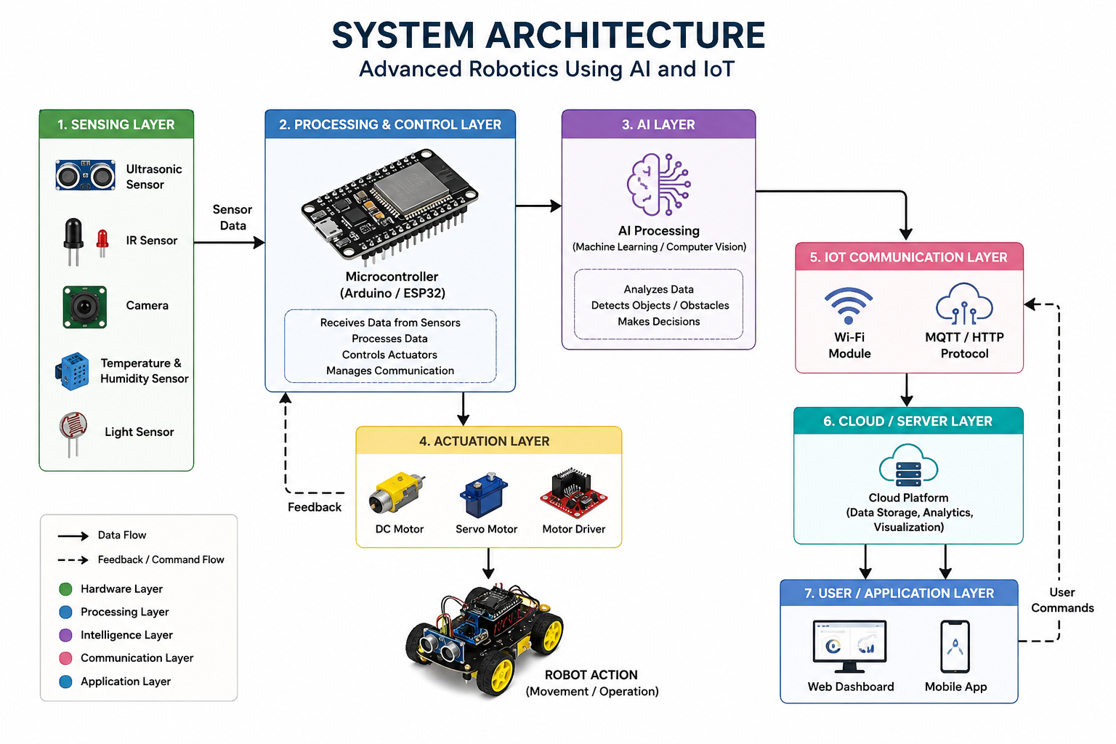
System Architecture
Sensors → Controller → AI Decision → Actuators, with IoT connectivity to cloud and user applications
Advanced Robotics Using AI and IoT | Anurag Betal | 2410030182 7

Slide 8
Methodology
1. Requirement Analysis
2. System Design
3. Data Collection
4. Data Processing
Identify tasks, sensors, processing and communication needs.
Define sensing, processing, AI, actuation and IoT components.
Collect real-time information from sensors.
Process inputs through a controller or computing platform.
5. AI Decision
6. Actuation
7. IoT Integration
8. Testing
Analyze information and determine an appropriate action.
Control motors or other actuators.
Transmit data for remote monitoring and communication.
Evaluate accuracy, response, reliability and overall operation.
Advanced Robotics Using AI and IoT | Anurag Betal | 2410030182 8

Slide 9
Internship Learning Timeline
Weeks 1–2 Robotics Fundamentals
Weeks 3–4 AI for Robotics
Weeks 5–6 IoT Integration
Weeks 7–8 Integration & Evaluation
Sensors, actuators, motors, controllers and basic robot operation.
Perception, obstacle detection, decision-making and autonomous behavior.
Wireless communication, data transmission and remote monitoring.
System integration, testing, optimization and project documentation.
Advanced Robotics Using AI and IoT | Anurag Betal | 2410030182 9

Slide 10
Expected Outcomes
• Understand the fundamental architecture and operation of robotic systems.
• Gain knowledge of AI-based decision-making and autonomous robotic behavior.
• Understand IoT communication, remote monitoring and connected robotic applications.
• Develop practical awareness of sensors, actuators, microcontrollers and programming.
• Improve troubleshooting, system analysis and problem-solving skills.
• Build a foundation for future work in automation, smart agriculture, healthcare, surveillance and autonomous systems.
Advanced Robotics Using AI and IoT | Anurag Betal | 2410030182 10

Slide 11
Scope of the Project
Smart Robotics
Connected Systems
Automation
Integration of sensors, controllers, AI and actuators for intelligent robotic operation.
IoT-based communication, remote monitoring and data exchange.
Reduced human intervention through sensor-based and AI-assisted control.
Applications
Industrial automation, agriculture, healthcare, surveillance, logistics and smart environments.
Advanced Robotics Using AI and IoT | Anurag Betal | 2410030182 11

Slide 12
Internship Completion
Student
Roll Number
Organization
Anurag Betal
2410030182
EduSkills Academy
Completion
Successfully completed the 8-week Advanced Robotics Using AI and IoT Virtual Internship.
Advanced Robotics Using AI and IoT | Anurag Betal | 2410030182 12

Slide 13
THANK YOU
Anurag Betal
Roll No.: 2410030182
Advanced Robotics Using AI and IoT

