Slide 1
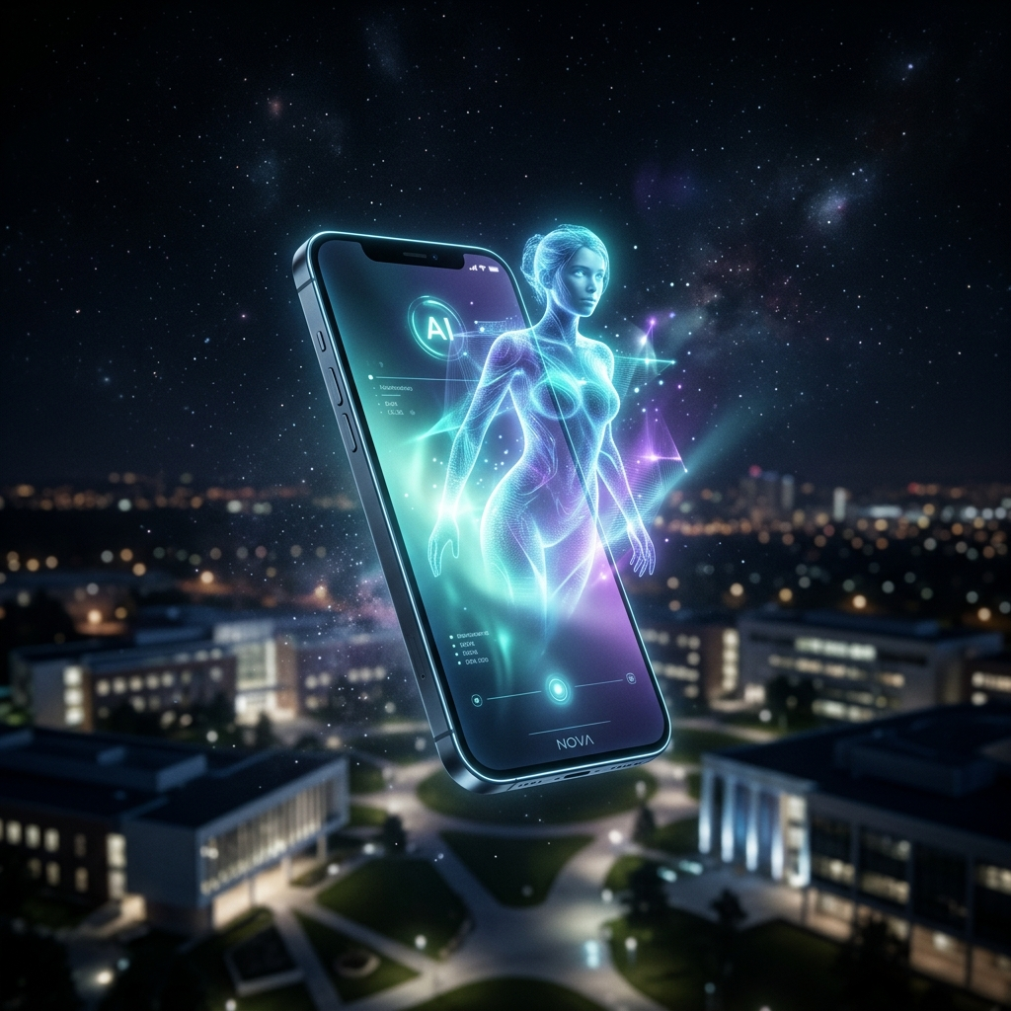
iQOO HACKATHON 2026 • AGENTKIT TRACK
AURA
The First Privacy-First Academic Operating System
On-Device Intelligence • Zero Cloud • 100% Offline

Slide 2
THE PROBLEM
The ₹0 Student Reality
📡
💸
🔓
No Internet
No Subscriptions
No Privacy
68% of Indian classrooms have unreliable connectivity
₹1,700/mo for ChatGPT Plus. Avg student budget: ₹0 for AI.
Every upload trains someone else's model on your notes.

Slide 3
COMPETITIVE LANDSCAPE
Why Existing AI Fails Students
Feature
ChatGPT
Gemini
Notion AI
AURA
Works Offline
❌
❌
❌
✅
Free Forever
❌
⚠️
❌
✅
On-Device LLM
❌
❌
❌
✅
Data Stays Local
❌
❌
❌
✅
Live Lecture Capture
❌
❌
❌
✅
Auto Scheduling
❌
❌
⚠️
✅

Slide 4
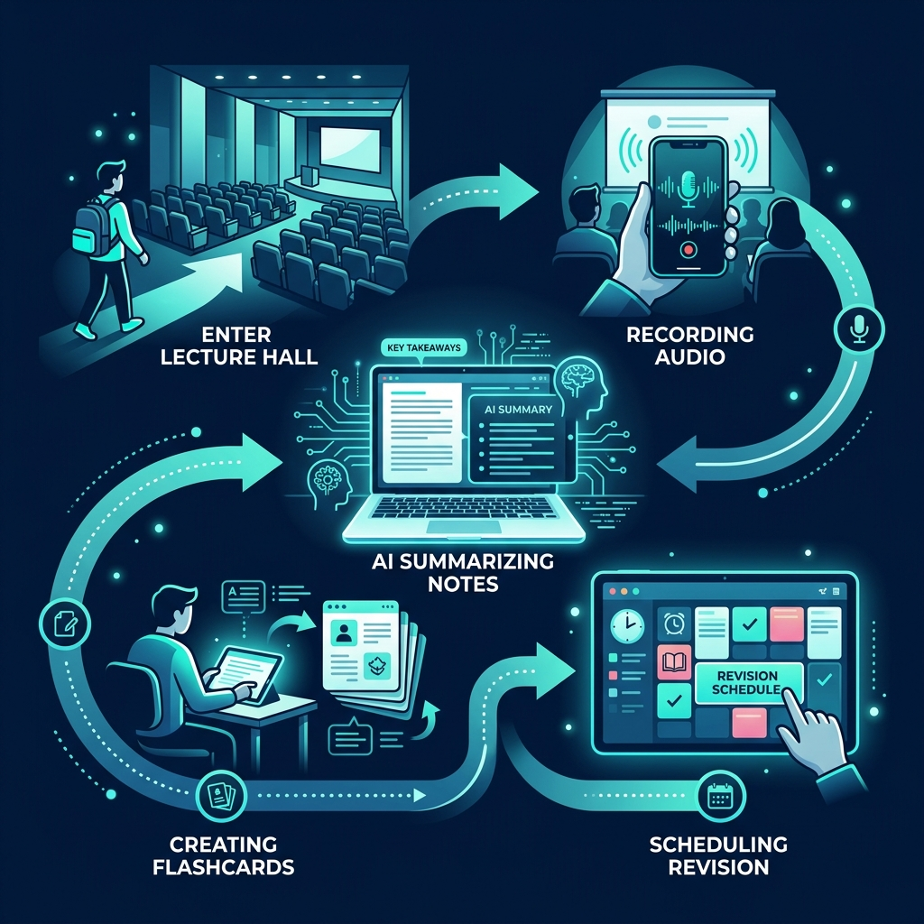
USER JOURNEY
The AURA Moment
📖 Enter Lecture
🎙️ Record
📝 Summarize
🃏 Flashcards
📅 Schedule

Slide 5
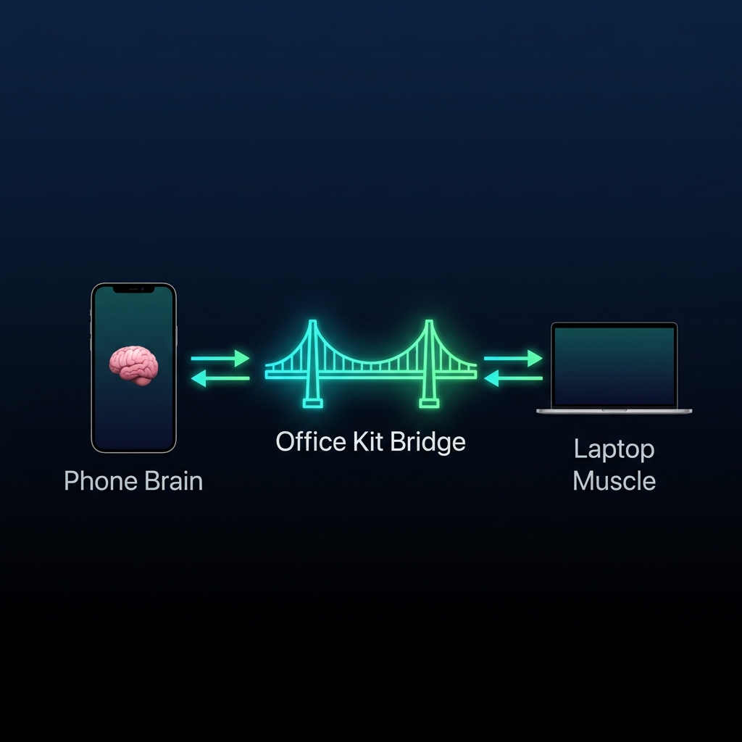
SYSTEM DESIGN
The Hybrid Architecture
🧠 Phone Brain
🔗 Office Kit Bridge
💻 Laptop Muscle
Gemini Nano / Llama 3.2 Speech-to-Text Context Engine
iQOO Office Kit Local TCP Socket Real-time Sync
FastAPI Server FAISS / ChromaDB PDF Vectorization

Slide 6
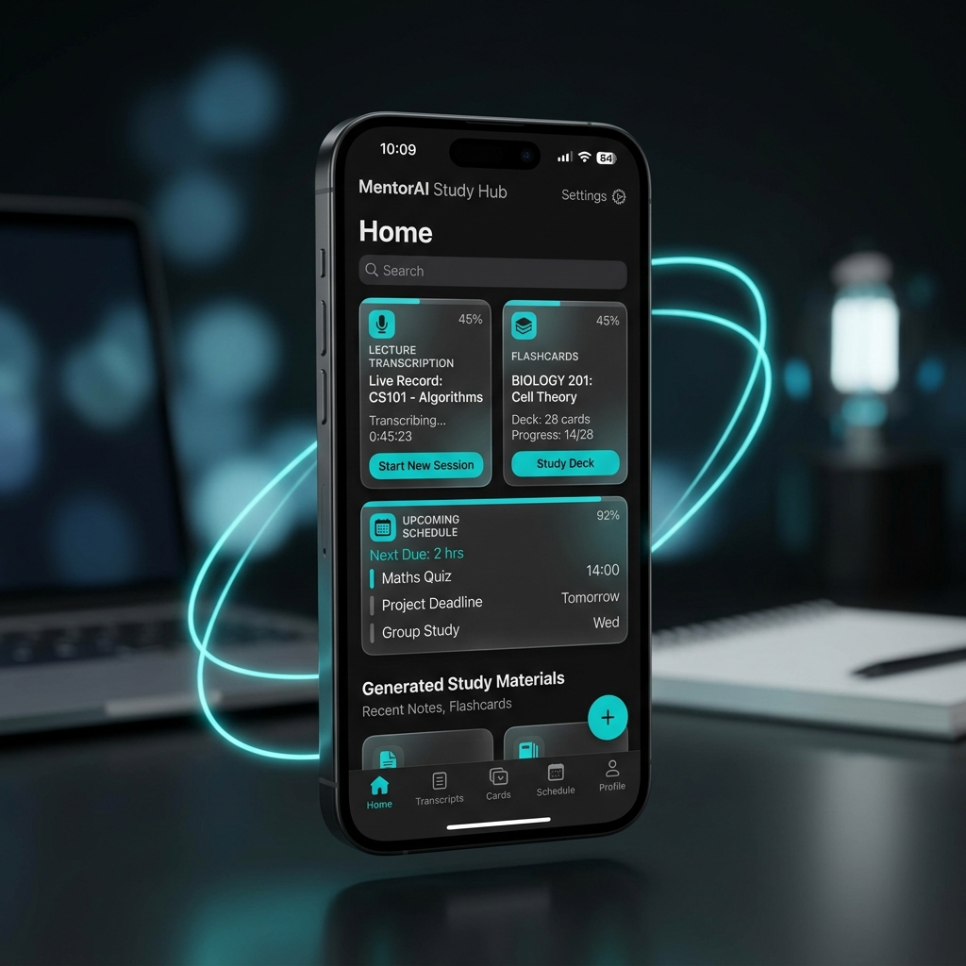
PRODUCT DEMO
Live Demo Flow
01
Open Aura during lecture
02
Tap Record — live STT begins
03
AI extracts key concepts
04
Auto-generates flashcards
05
Schedules revision in calendar

Slide 7
WHAT MAKES US DIFFERENT
Innovation Stack
🧠
📍
✈️
🔀
On-Device Gemini Nano
Deep Context Awareness
Fully Offline Intelligence
Hybrid Execution Model
First student app running Google's on-device foundation model for instant, private inference.
Fuses location, calendar, class schedule, and usage patterns into a single intelligence loop.
Core features work in airplane mode. No internet, no compromise, no data leaks.
Seamlessly distributes workloads between phone NPU and laptop GPU via iQOO Office Kit.

Slide 8

MARKET SIZE
Market Opportunity
250M+
Students in India alone
$15B
EdTech TAM by 2027
92%
Smartphone penetration among Indian college students
₹0
Aura's cost to the student

Slide 9
PLATFORM SYNERGY
Why iQOO is Essential
⚡
Flagship NPU Performance
iQOO's Snapdragon 8 Gen 3 NPU delivers 45 TOPS — enough to run quantized 3B parameter models at conversational speed on-device.
🔌
iQOO Office Kit Bridge
The proprietary Office Kit creates a seamless local TCP bridge between phone and laptop — the backbone of the Hybrid Architecture.
🔋
All-Day Battery
6000mAh battery ensures Aura runs through back-to-back lectures without power anxiety, unlike competitors.
📱
Phone-First Philosophy
iQOO's focus on performance-per-rupee matches Aura's mission: premium AI experiences accessible to every student at ₹0.

Slide 10
"Every student deserves a private AI companion."
Aura makes it possible — offline, on-device, and completely free.
AURA • AgentKit • iQOO Hackathon 2026

