Slide 1

AI-Driven Decision Intelligence for IPL Player Auction Analytics and Team Strategy Optimization
Summer Research Internship 2026
Team: Anurag Kamble · Shruti Suryawanshi · Omkumar Sirmalwad
Guided by: Prof. Saurabh N. Mehta · Prof. Kiran Talele
Organization: Sardar Patel Technology Business Incubator (SP-TBI), Mumbai
Academic Year: 2025–2026

Slide 2
Introduction & Problem Statement
IPL franchises must make timely decisions on player valuation, expected performance, squad composition, role fit and auction budgets. Traditional approaches combine statistics, scouting and domain experience.
Study 1 — Auction Price Prediction
Study 2 — Player Ranking & Classification
Important Limitation
Auction prices also depend on retention, franchise budgets, demand, recent form and injuries.
Can historical player statistics estimate IPL auction prices?
Can multi-season ball-by-ball data produce transparent, defensible player tiers?
Visual summary:
Player Statistics → ML Model → Auction Price Prediction
Ball-by-Ball Data → Performance Metrics → Player Classification

Slide 3

Objectives & Overall Architecture
01
Objectives
Literature review, XGBoost modelling, validation comparison, leakage diagnosis, performance pipeline, classification, head‑to‑head comparisons, evaluate utility & limits.
Architecture (high-level flow): IPL Analytics → [STUDY 1: Auction Dataset → Preprocessing → Feature Engineering → XGBoost → Price Prediction → Evaluation] | [STUDY 2: Ball-by-Ball → Match/Career Aggregation → Performance Matrix → Quantile Classification → Head-to-Head Analysis]

Slide 4



Datasets & Technology Stack
Datasets
Technology Stack
Dataset | Period | Notes
IPL Auction | 2008–2017 | 1,108 records · 42 features · Price prediction
Ball-by-Ball | 2012–2025 | Delivery-level IPL data · performance analysis
Longevity Pool | 2012–2025 | 11 players present every season · fair multi-season comparison
Python
Pandas · NumPy · Scikit-learn · XGBoost
Notebooks & Visualization
Jupyter · Matplotlib · Seaborn
Development
Dataset limitation: Missing retention history, franchise budget/demand, recent form, injury and strategic context.
VS Code · versioned experiments

Slide 5
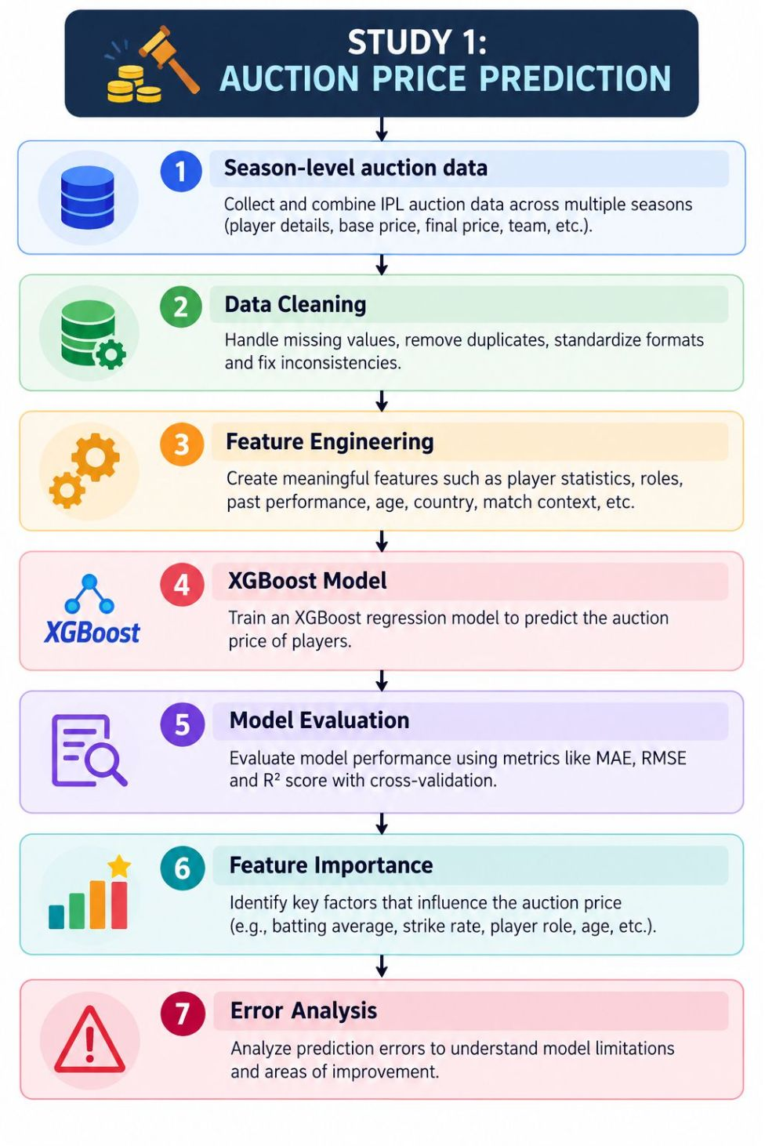
Study 1 — XGBoost Auction Price Prediction
Inputs & Feature Engineering
Inputs: Runs, Matches, Batting Average, Strike Rate, Wickets, Prev-season stats, Age, Year, Status
Derived: RunGrowth, MatchGrowth, AverageGrowth, StrikeRateGrowth, WicketGrowth, EconomyChange, AgeSquared
Model
XGBoost regression → Target: Final auction price (₹)
Visual
Feature importance (top 20) used to interpret drivers of predicted price.

Slide 6
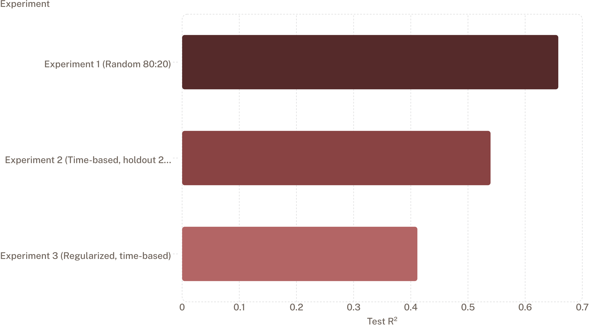
Study 1 — Experiments & Model Evaluation
Comparison of validation strategies and regularization effects. Metric: Test R² (do not call this accuracy).
Experiment 1 (Baseline)
Experiment 2
Experiment 3
Train R² = 0.9888 · Test R² = 0.6580 · MAE = ₹12.77M · RMSE = ₹17.72M
Time-based holdout (2017): Train R² = 0.9888 · Test R² = 0.5395 · MAE = ₹14.89M · RMSE = ₹22.36M
Regularized, time-based: Train R² = 0.7969 · Test R² = 0.4115

Slide 7



Model Diagnosis — Leakage, Bias & R²
Solutions & Notes
Problem: Random Split Optimism
Problem: Ordinal Encoding Bias
Use time-based validation for realistic generalization estimates.
Replace LabelEncoder with OneHotEncoder + ColumnTransformer to avoid ordinal bias.
Apply regularization and careful feature selection to control overfitting.
Information from similar seasons leaked across train/test → inflated Test R².
LabelEncoder produced artificial ordinal relations across categorical features.
R² reminder
Problem: Overfitting
R² = 1 − Σ(yᵢ − ŷᵢ)² / Σ(yᵢ − ȳ)². It quantifies explained variance on the evaluated dataset (e.g., R² = 0.5395 → ~54% variance explained). Do not call this "accuracy".
Very high Train R² vs lower Test R² indicates overfitting; regularization reduced gap but lowered Test R².

Slide 8
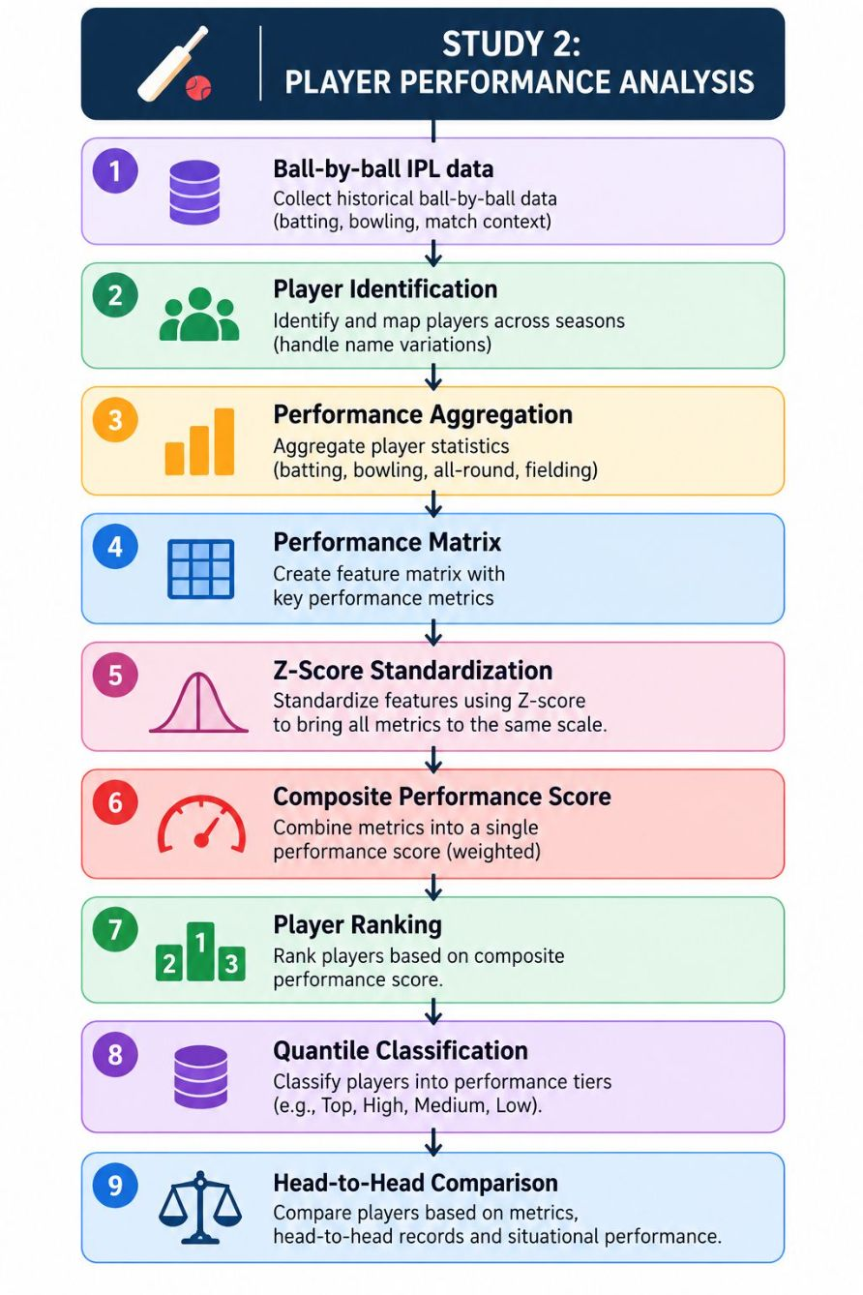
Study 2 — Ball-by-Ball Performance & Quantile Classification
Processing pipeline
Ball-by-Ball Data → Match-level aggregation → Career-level aggregation → Performance matrix (prevents double-counting)
Batting metrics
Runs · Batting Average · Strike Rate · Fours · Sixes · 50s · 100s
Bowling metrics
Wickets · Economy Rate · Bowling Average · Strike Rate · Wickets per Match
Classification rules
Batting: 5 quintile classes by Batting Average
Bowling: 4 quartile classes by Wickets per Match
Minimum sample: 15 innings

Slide 9
Player Comparison & Key Results
Head-to-head analysis augments ranking: answers “How does Player A perform vs Player B?”
Primary comparison metrics
Batting: Batting Average, Strike Rate
Bowling: Bowling Average (lower is better), Economy Rate (lower is better)
Directionality adjusted for bowling metrics so green always indicates row player advantage.
Key numeric reminders: Study 1 (time-based) Test R² = 0.5395 · MAE = ₹14.89M · RMSE = ₹22.36M. Study 2: 2012–2025, 11 longevity-qualified players, 5 batting classes, 4 bowling classes, 15-innings min.
Methodological note: Composite z-score was evaluated but not used as primary output because it can undervalue specialist bowlers.

Slide 10
Batting rank and quintile classification
Player | Average | Strike Rate | Innings | 100s | 50s | Class
V Kohli | 39.56 | 132.89 | 259 | 8 | 63 | Class 5 (Top 20%)
MS Dhoni | 38.30 | 137.45 | 241 | 0 | 24 | Class 5 (Top 20%)
DA Miller | 35.78 | 138.60 | 133 | 1 | 13 | Class 4 (60–80%)
AM Rahane | 30.50 | 125.02 | 183 | 2 | 33 | Class 4 (60–80%)
RG Sharma | 29.73 | 132.10 | 266 | 2 | 47 | Class 3 (40–60%)
MK Pandey | 29.20 | 121.52 | 161 | 1 | 22 | Class 3 (40–60%)
RA Jadeja | 27.86 | 130.30 | 194 | 0 | 5 | Class 2 (20–40%)
MA Agarwal | 22.97 | 133.53 | 125 | 1 | 13 | Class 2 (20–40%)
SP Narine | 17.62 | 166.51 | 118 | 1 | 7 | Class 1 (Bottom 20%)
JD Unadkat | 12.31 | 118.67 | 27 | 0 | 0 | Class 1 (Bottom 20%)

Slide 11
Bowling rank and quartile classification
Player | Innings | Wickets | WPM | Economy | Bowl Avg | Class
B Kumar | 190 | 198 | 1.04 | 1.37 | 4.85 | Class 4 (Top 25%)
SP Narine | 187 | 192 | 1.03 | 1.31 | 4.96 | Class 4 (Top 25%)
JD Unadkat | 111 | 110 | 0.99 | 1.58 | 5.43 | Class 3 (50–75%)
RA Jadeja | 225 | 170 | 0.76 | 1.68 | 6.68 | Class 2 (25–50%)
RG Sharma | 32 | 15 | 0.47 | 2.39 | 9.00 | Class 1 (Bottom 25%)
V Kohli | 26 | 4 | 0.15 | 2.65 | 27.75 | Class 1 (Bottom 25%)

Slide 12
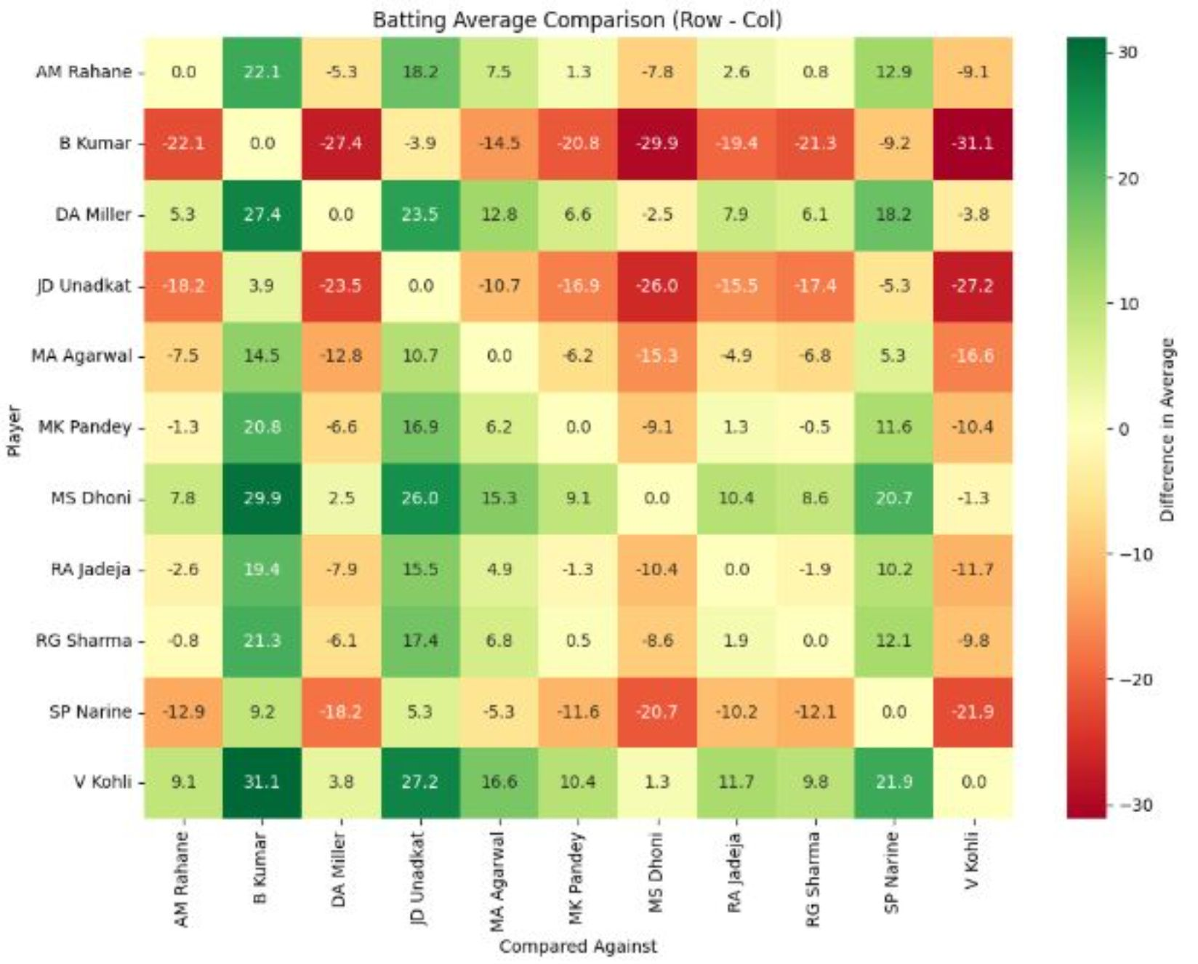
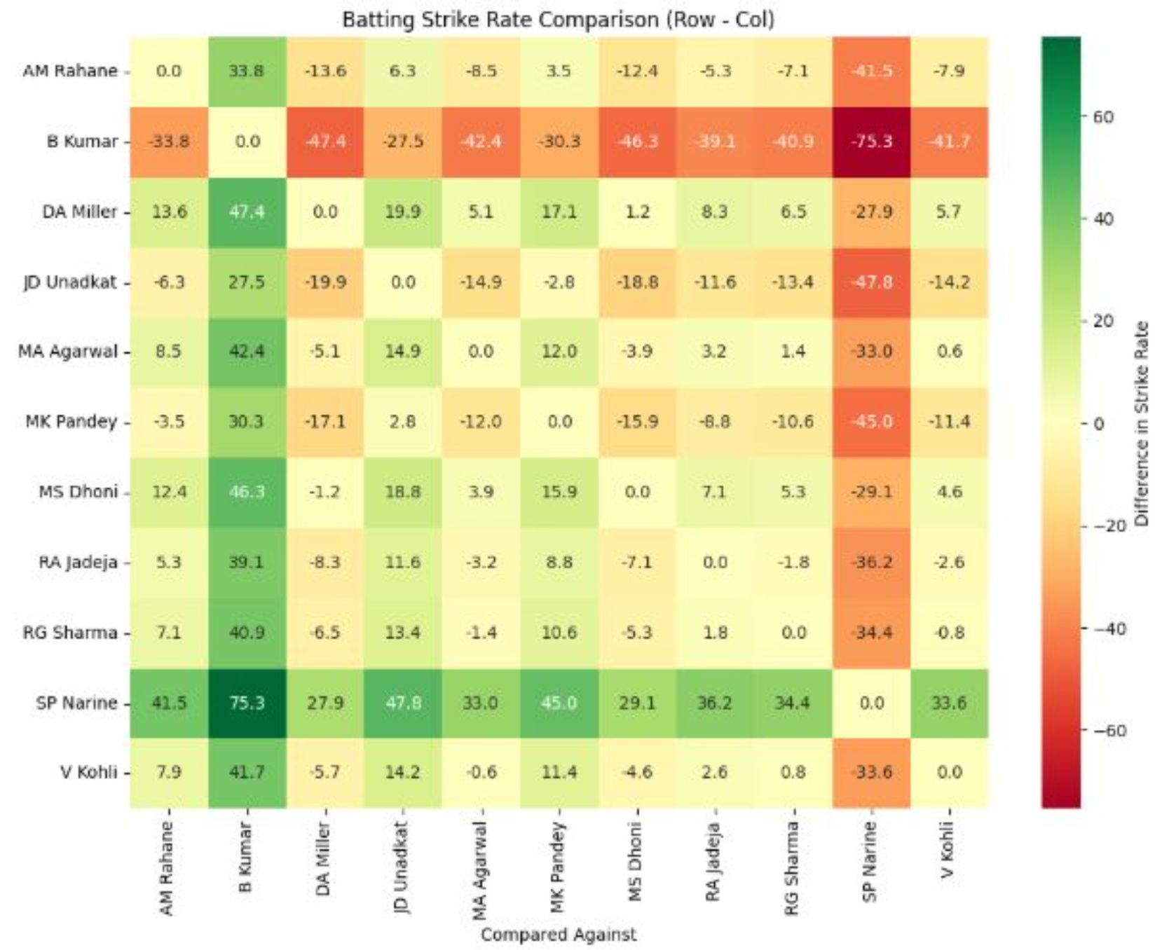
Visual outputs
Batting Average Heatmap
Strike Rate Heatmap

Slide 13
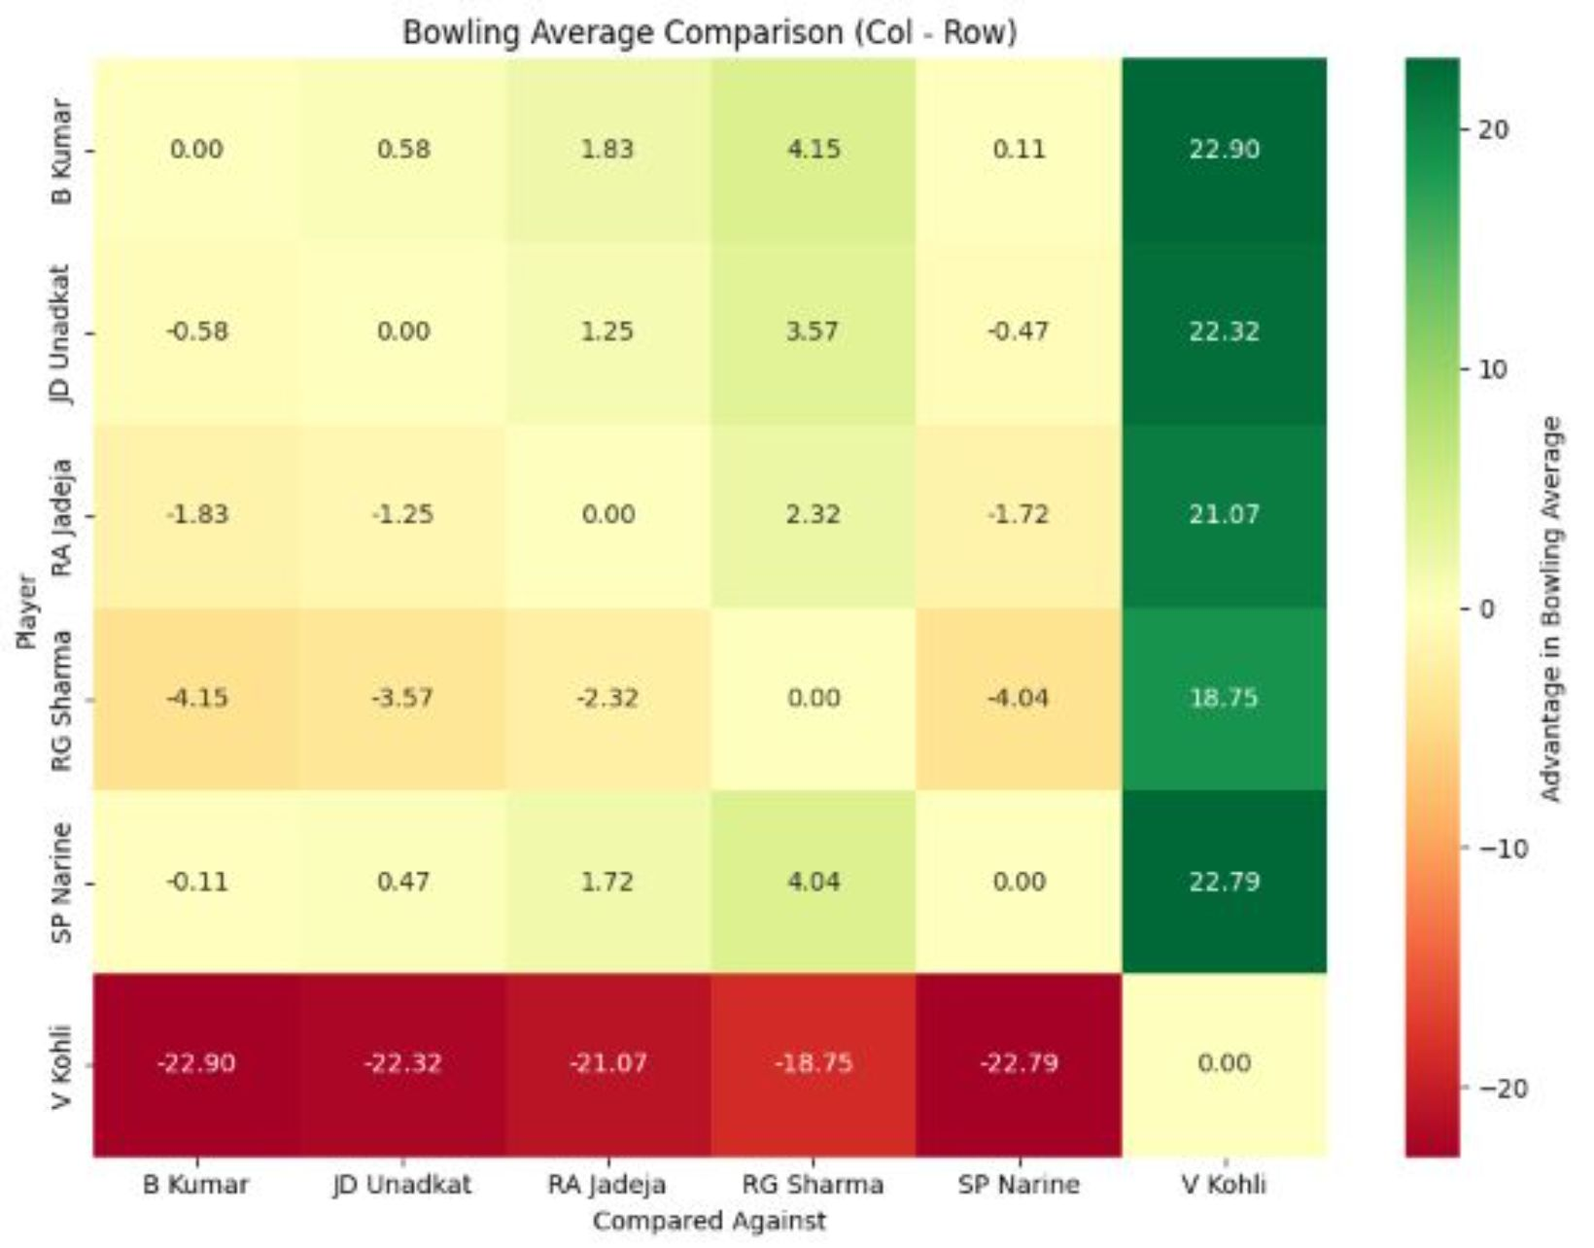
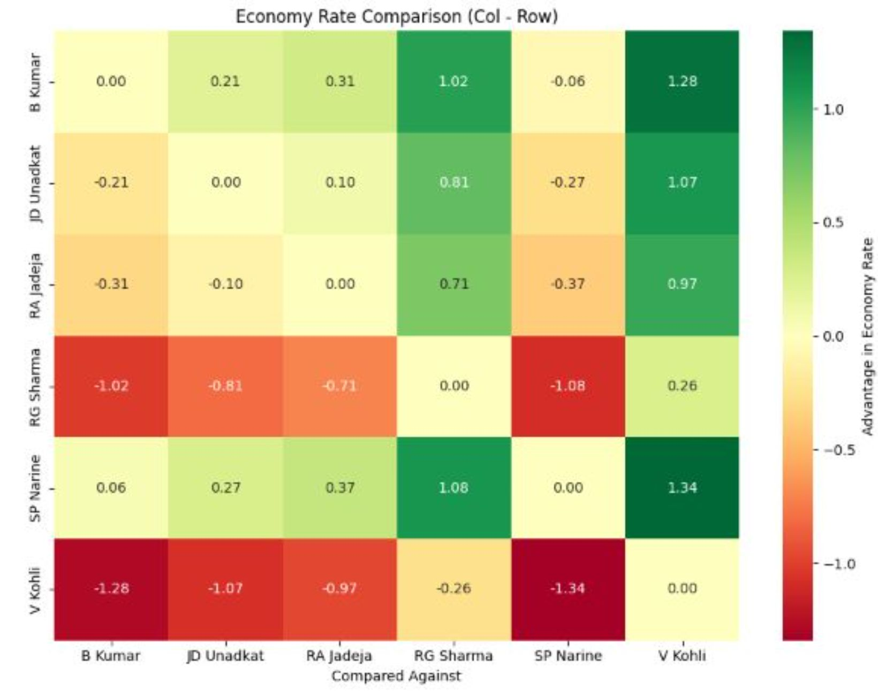
Bowling Average Heatmap
Economy Rate Heatmap

Slide 14
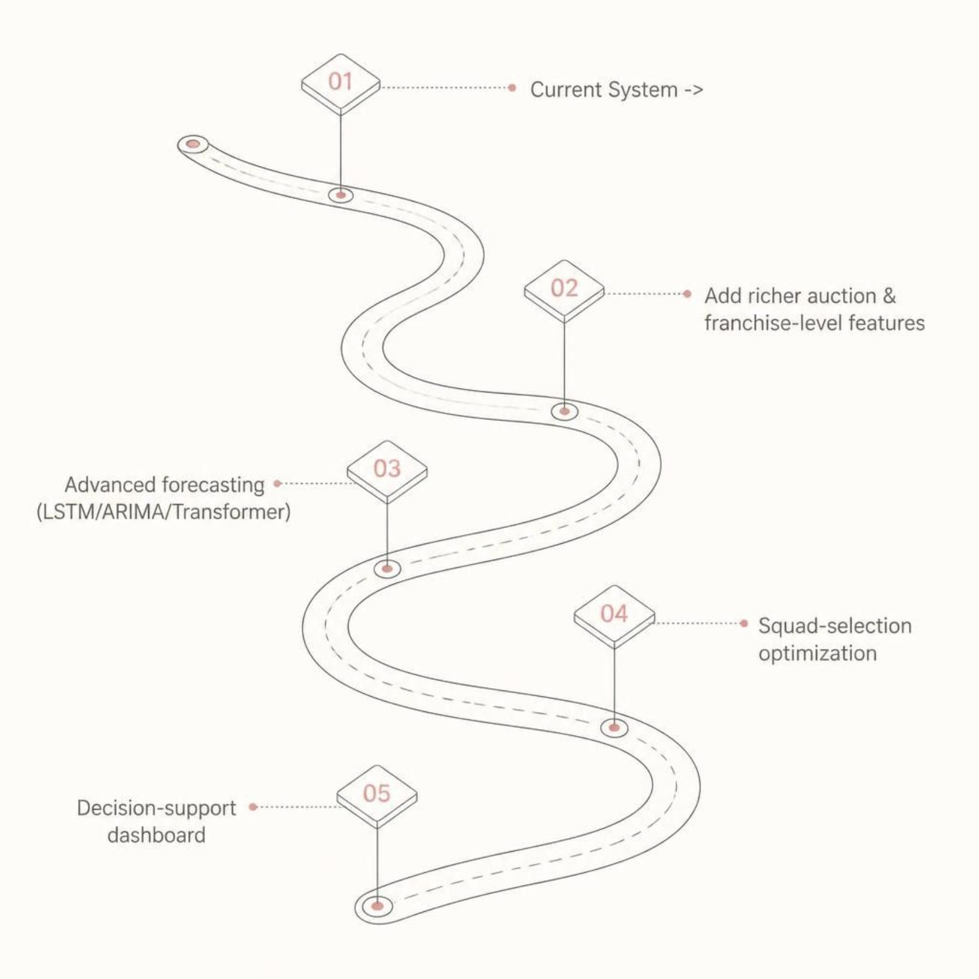
Conclusion, Limitations & Future Scope
Future scope (roadmap)
Additional directions
Include recent-form and prior-auction features
Explore SMOTE / cost-sensitive learning for rare high-value players
Sequence models (Transformer/BERT) for player-event sequences
Integrate squad-selection optimizer and deploy decision dashboard
Conclusion
Two complementary studies: XGBoost price modelling and ball-by-ball classification.
Realistic validation (time-based) is essential; predictions constrained by available signals.
Match-level aggregation and quantile classification produced transparent batting/bowling tiers.
Current limitations
Missing retention history, franchise budget/demand, recent form and injury/context signals.
Thank you — Questions?
Contact: Anurag Kamble · Shruti Suryawanshi · Omkumar Sirmalwad | SP-TBI, Mumbai

