Slide 1
PROJECT REPORT
HOSPITAL MANAGEMENT SYSTEM
Submitted By:
Anurag Ranjan
Digvijay Kumar
Piyush Mishra
Sudhanshu Ranjan

Slide 2
INTRODUCTION OF PROJECT
Hospital management system (HMS) is an element of health informatics that focuses mainly on the administrational needs of hospitals. I have used java as a front-end and oracle as a back-end.
This software is developed for Hospital Management System for handling works of Patient related records electronically. This system is made for work in place of manual system for Patient related management with an electronic speed and accuracy.

Slide 3
OBJECTIVES
Since, large numbers of patients have faith this Hospital; therefore, it is not easy to keep records of all the patients manually. Specially, manipulation and maintenance of records aren’t easy. So, it was required to develop an automated system for it to assist the organization to work easily and efficiently. Automated system provides electronic speed and accuracy so it takes less time for manipulation and maintenance of records.
My job is to develop such type of automated system . For this, the organization maintains manual registers, such as
Bed Detail: This is to store the details of bed which are available in the Hospital
Dept Detail: This is to store the details of department And Its Charge working in this organization
Test Detail: This table is used to store the information about the Tests who are registered in the organization to work in Nursing Home.
Employee Detail: This Table is used to store the details of the Employee for the Works in the hospital
Patient Detail : This is to store the details of Patient to be entered.
Doctor Detail: This is to store the details of the doctor & its specialization.
Final bill Detail: This register is maintained for storing information about the bill Detail in the hospital and their charges.

Slide 4
PROJECT CATEGORY
FRONT END-JAVA (SWING)
Introduction of Java:-
Java is pure object oriented programming language, which has derived C syntax and C++ object oriented programming features. Is compiled and interpreted language and is platform independent and can do graphics, networking, multithreading. It was initially called as OAK. Java was conceived by James Gosling, Patrick Naughton, Chris Warth, Ed Frank, and Mike Sheridan at Sun Microsystems, Inc. in 1991. Java can used to create two types of programs: application and applets.
Java Features
Simple
Secure
Platform independent
Multithreading
Distributed
Dynamic
Back-end : Oracle10g
About Oracle 10g
Oracle 10g is an RDBMS package developed by Oracle Corporation. This RDBMS package can manage any type of data in a well designed manner. Oracle is structured query language (SQL), is the set of commands that all program and users must use to access data within the Oracle Database.

Slide 5
PLATFORM TO BE USED
s/w USED
ApPLICATION : HOSPITAL management system
operating SYSTEM : WINDOWS 2007 (64-BIT)
FRONT END /GUI TOOLS : JAVA 1.6
RDBMS/BACK END : ORACLE 10g
H/W USED
RAM : 4 GB
HARD DISK: 500 GB
_{Intel Core i3}

Slide 6
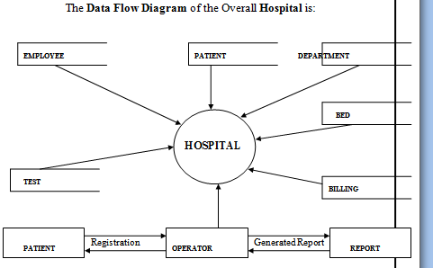
DATA FLOW DIAGRAM

Slide 7
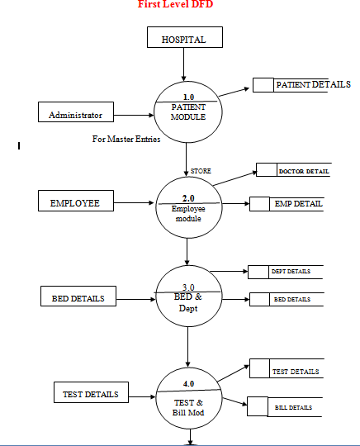
First Level DFD

Slide 8
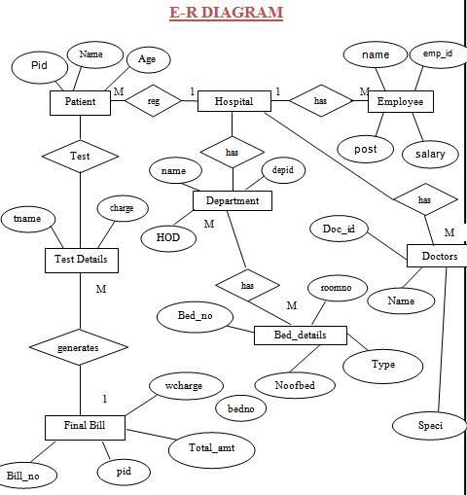

Slide 9
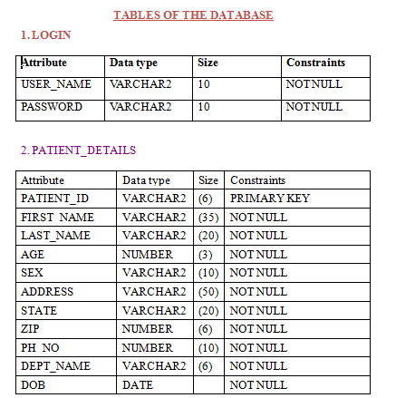

Slide 10
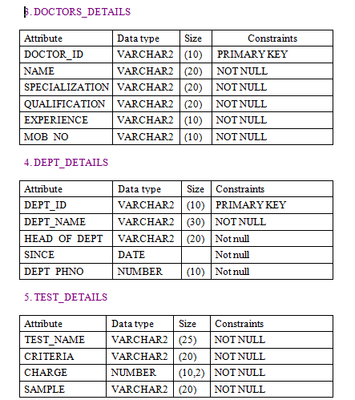

Slide 11
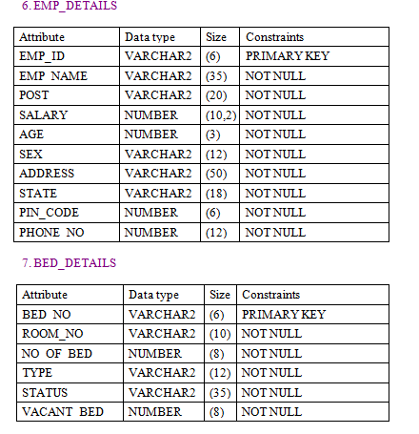

Slide 12
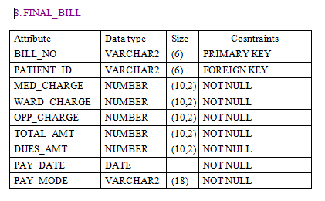

Slide 13
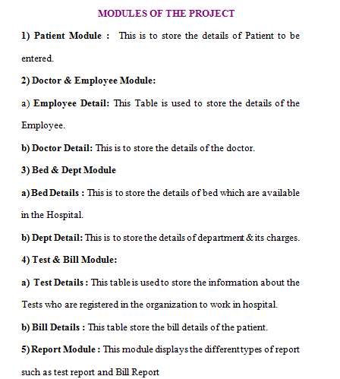

Slide 14
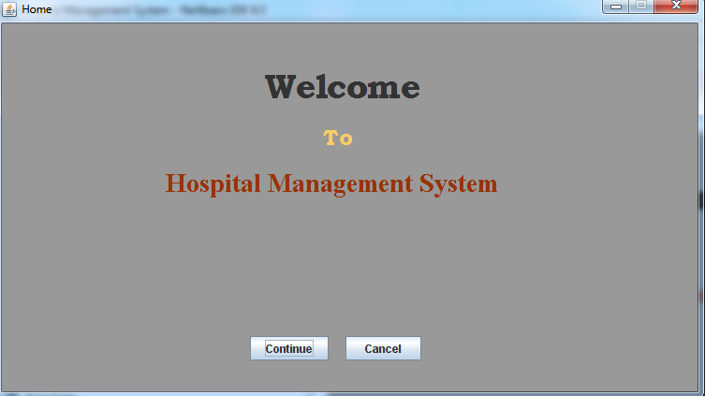

Slide 15
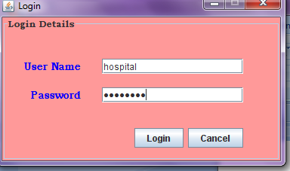

Slide 16
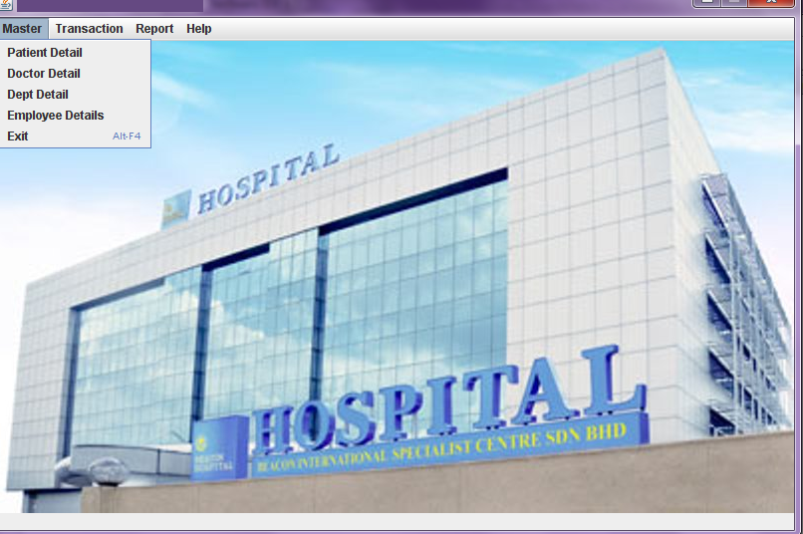

Slide 17
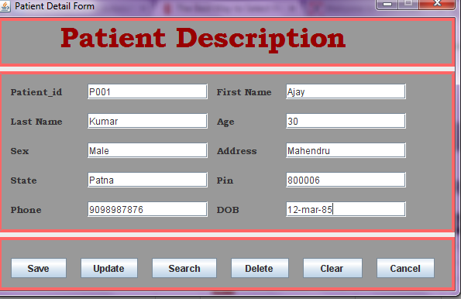

Slide 18
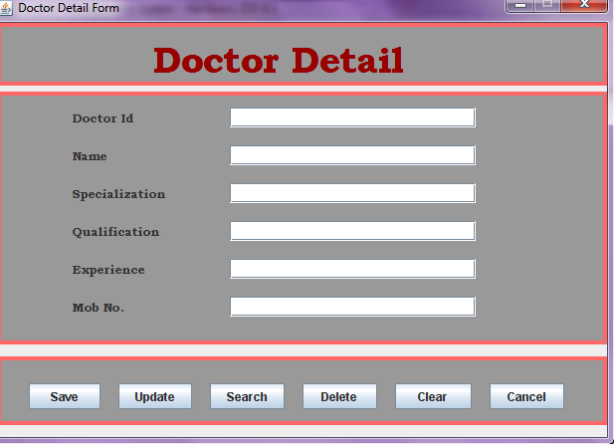

Slide 19
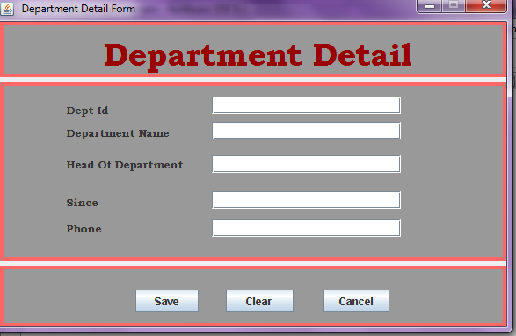

Slide 20
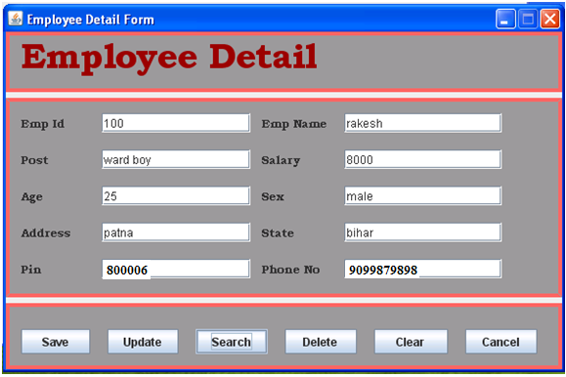

Slide 21
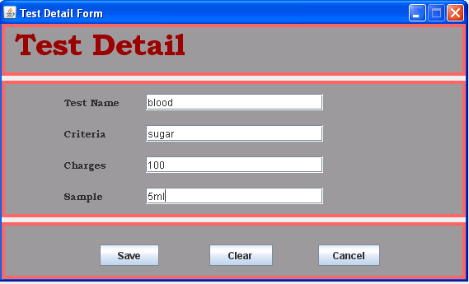

Slide 22
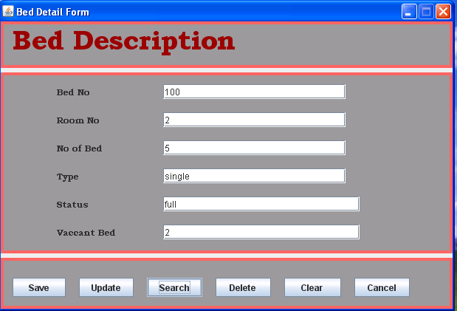

Slide 23
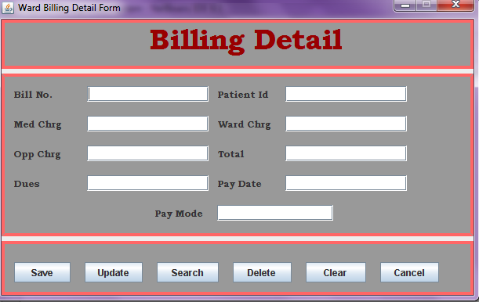

Slide 24
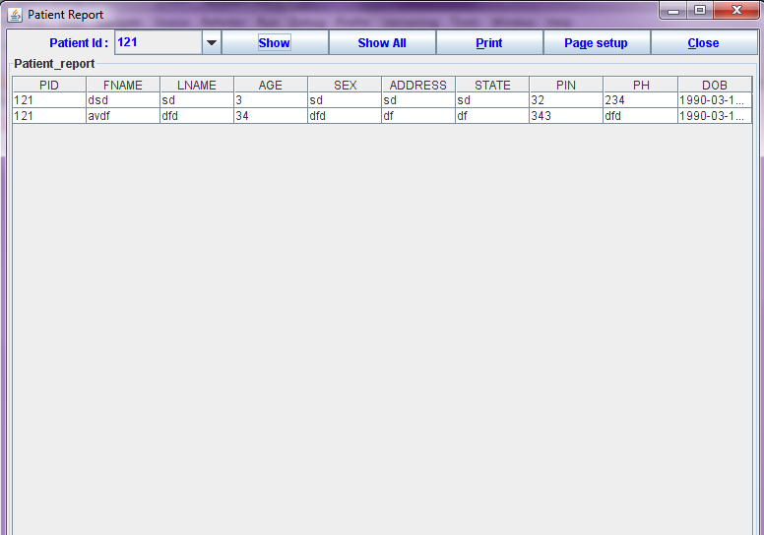
Patient report

Slide 25
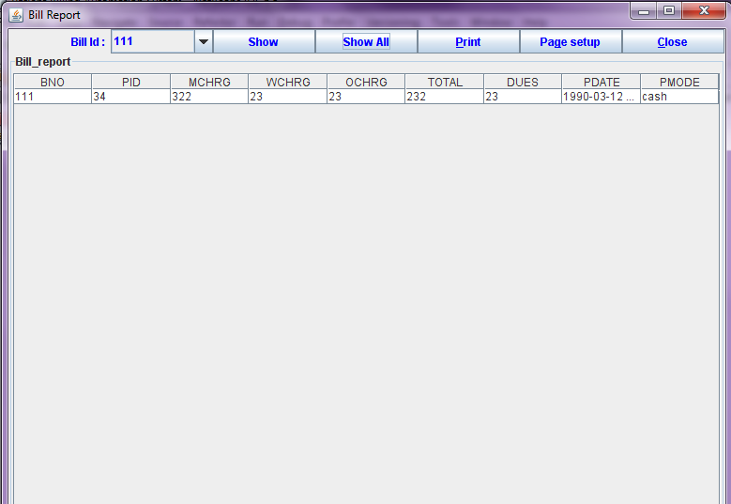
Bill report

Slide 26
TESTING
Testing is a measuring instrument for software quality with the unit of measurement being the number of defects found during testing.
Unit testing
Integration testing
Black box testing
White box testing
Acceptance testing

Slide 27
LIMITATION OF THE PROJECT
Limited time period.
Project tested only windows platform.
Due to the time limitation some of the features that could have been explored have not been used.

Slide 28
SCOPE OF FUTURE APPLICATION
Hierarchy modification/additional capabilities are inbuilt in the system.
Dynamic screens according to requirement can be introduced any time.
System is very flexible for further modifications.
With very little modification, it can be deployed for use in other hospital system.

Slide 29
BIBLIOGRAPHY
_{Books:}
SYSTEM ANALYSIS AND DESIGN – E. M. AWARD
_{JAVA – E.BALAGURUSWAMY}
ORACLE PL/SQL PROGRAMMING – O’REILLY SERIES
AN INTRODUCTION TO DATABASE SYSTEMS – C.J. DATE
JAVA2 PLATFORM UNLEASHED (SAMS) TECHMEDIA-JAWORSKI.
DATABASE SYSTEM CONCEPTS FIFTH EDITION –SILBERSCHATZ KORTH SUDARSHAN.

Slide 30
THANKS

