Slide 1
InceptionV3 with GRU-Based Attention Framework and Transformer for Image Caption Generation
Anurag Deshmane (2001CS08)

Slide 2
Need for Captioning an Image
Accessibility for Visually Impaired
Natural Disaster Response using Aerial/Satellite Images
CCTV Captions for Enhanced Security and Alarm System
Enhanced Image Search with Automatic Captioning
Enhanced product description for E-Commerce
Captions for News Images can improve information circulation

Slide 3

How can we achieve Image Captioning?
Image Captioning
NLP
Computer Vision
Leveraging the power of Computer Vision and Natural Language Processing

Slide 4
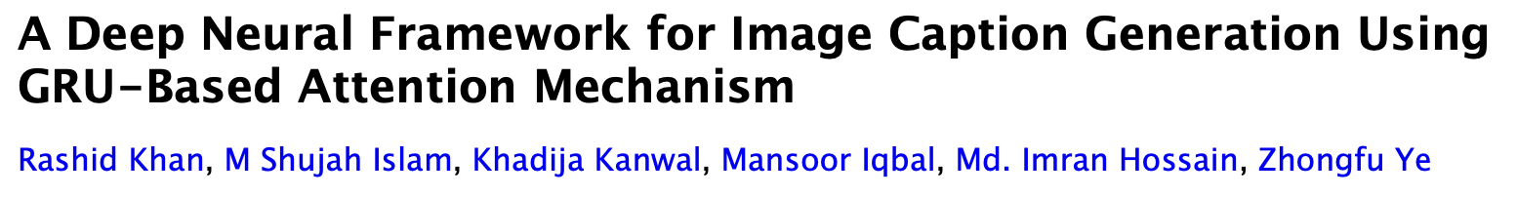
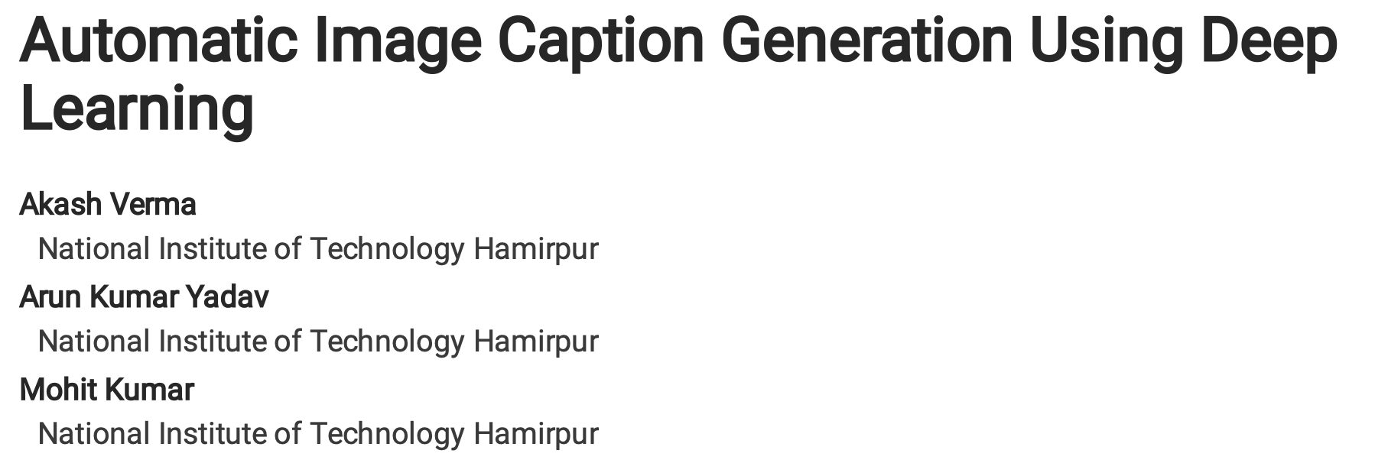
Reference Papers used
https://doi.org/10.48550/arXiv.2203.01594 MAR 2022
https://doi.org/10.21203/rs.3.rs-1282936/v1 JUNE 2022

Slide 5
My Proposed Architecture
InceptionV3 with GRU-Based Attention Framework and Transformer for Image Caption Generation
Steps:
Data Collection
Data Normalising and Preprocessing (Image + Captions)
Loading the training data (80%)
Word Embeddings
Defining our Model
Compiling our Model with ‘categorical_crossentropy’ loss function and ‘adam’ optimizer
Testing our model
Evaluation

Slide 6
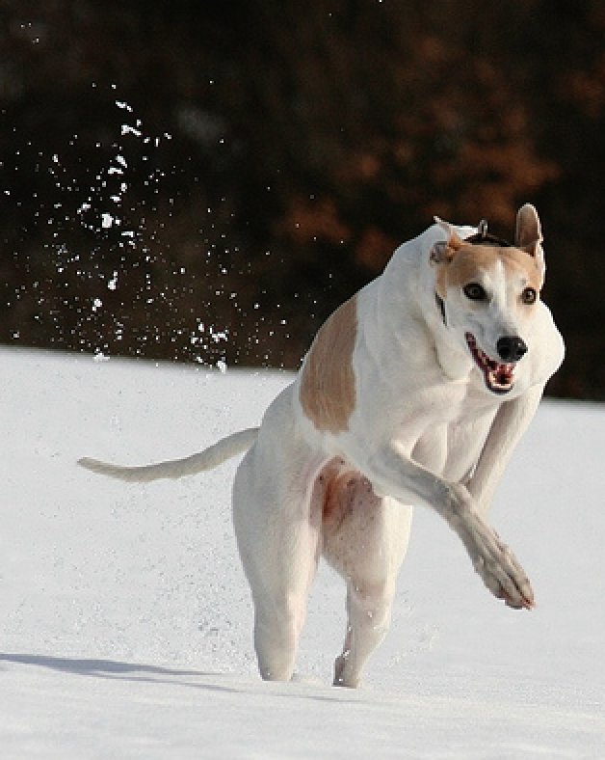
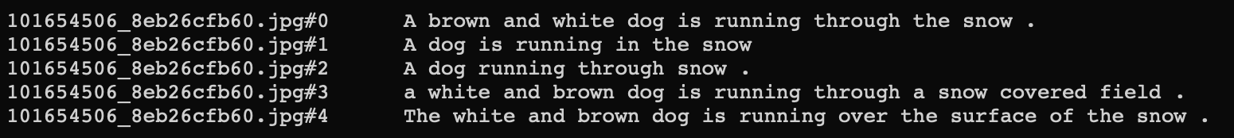

Data Collection
There are many open source datasets available online like:
Flicker8k (containing 8k images)
Flicker30k (containing 30k images)
MS COCO (containing 180k images)
But for our purpose, the Flicker8k dataset is enough to train the model.
Training Set - 6400 images
Testing Set - 1600 images
Each image has five captions describing that image. This way, we got 40000 unique image caption pairs.

Slide 7
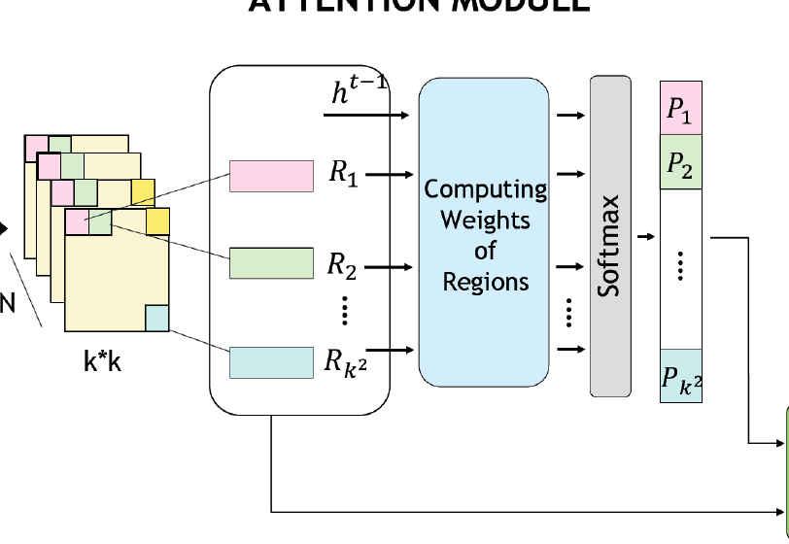
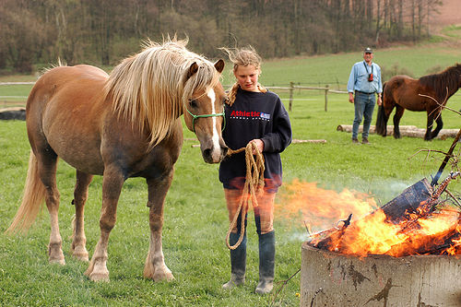
Proposed Model :
InceptionV3 + Attention + Transformer(as a decoder)
Vector Representation
InceptionV3
Weights + Values + Queries
image.jpg
LSTM
Multi-Head Attention
Transformer
(To enhance the text)
I aim to develop a system that uses pre-trained InceptionV3 layer for feature extraction, integrates those features with GRU-based attention mechanism, and creates captions using LSTM acting as a decoder.
Output
a group of horses standing around a fire
U
Using BERT
Fire Present

Slide 8
Evaluation using which Metrics?
We will use METEOR and BLEU as evaluation metrics, which are popular in the machine translation literature and are used in image caption generation papers, which I took as the reference.
The BLEU (BiLingual Evaluation Understudy) score is based on the n-gram precision of the generated caption with respect to the references.
The METEOR is based on the harmonic mean of uni-gram precision and recall and produces a good correlation with human judgment.

Slide 9
Future Work
Model Implementation:
To implement the architecture using Python3, Tensorflow.
To optimise the code and finetune it as per the application requirement.
Application Use:
Using BERT to extract valuable data from the text and implement an alarm system for Fire and Smoke Detection
To convert the output Text into Voice using a pre-trained model useful for visually impaired people.

