Slide 1

Software Engineering Damir Dobric/Andreas Pech
Presentation on
ML22/23-12 Implement Anomaly Detection Sample
Anurag De Sourav Paul Sumit Matriculation id -1400450 Matriculation id -1344118 anurag.de@stud.fra-uas.de sourav.sumit@stud.fra-uas.de
Team Name: Team_Anomaly
Date: 29.03.2023

Slide 2
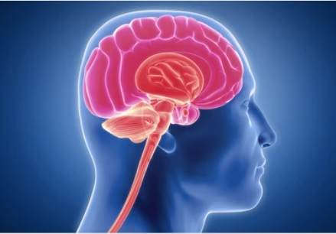
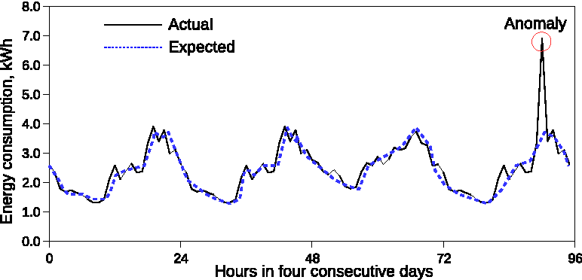
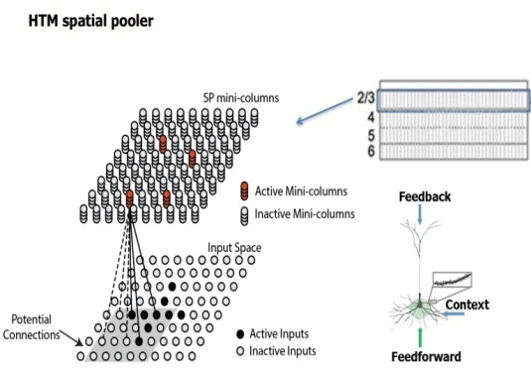
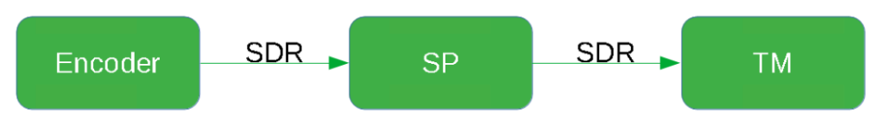
Discussion Topics
In this discussion our main focus will be on the topics which are written below:
Concept of HTM and HTM CLA
Multi sequence learning approach
Anomaly detection
Results
Code review

Slide 3
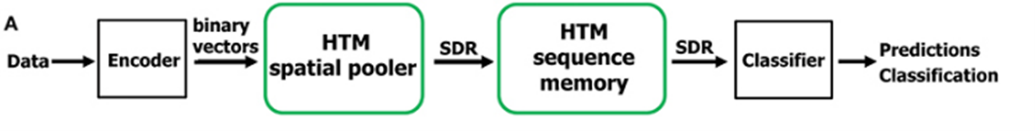
Hierarchical Temporal Memory (HTM)
Machine learning algorithm based on the core principles of the Thousand Brains Theory.
Takes inspiration from neocortex of human brain.
Hierarchical Temporal Memory Cortical Learning Algorithm (HTM CLA): Tries to simulate the way neocortex processes information in human brain.
Can be used process information, recognize and identify patterns and make future predictions based on past learning.
Promising approach for anomaly detection and prediction in a variety of applications in sectors, such as healthcare, finance, etc.

Slide 4
Multisequence learning
Htm cla is good is finding patterns in data
We are using neocortex api, specifically multisequence class, which is based on htm cla.
Multiple number of sequences can be trained with different datatypes.
We are going to use simple numerical integer sequences.
We have to tune hyper-parameters, like encoder and htmconfig, which facilitates training this type of data.

Slide 5
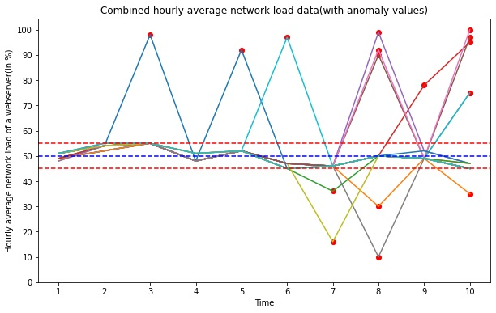
Anomaly detection
We have taken an artificially generated dataset and trained our htm engine.
We have added anomalies to random indexes in our prediction data.
We will try to train our data and detect anomalies using trained htm engine.

Slide 6
Code review!

Slide 7
results
We have achieved false negative rate (FNR) of 0.65, which is high.
We have also achieved false positive rate of 0.24.
It is imperative that fnr needs to be lower.
We need to train htm with more data to improve performance.

Slide 8
Thank You!

