Slide 1
MTRC Automation

Slide 2
Agenda
Utilities Walkthrough
GIT- Katalon Integration
Best Practices

Slide 3



MTRC Architecture and scope of SDET testing
Scope of SDET testing
True Data Sources
Dell Data Lake (DDL)
DELL DSC UI
MTRC Data Flow in SIT
MemSQL DB
Microservices
Landing Zone
Curation zone
Consumption Layer/ RDL Views
Workspace Views
SCDH
GLOVIA
Text File
PPCM
OTHERS
Validate UI and API Layers

Slide 4
MTRC Data Flow in DIT
1
2
3
4
Use DIT (Development Integration Test) environment for functional testing
Create workspace tables with definitions/structure matching the Workspace views
Reconfigure Spark jobs such that source for the jobs are workspace tables created instead of workspace views
Prepare test data. Capture the input vs output data in an excel
Load workspace tables with data required for testing functional scenarios
Trigger Spark Jobs in the specified sequence through Automation Script
Compare the output against the expected results captured as part of test data preparation.
Verify the data in the UI screens/Text files
For scenarios where user enters data in the UI screen, validate this data with MemSQL tables
Compare the output against the expected results captured as part of test data preparation.
Verify the data in the UI screens/Text files
For scenarios where user enters data in the UI screen, validate this data with MemSQL tables

Slide 5
Functional Test Data approach
Scope of SDET testing
DELL DSC UI
True Data Sources
Dell Data Lake (DDL)
MemSQL DB
Microservices
Landing Zone
Curation zone
Consumption Layer/ RDL Views
Workspace Views
Workspace Tables
OR
SCDH
GLOVIA
TEXT FILES
PPCM
OTHERS
Data preparation approach in DIT
1
2
3
4
Take an export of data from the views into an excel
Modify the data in the excel such that all combinations are covered for the functional testing
Import the modified data to the table that is created (which is the replica of the input views)
Use this controlled data for the functional testing
Validate UI and API Layers

Slide 6
Utility Name : CreateQATable.groovy
Function 1: createTable_MemSQL
Parameters : Reference Table name (schema.table name) , Target Schema
Author : Priyadarsini Raj
Description : This utility reads the structure of Reference Table name and creates QA Table in MemSQL under desired schema (where testers are allowed to create tables for testing)
Function 2: createTable_GP
Parameters : Reference Table name (schema.table name)
Author : Priyadarsini Raj
Description : This utility creates QA Table having structure as Reference Table name in Greenplum under desired schema

Slide 7
Utility Name : InsertDataToDBTables.groovy
Function 1: InsertData_MemSQL
Parameters : Excel sheet path, Reference Table name (schema.table name) , sql instance
Author : Priyadarsini Raj
Description : This utility reads the data from excel sheet and inserts the same to DB table in MemSQL which is passed as parameter
Function 2: InsertData_GP
Parameters : Excel sheet path, Reference Table name (schema.table name)
Author : Priyadarsini Raj
Description : This utility reads the data from excel sheet and inserts the same to DB table in greenplum which is passed as parameter

Slide 8
Utility Name: CompareData.groovy
Function name: CompareDBToFile
Parameters : Excel sheet path, Tablename, Column (to be used for sorting),
Author : Priyadarsini Raj
Description: This utility compares Output file data with Output table data in MemSQL
Note: Tester has to manually prepare output file by using input data

Slide 9
Utility Name : ReadDataToDB.groovy
Function 1: ReadData
Parameters : Table name (schema.table name) , Columnname (to be sorted on)
Author : Priyadarsini Raj
Description : This utility reads the data from DB table in MemSQL returns list
Function 2: ReadLookUpData
Parameters : Table name (schema.table name) , Column 1, Column 2, Sql object
Author : Priyadarsini Raj
Description : This utility reads the data from Lookup table in MemSQL which is passed as parameter and returns map
Function 3: ReadData_QueryToMap
Parameters : Query ,Connection String
Author : Priyadarsini Raj
Description : This utility execute the query and returns Map
NOTE: This utility can be used for Greenplum, MemSQL and Oracle

Slide 10
Utility Name : DbUtilities.groovy
Keyword 1: OracleConnect()
Parameters : Host, Username, Password and Service Name from Global Variable defined in Profile. Returns : Connection object.
Description : Will connect to Oracle Database and returns connection String.
Author : Anurag Deb
Keyword 2: executeQuery()
Parameters : SQL Select Query Returns : ResultSet Description : Will fetch query’s output from DB and store it to a ResultSet.
Author : Anurag Deb
Keyword 3: countQuery()
Parameters : a SQL statement Returns : single value result of SQL statement Description : Used for having value from Aggregate functions
Author : Anurag Deb
Keyword 4: executeNonQuery()
Parameters : a SQL statement Returns : single value result of SQL statement
Description : This method is used for SQL statements which updates the database. Like Create/update/Insert/Procedures
Author : Anurag Deb

Slide 11
Utility Name : DbUtilities.groovy
Keyword 5: MemSQLConnect2Instance :
Parameters : Takes Host, User and Password from Global Variable defined in Profile. Returns : Connection object of SQL Instance.
Description : Will connect to MemSql Database through SQL Instance Factory Method and returns connection String. Generally used if you are using groovy.
Author : Anurag Deb
Keyword 6: MemSQLConnect2Manager :
Parameters : Takes Host, User and Password from Global Variable defined in Profile. Returns : Connection object
Description : Will connect to MemSQL Database through Driver Manager and returns connection String. Generally used if you are using Java.
Author : Anurag Deb
Keyword 7: closeDatabaseConnection()
Parameter: Connection Instance
Description: If the connection variable’s value is not null or If session is not closed yet, this keyword will close the session.
Author : Anurag Deb
Keyword 8: DbtoCSV()
Parameters : Filename, Query Returns : CSV File
Description : Exports the DB values to CSV File
Author : Pathmanathan Kesavan

Slide 12
Utility Name : HandleExcel.groovy
Utility Name : FileUtil.groovy
Keyword 1: readDatafromExcel_ToMap ()
Parameters : Filename Returns : Map
Description : Converts the contents of a file into Map.(Column : Value)
Author : Priyadarsini Raj
Keyword 1: readFile2Text()
Parameters : Filename Returns : String
Description : Converts the contents of a file into String. User can write the lengthy Procedure/Select Query/PL/SQL Script in the file and this keyword will convert it to String to be passed as a Query.
Author : Anurag Deb
Keyword 1: CompareCSV()
Parameters : Filepath, InputFile , OutputFile
Description : Compares the CSV to CSV file and prints if the files match
Author : Arvind Sharma

Slide 13
Utility Name : CreateQuery.groovy
Keyword : DBquery()
Parameters : serial no (row number from data file) Returns : Query String
Description : Creates select query by reading data from internal data file based on selected DB type
Author : Nagesh Kalal

Slide 14
Utility Name : DropDown Values.groovy
Function 1: Filtering Dropdown Values
Parameters : Dropdown filter Size xpath, Dropdown Current value xpath, Temporary filter Object, Dummy Filter Object.
Author : RamPrasath
Description : This utility reads values of the dropdown and also knows the maximum size of the filter. Tester can use this utility for validation purpose by connecting with the database.
Function 2: Dropdown Filter For Multiple Graphs
Parameters 1 : Dropdown filter Size xpath, Dropdown Current value xpath, Temporary filter Object, Dummy Filter Object.
Parameters2 : Graph Name, Filter List values
Author : RamPrasath
Description : This Utility is used to validate Graphs results Corresponding to its input Filter .
If the input filtering values are higher in count we can set the range of input values to be validated according to the testers range.

Slide 15
FT7 - Approach for Testing
Keyword : AppFlowExpectedRow()
Parameters : Testcase Name, Excel Sheet Description : We have created data driven approach for testing functional scenarios. The keyword will fetch the entire row from the Excel where expected values & queries are kept.
Then according to the Condition flag it will proceed with the application flow. We just have to maintain the Excel & DB Connection in Test Suite when DDL comes into picture.
Author : Anurag Deb

Slide 16
Approach for Handling Angular Js
Problem statement : Selenium provides element locating techniques using ID name and class attributes which may not be there in Angular applications as it uses ng-bind, ng-class, ng-model, ng-options…etc.
Was not able to get text from date picker input field which used Mat Angular Js date picker.
Solution : JavaScript Executor Sample Code
String redate=js.executeScript("return document.getElementById('mat-input-5').value;").toString();
System.out.println(redate);
Here we have used Javascript executor to find the element in DOM.
Author : Anurag Deb

Slide 17
Approach for Handling Multiple WebElements
Problem statement : Finding pattern to create dynamic xpath for filter criteria
Solution : To find a xpath pattern and store all the elements in the List and iterator to get text or click the element. Sample Code :
List<WebElement> listval = driver.findElements(By.xpath("//span[@class='mat-checkbox-label']"));
//Same thing can be written in Katalon
//List<WebElement> listval = WebUI.findTestObject(ObjectRepository/Page/DealDetailsList)
System.out.println("list");
int i=0;
while( i < listval.size()) {
System.out.println(listval.get(i).getText());
i++;
}
Author : Anurag Deb

Slide 18
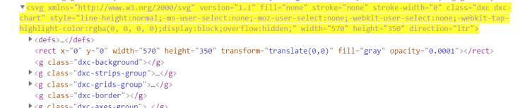
Approach for Handling SVG elements
SVG stands for Scalable Vector Graphics. It is mostly used for vector type diagrams like bar charts, pie charts, and other chart diagrams.
So is it difficult to get to the element?
Using selenium traditional xpaths, we won’t be able to capture the element. Even if we capture it, it might be not stable enough for automation and will be time-consuming.
How to capture SVG elements?
Using name()
Like for above example /*[local-name()=’svg’] or //*[name()=’svg’]
Suppose you have a graph like the below one and you want to capture all the coordinates like 25%.

Slide 19
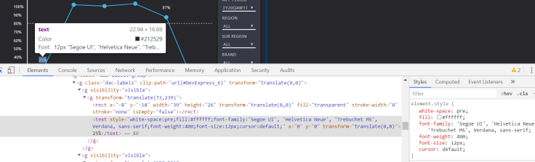
Approach for Handling SVG elements Contd.
For that we can use xpaths like :
((//*[name()=’svg’])//*[name()=’g’]/*[name()=’text’ and @x=’0′])
I found that all the points on the graph like 25%, 87% had x & y coordinates as 0, so I added “and @x=0″ to match the pattern I needed.
Author : Anurag Deb

Slide 20
UI Utilities
Cassandra data comparison from UI and DB
Cassandra Query Execution
Cassandra read/Write
Insert into Cassandra Table
Extract required data from DB Result Set
Sorting a result set in a map
Search and Clicking in table
Enter text in a UI table by Row/Col
JS click
Move to Element and click
Runtime Object creation(Test
Navigations
Selecting from Dropdown(test Obj, Value)
Page Load –Development In Progress

Slide 21
GITLab
GitLab is a web-based repository manager that lets
Teams collaborate on code
Duplicate code to safely create and edit new projects
Merge finished code into existing projects
GIT-Katalon Integration
The below tutorial presents a typical workflow for Git integration with Katalon Studio along with clear screenshots for better understanding.
Setup Document : https://docs.katalon.com/katalon-studio/docs/git-integration.html#checkout-branch
Troubleshooting Guide

Slide 22
Katalon Suite Reporting

Slide 23
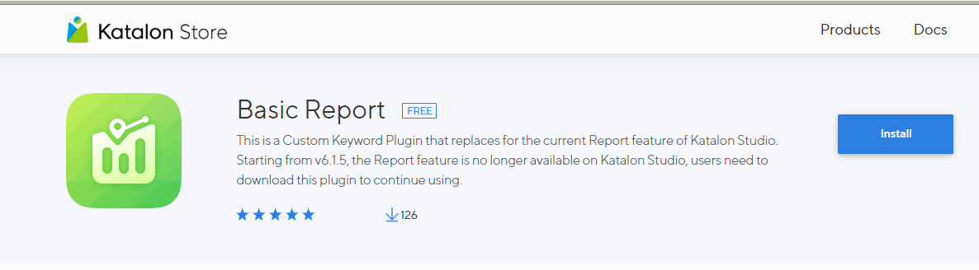
Install Basic Report plugin
Link : https://store.katalon.com/product/59/Basic-Report

Slide 24
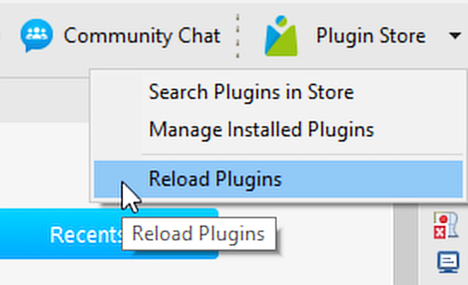
Reload Plugins

Slide 25
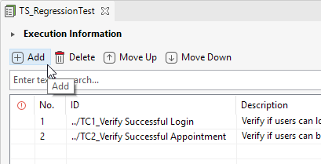
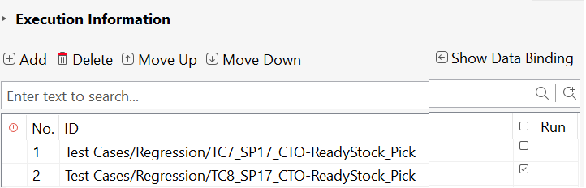
Design a Test Suite contd.
Manage Test Case List
Field | Description
Add Test Case
Execute a Test Suite

Slide 26



Design a Test Suite
Modify Execution Information
Field | Description
Page load timeout:
Retry
Mail Recipients
Last run:

Slide 27
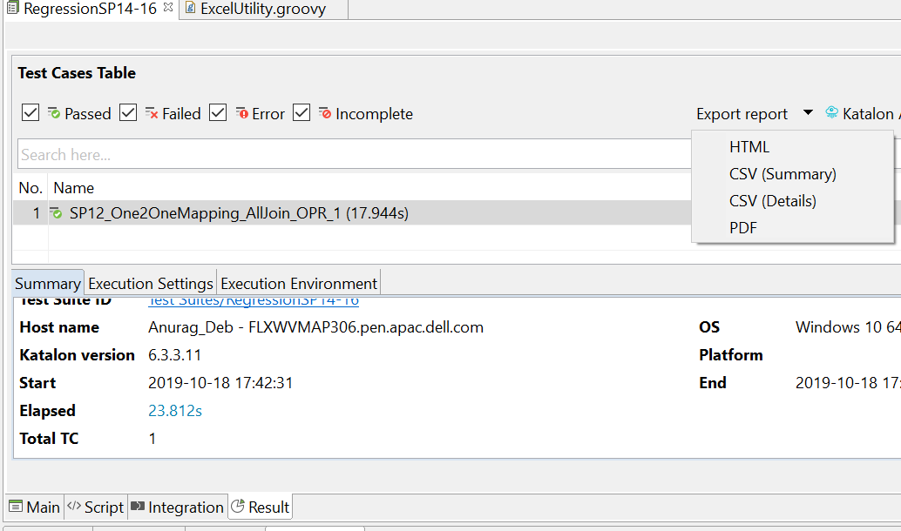
Exporting Reports

Slide 28



Katalon Suite & Analytics
Notes:
https://docs.katalon.com/katalon-analytics/docs/overview.html

Slide 29
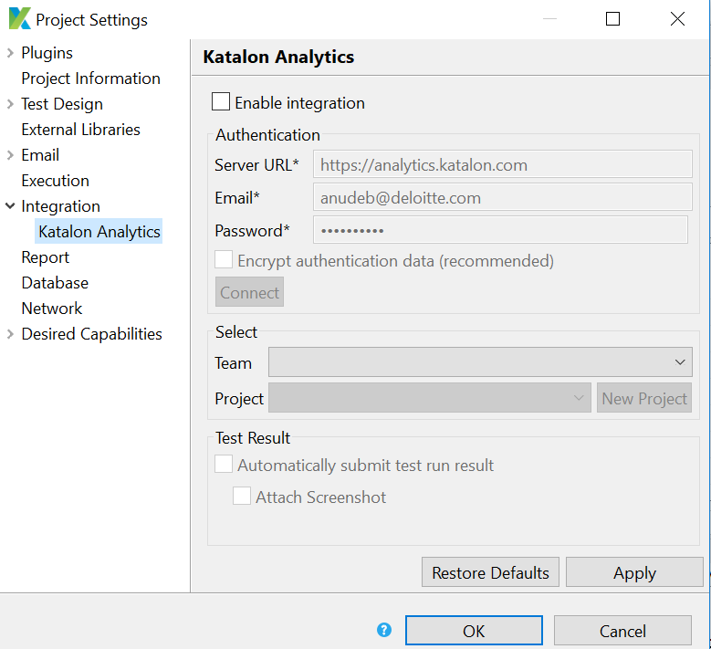
How to Enable it
Settings
In Katalon Studio,
Select Project > Settings > Integration > Katalon Analytics.
Check Enable Integration checkbox

Slide 30
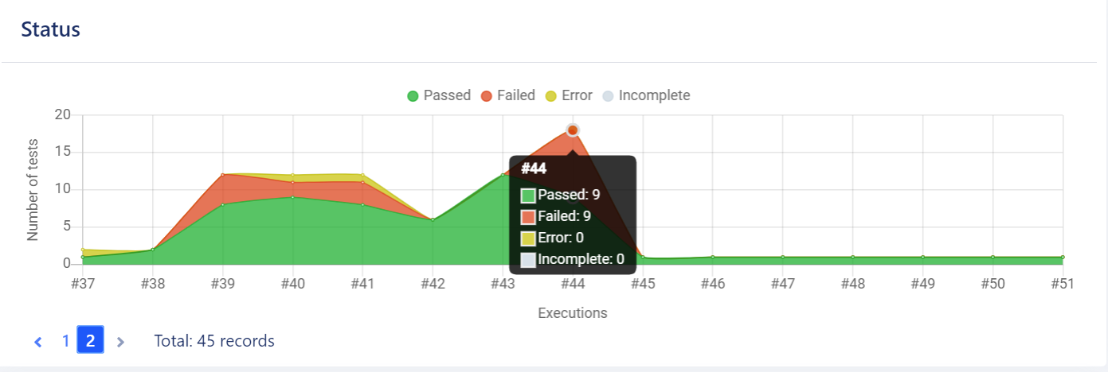
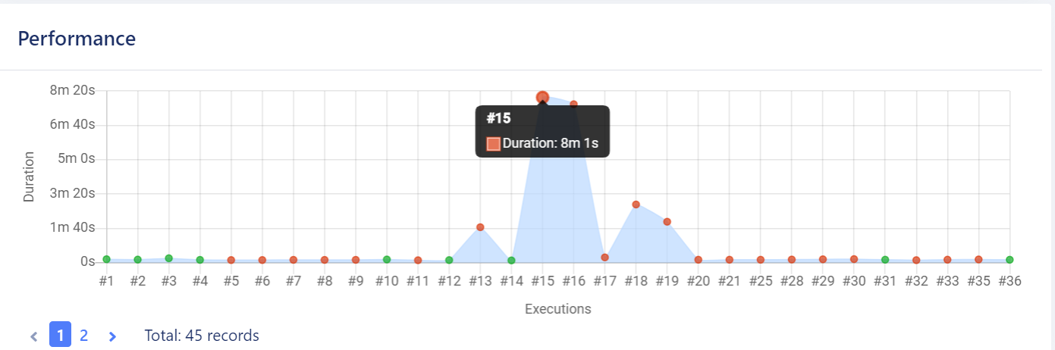
Test Design
(Status & Performance of your Suite)
In 44th iteration, there were 9 failed 9 passed. We can share this with the Management Team
In 15th Iteration, Suite took 8mins & 1 sec to complete

Slide 31
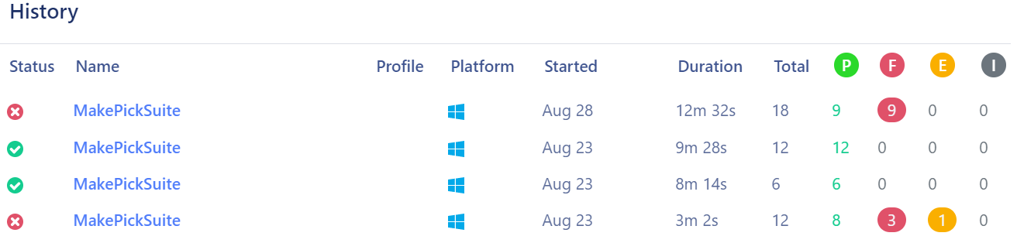
Test Design

Slide 32
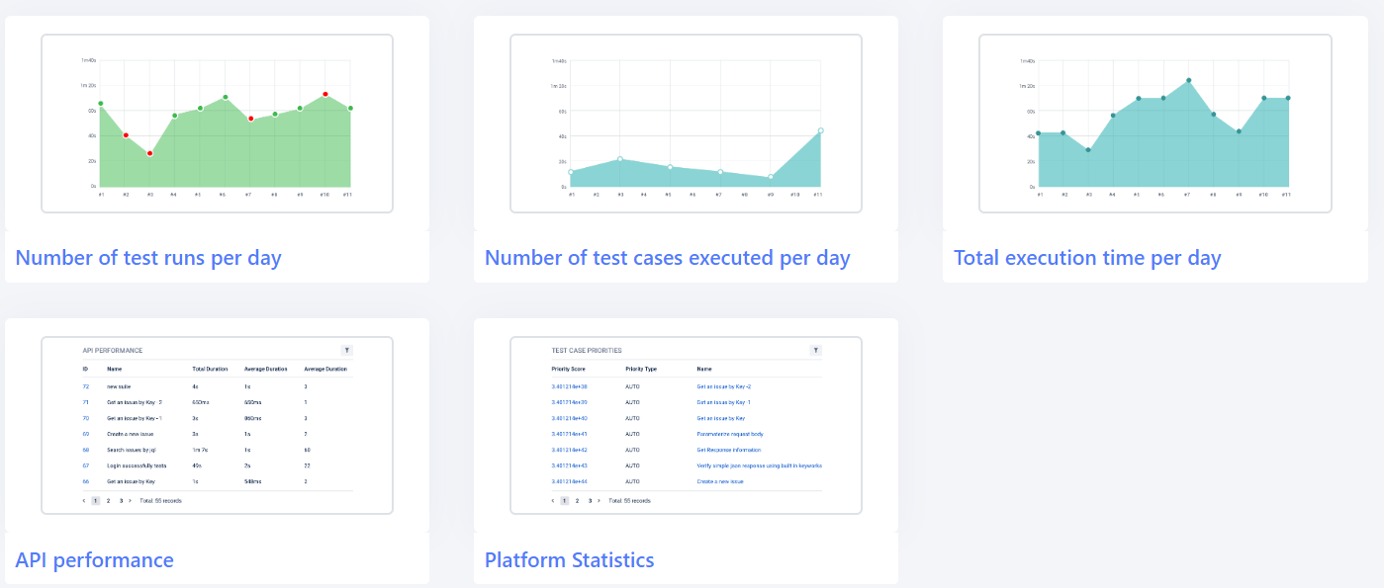
Reports

Slide 33
Extent Reporting

Slide 34
Why use extent?
Problem statement : 1) Sometimes while using VM, we have faced issue that report plugin is not getting loaded due to firewall.
2) If we want Pie-chart /visualization then we have to use Katalon Analytics which increase the load on Studio Tool
Solution : Extent Report.

Slide 35
import com.kms.katalon.core.util.KeywordUtil KeywordUtil.markPassed("Element is Present") KeywordUtil.markFailed("Element is not present")
Keywords
For failing a test case:
Use markFailed() Keyword instead of Assertion. Why? Because failed due to assertion will show as Error in your Report instead of Fail.

Slide 36
Best Practices
Naming Convections prompted by Katalon
Include Author name, Date, Description, parameter, return in the Utilities
Include Comments
Upload codes on daily basis
Pull before starting development of Test cases
Upload codes in development branch – (Only stable code should be pushed to Master)
Include Close connection steps whenever calling any keywords from DBUtilities
Never hardcode: use Config files, Profiles
Don’t create more objects: try to parameterize
Use more encapsulation for a specific set of steps which are repetitive
Maintain Folder structure
Rerun scripts multiple times before delivery
Use explicit wait
Share with Team

Slide 37
GreenPlum Access
Change Profile Queries:
Select * from public.user_info;
Select * from public.switch_user_profile(<profile>)
Grant Access Query:
GRANT SELECT ON <schema.tablename> to <userId>/<group>

Slide 38
Sikuli for Image Comparison
Problem statement : An image is being uploaded and published. So once it is published, a validation has to be done if the same image is being displayed or not
Solution : As selenium has no inbuilt function or class that can help in achieving this, Sikuli is suggested. By integrating Sikuli with Selenium, image comparison can be done.

Slide 39
Utility Name : Excel Macro
Problem Statement: When a user needs to compare large volume of data between two Sheets ,manually it would consume a good amount of time.
Description : Excel Macro can be used to compare data between two different sources.
Author : Arvind Sharma

